Slide 1
Bitcoin and Blockchain

Slide 2
Overview
Bitcoin address
Bitcoin transactions
Locking and unlocking script
Blocks and Bitcoin mining
Blockchain

Slide 3

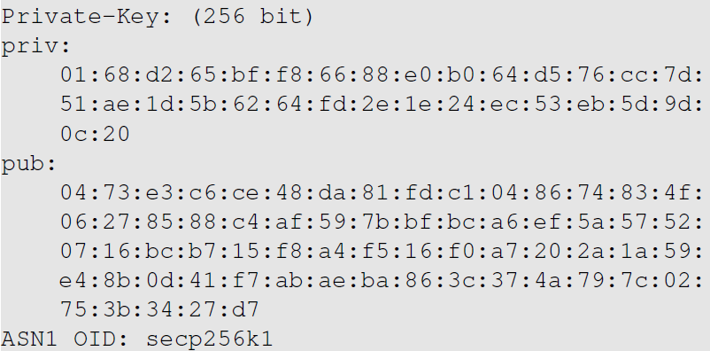
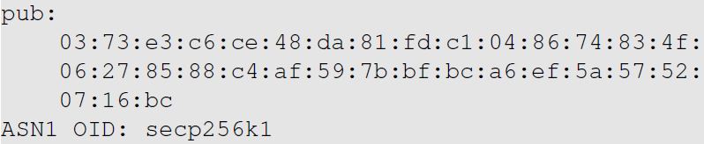
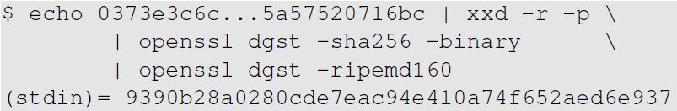
Bitcoin Address
Elliptic Curve Cryptography
Generating Public and Private Keys
Compressing Public Key
Generating Public-Key Hash

Slide 4
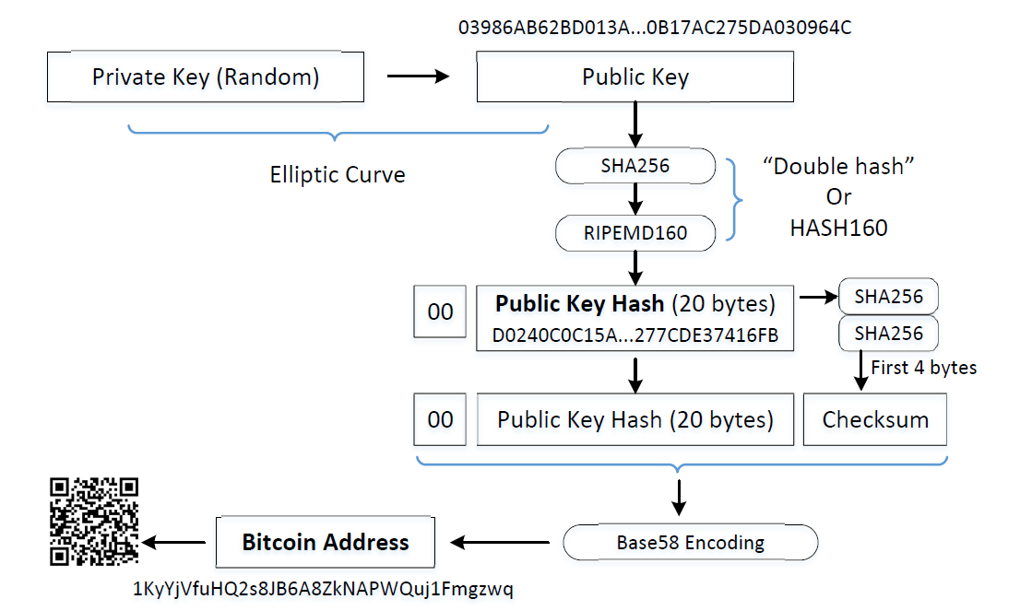
Turning Public-Key Hash into Bitcoin Address

Slide 5
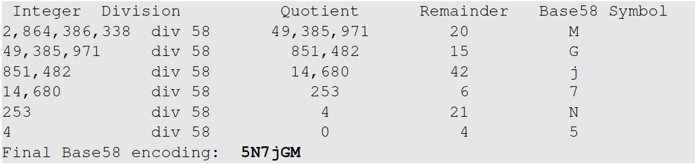
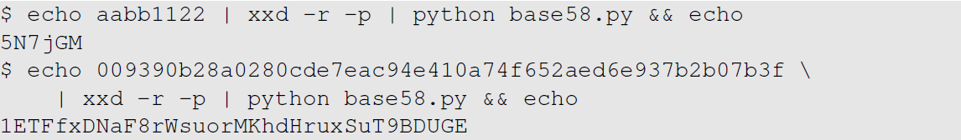
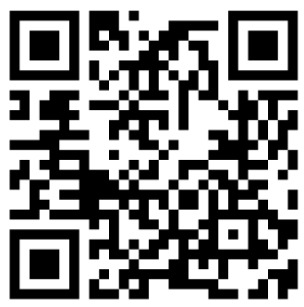
Base58 Encoding

Slide 6
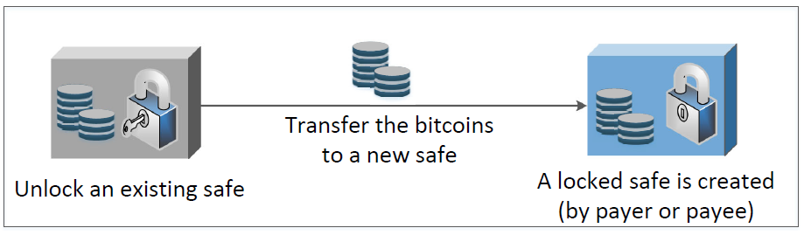
Transactions: Intuition

Slide 7
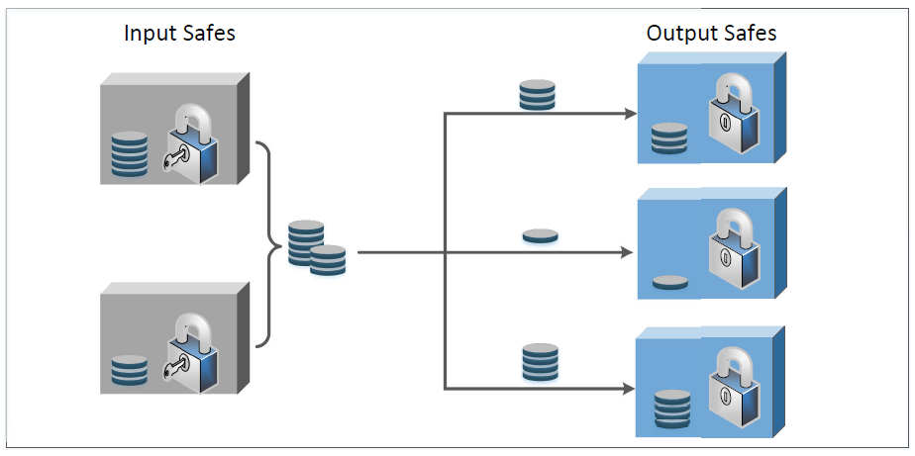
Components of Transactions & Examples

Slide 8
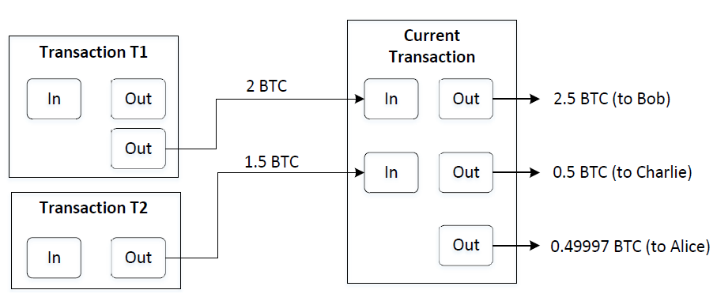
An Example
Changes
Transaction fee = (2 + 1.5) – (2.5 + 0.5 + 0.49997) = 0.00003 BTC

Slide 9
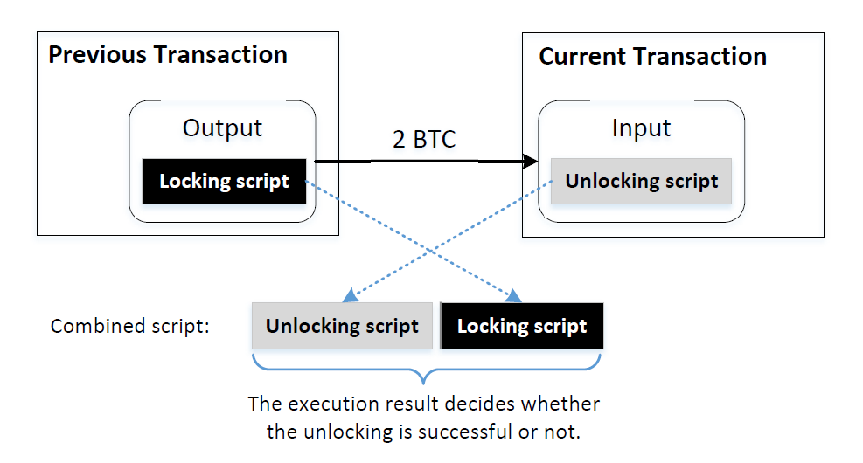
Locking and Unlocking Script

Slide 10
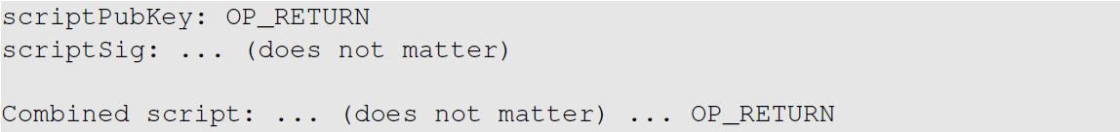
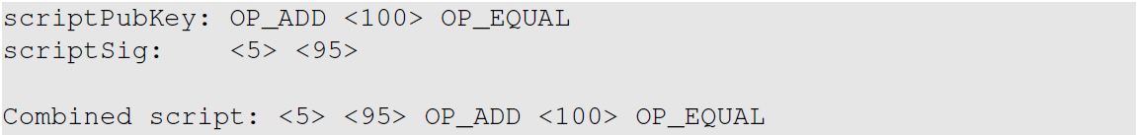
Script Examples

Slide 11
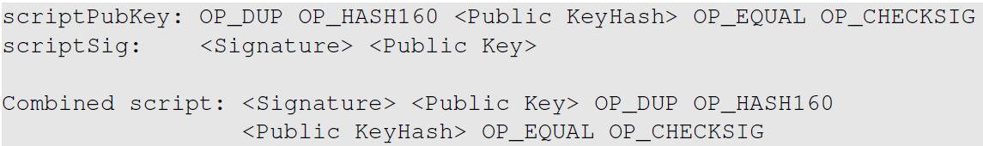
Pay-to-PubKey-Hash (P2PH)
Notes:
Note to instructor: using a board or drawing directly on the slide to show how the script execute

Slide 12
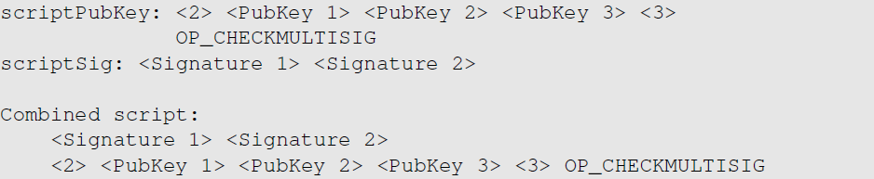
Pay-to-MultiSig (P2MS)

Slide 13
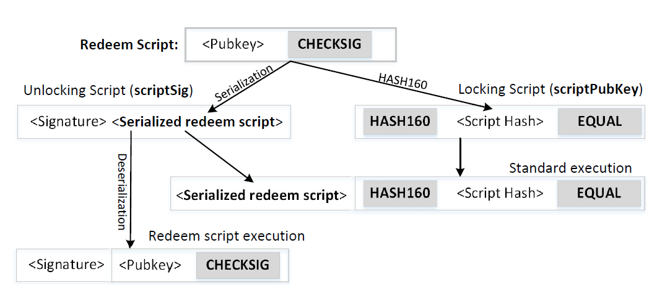
Pay-to-Script-Hash (P2SH)

Slide 14
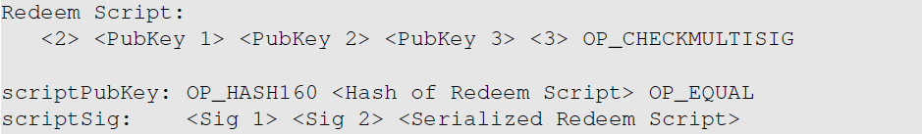
Use P2SH for MultiSig
Pay-to-MultiSig (P2MS)
Pay-to-Script-Hash (P2SH)

Slide 15
Sending Transaction
After a node has generated a transaction, it sends the transaction to its peers
Each peer will verify the transaction, and then forward it to their peers
Eventually, every node on the network will receive the transaction
Some special node called miner will be responsible for adding the transaction to the public ledger (i.e., blockchain).

Slide 16
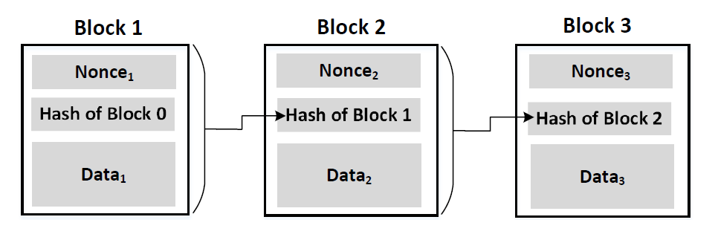
Generating Blocks
Miners group transactions into a new block
The new block is appended to the existing blockchain

Slide 17
Mining
Proof-of-Work: find a nonce, s.t. when the hash of the block satisfies a special requirement, such as having 20 leading zeros
Rewarding:
Coinbase transaction: new bitcoins are minted and given to the miner
Transaction fees
Once a miner has found a block, it immediately sends the block to its peers, who will verify the block and then forward the block to their peers.
Eventually, all the nodes will see this new block, and add it to their ledgers.

Slide 18
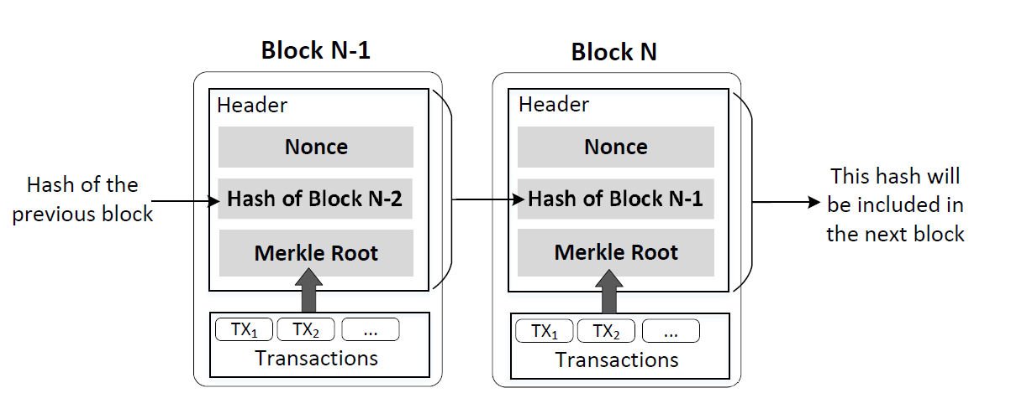
Include Merkle Root in Block

Slide 19
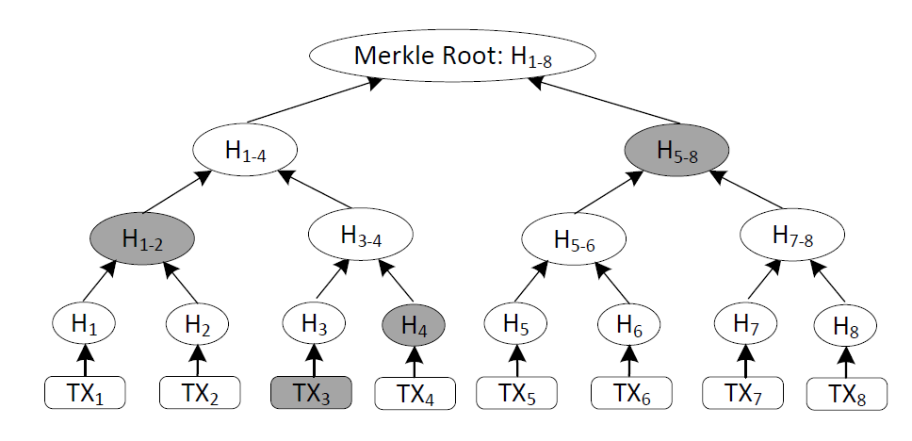
Merkle Tree
Benefit:
To find whether a transaction is included in a block, you don’t need all the transactions
Good for non-full nodes

Slide 20
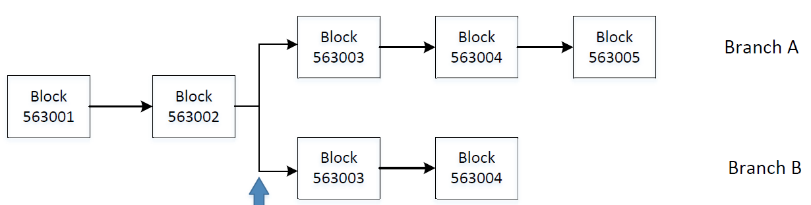
Branching
Branching occurs when two valid blocks are found at about the same time
The longest chain wins

Slide 21
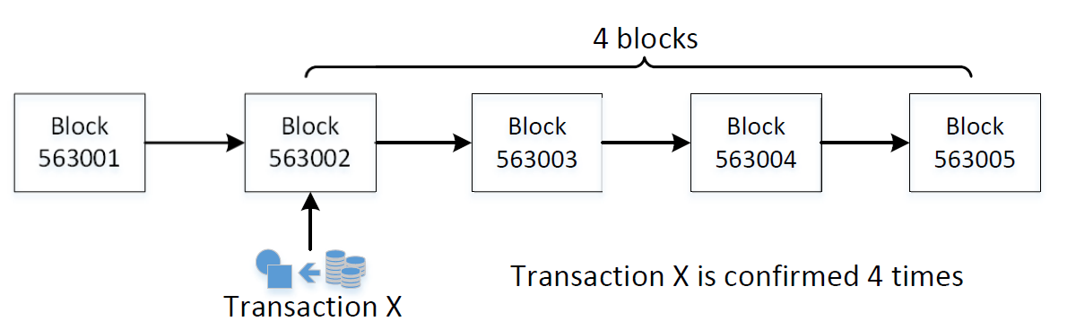
Confirmation Number
The larger a block’s confirmation number is, the less likely it will be removed from the blockchain

Slide 22
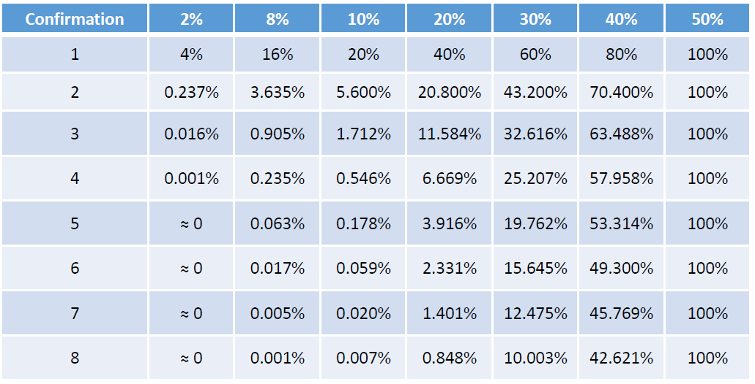
Probability of Double Spending

Slide 23
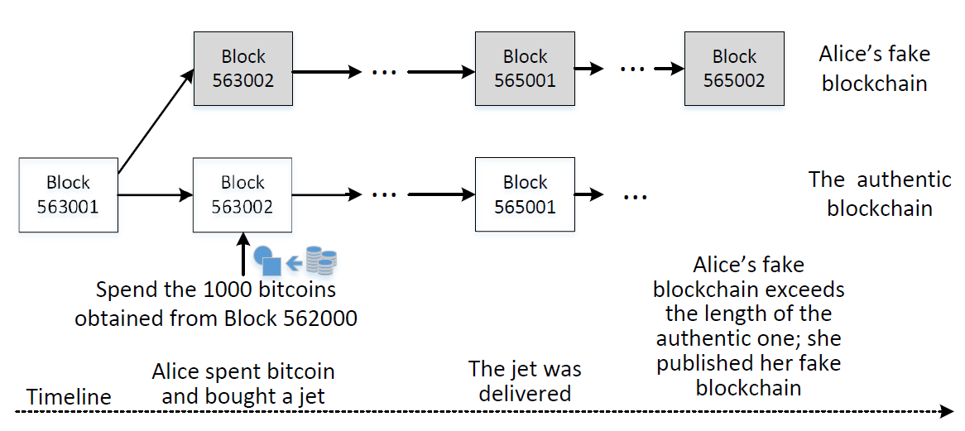
Double Spending with Majority Hash Power

Slide 24
Summary
Bitcoin address
Transactions, locking and unlocking script
Bitcoin mining
Blockchain, branching, confirmation number, and double spending

