Slide 1
Network Security Basics

Slide 2
Outline
IP Address and Network Interface
TCP/IP Protocols
Packet Sniffing
Packet Spoofing
Programming using Scapy
Lab environment and containers

Slide 3
ip address

Slide 4
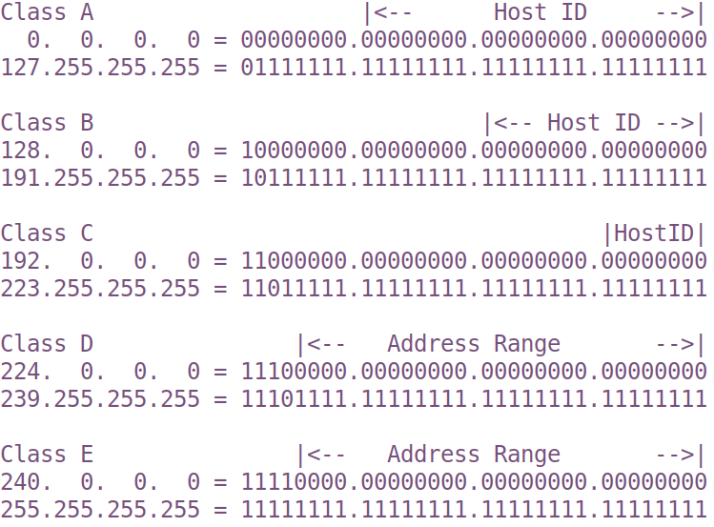
IP Address: the Original Scheme

Slide 5
CIDR Scheme (Classless Inter-Domain Routing)
192.168.60.5/24
Indicate the first 24 bits are network ID
Question: What is the address range of the network 192.168.192.0/19 ?
Notes:
192 = 110 00000
The first three bits are network ID. If we use binary to represent the third byte, the range is
192.168.(110 00000).0 to 192.168.(110 11111).FF, i.e., it is 192.168.192.0 to 192.168.223.255.
Note: many students have trouble answering this question. Without a good understanding of the CIDR notation
of the network prefix, they often struggle in understanding the BGP attack (network prefix hijacking).

Slide 6
Special IP Addresses
Private IP Addresses
10.0.0.0/8
172.16.0.0/12
192.168.0.0/16
Loopback Address
127.0.0.0/8
Commonly used: 127.0.0.1

Slide 7
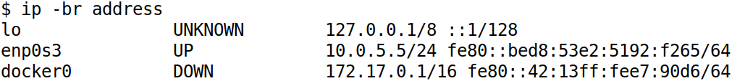
List IP Address on Network Interface

Slide 8
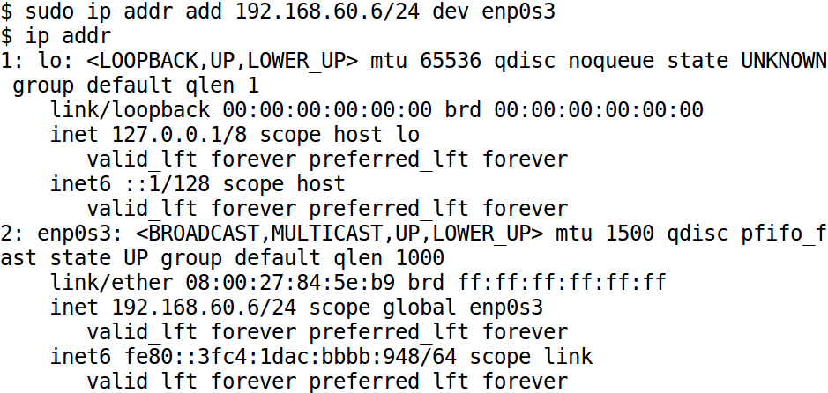
Manually Assign IP Address

Slide 9
Automatically Assign IP Address
DHCP: Dynamic Host Configuration Protocol
Notes:
Briefly illustrate how DHCP works

Slide 10
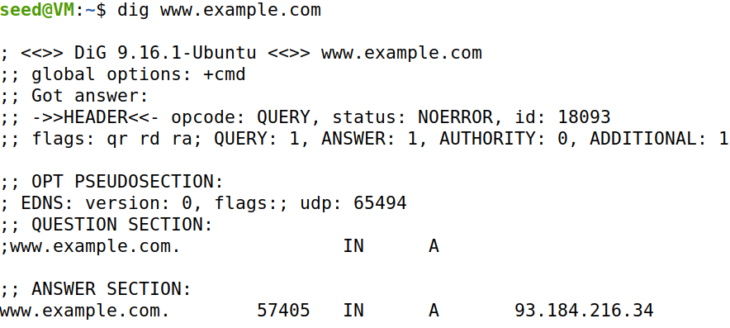
Get IP Addresses for Host Names: DNS

Slide 11
network Stack

Slide 12
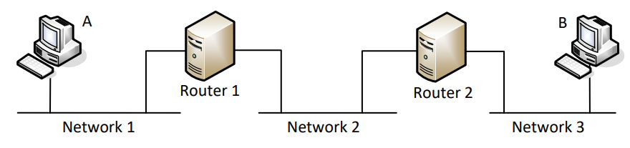
Packet Journey at High Level
Notes:
Use this diagram to illustrate how packet is sent from A to B, hop by hop.

Slide 13
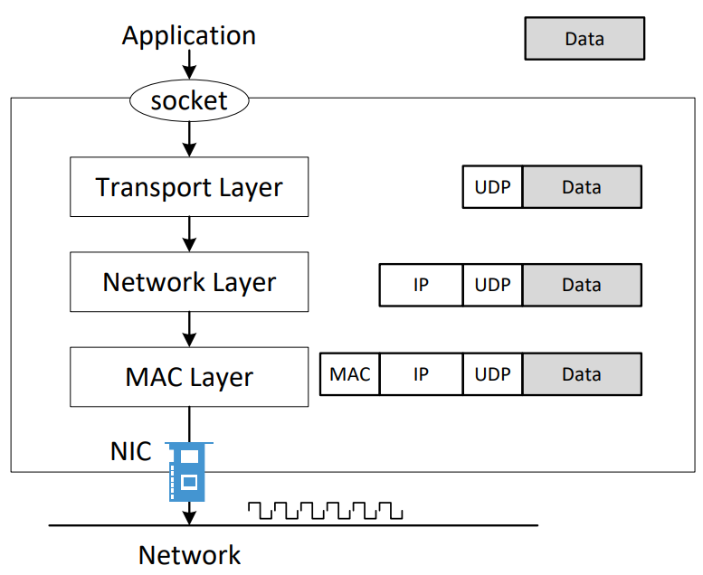
How Packets Are Constructed

Slide 14
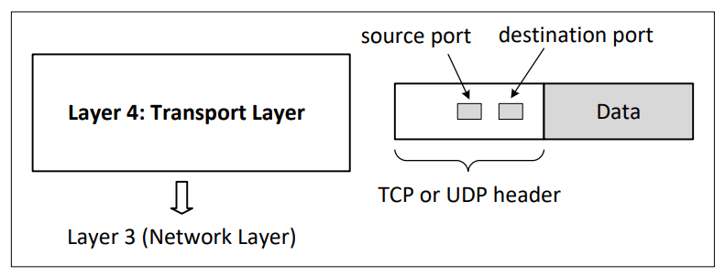
Layer 4: Transport Layer

Slide 15
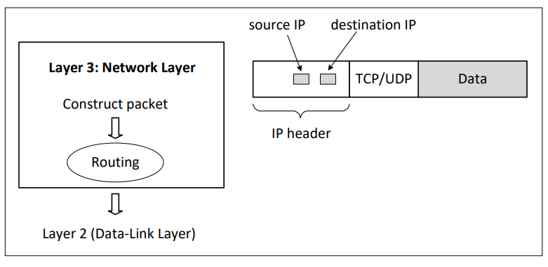
Layer 3: Network Layer

Slide 16
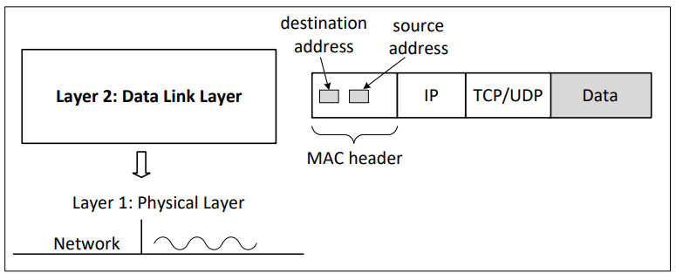
Layer 2: Data Link Layer (MAC Layer)

Slide 17
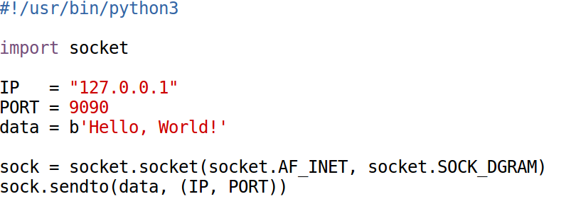
Sending Packet in Python (1)
UDP Client

Slide 18

Sending Packet in Python (1)
Execution Results
Notes:
Introduce the netcat tool, explain the meaning of “-luv”.

Slide 19
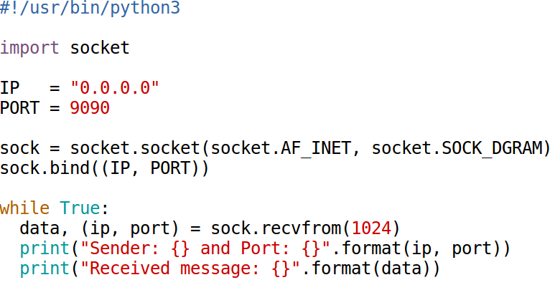
Receiving Packets in Python
UDP Server

Slide 20
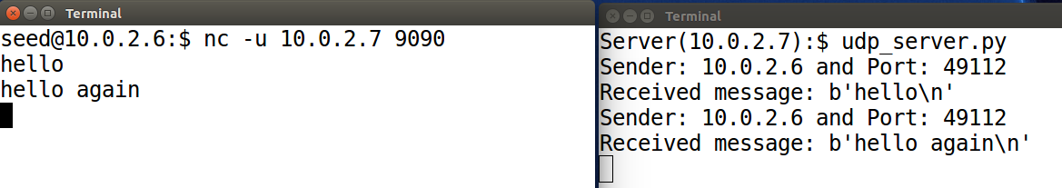
UDP Server

Slide 21
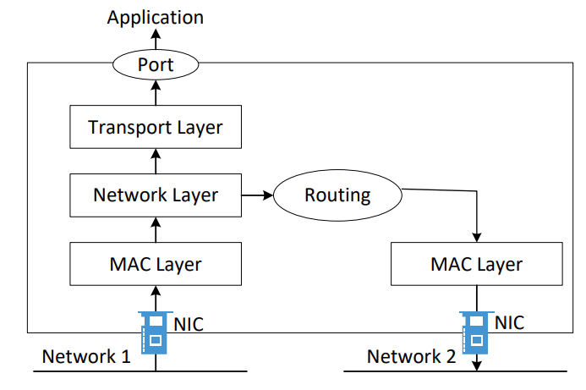
How Packets Are Received

Slide 22
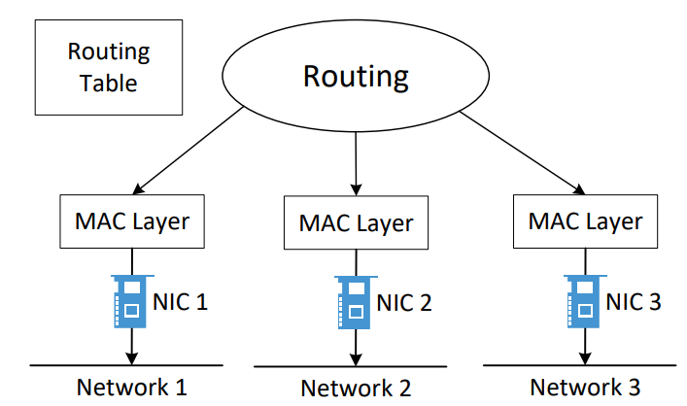
Routing

Slide 23
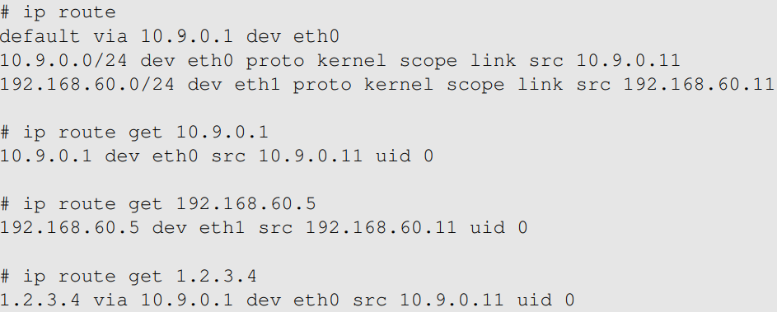
The “ip route” Command

Slide 24
Packet Sending Tools
Using netcat
Bash: /dev/tcp or /dev/udp pseudo device
Others: telnet, ping, etc.

Slide 25
packet sniffing

Slide 26
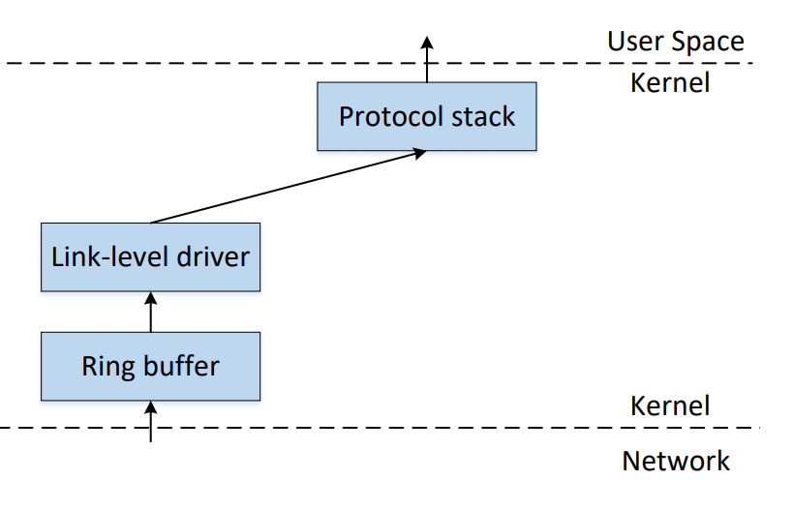
How Packets Are Received

Slide 27
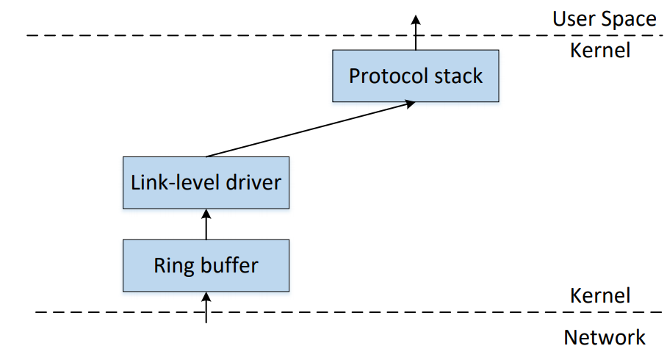
How To Get A Copy of Packet

Slide 28
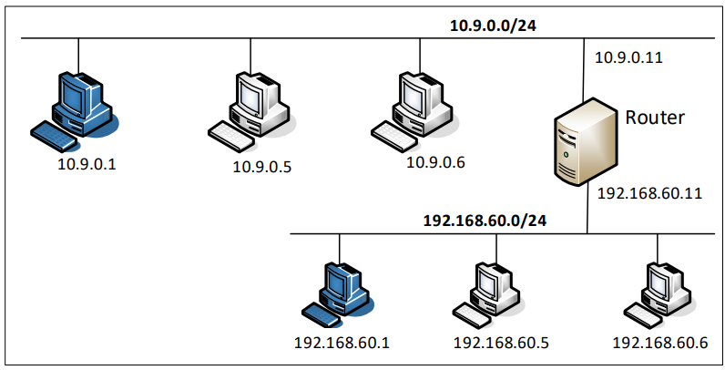
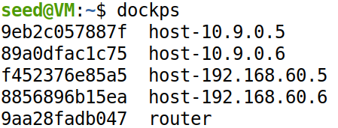
Lab Setup

Slide 29
Packet Sniffing Tools
Tcpdump
Command line
Good choice for containers (in the lab setup)
Wireshark
GUI
Good choices for the environment supporting GUI (not containers)
Scapy
Implement your own sniffing tools

Slide 30
Tcpdump Examples
tcpdump -n -i eth0
-n: do not resolve the IP address to host name
-i: sniffing on this interface
tcpdump -n -i eth0 -vvv “tcp port 179”
-vvv: asks the program to produce more verbose output.
tcpdump -i eth0 -w /tmp/packets.pcap
saves the captured packets to a PCAP file
use Wireshark to display them

Slide 31
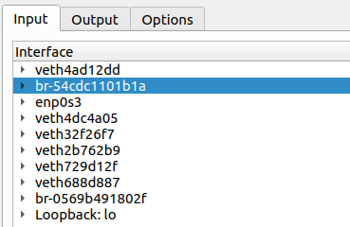
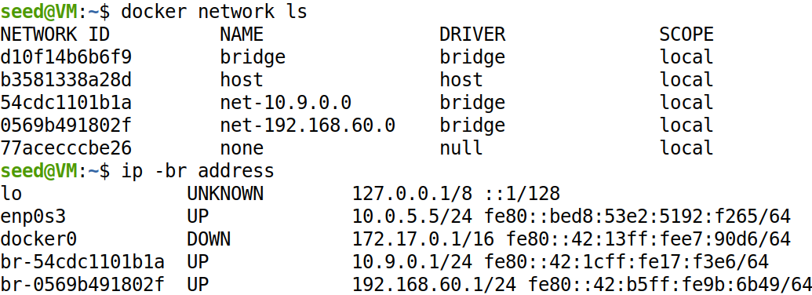
Wireshark and Containers
Find the correct interface

Slide 32
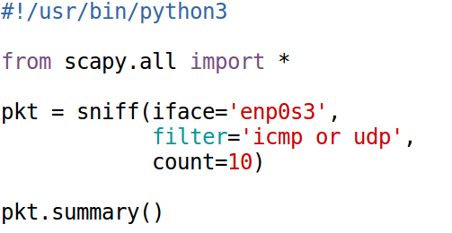
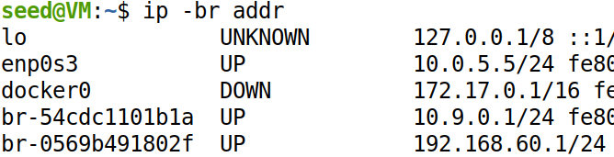

Scapy Example 1

Slide 33
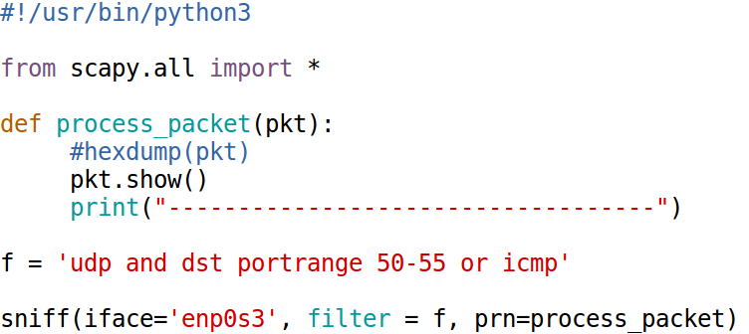
Scapy Example 2

Slide 34
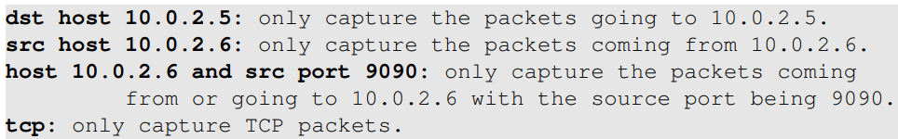
Filter Examples for Scapy
Berkeley Packet Filter (BPF) syntax
Same as tcpdump

Slide 35
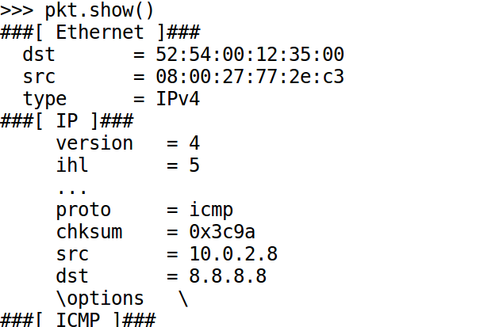
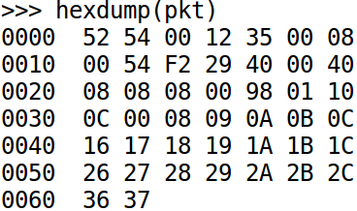
Scapy: Display Packets
Using hexdump()
Using pkt.show()

Slide 36
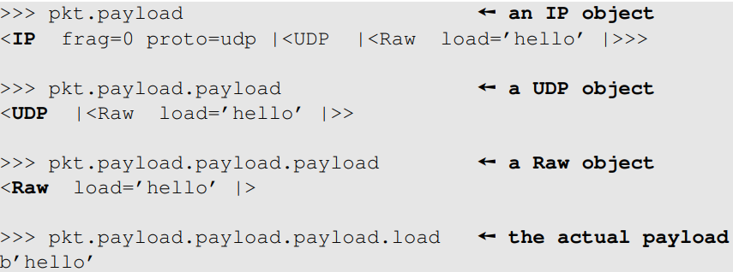
Scapy: Iterate Through Layers

Slide 37
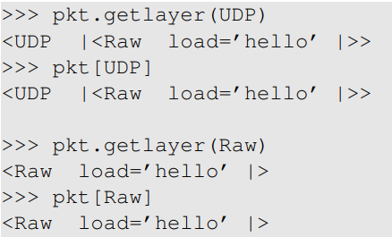
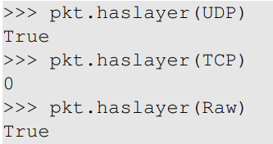
Accessing Layers
Get inner layers
Check layer existence

Slide 38
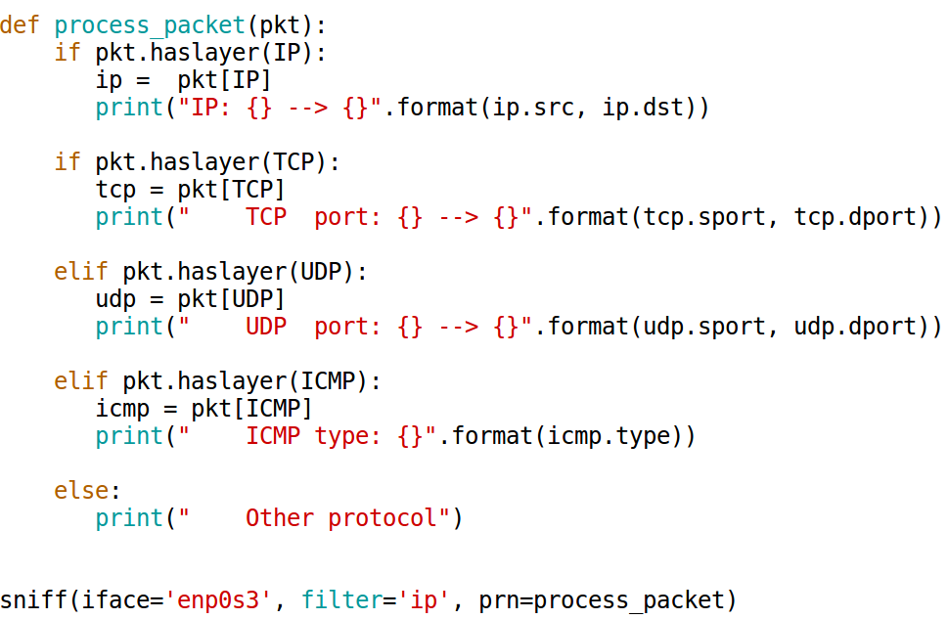
A Sniffer Example

Slide 39
packet spoofing

Slide 40
Packet Spoofing
In normal packet construction
Only some selected header fields can be set by users
OS set the other fields
Packet spoofing
Set arbitrary header fields
Using tools
Using Scapy

Slide 41
How To Spoof Packets
Notes:
Sending normal packet: socket
Sending spoofed packet: raw socket

Slide 42
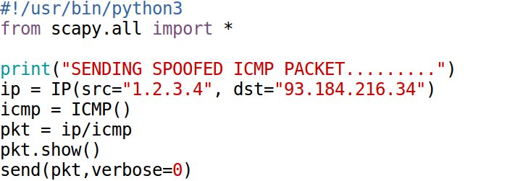
Spoofing ICMP Packets
Notes:
Explain the layer stacking in Scapy: ip/icmp

Slide 43
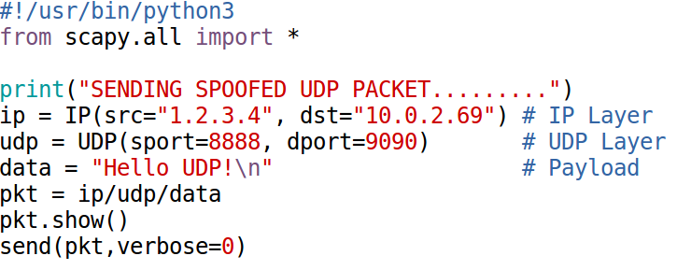
Spoofing UDP Packets

Slide 44
Sniff Request and Spoof Reply

Slide 45
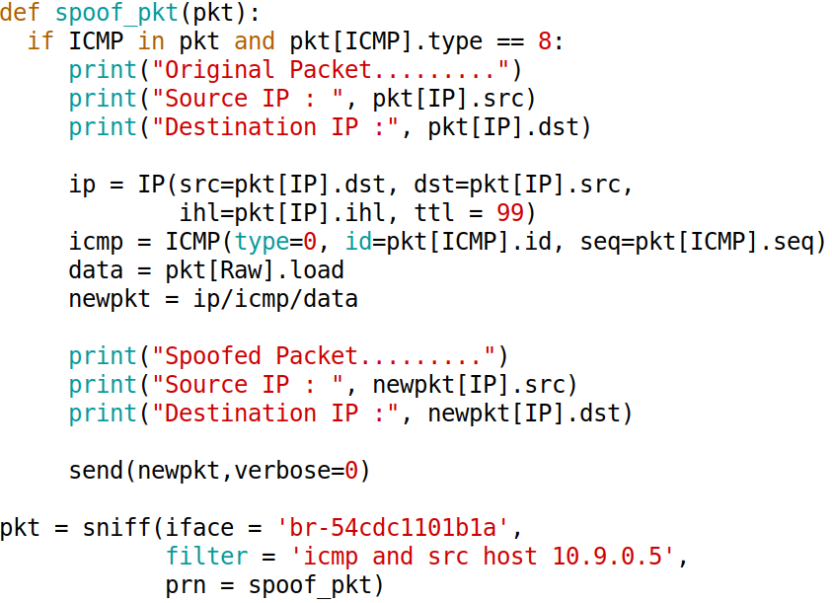
Sniff Request and Spoof Reply: Code

Slide 46
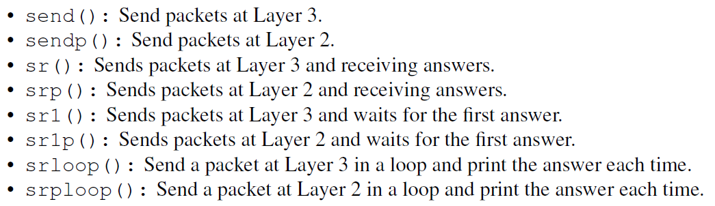
Other Uses of Scapy: Send and Receive

Slide 47
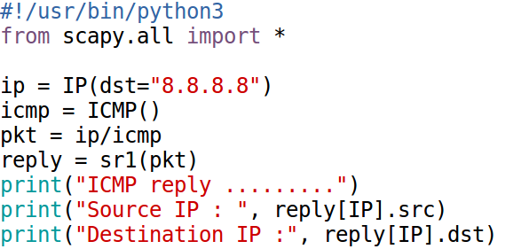
Example: implement ping

Slide 48
Example: implement traceroute
Notes:
Explain how traceroute works

Slide 49
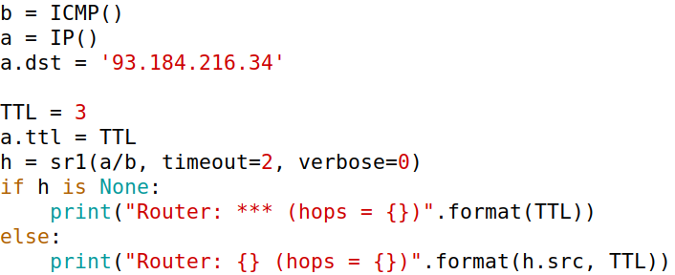
Traceroute Code

Slide 50
Sniffing/Spoofing Using C
C is much faster
My experiment: 40 times faster
Speed is important for some attacks
SYN flooding
DNS remote attack
Covered in another chapter

Slide 51
Lab environment setup

Slide 52

Lab Setup and Containers
Most labs in Internet Security use containers

Slide 53
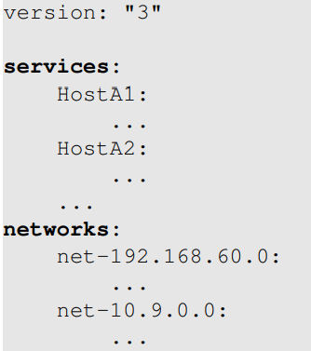
Docker Compose
Setup file: docker-compose.yml
Docker Manual:
https://github.com/seed-labs/seed-labs/blob/master/manuals/docker/SEEDManual-Container.md

Slide 54
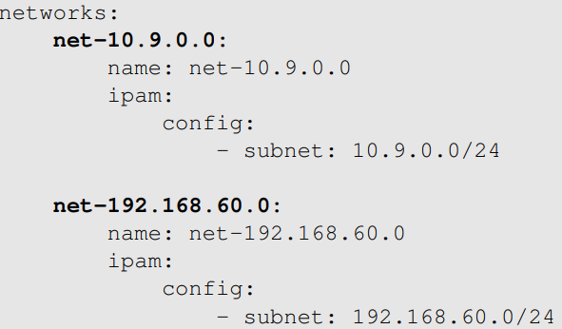

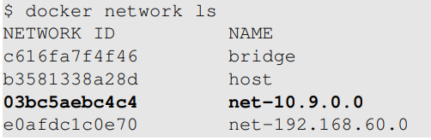
Set Up Networks
Find out interface name

Slide 55
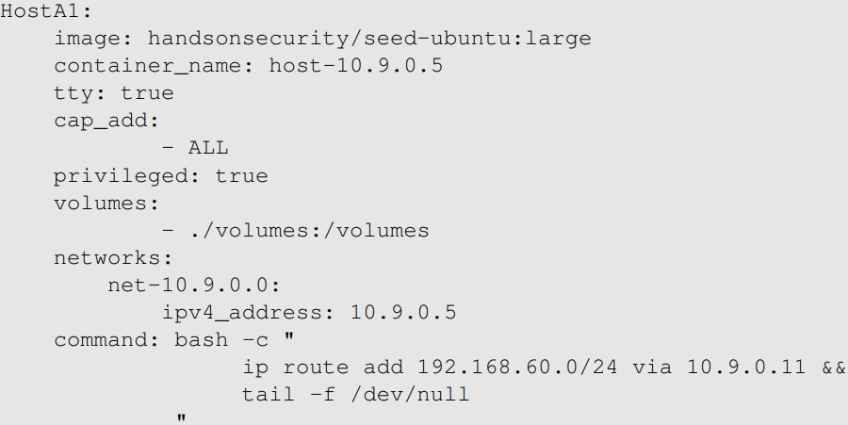
Set Up Hosts
Notes:
Explain the purpose of each entry.

Slide 56
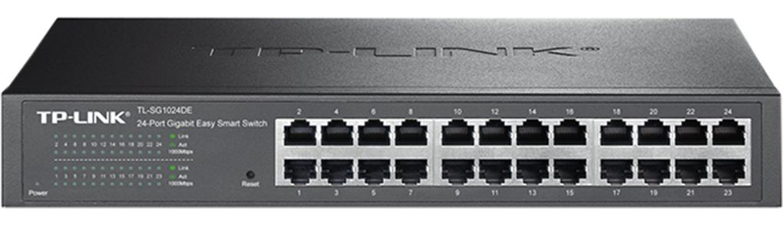
Sniffing Inside Containers
Limitation
Can only sniff its own traffic
Due to how the virtual network is implemented

Slide 57
Sniffing Inside Containers
Overcome the limitation
Use the “host” mode
network_mode: host

Slide 58
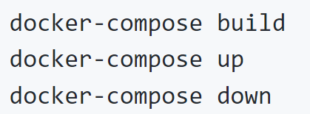
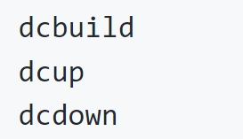
Start/Stop Containers
Alias created in the SEED VM

Slide 59
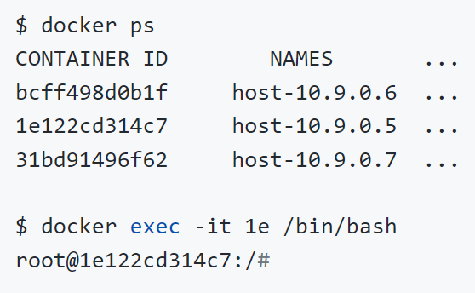
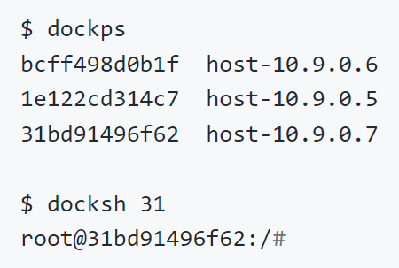
Get Into A Container
Alias created in the SEED VM

Slide 60
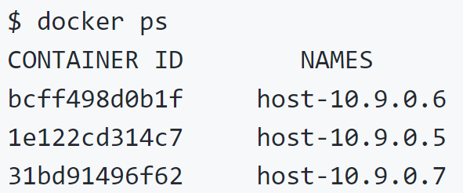
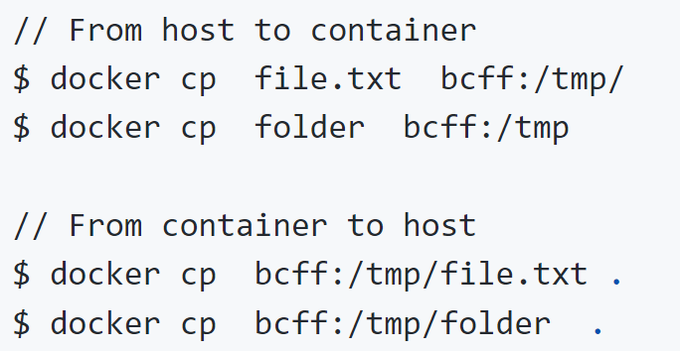
Copy Files Between Host and Container
Get container ID

Slide 61
LAB Discussion

Slide 62
Two Sets of Tasks
Set 1: Using Python
Set 2: Using C

