Slide 1
ARP Protocol and Attacks

Slide 2
Outline
Network Interface
Ethernet frame and MAC header
ARP protocol
ARP cache poisoning attack

Slide 3
Network Interface and Ethernet

Slide 4
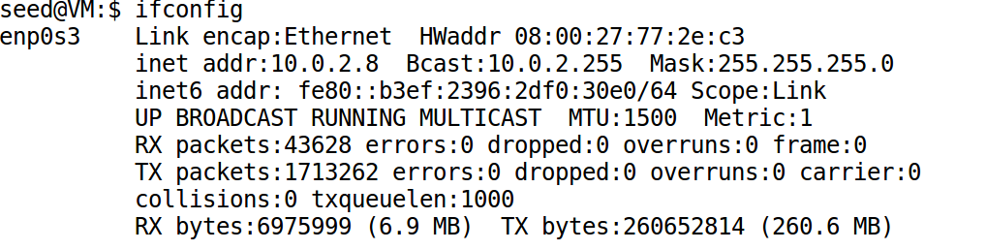
Network Interface Card (NIC)
Physical or logical link between computer and network
Each NIC has a hardware address: MAC address

Slide 5
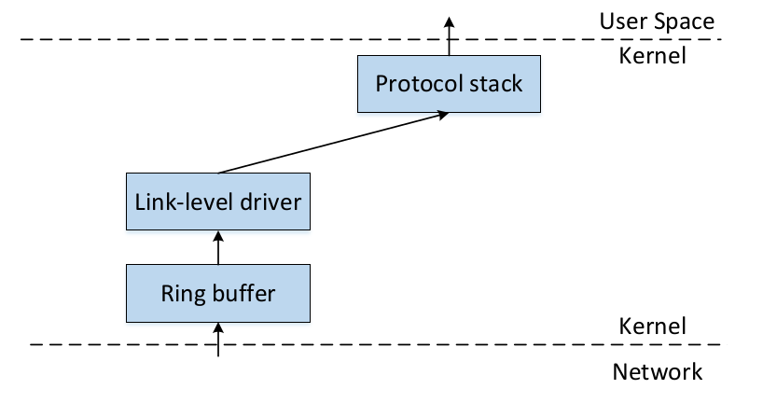
Packet Flow
Network Interface Card

Slide 6
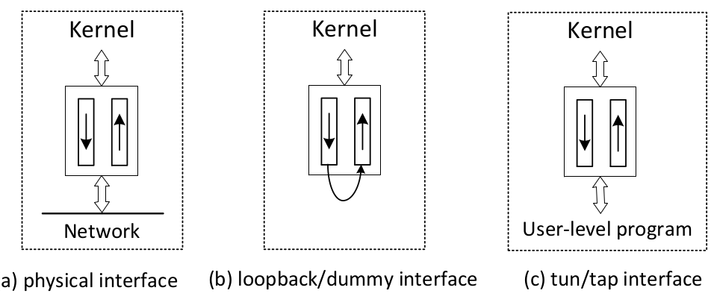
Physical and Virtual NIC
Notes:
One end of a NIC is the OS kernel (protocol stack). The other end can vary, especially for virtual NIC, which is implemented using software.

Slide 7
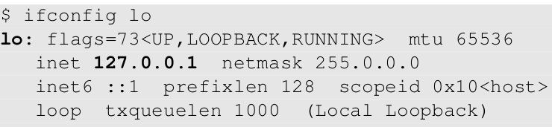
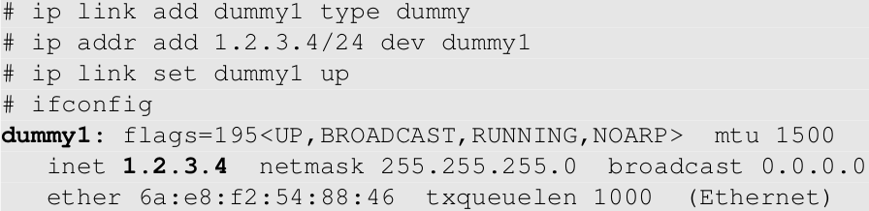
Examples of Virtual NIC
Loopback Interface
Dummy Interface (similar to loopback, but with its own IP)

Slide 8
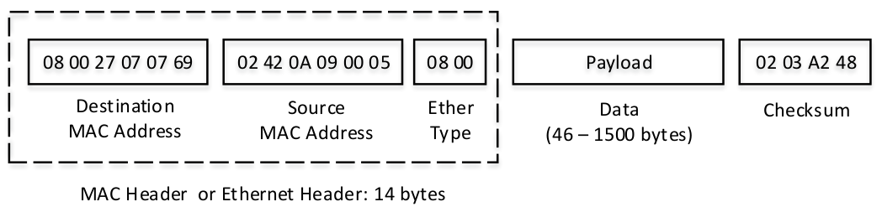
Ethernet Frame & MAC Header

Slide 9
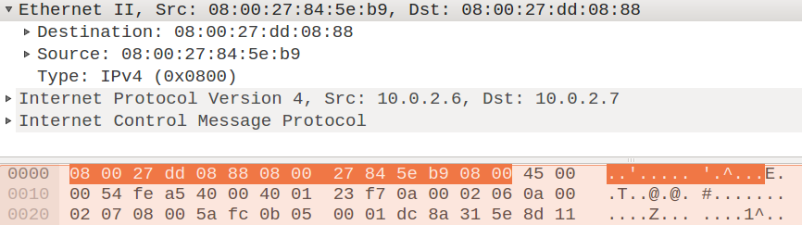
Ethernet Frame Example

Slide 10
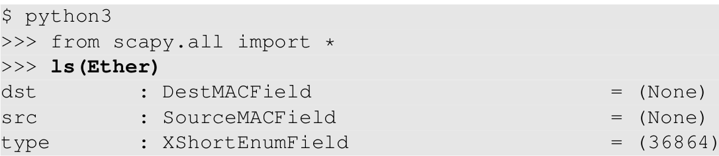
Scapy Program

Slide 11
Promiscuous Mode
Ethernet is a broadcast medium
NIC check destination MAC address
mine: accept the frame
not mine: discard it
Enable promiscuous mode
Will not check destination MAC
Take in all the packets on the local network
Useful for packet sniffing

Slide 12
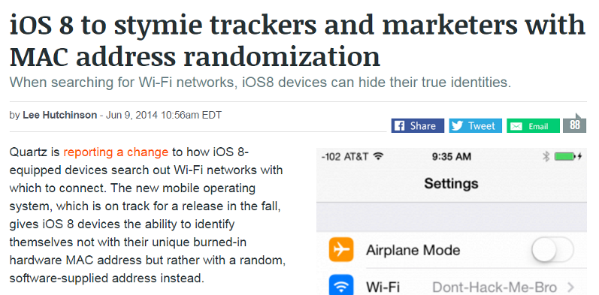
MAC Address Randomization and Privacy

Slide 13
The ARP Protocol

Slide 14
The ARP Protocol
Communication on LAN
Need to use MAC address
But we only know the IP address
ARP: Address Resolution Protocol
Find MAC from IP

Slide 15
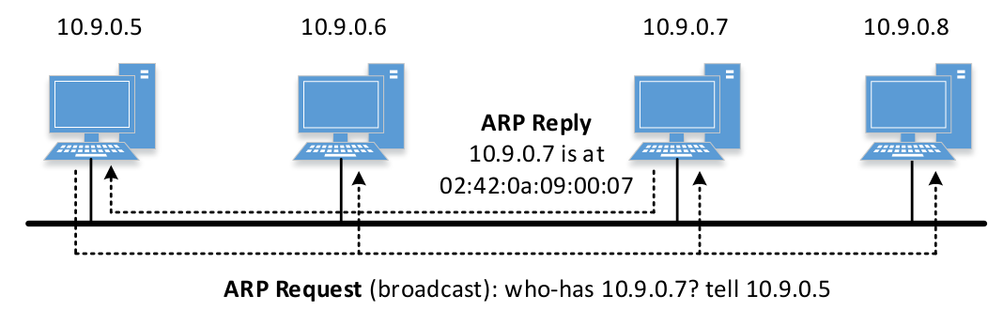
ARP Request/Reply

Slide 16
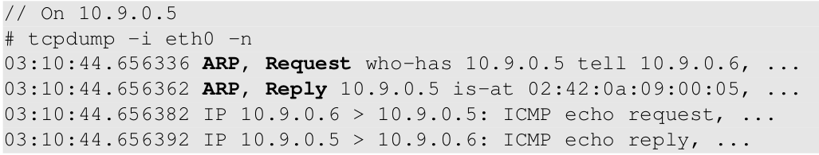
Send ARP Request: Example 1
ping 10.9.0.6 from 10.9.0.5

Slide 17
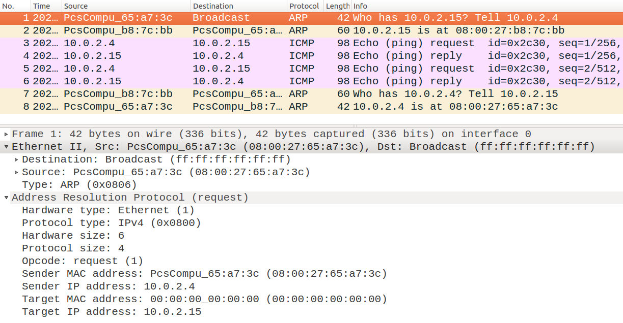
Send ARP Request: Example 2
ping 10.0.2.15 from 10.0.2.4

Slide 18
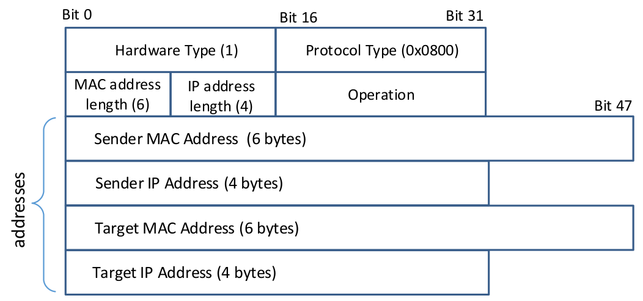
ARP Message Format

Slide 19
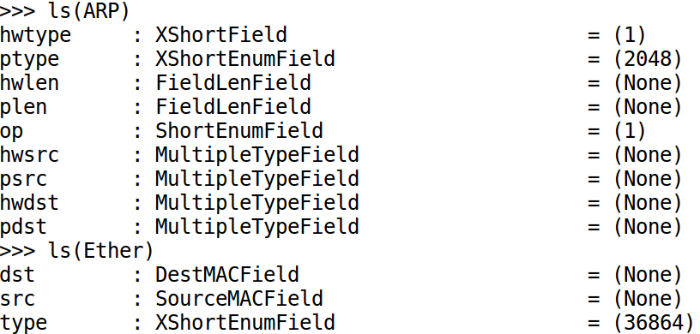
ARP Class in Scapy

Slide 20
Questions
Different behaviors of the following commands
ping 10.9.0.6 (existing, on LAN)
ping 10.9.0.99 (non-existing, on LAN)
ping 1.2.3.4 (non-existing, not on LAN)
ping 8.8.8.8 (existing, on the Internet)
Notes:
This is part of the lab. Students can figure out the answers from the lab.
Hint: before the ping packet (ICMP) is sent out, an ARP request will be sent out first.

Slide 21
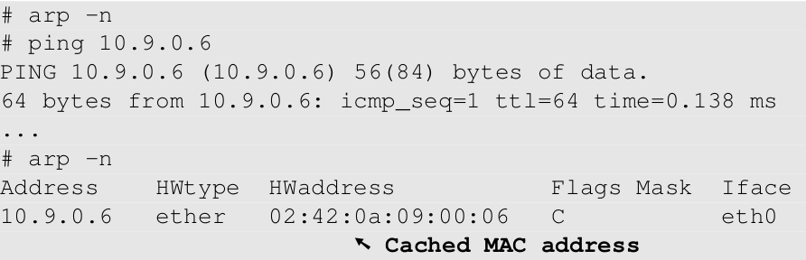
ARP Cache
Avoid sending too many ARP requests
ARP caches received information
empty cache

Slide 22
ARP Cache Poisoning Attack

Slide 23
ARP Cache Poisoning
Spoof ARP Messages
Request
Reply
Gratuitous message
Spoofed message might be cached by the victim
Which type of message will be cached depends on OS implementation

Slide 24
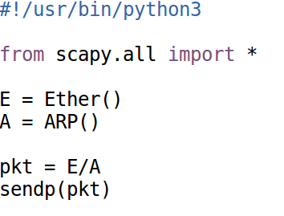
Constructing ARP Message
Construct ARP packet
Fields of ARP and Ether Class

Slide 25
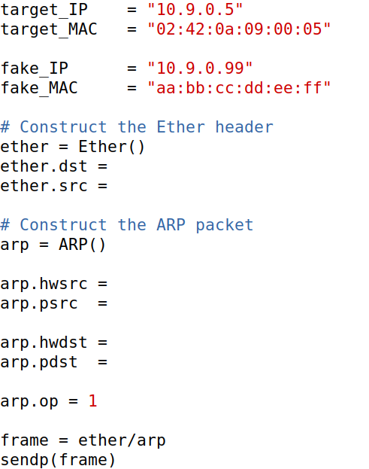
Spoof ARP Request/Reply: Code Skeleton
victim: 10.9.0.5
goal: map 10.9.0.99 to aa:bb:cc:dd:ee:ff
Notes:
This is part of the lab, so I intentionally leave out some of the important data. I typically ask students to help me fill in the missing information during the lecture. We will fill in the data on the diagram first as it is more intuitive, and then we complete the program.

Slide 26
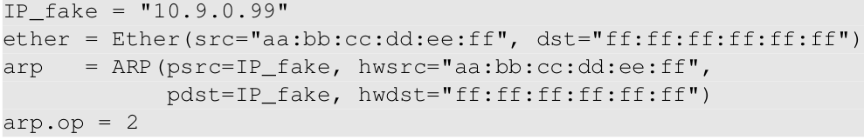
Spoofing Gratuitous Message
Special type of ARP message
Source IP = Destination IP
Destination MAC = broadcast address (ff:ff:ff:ff:ff:ff)

Slide 27
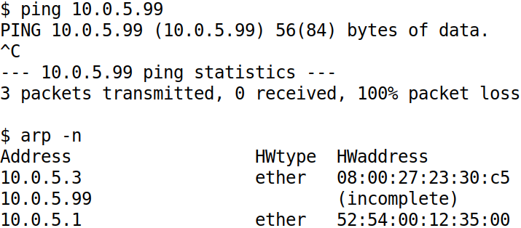
Note: ARP Becomes “Stateful”

Slide 28
man-in-the-middle Attack

Slide 29
MITM: Man-In-The-Middle Attack

Slide 30
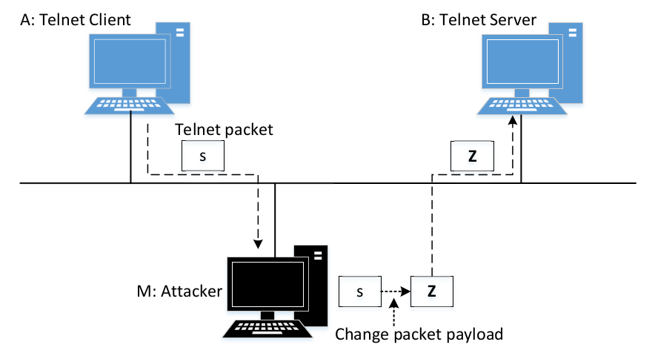
Man-In-The-Middle Attack

Slide 31
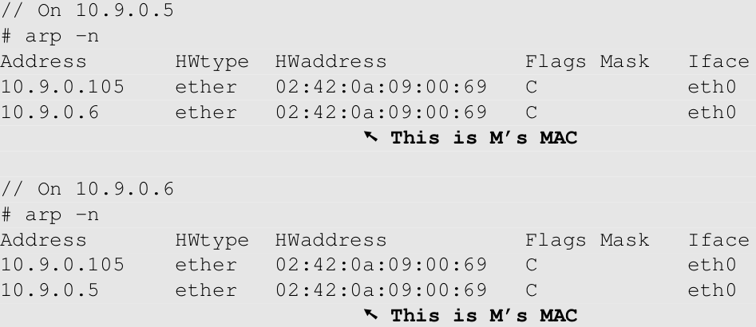
Use ARP Cache Poisoning to Redirect Packets
Poison A’s ARP cache, so B’s IP is mapped to M’s MAC.
Poison B’s ARP cache, so A’s IP is mapped to M’s MAC.
Machine A
Machine B

Slide 32
Forward Packets without Modification
Enable/Disable IP Forwarding
sysctl net.ipv4.ip_forward=1
sysctl net.ipv4.ip_forward=0

Slide 33
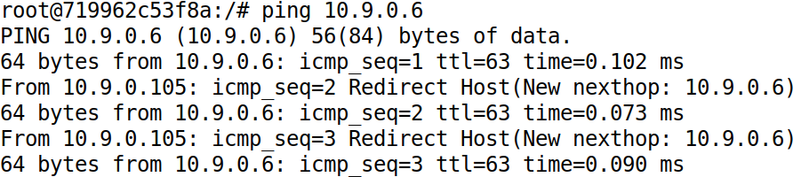
Demo
With IP forwarding on

Slide 34
MITM Step 1: Intercept Packets
Disable IP Forwarding
sysctl net.ipv4.ip_forward=0
How to Get the packet on M?
Notes:
Using sniffing

Slide 35
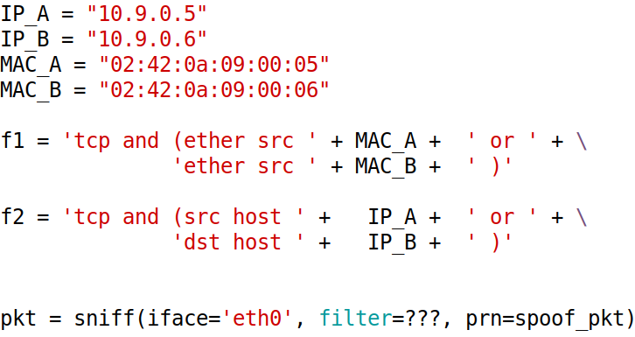
MITM Step 2: Get the Intercepted Packets
Question: which filter should we use, f1 or f2?
Notes:
See the discussion in the Book

Slide 36
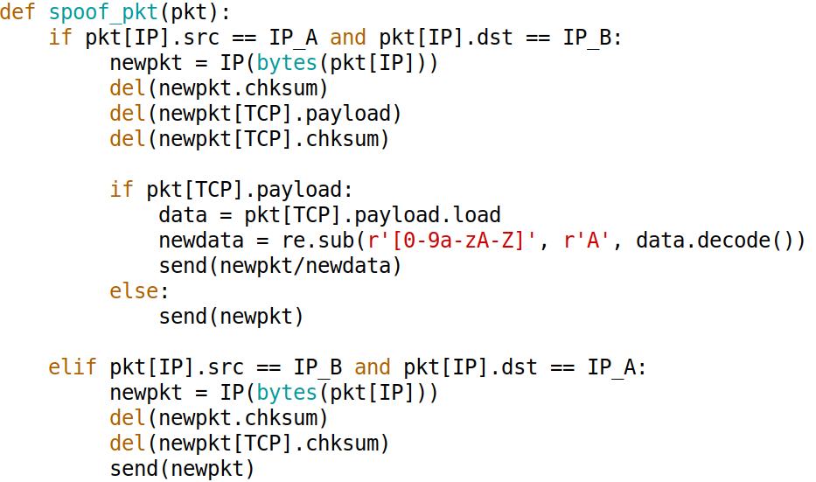
MITM Step 3: Modify Packets

Slide 37
MITM Step 4: Demo

Slide 38
Question
Disclaimer: this is a fiction!
In the 2020 State of Union address, President Trump said the following: "In 2019, Russian hackers launched many ARP cache-poisoning attacks from Russia against the computer networks inside the White House, but, as I can proudly tell you, under my leadership, my staff has successfully defeated all of these attacks ." Then he paused, looking at the audience, waiting for applause.
Do you applaud or not?
Notes:
This is meant to be a joke, so don’t take it very seriously.
Answer that is politically correct: whether you applaud or not depends on whether you are a democratic or republican.
Answer that is technically correct: I will not applaud, because the statement is not true: ARP cache-poisoning attack cannot be launched from a remote computer.

