Slide 1
IP Protocol and Attacks

Slide 2
Outline
The Role of the IP layer
IP Header
IP Fragmentation and Attacks
Routing
ICMP and Attacks

Slide 3
Functions and Properties of IP Layer
Basic functions
Routing
Passing packets to the transport layer
Provide error detection and diagnostic capability
Properties
Best effort delivery
Not responsible for reliable transmission

Slide 4
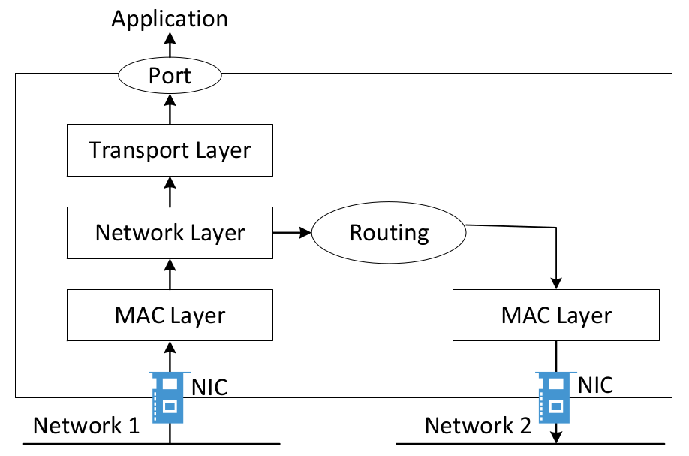
Packet Traversal

Slide 5
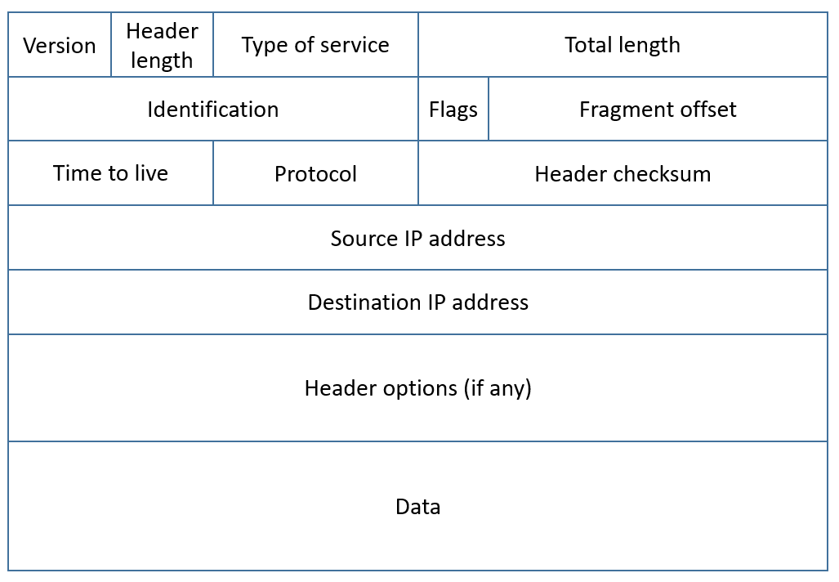
IP Header
Notes:
Talk about each field of the IP header

Slide 6
TTL and How Traceroute Works
TTL = 1, 2, 3, …
At each router: TTL --
Packet discarded and trigger ICMP when TTL=0
Notes:
Talk about how traveroute works

Slide 7
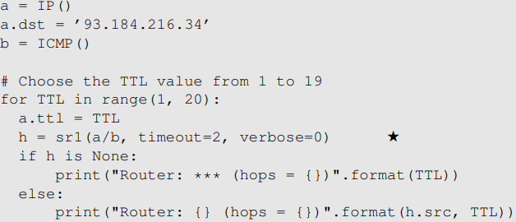
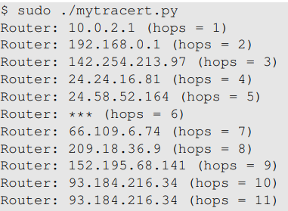
Implement traceroute

Slide 8
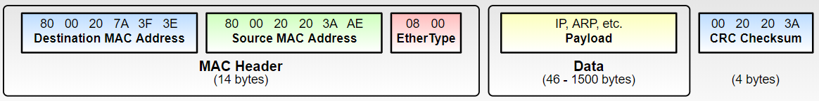
The Need for Fragmentation
Limit of packet size

Slide 9
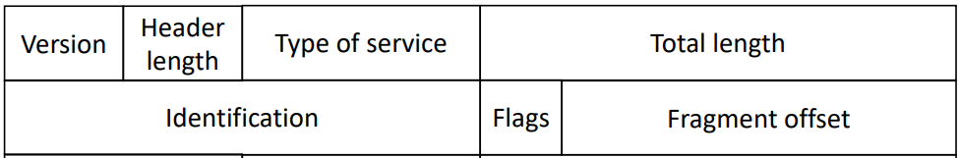
IP Header Fields for Fragmentation

Slide 10
How IP Fragmentation Works
Flags
bit 0: reserved, must be zero
bit 1: Do not Fragment (DF)
bit 2: More Fragment (MF). MF=0 for last fragment, 1 for others
Offset
The actual offset divided by 8 (think about why?)
Notes:
Read the book for the explanation of why the offset is divided by 8.

Slide 11
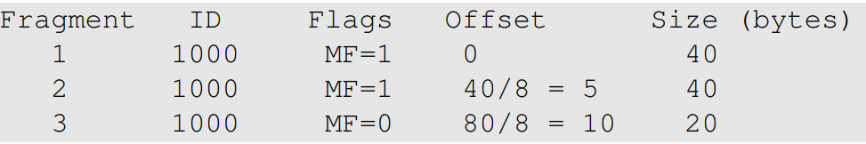
Example
Packet
ID field: 1000
Payload size: 100 bytes
Break into 3 fragments, each with at most 40 bytes of payload

Slide 12
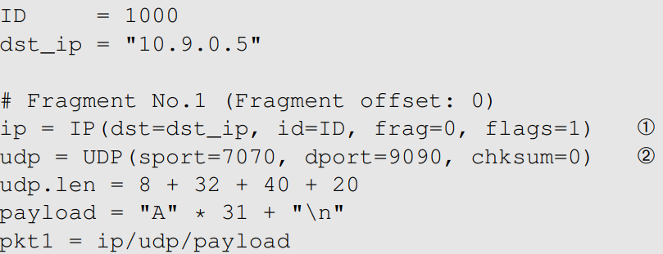
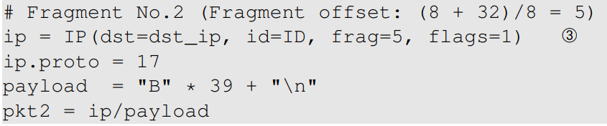
Build Fragments Manually (1)
Fragment 1
Fragment 2

Slide 13
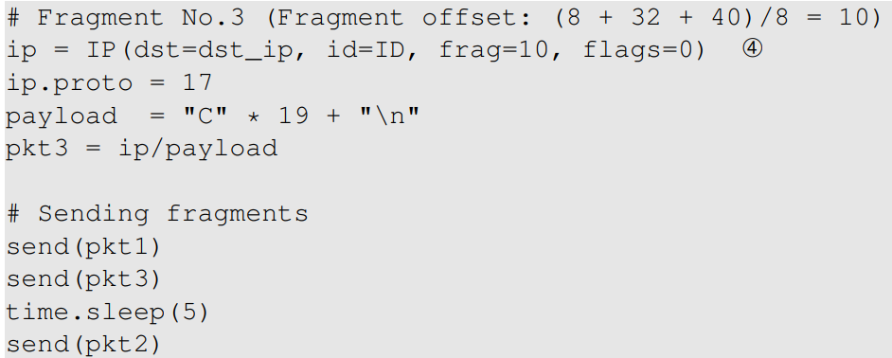
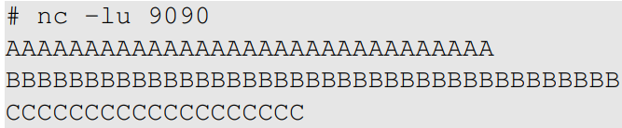
Build Fragments Manually (2)
Fragment 3
Execution Result

Slide 14
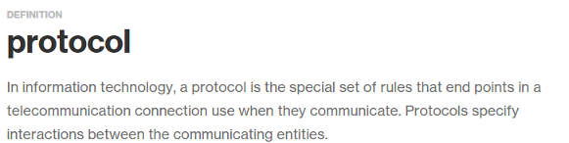
Attacks on IP Fragmentation

Slide 15
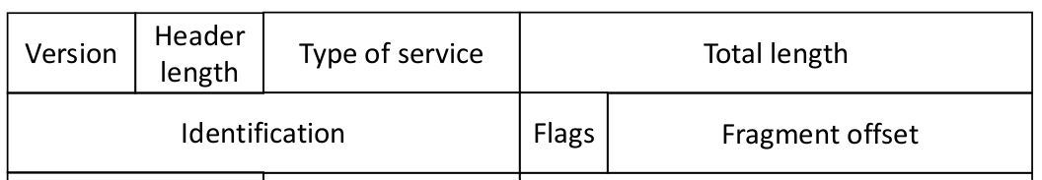
Attack 1: Tie Up Target's Resources
Question: Can you use a small amount of bandwidth to tie up a target machine's significant amount of resource?
Hint: use 2 small packets to cause server to allocate 60KB of RAM

Slide 16
Attack 2: Create a Super-Large Packet
Question: Can you create an IP packet that is larger than 65,536 bytes? (The Ping-of-Death Attack)

Slide 17
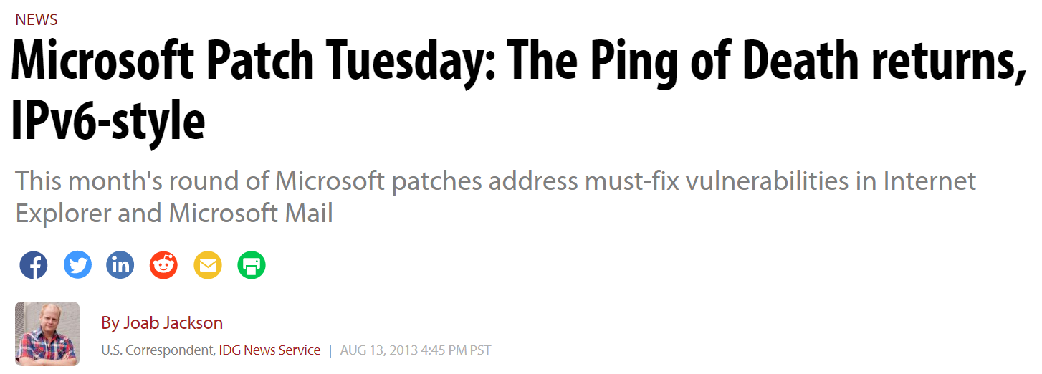
A Recent Ping of Death Vulnerability

Slide 18
Attack 3: Create Abnormal Situation
Question: Can you create some abnormal conditions using "offset" and "payload size"? (Teardrop Attacks)

Slide 19
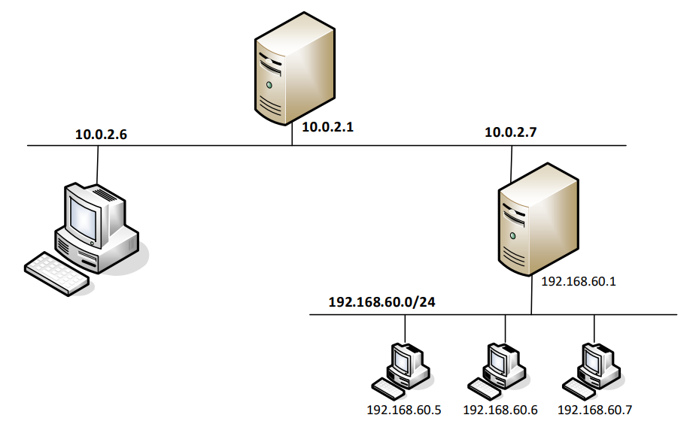
Routing

Slide 20
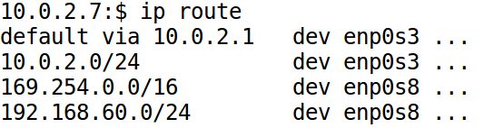

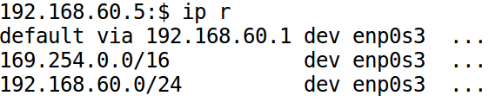
Routing Table

Slide 21
Routing Rules
Question: What interface will be used to route packets to
(1) 192.200.60.5?
(2) 192.168.30.5?
(3) 192.168.60.5?
Routing Entry | Packet 1 | Packet 2 | Packet 3
A: 0.0.0.0/0 dev interface-a
B: 192.168.0.0/16 dev interface-b
C: 192.168.60.0/24 dev interface-c
D: 192.168.60.5/32 dev interface-d

Slide 22
Changing Routing Table
$ sudo ip route add 192.168.60.0/24 dev enp0s3 via 10.0.2.7
$ sudo ip route del 192.168.60.0/24
$ ip route

Slide 23
How Are Routing Tables Configured
For routers
Routing protocols, OSPF, BGP, etc.
For hosts
DHCP
Using default routers
Manual configuration
ICMP redirect messages

Slide 24
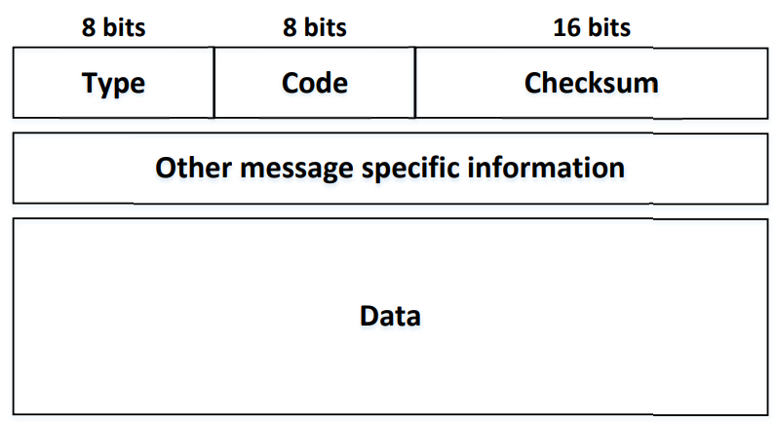
ICMP: Internet Control Message Protocol
Send Error messages
Send Operational information

Slide 25
ICMP Echo Request/Reply
Used by ping
Type
8: request
0: reply

Slide 26
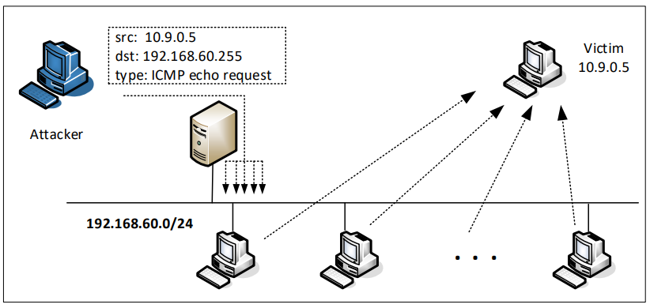
Smurf Attack
Direct broadcast address
Example: 192.168.60.255 for network 192.168.60.0/24

Slide 27
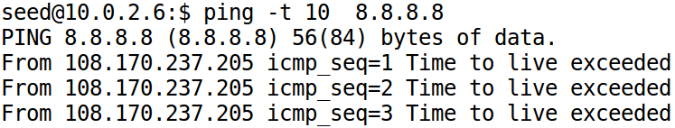
ICMP Time Exceeded
Type: 11
Code:
0: Time-to-live exceeded in transit
1: Fragment reassembly time exceeded
TTL=10

Slide 28
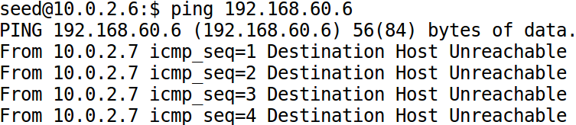
ICMP Destination Unreachable
Type:
Code
0: Destination network unreachable
1: Destination host unreachable
3: Destination port unreachable

Slide 29
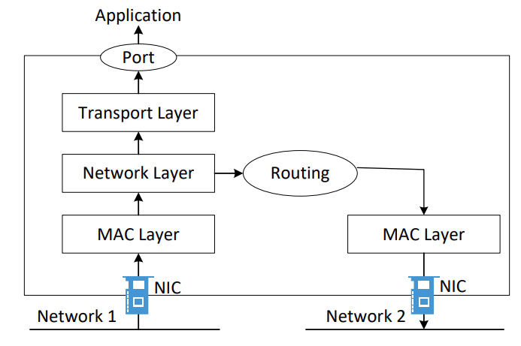
ICMP Redirect

Slide 30
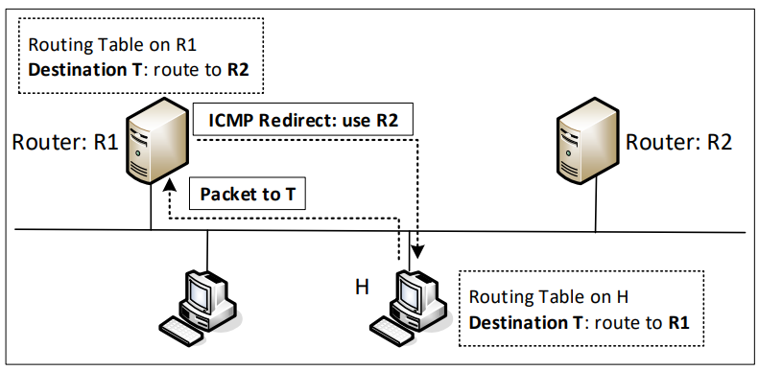
ICMP Redirect and Attacks
Notes:
Explain when this type of ICMP message is sent

Slide 31
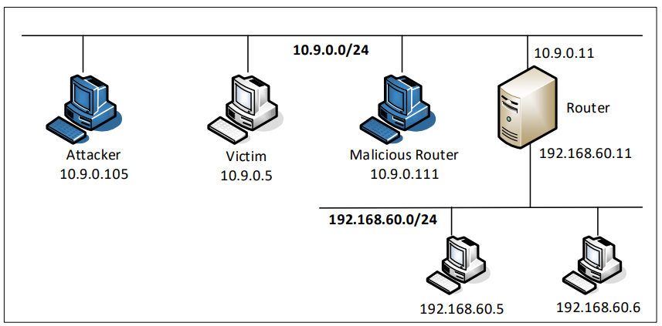
ICMP Redirect Experiment: Setup

Slide 32
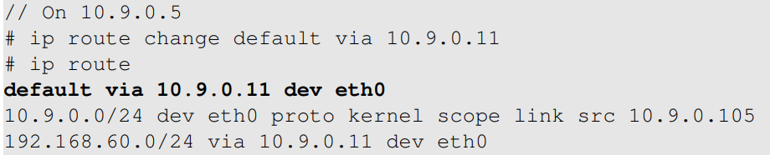
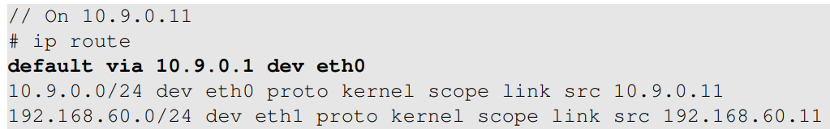
ICMP Redirect Experiment: Setup
Make 10.9.0.11 the default router
10.9.0.11’s default router is 10.9.0.1

Slide 33

ICMP Redirect Experiment
10.9.0.5 can directly send to 10.9.0.1: trigger ICMP redirect
After redirection (check 10.9.0.5)

Slide 34
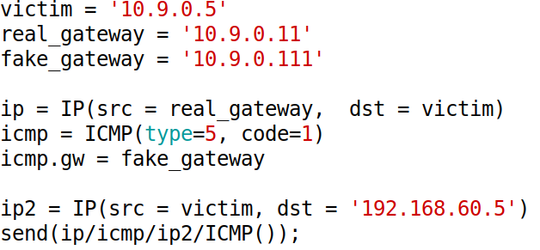
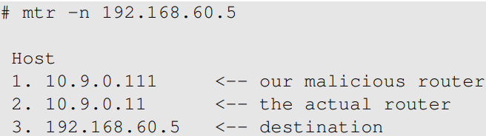
Spoofing ICMP Redirect Message
Attack result
Notes:
According to the ICMP protocol, ICMP redirect message should contain a data section
that includes a copy of the entire IP header, plus at least the first eight bytes of data from the
IP packet that caused the redirect message. The data section is used by the host to see which
packet has caused the error message, so the recipient can know which route should be updated.
Moreover, on Ubuntu 20.04, the recipient of the ICMP redirect message will verify whether the
packet information enclosed in the data part is consistent with the packets that were sent out. If
not, the message will be dropped.

Slide 35
MITM Attack By Spoofing ICMP Redirect
Redirect traffic to attacker’s machines
Make changes before sending the packets out
Similar to the MITM attacking using the ARP cache poisoning attack

Slide 36
Question: ICMP Redirect
Question 1: Can you launch ICMP redirect from a remote computer?
Question 2: Can you use ICMP redirect attacks to redirect to a remote computer?

Slide 37
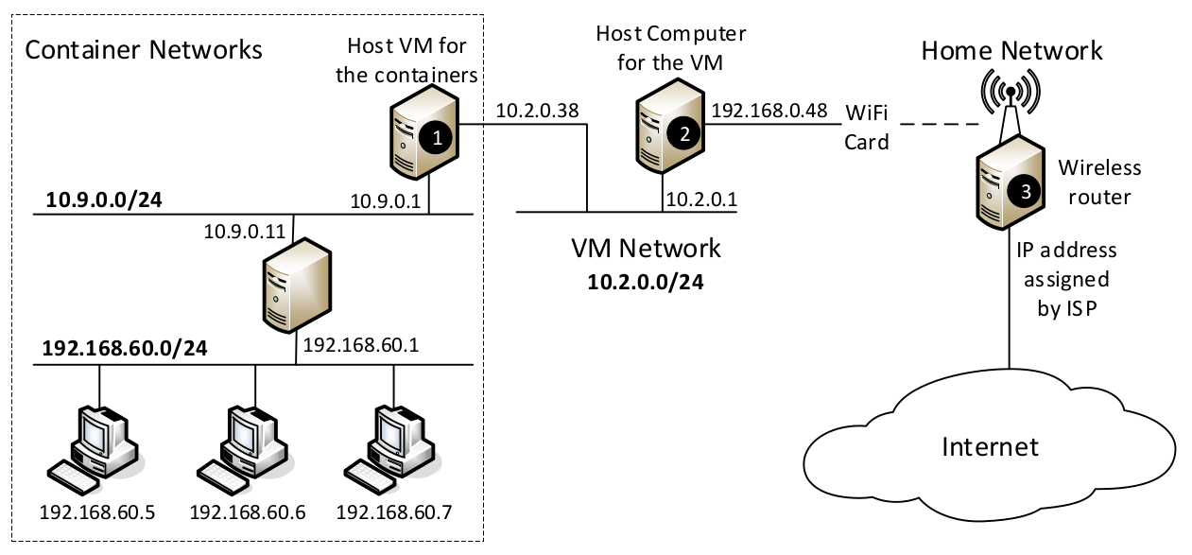
NAT: Network Address Translation
Notes:
Use this diagram to explain how the NAT works. There are several level of private networks in this diagram, each one has a NAT server.

Slide 38
Summary
The Role of the IP layer
IP Header
Routing
ICMP

