Slide 1
Transport Layer and UDP

Slide 2
Outline
Transport layer protocol
Port number
UDP protocol
Attacks using UDP

Slide 3
Transport Layer Protocols
Properties | TCP | UDP
Connections | √
Packet boundary |  | √
Reliability | √
Ordering | √
Speed |  | Faster
Broadcast |  | √

Slide 4
Port Number: Why Need It
Analogy
IP Address: address of machines
Port number: address of applications (within a machine
 | Mailing Address
IP address | Apartment building’s street address
Port number | Apartment number

Slide 5
Port Number
Well-known ports: 0 – 1023
ftp (20, 21), ssh (22), telnet (23), smtp (25), DNS (53), http (80), https (443)
Super-user privilege needed, why?
Less well-known ports: 1024 – 49151
OpenVPN (1194), Microsoft SQL server (1433), Docker (2375-2377)
Private ports: 49152 – 65535
Source port number

Slide 6
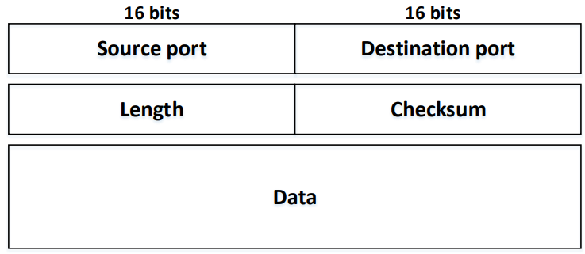
UDP Header and Protocol
Notes:
Note: checksum is optional for IPv4. Set this field to zero if we want the receive not to check the checksum.

Slide 7
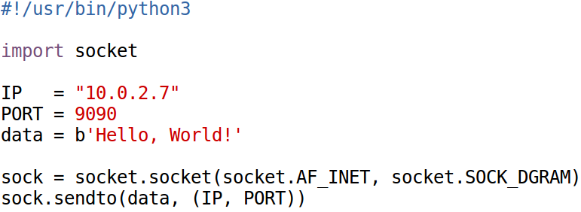
UDP Client Program

Slide 8
Source Port Number
Application does not specify one
OS will assign a random source IP
Common for most client programs
Application specifies one
not common for client
needed for server

Slide 9
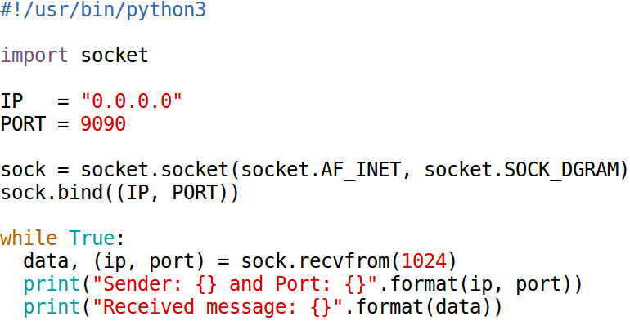
UDP Server Program

Slide 10
UDP Applications
DNS Protocol
Port number: 53
Video/Audio Streaming, Skype, Zoom
Netflix and YouTube use TCP (no need for real time)
Real-Time Applications

Slide 11
Question
UDP does not preserve order and does not handle packet loss. If an application does care about packet loss and order, can it still use UDP?
Notes:
Yes. The application needs to handle the order and packet loss by itself, instead of relying on the protocol to handle them.

Slide 12
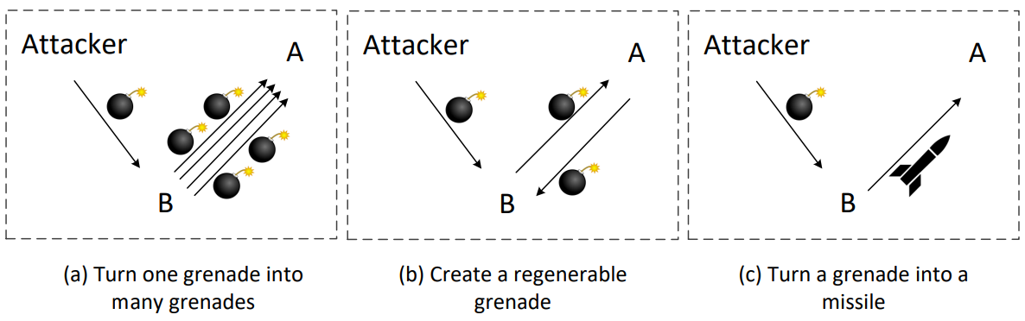
UDP Attack
Mostly used for Denial-Of-Service (DOS) Attacks
Strategies: magnify attacking power

Slide 13
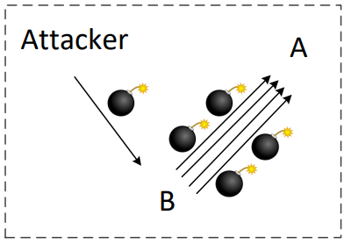
Strategy 1: Turn One Grenade into Many
Example: Smurf Attack (ICMP), Fraggle Attack (UDP)

Slide 14
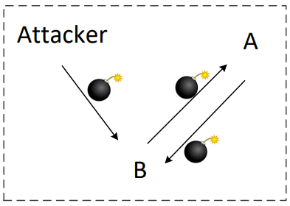
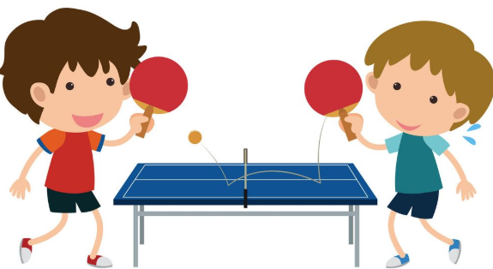
Strategies: Create Regenerable Grenade
Example: UDP Ping Pong Attack

Slide 15
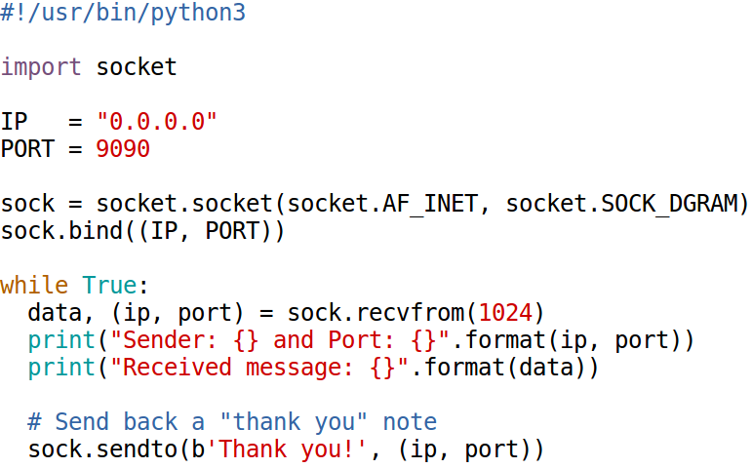
UDP Ping Pong Attack: Vulnerable Server

Slide 16
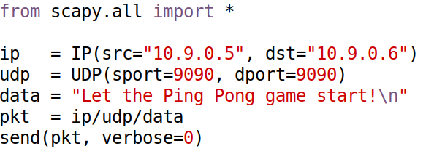
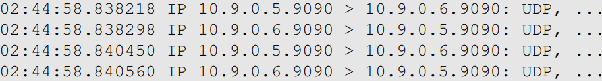
UDP Ping Pong Attack: Attack
Attack results (look at the timestamp to see how fast the Ping Pong ball is):
Notes:
Fun fact: If we convert this into real Ping Pong on a real Ping Pong table, this ball is
traveling at a speed of 5200 meters per second, about Mach 10.

Slide 17
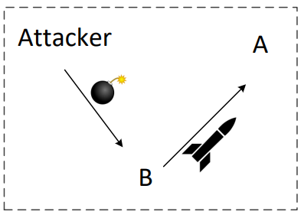
Strategy 2: Turn Grenade to Missile
Example: UDP Amplification Attack

Slide 18
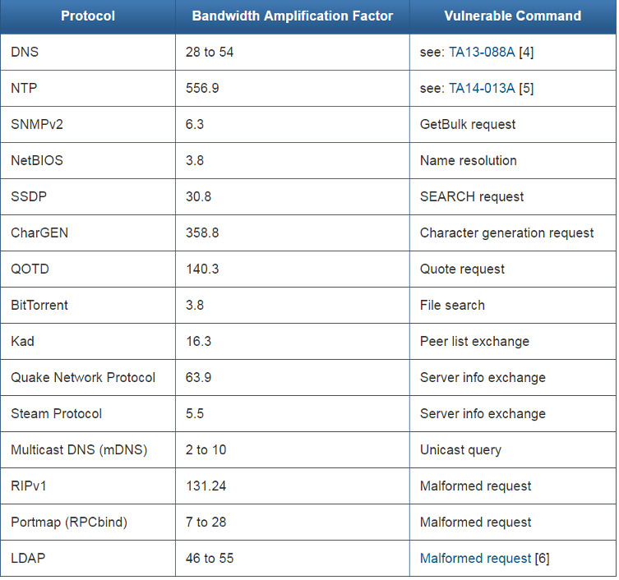
Bandwidth Amplification Factor
Source: Christian Rossow

