Slide 1
Virtual Private Network

Slide 2
Outline
Why VPN is needed
IP Tunneling
How VPN works
TUN/TAP interface
Layer-2 and Layer-3 VPNs

Slide 3
Introduction
Networks primarily intended for internal use are called private network.
If we grant access from outside to the private network, the attack surface will significantly broaden.
If the internal resources still use IP address as the basis for authorization, it is not difficult for attackers to access the protected resources

Slide 4
Virtual Private Network
VPN allows users to create a secure, private network over a public network such as the Internet. This is achieved by:
Having a designated host (VPN server) on the network
Outside computers have to go through the VPN server to reach the hosts inside a private network via authentication.
VPN server is exposed to the outside and the internal computers are still protected, via firewalls or reserved IP addresses.

Slide 5
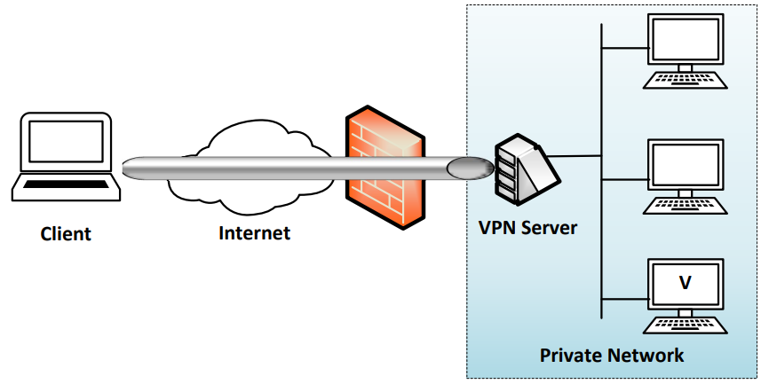
A Typical Setup

Slide 6



IP Tunneling
Traffics inside the tunnel are protected
Tunnel End A
Tunnel End B
The tunnel goes through a public network, such as the Internet.
The actual packet between the two ends of the tunnel
The payload carries another IP packet, which is the packet that needs to be protected, such as packets to/from a private network

Slide 7
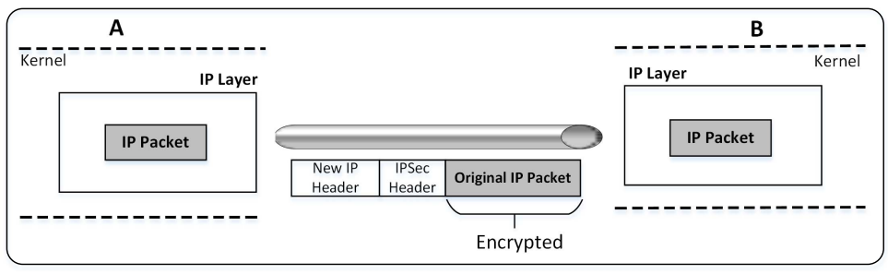
IP Tunneling: IPSec Approach

Slide 8
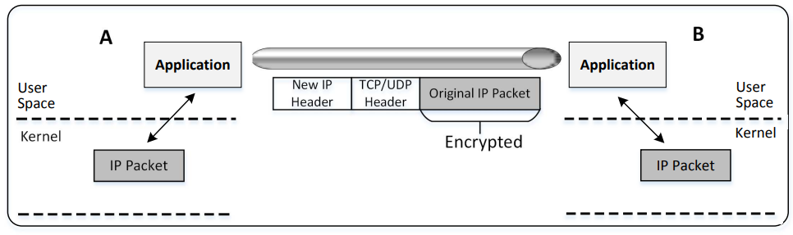
IP Tunneling: SSL/TLS Approach

Slide 9
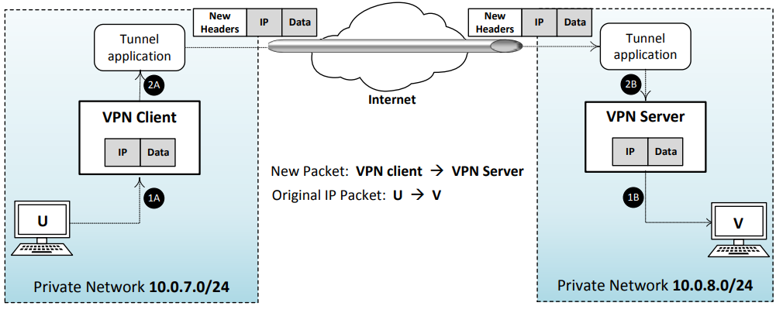
An Overview of How TLS/SSL VPN Works

Slide 10
TUN/TAP Virtual Interface

Slide 11
Question/Discussion
How can applications get packets, including headers?

Slide 12
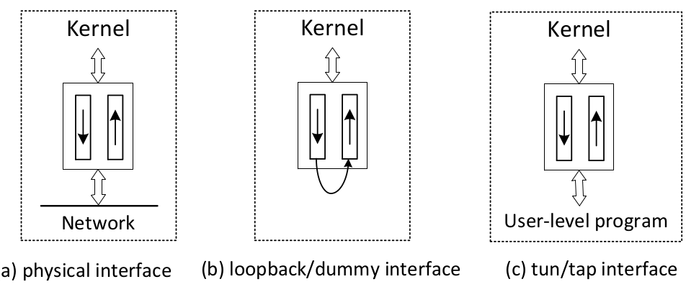
Physical and Virtual NIC
One end of a NIC is the OS kernel (protocol stack). The other end can vary, especially for virtual NIC, which is implemented using software.

Slide 13
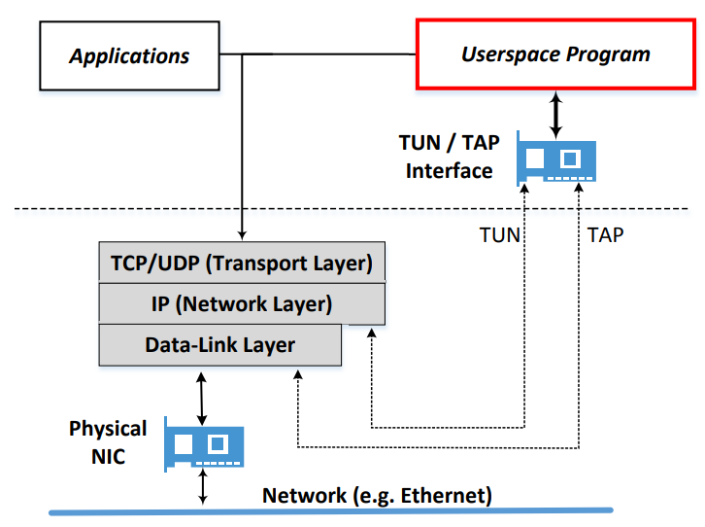
The TUN/TAP Interface

Slide 14
TUN/TAP Interface
TUN Virtual Interface
Work at OSI layer 3 or IP level
For Layer-3 VPN
TAP Virtual Interfaces
Work at OSI layer 2 or Ethernet level
For Layer-2 VPN
Notes:
TUN/TAP interfaces can be seen as a point-to-point network device, which connects two computers

Slide 15
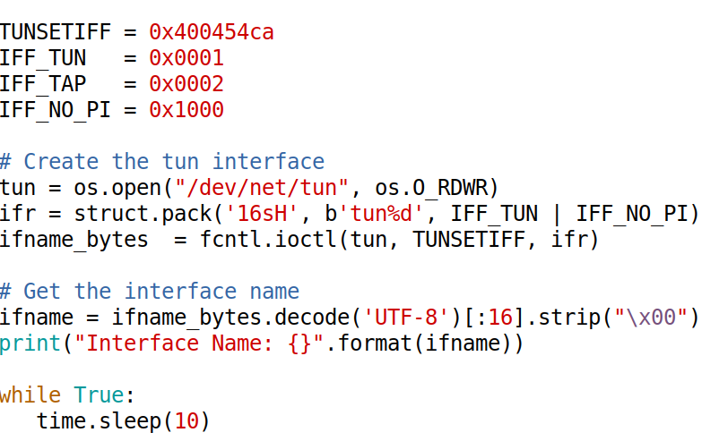
Creating TUN Interface in Python

Slide 16
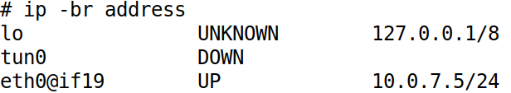
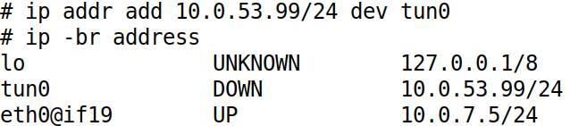
Configure TUN Interface (1)
Show the TUN Interface
Set the IP Address for the TUN Interface

Slide 17
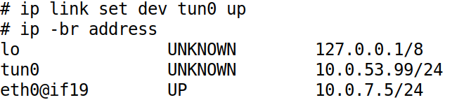
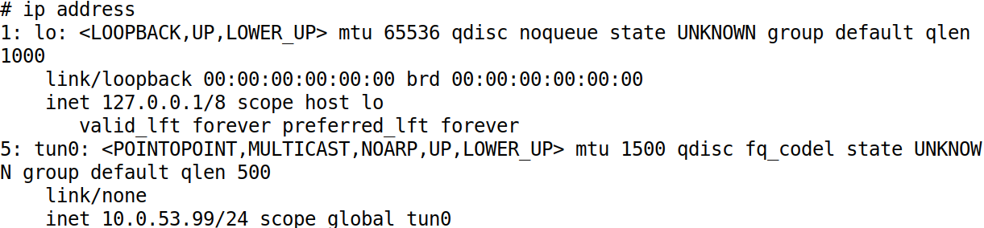
Configure TUN Interface (2)
Bring Up the TUN Interface

Slide 18
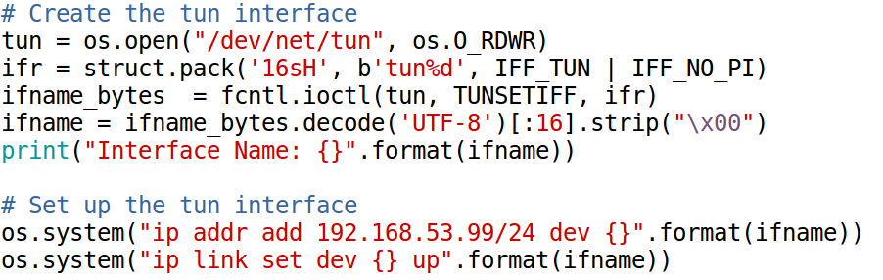
Add the Configuration to Python Code

Slide 19
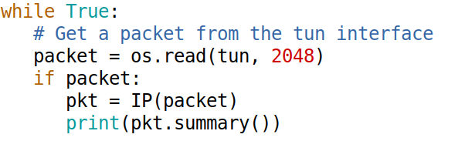
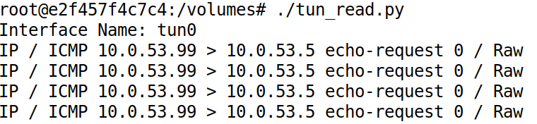
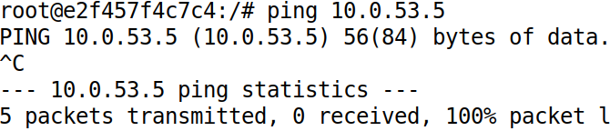
Reading From the TUN Interface
The Code
Testing

Slide 20
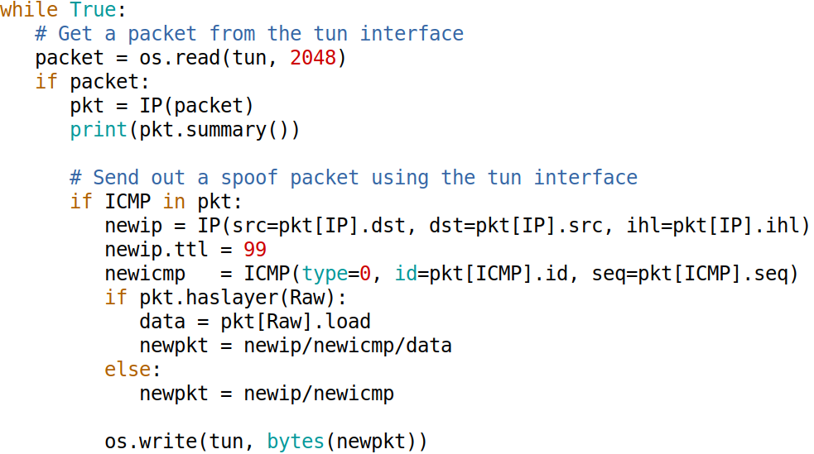
Writing to the TUN Interface (1)

Slide 21

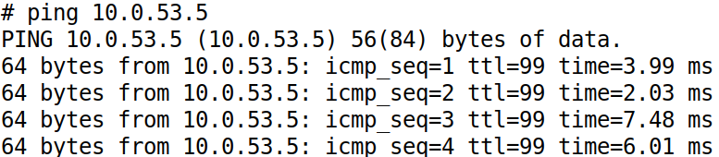
Writing to the TUN Interface (2)
Testing

Slide 22
Creating IP Tunnel

Slide 23
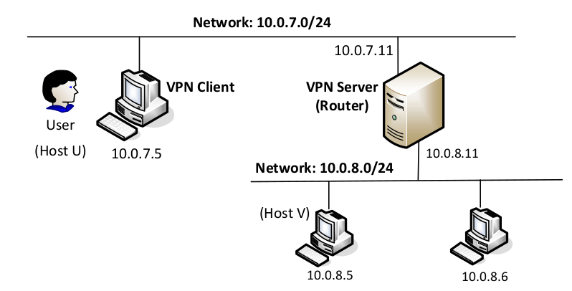
Network Configuration

Slide 24
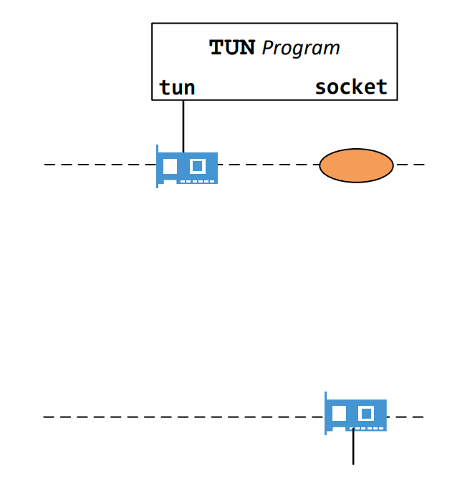
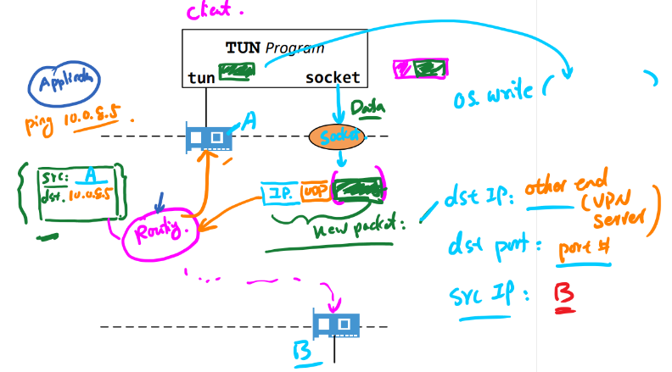
Client: Put IP Packet Inside Tunnel
sample drawing (please remove)
Notes:
Draw the diagram in the class to show students how packets traverse through the TUN interface. A sample drawing is placed on the slides.

Slide 25
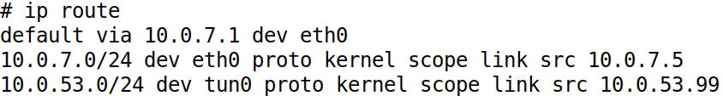
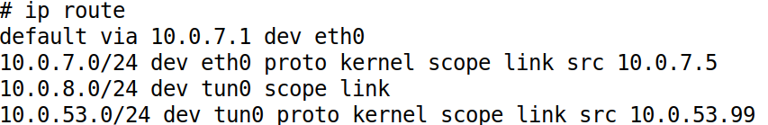
Route to TUN Interface
Routing Table
Route Traffic to the TUN Interface
# ip route add 10.0.8.0/24 dev tun0

Slide 26
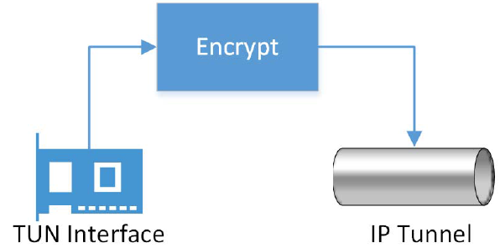
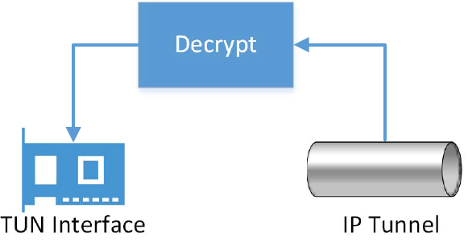
Send/Receive Packets via Tunnel
Sending a packet via the tunnel
Get an IP packet from the TUN interface
Encrypt it (also add MAC)
Send it as a payload to the other end of the tunnel
Receiving a packet from the tunnel
Get a payload from the tunnel
Decrypt it and verify its integrity
We get the actual packet
Write the packet to the TUN interface

Slide 27
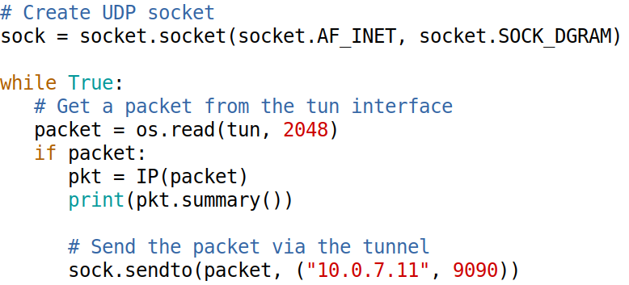
Client Code
… set up and configure the TUN interface …

Slide 28
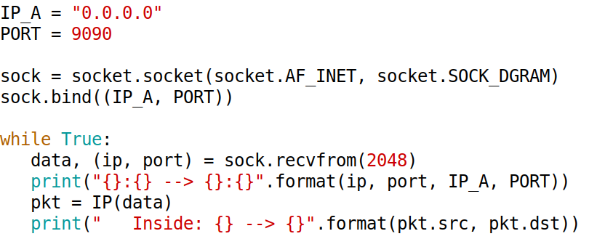
Server Code

Slide 29
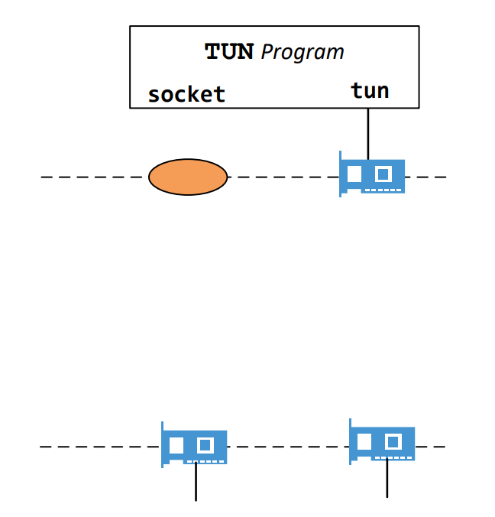
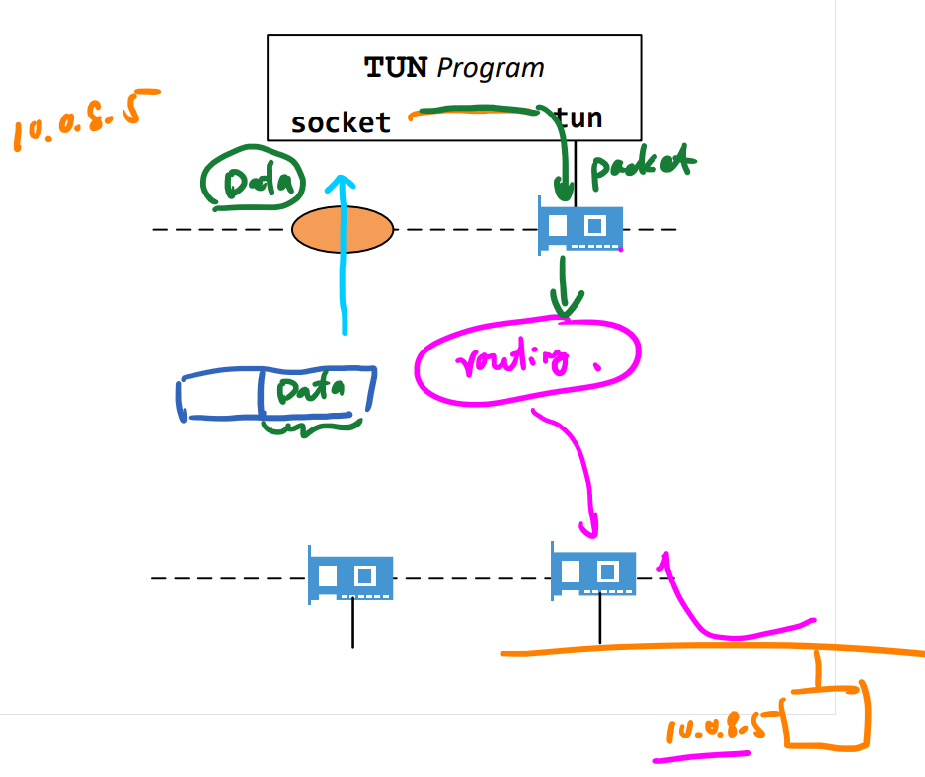
Server: Forward IP Packet
sample drawing (please remove)

Slide 30
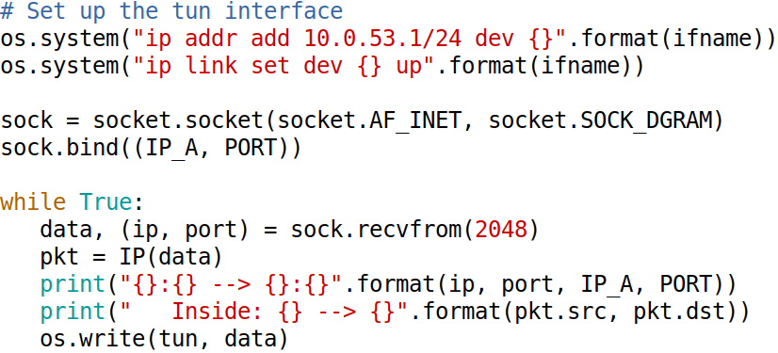
Server Code
… Create and TUN interface …

Slide 31
Testing
// From VPN Client
# ping 10.0.8.5
// Observe from 10.0.8.5
# tcpdump -n -i eth0

Slide 32
Returning From Private Network

Slide 33
Routing Back to VPN Server

Slide 34
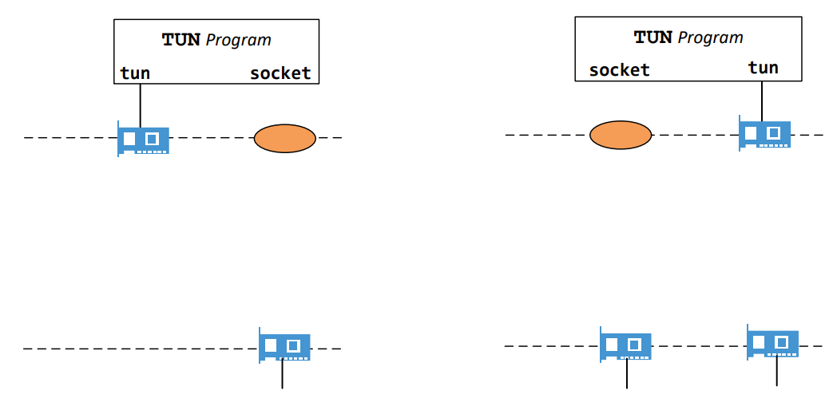
Tunneling Packet To Client

Slide 35
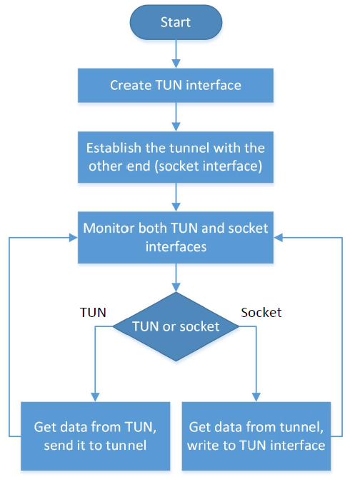
Monitoring Both Interfaces
Each tunnel application has two interfaces: socket and TUN
Need to monitor both
Forward packets between these two interfaces

Slide 36
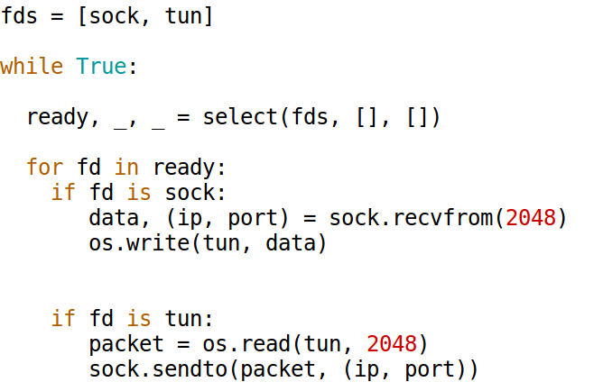
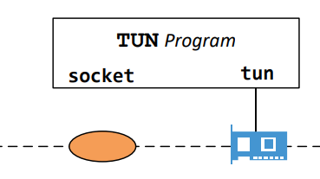
Monitoring Multiple Interfaces

Slide 37
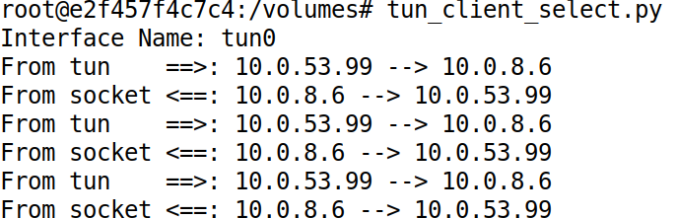
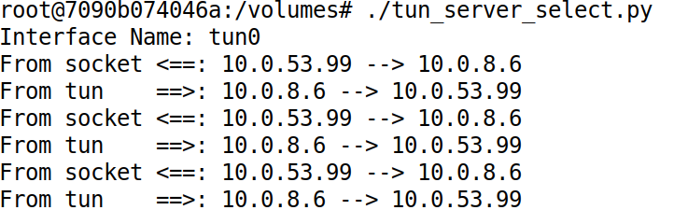
Complete the Tunnel
VPN Client
Run "ping 10.0.8.6“
VPN Server

Slide 38
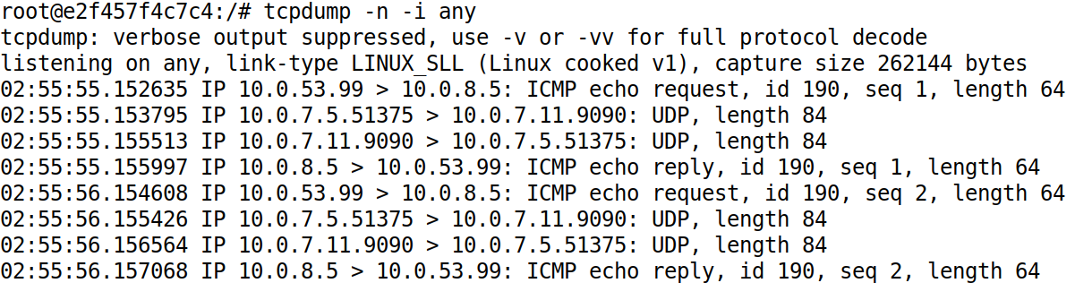
Network Traffic: From VPN Client

Slide 39
Review: The Whole Picture
Notes:
It is important to do a review here.
Use this diagram to illustrate the entire flow

Slide 40
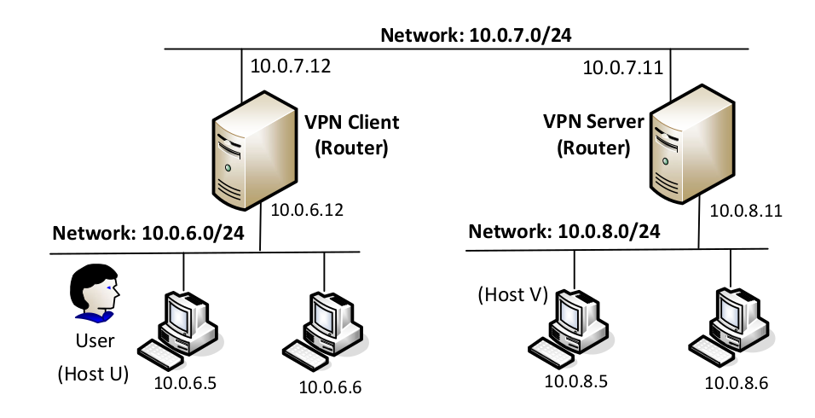
Network To Network

Slide 41
Layer-2 VPN

Slide 42
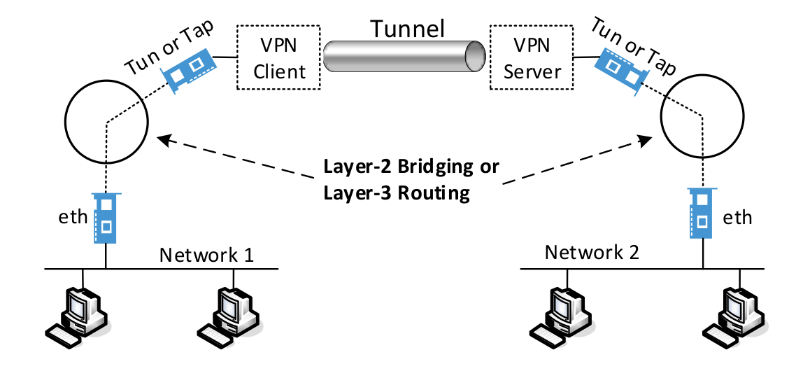
Layer-2 versus Layer 3 VPN

Slide 43
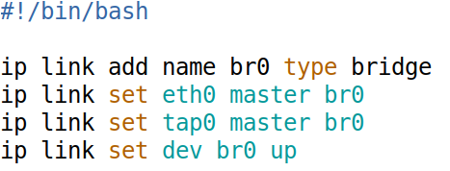
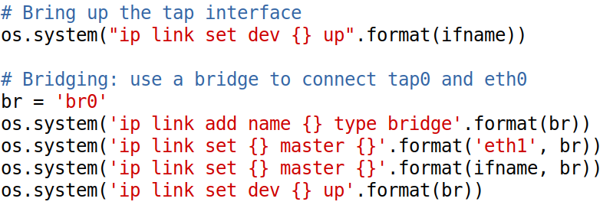
Bridging TAP and Ether Interfaces
Using commands
In Python program

Slide 44
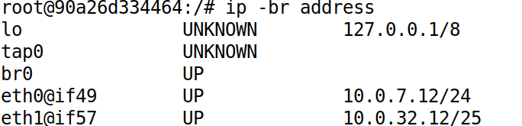
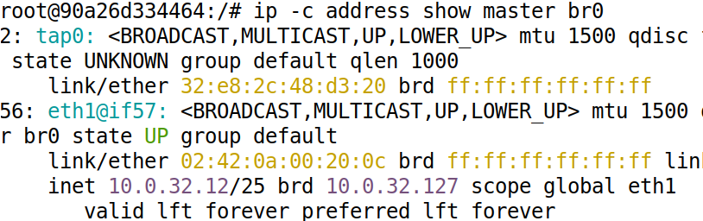
List the Bridge and Interfaces
List the bridges
List the interfaces

Slide 45
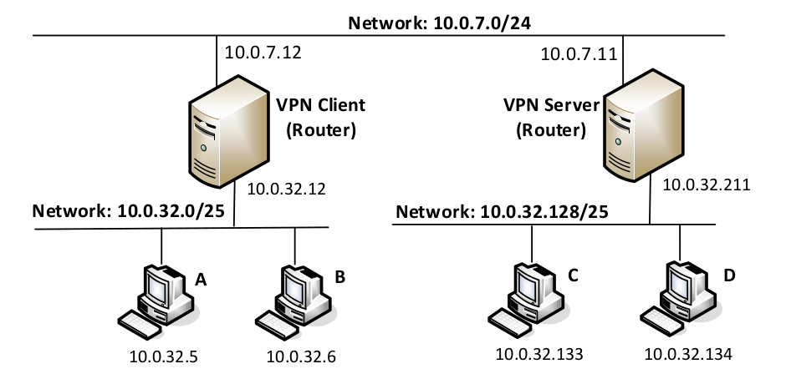

Bridging Two Networks: Setup
See the note
Notes:
Typically, the goal of bridging is to connect two segments of the same network, i.e., both segments have the same network prefix. However, in Docker, we cannot directly create two network segments with the same network prefix. We use a trick to achieve that. We first create two different networks: 10.0.32.0/25 and 10.0.32.128/25 (see the figure). Once all the containers have started, on Hosts A, B, C, and D, we delete the original addresses on their eth0 interfaces, and replace them with another address, which is the same address, but with a different netmask (24 bits, instead of 25 bits). Now all these hosts are on the “same” network, 10.0.32.0/24. The changes are made in the Compose file. See the command entry for Host A:

Slide 46
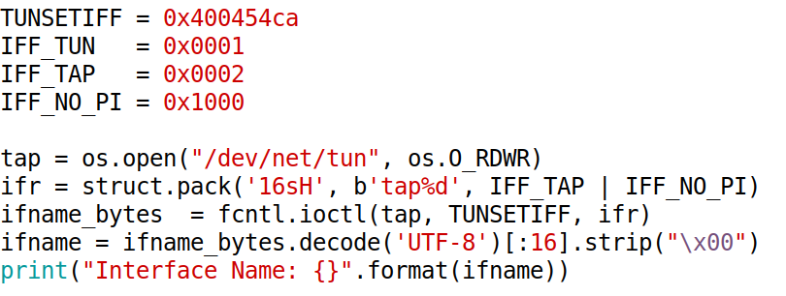
Create TAP Interface

Slide 47
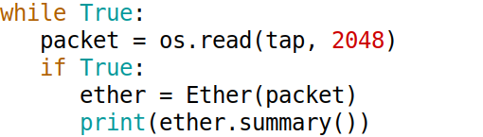
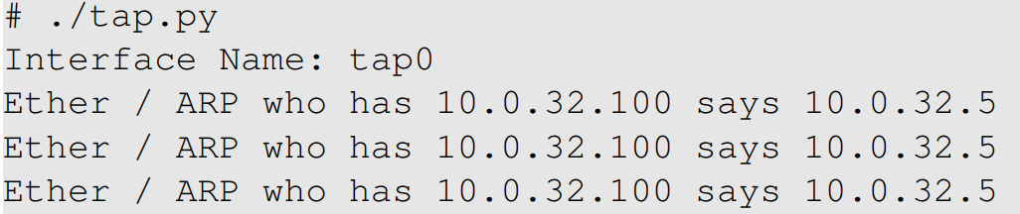
Test the TAP Interface
Ping 10.0.32.100 from 10.0.32.5
Notes:
From 10.0.32.5 (Host A), we ping a non-existing host within the same network, such as 10.0.32.100. Because Host A does not know the MAC address of the destination, it sends out ARP request messages. These broadcast messages reach the eth1 interface on the VPN client. This interface is connected to the bridge br0, which forwards the ARP message to the tap0 interface. That is why our TAP program gets the message. See the following:

Slide 48
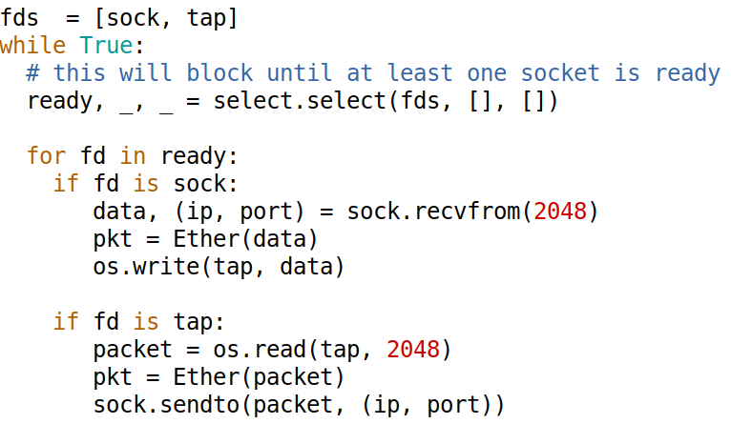
TAP Client/Server Program
Write the TAP interface
Write the tunnel

Slide 49
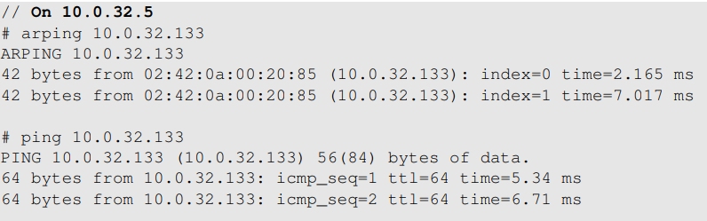
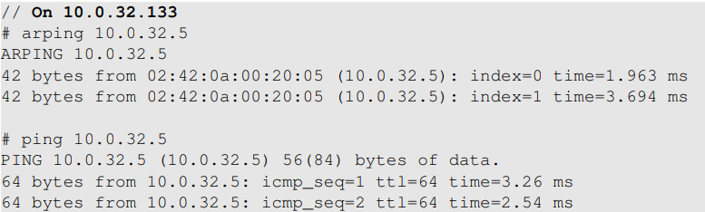
Testing the Layer-2 Tunnel

