Slide 1
DNS and Attacks

Slide 2
Outline
How DNS works
Constructing DNS packets
DNS cache poisoning attacks
Local
Remote
DNS Rebinding attack
DNSSEC

Slide 3
dns infrastructure

Slide 4
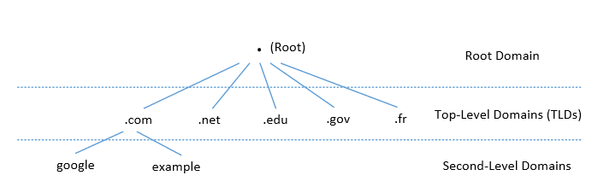
DNS Domain Hierarchy
Domain namespace is organized in a hierarchical tree-like structure.
Each node is called a domain, or subdomain.
The root of the domain is called ROOT, denoted as ‘ . ‘.
Below ROOT, we have Top-Level Domain (TLD). Ex: In www.example.com, the TLD is .com.
The next level of domain hierarchy is second-level domain which are usually assigned to specific entities such as companies, schools etc

Slide 5
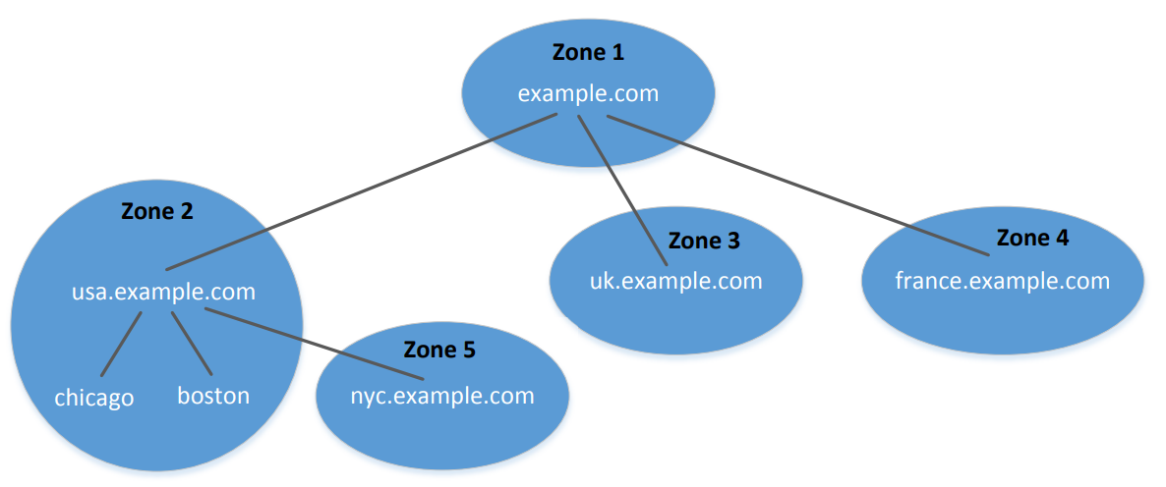
DNS Zones

Slide 6
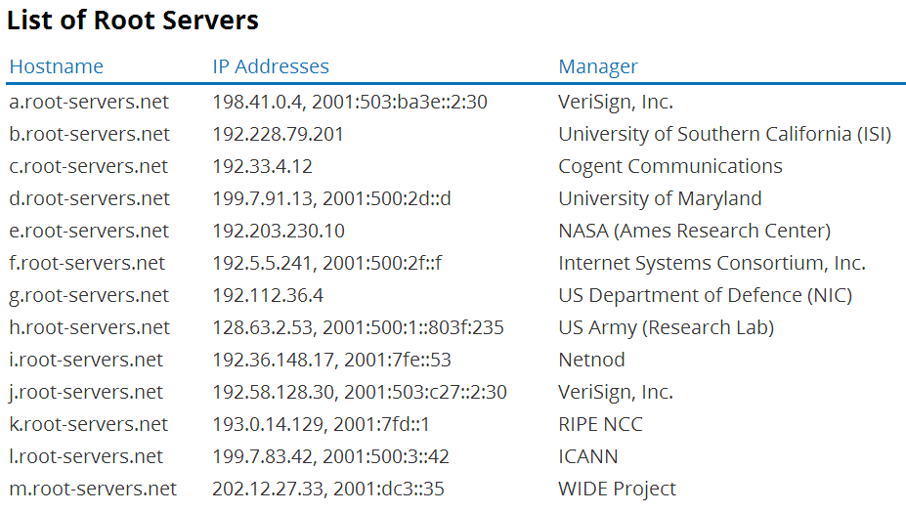
DNS Root Servers

Slide 7
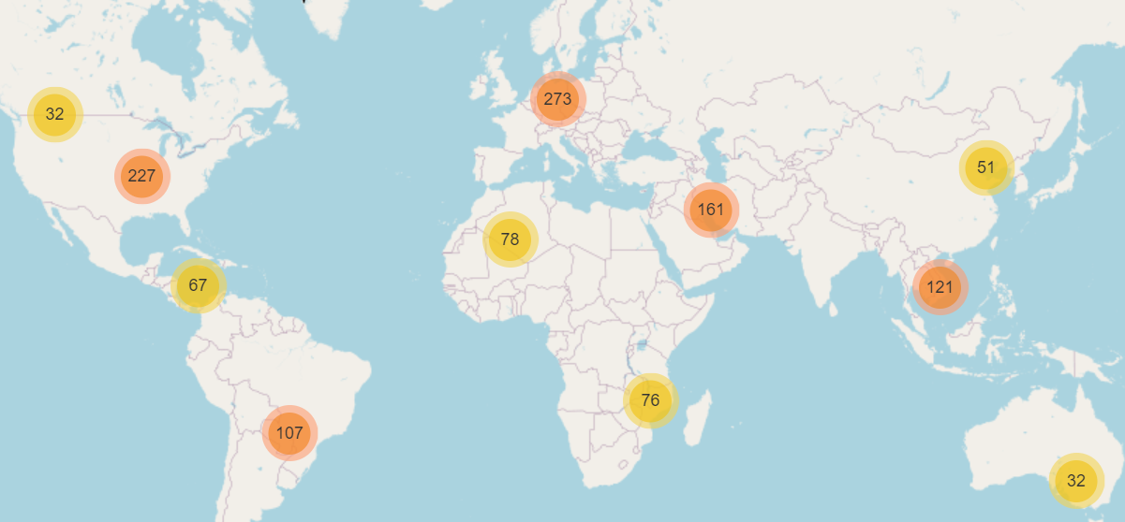
DNS Root Server
source: https://root-servers.org/

Slide 8
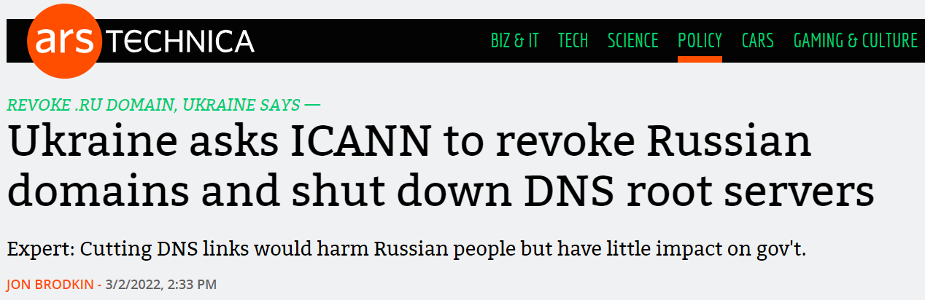
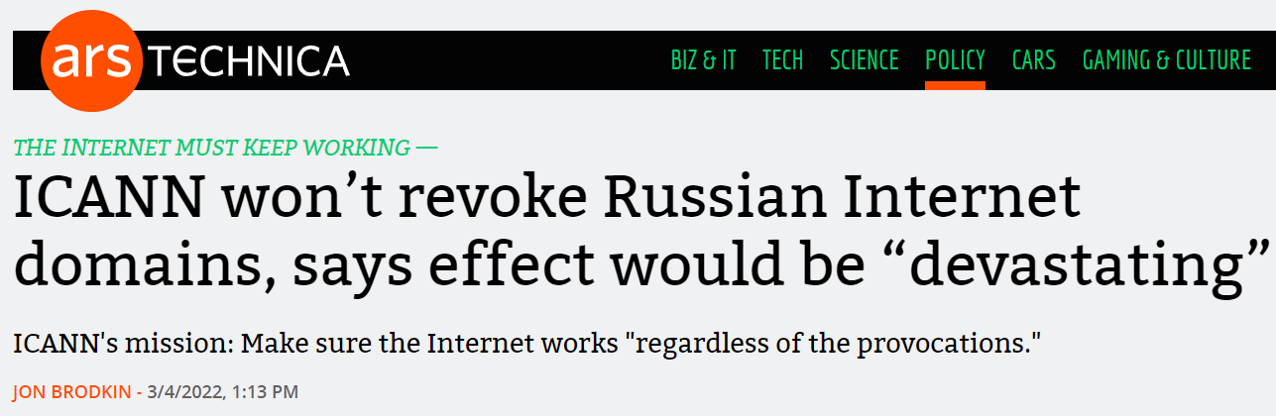
DNS Root Server and Politics

Slide 9
Root Zone File
https://www.internic.net/domain/root.zone

Slide 10
Top Level Domain (TLD)
Infrastructure TLD: .arpa
Generic TLD (gTLD): .com, .net,
Sponsored TLD (sTLD): These domains are proposed and sponsored by private agencies or organizations that establish and enforce rules restricting the eligibility to use the TLD: .edu, .gov, .mil, .travel, .jobs
Country Code TLD (ccTLD): .au (Australia), .cn (China), .fr (France)
Reserved TLD: .example, .test, .localhost, .invalid

Slide 11
dns query process

Slide 12
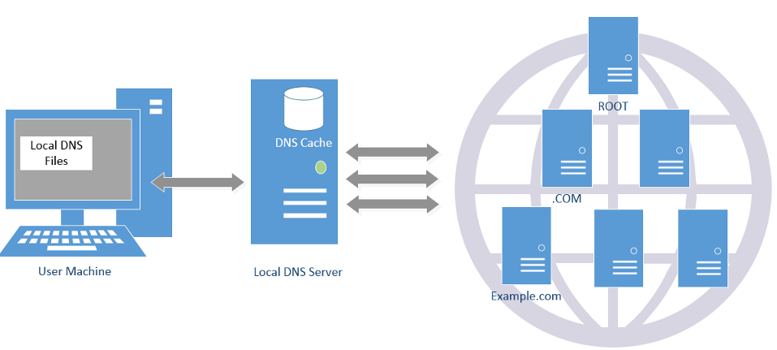
DNS Query Process and Cache

Slide 13
Local DNS Files
/etc/host: stores IP addresses for some hostnames. Before machine contacts the local DNS servers, it first looks into this file for the IP address.
/etc/resolv.conf: provide information to the machine’s DNS resolver about the IP address of the local DNS server. The IP address of the local DNS server provided by DHCP is also stored here.

Slide 14
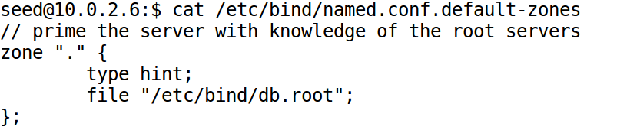
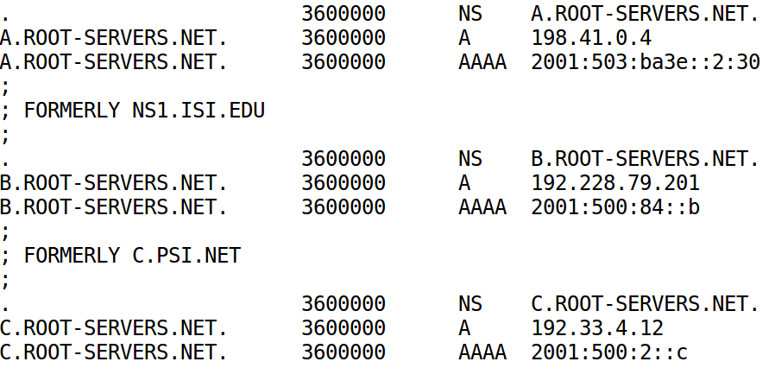
How Local DNS Server Get Root Server's IP

Slide 15
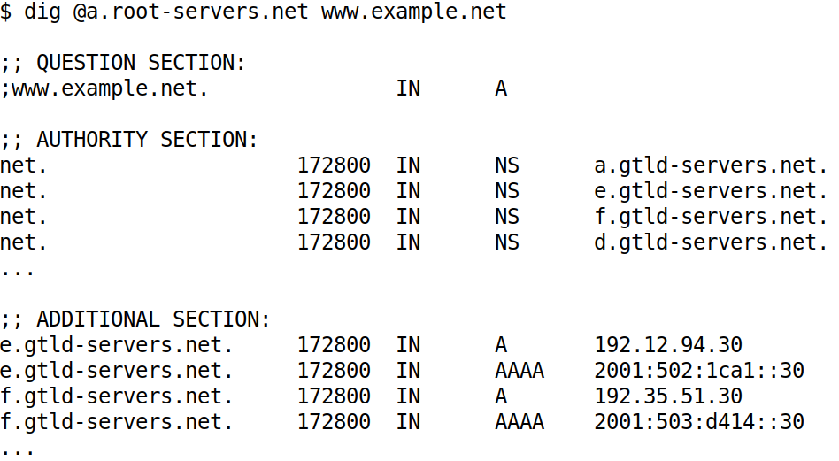
DNS Query Process: Query the Root Server

Slide 16
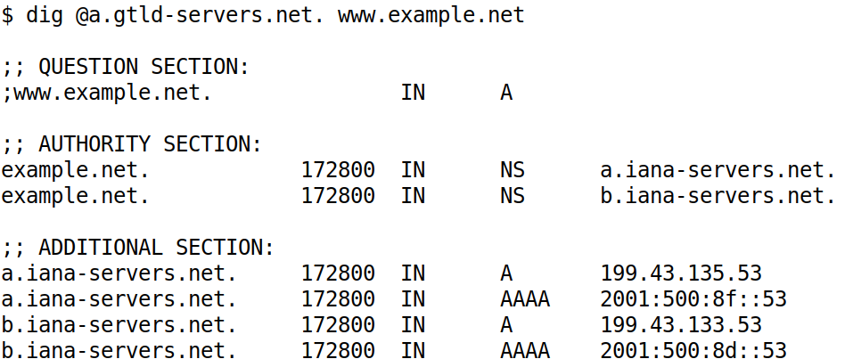
DNS Query Process: Query the net Server

Slide 17
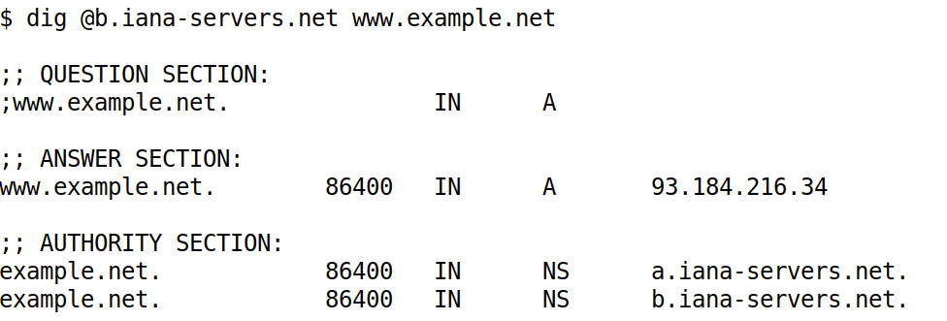
DNS Query Process: Query example.net’s nameserver

Slide 18
Lab Setup for DNS Infrastructure Lab

Slide 19
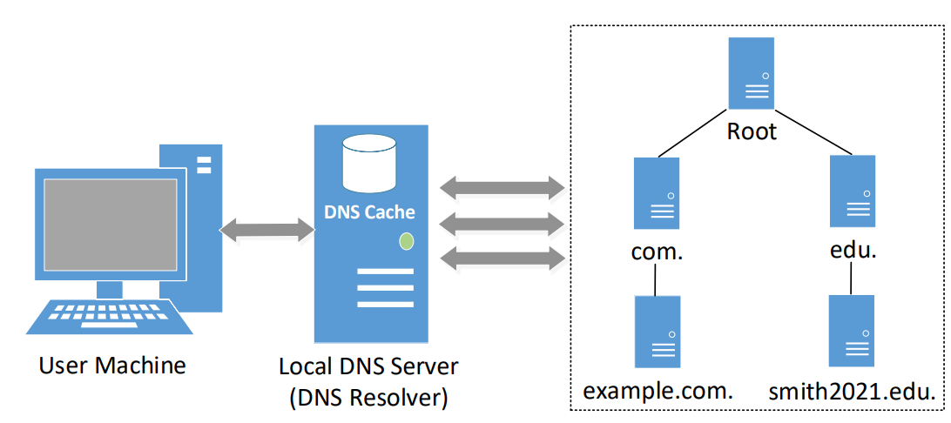
A Simplified DNS Infrastructure

Slide 20
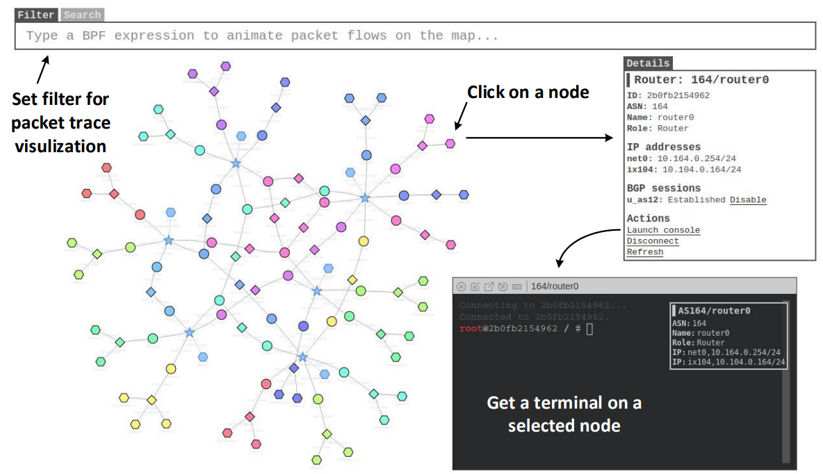
Internet Emulator

Slide 21
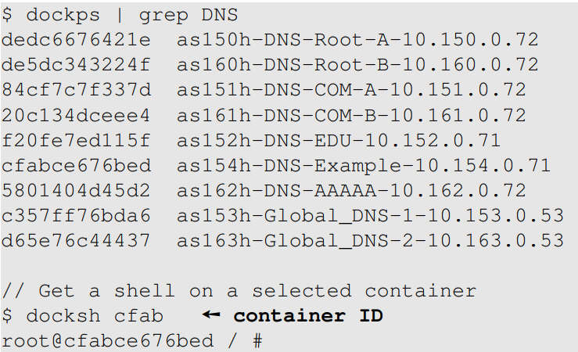
DNS Nameservers

Slide 22
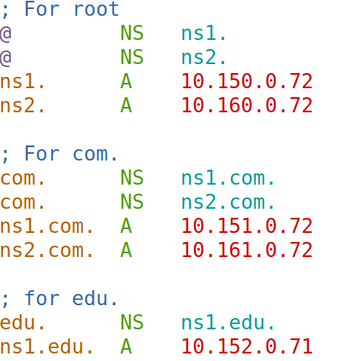
Root’s Zone File

Slide 23
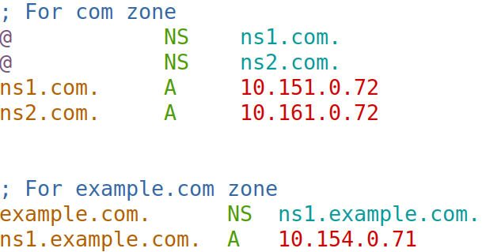
COM’s Zone File

Slide 24
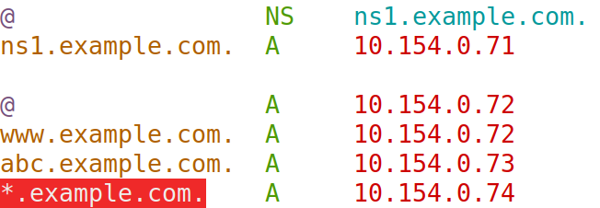
Example.com’s Zone File

Slide 25
Lab setup for DNS Attack Labs

Slide 26
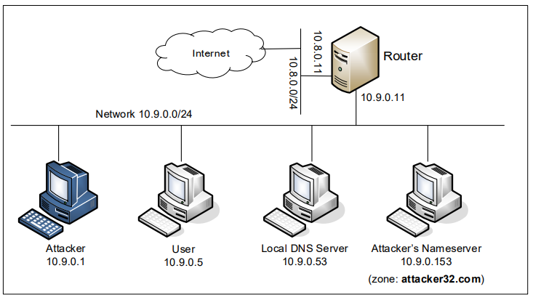
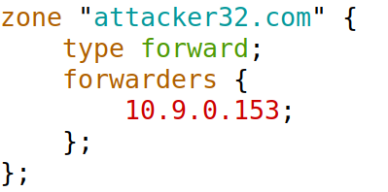
Lab Setup for DNS Attack Labs
On Local DNS Server
/etc/bind/named.conf

Slide 27
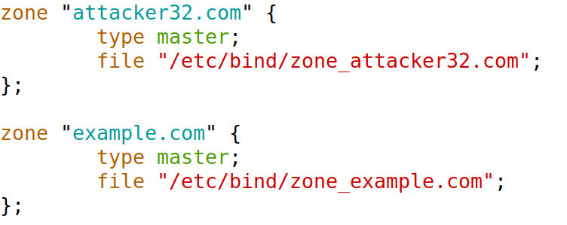
Set Up Two Zones on Attacker Machine
/etc/bind/named.conf

Slide 28
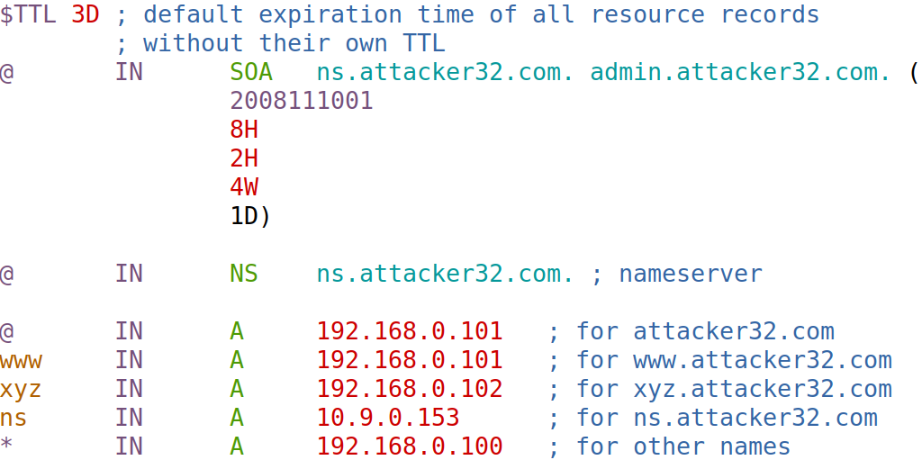
For Attacker32.com Domain

Slide 29
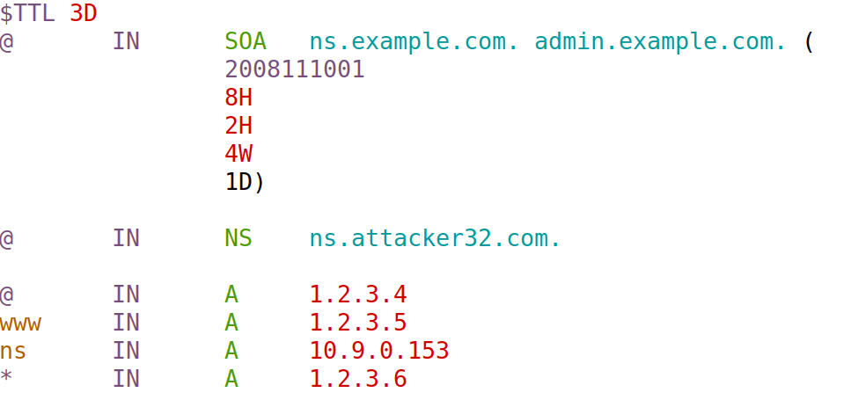
For Example.com Domain

Slide 30
construct dns packets

Slide 31
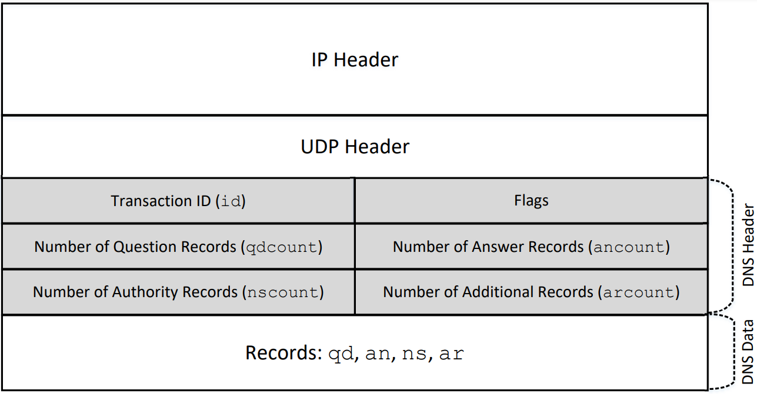
Header of DNS Packet

Slide 32
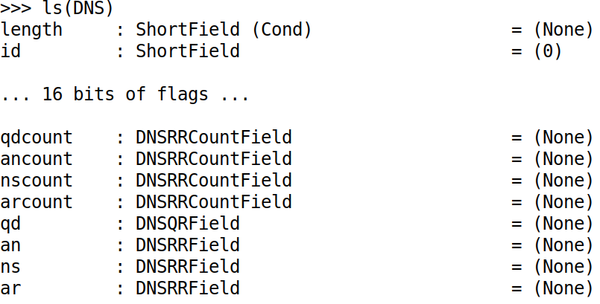
Constructing DNS Header Using Scapy

Slide 33
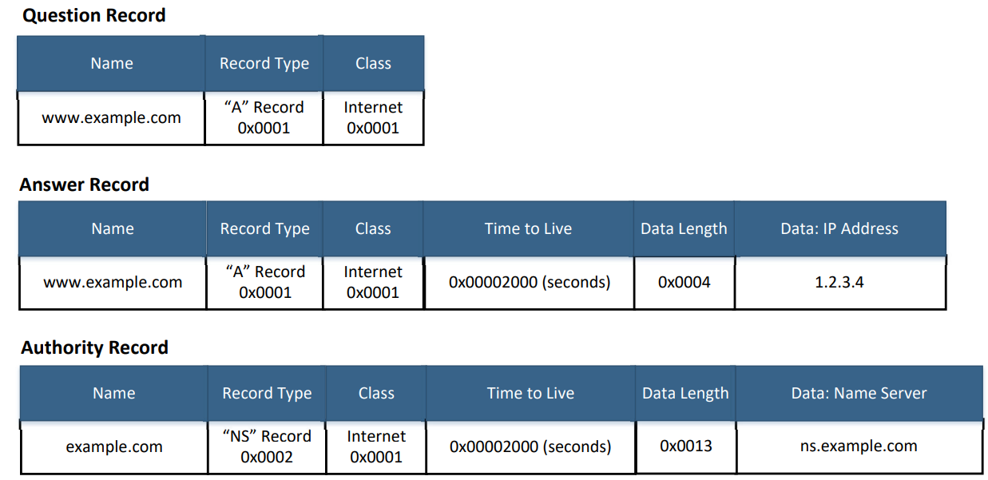
DNS Record Types

Slide 34
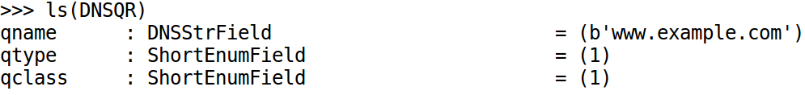
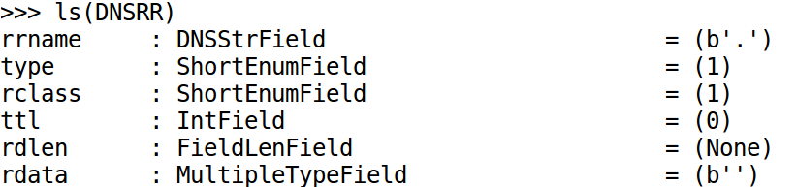
Constructing DNS Records Using Scapy
DNSQR Class
DNSRR Class

Slide 35
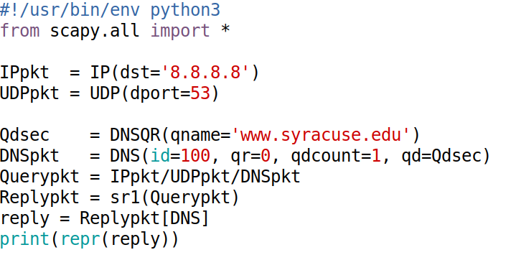
Example: Send a DNS Query

Slide 36
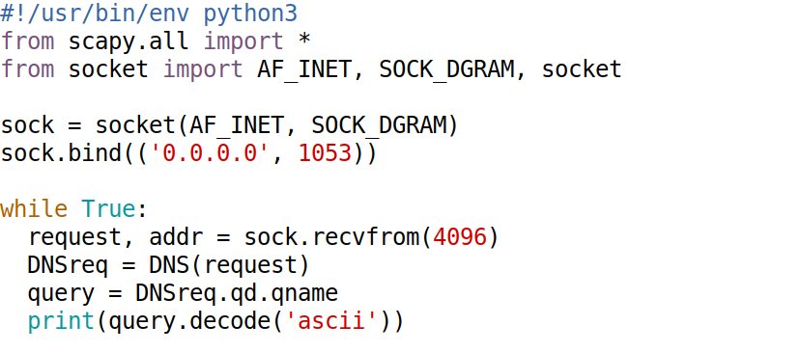
Implement a Simple DNS Server (1)

Slide 37
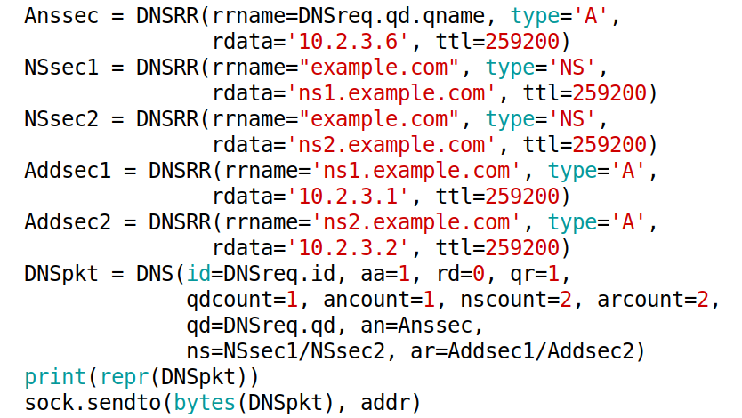
Implement a Simple DNS Server (2)

Slide 38
Attack surface

Slide 39
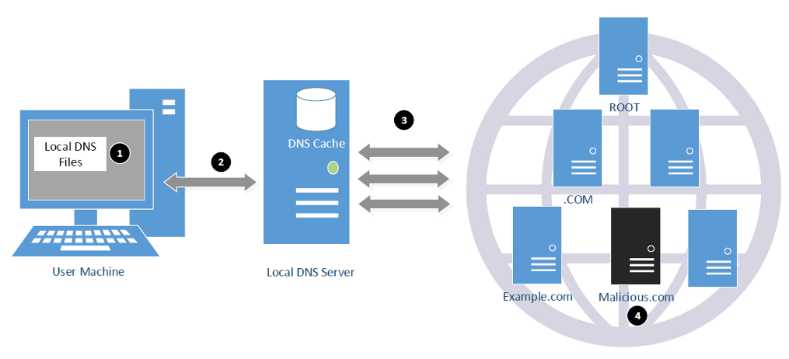
Attack Surface Overview

Slide 40
Local DNS Cache Poisoning Attack

Slide 41
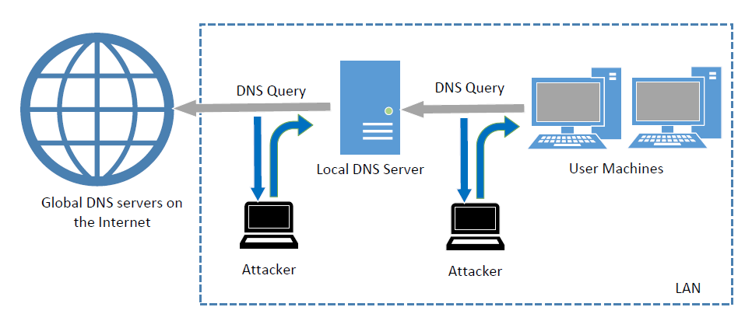
Local DNS Cache Poisoning Attack

Slide 42
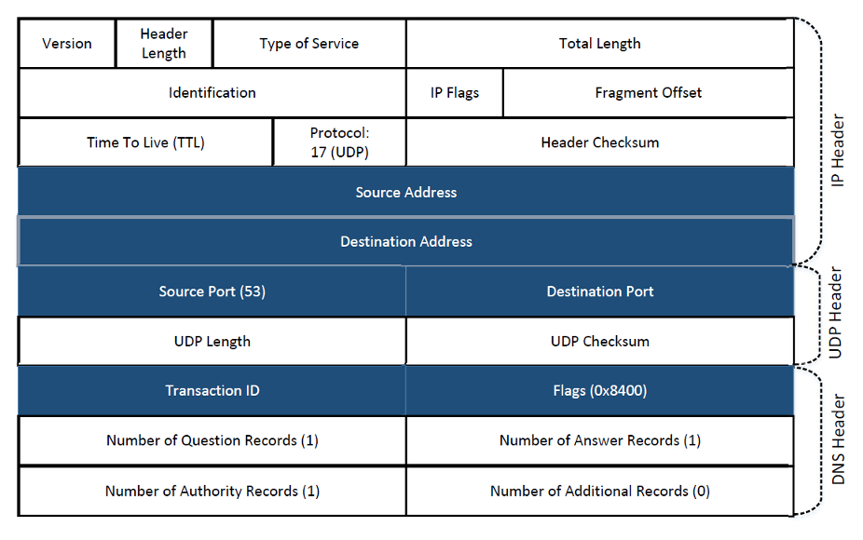
Challenges in Reply Spoofing

Slide 43
Lab Setup

Slide 44
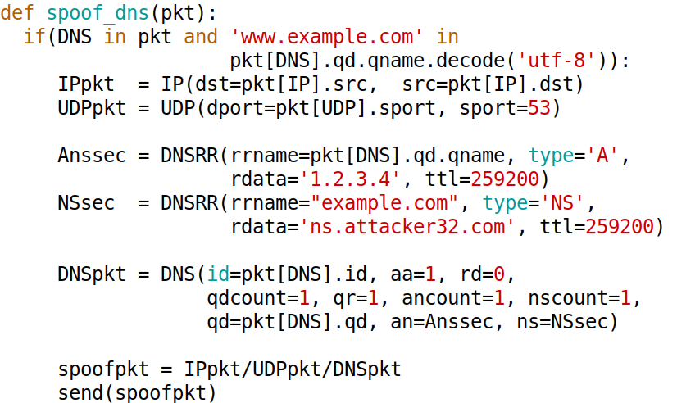
Local DNS Cache Poisoning Attack

Slide 45
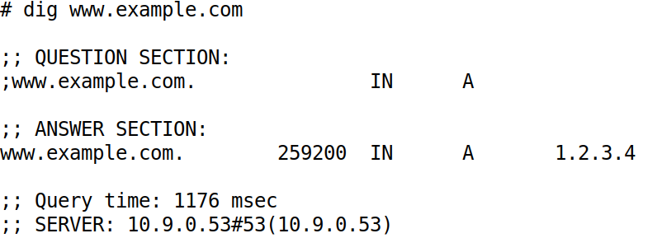
Attack Result

Slide 46
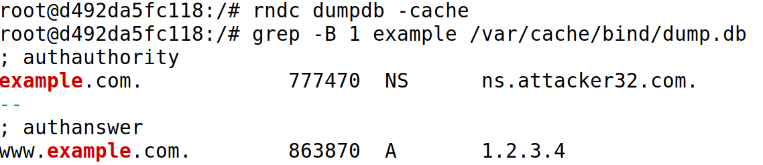
Poisoned DNS Cache
Clean the cache: rndc flush

Slide 47
How to Hijack the Entire Domain?
Notes:
Discussion: guide students to come up with their ideas

Slide 48
Targeting the Authority Section

Slide 49
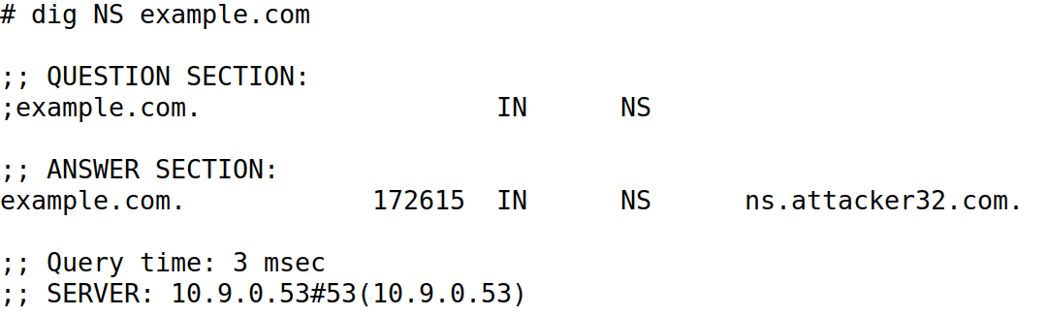
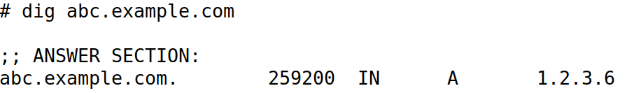
Attack Results

Slide 50
The Kaminsky Attack

Slide 51
Challenges in Reply Spoofing

Slide 52
The Problem Caused by the Cache

Slide 53
The Kaminsky Attack
Notes:
Use this empty slide to draw step-by-step how the Kaminsky attack works.

Slide 54
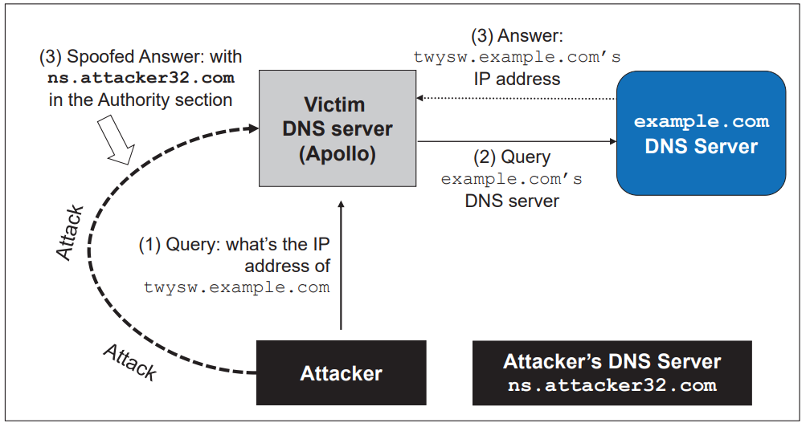
The Kaminsky Attack

Slide 55
Performance Issue: Python + Scapy vs. C
 | Python + Scapy | C
Difficulty in coding
Speed

Slide 56
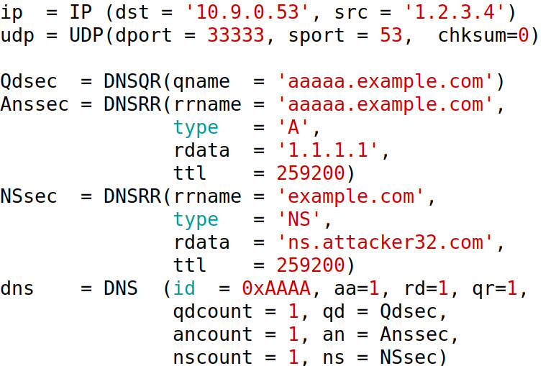
Create a Spoofed Response (Template)

Slide 57
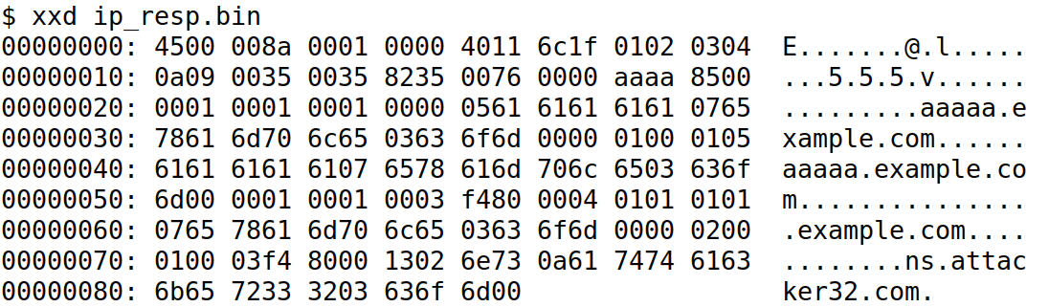
Find Offsets

Slide 58
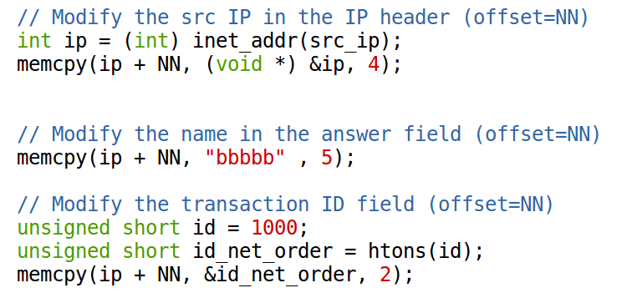
Modify the Pre-Built Packet in C

Slide 59
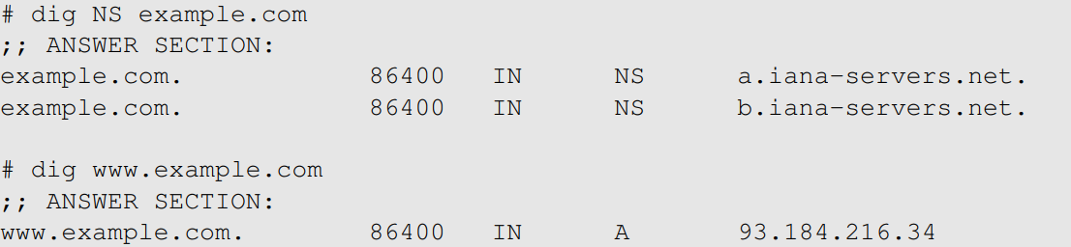
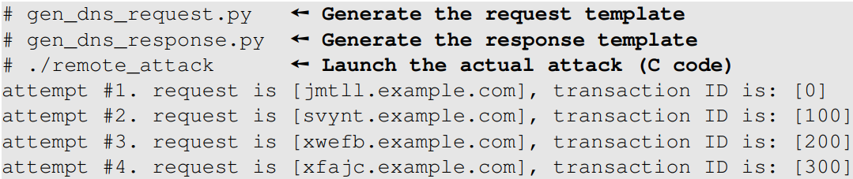
Demo (1)

Slide 60
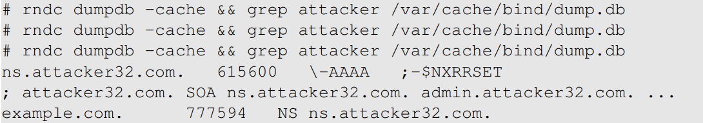
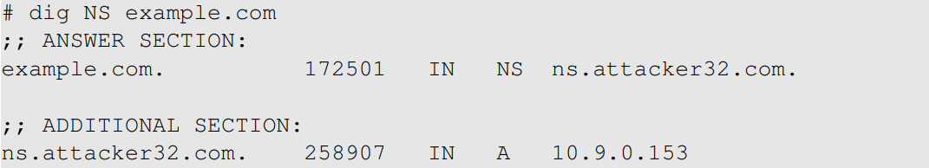
Demo (2)

Slide 61
Fake Records in Legitimate Response

Slide 62

Fake Response Attack

Slide 63
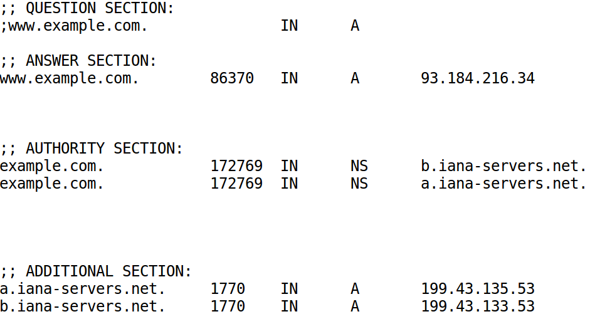
An Example of Valid Response
Notes:
Three scenarios
Lying about the authority section
Lying about the additional section
Lying about the answer section

Slide 64
DNS Rebinding Attack

Slide 65
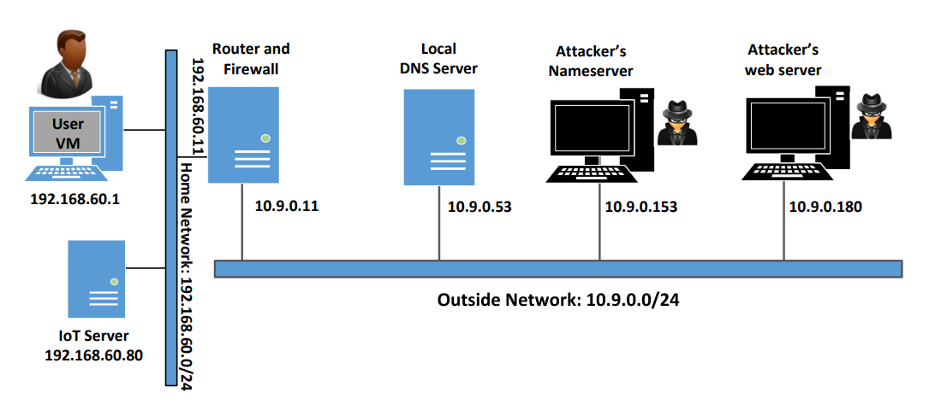
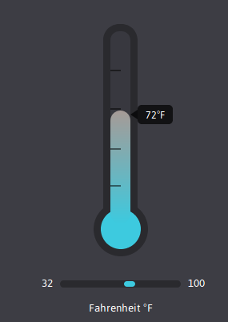
Lab Setup

Slide 66


Password Protected IoT Device
Web server

Slide 67

Same Origin Policy

Slide 68
Defeating Same Origin Policy
www.attacker32.com

Slide 69

DNS Rebinding: Initial Zone File (attacker32.com)

Slide 70

DNS Rebinding: Modification
Restart the nameserver
# service named restart

Slide 71
Denial-of-service attacks on DNS

Slide 72
Case Studies
DOS attacks on the root servers
August 25, 2013: DOS attacks on .cn nameservers
shutting down the servers for two to four hours
December 24, 2009: DOS attack on UltraDNS
affects thousands of online shoppers
October 21, 2016: DDOS attack on the Dyn Network
DNS provider
affects many companies, including Amazon, Twitter, GitHub, CNN, Airbnb, etc.

Slide 73
An Interesting Case
May 18, 2009: DOS Attack on DNSPod in China
led to the worst Internet incident in China

