Slide 1
DNSSEC: Securing DNS

Slide 2
Outline
How DNSSEC works
How to set up DNSSEC on nameservers

Slide 3
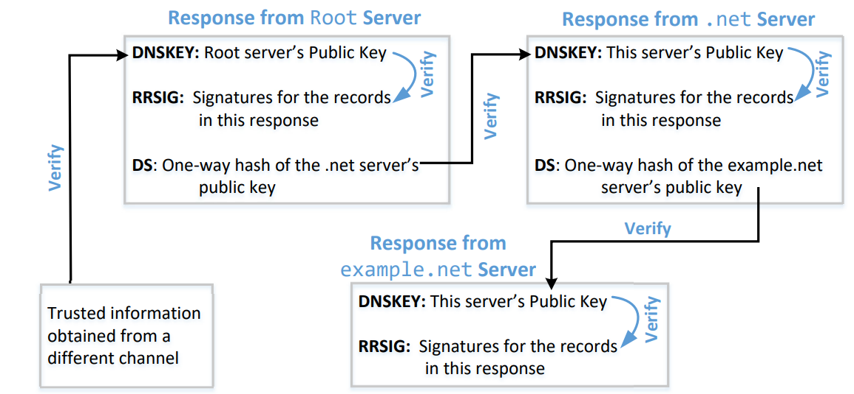
An Overview

Slide 4
Public Keys
Zone Signing Key (ZSK)
Signing zone data
Key Signing Key (KSK)
Signing ZSK

Slide 5
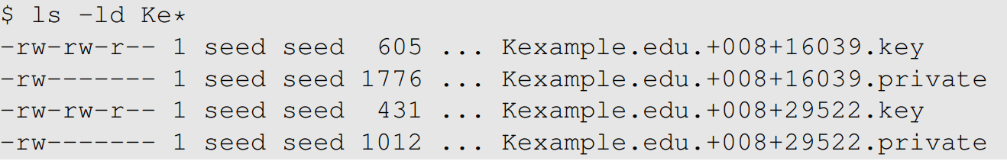
Generating KSK and ZSK Keys for Zone
Key Generation
Generated Keys

Slide 6
Signing the Zone File
$ dnssec-signzone -e 20501231000000 -S -o example.edu example.edu.db
DNSKEY resource records
One for ZSK and one for KSK
RRSIG resource records
Signatures for DNS records
DS record: for the parent zone

Slide 7
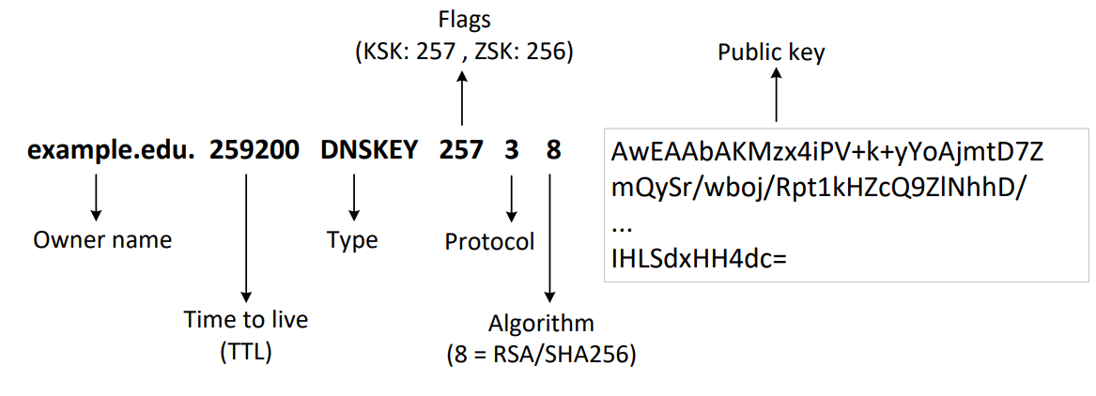
DNSKEY Resource Record

Slide 8
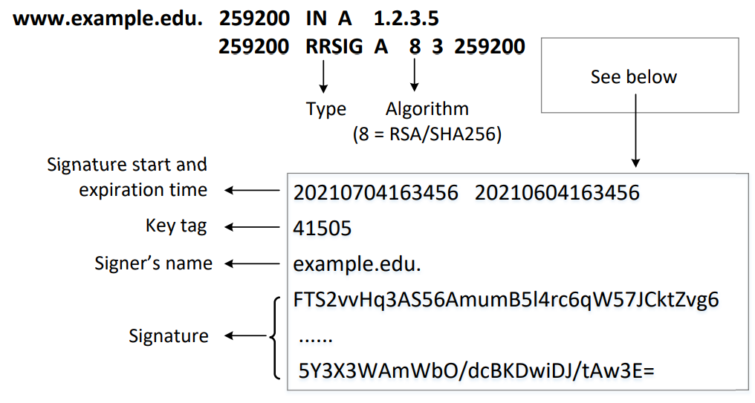
RRSIG Resource Record

Slide 9
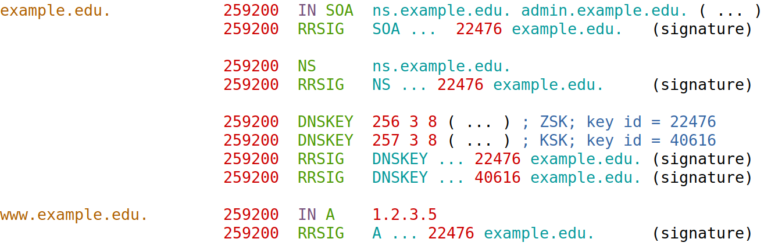
The Zone File for Example.edu
$ dnssec-signzone -e 20501231000000 -S -o example.edu example.edu.db

Slide 10
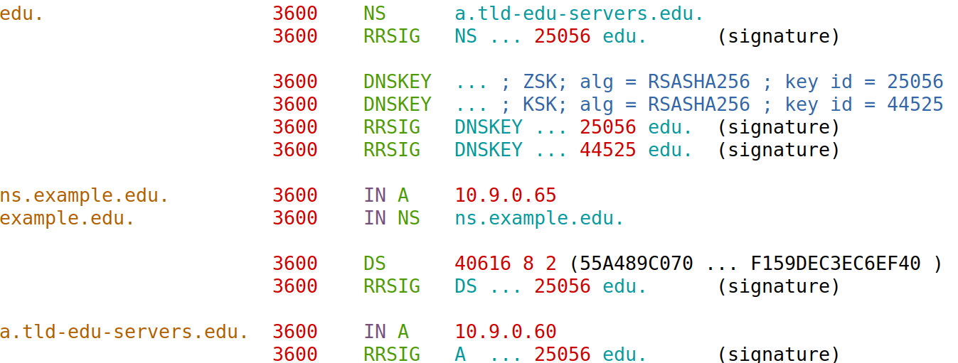
The Zone File for edu
$ dnssec-signzone -e 20501231000000 -S -o edu edu.db

Slide 11
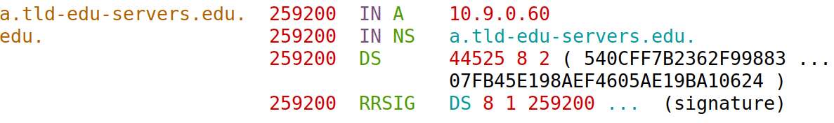
The Zone File (part) for root

Slide 12
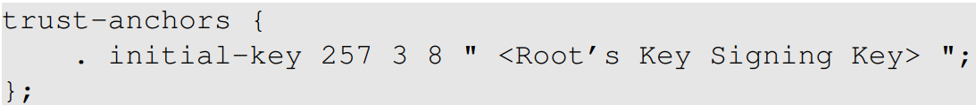
Local DNS Server
The root of trust: how to verify root server’s public key?
/etc/bind/bind.keys

Slide 13
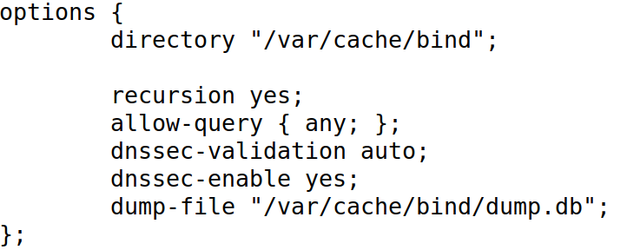
Enabling DNSSEC on Local DNS Server
/etc/bind/named.conf.options

Slide 14
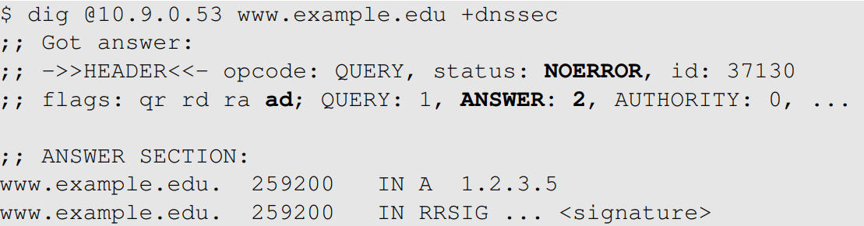
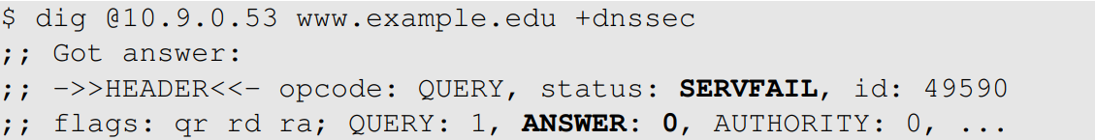
Testing

Slide 15
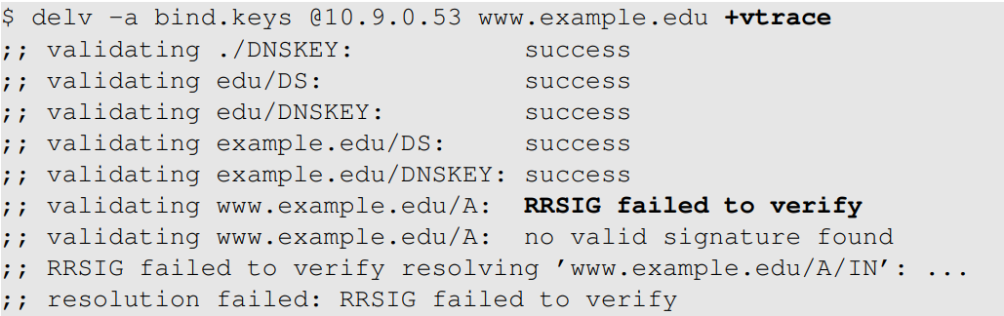
See the Verification Process

Slide 16
Discussion: TLS/SSL Solution
DNSSEC:
From name, get the authentic IP address
TLS/SSL
Don’t trust IP
Prove ownership of the name
Both use public key technologies
Different public key infrastructure

Slide 17
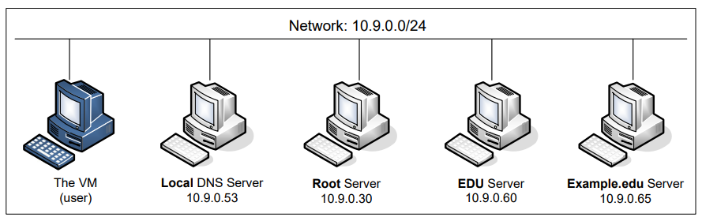
DNSSEC Lab

