Slide 1
Linux Security Basics

Slide 2
Outline
Users and groups
Permissions and access control
Running commands with privilege
Authentication

Slide 3
user and group

Slide 4
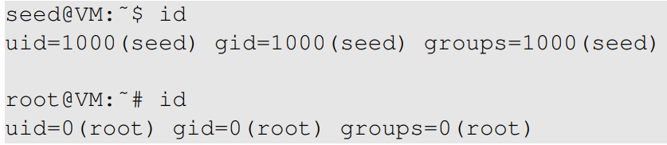
Users
In Linux, each user is assigned a unique user ID
User ID is stored in /etc/password
Find user ID
Notes:
Talk about root user’s special ID 0

Slide 5
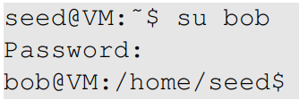
Add Users & Switch to Other Users
Add users
Directly add to /etc/password
Use “adduser” command
Switch to another user

Slide 6
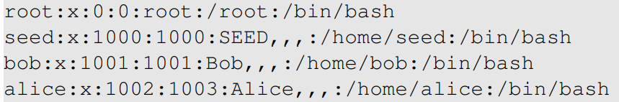
Group
Represent a group of users
Assigning permissions based on group
A user can belong to multiple groups
A user’s primary group is in /etc/password

Slide 7
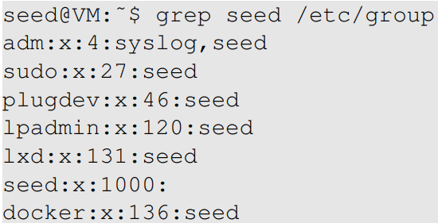

Which Group Does a User Belong To?

Slide 8
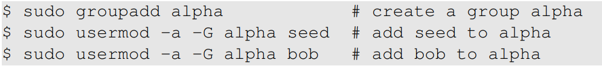
Group Management
How to add users

Slide 9
permissions and access control

Slide 10
Traditional Permission Model
Types of access on files
read (r): user can view the contents of the file
write (w): user can change the contents of the file
execute (x): user can execute or run the file if it is a program or script
Types of access on directories
read (r): user can list the contents of the directory (e.g., using ls)
write (w): user can create files and sub-directories inside the directory
execute (x): user can enter that directory (e.g., using cd)

Slide 11
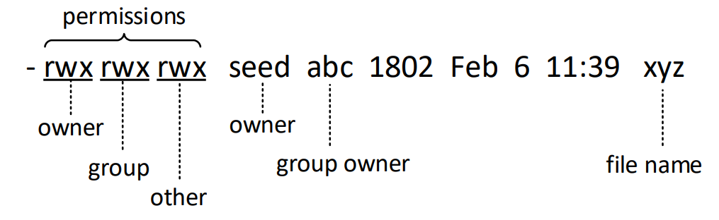
File Permissions
Notes:
Use this diagram to show the octal representation of permissions, and how to change permissions

Slide 12
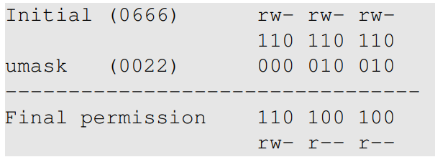
Default File Permissions
umask value: decides the default permissions for new files
Example
Notes:
The operation is not XOR or AND (many students are confused because they think the operations is either XOR or AND.
The actual operation is Initial AND NOT(umask)

Slide 13
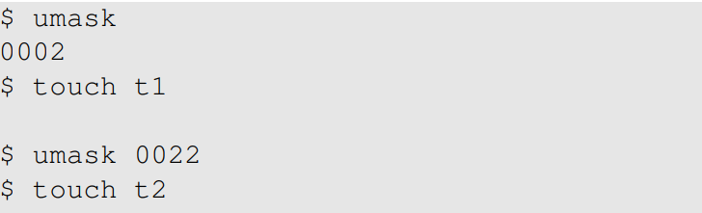
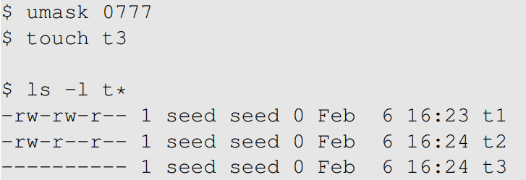
Examples (umask)
Notes:
During the lecture, use the umask values to derive the final permission, and compare them with the final results.

Slide 14
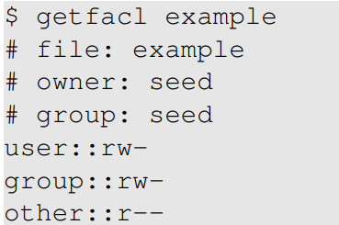
Access Control List
Fine grained ACL
Assign permissions to individual users/groups
Coexist with the traditional permission model
Example

Slide 15
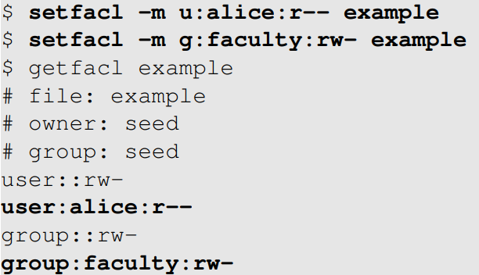

ACL Commands

Slide 16
running command with privilege

Slide 17
Why
Three command mechanisms
sudo
Set-uid programs (covered in a separate chapter)
POSIX capabilities

Slide 18
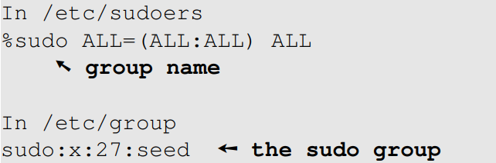
Using sudo
sudo: Super-user Do
Run commands as a superuser
A user must be authorized (/etc/sudoers)
Here is how the seed user is allowed to run sudo

Slide 19
Getting Root Shell
In Ubuntu 20.04, the root user account is locked
Cannot log into the root account
There are many ways to get a root shell
sudo –s
sudo bash
sudo su
It is not recommended to run commands using a root shell. Instead, use sudo to run individual commands.

Slide 20
Running Command Using Another User
Run command using another user (instead of root, default)

Slide 21
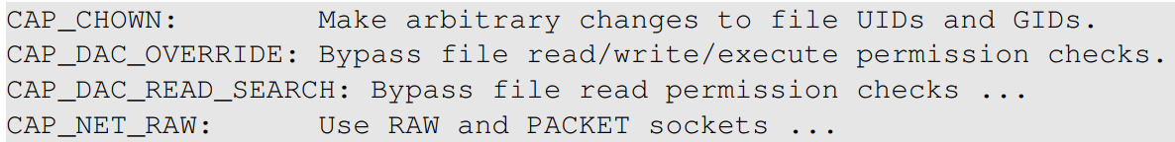
POSIX Capabilities
Divide the root privilege into smaller privilege units
Known as capabilities
Use “man capabilities” to find all the capabilities
Examples

Slide 22
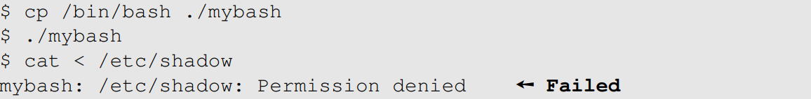
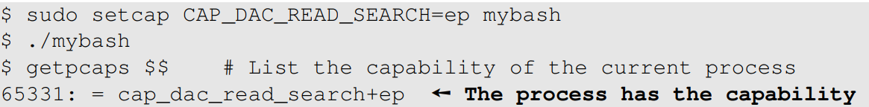
Setting File Capabilities (1)
Before
Setting the capabilities

Slide 23
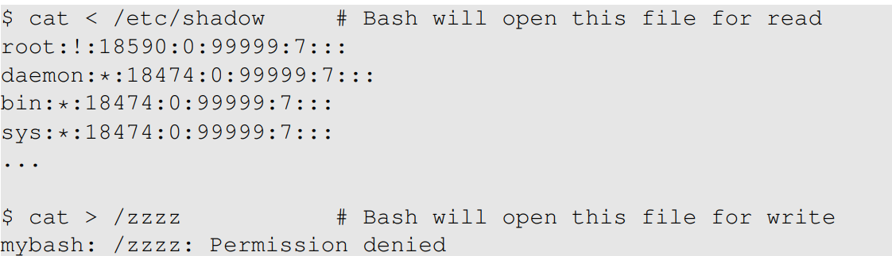
Setting File Capabilities (2)
After

Slide 24
Case Study 1: Wireshark
Wireshark
Sniffing tool, needs privilege
The graphic part is not privileged
The sniffing part is done by dumpcap, privileged

Slide 25

Case Study 2: ping
The ping program
Uses raw socket
Has the CAP_NET_RAW capability

Slide 26
authentication

Slide 27
Authentication Methods
A process to verify a user’s identity
Typical authentication methods
based on something the user knows: password
based on something the user has: ID card
based on something the user is or does: fingerprint
Multi-factor authentication

Slide 28
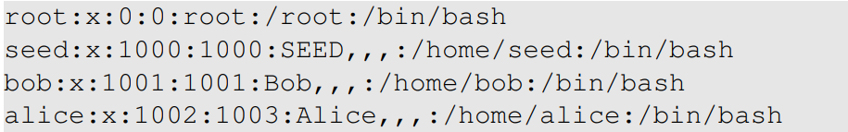
The Password File
Each entry contains a user account information
Password is not stored here (used to be)

Slide 29
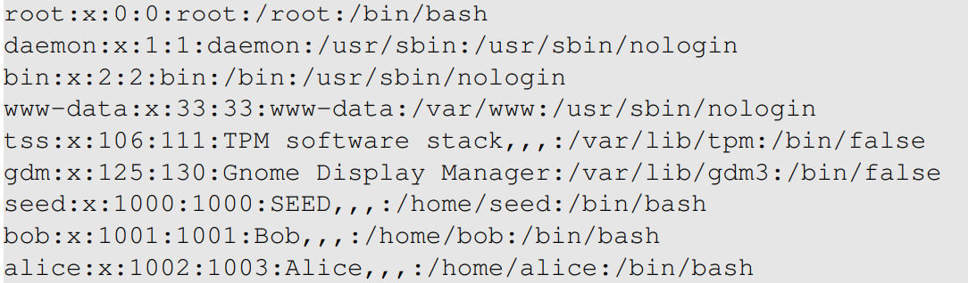
First Command After Login
The last field of each entry
Notes:
Special commands: /usr/sbin/nologin, /bin/false

Slide 30
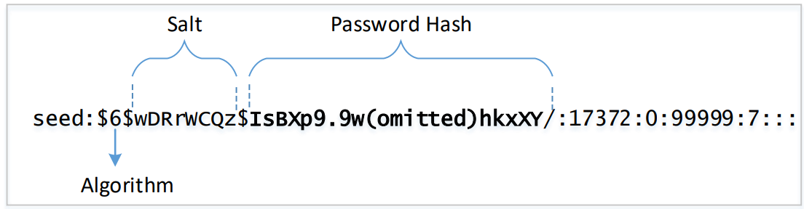
The Shadow File
Store password, why not use /etc/password anymore?
Structure for each entry
Notes:
Explain the need for the shadow file

Slide 31
The Purpose of Salt
Defeat brute-force attacks
dictionary attack, rainbow table attack
These 3 accounts have the same password

Slide 32
Locking Account
Putting an invalid value in the password field
The root account is locked

