Slide 1
Web Security Basics

Slide 2
Outline
The web architecture
Web server
HTTP protocol, cookies
JavaScript and sandboxing

Slide 3
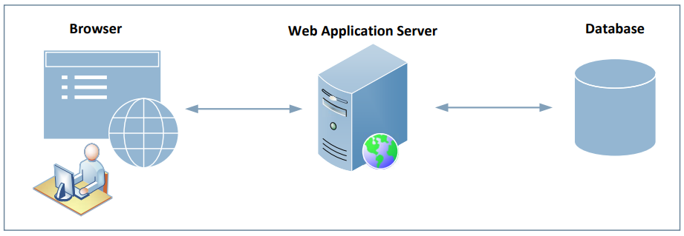
The Web Architecture

Slide 4
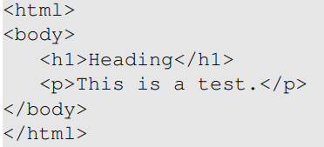
HTML
Hypertext Markup Language
For creating web pages
Example

Slide 5
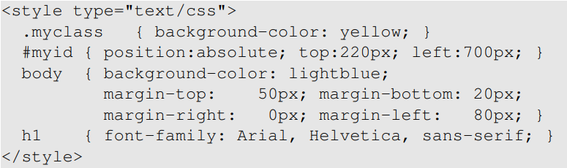
CSS: Cascading Style Sheets
Specify the presentation style
Separate content from the presentation style
Example

Slide 6
Dynamic Content
Adobe Flash
Microsoft Silverlight
ActiveX
Java applets
JavaScript

Slide 7
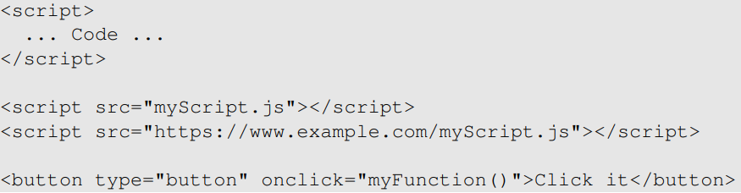
JavaScript
Also known as ECMAScript
Scripting language for web pages
Different ways to include JavaScript code

Slide 8
Web Server

Slide 9
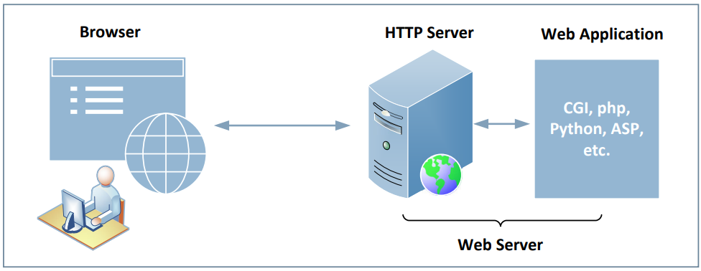
HTTP Server & Web Application Server

Slide 10
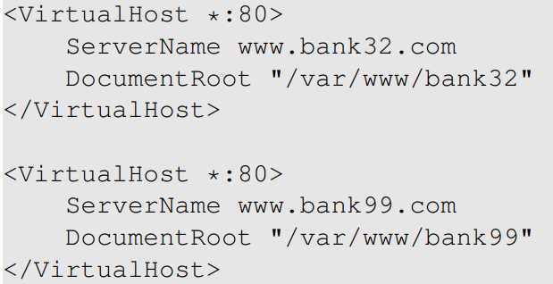
Case Study: Apache Server
Configuration: Virtual Hosting

Slide 11
How HTTP Server Interacts with Web Applications
CGI: The Common Gateway Interface
Starts the CGI program in a new process
FastCGI: a variation of the CGI, faster
Modules: directly execute script-based programs

Slide 12
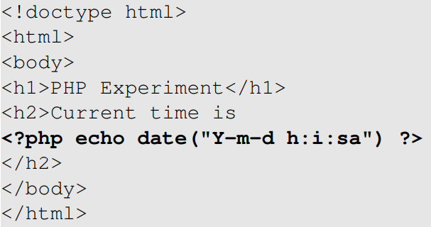
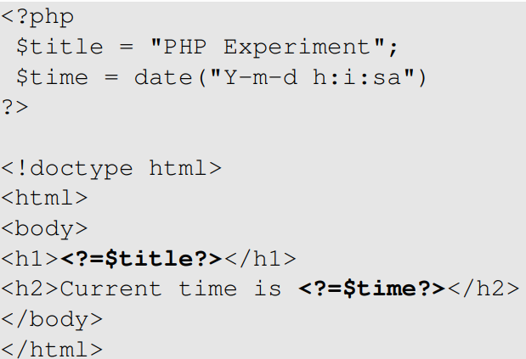
PHP Example
Inline Approach
Template Approach

Slide 13
HTTP Protocol

Slide 14
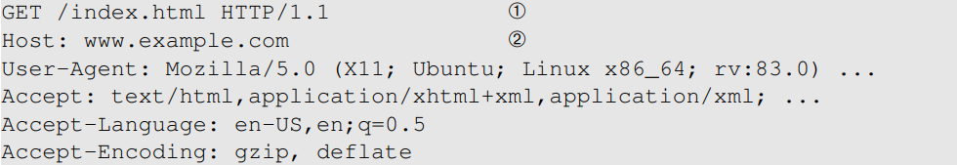
HTTP: Interacting with Server (1)
An example of HTTP request

Slide 15
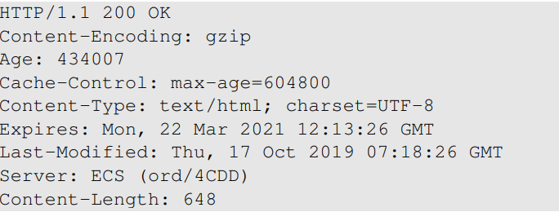
HTTP: Interacting with Server (2)
An example of HTTP response
HTTP 404 (not found)
A Joke: I had trouble finding my new classroom. Room 404, classroom not found

Slide 16

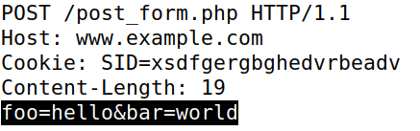
GET versus POST Requests
Main difference
how they send data to the server
GET request
Post request

Slide 17
Cookies
Web server is stateless
does not maintain a long-term connection with the client
HTTP Cookies: used to save information on the client side
Browser save cookies
Attach cookies in every request

Slide 18
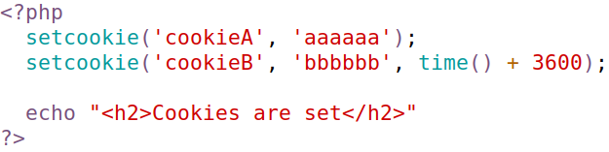
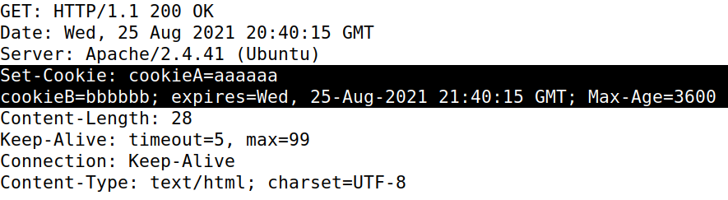
Setting Cookies
Server: setting cookies
HTTP response

Slide 19
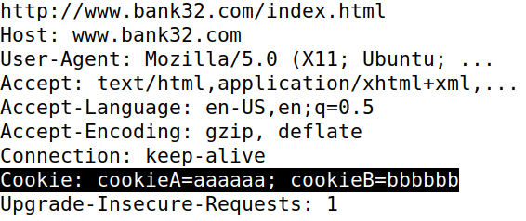
Attaching Cookies
Browser: attach all the cookies belonging to the target server

Slide 20
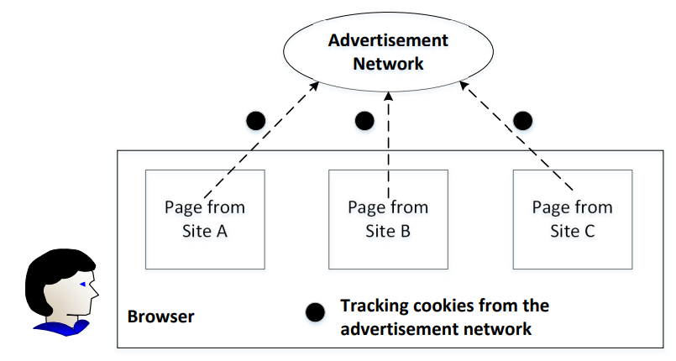
Tracking Using Cookies

Slide 21
Prevent Tracking
Using anonymous mode in browsing
Block third-party cookies
First-party cookies are essential for browsing
Third-part cookies are mainly used for advertisement, information collection, etc.

Slide 22
Session Cookies
A cookie: store session ID
The session ID identifies a session
Session data are typically maintained on the server
Session is typically created after user login
Have the session ID = have the access
Security sensitive
ID: Random number

Slide 23
JavaScript and sandbox

Slide 24
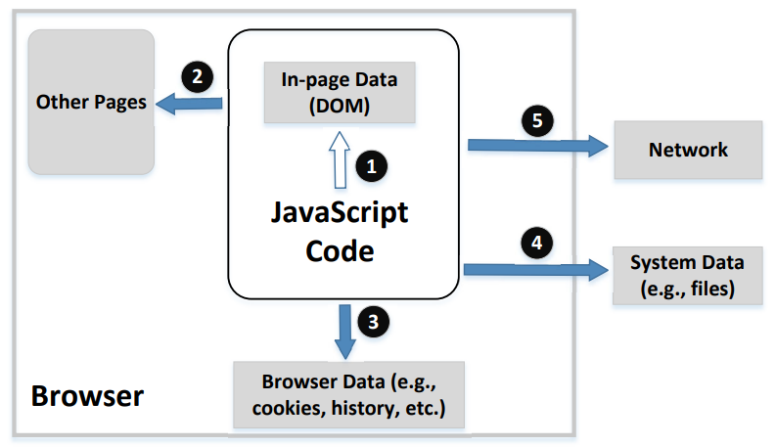
Protection Needs

Slide 25
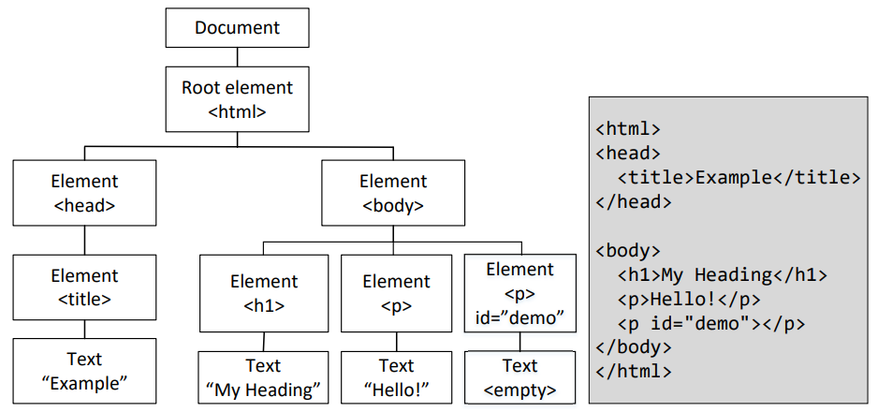
Access Page Data and DOM

Slide 26
Access File System
JavaScript cannot directly access local file system
User needs to grant permission via file selection
File selection: grant permissions by selection
Get the file handlers

Slide 27
Access Network and Ajax
Three communication mechanisms
Normal HTTP
Ajax
WebSocket
Security policies are different

Slide 28
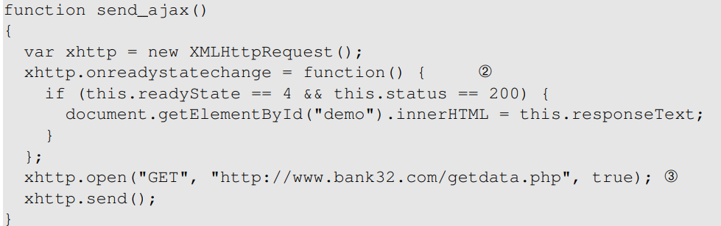
Ajax Example
Asynchronous JavaScript and XML (Ajax)
Slowly being superseded by the Fetch API
Ajax example

Slide 29
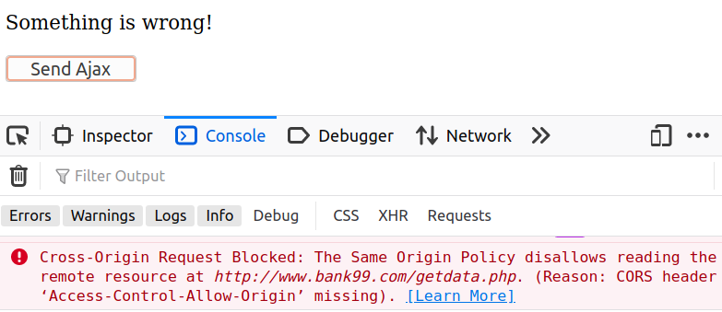
Same Origin Policy on Ajax
Page from www.bank32.com trying to access www.bank99.com (using Ajax)

Slide 30
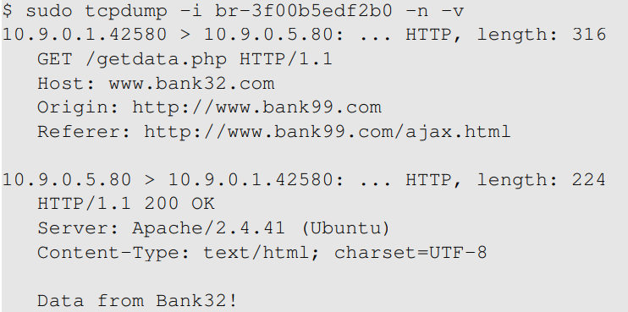
What is Blocked: Request or Response?
Request was sent out, response came back
Browser blocks Ajax code from accessing the response

Slide 31
Why Blocking the Response?
Cross-Origin access compromise privacy
Same-origin policy is enforced
Example: Ajax code in Facebook page
allowed to access the user’s Facebook data
not allowed to access the user’s Google data

Slide 32
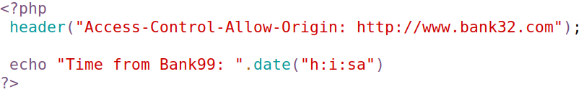
Relaxing the Restriction
The same-origin policy is too restrictive
CORS (Cross-Origin Resource Sharing)
Whitelist provided by server: grant permissions
CORS policy on www.bank99.com

Slide 33
WebSocket
Ajax uses HTTP: half-duplex
Browser sends request, server responds
No “push” mechanism (from server)
WebSocket is full-duplex
Both browser/server can send data (without request)

Slide 34
Security Policy on WebSocket
Browser does not restrict data from WebSocket
Different from Ajax
Access control on client side
Access control is conducted on server side
Check the “Origin” of the request

Slide 35
Cable Haunt Attack
Discovered: January 2020
Affected many Broadcom-based cable modems
These modems run a WebSocket-based server program
JavaScript code can interact with the server: a door is open
Attacker exploits a buffer overflow vulnerability on the server

