Slide 1
Clickjacking Attack

Slide 2
Outline
Iframe and its properties
Clickjacking using iframes
Countermeasures (CSP)
Iframe's security features

Slide 3
iframe and properties

Slide 4

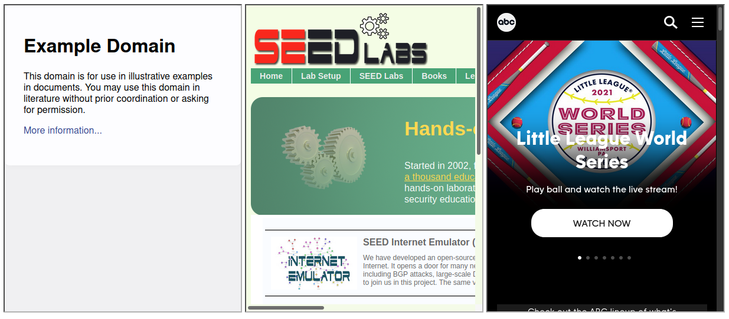
Iframe Examples

Slide 5
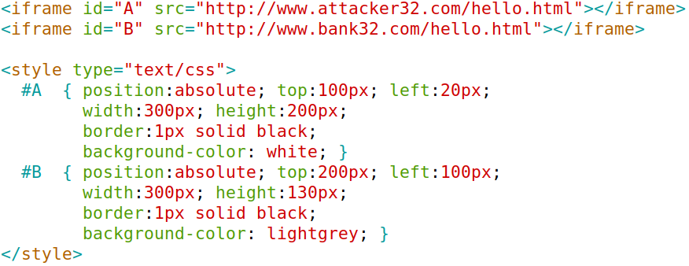
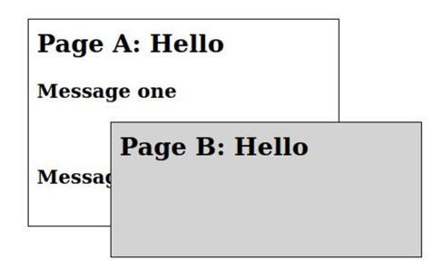
Overlapping iframes

Slide 6
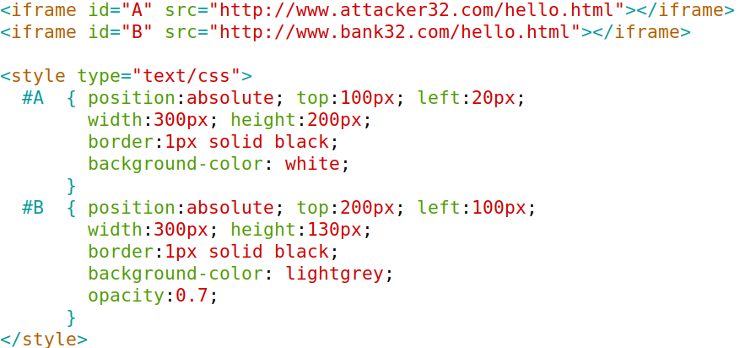
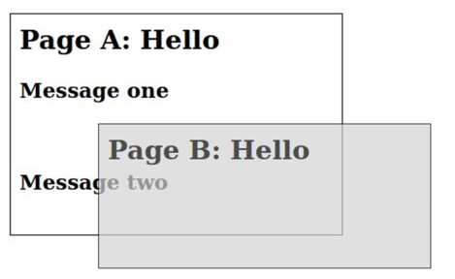
Transparent iframe

Slide 7
Attack Using Transparent iframe

Slide 8
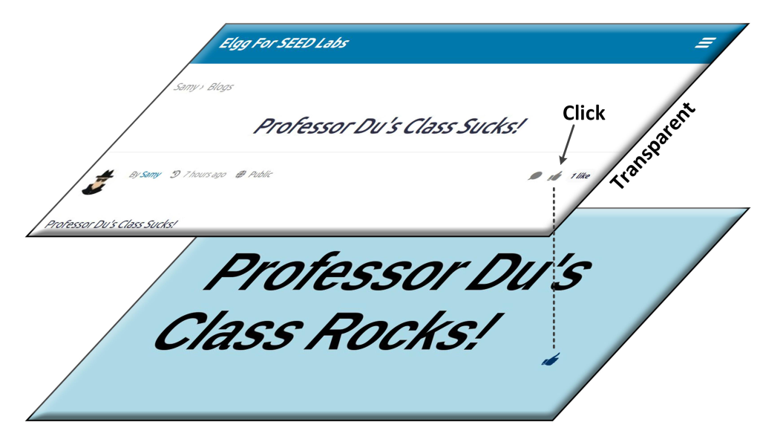
Attack 1: LikeJacking

Slide 9
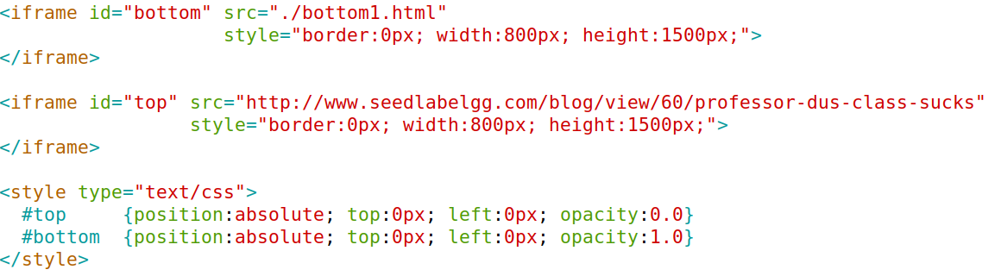
Attack Page
Inside bottom1.html

Slide 10
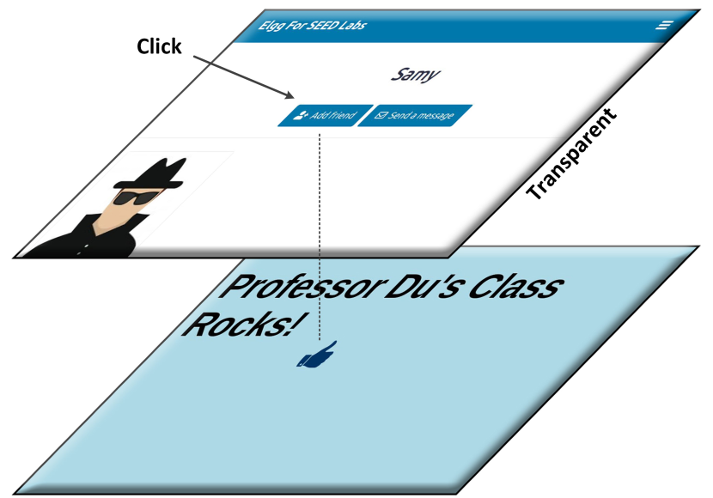
Attack 2: Adding A Friend

Slide 11
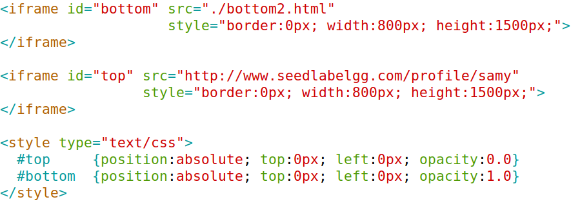
Attack Code

Slide 12
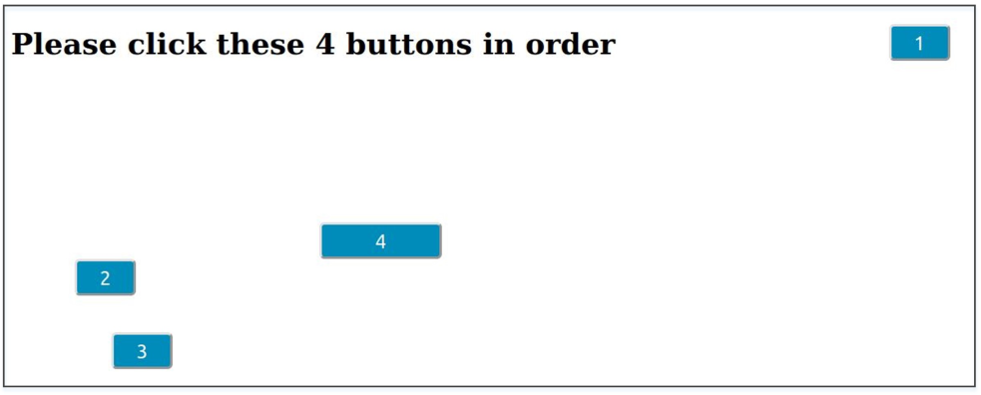
Attack 3: Sequence of Clicks

Slide 13
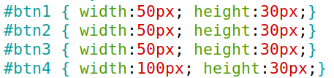
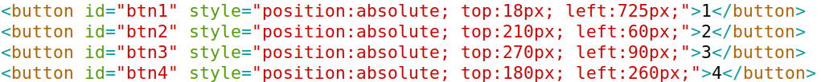
Attack Code

Slide 14
Attack Using Small-size iframe

Slide 15
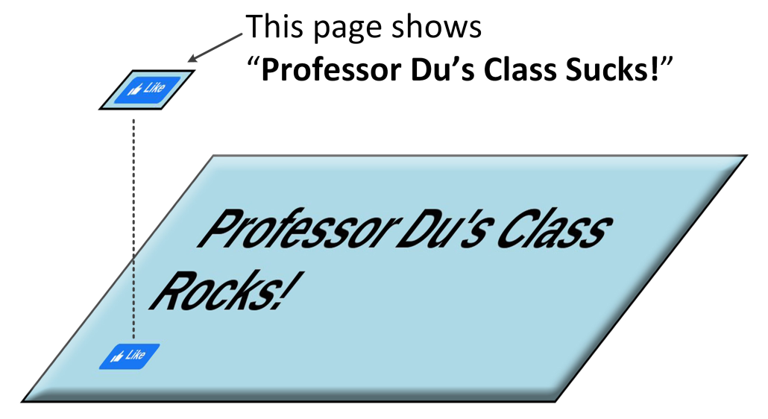
Attack

Slide 16
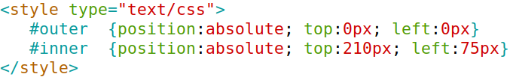
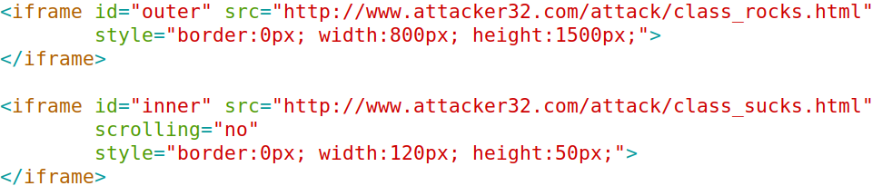
Attack Code

Slide 17
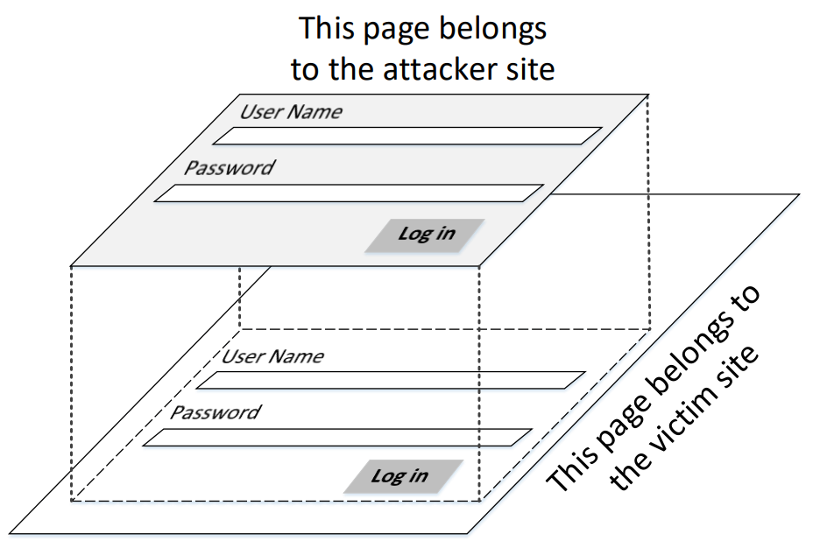
Fake Login

Slide 18
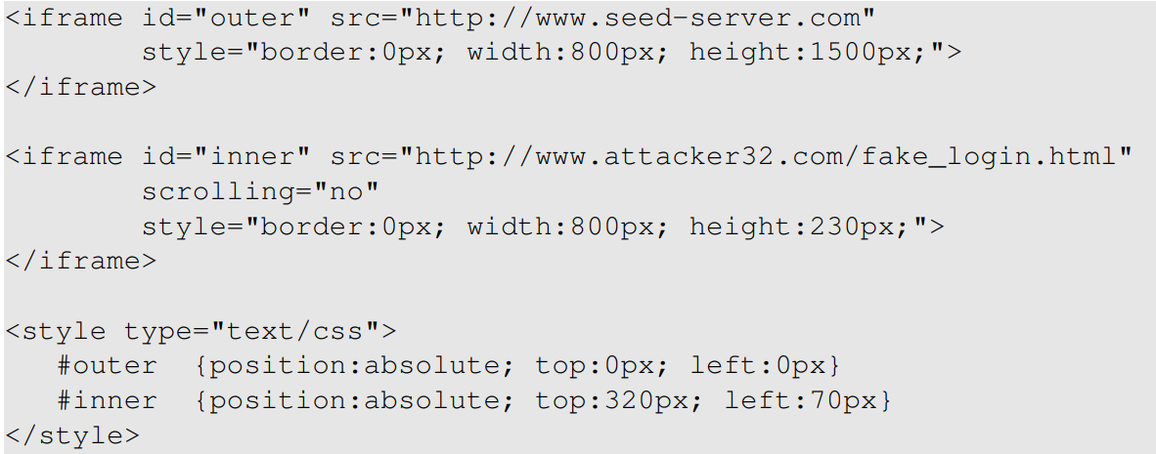
Attack Code

Slide 19
countermeasures

Slide 20

Framekiller and Framebuster
Use JavaScript code to detect iframe
Jump out if detected
Not reliable, no longer used

Slide 21
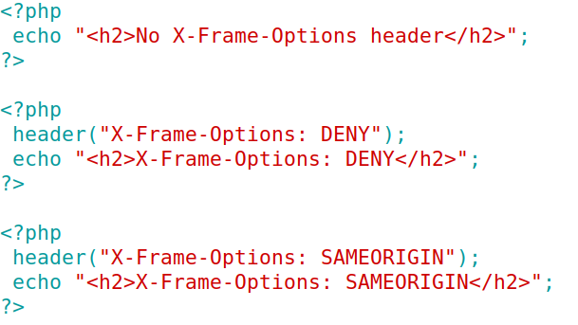
X-Frame-Options Approach
Options
X-Frame-Options: DENY
X-Frame-Options: SAMEORIGIN
Initial solution
Now outdated
Examples (3 pages)

Slide 22
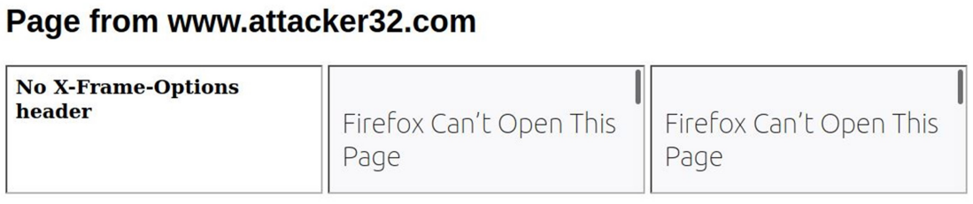
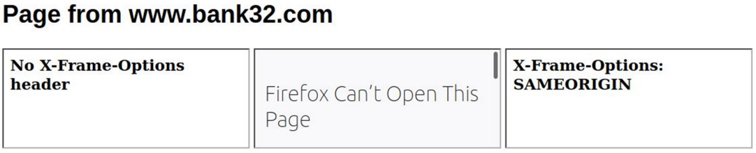
Results
Page
content

Slide 23
Content Security Policy (CSP)
Allows web applications to define restriction rules
script-src: specifies a white-list of script sources
img-src: restricts image sources
frame-ancestors: specifies the valid parents that may embed a page using <frame>, <iframe>, <object>, <embed>, or <applet>

Slide 24
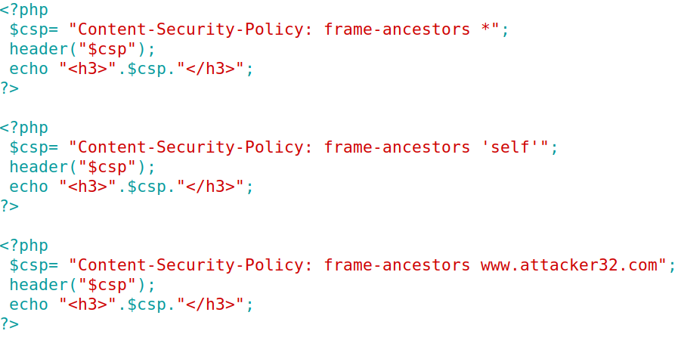
CSP Examples
csp-all.php
csp-self.php
csp-url.php

Slide 25

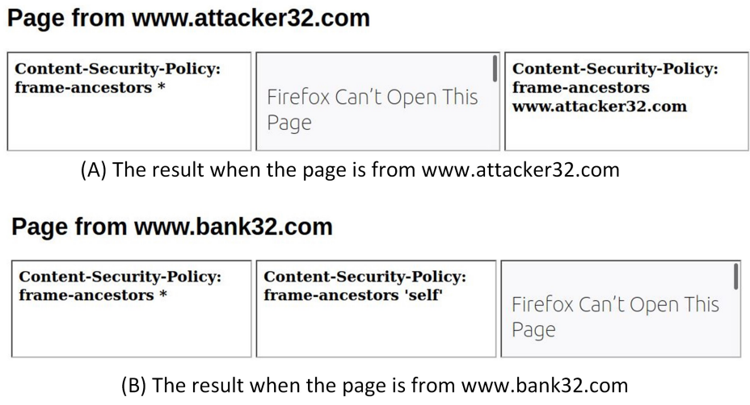
Results
Page content

Slide 26
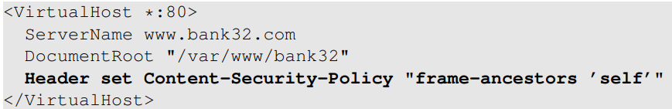
Setting the CSP header on Apache
CSP header can be set for individual page
Set CSP header on all pages

Slide 27
security in iframe

Slide 28
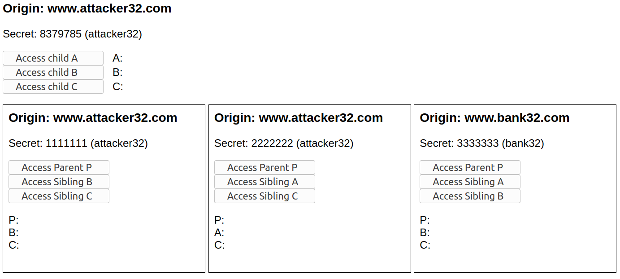
Iframe’s Same Origin Policy
Three iframes

Slide 29
Access Iframes
Parent Accessing Child
Child Accessing Parent
Child Accessing Siblings

Slide 30
Experiment: Discussion Slide
Notes:
Use this diagram to ask students what results will be

Slide 31
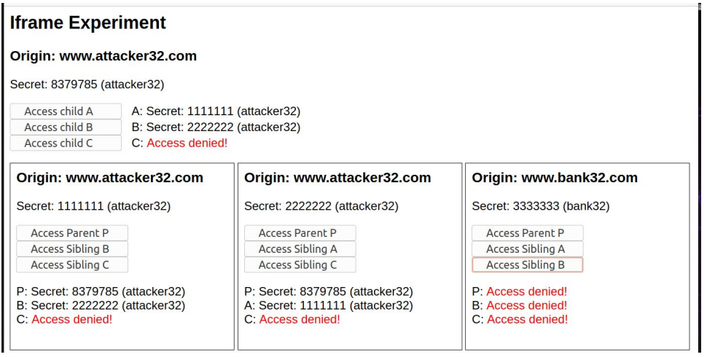
Experiment: Result Slide
Notes:
This slide is just a reference slide. Use the discussion slide in the lecture.

Slide 32
Using Iframe to Sandbox Content
Setting sandbox
Options
allow-same-origin
allow-scripts
allow-forms
allow-modals
allow-top-navigation

Slide 33
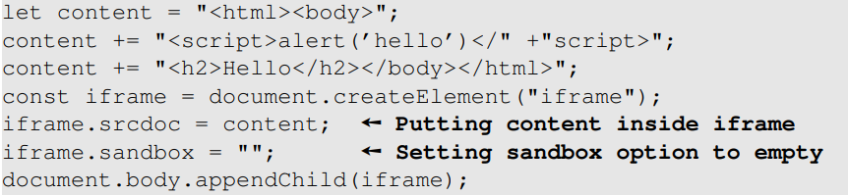
Sandboxing Dynamic Content
Example
If the content comes from outside, this mechanism can protect against code injection

Slide 34
Summary
Iframe, its attributes and security features
Clickjacking attacks
Countermeasures

