Slide 1
HW2 Solutions
Dr. Shengquan Wang

Slide 2
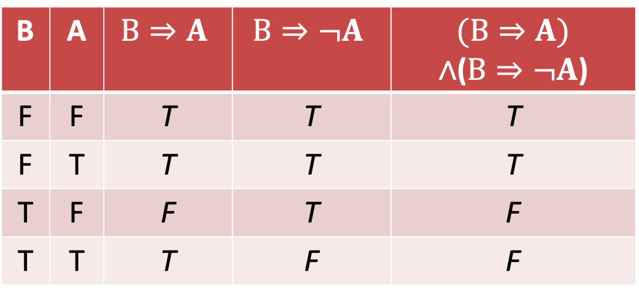
Q2.1
B | A | $$B⇒A$$ | $$B⇒¬A$$ | $$(B⇒A)$$ $∧$($B⇒¬A$)
F | F | T | T | T
F | T | T | T | T
T | F | F | T | F
T | T | T | F | F

Slide 3
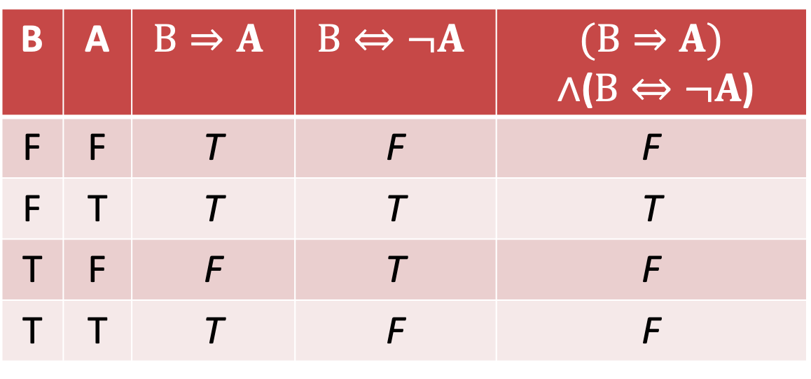
Q2.2
B | A | $$B⇒A$$ | $$B⇔¬A$$ | $$(B⇒A)$$ $∧$($B⇔¬A$)
F | F | T | F | F
F | T | T | T | T
T | F | F | T | F
T | T | T | F | F

Slide 4
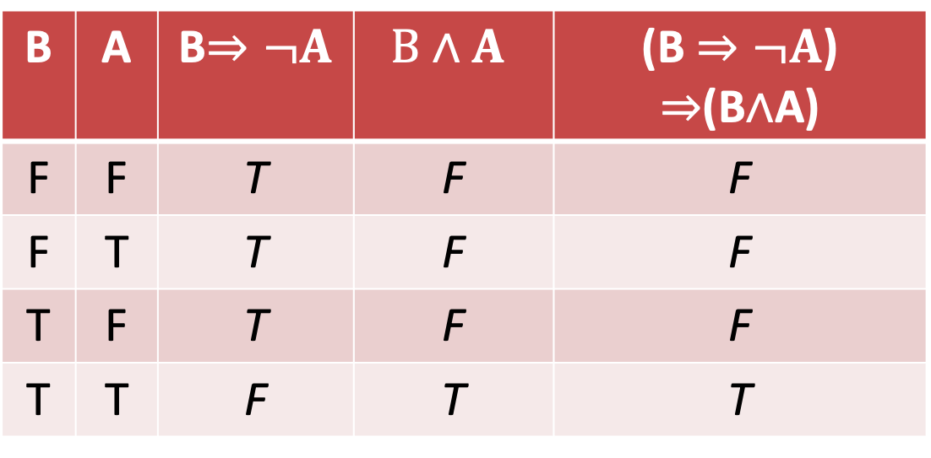
Q2.3
B | A | B$⇒¬A$ | $$B∧A$$ | (B $⇒¬A$) $⇒$(B$∧$A)
F | F | T | F | F
F | T | T | F | F
T | F | T | F | F
T | T | F | T | T

Slide 5
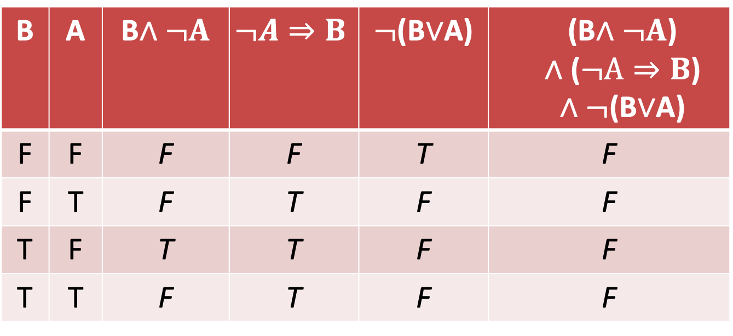
Q2.4
B | A | B$∧¬A$ | $$¬A⇒B$$ | $¬$(B$∨$A) | (B$∧¬A$) $$∧\text{(}¬A⇒B\text{)}$$ $∧¬$(B$∨$A)
F | F | F | F | T | F
F | T | F | T | F | F
T | F | T | T | F | F
T | T | F | T | F | F

Slide 6



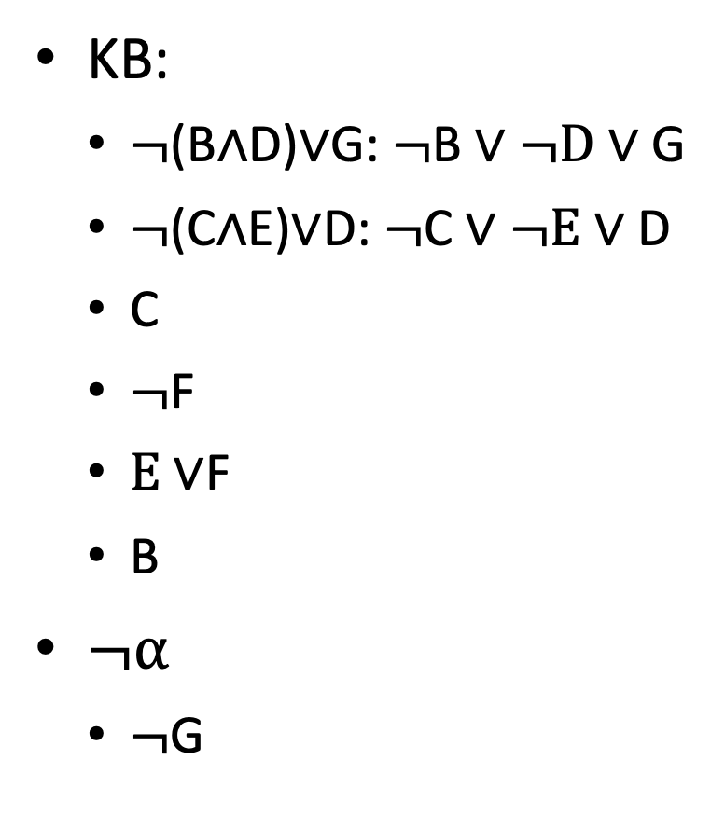




Q3
KB:
$¬$(B$∧$D)$∨$G: $¬$B $∨¬D∨$G
$¬$(C$∧$E)$∨$D: $¬$C $∨¬E∨$D
C
$¬$F
$E∨$F
B
$¬α$
$¬$G
KB $∧¬α$
$¬$B $∨¬D∨$G
$¬$C $∨¬E∨$D
C
¬F
$E$∨F
B
¬G
$¬D∨$G
$¬E$ $∨D$
$$E$$
D
G

Slide 7
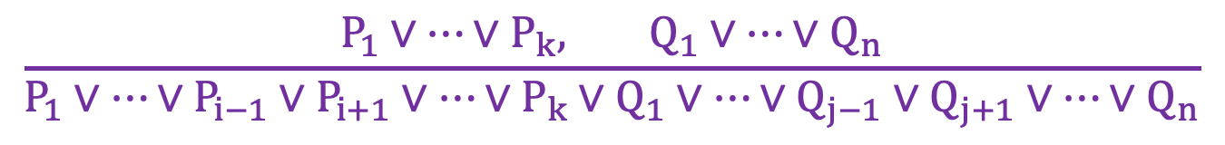
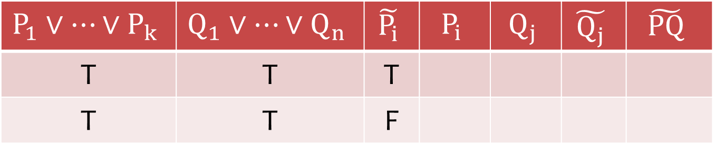

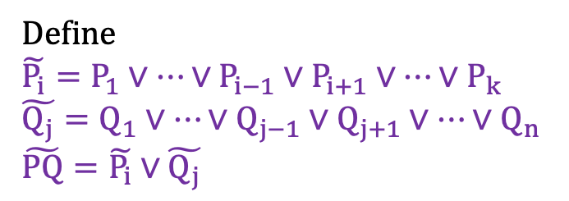
Q4.1 (Truth Table Approach)
$$\frac{P_{1}∨⋯∨P_{k}, Q_{1}∨⋯∨Q_{n}}{P_{1}∨⋯∨P_{i−1}∨P_{i+1}∨⋯∨P_{k}∨Q_{1}∨⋯∨Q_{j−1}∨Q_{j+1}∨⋯∨Q_{n}}$$
$$P_{i}\text{≡}¬Q_{j}$$
Define
$$\tilde{P_{i}}=P_{1}∨⋯∨P_{i−1}∨P_{i+1}∨⋯∨P_{k}$$
$$\tilde{Q_{j}}=Q_{1}∨⋯∨Q_{j−1}∨Q_{j+1}∨⋯∨Q_{n}$$
$$\tilde{PQ}=\tilde{P_{i}}∨\tilde{Q_{j}}$$
$$P_{1}∨⋯∨P_{k}$$ | $$Q_{1}∨⋯∨Q_{n}$$ | $$\tilde{P_{i}}$$ | $$P_{i}$$ | $$Q_{j}$$ | $$\tilde{Q_{j}}$$ | $$\tilde{PQ}$$
T | T | T
T | T | F
T
T
F
T
T

Slide 8
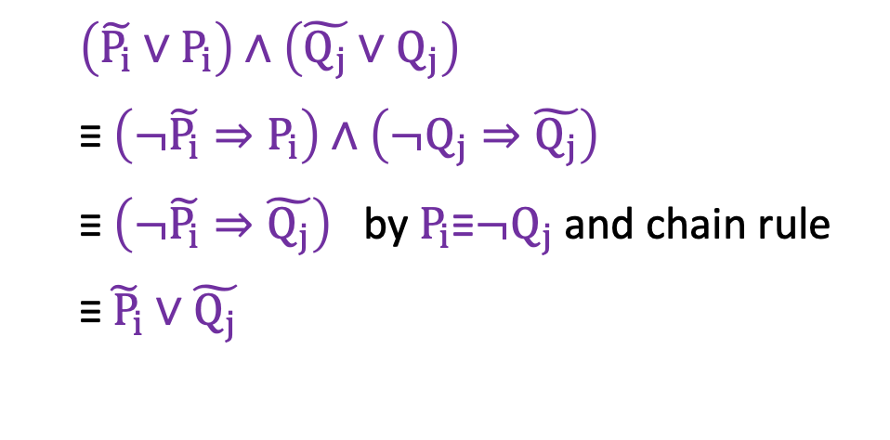
Q4.1 (Chain Rule Approach)
$$\frac{P_{1}∨⋯∨P_{k}, Q_{1}∨⋯∨Q_{n}}{P_{1}∨⋯∨P_{i−1}∨P_{i+1}∨⋯∨P_{k}∨Q_{1}∨⋯∨Q_{j−1}∨Q_{j+1}∨⋯∨Q_{n}}$$
$$P_{i}\text{≡}¬Q_{j}$$
Define
$$\tilde{P_{i}}=P_{1}∨⋯∨P_{i−1}∨P_{i+1}∨⋯∨P_{k}$$
$$\tilde{Q_{j}}=Q_{1}∨⋯∨Q_{j−1}∨Q_{j+1}∨⋯∨Q_{n}$$
$$\tilde{PQ}=\tilde{P_{i}}∨\tilde{Q_{j}}$$
$\left(\tilde{P_{i}}∨P_{i}\right)∧\left(\tilde{Q_{j}}∨Q_{j}\right)$
$\text{≡} \left(¬\tilde{P_{i}}⇒P_{i}\right)$ $∧\left(¬Q_{j}⇒\tilde{Q_{j}}\right)$
$\text{≡} \left(¬\tilde{P_{i}}⇒\tilde{Q_{j}}\right)$ by $P_{i}\text{≡}¬Q_{j}$and chain rule
$\text{≡}\tilde{{ P}_{i}}∨\tilde{Q_{j}}$

Slide 9
Q4.2
We consider Horn clauses C1 and C2. Then both C1 and C2 have at most one positive literal.
After the resolution, one positive and one negative will be cancelled out. Then the resolved clause still has at most one positive literal. Therefore, the resolved clause is still a Horn clause.

Slide 10
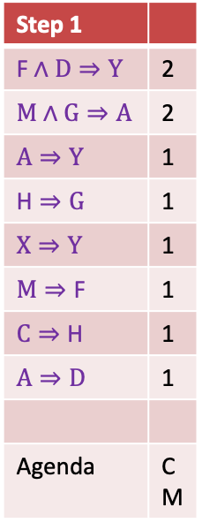
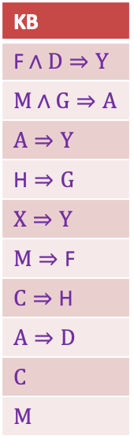
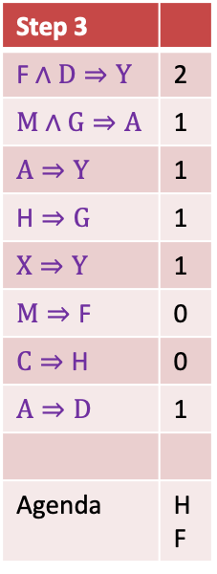
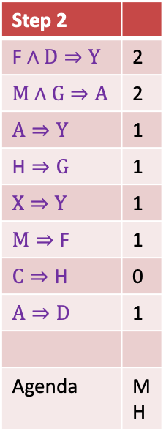
Q5
KB
$$\text{F}∧D⇒Y$$
$$M∧G⇒A$$
$$A⇒Y$$
$$\text{H}⇒G$$
$$X⇒Y$$
$$M⇒\text{F}$$
$$C⇒\text{H}$$
$$A⇒D$$
$$C$$
$$M$$
Step 1
$$\text{F}∧D⇒Y$$ | 2
$$M∧G⇒A$$ | 2
$$A⇒Y$$ | 1
$$\text{H}⇒G$$ | 1
$$X⇒Y$$ | 1
$$M⇒\text{F}$$ | 1
$$C⇒\text{H}$$ | 1
$$A⇒D$$ | 1
Agenda | C M
Step 2
$$\text{F}∧D⇒Y$$ | 2
$$M∧G⇒A$$ | 2
$$A⇒Y$$ | 1
$$\text{H}⇒G$$ | 1
$$X⇒Y$$ | 1
$$M⇒\text{F}$$ | 1
$$C⇒\text{H}$$ | 0
$$A⇒D$$ | 1
Agenda | M H
Step 3
$$\text{F}∧D⇒Y$$ | 2
$$M∧G⇒A$$ | 1
$$A⇒Y$$ | 1
$$\text{H}⇒G$$ | 1
$$X⇒Y$$ | 1
$$M⇒\text{F}$$ | 0
$$C⇒\text{H}$$ | 0
$$A⇒D$$ | 1
Agenda | H F

Slide 11
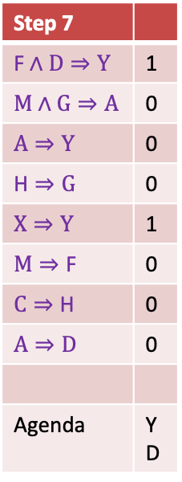
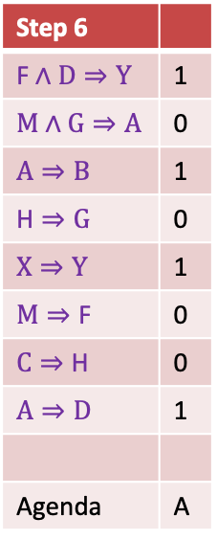
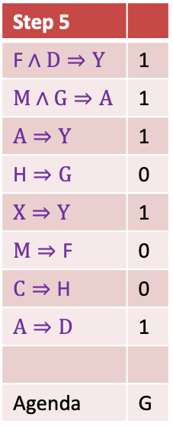

Q5
Step 4
$$\text{F}∧D⇒Y$$ | 2
$$M∧G⇒A$$ | 1
$$A⇒Y$$ | 1
$$\text{H}⇒G$$ | 0
$$X⇒Y$$ | 1
$$M⇒\text{F}$$ | 0
$$C⇒\text{H}$$ | 0
$$A⇒D$$ | 1
Agenda | F G
Step 5
$$\text{F}∧D⇒Y$$ | 1
$$M∧G⇒A$$ | 1
$$A⇒Y$$ | 1
$$\text{H}⇒G$$ | 0
$$X⇒Y$$ | 1
$$M⇒\text{F}$$ | 0
$$C⇒\text{H}$$ | 0
$$A⇒D$$ | 1
Agenda | G
Step 6
$$\text{F}∧D⇒Y$$ | 1
$$M∧G⇒A$$ | 0
$$A⇒B$$ | 1
$$\text{H}⇒G$$ | 0
$$X⇒Y$$ | 1
$$M⇒\text{F}$$ | 0
$$C⇒\text{H}$$ | 0
$$A⇒D$$ | 1
Agenda | A
Step 7
$$\text{F}∧D⇒Y$$ | 1
$$M∧G⇒A$$ | 0
$$A⇒Y$$ | 0
$$\text{H}⇒G$$ | 0
$$X⇒Y$$ | 1
$$M⇒\text{F}$$ | 0
$$C⇒\text{H}$$ | 0
$$A⇒D$$ | 0
Agenda | Y D

Slide 12

Q6.1
P(f|c) $∝$ P(f,c) = P(c|f)P(f) = 0.7*0.8 = 0.56
P(¬f|c) $∝$ P(¬f,c) = P(c|¬f)P(¬f) = 0.2*0.2 = 0.04
P(f|c) = 0.56/(0.56+0.04) = 0.9333

Slide 13
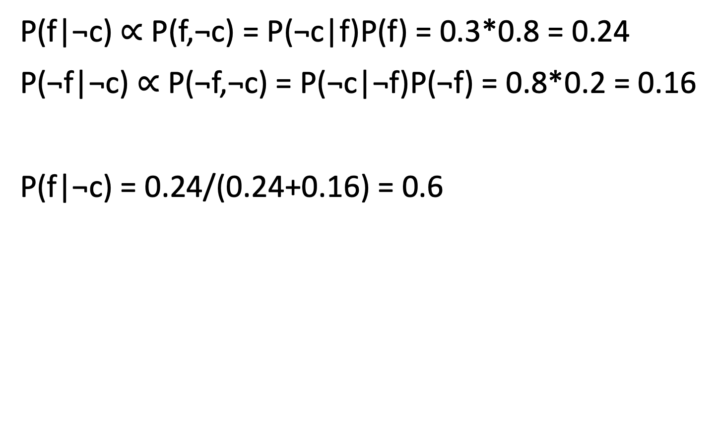
Q6.2
P(f|¬c) $∝$ P(f,¬c) = P(¬c|f)P(f) = 0.3*0.8 = 0.24
P(¬f|¬c) $∝$ P(¬f,¬c) = P(¬c|¬f)P(¬f) = 0.8*0.2 = 0.16
P(f|¬c) = 0.24/(0.24+0.16) = 0.6

Slide 14
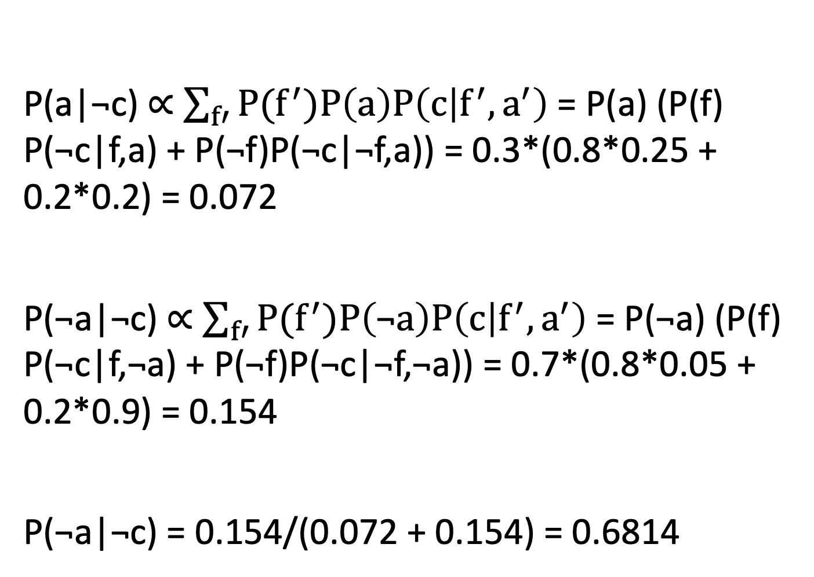
Q7.1
P(a|¬c) $∝$ $\sum_{f′}{P(f^{′})P\left(a\right)P\left(c | f^{′},a^{′}\right)}$ = P(a) (P(f) P(¬c|f,a) + P(¬f)P(¬c|¬f,a)) = 0.3*(0.8*0.25 + 0.2*0.2) = 0.072
P(¬a|¬c) $∝$ $\sum_{f′}{P(f^{′})P\left(\text{¬}a\right)P\left(c | f^{′},a^{′}\right)}$ = P(¬a) (P(f) P(¬c|f,¬a) + P(¬f)P(¬c|¬f,¬a)) = 0.7*(0.8*0.05 + 0.2*0.9) = 0.154
P(¬a|¬c) = 0.154/(0.072 + 0.154) = 0.6814

Slide 15
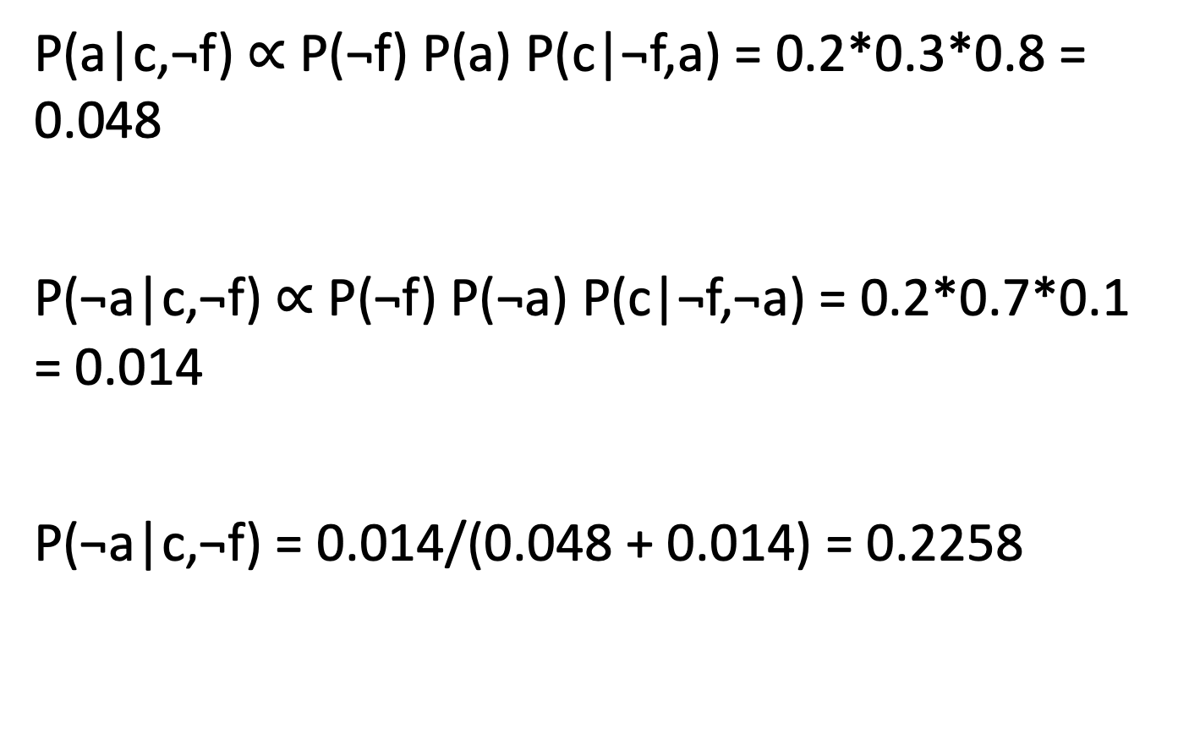
Q7.2
P(a|c,¬f) $∝$ P(¬f) P(a) P(c|¬f,a) = 0.2*0.3*0.8 = 0.048
P(¬a|c,¬f) $∝$ P(¬f) P(¬a) P(c|¬f,¬a) = 0.2*0.7*0.1 = 0.014
P(¬a|c,¬f) = 0.014/(0.048 + 0.014) = 0.2258

Slide 16
Q8.1
P(f,a,¬c,¬v) = P(f)*P(a)*P(¬c|f,a)*P(¬v|¬c)
= 0.8*0.3*0.25*0.8
= 0.048

Slide 17
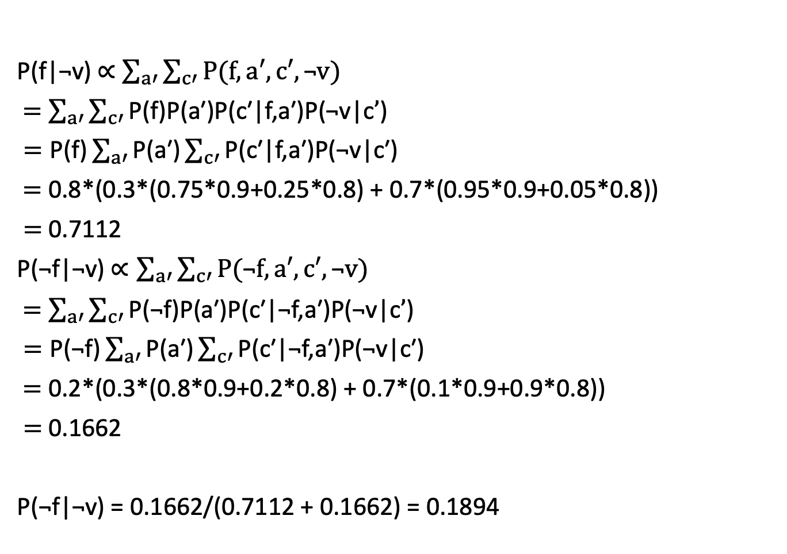
Q8.2
P(f|¬v) $∝$ $\sum_{a′}{\sum_{c′}{P(f,a′,c′,\text{¬}v)}}$
$=$ $\sum_{a′}{\sum_{c′}{\text{P}\text{(}\text{f}\text{)}\text{P}\text{(}\text{a}\text{′}\text{)}\text{P}\text{(}\text{c}\text{′}\text{|}\text{f}\text{,}\text{a}\text{′}\text{)}\text{P}\text{(¬}\text{v}\text{|}\text{c}’\text{)}}}$
$=\text{P}\text{(}\text{f}\text{)}\sum_{a′}{\text{P}\text{(}\text{a}\text{′)}\sum_{c′}{\text{P}\text{(}\text{c}\text{′|}\text{f}\text{,}\text{a}\text{′)}\text{P}\text{(¬}\text{v}\text{|}\text{c}\text{′)}}}$
$=$ 0.8*(0.3*(0.75*0.9+0.25*0.8) + 0.7*(0.95*0.9+0.05*0.8))
$=$ 0.7112
P(¬f|¬v) $∝\sum_{a′}{\sum_{c′}{P(\text{¬}f,a′,c′,\text{¬}v)}}$
$=$ $\sum_{a′}{\sum_{c′}{\text{P}\text{(¬}\text{f}\text{)}\text{P}\text{(}\text{a}\text{′)}\text{P}\text{(}\text{c}\text{′|¬}\text{f}\text{,}\text{a}\text{′)}\text{P}\text{(¬}\text{v}\text{|}\text{c}’\text{)}}}$
$=\text{P}\text{(¬}\text{f}\text{)}\sum_{a′}{\text{P}\text{(}\text{a}\text{′)}\sum_{c′}{\text{P}\text{(}\text{c}\text{′|¬}\text{f}\text{,}\text{a}\text{′)}\text{P}\text{(¬}\text{v}\text{|}\text{c}\text{′)}}}$
$=$ 0.2*(0.3*(0.8*0.9+0.2*0.8) + 0.7*(0.1*0.9+0.9*0.8))
$=$ 0.1662
P(¬f|¬v) = 0.1662/(0.7112 + 0.1662) = 0.1894

Slide 18
Q9
(a). Not true. Not any case.
(b). Not true. Violation of D-Separation Case 3.

Slide 19
Q10
(a). Not true, not any case.
(b). True. D-Separation Case 1.

Slide 20
Q11.1
Without: 2⁸-1
1
2
2
2
With
S₁
S₂
S₃
S₄
2x8-1=15 parameters
Z₁
Z₂
Z₃
Z₄
2
2
2
2
Based on Slides in class

Slide 21
Q11.2
Without: 3⁸-1
2
6
6
6
With
S₁
S₂
S₃
S₄
2+6*7=44 parameters
Z₁
Z₂
Z₃
Z₄
6
6
6
6
S₁ could be any of three potential values a, b, and c, so P(S₁) needs 2 parameters.
For each S₁ value (out of 3), there are 2 parameters, so P(Z₁|S₁) needs 3*2=6 parameters.
Same for P(Z₂|S₂), P(Z₃|S₃), and P(Z₄|S₄)
Same for P(S₂|S₁), P(S₃|S₂), and P(S₄|S₃)

Slide 22
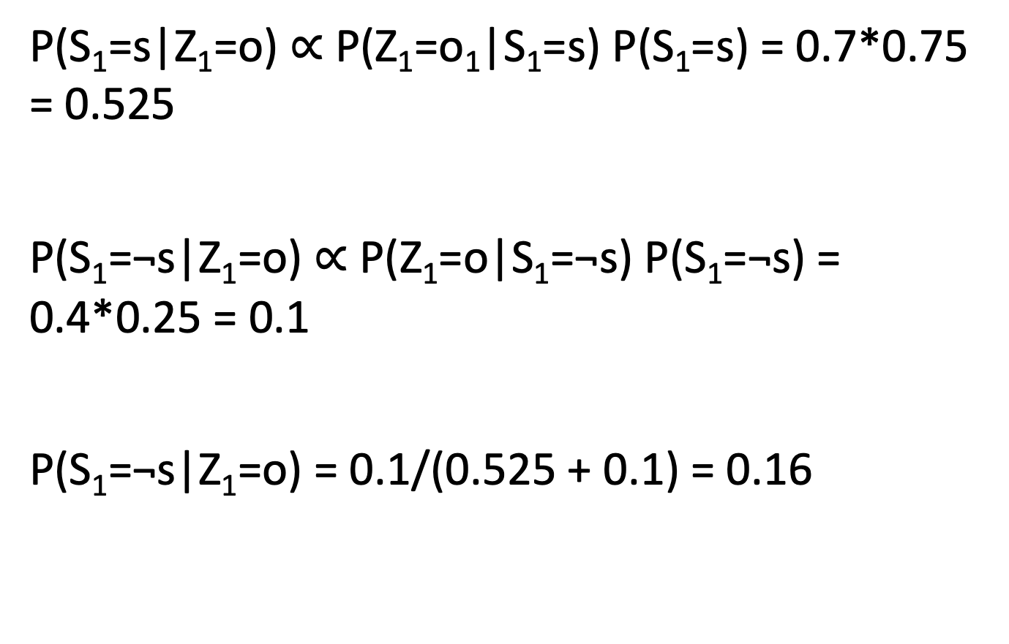
Q12.1
P(S₁=s|Z₁=o) $∝$ P($\text{Z}\text{1}\text{=}\text{o}\text{1}$|S₁=s) P(S₁=s) = 0.7*0.75 = 0.525
P(S₁=¬s|Z₁=o) $∝$ P(Z₁=o|S₁=¬s) P(S₁=¬s) = 0.4*0.25 = 0.1
P(S₁=¬s|Z₁=o) = 0.1/(0.525 + 0.1) = 0.16

Slide 23
Q12.2
P(S₂=¬s|Z₁=o)
= P(S₂=¬s|S₁=s, Z₁=o) P(S₁=s|Z₁=o) + P(S₂=¬s|S₁=¬s, Z₁=o) P(S₁=¬s|Z₁=o)
= P(S₂=¬s|S₁=s) P(S₁=s|Z₁=o) + P(S₂=¬s|S₁=¬s) P(S₁=¬s|Z₁=o)
= 0.1*(1-0.16) +0.8*0.16
= 0.212

Slide 24
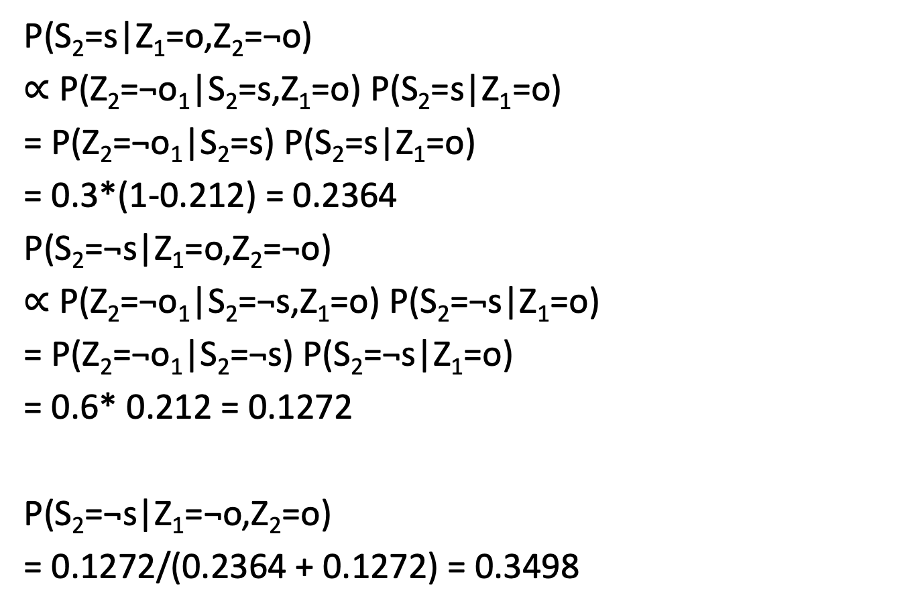
Q12.3
P(S₂=s|Z₁=o,Z₂=¬o)
$∝$ P($\text{Z}\text{2}\text{=¬}\text{o}\text{1}$|S₂=s,Z₁=o) P(S₂=s|Z₁=o)
= P($\text{Z}\text{2}\text{=¬}\text{o}\text{1}$|S₂=s) P(S₂=s|Z₁=o)
= 0.3*(1-0.212) = 0.2364
P(S₂=$\text{¬}$s|Z₁=o,Z₂=¬o)
$∝$ P($\text{Z}\text{2}\text{=¬}\text{o}\text{1}$|S₂=$\text{¬}$s,Z₁=o) P(S₂=$\text{¬}$s|Z₁=o)
= P($\text{Z}\text{2}\text{=¬}\text{o}\text{1}$|S₂=$\text{¬}$s) P(S₂=$\text{¬}$s|Z₁=o)
= 0.6* 0.212 = 0.1272
P(S₂=$\text{¬}$s|Z₁=¬o,Z₂=o)
= 0.1272/(0.2364 + 0.1272) = 0.3498

Slide 25
Q12.4
P(S₃=¬s|Z₁=o, Z₂=¬o)
= P(S₃=¬s|S₂=s, Z₁=o, Z₂=¬o) P(S₂=s|Z₁=o, Z₂=¬o) + P(S₃=¬s|S₁=¬s, Z₁=o, Z₂=¬o) P(S₂=¬s|Z₁=o, Z₂=¬o)
= P(S₃=¬s|S₂=s) P(S₂=s|Z₁=¬o, Z₂=o) + P(S₃=¬s|S₂=¬s) P(S₂=¬s|Z₁=¬o, Z₂=o)
= 0.1*(1-0.3498) + 0.8* 0.3498
= 0.34486

Slide 26
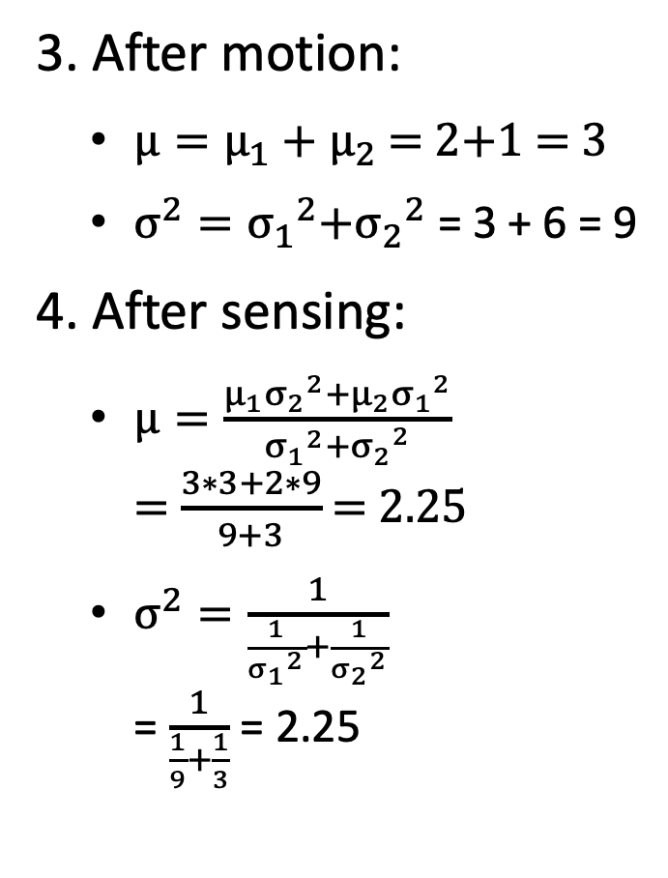
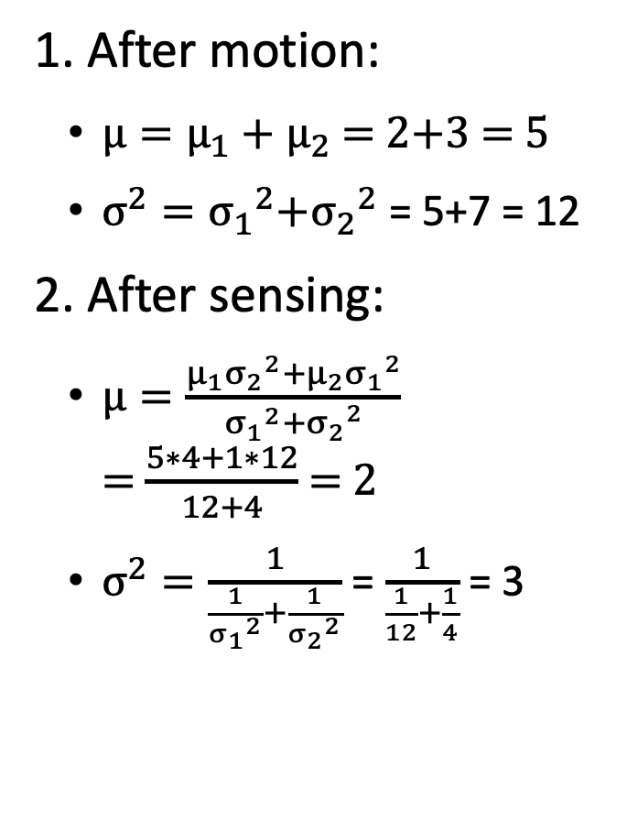
Q14
1. After motion:
${μ=μ}_{1}+μ_{2}$ = 2+3 = 5
$σ^{2}={σ_{1}}^{2}{{+σ}_{2}}^{2}$ = 5+7 = 12
2. After sensing:
$μ=\frac{{{μ_{1}σ}_{2}}^{2}{{+μ_{2}σ}_{1}}^{2}}{{σ_{1}}^{2}{{+σ}_{2}}^{2}}$ = $\frac{5∗4+1∗12}{12+4}$ = 2
$σ^{2}=\frac{1}{\frac{1}{{σ_{1}}^{2}}+\frac{1}{{σ_{2}}^{2}}}$ = $\frac{1}{\frac{1}{12}+\frac{1}{4}}$ = 3
3. After motion:
${μ=μ}_{1}+μ_{2}$ = 2+1 = 3
$σ^{2}={σ_{1}}^{2}{{+σ}_{2}}^{2}$ = 3 + 6 = 9
4. After sensing:
$μ=\frac{{{μ_{1}σ}_{2}}^{2}{{+μ_{2}σ}_{1}}^{2}}{{σ_{1}}^{2}{{+σ}_{2}}^{2}}$ = $\frac{3∗3+2∗9}{9+3}$ = 2.25
$σ^{2}=\frac{1}{\frac{1}{{σ_{1}}^{2}}+\frac{1}{{σ_{2}}^{2}}}$ = $\frac{1}{\frac{1}{9}+\frac{1}{3}}$ = 2.25

