Slide 1
NLP GRADUATION PROJECT / 2026
End-to-End Fine-Grained
Arabic Dialect Classification
Benchmarking Classical ML Ensembles vs. Pre-Trained Transformers
AraBERTv02 & MARBERTv2
CHAMPION MODEL
UNSEEN TEST ACCURACY
MACRO F1
MARBERTv2
92.25%
92.24%
DIALECT-AWARE NLP
TARGET DIALECTS
Beirut • Cairo • Doha • MSA • Tunis
GitHub / meedooatef22/arabic-dialect-classification
Notes:
Welcome everyone. Today we present our graduation project on Fine-Grained Arabic Dialect Classification, where we built an end-to-end NLP pipeline from raw data hygiene and classical ensembles up to fine-tuning MARBERTv2, achieving 92.25% accuracy on unseen test data, deployed in a real-time Streamlit web platform.

Slide 2
THE PROBLEM
Why Is Arabic Dialect Classification Challenging?
Sociolinguistic Diglossia
Heavy Morphological Agglutination
Lexical Overlap & Short Text
01
02
03
• Formal MSA coexists with regional spoken dialects (Ammiya) used in everyday social media.
• No standardized spelling: Hamza (أ/إ/ا), Ya (ى/ي), and Ta-Marbuta (ة/ه) vary.
• Prepositions, negations, and pronouns fuse directly into word stems.
• Examples: “شورايك” (Beirut), “هالفيش” (Doha), “فماش” (Tunis) drive high OOV rates.
• Neighboring dialects such as Beirut and Doha share vocabulary in unvocalized writing.
• Conversational messages are often only 2–4 words, providing minimal context.
ORTHOGRAPHIC VARIATION
SUBWORD COMPLEXITY
LOW-CONTEXT AMBIGUITY
ARABIC DIALECT CLASSIFICATION
02 / 12
Notes:
Standard Arabic NLP models fail on social media text because of Diglossia, lack of spelling standards, heavy prefix/suffix agglutination like 'شورايك' or 'فماش', and strong lexical overlap across short conversational phrases.

Slide 3
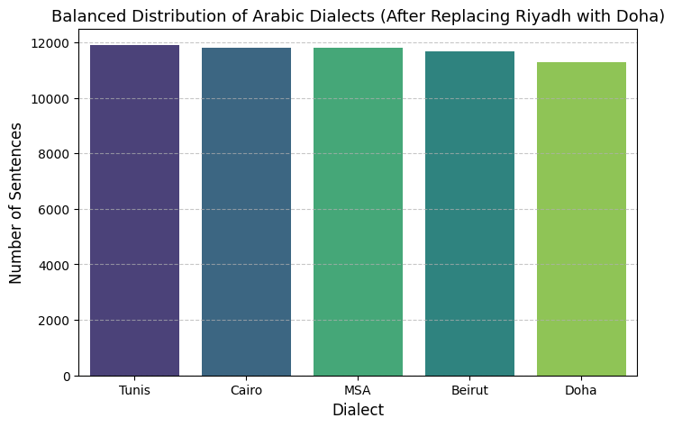
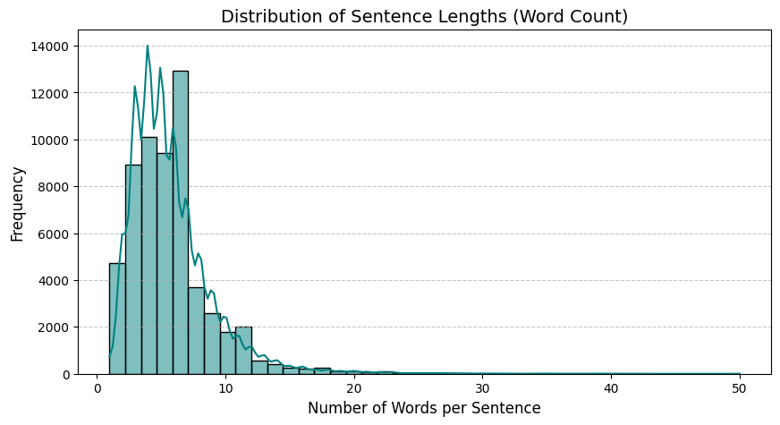
DATA & VALIDATION
Dataset Overview & Strict Data Hygiene (MADAR Corpus)
Corpus & Split Integrity
RAW CORPUS
DEDUPLICATED
DUPLICATES
40,000
38,963
1,037
5 balanced classes • 8,000 raw sentences per dialect
Duplicates removed before splitting
Exact and post-cleaning deduplication prevents the same or normalized-equivalent sentence from crossing train/test boundaries.
STRATIFIED 70 / 15 / 15 SPLIT
Train 27,274 (70%)
Validation 5,844 (15%)
Unseen test: 5,845 sentences (15%)
Split after de-duplication • no intentional overlap
ARABIC DIALECT CLASSIFICATION
03 / 12
Notes:
We used 40,000 sentences across 5 dialects. Crucially, we performed deduplication before splitting, leaving 38,963 unique sentences partitioned via stratified 70/15/15 splitting to guarantee zero data leakage between train and test sets.

Slide 4
TEXT ENGINEERING
Domain-Specific Arabic Preprocessing Pipeline
01 Retain Arabic Stopwords
02 Retain Short Sentences
• Generic lists can delete negations, pronouns, and interrogatives.
• Here, function words are strong dialect fingerprints.
• One- and two-word turns may carry concentrated regional signals.
• Examples: “يعيشك”, “شورايك”, and “معلش”.
Cairo: إيه / مش / عايز • Beirut: شو / ما / بدي
DON’T DISCARD SIGNAL
Tunis: شنوة / برشا / فماش • Doha: وش / مو / ابغى
03 Deterministic Regex Normalization
04 Before → After
clean_arabic_text
RAW INPUT
• Strip tashkeel, tatweel, URLs, digits, and non-Arabic characters.
• Normalize variants: (إ / أ / آ → ا), (ى → ي), (ة → ه).
“شُورَأْيَك بـ 10 دولار للتلاتة؟!!”
NORMALIZED OUTPUT
“شورايك ب دولار للتلاته”
ARABIC DIALECT CLASSIFICATION
04 / 12
Notes:
A critical engineering decision in our pipeline was retaining stopwords and short sentences. Words like 'شو', 'إيه', and 'برشا' are stopwords in standard NLP, but here they are the primary predictors of the dialect.

Slide 5
MODEL DEVELOPMENT
End-to-End Modeling Progression
PHASE 01
PHASE 02
PHASE 03 / CHAMPION
Classical ML & Stacking
AraBERTv02 Fine-Tuning
MARBERTv2 Fine-Tuning
HYBRID TF-IDF • 150,000 FEATURES
aubmindlab/bert-base-arabertv02
UBC-NLP/MARBERTv2
• Word n-grams (1–3): 75k features for words and idioms.
• Character n-grams (2–5), char_wb: 75k features for subword patterns.
• LinearSVC, Logistic Regression, MultinomialNB, and SGD.
• 5-fold StackingClassifier meta-learner.
PARAMETERS
EPOCHS
136M
4
PARAMETERS
DIALECTAL TWEETS
163M
1B
• Pre-trained primarily on formal MSA news and encyclopedic text.
• Learning rate: 3e-5 • Batch size: 32.
• Pre-trained on 1 billion dialectal Arabic tweets plus MSA data.
• 100k dialect-aware WordPiece vocabulary.
• Selected as the champion model for unseen-test performance.
STRONG CLASSICAL BASELINE
MSA-ORIENTED PRE-TRAINING
DIALECT-AWARE PRE-TRAINING
ARABIC DIALECT CLASSIFICATION
05 / 12
Notes:
We progressed systematically across three paradigms: first, a 150k-feature hybrid word+character TF-IDF Stacking Ensemble; second, AraBERTv02 pre-trained on formal news; and third, MARBERTv2 pre-trained on 1 billion dialectal tweets.

Slide 6
TRAINING STRATEGY
Anti-Overfitting & Regularization Strategy in MARBERTv2
The Challenge / AraBERTv02
The Solution / MARBERTv2
VALIDATION LOSS ROSE AFTER EPOCH 2
2e-5
10%
Peak learning rate
Linear warmup
0.371
0.305
0.264
0.05
Weight decay
0.05
Label smoothing
Epoch 2
Epoch 3
Epoch 4
TRAINING CONTROLS
• EarlyStoppingCallback: patience = 2; monitor eval_f1_macro.
• load_best_model_at_end = True • FP16 mixed precision.
Training loss reached 0.072 by Epoch 4, while validation loss kept rising. Higher learning rates encouraged memorization of short phrases.
ARABIC DIALECT CLASSIFICATION
06 / 12
Notes:
When training AraBERTv02, we noticed validation loss creeping up after Epoch 2. To prevent overfitting in MARBERTv2, we engineered a strict regularization setup using a 2e-5 learning rate, 0.05 weight decay, and 0.05 Label Smoothing, resulting in rock-solid convergence.

Slide 7
QUANTITATIVE RESULTS
Experimental Benchmark Results Across All Models
CLASSICAL STACKING / TEST ACCURACY
ARABERTV02 / VALIDATION ACCURACY
MARBERTV2 / UNSEEN TEST ACCURACY
90.93%
91.03%
92.25%
4-model meta-learner
Fine-tuned transformer
Macro F1: 92.24%
Model Architecture
Feature Type
Val Accuracy
Test Accuracy
Test Macro F1
Logistic Regression
Hybrid TF-IDF (150k)
89.37%
89.70%
89.70%
SGD Classifier
Hybrid TF-IDF (150k)
89.90%
90.20%
90.20%
Multinomial Naive Bayes
Hybrid TF-IDF (150k)
90.35%
90.47%
90.45%
LinearSVC (C=0.5)
Hybrid TF-IDF (150k)
90.59%
90.52%
90.52%
Classical Stacking Ensemble
4-Model Meta-Learner
90.85%
90.93%
90.92%
AraBERTv02 (Fine-Tuned)
Subword Transformer
91.03%
—
91.00%
MARBERTv2 (Champion)
Dialect-Aware Transformer
92.02%
92.25%
92.24%
All figures shown as reported in the project benchmark; “—” indicates no test accuracy listed for AraBERTv02.
ARABIC DIALECT CLASSIFICATION
07 / 12
Notes:
Here is our complete quantitative progression. Our hybrid TF-IDF Stacking Ensemble achieved an impressive 90.93% test accuracy, AraBERTv02 reached 91.03% validation accuracy, and MARBERTv2 outperformed all models with 92.25% unseen test accuracy and 92.24% Macro F1.

Slide 8
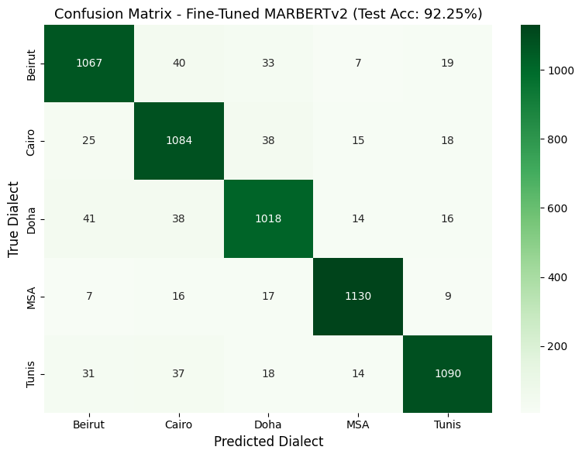
ERROR PROFILE
Champion Model (MARBERTv2) Per-Dialect Breakdown
Dialect
Precision
Recall
F1-Score
Support
Tunis (Maghrebi)
95.21%
93.69%
94.44%
1,173
MSA (Formal)
93.60%
94.61%
94.10%
1,168
Cairo (Egyptian)
92.42%
91.47%
91.94%
1,172
Doha (Gulf)
90.02%
91.47%
90.74%
1,172
Beirut (Levantine)
90.09%
89.99%
90.04%
1,160
77 ERRORS ELIMINATED
530 → 453
14.5% fewer test errors on the same test set
ARABIC DIALECT CLASSIFICATION
08 / 12
Notes:
MARBERTv2 achieved >=90% F1-score across every single dialect, led by Tunis at 94.44% and MSA at 94.10%. Compared to Stacking, MARBERTv2 eliminated 77 errors on the exact same test set.

Slide 9
MODEL INTERPRETABILITY
Deep Error Analysis: Why Do 7.75% (453) Errors Remain?
Average Sentence Length
Average Prediction Confidence
7.21 words
3.86 words
95.83%
77.57%
Correct predictions
5,392 samples
Misclassified
453 samples
Correct predictions
Misclassified • −18.26 pp
Theoretical Dataset Ceiling / Ambiguous Written Language
EXAMPLE 1 / A MODEL-RESCUED CASE
TOP CONFUSION PAIR
“شورايك بعشره دولار للتلاته”
Beirut ↔ Doha
Stacking → Doha | MARBERTv2 → Beirut (97.92% confidence)
91 mutual errors; shared Levantine/Gulf vocabulary in unvocalized text.
EXAMPLE 2 / NATURAL AMBIGUITY
“تاني تقاطع عاليمين” • “ايوه مسموح”
Everyday phrases can occur in Cairo, Beirut, and Doha; text alone may not resolve the label.
ARABIC DIALECT CLASSIFICATION
09 / 12
Notes:
We didn't stop at accuracy numbers; we analyzed all 453 errors. We discovered that misclassified sentences average only 3.86 words compared to 7.21 words for correct ones. Phrases like 'تاني تقاطع عاليمين' or 'ايوه مسموح' are genuinely used across multiple dialects, proving our model reached the natural linguistic ceiling of written text.

Slide 10
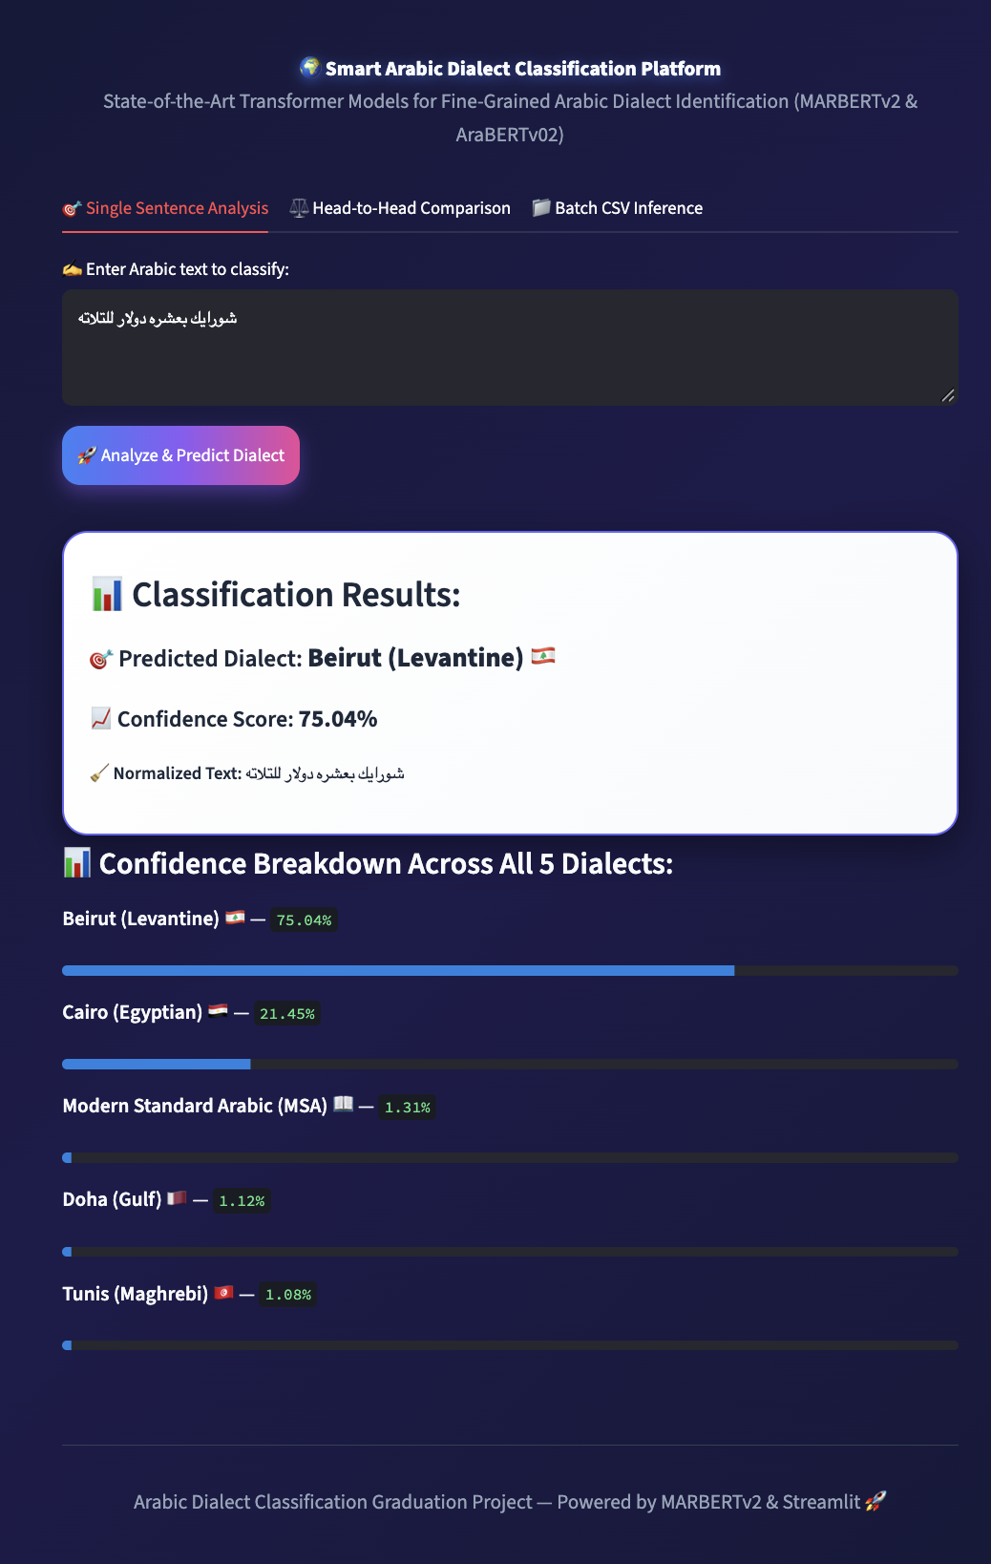
DEPLOYMENT
Production Web Platform (Streamlit & Ngrok Deployment)
Three Modes in the Web App
Single Sentence Analysis
01
Normalize text, return top dialect + confidence, and show probability bars for all five classes. Smart linguistic alert when confidence <45%.
Head-to-Head Comparison
02
Run MARBERTv2 and AraBERTv02 side by side for a live comparison (92.25% vs. 91.03% reported benchmark).
Batch CSV Inference
03
Upload a CSV with a `text` column, classify hundreds of rows on GPU, then download UTF-8 results.
ARABIC DIALECT CLASSIFICATION
10 / 12
Notes:
To turn our research into a usable product, we built and deployed an interactive Streamlit web application featuring real-time single-sentence analysis with 5-dialect probability bars, side-by-side model comparison between MARBERTv2 and AraBERTv02, and batch CSV classification.

Slide 11
TAKEAWAYS
Conclusion & Future Directions
What We Achieved
Future Work
01
Leak-free data pipeline
01
Broader dialect coverage
38,963 unique sentences after deduplication and stratified splitting.
Expand from five target dialects to 25+ fine-grained Arab cities (MADAR-26).
02
Best-performing model
02
Audio + text fusion
MARBERTv2 reached 92.25% test accuracy, ahead of AraBERTv02 (91.03% validation) and Stacking (90.93% test).
Use pronunciation to disambiguate very short phrases with identical spellings.
03
Open-source delivery
03
Efficient edge inference
GitHub documentation, README.md, six modular notebooks, technical report, and bilingual Streamlit apps.
Quantize with ONNX / INT8 for low-latency mobile and edge deployment.
FROM DATA HYGIENE → MODEL BENCHMARKING → PRACTICAL DEPLOYMENT
ARABIC DIALECT CLASSIFICATION
11 / 12
Notes:
In conclusion, our project demonstrates a rigorous engineering workflow from data deduplication to state-of-the-art transformer fine-tuning and web deployment. Looking ahead, we aim to expand to 26 cities and integrate audio features to disambiguate ultra-short shared phrases.

Slide 12
12 / CLOSING
Thank You!
Live Interactive Demo & Q&A Session
READY FOR LIVE TESTING ON STREAMLIT
Single Sentence | MARBERTv2 vs. AraBERTv02 | Batch CSV
GITHUB REPOSITORY
github.com/meedooatef22/arabic-dialect-classification
NLP GRADUATION PROJECT
QUESTIONS / DEMO
Notes:
Thank you for listening! We now invite the committee to test our live Streamlit platform with any Arabic dialect sentences, and we welcome your questions.

