Slide 1


Diabetes Prediction and Management Using Machine Learning
This presentation explores the role of machine learning in diabetes prediction and management, examining techniques, datasets, and preprocessing methods.
GROUP MEMBERS AND ROLL ID:
S. MEENAKSHI VARMA-2310080009
K. SAI SUVVIDH-2310080027
K. PHANI TEJA-2310080065
K. SAMITH REDDY-2310080021
K. DEVAANAND KUMAR-2310080052

Slide 2
Introduction
Chronic Metabolic Disorder
Diabetes affects millions globally, impacting glucose regulation.
Diabetes is a chronic metabolic disorder that affects millions of people worldwide. It is characterized by high blood glucose levels and can lead to severe complications such as cardiovascular disease, kidney failure, neuropathy, and retinopathy. Early detection and effective management of diabetes are crucial for improving patient outcomes and reducing healthcare burdens.
Traditional diagnostic methods for diabetes rely on clinical assessments and laboratory tests, which may be time-consuming and less effective in handling complex patient data. The emergence of machine learning (ML) techniques has provided new opportunities for improving diabetes prediction, risk assessment, and disease management. This review explores various studies that leverage ML models for diabetes classification and prediction, highlighting their methodologies, performance metrics, and potential applications.
Early Detection is Key
Early diagnosis and management reduce complications.
Machine Learning's Potential
ML offers improved prediction and risk assessment.

Slide 3
Literature Review
A Novel Diabetes Healthcare Disease Prediction Framework Using Machine Learning Techniques – Developed an Intelligent Diabetes Mellitus Prediction Framework (IDMPF) using ML models, but the study was later retracted due to data integrity issues.
Diabetes Prediction Using Machine Learning Techniques – Compared multiple ML models on the PIDD dataset, showing that Random Forest and SVM had the highest predictive performance.
Early Prediction Model for Type-2 Diabetes Based on Lifestyle Factors – Investigated lifestyle-based diabetes prediction using ML models, emphasizing the importance of real-time health monitoring.
Explainable Stacking-Based Model for Predicting Hospital Readmission for Diabetic Patients – Proposed a stacking ensemble model to predict 30-day hospital readmission rates and identify key risk factors.
Analysis of Prediction Accuracy of Diabetes Using Classifier and Hybrid Machine Learning Techniques – Demonstrated that XGBoost outperformed Random Forest in diabetes classification with an accuracy of 74.10%.
An Ensemble Approach for Classification and Prediction of Diabetes Mellitus Using Soft Voting Classifier – Showed that an ensemble model using Random Forest, Logistic Regression, and Naïve Bayes improved classification accuracy.
Comparative Anatomization of Data Mining and Fuzzy Logic Techniques in Diabetes Prognosis – Evaluated multiple datasets and ML models, with RF achieving 99.7% accuracy, outperforming fuzzy logic-based methods.
Predictive Models for Diabetes Management Using Big Data Analytics – Explored statistical and ML-based predictive models for early diabetes diagnosis and risk assessment, highlighting challenges in clinical validation.
Data Analytics Suite for Type 2 Diabetes Management – Introduced a multi-tier classification and risk prediction model to enhance clinical decision-making in diabetes management.
Enhancing Diabetes Prediction with Explainable AI and Cloud-Based Deployment – Proposed a cloud-based hybrid ML system for scalable and explainable diabetes prediction and patient monitoring.

Slide 4
Problem Statement & Objectives
Problem Statement
Objectives
Analyze ML techniques for diabetes prediction using structured datasets.
Explore data warehouses for managing large-scale healthcare data.
Evaluate model accuracy (Decision Trees, Random Forest, SVM, ensembles).
Assess feature selection and preprocessing impact on classification.
Investigate explainable AI for better model interpretability in healthcare.
Explore cloud-based AI for real-time risk assessment and monitoring.
Identify challenges like scalability, privacy, and clinical validation.
Traditional methods are slow and lack real-time risk assessment.
Healthcare data is growing, creating opportunities for AI-driven prediction.
Data warehouses help manage large-scale medical data efficiently.
ML models improve accuracy, but data integrity and optimization are challenges.
Scalability and cloud deployment enable real-time monitoring.
Diabetes requires early detection to prevent complications.
Explainability and ethics are crucial for AI adoption in healthcare.

Slide 5
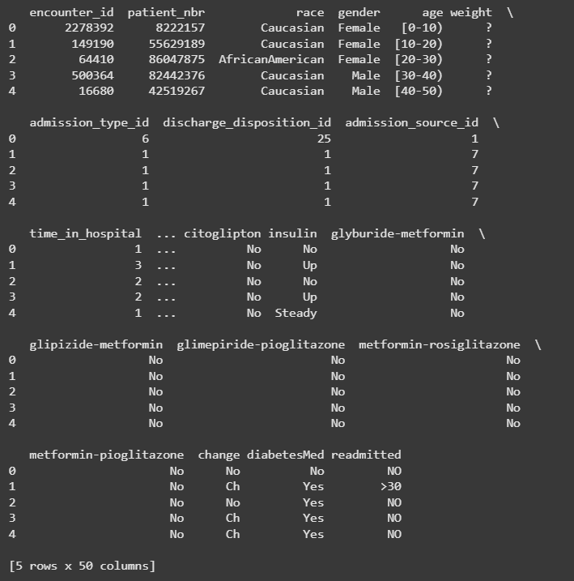
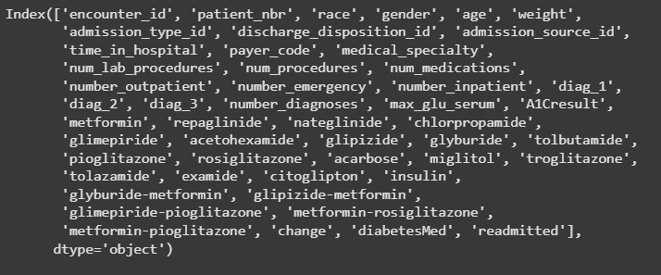
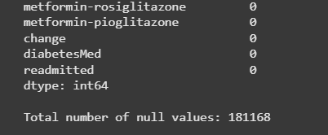
Data Collection & Datasets Available
diabetic_data.csv

Slide 6
Preprocessing Techniques
Feature Scaling – Normalization (Min-Max Scaling) or Standardization (Z-score) to standardize numerical data.
Feature Selection – Selecting important features using correlation analysis, Recursive Feature Elimination (RFE), or LASSO regression.
Data Balancing – Addressing class imbalance using techniques like SMOTE (Synthetic Minority Over-sampling Technique).
Outlier Detection & Removal – Identifying and removing outliers using IQR, Z-score, or log transformations.
Categorical Encoding – Converting categorical variables into numerical form using One-Hot Encoding or Label Encoding.
Dimensionality Reduction – Applying PCA (Principal Component Analysis) to handle high-dimensional data and improve efficiency.
Data Splitting – Dividing the dataset into training and testing sets using stratified sampling to ensure balanced distribution.
Feature Engineering – Creating new features or transforming existing ones based on domain knowledge (e.g., lifestyle factors).
Time-Series Processing – Analyzing trends over time for patient history data (if applicable).
Data Cleaning – Handling missing values, removing duplicates, and correcting inconsistencies.

Slide 7





Conclusion & Future Work
Effective preprocessing techniques such as data cleaning, normalization, and feature selection significantly enhance the performance of machine learning models in diabetes prediction.
Handling missing values, outlier detection, and balancing class distribution are crucial steps to ensure accurate and reliable disease classification.
Implementing automated preprocessing pipelines to streamline data preparation and improve scalability for large healthcare datasets.
Exploring advanced techniques like feature engineering, deep learning-based preprocessing, and real-time data integration for enhanced predictive accuracy.

Slide 8


