Slide 1
Classification of a human brain using Support Vector Machines
Philipp Glock

Slide 2
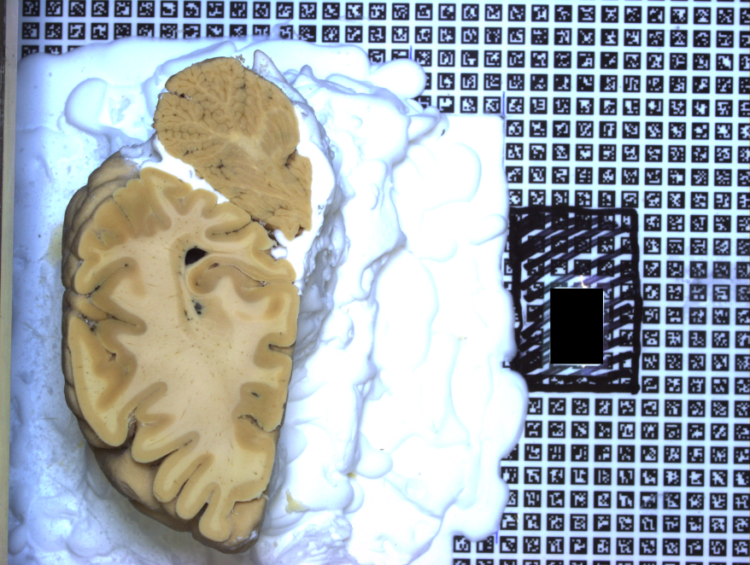
Human Brain Project
Build 3D model of a human brain
Predict 2D brain parts
Rebuild 3D model
Automate 2D brain recognition
Notes:
Simulate human brain to understand it. For medical purposes and technical ones.

Slide 3
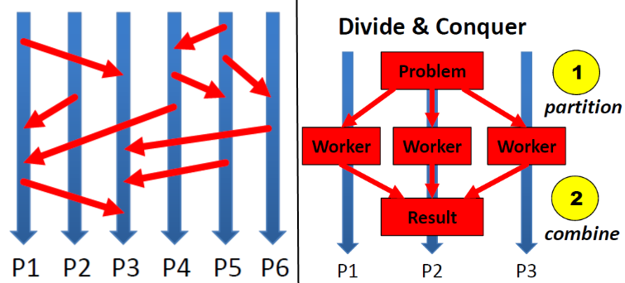
Background
Cluster System Judge:
GPU cluster ( only CPUs used)
PBS (portable batch system)
MPI, IPython
Python
Numpy
Scikit-learn
Scikit-image
Notes:
Get python, ipython running on Judge. Getting aquainted

Slide 4
Data Preprocessing
From images to libsvm
Find error in conversion script and fix it
Simple parallelisation
Sampling
Random sampling all images
Rescaling uniformly distributed images
Notes:
Parallel convertation and sampling

Slide 5
Feature Extraction
Different color space
HSV color space
Often used for object recognition
Easy to parallelise
Local features
Sliding window
Local standard deviation
Segmentation
Watershed Segmentation
Notes:
What can be done to improve accuracy?
Additional features, few features to start with

Slide 6
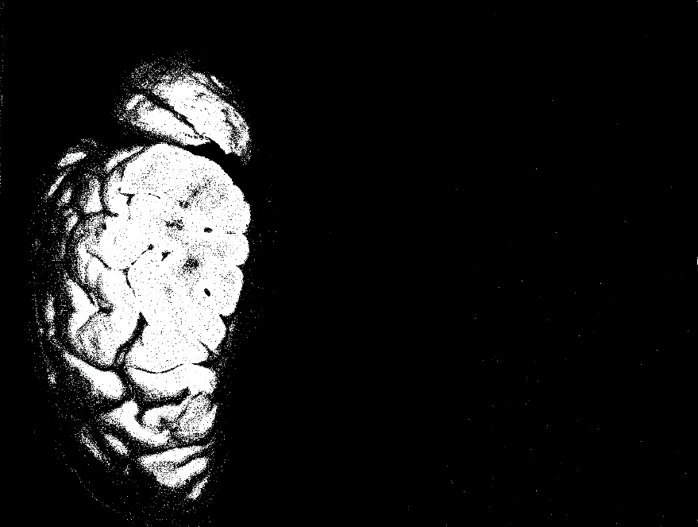
Data Modeling
Different Models
Focused SVM
Grid search, no scaling
More robust
Random Forest
KNN
No scaling
Notes:
Svm popular, random forest blackbox due to randomness

Slide 7
SVM advanced
Kernel Approximation
Random Features using Monte Carlo Approximation
Data independent
Nystroem Method
Data dependent
Multiple Models
Improves accuracy
Possible overfitting
Data has to be consistent
Notes:
Kernel approximation speed up since no parallelization available
Multiple models may be used

Slide 8
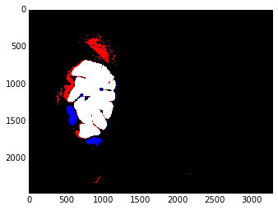
Deployment
Ipython Notebook
Browser based
Additional functions/magics, e.g. %timeit
Code, Documentation and Results displayed
Parallel thanks to ipcluster, PBS compatible
Easy to extend/modify
Postprocessing
Visualize Accuracy

Slide 9
Twister
Iterative map/reduce
SVM implementation based on libsvm
Development version
Unstable
Communication overhead
Slower than scikit-learn for small to medium data

Slide 10
Conclusion
Ipython can be used on a judge
Feature extraction, image segmentation has been done
SVM model for automatic prediction of cross sections
Manual correction needed
Lack of stable parallel svm implementations

