Slide 1
Classification of a human brain using Support Vector Machines
Philipp Glock

Slide 2
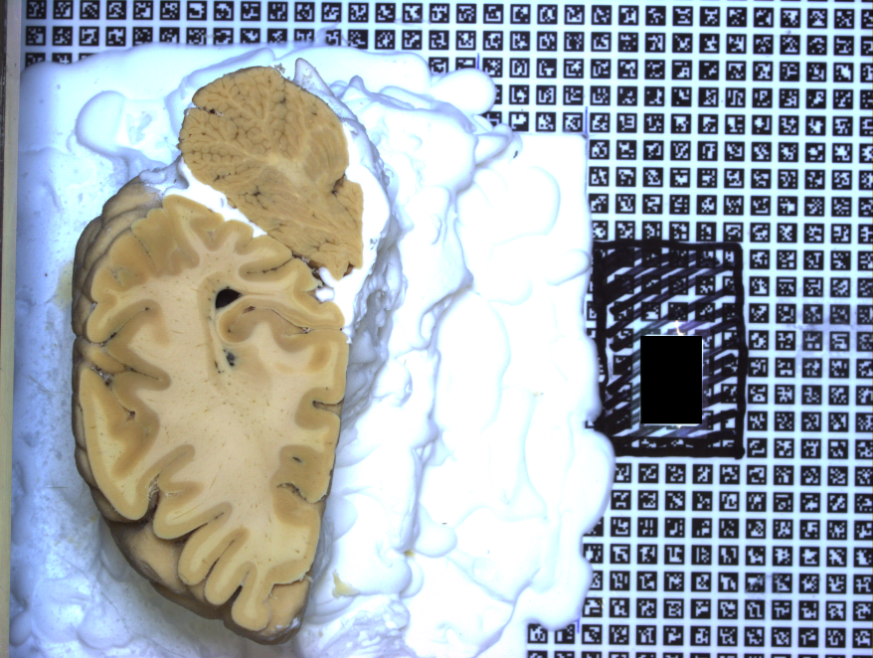
Human Brain Project
Build 3D model of a human brain
Predict 2D brain parts
Rebuild 3D model
Automate 2D brain recognition

Slide 3
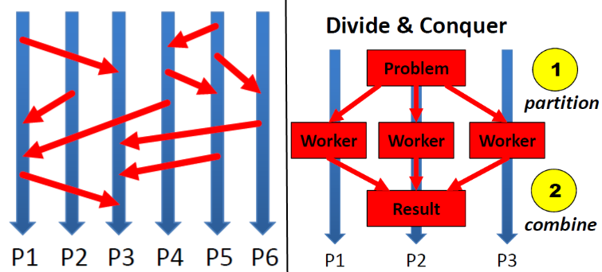
Background
Cluster System Judge:
GPU cluster ( only CPUs used)
PBS (portable batch system)
MPI, Ipython
Python
Numpy
Scikit-learn
Scikit-image

Slide 4
Data Preprocessing
From images to libsvm
Find error in conversion script and fix it
Simple parallelisation
Sampling
Random sampling all images
Rescaling uniformly distributed images

Slide 5
Feature Extraction
Different color space
HSV color space
Often used for object recognition
Easy to parallelise
Local features
Sliding window
Local standard deviation
Segmentation
Watershed Segmentation

Slide 6
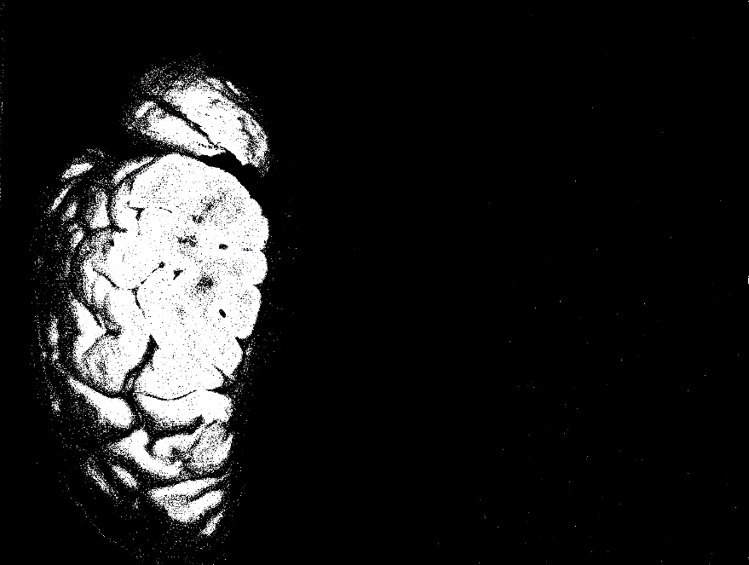
Data Modeling
Different Models
Focused SVM
Grid search, no scaling
More robust
Random Forest
KNN
No scaling

Slide 7
SVM advanced
Kernel Approximation
Random Features using Monte Carlo Approximation
Data independent
Nystroem Method
Data dependent
Multiple Models
Improves accuracy
Possible overfitting
Data has to be consistent

Slide 8
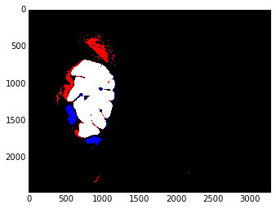
Deployment
Ipython Notebook
Browser based
Additional functions/magics, e.g. %timeit
Code, Documentation and Results displayed
Parallel thanks to ipcluster, PBS compatible
Easy to extend/modify
Postprocessing
Visualize Accuracy

Slide 9
Twister
Iterative map/reduce
Svm implementation based on libsvm
Development version
Unstable
Communication overhead
Slower than scikit-learn for small to medium data

Slide 10
Conclusion

