Slide 1
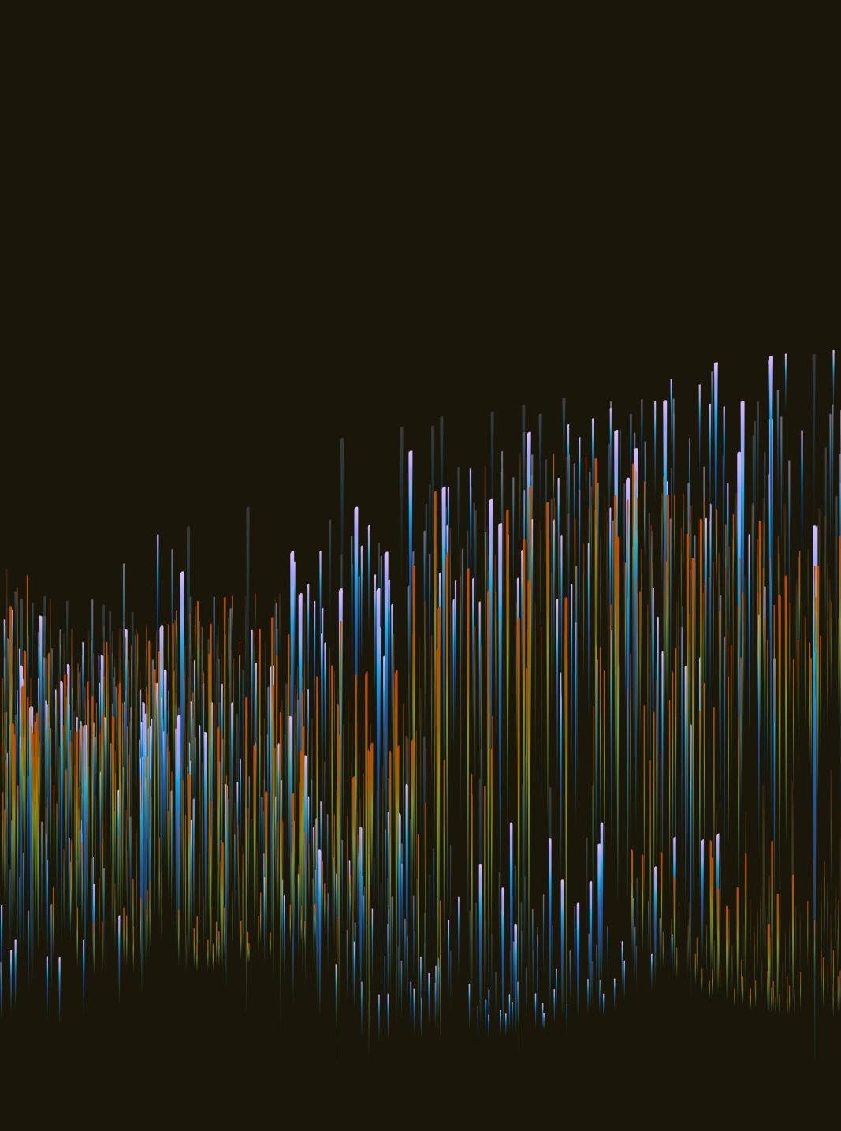
PREPROCESSING
Tom Bednarek | z5419069
Notes:
To get the data ready for the model first we need to do some preprocessing
To do this we first need to look at the characteristics of audio

Slide 2
AUDIO CHARACTERISTICS
Volume
Pitch
Frequency
Amplitude
Timbre
Duration
Noise
Notes:
So we have things like
List them

Slide 3
AUDIO CHARACTERISTICS FOR AUGMENTATION
Pitch
Duration
Noise
Notes:
The ones I care about for augmentation however are
List them

Slide 4
AUDIO CHARACTERISTICS FOR AUGMENTATION
Pitch – Higher or lower voice
Duration – Slower rate of speech
Noise – Muffle unnecessary data
Combination of the above
Example – Pitched then stretched Audio
Notes:
Why?
Pitch – People can have a higher or lower voice
Duration – People can talk faster or slower
Noise – can muffle some data the model might be extracting when we don’t need it
Combo since people can do multiple like speak lower and slower

Slide 5

AUGMENTED AUDIOS Angry “Don’t forget a jacket”
ORIGINAL
NOISED
PITCHED
STRETCHED
Notes:
So after applying each of the augmentations this is what it sounds like

Slide 6
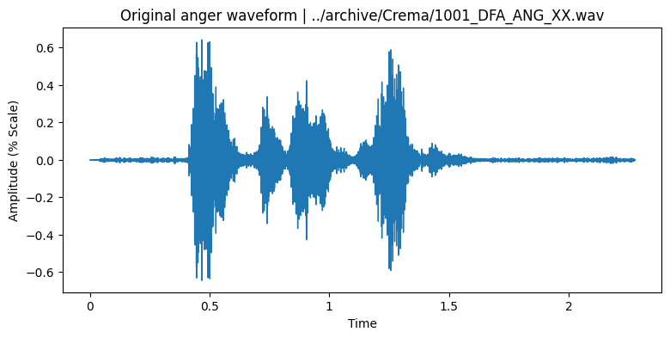

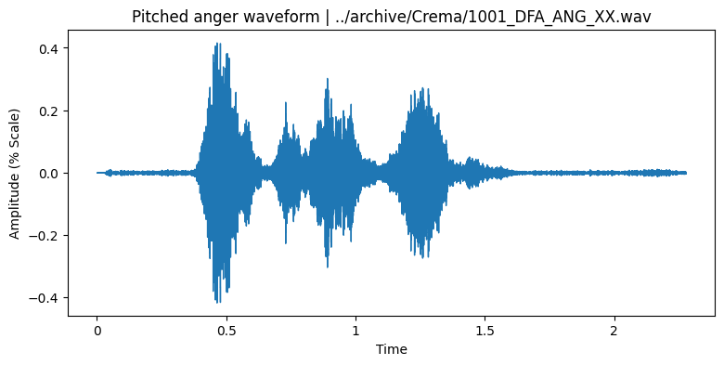
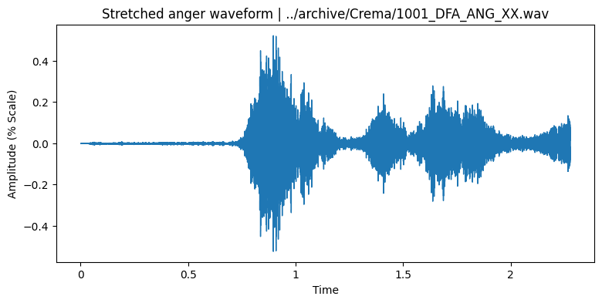
VISUALISATIONS | WAVEFORM
Notes:
Describe these, don’t forget about the scales

Slide 7
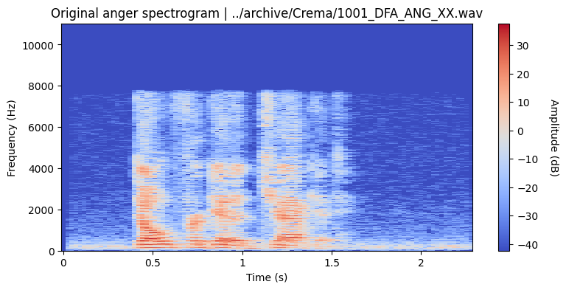
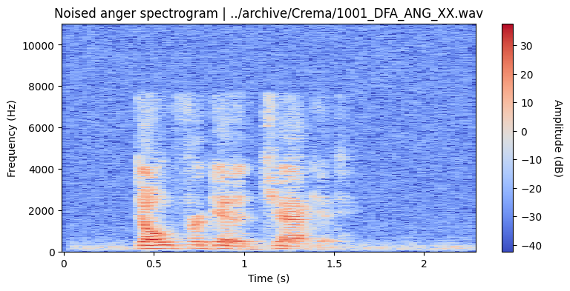
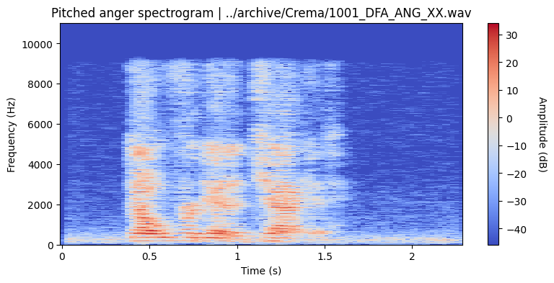
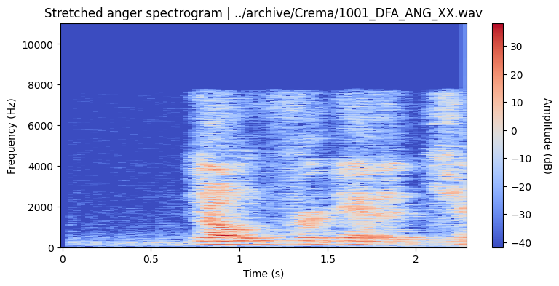
VISUALISATIONS | SPECTROGRAM
Notes:
Describe these, don’t forget about the scales again

Slide 8
FEATURE EXTRACTION
MFCC (Mel Frequency Cepstral Coefficients) – Timbre or tone which emotions often alter
RMS (Root Mean Square) – Volume or amplitude which is tied to emotion
ZCR (Zero Crossing Rate) – Smoothness of signal to detect when the emotion is occurring
F0 (Fundamental Frequency) – Basic frequency of sound
Jitter (Pitch Jitter) – Emotions cause fluctuations in pitch
Shimmer (Amplitude Shimmer) – Emotions cause fluctuations in volume
Speech Rate – Emotions can increase rate of speech
Notes:
Just read them

Slide 9
SAVED IN A MATRIX WE THEN FEED IT TO A MODEL…
Notes:
Moving onto the next part

