Slide 1

Image Retrieval and Annotation via a Stochastic Modeling Approach
Jia Li, Ph.D.
The Pennsylvania State University

Slide 2
Outline
Introduction
Image retrieval: SIMPLIcity
Automatic annotation: ALIP
  A stochastic modeling approach
Conclusions and future work

Slide 3
Image Retrieval
The retrieval of relevant images from an image database on the basis of automatically-derived image features
Applications: biomedicine, defense, commercial, cultural, education, entertainment, Web, ……
Approaches:
  Color layout
  Region based
  User feedback

Slide 4
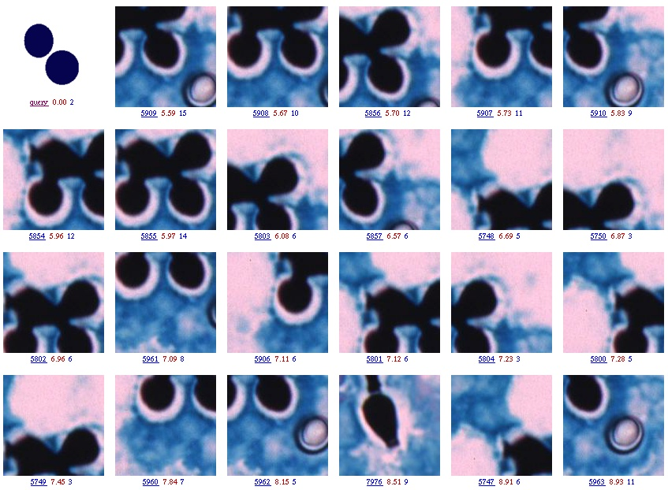

Slide 5
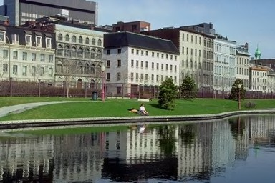
Can a computer do this?
“Building, sky, lake, landscape, Europe, tree”

Slide 6
Outline
Introduction
Image retrieval: SIMPLIcity
Automatic annotation: ALIP
  A stochastic modeling approach
Conclusions and future work

Slide 7
The SIMPLIcity System
Semantics-sensitive Integrated Matching for Picture LIbraries
Major features
  Sensitive to semantics: combine semantic classification with image retrieval
  Region based retrieval:wavelet-based feature extraction and k-means clustering
  Reduced sensitivity to inaccurate segmentation and simple user interface: Integrated Region Matching (IRM)

Slide 8
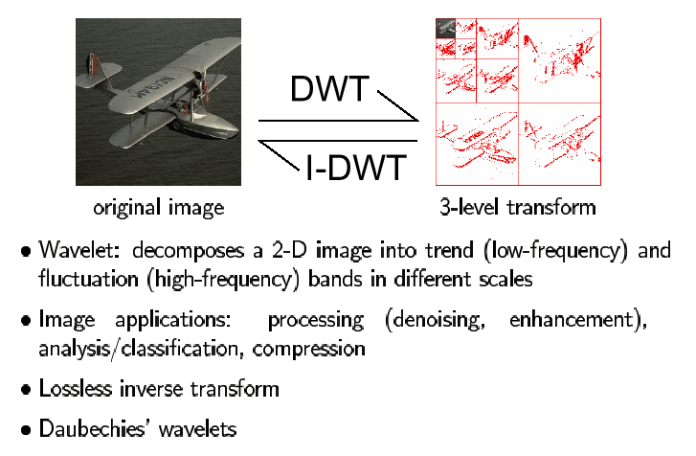
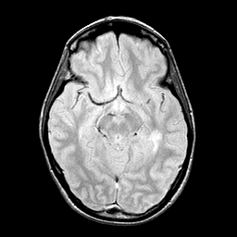
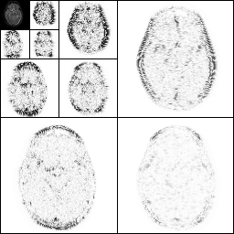
Wavelets

Slide 9
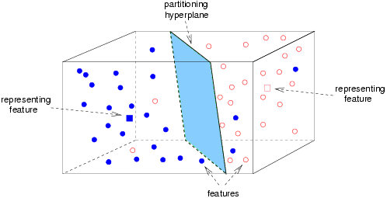
Fast Image Segmentation
Partition an image into 4×4 blocks
Extract wavelet-based features from each block
Use k-means algorithm to cluster feature vectors into ‘regions’
Compute the shape feature by normalized inertia

Slide 10

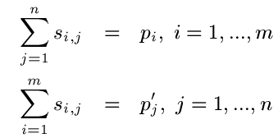
IRM: Integrated Region Matching
IRM defines an image-to-image distance as a weighted sum of region-to-region distances
Weighting matrix is determined based on significance constrains and a ‘MSHP’ greedy algorithm

Slide 11
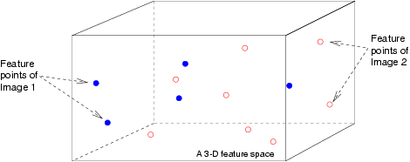
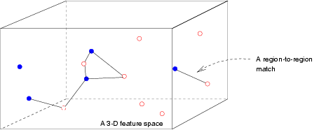
A 3-D Example for IRM

Slide 12
IRM: Major Advantages
Reduces the influence of inaccurate segmentation
Helps to clarify the semantics of a particular region given its neighbors
Provides the user with a simple interface

Slide 13
Experiments and Results
Speed
  800 MHz Pentium PC with LINUX OS
  Databases: 200,000 general-purpose image DB
  (60,000 photographs + 140,000 hand-drawn arts)
  70,000 pathology image segments
  Image indexing time: one second per image
  Image retrieval time:
    Without the scalable IRM, 1.5 seconds/query CPU time
    With the scalable IRM, 0.15 second/query CPU time
  External query: one extra second CPU time

Slide 14
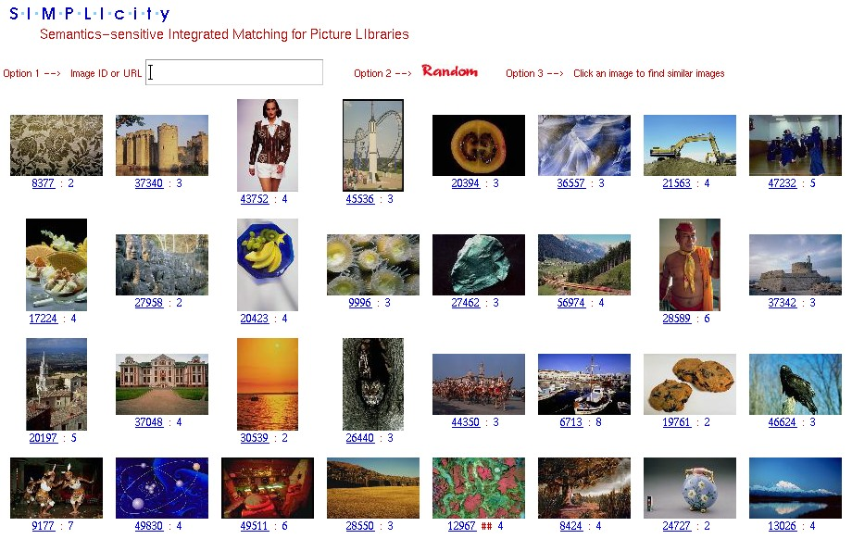
RANDOM SELECTION

Slide 15
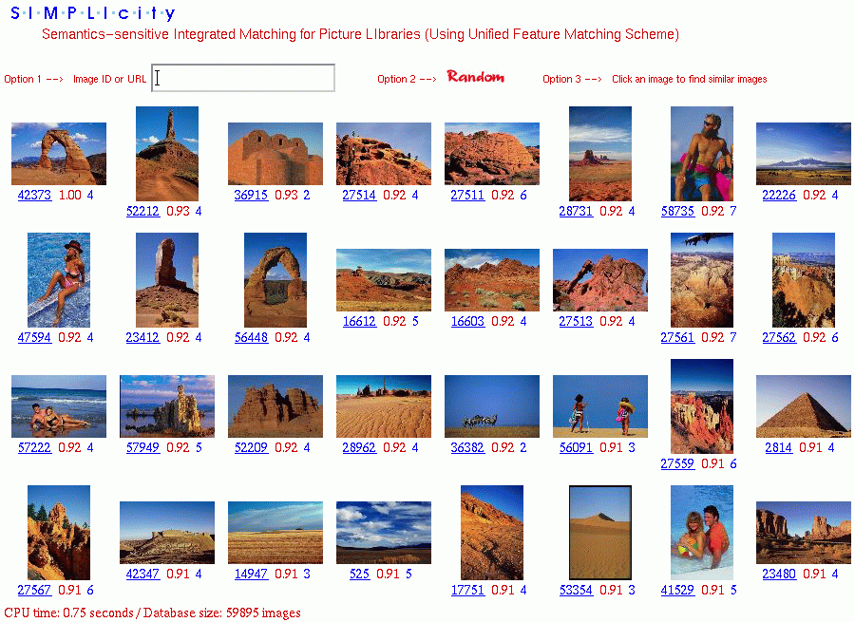
Query Results
Current SIMPLIcity System

Slide 16
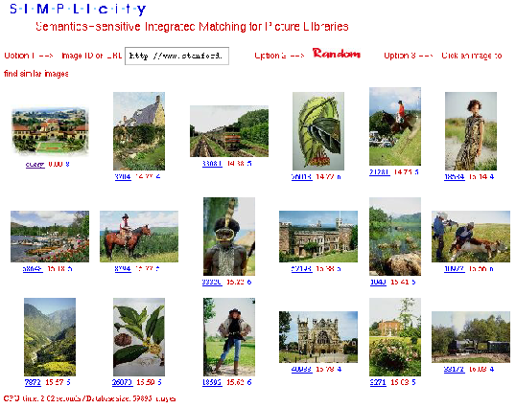
External Query

Slide 17
Robustness to Image Alterations
10% brighten on average
8% darken
Blurring with a 15x15 Gaussian filter
70% sharpen
20% more saturation
10% less saturation
Shape distortions
Cropping, shifting, rotation

Slide 18
Status of SIMPLIcity
Researchers from more than 40 institutions/government agencies requested and obtained SIMPLIcity
We applied SIMPLicity to:
  Automatic image classification
  Searching of pathological images
  Searching of art and cultural images

Slide 19
Outline
Introduction
Image retrieval: SIMPLIcity
Automatic annotation: ALIP
  A stochastic modeling approach
Conclusions and future work

Slide 20
Image Database
The image database contains categorized images.
Each category is annotated with a few words.
  Landscape, glacier
  Africa, wildlife
Each category of images is referred to as a concept.

Slide 21
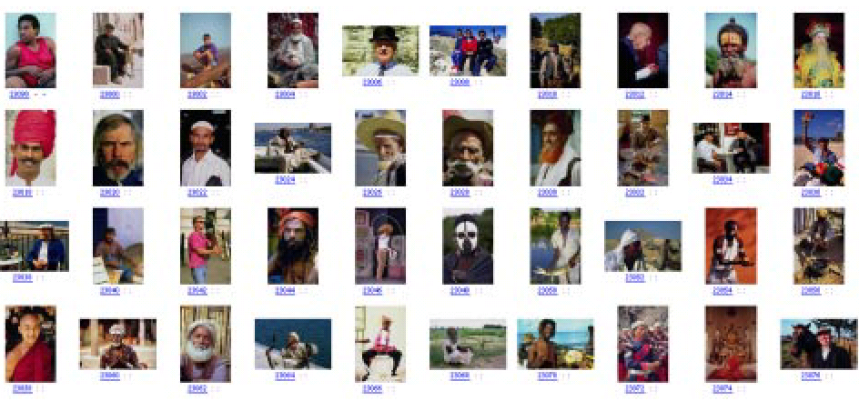
A Category of Images
Annotation: “man, male, people, cloth, face”

Slide 22
ALIP: Automatic Linguistic Indexing for Pictures
Learn relations between annotation words and images using the training database.
Profile each category by a statistical image model: 2-D Multiresolution Hidden Markov Model (2-D MHMM).
Assess the similarity between an image and a category by its likelihood under the profiling model.

Slide 23
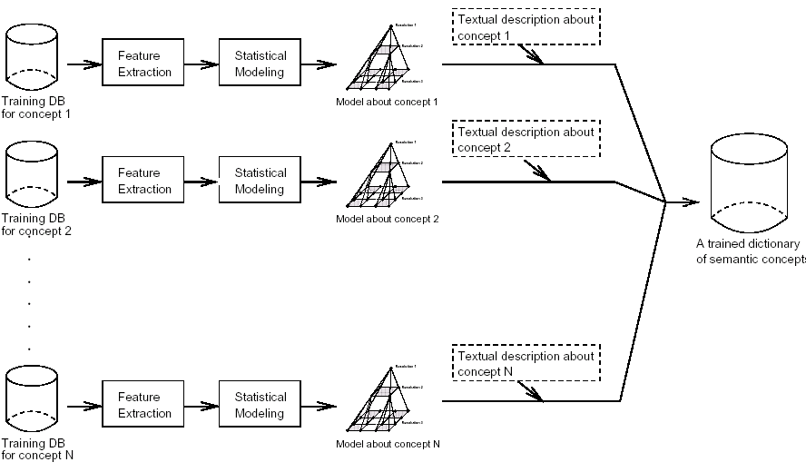
Training Process

Slide 24
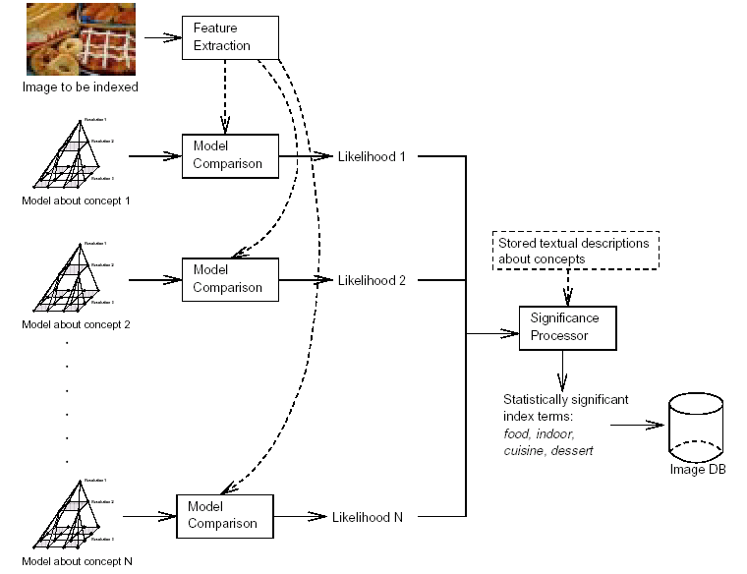
Automatic Annotation Process

Slide 25
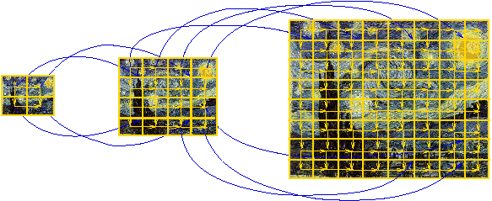
Model: 2-D MHMM
Represent images by local features extracted at multiple resolutions.
Model the feature vectors and their inter- and intra-scale dependence.
2-D MHMM finds “modes” of the feature vectors and characterizes their spatial dependence.

Slide 26
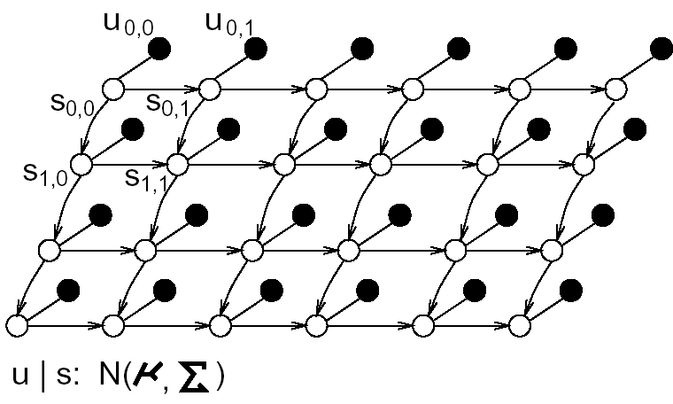
2D HMM
Regard an image as a grid. A feature vector is computed for each node.
Each node exists in a hidden state.
The states are governed by a Markov mesh (a causal Markov random field).
Given the state, the feature vector is conditionally independent of other feature vectors and follows a normal distribution.
The states are introduced to efficiently model the spatial dependence among feature vectors.
The states are not observable, which makes estimation difficult.

Slide 27
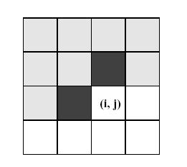
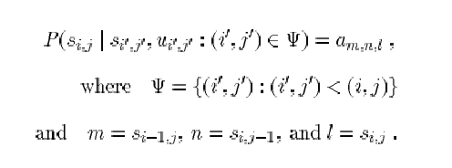
2D HMM
The underlying states are governed by a Markov mesh.
(i’,j’)<(i,j) if i’<i; or i’=i & j’<j

Slide 28
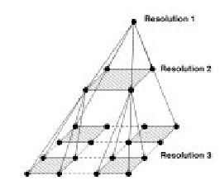
2D MHMM
An image is a pyramid grid.
A Markovian dependence is assumed across resolutions.
Given the state of a parent node, the states of its child nodes follow a Markov mesh with transition probabilities depending on the parent state.

Slide 29

2D MHMM
First-order Markov dependence across resolutions.

Slide 30

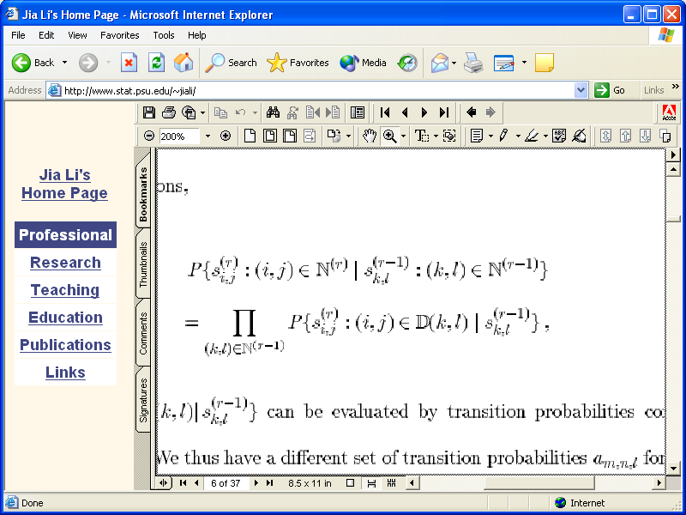
2D MHMM
  The child nodes at resolution r of node (k,l) at resolution r-1:
  Conditional independence given the parent state:

Slide 31
Annotation Process
Rank the categories by the likelihoods of an image to be annotated under their profiling 2-D MHMMs.
Select annotation words from those used to describe the top ranked categories.
Statistical significance is computed for each candidate word.
Words that are unlikely to have appeared by chance are selected.
Favor the selection of rare words.

Slide 32
Initial Experiment
600 concepts, each trained with 40 images
15 minutes Pentium CPU time per concept, train only once
highly parallelizable algorithm

Slide 33

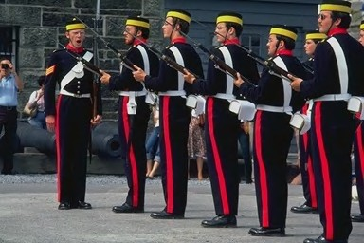
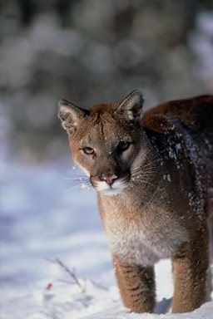
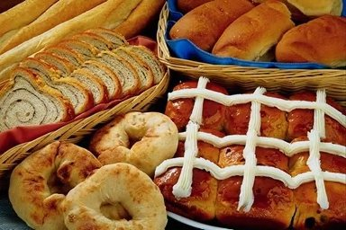
Preliminary Results
Computer Prediction: people, Europe, man-made, water
Building, sky, lake, landscape, Europe, tree
People, Europe, female
Food, indoor, cuisine, dessert
Snow, animal, wildlife, sky, cloth, ice, people

Slide 34
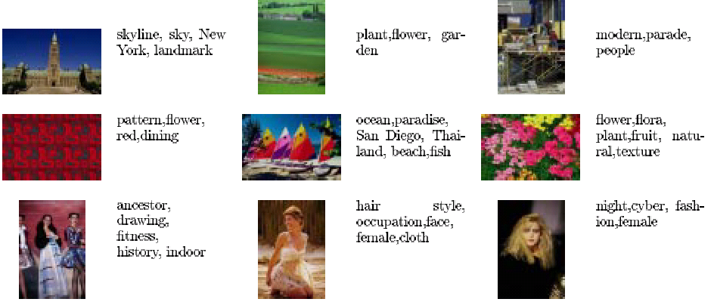
More Results

Slide 35
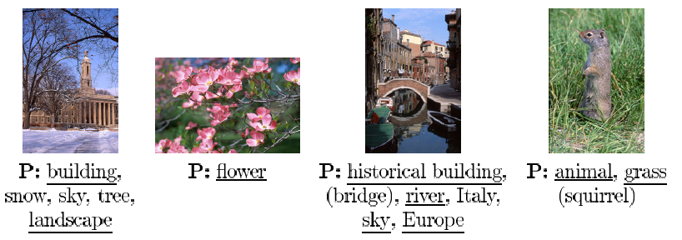
Results: using our own photographs
P: Photographer annotation
Underlined words: words predicted by computer
(Parenthesis): words not in the learned “dictionary” of the computer

Slide 36
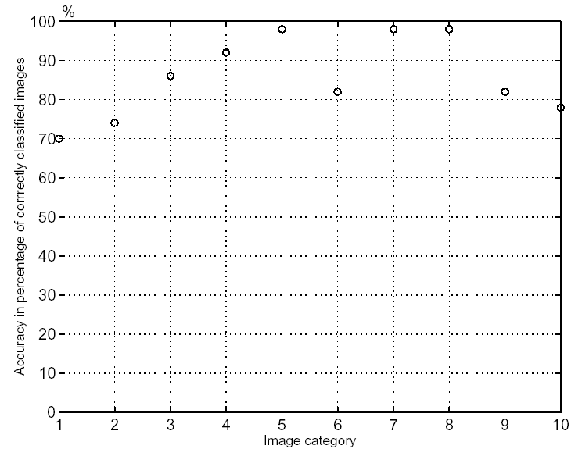
Systematic Evaluation
10 classes:
Africa,
beach,
buildings,
buses,
dinosaurs,
elephants,
flowers,
horses,
mountains,
food.

Slide 37
600-class Classification
Task: classify a given image to one of the 600 semantic classes
Gold standard: the photographer/publisher classification
This procedure provides lower-bounds of the accuracy measures because:
  There can be overlaps of semantics among classes (e.g., “Europe” vs. “France” vs. “Paris”, or, “tigers I” vs. “tigers II”)
  Training images in the same class may not be visually similar (e.g., the class of “sport events” include different sports and different shooting angles)
Result: with 11,200 test images, 15% of the time ALIP selected the exact class as the best choice
  I.e., ALIP is about 90 times more intelligent than a system with random-drawing system

Slide 38
More Information
J. Li, J. Z. Wang, ``Automatic linguistic indexing of pictures by a statistical modeling approach,''
IEEE Transactions on Pattern Analysis and Machine Intelligence,
25(9):1075-1088,2003.

Slide 39
Conclusions
SIMPLIcity system
Automatic Linguistic Indexing of Pictures
  Highly challenging
  Much more to be explored
Statistical modeling has shown some success.

Slide 40
Future Work
Explore new methods for better accuracy
  refine statistical modeling of images
  learning from 3D medical images
  refine matching schemes
Apply these methods to
  special image databases
  very large databases
Integration with large-scale information systems
……

