Slide 1
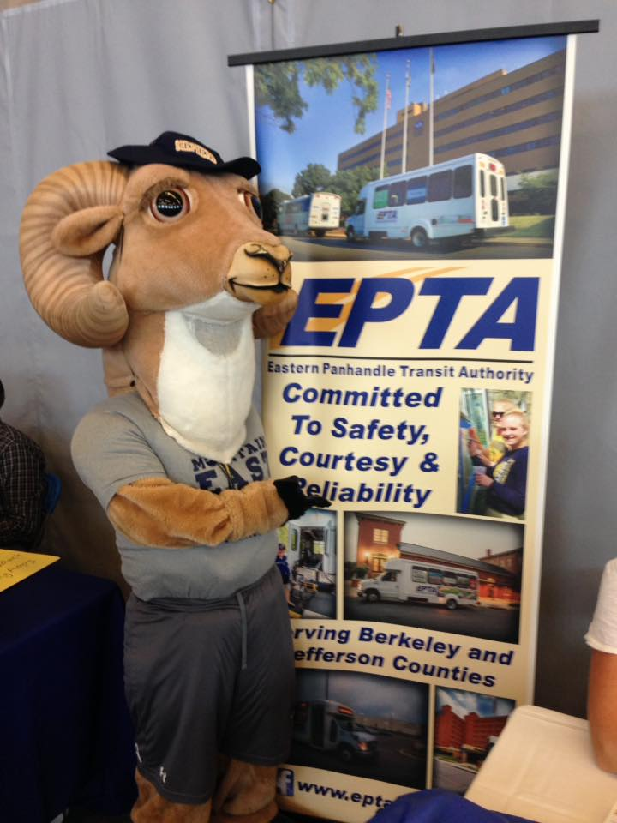
EPTA Services
The Case for Continued Funding
Shepherd University · Ram Force One & Ram Express
Ridership Data · Student Survey (n=445) · Enrollment Trends · FY2011-12 through FY2025-26

Slide 2
What We'll Cover Today
Service Overview
Enrollment & Impact
01
04
What EPTA is and who it serves
Why ridership is rising as enrollment falls
Ridership Trends
Patron Stories
02
05
14 years of data — and a record-setting FY25-26
Voices of the people who depend on EPTA
Student Voice
The Ask
03
06
445 survey respondents speak for themselves
What continued funding means for students

Slide 3
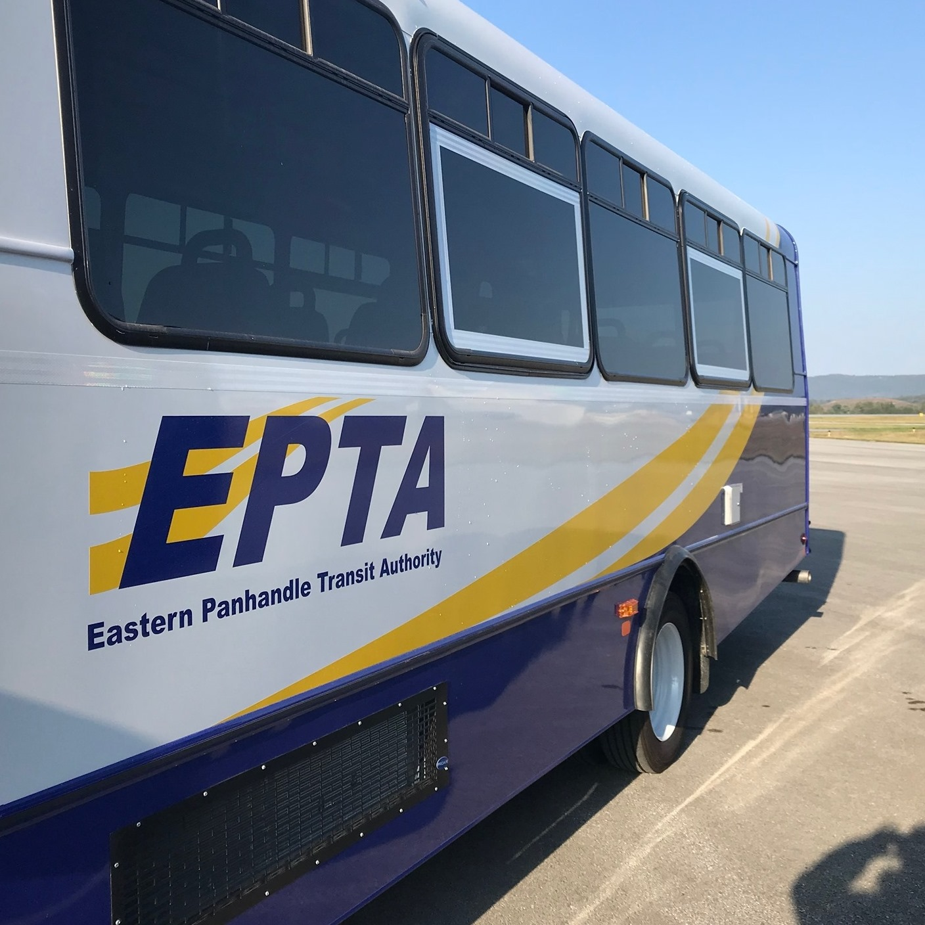
Service Overview
Two routes. Five days a week. Free to all students.

Slide 4
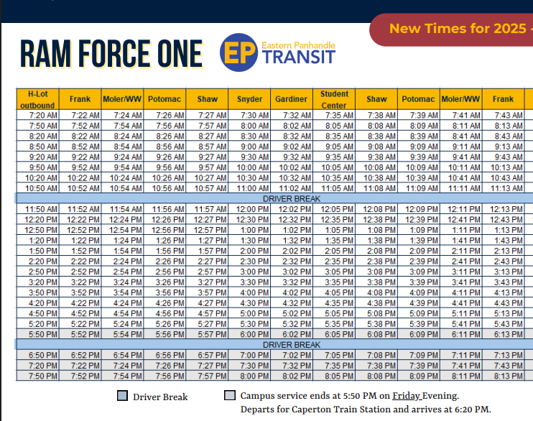
Complete Campus Coverage
Free campus transit for all Shepherd University students, Monday–Friday

Slide 5
Two Routes, One Mission
Free campus transit for all Shepherd University students, Monday–Friday
Ram Force One
Ram Express
Campus circulator
Commuter connector
🕐 Hours
7:30 AM – 9:20 PM
🕐 Hours
Departs Caperton Station Martinsburg M-F at
6:50 AM & 2:50 PM
Returns from H-Lot at 3:20 and 8:15pm M-Th and 5:15pm Fridays
📅 Days
Mon – Fri (AM & PM service)
Connects West Campus residential halls, East Campus academic buildings, H-Lot, Rams Den, and Wellness Center
Links Caperton Train Station in Martinsburg directly to campus — a vital link for commuters without cars and then cycles constantly between H-Lot and Knutti Corner

Slide 6
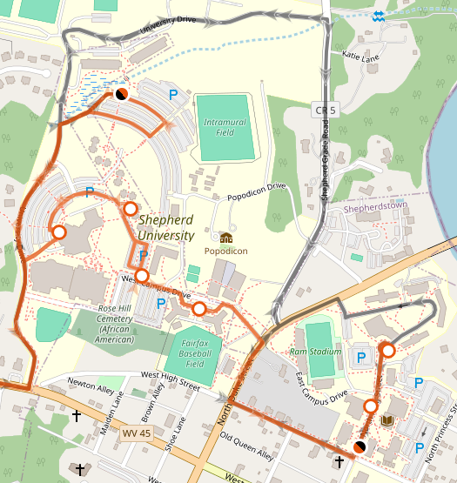
Free campus transit for all Shepherd University students, Monday–Friday
Two Routes, One Mission

Slide 7
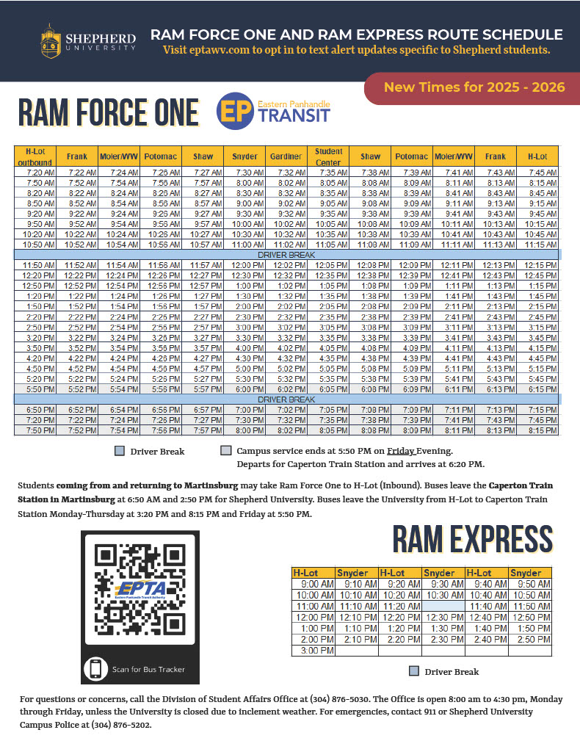
Free campus transit for all Shepherd University students, Monday–Friday
Two Routes, One Mission

Slide 8
Ridership Trends
14 years of data — and a record-setting FY2025-26.

Slide 9
Ridership Has Never Been Higher
Annual ridership, FY2011-12 through FY2025-26 (FY12-13 excluded — data anomaly)
* FY25-26 +19% above FY24-25

Slide 10
FY2025-26: A Record Year
37,173
+19%
6,501
12.1+
Riders to date
Growth vs FY24-25
February 2026
Riders per 100
Aug 2025 – May 2026
31,306 full-year prior
Highest single month ever
Students enrolled
Every month in FY25-26 exceeded the same month last year

Slide 11
Service Demand Across All Three Routes
Monthly ridership by route — FY2024-25 (Aug–Feb, full data)
Ram Force One AM carries the majority of riders — but all three routes show consistent demand throughout the semester.

Slide 12
Student Voice
445 students surveyed — Feb 17 through Mar 5, 2025.

Slide 13
Students Depend on EPTA
Student survey, n=445 · 60% residential, 39% commuter
57%
75%
93%
94%
Ride daily or more
"Extremely important"
Satisfied
Sufficient stops
Multiple times/day + daily
Q6: importance of campus bus
Q12: agree + strongly agree
Q9: routes meet their needs

Slide 14
Why Students Ride
Q3: Reasons for using EPTA (% of 360 active riders, multi-select)
56%
cite parking difficulties
as a reason to ride
18%
ride for accessibility
or disability reasons
📷 INSERT PHOTO: Student boarding

Slide 15
When Service Matters Most
Q7: Critical time slots (multi-select, n=420)
Q8: Would support a small fee to maintain service?
Note: Many students oppose a fee not because they lack support for the service, but because they already pay a $70 parking pass that doesn't work across campus.
87% rate service
extr. or very important

Slide 16
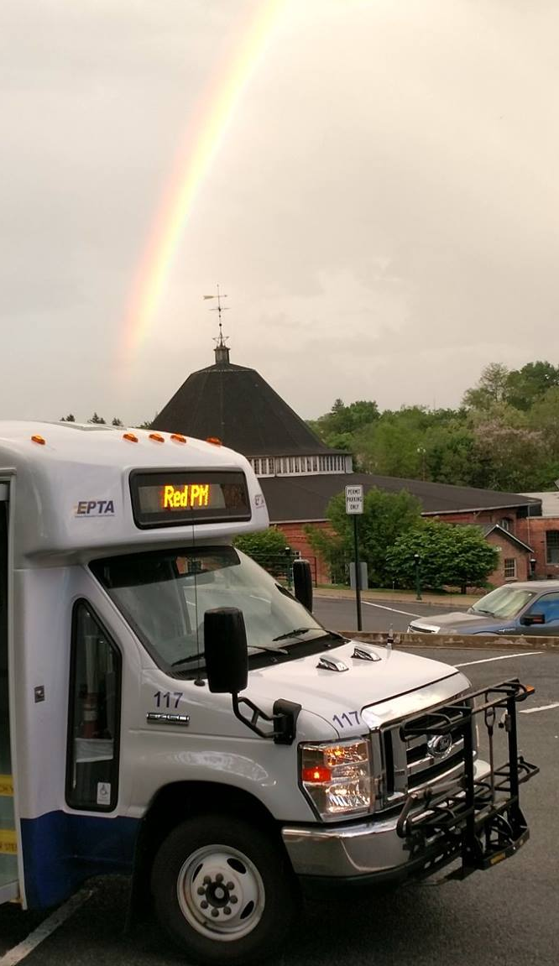
In Their Own Words
Accessibility & Disability
"If the EPTA were not available I would not be able to attend classes. I am disabled and cannot walk across campus and cannot drive so I rely on the bus as transit to classes, work, and food."
📷
INSERT PHOTO:
Student with mobility
aid using EPTA
"As a student who has POTS the EPTA makes it easier for me to get from one side to another without worry of an episode — walking is very hard and can be dangerous for my condition."
"The elimination of the EPTA services would be discriminatory to those with disabilities who cannot easily transport themselves across campus."
178 students left written comments · 47 volunteered for a focus group

Slide 17
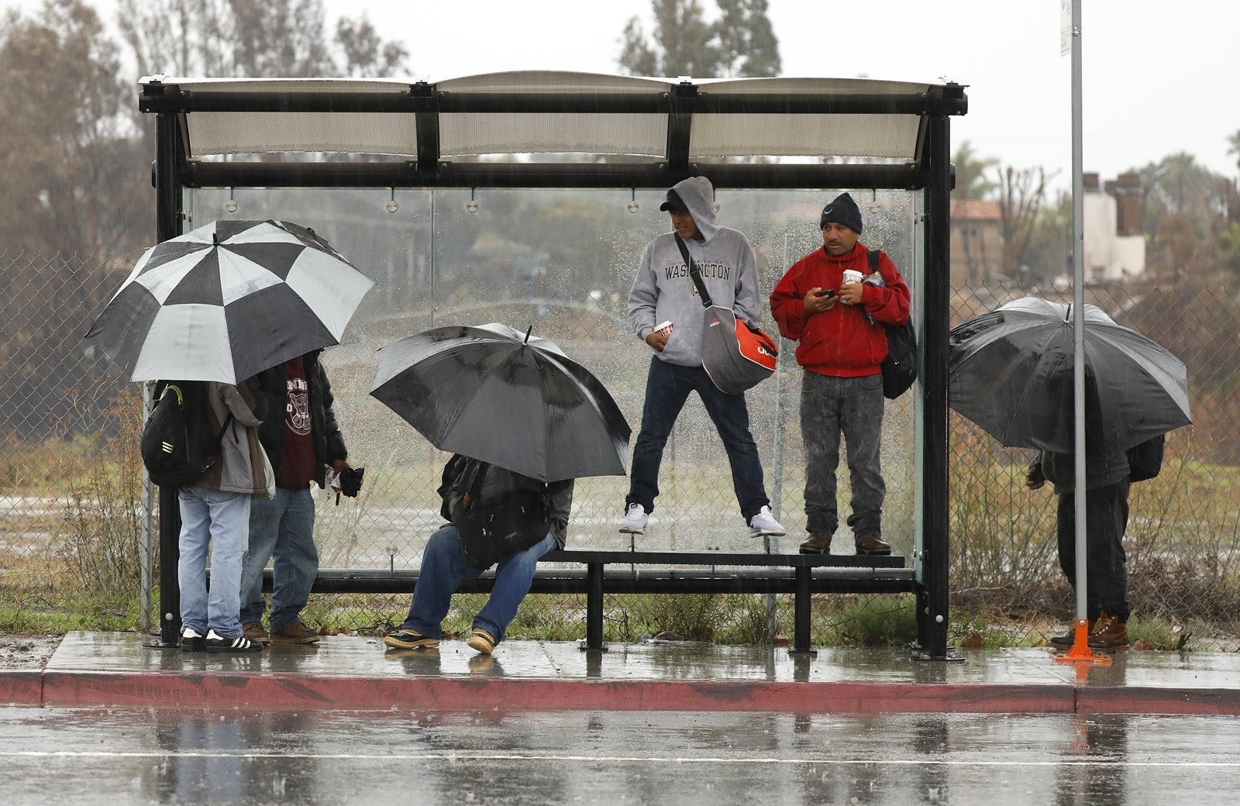

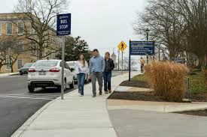
In Their Own Words
Safety & Weather
"Disabled and injured students are owed transportation across campus. As a woman who takes classes that end at 7pm and 9pm, I do not feel safe walking back to my campus apartment alone in the dark."
📷
INSERT PHOTO:
Bus in winter /
students in cold weather
"Walking to class in freezing temperatures at 8am is really hard… sometimes the only reason I have the motivation to go to my earliest classes is because I know there is a bus."
"I am a commuter who had a car accident when roads were icy on the way to campus. The EPTA shuttle has allowed me to continue to attend Shepherd despite losing my car."

Slide 18
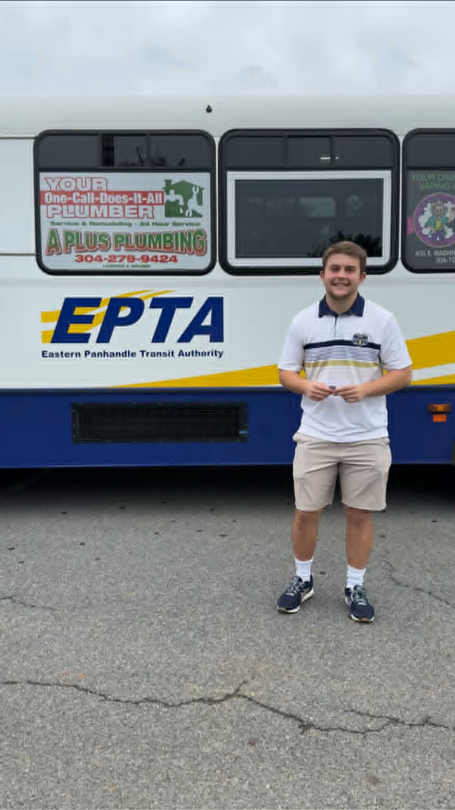
In Their Own Words
Parking & Residential Access
"As a residential student, we have nowhere to park. When it's really cold or there's a time crunch, I need the bus to get across campus from West Woods."
📷
INSERT PHOTO:
H-Lot / parking area
or residential halls
"EPTA is one of my favorite things about SU. It makes navigating campus so much easier for students, especially the not insignificant number with disabilities, and is a crucial part of Shepherd's parking strategy."
"Every student is furious about reductions/cuts to EPTA and feels it's punitive. If programs and services continue to be cut, enrollment will keep declining as SU becomes less attractive and competitive."

Slide 19
Enrollment & Impact
Ridership growing as enrollment falls — a vital safety net.

Slide 20
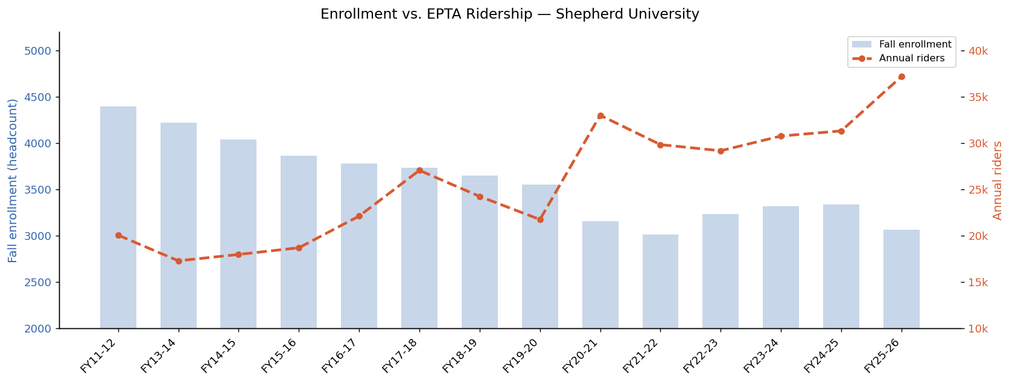
Increasing Ridership meets decreasing enrollment

Slide 21
More Essential Per Student Than Ever
Fall enrollment has fallen 30% since 2011 — yet ridership has grown. Students rely on EPTA more, not less.
-30%
+163%
3,069
Enrollment decline
Ridership per student
Students enrolled
4,393 (2011) → 3,069 (2025)
4.6 (FY11) → 12.1+ (FY26)
Fall 2025 — lowest in 14 years

Slide 22
The Ask
What continued funding means for Shepherd students.

Slide 23
What Continued Funding Protects
Accessibility
Students with disabilities, POTS, chronic conditions, and temporary injuries depend on EPTA as their primary way to reach class, dining, and work.
Student Safety
The 7pm–9pm window carries 110 students who don't feel safe walking alone in the dark — especially women with late-night classes.
Parking Relief
56% of riders cite parking as a primary reason. Eliminating EPTA shifts that burden back to an already strained parking infrastructure.
Enrollment
Students explicitly link EPTA to their decision to stay at Shepherd. Cuts signal disinvestment in student services at a critical enrollment moment.
Martinsburg Link
Ram Force One connects students without cars from Martinsburg — removing it cuts off transit-dependent commuters with no alternative.

Slide 24
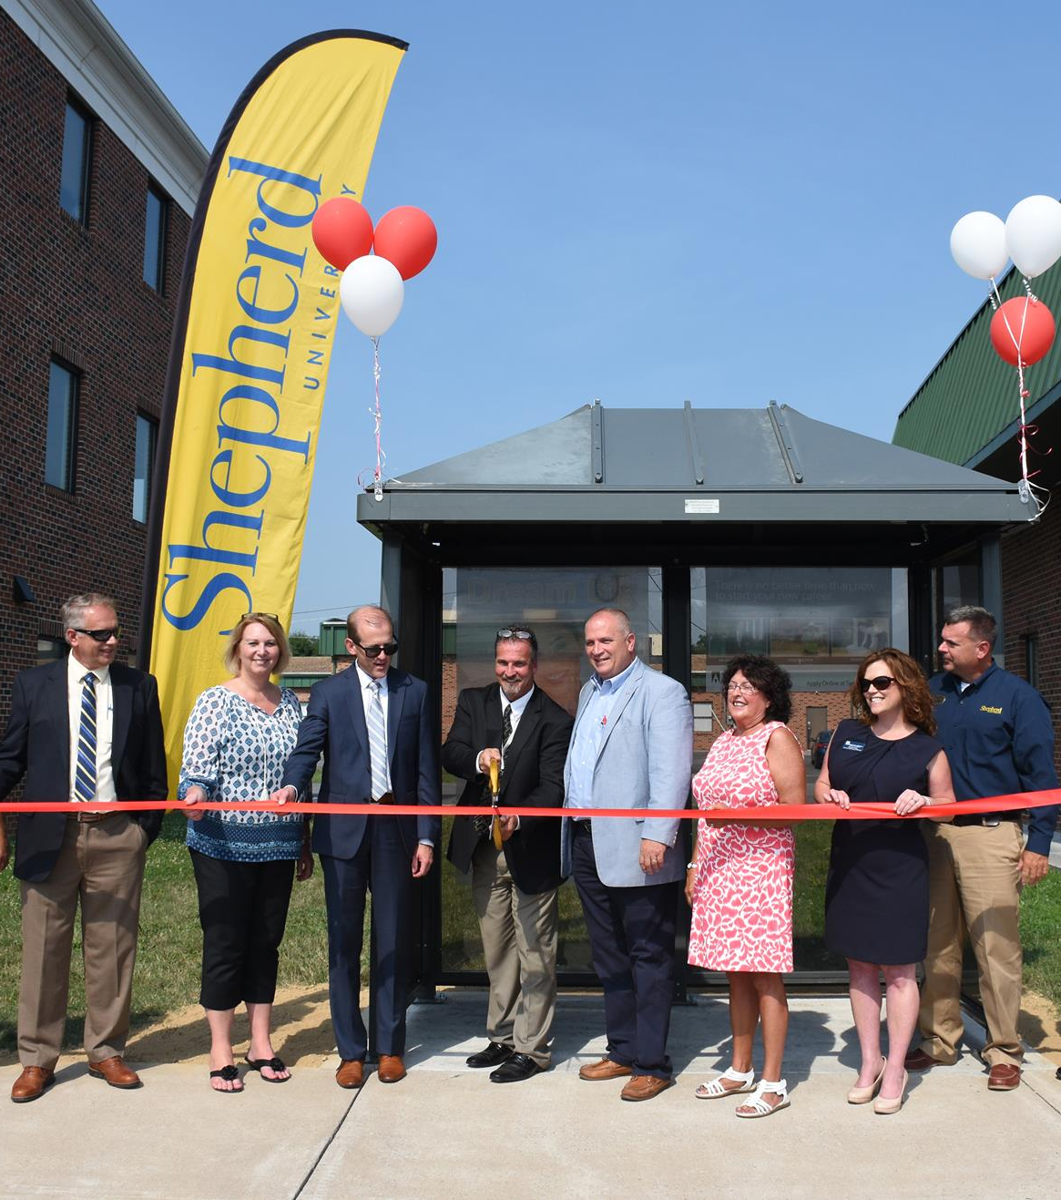
The data is clear.
The students have spoken.
EPTA is not a convenience — it's infrastructure.
37,173 riders in FY25-26 and growing
Record ridership despite falling enrollment
75% of students call it extremely important
93% report satisfaction with service
43% of students support a fee increase to maintain service
Critical for disability access, safety & parking
Questions? · EPTA Services 2025 · Shepherd University

