Slide 1
Safe Summer Stats Workshop 2020
The era of bad stuff, but also free virtual meetings.
Visit Erin Nishimura’s lab at: onishlab.colostate.edu
Writing workshop – July 16th
Science communication workshop – August 6th
This is informal! Ask questions! Discuss!
Program:
Mikaela Elder – Regression
Rob Williams – Permutation Test
Adeline Williams – Chi-square
Adeline and David King – Equivalence Testing
Ben Prytherch – Effect Size and Power Analysis

Slide 2
Equivalence testing: Statistical test for NO difference
Lakens, Daniël, et al. “Equivalence Testing for Psychological Research: A Tutorial.” Advances in Methods and Practices in Psychological Science, vol. 1, no. 2, 2018

Slide 3
Statistical test | Null hypothesis (H₀) | p-value | p-value < 0.05 | p-value > .05
Two-sample t-test | No difference between the means of the samples | Probability of seeing observed ∆ (or greater) if H₀ is true | Reject H₀. Support H_{a}: means are unequal. | Fail To Reject H₀
How do we test the inverse? that the means are not different?
Can’t we just use a high p-value to accept H₀? No? Why the H naught?
Hypothesis testing can only reject based on low probability of a hypothesis.
Other methods compare probabilities, i.e., p(H₁)/p(H₂) to see which is higher; Bayesian modeling, mixture models…
How do we test, and get a p-value, for two things being equal?

Slide 4
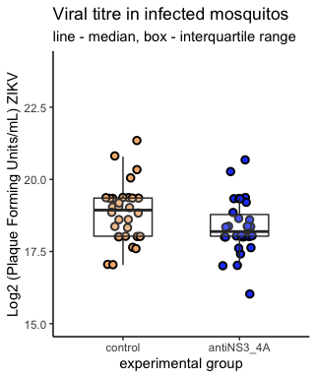
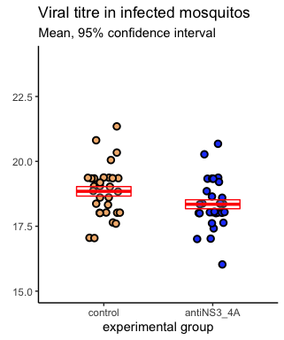
Real example: are these two samples the same?

Slide 5
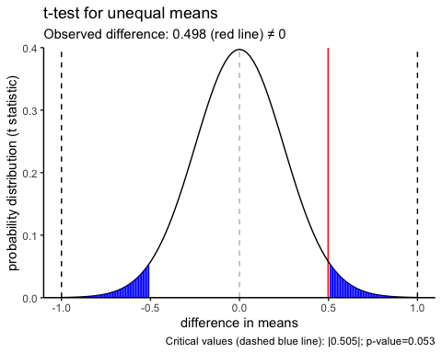
T-test (unequal means)
observed difference

Slide 6
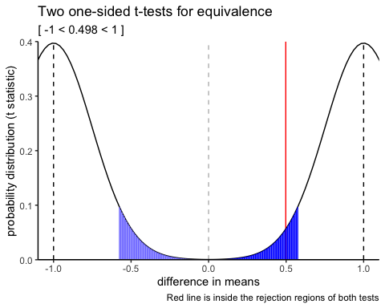
Equivalence test: Two One-Sided Tests (TOST).
observed difference
*Caveat: You must define an equivalence range. We’re using ±1

Slide 7
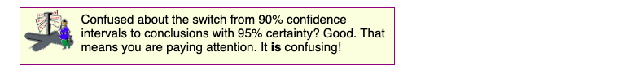
Help doc from Prism/GraphPad
TOSTER package (R) output:
confidence intervals
90% c.i. within [-1,1]; TOST passes.
95% c.i. includes 0; test fails.
observed
Two one-sided t-test distributions
Original two-sided t-test against 0: distribution
observed

Slide 8
## TOST results: ## t-value lower bound: 5.94 p-value lower bound: 0.00000009 ## t-value upper bound: -1.99 p-value upper bound: 0.026 ## degrees of freedom : 57.8 ## ## Equivalence bounds (raw scores): ## low eqbound: -1 ## high eqbound: 1 ## ## TOST confidence interval: ## lower bound 90% CI: 0.076 ## upper bound 90% CI: 0.919 ## ## NHST confidence interval: ## lower bound 95% CI: -0.007 ## upper bound 95% CI: 1.002 ## ## Equivalence Test Result: ## The equivalence test was significant, t(57.8) = -1.992, p = 0.0255, given equivalence bounds of -1.000 and 1.000 (on a raw scale) and an alpha of 0.05.
##
## Null Hypothesis Test Result: ## The null hypothesis test was non-significant, t(57.8) = 1.975, p = 0.053, given an alpha of 0.05.
##
## Based on the equivalence test and the null-hypothesis test combined, we can conclude that the observed effect is statistically not different from zero and statistically equivalent to zero.

Slide 9
Statistical test | Null hypothesis (H₀) | p-value | p-value < 0.05 | p-value > .05
Two-sample t-test | No difference in means | Probability of seeing observed ∆ (or greater) if H₀ is true | Reject H₀. Support H_{a}: means are unequal. | Fail To Reject H₀ (not accept H₀₎
Two one-sided tests TOST | There is a difference in means (defined by equivalence boundaries). | Same as above. | Reject both H₀, Groups have no difference. | Fail To Reject either H_{0,} Groups are not statistically equivalent.

Slide 10
Possible outcomes
 | t-test for difference Reject null | t-test for difference Fail to Reject null
Two one-sided tests: both tests reject null | Different, but within equivalence bounds. Two groups are different (but not enough to exclude the equivalence bounds) | Equivalent. Two groups are equivalent. (and not different).
Two one-sided tests either test Fails To Reject | Different and exceeding equivalence bounds. | Inconclusive. There is not enough statistical evidence to determine difference or equivalence.

Slide 11
Choice of smallest effect size of interest (SESOI)
Tutorial (Lakëns et al., 2018) discussion.
Just-noticeable difference. Burriss et al., 2015:
Research question: Do ovulating women signal men by becoming more flush in the face?
NIH funded research?
Maybelline?
Just-noticeable difference: Change in face redness perceptable by men.
Authors’ conclusions: women do become more flush, but not enough to be discernable by the naked eye. (Maybelline cancels rouge project)
Statistical Power, no laughing matter
What effect size can we detect at alpha=.05, sample size n, power=.8?
Effect size in units of Cohen’s d.
Run TOST using effect size, rather than raw value.
We used an intuitive value, 2-fold change (1 unit in log2)

Slide 12
One more thing
TOSTER has functions for:
one-sample t-test
two-sample t-test
proportion test
correlation (r)
meta analysis
I will forever look at the 95% confidence interval as the TOST equivalence bound at alpha=.025
Predefining an equivalence bound a priori is a specific test of a hypothesis. A succinct framing of the question.

