Slide 1
Safe Summer Stats Workshop 2020
The era of bad stuff, but also free virtual meetings.
Visit Erin Nishimura’s lab at: onishlab.colostate.edu
Writing workshop – July 16th
Science communication workshop – August 6th
Show and Tell Style. Informal! Ask questions! Discuss!
Program:
Mikaela Elder – Regression
Rob Williams – Permutation Test
Adeline Williams – Chi-square
Adeline and David King – Equivalence Testing
Ben Prytherch – Effect Size and Power Analysis

Slide 2
Equivalence testing: Statistical test for NO difference
We learned how to do this in undergrad stats…. right?
Lakens, Daniël, et al. “Equivalence Testing for Psychological Research: A Tutorial.” Advances in Methods and Practices in Psychological Science, vol. 1, no. 2, 2018
(not really a tutorial)

Slide 3
Statistical test | Null hypothesis (H₀) | p-value | p-value < 0.05 | p-value > .05
Two-sample t-test | No difference between the means of the samples | Probability of seeing observed ∆ (or greater) if H₀ is true | Reject H₀. Support H_{a}: means are unequal. | Fail To Reject H₀
How do we test the inverse? that the means are not different?
Can’t we just use a high p-value to accept H₀? No? Why the H naught?
What if p(H_{a}) is also high? We’re only describing p(H₀)
Other methods compare probabilities, i.e., p(H₁)/p(H₂) to see which is higher; Bayesian modeling, mixture models…
How do we test, and get a p-value, for two things being equal?
Example from Adeline’s data.

Slide 4
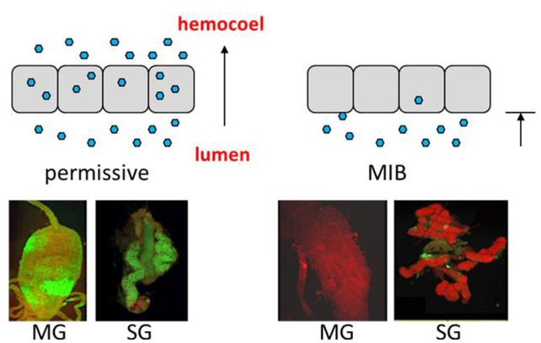
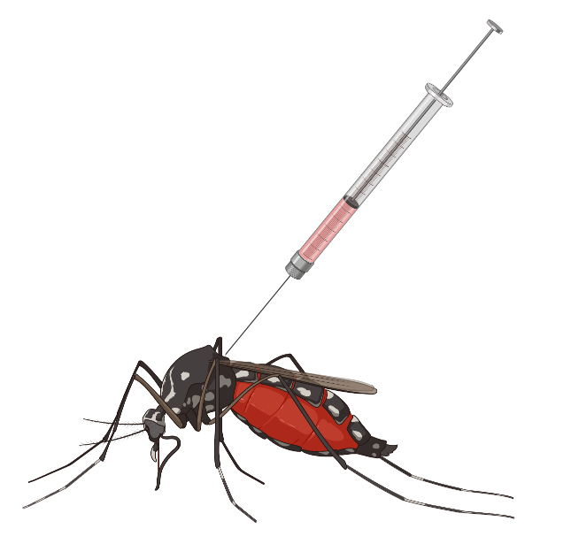
Anti-NS3/4A are resistant to ZIKV due to midgut infection barrier (MIB)
Franz et al., 2015
Notes:
Stars indicate prevalences (chi square)
Those with disseminated infection have lower titer

Slide 5
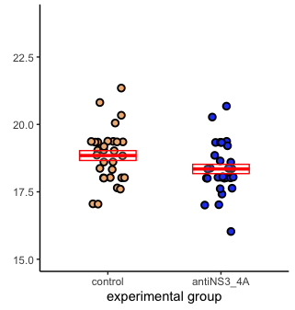
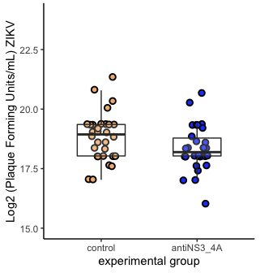
Zooming in on the data: is there a difference between antiNS3/4A and the control?
Viral titre in infected mosquitos
Mean, 95% confidence intervals
Same data: median, interquartile range. (Whiskers are 1.5*IQR)

Slide 6
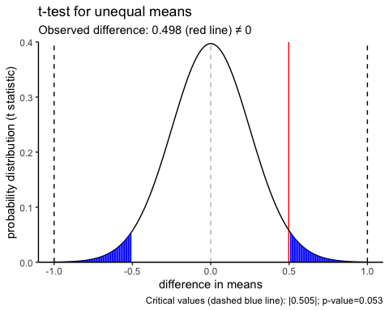
T-test (unequal means)
observed difference

Slide 7
Define an equivalence boundary
Question: When you present this to your peers, how far apart do they need to be before you say they are different?
Answer: A 2-fold difference
Equivalence bounds: ±1 in log2 space.
We’ll discuss different choices for this at the end.

Slide 8
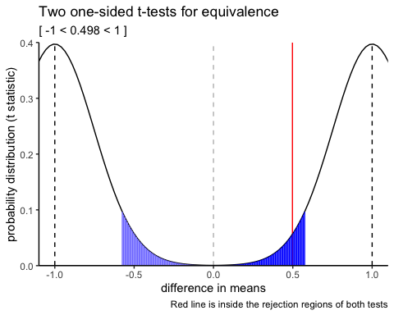
Equivalence test: Two One-Sided Tests (TOST).
observed difference

Slide 9
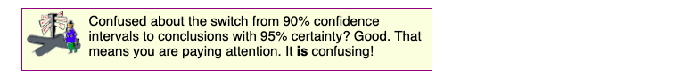
Help doc from Prism/GraphPad
TOSTER package (R) output:
confidence intervals
90% c.i. within [-1,1]; TOST passes.
95% c.i. includes 0; test fails.
observed
Two one-sided t-test distributions
Original two-sided t-test against 0: distribution
observed

Slide 10
## TOST results: ## t-value lower bound: 5.94 p-value lower bound: 0.00000009 ## t-value upper bound: -1.99 p-value upper bound: 0.026 ## degrees of freedom : 57.8 ## ## Equivalence bounds (raw scores): ## low eqbound: -1 ## high eqbound: 1 ## ## TOST confidence interval: ## lower bound 90% CI: 0.076 ## upper bound 90% CI: 0.919 ## ## NHST confidence interval: ## lower bound 95% CI: -0.007 ## upper bound 95% CI: 1.002 ## ## Equivalence Test Result: ## The equivalence test was significant, t(57.8) = -1.992, p = 0.0255, given equivalence bounds of -1.000 and 1.000 (on a raw scale) and an alpha of 0.05.
##
## Null Hypothesis Test Result: ## The null hypothesis test was non-significant, t(57.8) = 1.975, p = 0.053, given an alpha of 0.05.
##
## Based on the equivalence test and the null-hypothesis test combined, we can conclude that the observed effect is statistically not different from zero and statistically equivalent to zero.

Slide 11
Possible outcomes
t-test
 | t-test for difference Reject null | t-test for difference Fail to Reject null
Two one-sided tests: both tests reject null | Different, but within equivalence bounds. | Equivalent (what we saw).
Two one-sided tests either test Fails To Reject | Different and exceeding equivalence bounds. | Inconclusive.
TOST

Slide 12
Choice of smallest effect size of interest (SESOI)
Tutorial (Lakëns et al., 2018) discussion.
Just-noticeable difference. Burriss et al., 2015:
Research question: Do ovulating women signal men by becoming more flush in the face?
NIH funded research?
Maybelline?
Just-noticeable difference = min. ∆ in face redness perceptible by men.
Authors’ conclusions: women do become more flush, but not enough to be discernable by the naked eye. (Maybelline cancels rouge ad project)
Statistical Power, no laughing matter
What effect size can we detect at alpha=.05, sample size n, power=.8?
Effect size in units of Cohen’s d.
Run TOST using effect size, rather than raw value.
Inform your choice from prior research.
Notes:
last point. For a specific study, what effect size did they have a certain power to detect? Base it on that.

Slide 13
One more thing
I will forever look at the 95% confidence interval as the TOST equivalence boundary at α = .025
Predefining an equivalence bound a priori is a specific test of a hypothesis. A succinct framing of the question.
TOSTER has functions for:
one-sample t-test
two-sample t-test
proportion test
correlation (r)

