Slide 1
Ajax Engineering Ltd – Equity Research Report
Prepared by: Sangram Kesari Mohanty
Sector: Capital Goods / Construction Equipment

Slide 2
Investment Snapshot
Market leader in Self Loading Concrete Mixers
ROE ~25%, ROCE ~33%
Debt-free balance sheet
Infrastructure capex tailwind
Recommendation: BUY

Slide 3
Company Overview
Founded 1992
Headquartered in Bangalore
Manufactures concrete equipment
Strong dealer & service network

Slide 4
Product Portfolio
Self Loading Concrete Mixers
Concrete Batching Plants
Transit Mixers
Concrete Pumps

Slide 5
Industry Outlook
Infrastructure spending rising in India
Construction equipment demand growing
Expected industry growth ~10–12% CAGR

Slide 6
Competitive Advantage
Market leadership in SLCM segment
Strong brand and distribution
High return ratios
Low financial leverage

Slide 7
Financial Highlights
Revenue CAGR ~20%
Profit CAGR ~30%
Strong operating leverage

Slide 8
Peer Comparison
Ajax Engineering – ROE ~25%, PE ~24
Action Construction Equipment – ROE ~20%, PE ~32
BEML – ROE ~16%, PE ~40

Slide 9
Growth Drivers
Infrastructure capex
Urbanization
Road construction
Metro expansion

Slide 10
Risk Factors
Infrastructure spending slowdown
Commodity inflation
Demand cyclicality

Slide 11
Valuation View
Current PE in mid‑20s
Industry peers trading above 30 PE
Potential valuation re‑rating

Slide 12
Investment Recommendation
Rating: BUY
Entry: ₹460–₹500
Target: ₹650–₹720
Stop Loss: ₹420
Horizon: 18–24 months

Slide 13
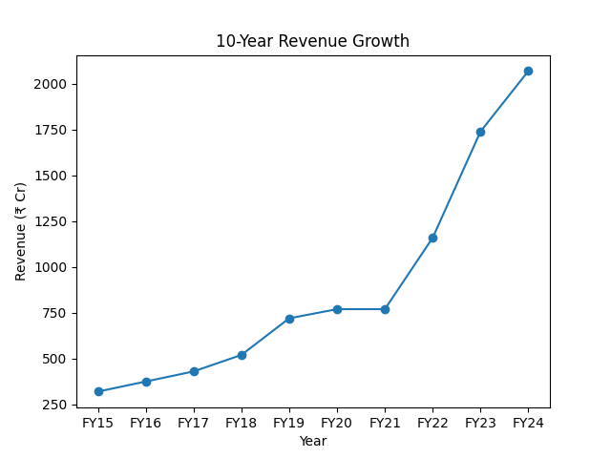
10-Year Revenue Growth

Slide 14
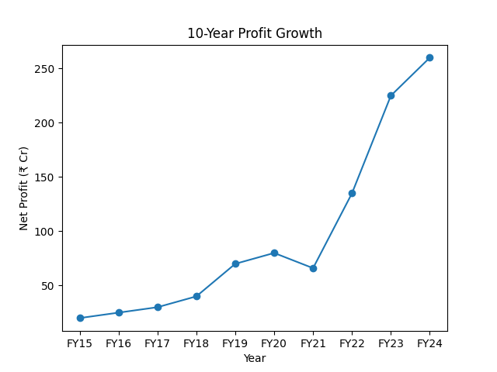
10-Year Profit Growth

Slide 15
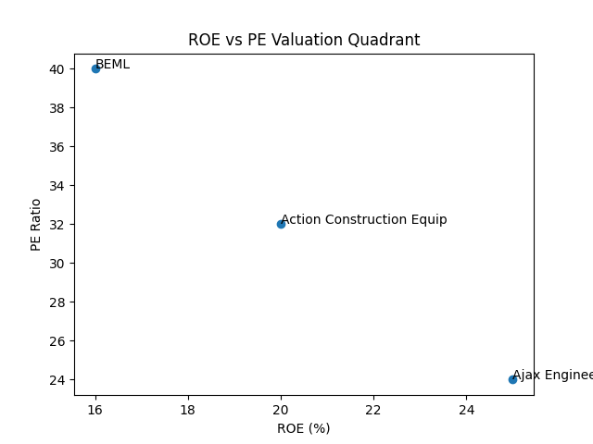
ROE vs PE Valuation Quadrant

Slide 16
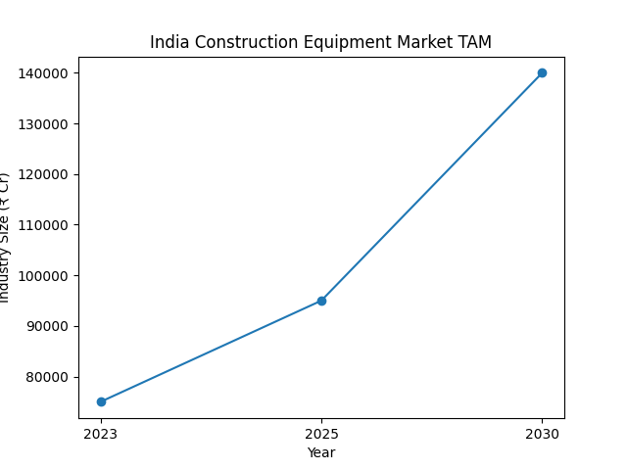
Industry TAM Growth

