Slide 1
Predicting Student Admissions
with 2 layer Neural Network
by Amir Muhammad
August 2019

Slide 2
Problem
This is an effort to predict student admissions to graduate school based on three pieces of data:
- GRE Scores (Test)
- GPA Scores (Grades)
- Class rank (1-4)

Slide 3
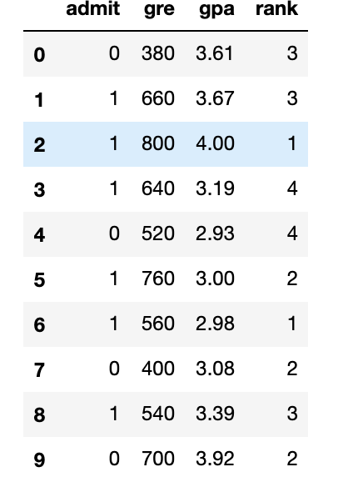
Data analysis
The dataset contains the historical data of students who applied to UCLA.
GRE Scores (Test)
GPA Scores (Grades)
Class rank (1-4)
Admitted/Rejected
The dataset originally came from here: http://www.ats.ucla.edu/

Slide 4
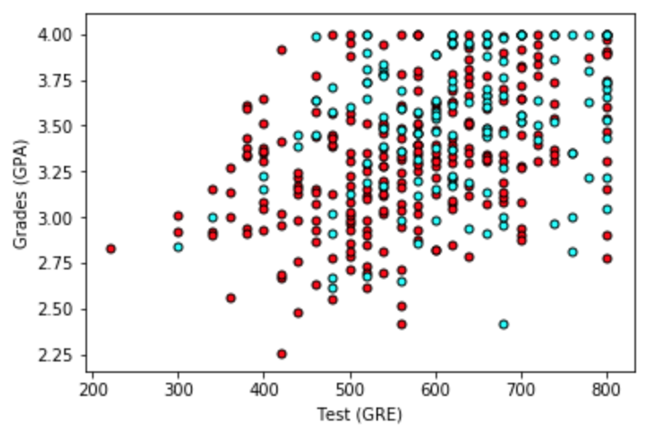
Data analysis
Plotting the data to see how it looks. In order to have a 2D plot, uses Grades and Test results.
Roughly, it looks like the students with high scores in the grades and test got admitted, while the ones with low scores didn't, but the data is not as nicely separable as we hoped it would.

Slide 5
Data analysis
As the 2D plot is not giving clear insight based on just Grades and Test scores, maybe it would help to take the rank into account?
Let's make 4 plots, each one for each rank.

Slide 6
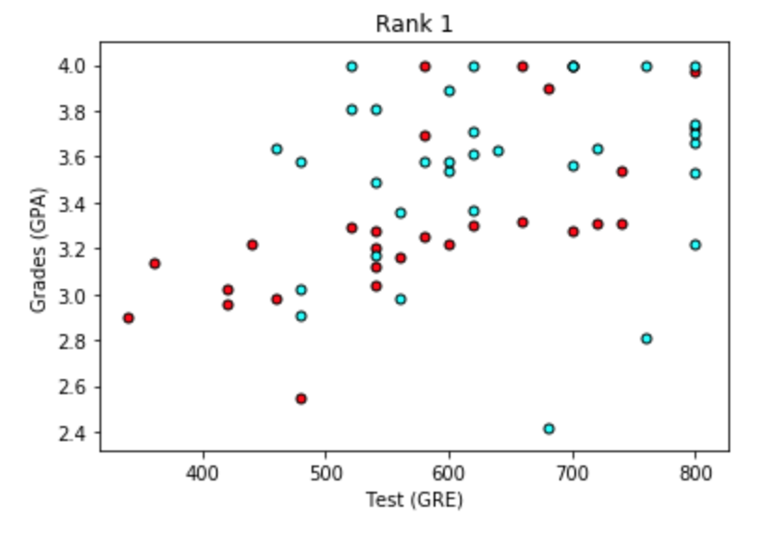
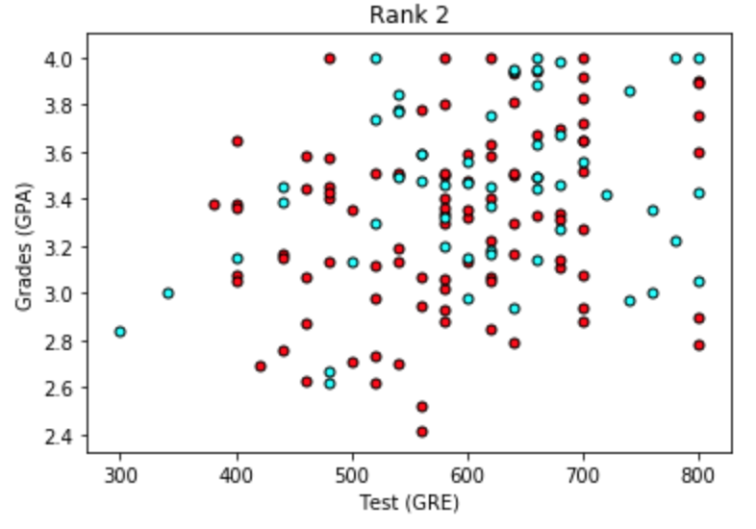
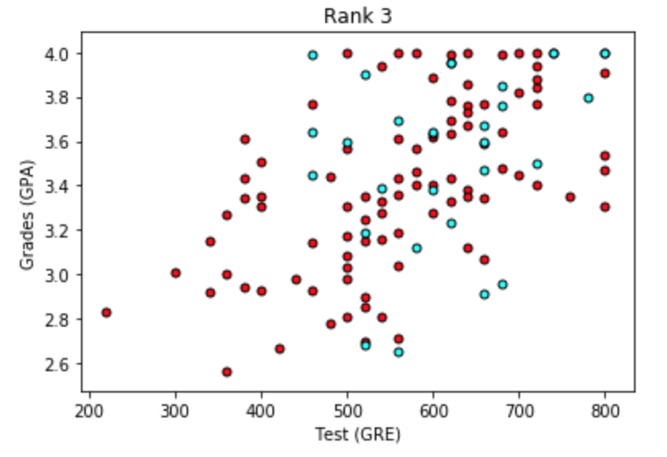
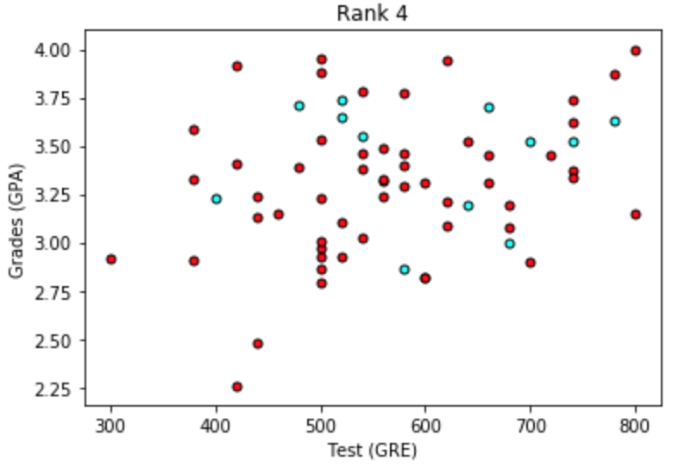

Slide 7
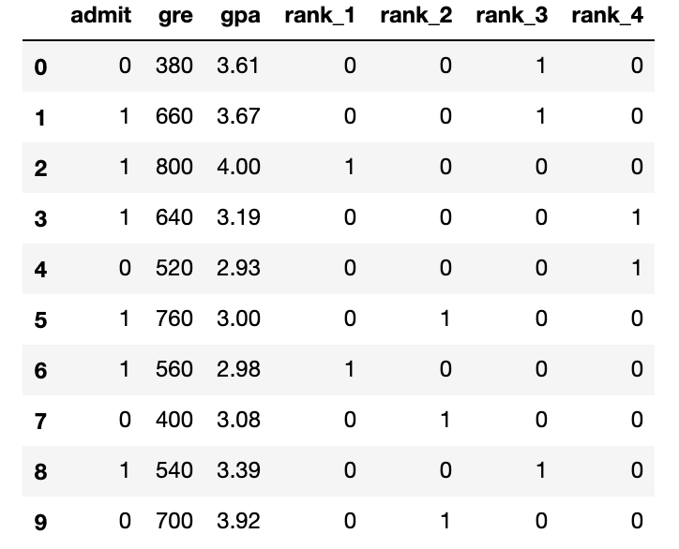
Data analysis
Taking Rank into account looks more promising. It seems that the lower the rank, the higher the acceptance rate. We use the rank as one of our inputs.
In order to do this, trying one-hot encoding using numpy 'get_dummies' function to convert the categorical variable Rank.

Slide 8
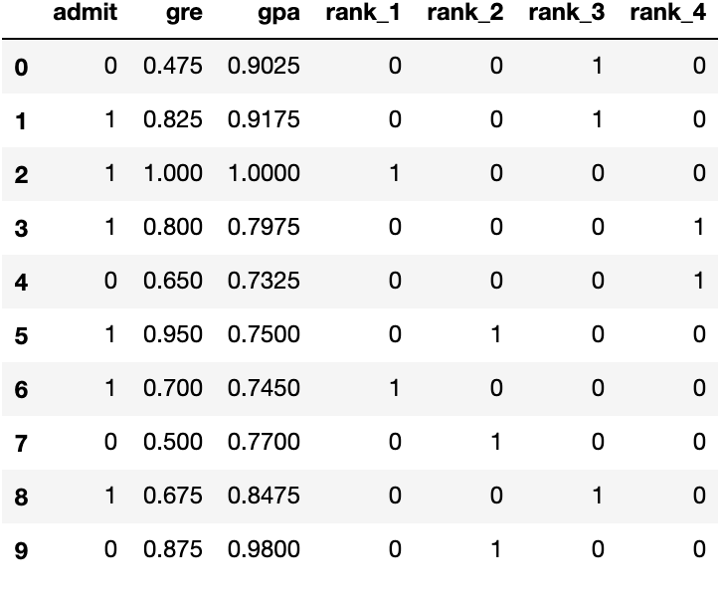
Scaling the data
The range for grades is 1.0-4.0, whereas the range for test scores is roughly 200-800, which is much larger. This means our data is skewed, and that makes it hard for a neural network to handle.
We fit our two features into a range of 0-1, by dividing the grades by 4.0, and the test score by 800.

Slide 9
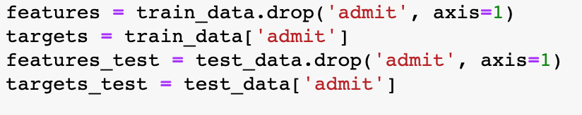
Training the model
In order to test our algorithm, we split the data into a Training and a Testing set. The size of the testing set is 10% of the total data.
Now, as a final step before the training, split the data into features (X) and targets (y).

Slide 10
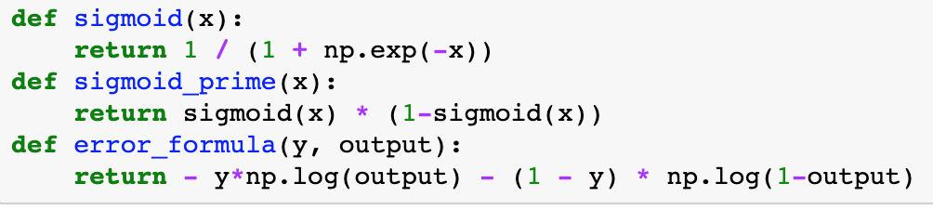
Training the model
Uses Activation (Sigmoid) function to train the 2-layer neural network.
Neural Network hyperparameters : epochs = 1000; learnrate = 0.5

Slide 11

Conclusion
Using a 2 layer Neural Network, this simple function is able to predict which candidate will be successfully admitted to UCLA with 80% accuracy rate.

