Slide 1




IT COURSE FINAL PROJECT
PRESENTATION
PREPARED BY UMEEMAH SAEED

Slide 2
ABOUT COURSE
Duration: 3 months (48 hours)
Focus: Practical IT skills for daily use and career readiness
Tools learned: Word, Excel, PowerPoint, GitHub
Networking basics: Internet, IP, troubleshooting
Logic building & problem-solving
Hands-on assignments and final project

Slide 3

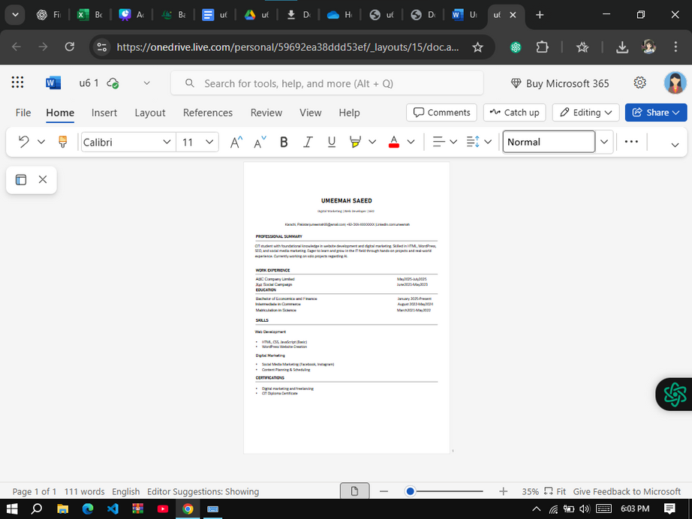
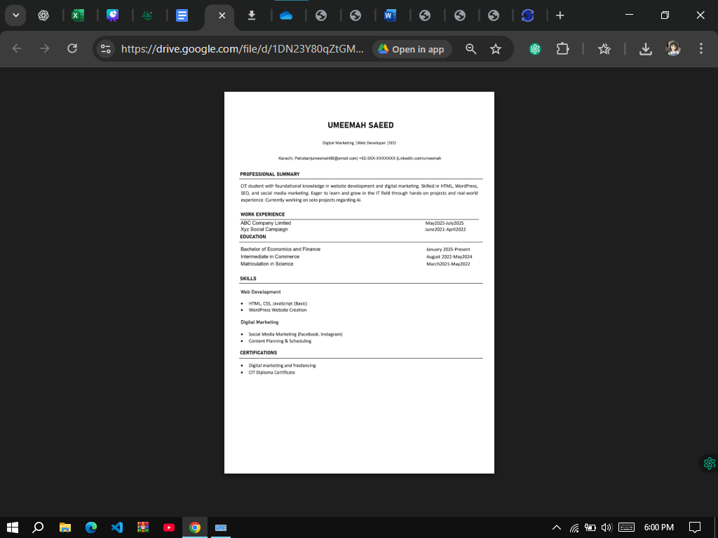

RESUME (CV)
THIS IS MY CV WHICH I CREATED USING MS WORD. I APPLIED FORMATTING LIKE HEADINGS, FONTS, ALIGNMENT, AND ADDED A PROFESSIONAL LAYOUT WITH SECTIONS FOR EDUCATION, SKILLS, AND PROJECTS.
CREATED USING MS WORD – FORMATTING, TABLES, LAYOUT

Slide 4
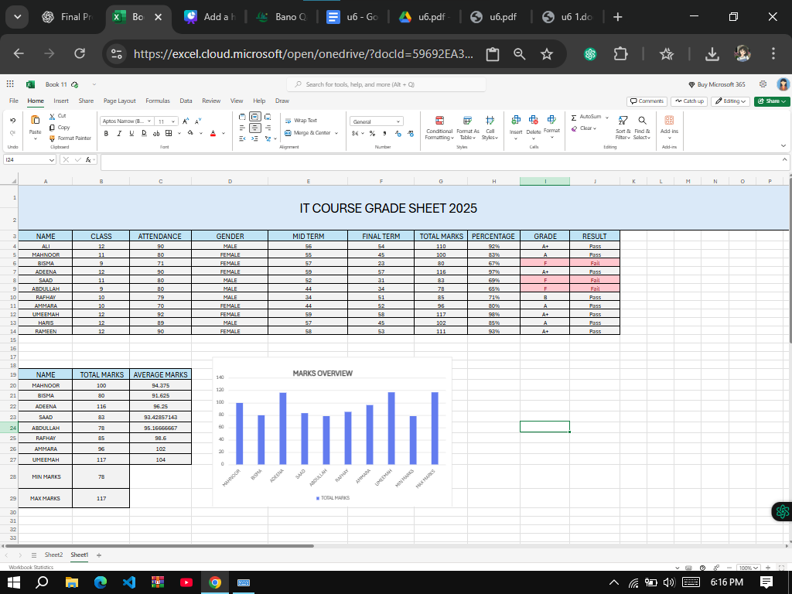


SPREADSHEET(ANALYSIS)
Here is my Grade Sheet built in Excel. I used formulas to calculate total marks and percentages. I also applied conditional formatting to highlight pass and fail students. Then, I used VLOOKUP for grades and results.
EXCEL GRADE SHEET WITH FORMULAS & FUNCTIONS

Slide 5
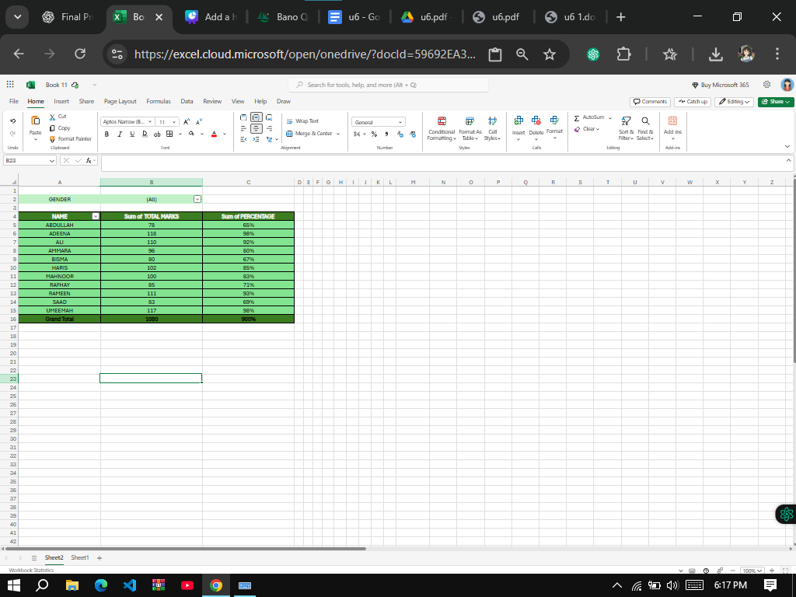


EXCEL ANALYSIS (CHARTS/PIVOT)
Pivot Table
I ALSO ANALYZED THE DATA WITH CHARTS AND PIVOT TABLES. THE BAR CHART COMPARES STUDENTS’ MARKS, AND THE PIE CHART SHOWS PASS VS FAIL. PIVOT TABLES HELPED ME QUICKLY SUMMARIZE CLASS PERFORMANCE.

Slide 6


POWERPOINT
Designed structured presentations
Used themes, transitions, animations
Added charts, images, and screenshots
Prepared portfolio presentation
PowerPoint helped me present information clearly. I learned how to design slides, use transitions and animations, and make professional presentations. This final portfolio presentation is one of my projects in PowerPoint

Slide 7


NETWORKING BASICS
Introduction to computer networks
IP addresses & subnet basics
Internet troubleshooting
Importance of networking in IT
In Networking, I learned how devices connect, how IP addresses work, and some basics of troubleshooting. It gave me a foundation to understand how the internet and communication systems function.

Slide 8
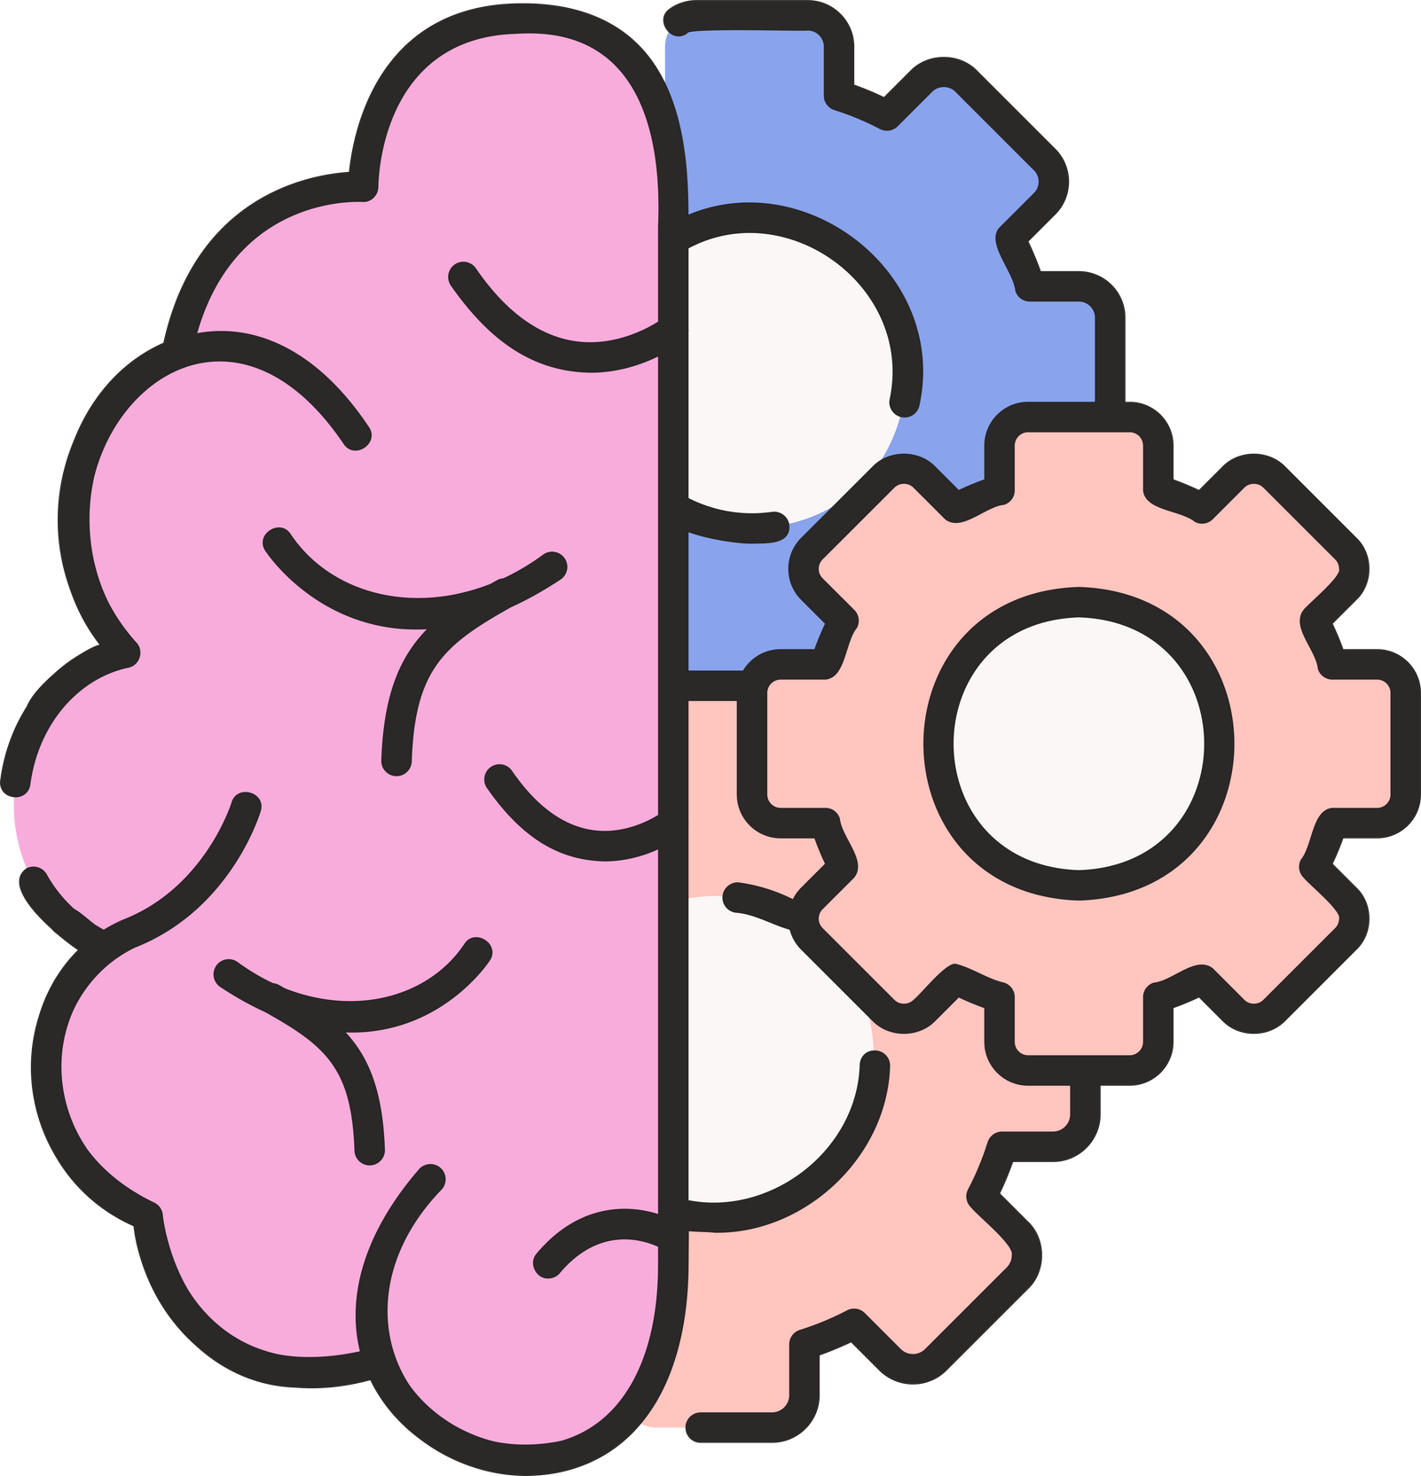
LOGIC BUILDING
Introduction to programming mindset
Practiced loops (for, while) and conditions (if-else)
Wrote simple programs (e.g., check prime number, reverse number)
Built foundation for coding and algorithms
Logic Building was about learning how to think like a programmer. Instead of just writing code, I learned how to break problems into smaller steps. For example, I practiced writing small programs to check prime numbers, reverse digits, or print sequences. We used loops and conditions to solve problems. This helped me improve my logical thinking, which is important in both coding and real-life problem-solving.

Slide 9

REFLECTION
Confidence in IT tools
Can make CVs
spreadsheets
presentations
Learned GitHub basics
Networking knowledge
THIS COURSE GAVE ME PRACTICAL IT SKILLS. NOW I FEEL CONFIDENT IN MAKING PROFESSIONAL DOCUMENTS, ANALYZING DATA IN EXCEL, AND DESIGNING CLEAR PRESENTATIONS.

Slide 10

CAREER NEXT STEPS
Learn advanced Excel
Python basics
Earn certifications
Start freelancing(CV design,Excel analysis)

Slide 11


THE END
INSTRUCTOR:
SIR ABDUL MUNIM USMANI

