Slide 1
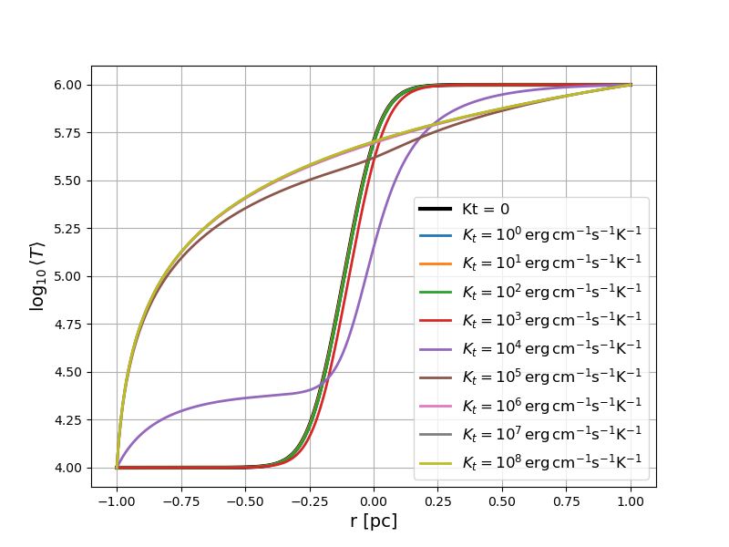
Temperature Profile

Slide 2
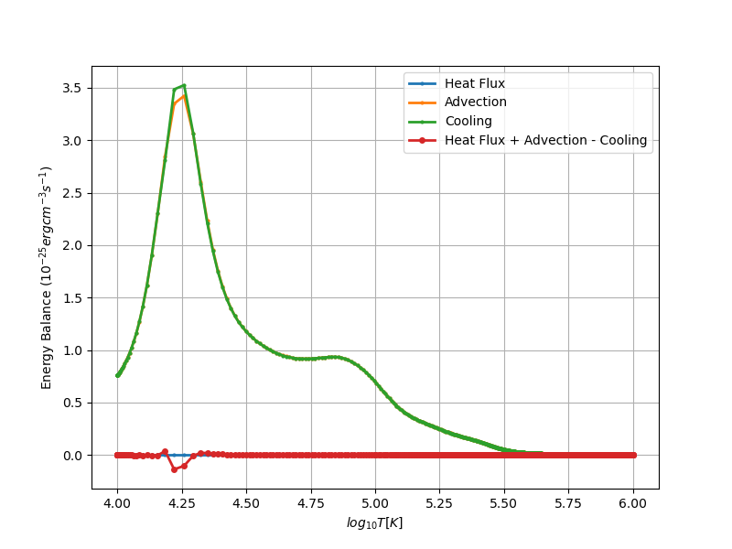
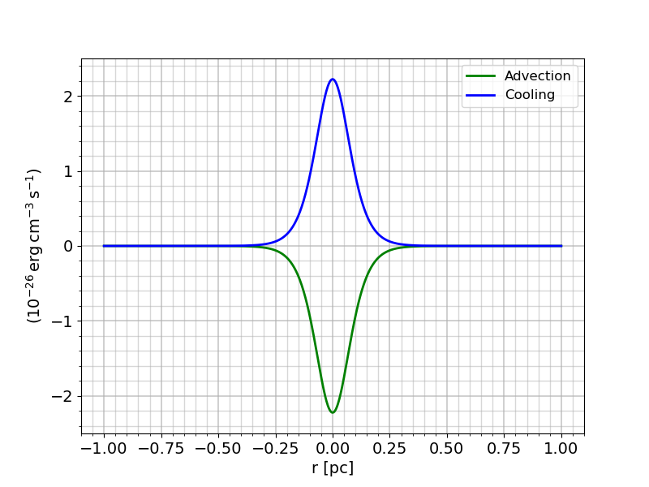
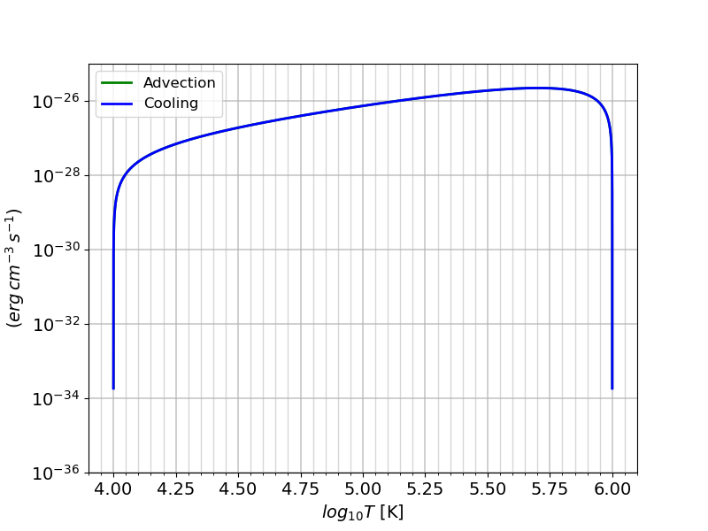
Kt = 0

Slide 3
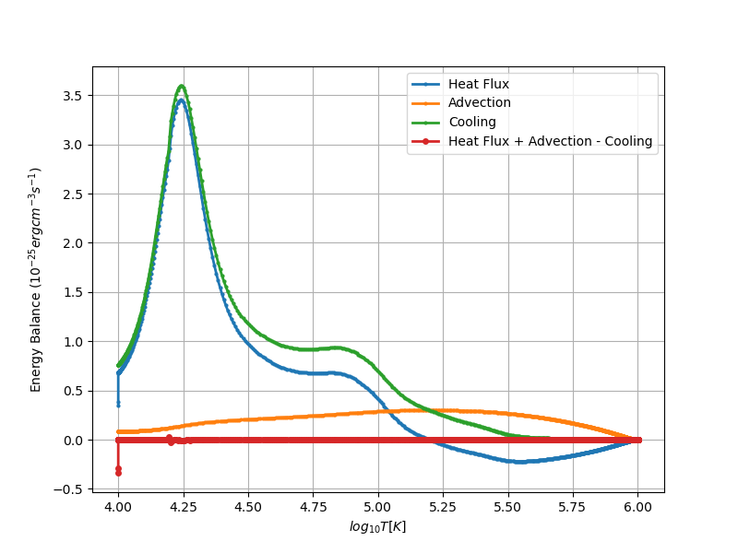
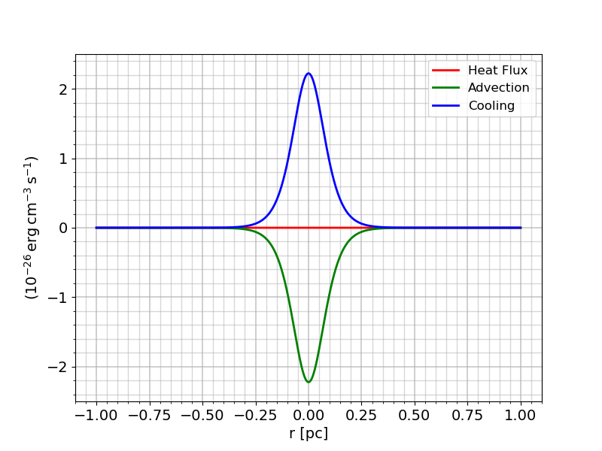
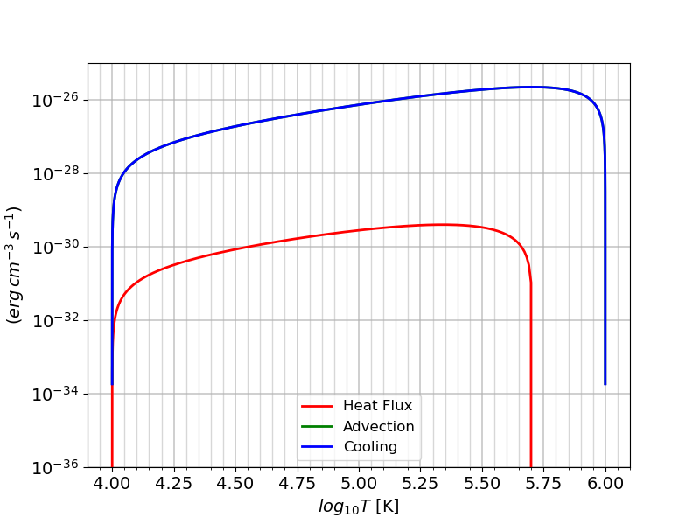
Kt = 1 erg s⁻¹cm⁻¹K⁻¹

Slide 4

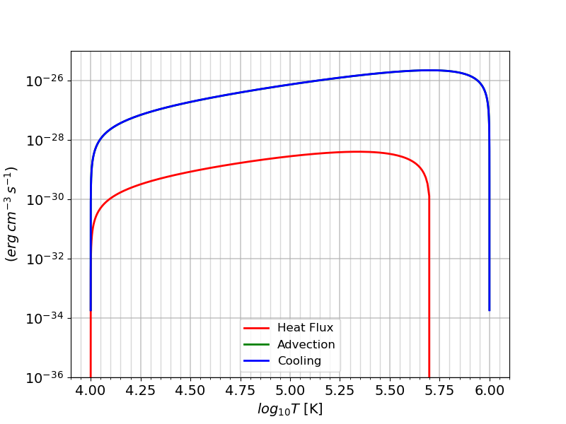
Kt = 10 erg s⁻¹cm⁻¹K⁻¹

Slide 5

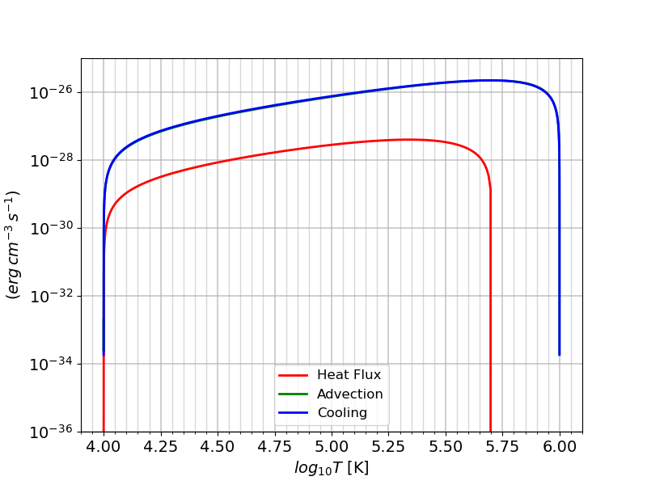
Kt = 10² erg s⁻¹cm⁻¹K⁻¹

Slide 6
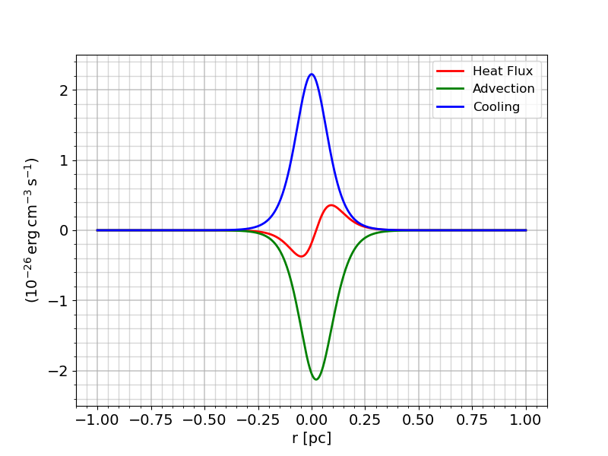
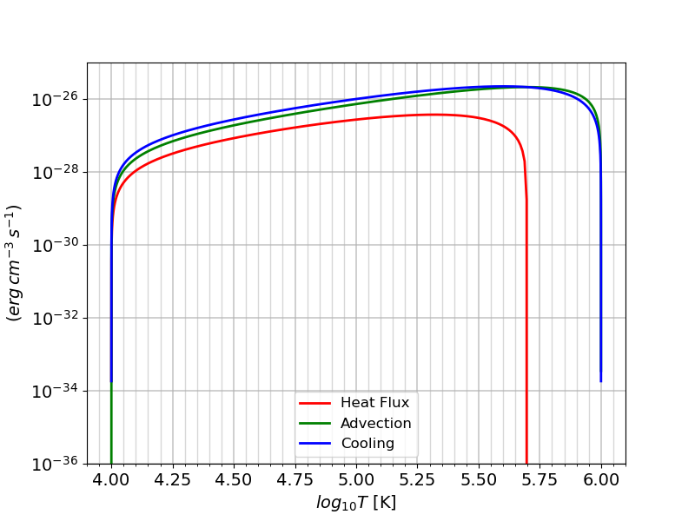
Kt = 10³ erg s⁻¹cm⁻¹K⁻¹

Slide 7
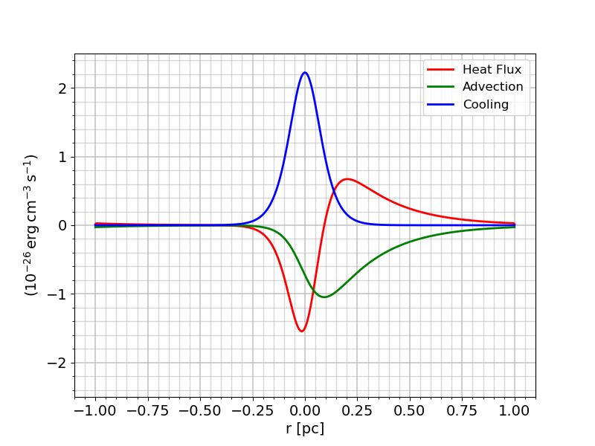
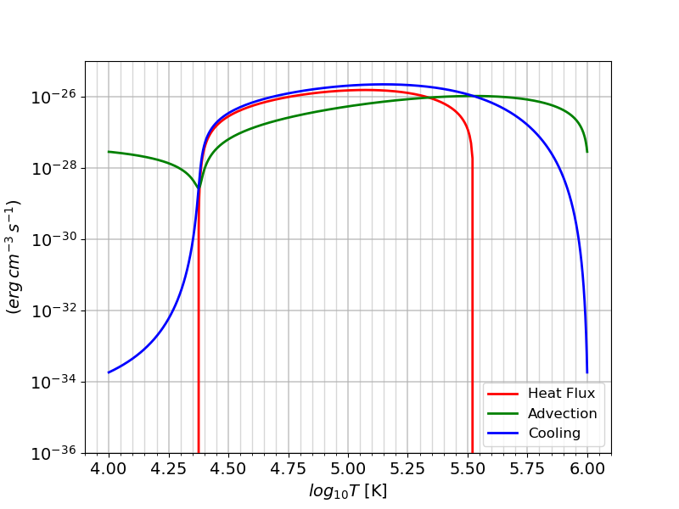
Kt = 10⁴ erg s⁻¹cm⁻¹K⁻¹

Slide 8
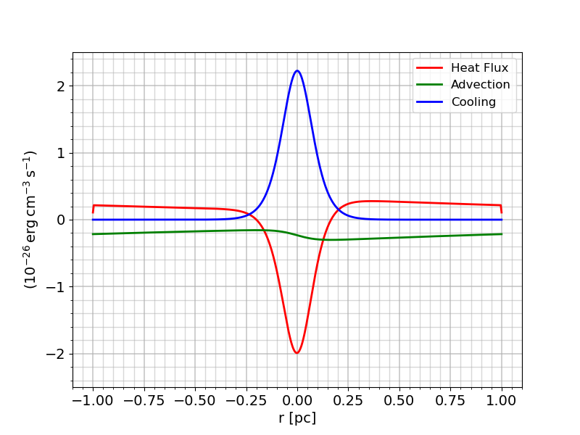
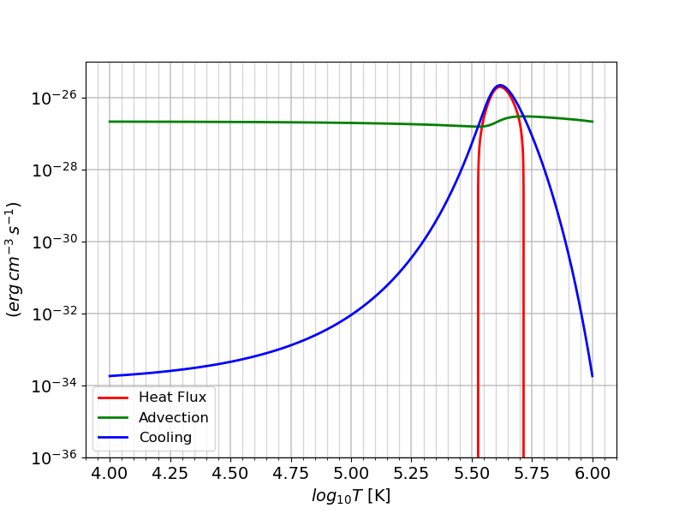
Kt = 10⁵ erg s⁻¹cm⁻¹K⁻¹

Slide 9
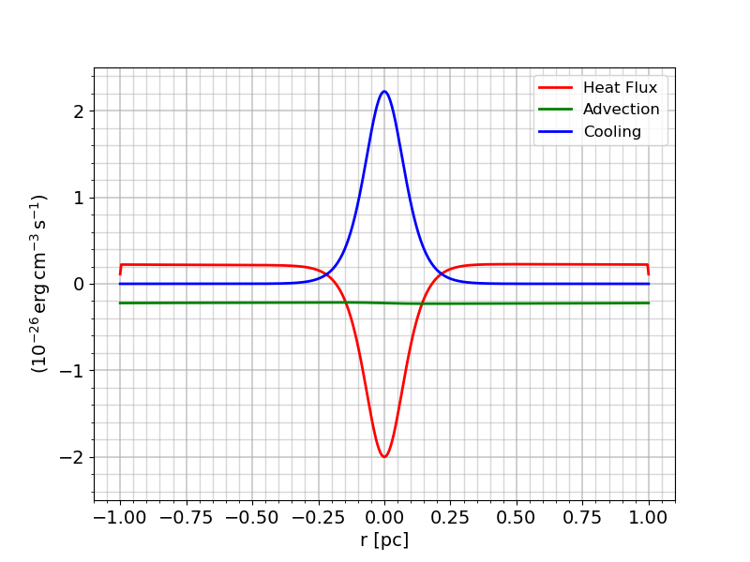
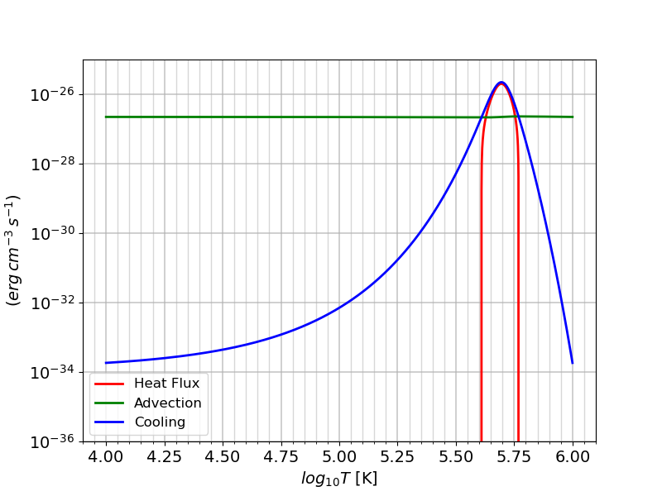
Kt = 10⁶ erg s⁻¹cm⁻¹K⁻¹

Slide 10

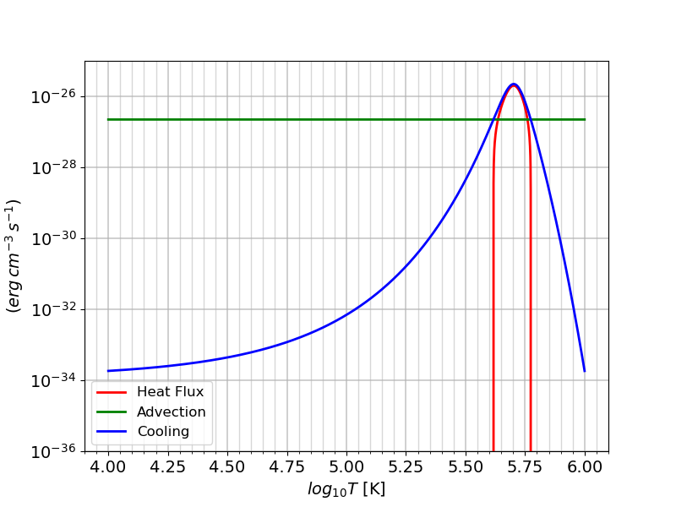
Kt = 10⁷ erg s⁻¹cm⁻¹K⁻¹

Slide 11


Kt = 10⁸ erg s⁻¹cm⁻¹K⁻¹

