Slide 1
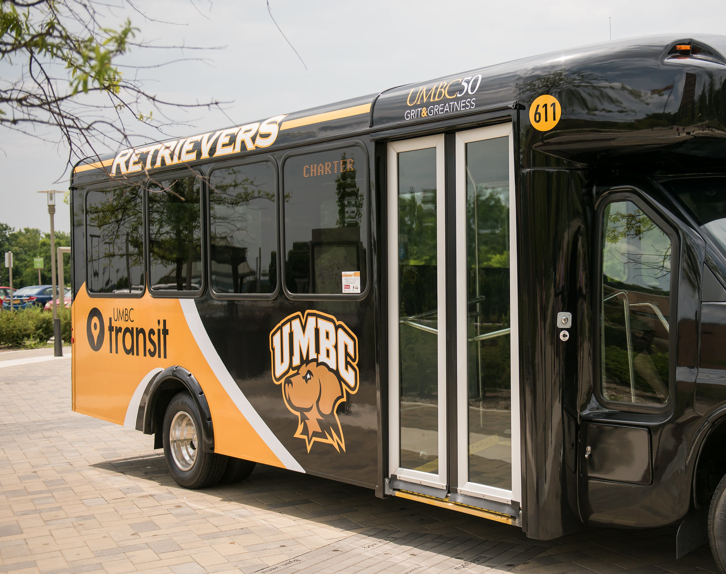
UMBC Transit Management System
Project by:
Meenakshi Desu

Slide 2

Business Situation
UMBC Transit Management System is designed for Administrational purpose and Employees who works under transit department can use its front-end application to retrieve their schedule from database.
Who Will Use It:
Bus Drivers
Administrators
Any other High officials

Slide 3
Contd.,
What Operations will be supported?
For Administrators, they can create tables, insert new list, add schedules, update insurance information and the feed back related to drivers, bus and many more.
Bus Drivers, able to view their schedules and mark them as complete.
Any high officials from UMBC, do have the access to track the database and its operations.

Slide 4
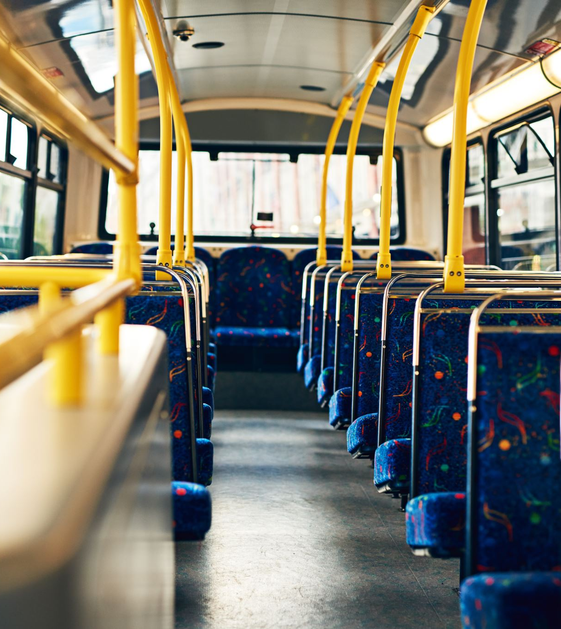
What data needs to be stored:
Bus route information, such as route number, starting/ending locations, stops, insurance and schedules
Bus schedule information, such as departure/arrival times, assigned drivers, and assigned buses
Bus information, such as bus number, capacity, model, year, and insurance
Driver/Manager information like their hiring data, feedback, number of schedules they served.

Slide 5
Assumptions
The database will be utilized only by authorized people with adequate security clearances, according to the assumptions set for this system.
In addition, the system will presume that data submitted into the system will be correctly structured and checked to guarantee consistency and correctness. It is also believed that the system would be routinely maintained and upgraded to ensure peak performance.

Slide 6
Project Schedule
Project Topic Selection: April 10th – April 12th
Project Overview/Planning: April 15th – April 20th
Design of ER Diagram – April 21st to April 25th
EER Diagram and rectification – April 27th to April 28th
Creation of tables and inserting data – April 29th to May 3rd
Working on SQL queries – May 5th to May 10th
Rechecking – May 11th to May 12th
PPT and Documentation – May 13th to May 14th

Slide 7
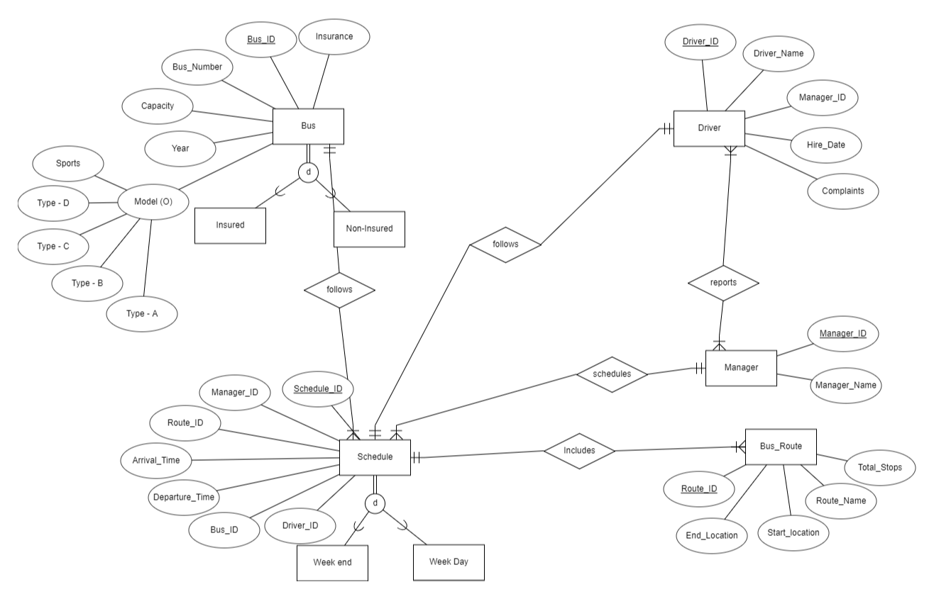
ER Diagram

Slide 8
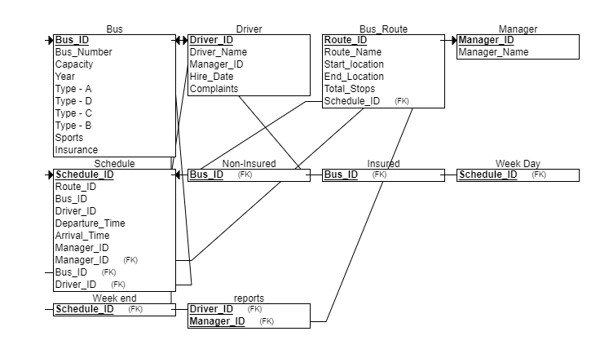
EER Diagram

Slide 9
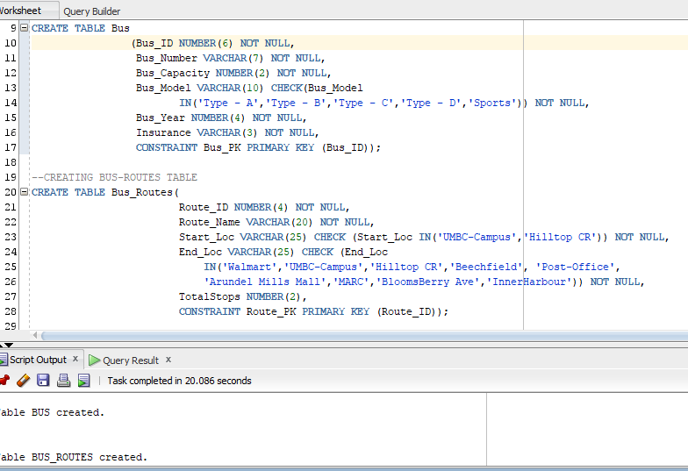
Creation of Tables: Bus, Bus Routes

Slide 10
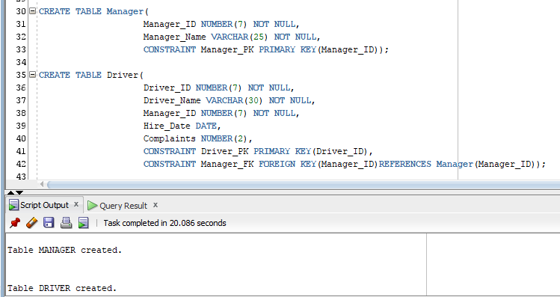
Creation of Tables: Manager, Driver

Slide 11
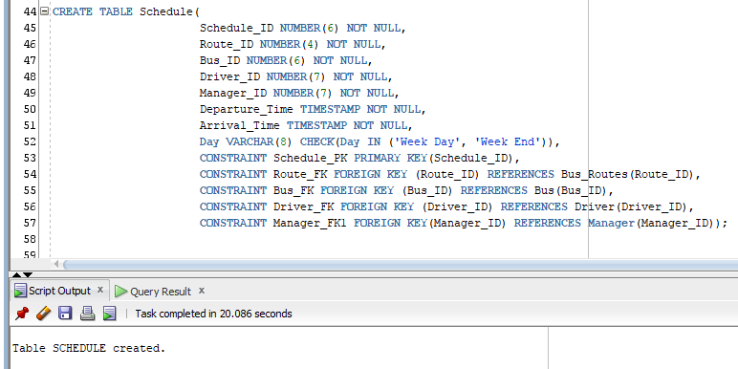
Creation of Tables: Schedule

Slide 12
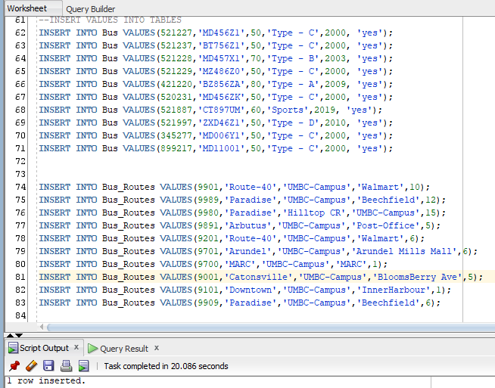
Inserting Data into Tables: Bus, Bus Routes

Slide 13
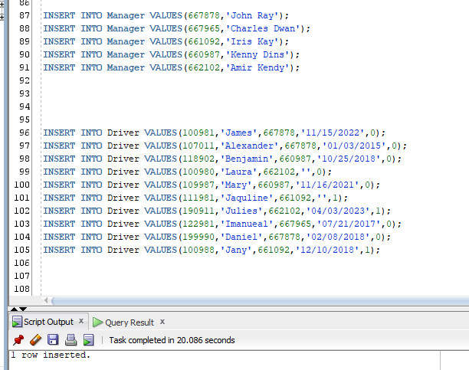
Inserting Data into Tables: Manager, Driver

Slide 14
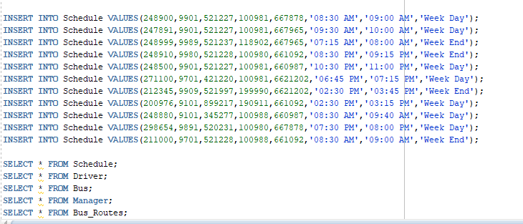
Inserting Data into Tables: Schedule

Slide 15
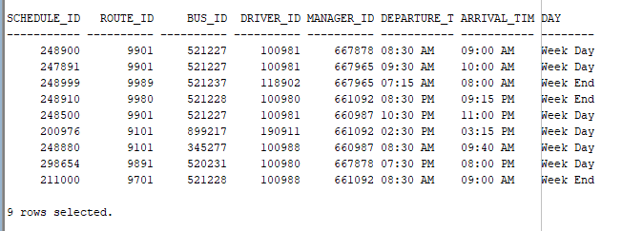
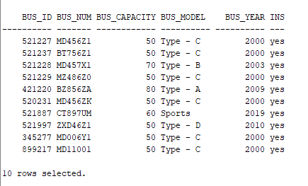
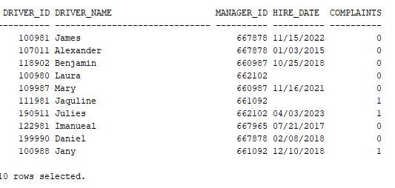
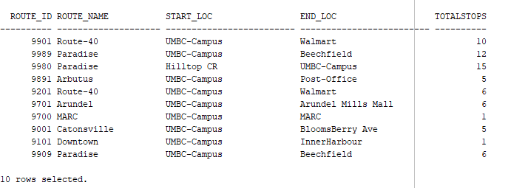
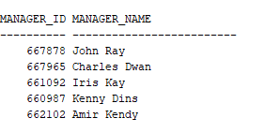

Slide 16
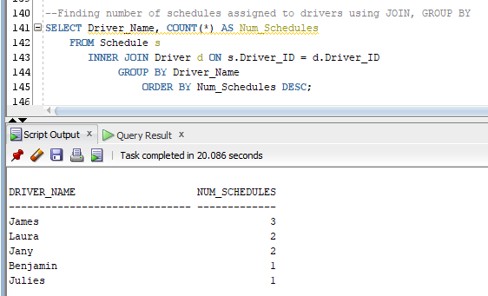
1. Finding number of schedules assigned to drivers using JOIN, GROUP BY

Slide 17
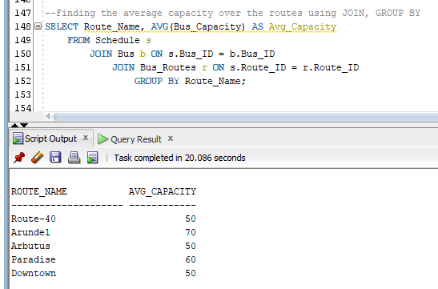
2. Finding average capacity based on route using JOIN, GROUP BY

Slide 18
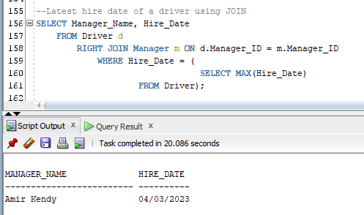
3. Finding recent hire using Right JOIN between Driver and Manager table

Slide 19
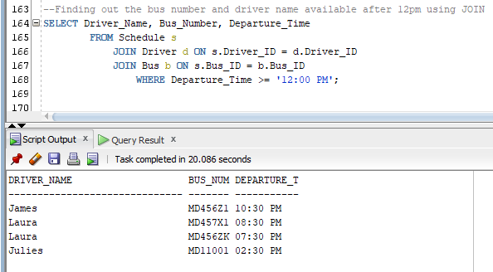
4. Finding list of bus number and driver name available after 12pm using JOIN

Slide 20
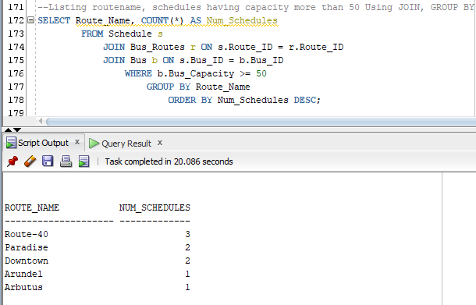
5. Finding route name and their schedule having capacity >=50 USING JOIN, GROUP BY

Slide 21
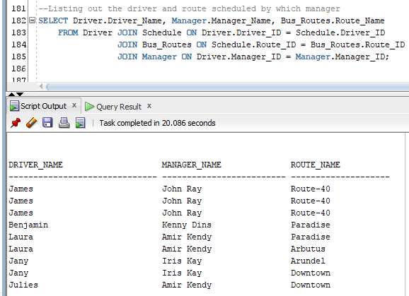
6. Listing out the driver, route name manager name with the number of schedules they have assigned using JOINS

Slide 22
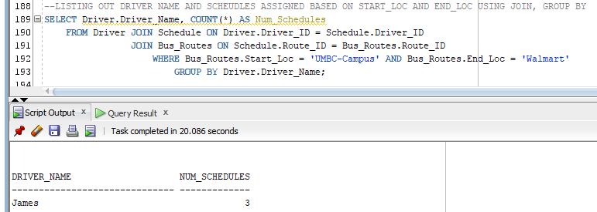
7. Finding out the driver and total schedules based on start and end location using JOIN

Slide 23
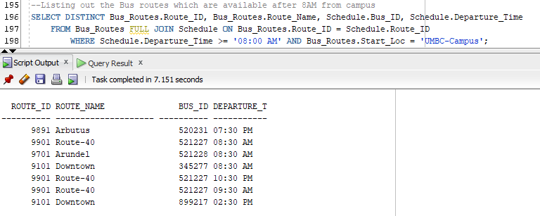
8. Finding available buses, route Name from UMBC-Campus after 8AM using JOIN

Slide 24
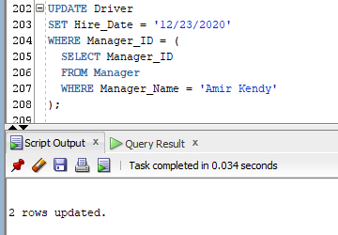
9. Update driver’s hire date based on Manager name

Slide 25
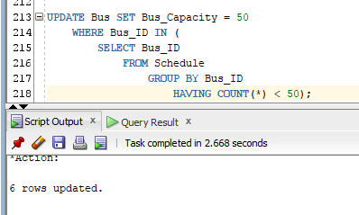
10. Update driver’s hire date based on Manager name

Slide 26
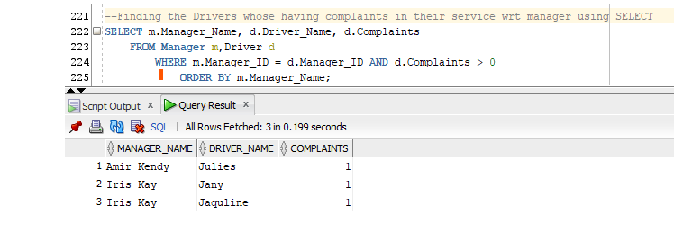
11. SELECT driver’s Name whose having complaints in their service wrt Manager name

