Slide 1
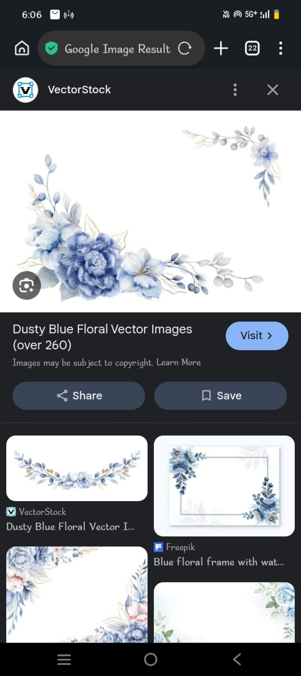
STUDENT NAME : meena b REGISTER NO AND NMID : 24131210500122022 nmid : anasanm121anm12124213022 DEPARTMENT : BCA COLLEGE : IMMCULTE COLLEGE FOR WOMEN UNIVERSITY : ANNAMALAI UNIVERSITY

Slide 2
Project title !!!
SMART STUDENT PORTFOLIO SYSTEM

Slide 3

Agenda !!!
PROBLAM STATEMENT
POJECT OVERVIEW
END USERS
TOOLS AND TECHNOLOIES
POTFOLOI DESIGN AND LAYOUT
FEATURES AND FUNCTIONALITY
RESULT AND SCREENSHOTS
CONCLUSION
GITHUB LINK

Slide 4

PROGRAM STATEMENT !!!
IN THE DEGITAL ERA,HAVING A STRONG ONLINE PRESENCE IS CRUCIL FOR STUDENT TO SHOWCASE THEIR SHILLS,ACHIVEMENTS,AND PROJECT.
TRADITIONL RESUMES AE LIMITED TO STATIC FORMAS AND FAIL TO HIGHLIGHT CREATIVITY AND INTERACTIVITY.
WITHOUT WELL-DESIGNED PORTFOLIO,STUDENT FACE CHALLENES IN PRESENTING THEIR CAPABILITIES EFFECTIVELY TO RECRUITERS,INSTITUTIONS,ND COLLABORAORS.
THERE IS NEED FOR AN INTERACTIVE,RESPONSIVE,AND VISULLY APPEALING ONLINE POTFOLIO WHERE STUDENT CAN PRESENT THEIR PERSONAL DETAILS,ACADEMIC QUALIFICATION TECHNICAL EXPERTISE,AND PROJECTS IN PROFESIONAL AND USER-FRIENDLY MANNER.

Slide 5

PROJECT OVERVIEW !!!
THIS PROJECT AIMS TO DEVELOP AN INTERCTIVE STUDENT PORTFOLIO WEBSITE USINF HTML,CSS,AND JAVASCRIPT.
THE WEBSITE IS DESIGNED TO BE REPONSIVE,ATTRACTIVE,EASY TO NAVGATE,ENABLING STUDENT TO SHOWCASE THEIR PERSONL PROFILE,ACADEMIC BACKGROUND,SKILL,ACHIVEMENTS,ND PROJECTS EFFECTIVELY.
THE PORTFOLIO SERVES AS A DIGITAL
RESUME AND PERSONAL BRANDING TOOL
ALLOWING STUDENT TO STAND OUT IN
COMPETITIVE ENVIRONMRNTS SUCH AS
JOB INTERVIEWS ,
INTERNSHIPS,,
ACADEMIC APPLICATIONS ////

Slide 6

END USRES !!!
STUDENTS : TO SHOWCASE THEIR PROFIL
SKILL,PROJECT.
EMPLOYEEARS : TO EVALUATE A STUDENT TECHNICL
BILITIES AND PAST WORK
UNVERSITY : FOR ADMISSION SCHOLRSIP PROJECT
EVALUATIONS
COLLABORATORS : DEVELOPERS DESINERS PEERS LOOKING
FOR POTENTIALK TEAMWORK

Slide 7

TOOLS AND TECHNOLOGIES !!!
CATEORY TOOLS // TECHNOLOIES FORNTENT HTML5, CSS3, JAVASCRIPT .
DESIGN FIGM // CNV (OPTIONAL) VERSION CONTROL GIT, GITHUB CODE EDITOR VS CODE RESPONSIVE DESIGN C FLEXBOX, CSS GRID,MEDIA QUERIES .
DEPLOYMENT GITHUB PAGES // NETLIFY

Slide 8

PORTFOLIO DESIGN AND LAYOUT !!!
HOME PAGE >>> STUDENT INTRODUCTION, PROFILE
PICTURE,TAGLINE.
ABOUT ME >>> PERSONL INFORMTION EDUCATION
BACKGROUND .
SKILL >>> LIST OF TECHNICAL AND SOFT SKILL.
PROJECT >>> INTERCTIVE CRDS SHOWCASIN PROJECT
TITLES DESCRIPTIONS , LIVE / DEMO LIKES.
ACHIVEMENTS >>> CERTIFICATES , AWARDSN , MILESTONES
CONTACT SECTION >>> EMAIL,PHONE, SOCIAL MEDIA LINKS

Slide 9

LAYOUT FEATURES !!!
HEADER ~
>>> SMOOTH SCROLLING TO SECTIONS .
RESPONSIVE GRID~
>>> OPTIMIZED FOR DESKTOPS ,TBLETS ,MOBILE.
COLORE PALETTE~
>>> CLEAN,MODERN PROFESSIONAL.
TYPOGRAPHY ~
>>> READABLE AND MINIMLISTI FONT STYLING.

Slide 10

RESPONSIVE DESIGN : WORK SEAMLESSLYN ON ALL DEVICES. INTERCTIVE NAVIGATION : SMOOTH SCROLLING AND MENU HIGHLIHTS. PROJECT SHOWCASE : DISPLAY S COMPLETED PROJECTS WITH LIVE DEMO LIKES
FETURES AND FUNCTIONALITY !!!
SKILL BADGES :
VISUAL REPRESENTATION OF
TECHNICAL PROFICIENCY.
CONTACT FROM :
USERS CAN REACH OUT
DIRECTLY.
SOCIAL MEDIA
INTEGRATION :
LINKS TO LINKEDIN , GITHUB
AND OTHER PROFILES.

Slide 11
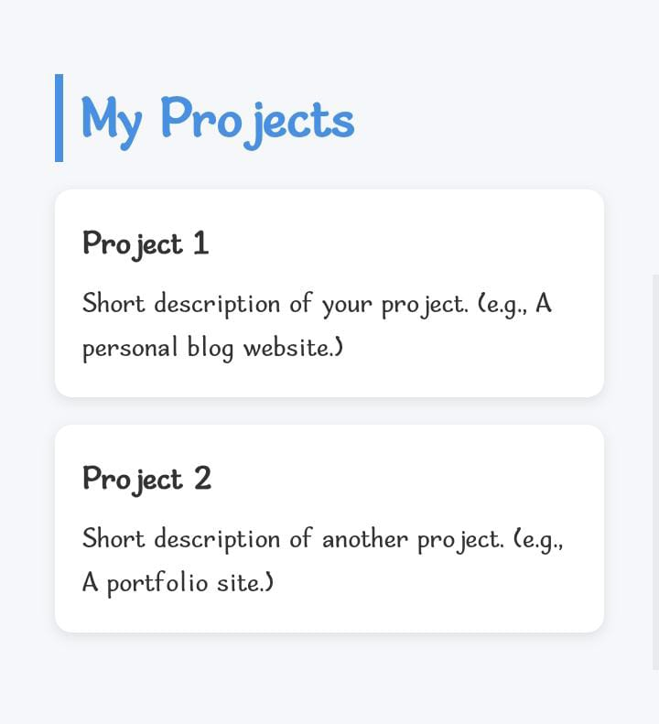
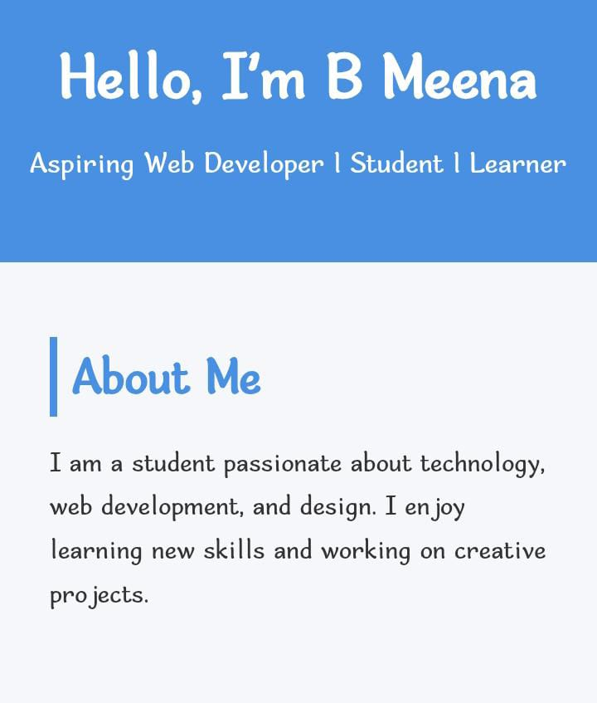
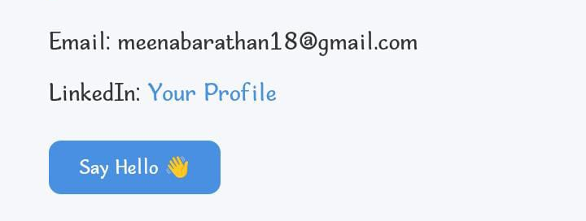
RESULTS AND SCREENSHOTS !!!

Slide 12
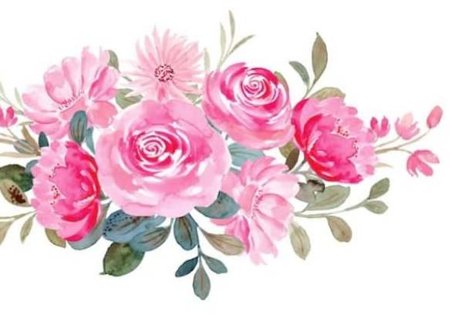
CONCLUSION !!!
THE INTERCTIVE STUDENT PORTFOLIO WEBSITE SUCCESSFULLY DEMONSTTRATS HOW STUDENT CAN SHOWCASE THEIR SKILLS,ACHIVEMENTS, AND PROJECT IN A MODERN ND PROFESSIONL WEY . BY USING HTML , CSS , JAVASCRIPT , THE PORTFOLIO OFFERS A CLEN UI , RESPONSIVE DESIGN , AND ENGAGING INTERCTIVITY.
THIS PROJECT HIGHLIGHTS THE IMPORTANCE OF PERSONAL BRANDING AND PROVIDES A PRACTICAL EXAMBLE OF CREATIN AN ONLINE PRESENCE THAT ATTRACTS RECRUITERS , COLLABORATORS , AND CADEMIC EVALUATORS

Slide 13
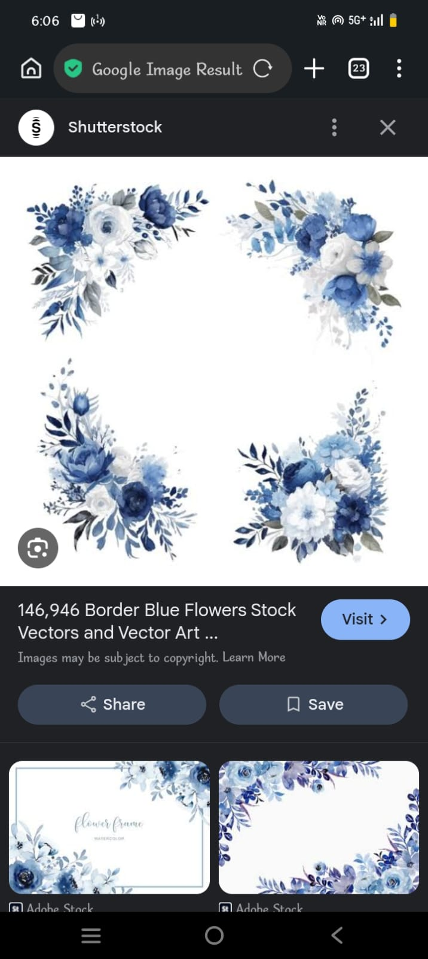
GITHUB !!!
CLICK HERE TO VIEW PROJECT ON GITHUB .
( REPLACE “ # “ WITH YOUR REPOSITORY LINK ONCE UPLODED )
https://github.com/meenabarathan18-design/Meena.git

