Slide 1
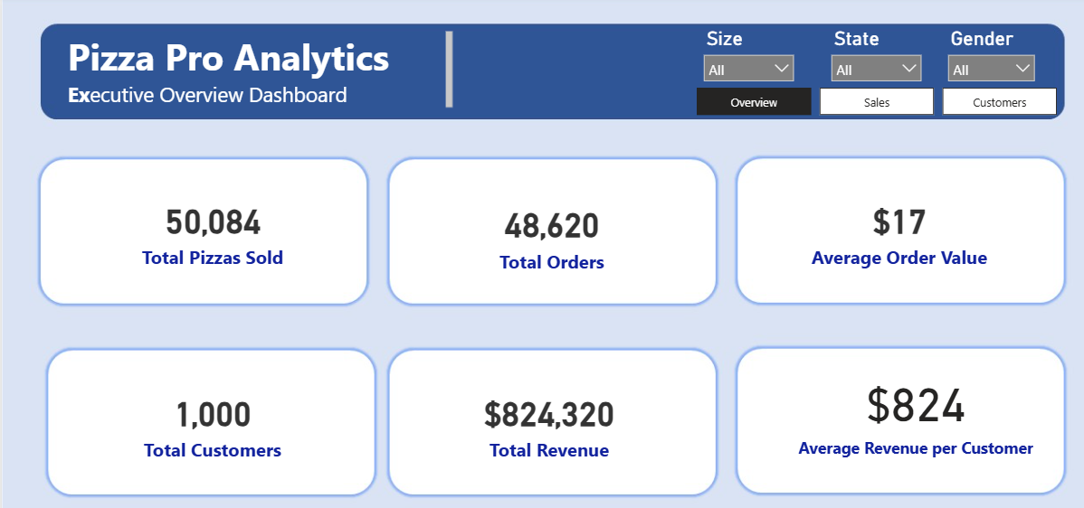
Pizza Pro Analytics
Detailed Business Insights & Recommendations Report
Power BI • DAX • Data Storytelling
Prepared by: Aminat Ajose

Slide 2
Business Problem, Objective and Analytics Approach
Business problem
Project objective
• Pizza Pro needs clear visibility of what is driving revenue, demand and customer value.
• The business must identify top-performing pizzas, weak menu items and peak ordering periods.
• Customer and regional behaviour should guide marketing, loyalty and growth decisions.
• Convert sales and customer data into decision-ready Power BI dashboards.
• Summarise product, time, customer and location patterns using business KPIs.
• Translate dashboard findings into practical recommendations for revenue growth and operational improvement.

Slide 3
Overall Business Performance
$824,320
48,620
50,084
1,000
$17
$824
Total Revenue
Total Orders
Pizzas Sold
Customers
Average Order Value
Revenue / Customer
Dashboard view
What the KPIs show
• Sales volume is strong: 50K pizzas sold from 48.6K orders.
• AOV is only $17, so revenue growth should target basket size, not only new customers.
• Average revenue per customer is high at $824, suggesting strong repeat purchasing behaviour.
• Action: introduce bundles, add-ons and loyalty incentives to increase value per transaction.

Slide 4
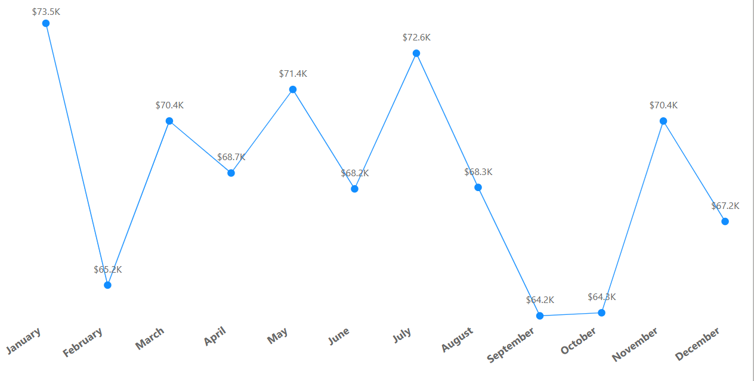
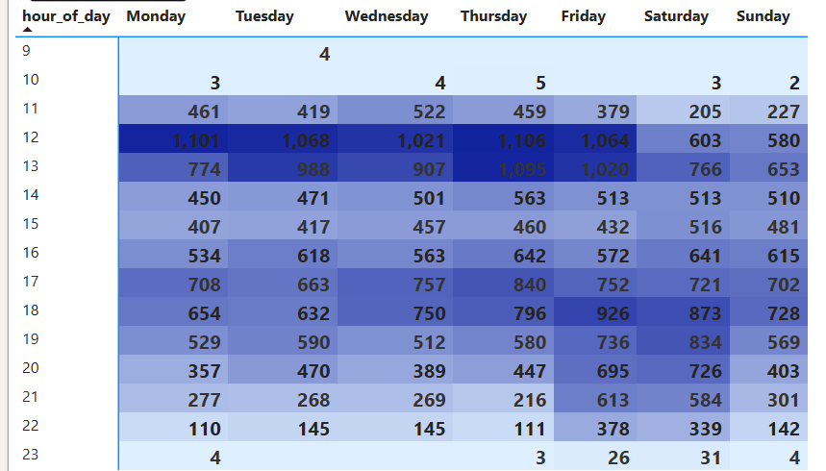
Monthly Revenue Pattern and Seasonality
Sales and product dashboard snapshot
Trend insight
• Pizza Pro maintained a relatively stable monthly revenue pattern, with sales generally ranging between $64K and $74K across the year.
• The strongest month was January at approximately $74K, followed by July at about $73K and May at around $71K.
• The weakest months were September and October, both at approximately $64K, showing a slight decline after the summer period.
• Action: use a monthly promotion calendar to strengthen weaker months, especially September and October, to maintain stronger revenue momentum.
Operational implication
• Order activity is strongest during lunchtime, particularly between 12 PM and 1 PM.
• There is also strong evening demand, especially on Friday and Saturday between 6 PM and 8 PM.
• In contrast, very early and late hours, such as 9 AM, 10 AM, and 11 PM, show much lower activity.
• Action: Prioritise staffing, stock preparation, and delivery capacity around 12 PM–1 PM, while also preparing for stronger evening demand on Fridays and Saturdays.
• Off-peak discounts can help spread demand more evenly across the day.

Slide 5
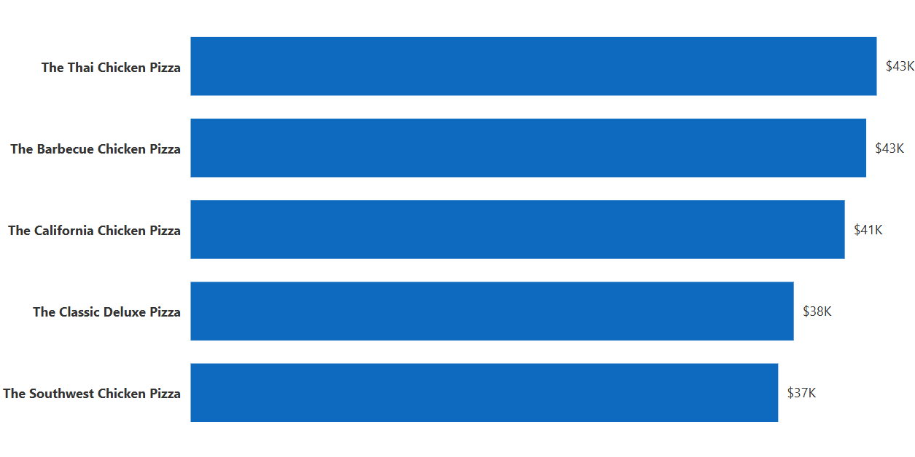
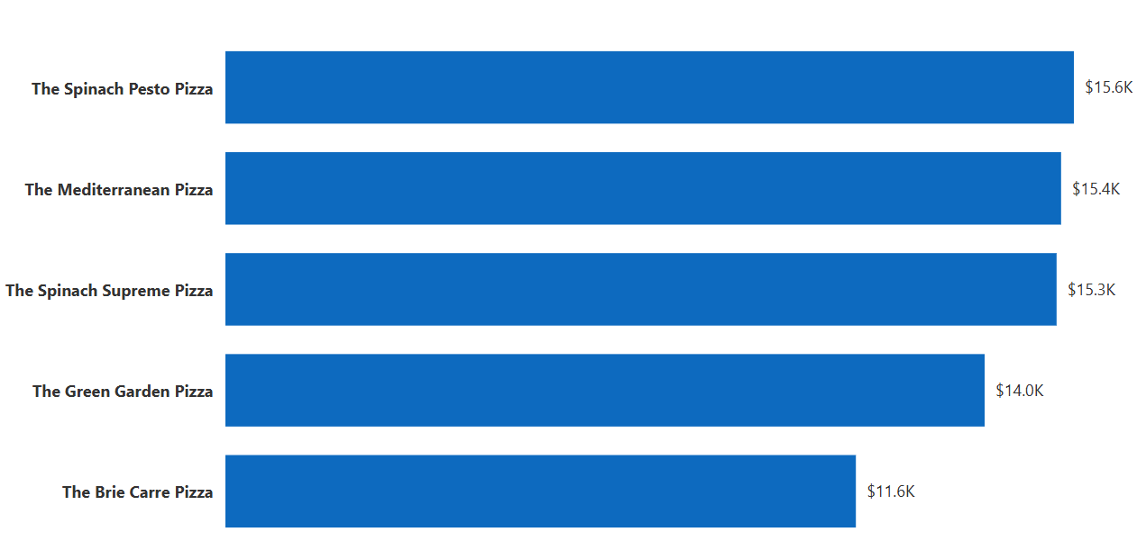
Revenue Leaders and Menu Items Requiring Review
Top revenue pizzas
Key findings
• Thai Chicken and Barbecue Chicken lead revenue at approximately $43K each.
• California Chicken follows closely at about $41K, so Chicken pizzas dominate the top 3.
• Brie Carre is the weakest revenue product at about $11.6K.
• Spinach Pesto, Mediterranean, Spinach Supreme and Green Garden are also low revenue products.
Bottom revenue pizzas
Recommendation
• Label Thai, BBQ and California Chicken as “Best Sellers” and use them in premium bundles.
• Run a 4-week test on low performers: menu repositioning, price adjustment and product description change.
• If Brie Carre remains weak after testing, consider replacing it with a product closer to customer demand.

Slide 6
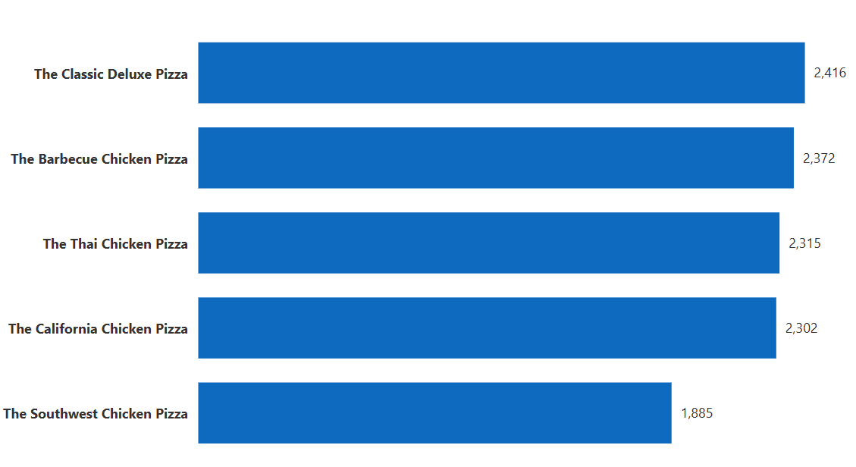
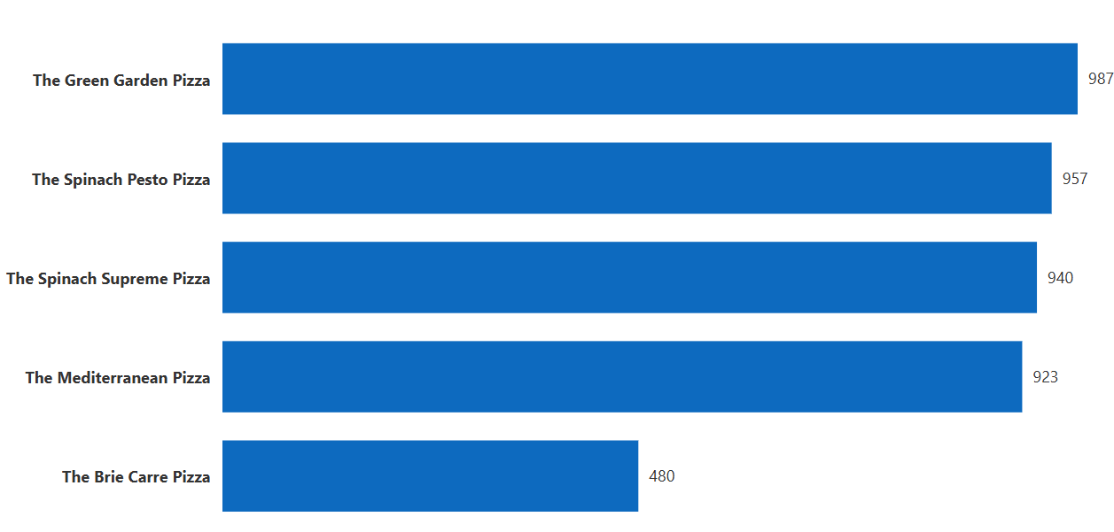
Order Quantity Shows Popularity, Not Just Revenue
Most ordered pizzas
Demand insight
• Classic Deluxe and Barbecue Chicken are the most ordered pizzas at around 2.4K orders each.
• Thai Chicken and California Chicken are also strong demand products at about 2.3K orders each.
• Brie Carre has only 480 orders, far below the top products and confirming weak demand.
• The strongest products are both popular and high revenue, making them critical menu anchors.
Least ordered pizzas
Stock and menu action
• Protect ingredient availability for Classic Deluxe, BBQ Chicken, Thai Chicken and California Chicken.
• Create low-waste stock plans for low-demand pizzas to avoid tying up inventory.
• Use customer feedback before removing weak products to avoid losing niche customers unnecessarily.

Slide 7
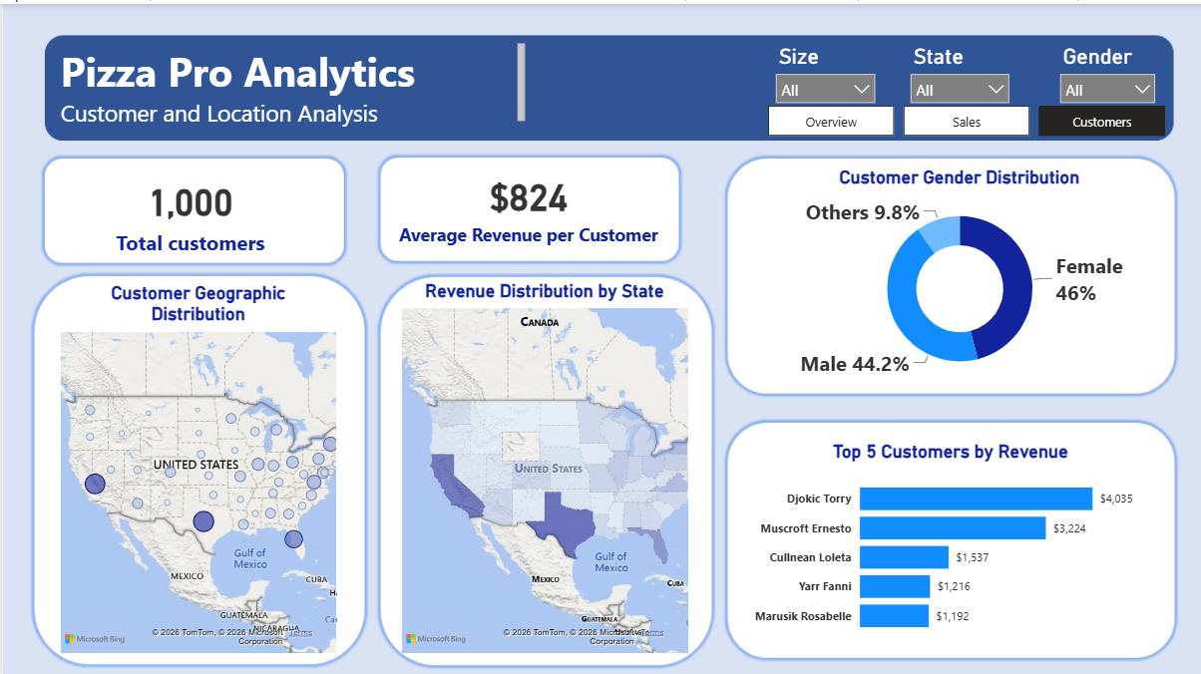
Who Buys, Where They Are, and How to Retain Them
Customer dashboard snapshot
Customer and regional insight
• Pizza Pro has 1,000 customers, generating an average revenue of $824 per customer.
• Gender distribution is balanced: Female 46%, Male 44.2%, Others/Unknown 9.8%.
• Top customers such as Djokic Torry ($4,035) and Muscroft Ernesto ($3,224) highlight an opportunity for VIP rewards and personalised loyalty campaigns.
• Customer density is strongest on the East Coast, especially the Northeast and Mid-Atlantic.
• There are also visible customer clusters in California and parts of the Midwest.
Customer action
• Create a VIP segment for customers spending above $1,000.
• Use East Coast loyalty campaigns to protect the strongest customer base.
• Use awareness offers in sparse Central and Mountain West regions.
• Focus segmentation on spend, location and purchase behaviour rather than gender alone.

Slide 8
Priority Actions for Revenue Growth and Operational Improvement
1. Optimise pizza portfolio
2. Increase average order value
• Market Thai, BBQ and California Chicken as premium best sellers.
• Review Brie Carre, Green Garden, Spinach Pesto, Spinach Supreme and Mediterranean pizzas.
• Test price, menu placement and recipe changes before discontinuing weak products.
• Move AOV from $17 upward through bundles, add-ons and family deals.
• Promote “pizza + drink + side” offers at checkout.
• Use best sellers as anchors for higher-value combo meals.
3. Improve customer retention
4. Align operations to demand
• Create VIP rewards for top customers spending above $1,000.
• Introduce points, birthday rewards and repeat-purchase incentives.
• Use personalised offers based on product preference and region.
• Increase staffing and preparation during 12 PM–1 PM peak periods.
• Use off-peak discounts for quieter hours and weaker months.
• Use state-level marketing for strong regions and awareness campaigns for sparse regions.

