Slide 1
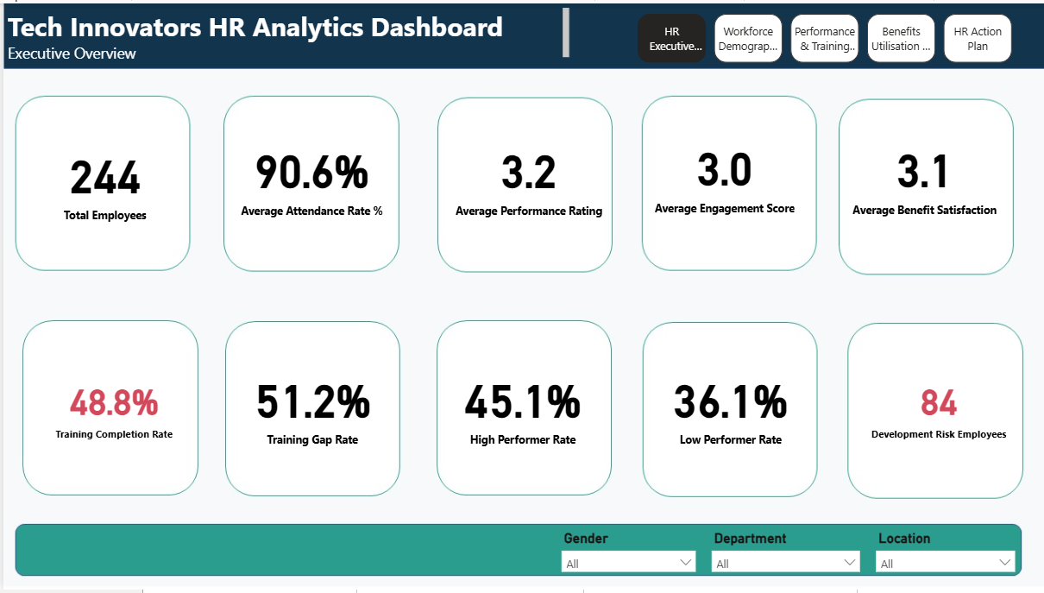
Tech Innovators HR Analytics
Business Insights & Recommendations Report
Power BI • DAX • HR Analytics
Prepared by: Aminat Ajose
1

Slide 2
Business Problem, Objective and Analytics Approach
Business problem
Project objective
• Tech Innovators needs clearer visibility of employee performance, engagement and development needs.
• HR decisions are limited by periodic performance reviews rather than real-time workforce insight.
• Benefit programmes require better evidence on utilisation, satisfaction and value delivered.
• Convert structured HR, performance and benefits data into decision-ready Power BI dashboards.
• Measure workforce health using KPIs for training, performance, engagement, benefits and development risk.
• Translate dashboard findings into practical HR actions that improve employee support and resource allocation.
2

Slide 3
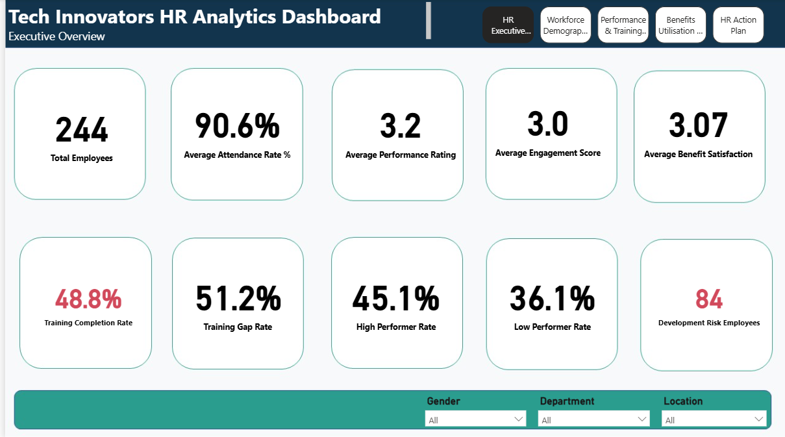
Overall Workforce Performance
244
90.6%
48.8%
3.2
3.0
84
Total Employees
Attendance Rate
Training Completion
Avg Performance
Avg Engagement
Development Risk Employees
Dashboard view
What the KPIs show
• Attendance is strong at 90.6%, so workforce availability is not the primary operational concern.
• Training completion is only 48.8%, leaving a 51.2% training gap that requires HR follow-up.
• Performance and engagement are moderate at 3.2 and 3.0 respectively, suggesting room for improvement.
• Action: prioritise training completion, development-risk employees and department-level support.
3

Slide 4
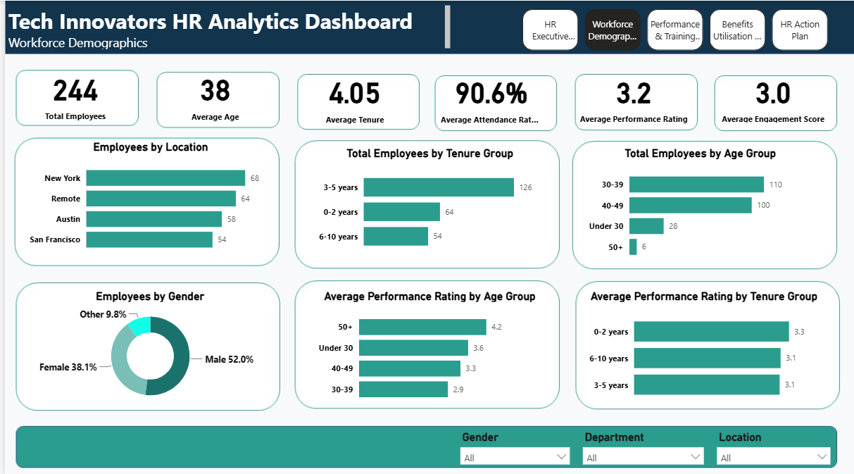
Workforce Demographics and Segmentation
Demographics dashboard
Segmentation insight
• The workforce is balanced across New York, Remote, Austin and San Francisco, with New York as the largest base.
• Remote employees form a major workforce group, so training and engagement strategies must support hybrid working.
• Employees aged 30–39 are the largest age group but show the lowest average performance rating.
• The largest tenure group is 3–5 years, indicating a strong core workforce with opportunities for renewed development.
Workforce action
• Use demographic segmentation to tailor training and engagement actions by employee group.
• Review performance patterns for the 30–39 age group because it has the largest workforce share.
• Ensure remote employees receive equal access to training, benefits communication and manager support.
4

Slide 5
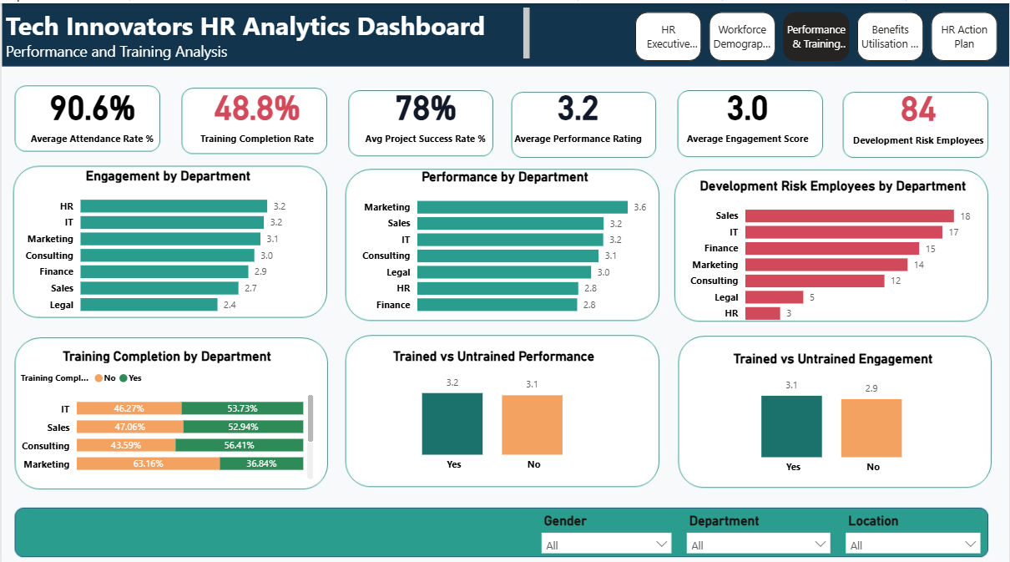
Performance and Training Gaps
Performance and training dashboard
Key findings
• Marketing records the highest average performance, while HR and Finance sit at the lower end.
• Legal and Sales show weaker engagement, which could become a future retention and productivity concern.
• Sales, IT and Finance have the highest counts of development-risk employees.
• Trained employees show slightly stronger performance and engagement than untrained employees.
Recommended action
• Track development-risk rate by department, not only the count, to support fair comparison.
• Launch manager-led training follow-up for departments with weaker completion rates.
• Use coaching and performance improvement plans for employees with low performance or low engagement.
5

Slide 6
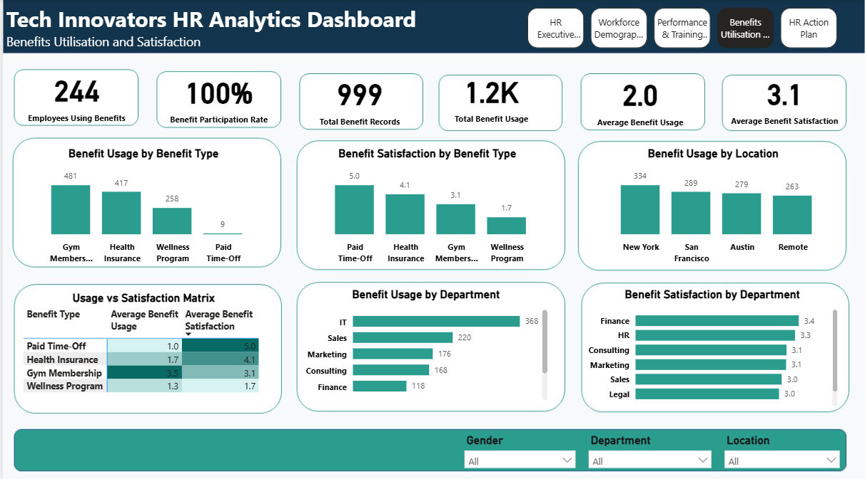
Benefits Utilisation and Value Assessment
Benefits dashboard
Benefit insight
• Benefit participation is 100%, but satisfaction varies significantly by benefit type.
• Health Insurance combines high usage with high satisfaction, making it a strong value benefit.
• Gym Membership is heavily used but only moderately satisfying, suggesting a quality or value improvement opportunity.
• Wellness Program has very low satisfaction and should be reviewed or redesigned.
Cost and value action
• Protect high-value benefits such as Health Insurance.
• Investigate Paid Time-Off recording because usage appears very low despite high satisfaction.
• Use a usage-versus-satisfaction matrix to decide which benefits to maintain, improve, promote or retire.
6

Slide 7
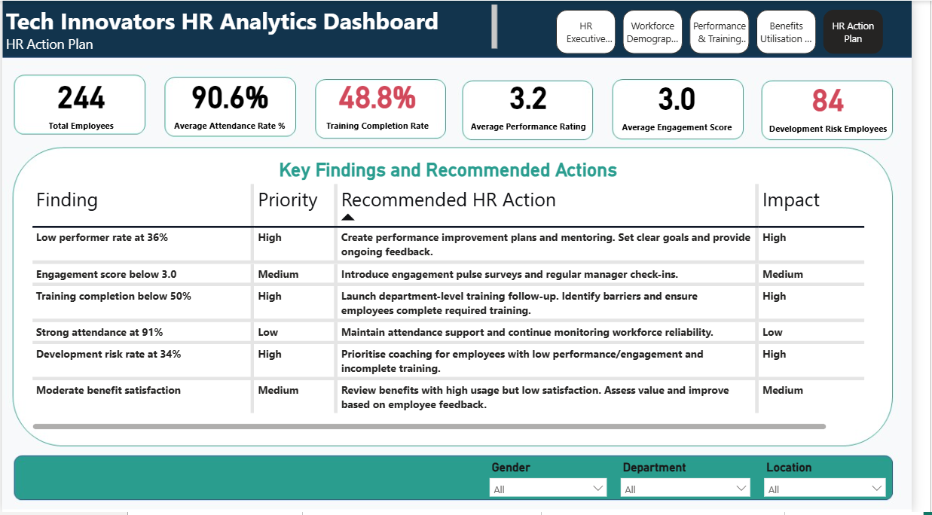
HR Action Plan: From Insight to Intervention
Action plan dashboard
Priority actions
• Improve training completion through department-level tracking and manager accountability.
• Prioritise 84 development-risk employees for coaching, training follow-up and structured support.
• Address engagement weaknesses through pulse surveys, manager check-ins and recognition initiatives.
• Review low-value benefits and redesign benefit communication around employee needs.
Expected business impact
• Faster identification of employees requiring support.
• More efficient investment in benefits that employees actually value.
• Better alignment between HR activity, workforce productivity and employee experience.
7

Slide 8
Priority Actions for Workforce Performance and HR Efficiency
1. Close the training gap
• Move completion from 48.8% upward through department-level follow-up.
• Identify barriers to training completion and monitor progress monthly.
• Use training completion as a standard HR performance management KPI.
2. Support development-risk employees
• Create a targeted support list for the 84 employees in the development-risk group.
• Prioritise coaching where low performance or low engagement overlaps with incomplete training.
• Track improvement after intervention using performance, engagement and training metrics.
3. Improve engagement and performance consistency
• Use pulse surveys and manager check-ins in departments with weaker engagement.
• Review Sales, Legal, HR and Finance more closely because they show notable people-risk signals.
• Introduce mentoring and performance improvement plans for low-performing employees.
4. Optimise benefit value
• Maintain Health Insurance as a high-value benefit.
• Improve Gym Membership quality/value because usage is high but satisfaction is moderate.
• Review the Wellness Program due to low satisfaction and validate Paid Time-Off data capture.
8

Slide 9
Analytics Delivery: Data Model, Measures and Stakeholder Value
Analytics approach
Business value delivered
• Integrated employee demographics, performance and benefits data using Employee ID as the relationship key.
• Built a Power BI model that supports workforce segmentation across department, gender and location.
• Developed DAX KPIs for attendance, training completion, performance, engagement, benefit participation and development risk.
• Converted operational HR metrics into management-level insight and action planning.
• Provides HR leaders with a single view of performance, training, benefits and workforce risk.
• Moves HR reporting from periodic review to proactive intervention.
• Highlights where investment should be protected, improved or reviewed.
• Supports better employee experience, stronger performance management and more efficient resource allocation.
9

