Slide 1


Twitter Engagement Analysis
For Influencers
By Meenakshi Sethi

Slide 2
Objective:
This project explores the relationship between
tweet timing and engagement,
providing insights for influencers to optimize content strategies based on temporal engagement patterns.

Slide 3
Introduction:
Understanding Twitter Engagement Dynamics
In the fast-paced world of social media, timing plays a crucial role in maximizing engagement.
This analysis examines the activity of technology influencers on Twitter from February to May 2022.
By identifying the optimal times for posting content, influencers can enhance their visibility and interaction on the platform.

Slide 4
Key Metrics & Dataset Overview:
The dataset consists of over 24,000 tweets, 4,000 profile snapshots, and engagement metrics such as retweets, likes, and follower growth.
The data spans the activity of several technology influencers, focusing on how tweet timing affects their reach and engagement.

Slide 5
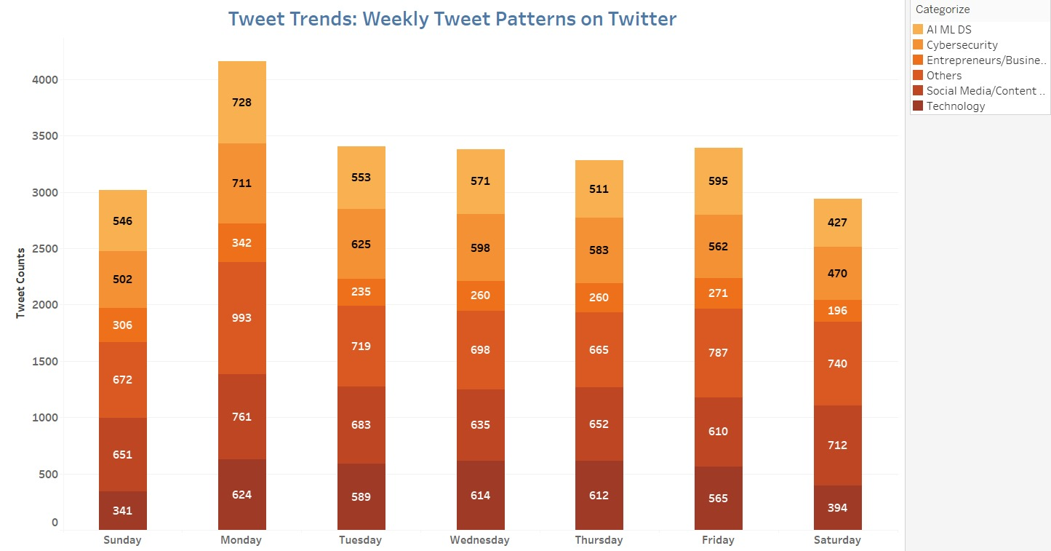
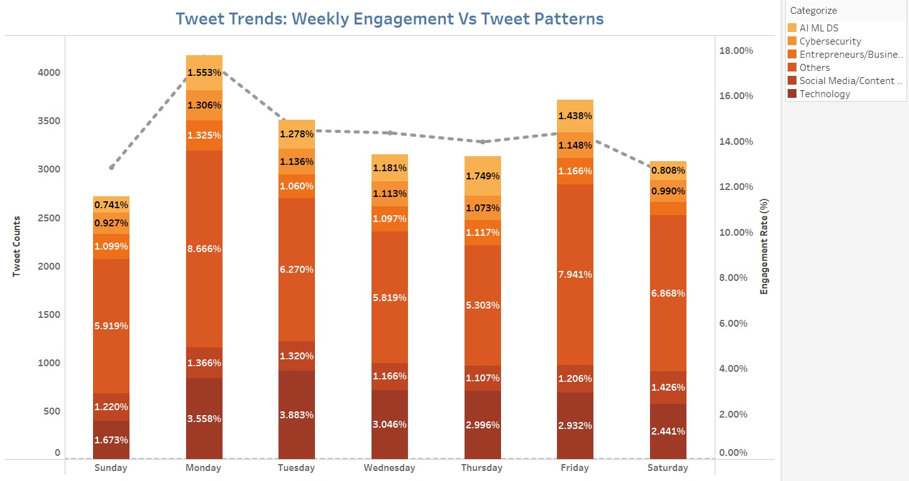
Weekly Trends
The graph on the left indicates the category-wise distribution of number of tweets in days of the week while the graph on the right indicates the category-wise (6) engagement of users over the duration of a week.
Tweet Volume: Monday has the highest tweet volume, while Saturday sees the lowest number of tweets posted.
Engagement: User engagement is highest on Mondays and Fridays and lowest on Sundays.
Despite fewer tweets on Fridays, user engagement remains high, indicating active interactions on the platform.

Slide 6
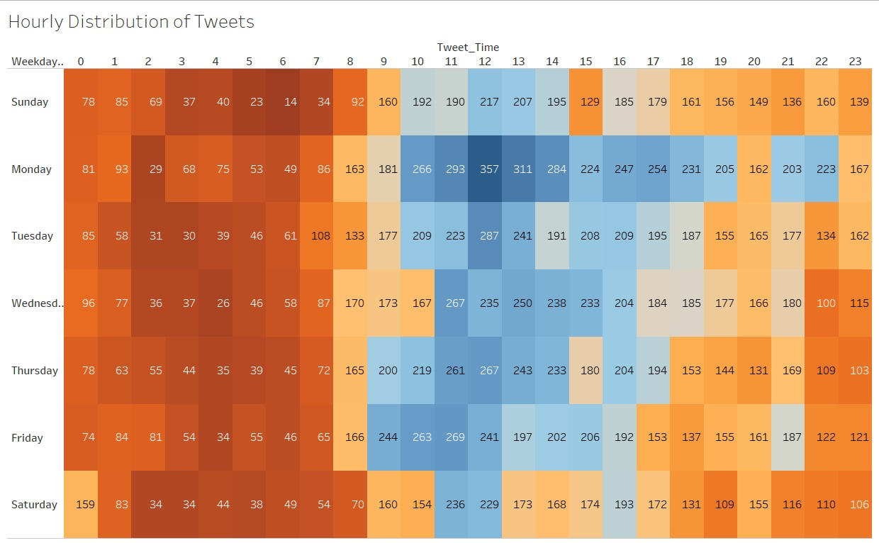
Engagement Rate vs. Tweet Timing
Note:
Heatmap analysis
Engagement peaks during 12 PM - 2 PM and 7 PM - 9 PM, with Monday and Friday having the highest engagement rates.
These time slots offer influencers the best opportunity to capture audience attention and increase interaction.

Slide 7
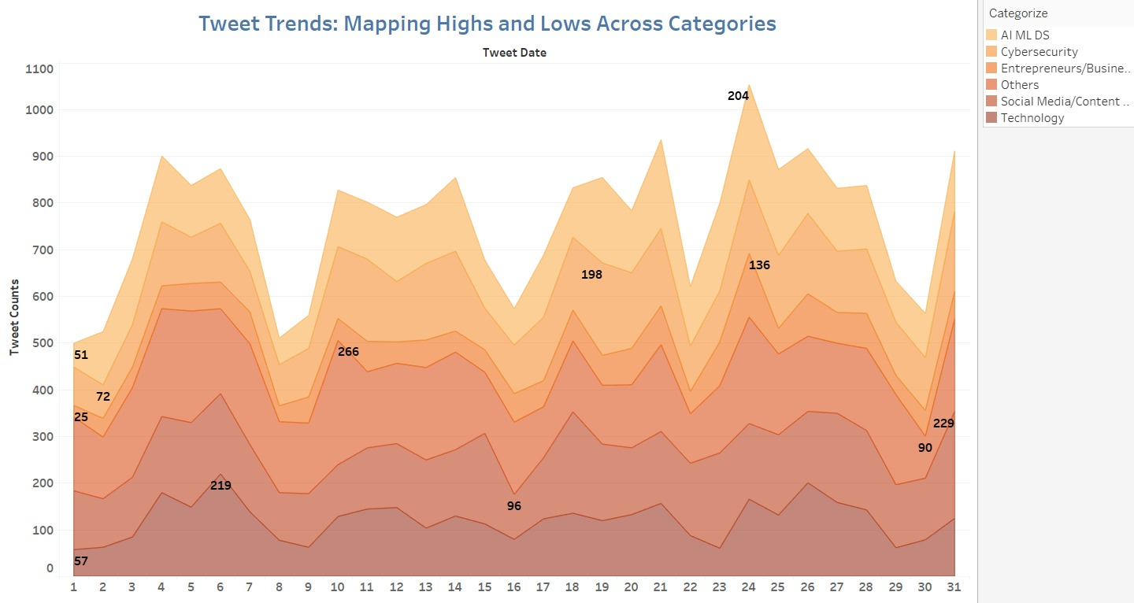
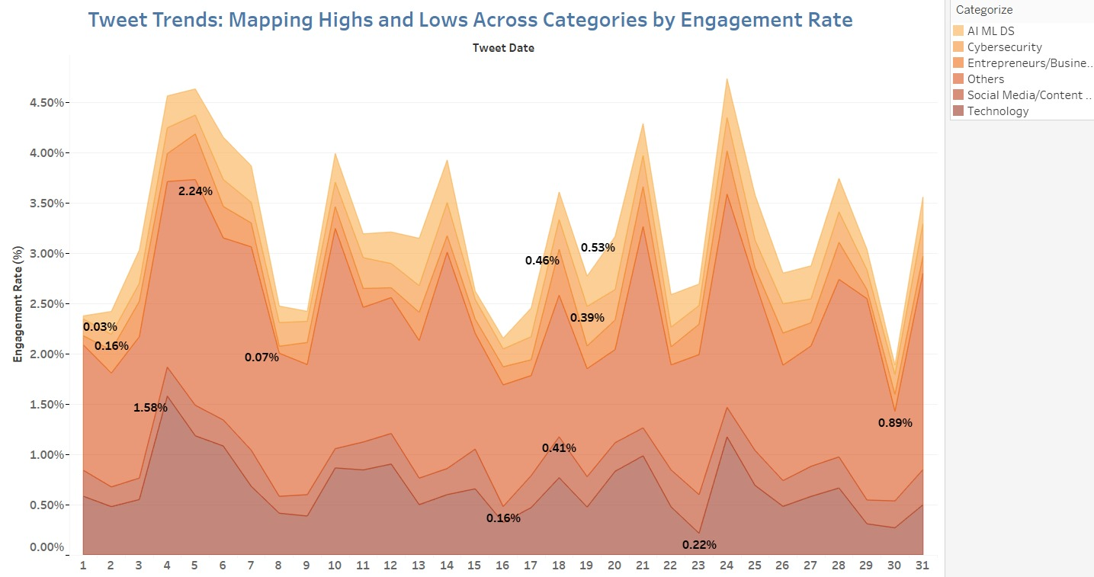
Tweet Volume vs. Engagement Rate
First picture shows number of tweets in different groups over time. Second picture shows how much people engaged with tweets in different groups over time. Some groups had more tweets, but other groups had higher tweet engagement. Both pictures show ups and downs, meaning tweet activity and engagement changed a lot during the time shown.

Slide 8
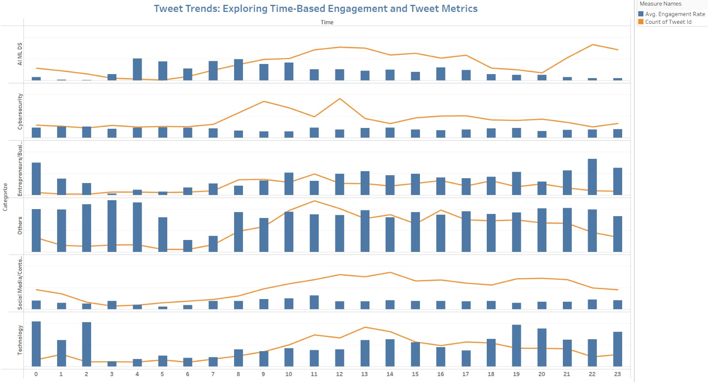
Weekly Engagement Trends
The top line chart tracks the total tweet count, showing an overall increasing trend with periodic peaks and valleys. The second and third line charts display average retweets and replies per tweet, exhibiting more stable patterns with minor fluctuations. The fourth and fifth line charts represent average favorites and impressions per tweet, maintaining relatively consistent levels over time with some spikes. Overall, the visualization allows for comparing multiple engagement metrics side-by-side to analyze tweet performance trends over the displayed time period.

Slide 9
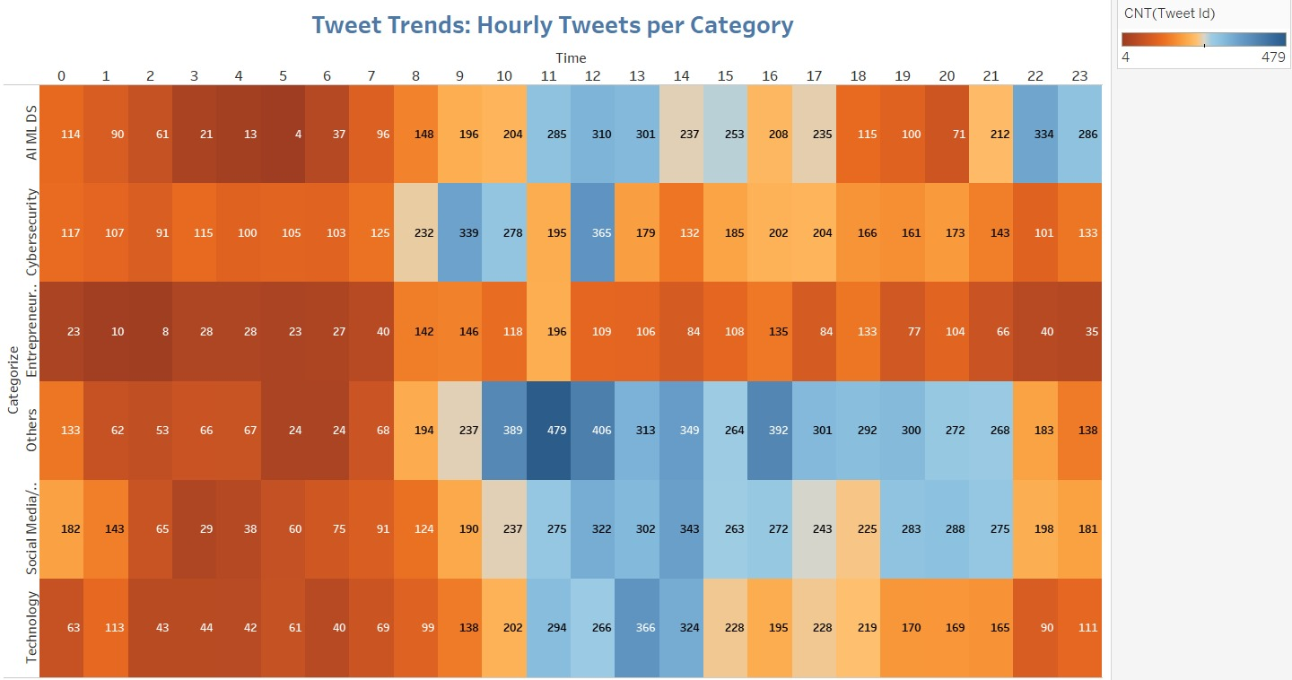
TWEET TRENDS
The heatmap shows the hourly volume of tweets categorized into different topics or categories, with the x-axis representing the hours of the day (0 to 23) and the y-axis representing the categories. The color gradient from orange to blue indicates the intensity of tweet activity, with orange representing a higher volume of tweets and blue representing a lower volume. There appears to be a distinct pattern in the tweet volume across different categories, with some categories exhibiting higher activity during certain hours of the day, possibly reflecting the daily routines and interests of Twitter users.

Slide 10
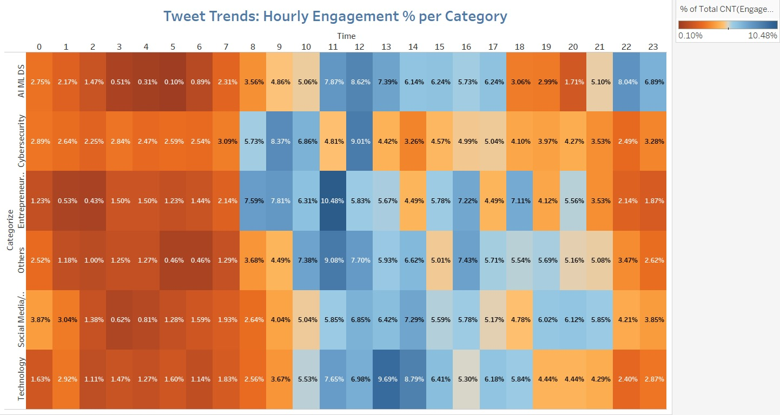
TWEET TRENDS
The heatmap displays the hourly engagement percentage for different categories of tweets, with the x-axis representing the hours of the day (0 to 23) and the y-axis representing the categories. The color gradient from orange to blue indicates the level of engagement, with orange representing higher engagement percentages and blue representing lower engagement percentages. There appears to be a distinct pattern in the engagement levels across different categories and hours, suggesting that certain categories tend to attract higher engagement during specific times of the day, potentially related to user behavior and interests.

Slide 11
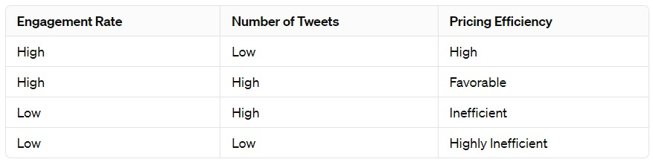
Product Idea:
Based on the visualization we have seen before, there is a scope for making a tool that analyzes the trends we have made using time analysis to highlight the activity “hot-zones” and make recommendations for creators to know what are the correct times to post a tweet to maximize engagement.
Using these trends as reference there can be a slot-wise advertisement system that can be created to aid companies looking to run marketing campaigns for short but high activity time to achieve most value for their money. These trends can be used to formulate a pricing strategy which determines which hourly slot should be charged with what amount compared to others based on the engagement rate.
Pricing Efficiency Matrix: The Pricing Efficiency Matrix simplifies pricing decisions by correlating engagement rates and tweet volumes with pricing efficiency.
This tool enables influencers to optimize their pricing structures, ensuring maximum returns on social media collaborations.

Slide 12
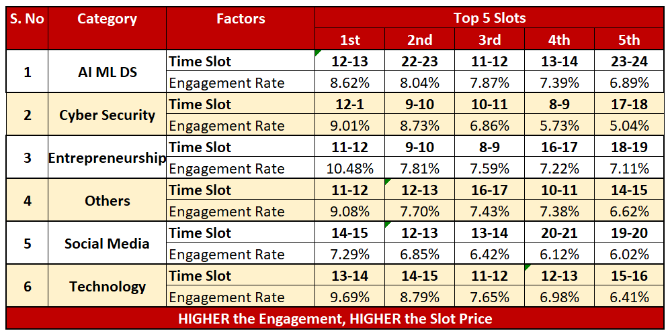
Takeaway
Peak engagement timings differ from peak tweet hours, presenting an opportunity for influencers to strategically time their content publication.
Tailoring pricing strategies based on time-based engagement patterns allows influencers to optimize monetization opportunities, charging premium rates for peak engagement hours and adjusting prices during off-peak periods.

Slide 13
Conclusion:
Through a comprehensive analysis of Twitter data, uncovered the intricate relationship between time and engagement. With these insights, influencers can strategically schedule their tweets to align with peak engagement hours, thus maximizing their reach and impact.
Findings suggest opportunities for influencers to monetize their platform by offering premium pricing for tweet slots during peak engagement periods, ultimately empowering them to unlock the full potential of their social media presence.

Slide 14
THANK YOU !!

