Slide 1

Proposed Analysis For Sample Data
Using RStudio
Meenakshi Rajgopal

Slide 2
Content
Analysis Flow
About Sample Data
Cleaning the Data
Text Analysis Flow
Analysis
Result Interpretation

Slide 3
Analysis Flow
Read the Data(Problem)
Clean the Data Using any tool
Analysis
Result Interpretation
Notes:
IDEA OF CRISP-DM - Cross-industry standard process for data mining
The analysis flow should always start by understanding the business first and then understand the data.
Once we have knowledge in the area, we can start preparing the data, modelling, evaluation and finally deploy the findings.

Slide 4
About Sample Data
This is a survey data which has lot of feedbacks, ratings, date on which survey was taken, etc. from students who attended Golden Gate University.
It is a complicated dataset since almost all the details are in non-numeric values. We need numeric data to do the basic statistical analysis.

Slide 5
Cleaning the Data
All the analysis and cleaning is done in RStudio. We can also use Tableau or MicroStrategy to prepare charts and dashboards.
My objective here is to get insights on what the data is telling us so that GGU can use the information and improve upon that.
There are many useful variables like;
Questions on the survey – Text analysis can help us understand the sentiments or frequently used words in the answers.
Date on which survey was taken – Histogram can tell us During which date range students take the survey like do they wait till the end of the semester; do they wait for the grades or during the semester.
Rating – which can tell us how well is GGU standing in front of the students and how likely are they to promote GGU (almost like a net promoter score).

Slide 6
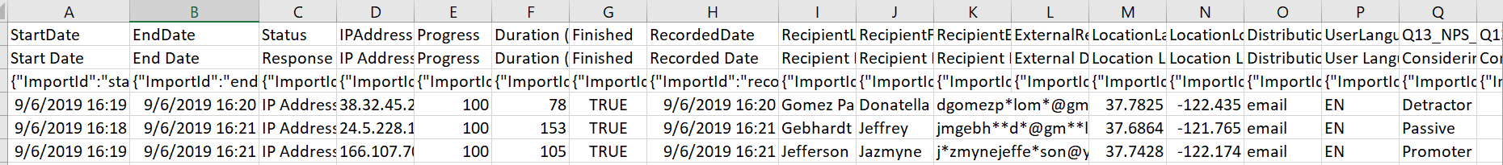

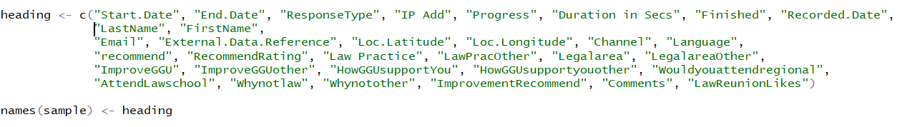
Cleaning the Data
Our original data had uneven column headings and duplicate rows in the beginning. This will remove 3rd row while keeping 1st and 2nd rows along with start row as second.
Updating with shorter column headings.

Slide 7
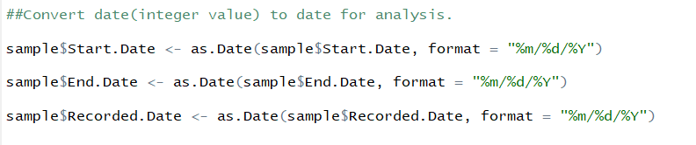

Cleaning the Data
Convert the date to “Date” Format.
Convert the non-numeric values to numeric.

Slide 8
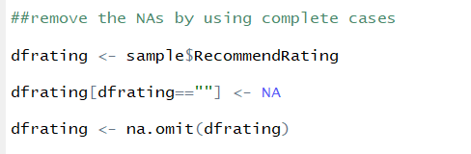
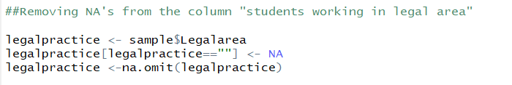
Cleaning the Data
Drop NA’s from columns for text analysis

Slide 9
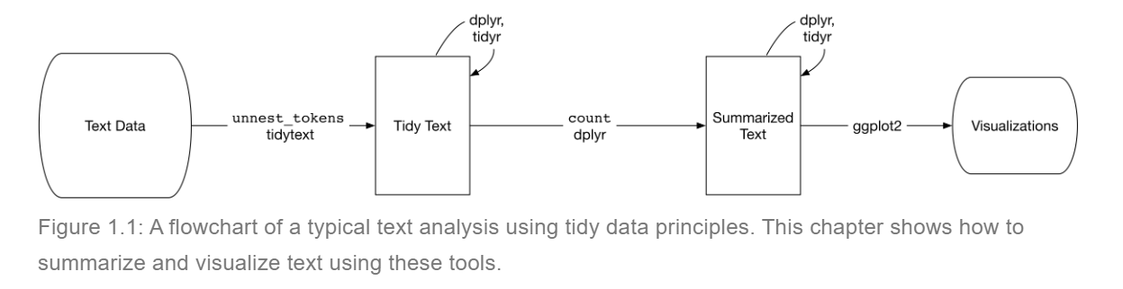
Text Analysis Flow
I will be submitting the analysis codes in a separate PDF. Below flow chart is the basic idea of the text analysis performed for this data.

Slide 10
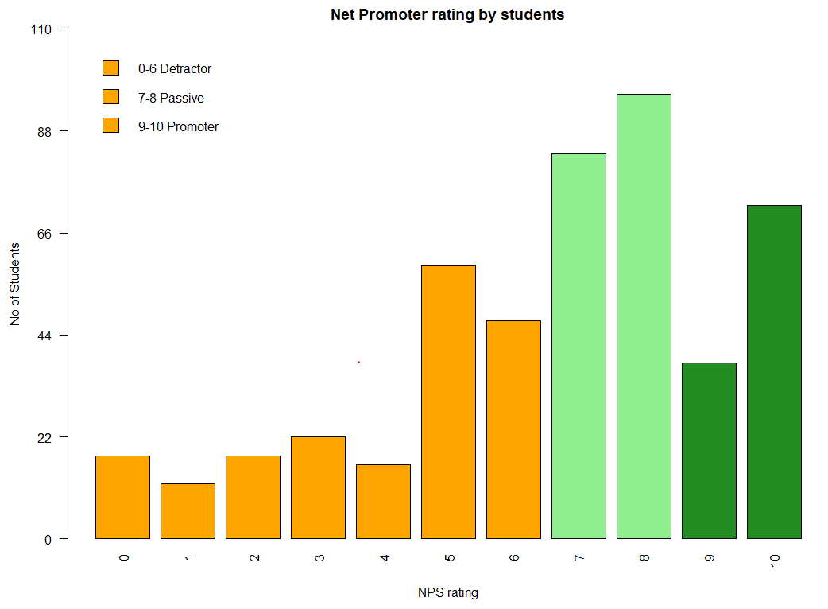
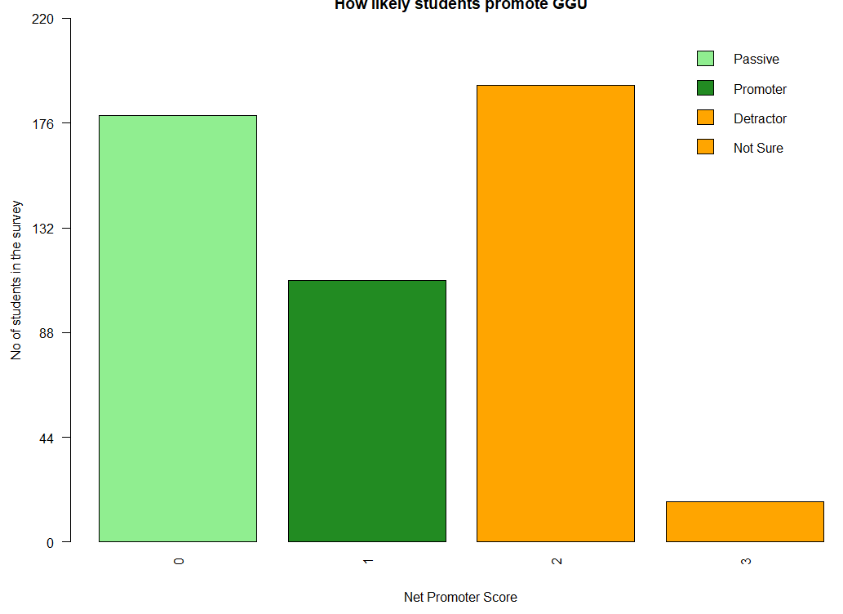
Analysis
Using the Column “Considering your complete experience with GGU Law, how likely would you be to recommend the law school to a friend or colleague? “ Group
Bar Plot - Using the rating column “Considering your complete experience with GGU Law, how likely would you be to recommend the law school to a friend or colleague?
Notes:
Here bar plots are done after converting the score for the group (passive, Promoter, Detractor and blanks) to numeric values.
The Ratings are already in numbers however had to be changed to integer since R was defaulting it to character.
Both the graphs give us similar idea:
First indicates how many students gave each of the rating.
Second indicates how many students fall under passive, Promoter, Detractor and blanks.

Slide 11
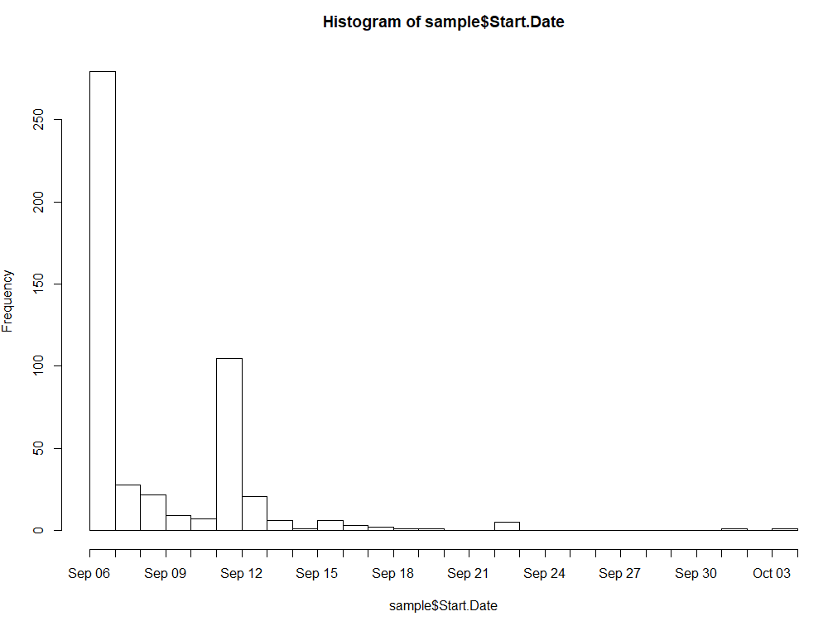
Analysis
This histogram indicates that most of the students took the survey between September 6th and September 12th week.
We can also check how soon students take the survey so that we can fix a duration for them to finish.

Slide 12
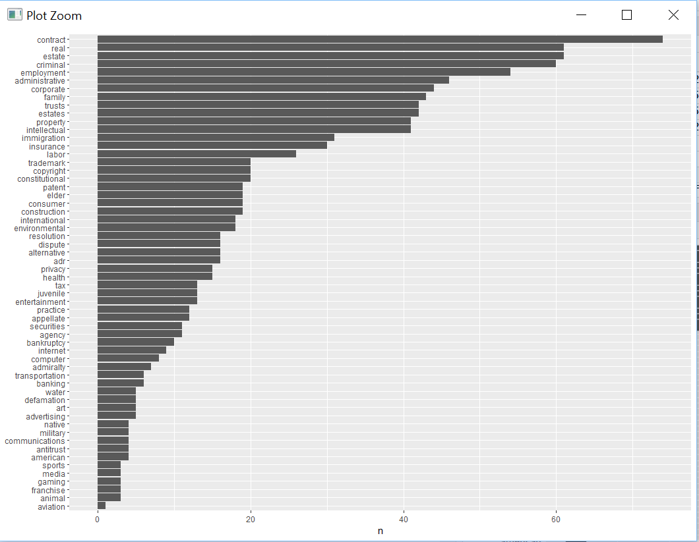
Analysis
By using tidytext format we can
analyze the most frequent words used
in the survey feedback for “What are
your legal practice areas?”
Contact, Real estate, criminal,
Employment, corporate, Family are some of
the most used words in the answers. It
indicates which area most of them would be
practicing without having to read through all
the answers.
Notes:
Tokenization - Break the text into individual tokens, remove stop words, count and visualize
The highest was “Law” however since all the answers include the word law, I removed it through filter while using ggplot2 visual code.

Slide 13
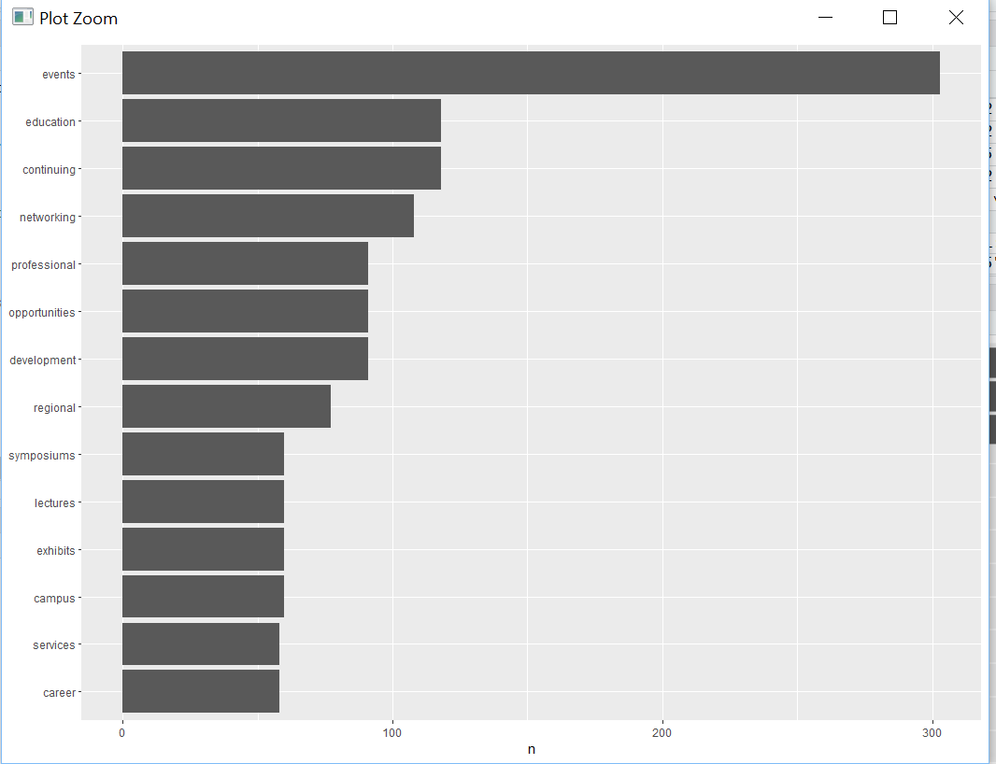
Analysis
Now we look at the column “How can GGU
better support you? “
Events, networking, professional,
opportunity, are some of the most used words
in the answers. It indicates which area most of
them are asking for improvement or to conduct
more networking events, more professional
opportunities', etc.

Slide 14
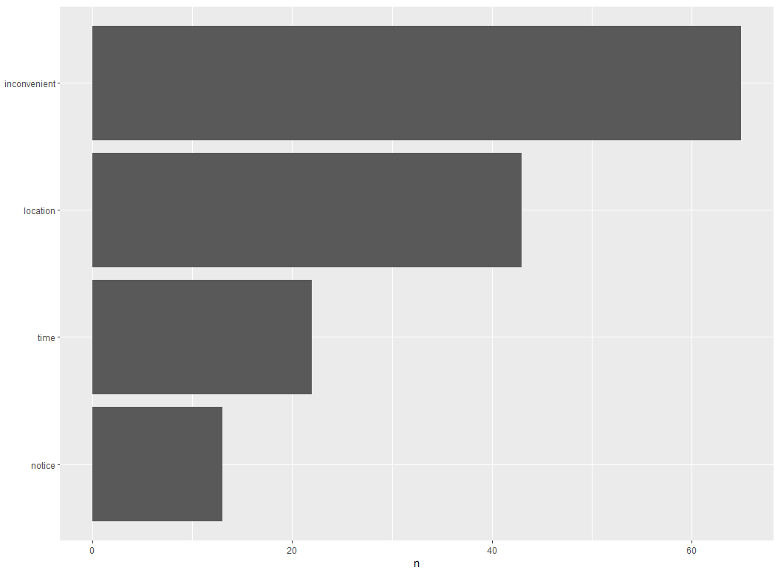

Analysis
Now we can look only the data where ratings are
“Detractors”. This will tell us the possible reason
why students are not willing to promote and has
given rating 6 or below.
Looking at the column “Why not Law School?
Filter only detractor from rating column.
Inconvenient, Time, location are most used
words here.

Slide 15
Result Interpretation
We get some idea based on the bar charts that how likely students are willing to promote GGU. We have many students under category passive and detractor.
We can improve this situation based on the result from text analysis on the survey answers. Both the graphs shows most frequently used words and the second graph says how GGU can improve by introducing more events on networking and professional improvement area.
The second graph shows in what area students are working now which can give us an idea how the program is working or in which legal area the program is proving beneficial.
We can perform similar analysis or use other text mining techniques like sentiment analysis etc. to get more insights.
We can also perform cluster analysis with different tools which will make clusters of most provided feedbacks and make it clearer.
I have only performed 2-3 to give an understanding of how we can work on a survey data.

