Slide 1
ONLINE VOTING SYSTEM
Using Aadhaar-Style OTP Verification
Secure • Simple • One-Vote Restriction • Automated Results
Project Presentation
K. Sandhya Rani | 2520030473
M. Meenakshi | 2520030315
TEAM 10

Slide 2
Project Overview
01
What the system does and why it is proposed
Purpose
Core Idea
Expected Value
• Provide a web-based voting workflow for eligible voters.
• Verify voter identity using OTP sent to the registered mobile number.
• Authenticate → authorize → cast one vote → store → count → generate result.
• Keep voter, candidate, election and vote information centrally managed.
• Reduce paperwork and manual effort.
• Make vote processing and result generation faster and easier to manage.
01
02
03
04
05
Voter details
OTP verification
Candidate selection
Vote stored
Result generated
Scope Note
• This is an academic prototype. OTP-based verification is demonstrated through the registered mobile number; official UIDAI authentication is not claimed unless an authorized integration is actually implemented.
Online Voting System • Team 10
2

Slide 3
Problem Statement
02
The project addresses practical limitations of conventional voting workflows
Accessibility
Manual Verification
• Voters must reach the designated polling location and follow its operating schedule.
• Identity and voter records may require conventional checking and human involvement.
Administrative Effort
Processing
• Physical records and coordination increase workload for election personnel.
• Vote recording, record consolidation and result handling can require significant manual effort.
Project Requirement
• A system that verifies eligible voters before voting, restricts a verified voter to one vote, stores vote data systematically, and supports faster result generation.
Online Voting System • Team 10
3

Slide 4
Existing System
03
Conventional voting workflow represented in the current project scope
1
Voter information is checked and recorded through conventional procedures.
2
Physical documents may be required during voter verification.
3
Polling activities depend on physical polling infrastructure.
4
Vote recording and verification involve greater human involvement.
5
Manual data entry can introduce record-management errors.
6
Voters must follow the polling location's operating schedule.
7
Monitoring the overall process requires coordination among election officials.
8
Manual handling of records increases administrative workload.
Key Limitation
• The conventional approach depends more heavily on physical infrastructure and manual handling of voter records and voting operations.
Online Voting System • Team 10
4

Slide 5
Proposed System
04
A structured digital workflow built around OTP verification and one-vote control
Digital Access
OTP Authentication
One-Vote Rule
• Web-based portal for eligible voters.
• OTP sent to the voter's registered mobile number.
• Verified voter is permitted to cast only one vote.
Admin Control
Centralized Data
Automated Results
• Manage voters, candidates, elections and results.
• Voter, candidate, election and vote information stored in the database.
• Valid votes are counted and results are generated from stored data.
Proposed Flow
• Voter → Web Interface → OTP Verification → Voting Module → Database → Result Module → Admin
Online Voting System • Team 10
5

Slide 6
System Workflow
05
Step-by-step operation of the proposed system
1
Registration / Login
2
OTP Generation
3
Verification
Voter enters required identification details and registered mobile number.
System sends an OTP to the registered mobile number.
Voter enters the OTP; the system validates it.
4
Voting
5
Vote Storage
6
Results
Verified voter views candidates and selects one candidate.
The vote is recorded with the relevant voter, candidate and election details.
Votes are counted and election results are generated.
Online Voting System • Team 10
6

Slide 7
System Architecture
06
Layered view of the major modules and data flow
Voter Interface
Authentication
Voting Module
Database
Registration / Login
Identification details
Voter validation
OTP generation & verification
Candidate display
One-vote restriction
Voter • Candidate
Election • Vote data
Result Module
Admin Module
Count valid votes
Generate results
Manage voters, candidates
and election status
Architecture Logic
• Presentation layer collects input; authentication validates the voter; the voting module enforces the one-vote workflow; the database stores records; result and admin modules operate on the stored information.
Online Voting System • Team 10
7

Slide 8
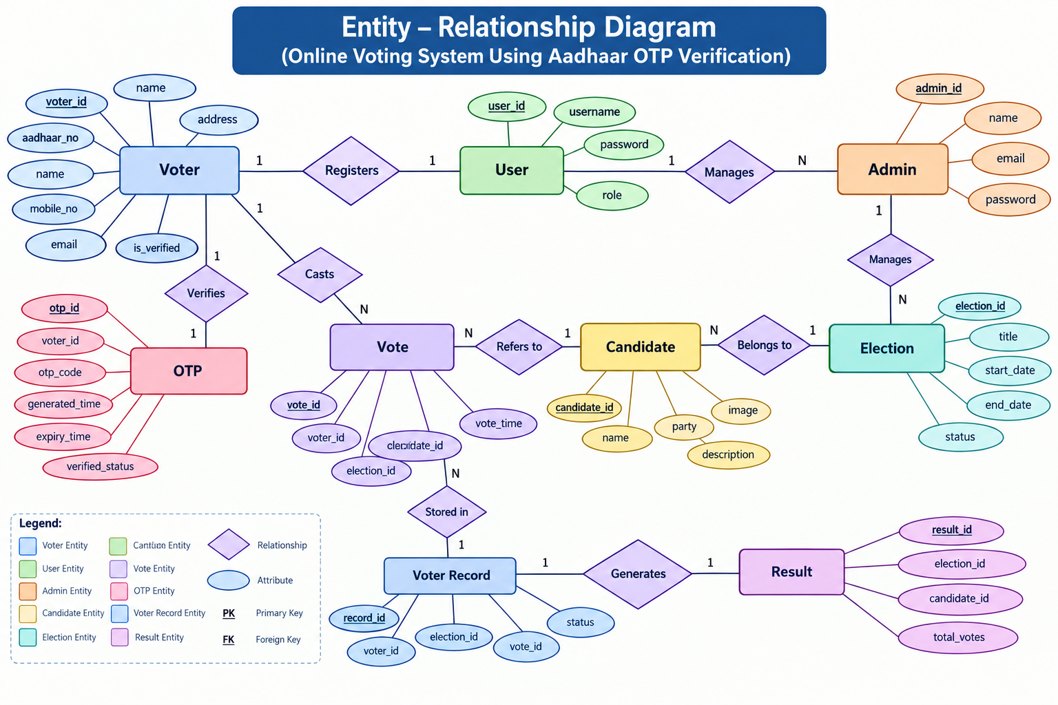
Entity–Relationship (ER) Diagram
07
Database entities, attributes and relationships for the voting workflow
Online Voting System • Team 10
8

Slide 9
Major System Modules
08
Functional responsibilities of the application
Voter Module
Authentication Module
Voting Module
• Enter voter details
• Request / receive OTP
• View candidates
• Cast one vote
• Validate voter details
• Generate OTP
• Check OTP and expiry
• Mark verification status
• Display active candidates
• Check one-vote condition
• Record vote
• Associate vote with election
Admin Module
Result Module
• Manage voters
• Add / remove candidates
• Manage elections
• Monitor voting status
• Retrieve valid votes
• Count votes
• Generate candidate totals
• Display final results
Online Voting System • Team 10
9

Slide 10
Tools & Technologies
09
Technology stack specified in the project
Frontend
Backend
Database
HTML
CSS
JavaScript
Python
Flask
MySQL
Authentication
Development
Testing
OTP
Verification
VS Code
Web Browser
Implementation View
• Frontend handles the user interface; Flask/Python provides backend logic; MySQL stores application data; OTP verification provides the authentication step; VS Code and a web browser support development and testing.
Online Voting System • Team 10
10

Slide 11
Security, Benefits & Limitations
10
Points to be ready for during evaluation
Security Controls
Benefits
Prototype Limitations
• OTP-based verification
• One-vote restriction
• Voter verification status
• Controlled admin functions
• Database-backed vote records
• Reduced paperwork
• Lower manual effort
• Faster vote processing
• Automatic result calculation
• Convenient user workflow
• Internet and system availability are required.
• Real-world elections need stronger security, auditability, privacy, accessibility and independent verification.
• Official Aadhaar/UIDAI integration is outside this academic prototype unless explicitly implemented.
What We Would Add Next
• Role-based access control
• Audit logs
• Stronger session security
• Encrypted sensitive data
• Independent security testing
• Scalable deployment and monitoring
Online Voting System • Team 10
11

Slide 12
Conclusion & Key Takeaway
11
A concise summary for the final evaluation
The project demonstrates a structured online voting workflow built around voter verification, one-vote control, centralized data management and automated result generation.
✓
Voter enters identification details and registered mobile number.
✓
OTP verification adds an authentication step before voting.
✓
Verified voters proceed to candidate selection and one-time vote submission.
✓
Vote, candidate and election information are managed through the database.
✓
Admin functions support election and result management.
✓
The prototype provides a clear foundation for studying authentication, database management and secure voting concepts.
Final Line for Presentation
• “Our main focus is not only online voting, but a complete workflow in which voter verification, vote restriction, data management and result generation work together as one system.”
Online Voting System • Team 10
12

Slide 13
THANK YOU
Questions & Discussion
K. Sandhya Rani • M. Meenakshi
Team 10

