Slide 1
Domain Name System(DNS)
A Presentation by : Meenakshi
Roll no. : 2301730200
Course : BTech CSE AIML – C

Slide 2
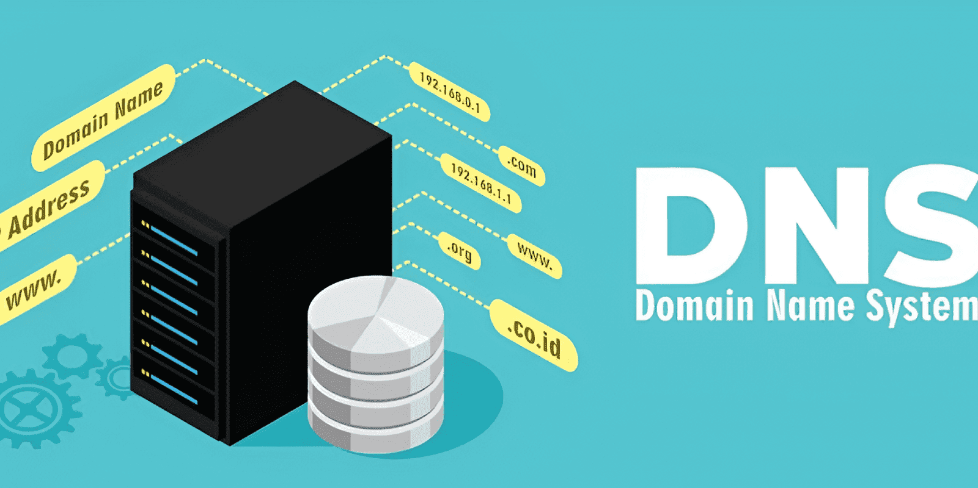
What is DNS?
DNS stands for Domain Name System
• It converts domain names into IP addresses
• Example: google.com → 142.250.x.x
• Called the ‘Phonebook of the Internet’

Slide 3
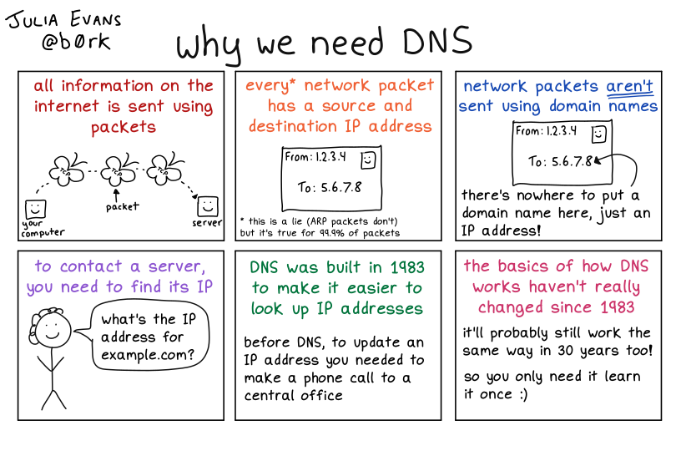
Why DNS is Needed?
• Humans remember names easily
• Computers communicate using IP addresses
• DNS helps connect both

Slide 4
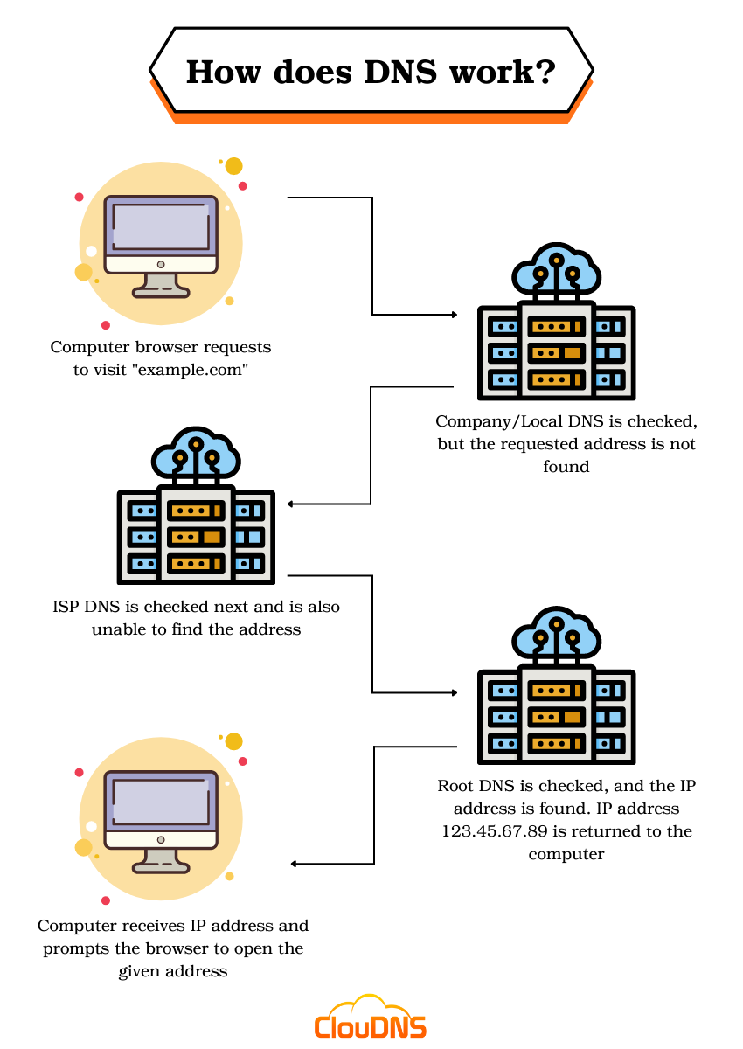
How DNS Works?
1. User enters website name
2. Browser sends DNS request
3. DNS server finds IP address
4. Browser connects to the website

Slide 5
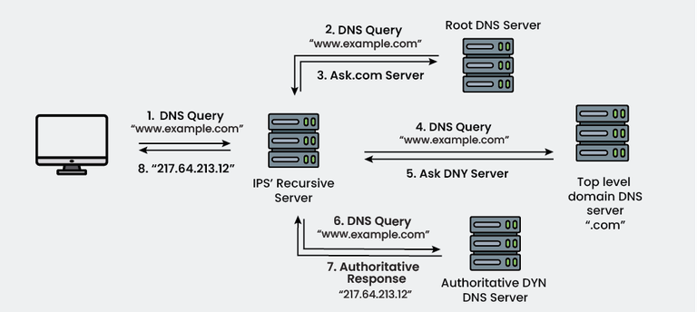
Types Of DNS Servers
• Recursive Resolver
• Root Server
• TLD Server
• Authoritative Server

Slide 6
ADVANTAGES & DISADVANTAGES
• Easy internet access
• Faster website access using caching
• User-friendly system
• DNS attacks possible
• Server failure can affect access
• Requires maintenance

Slide 7
Applications Of DNS
• Web browsing
• Email services
• Cloud services
• Online applications

Slide 8
THANK YOU!

