Slide 1
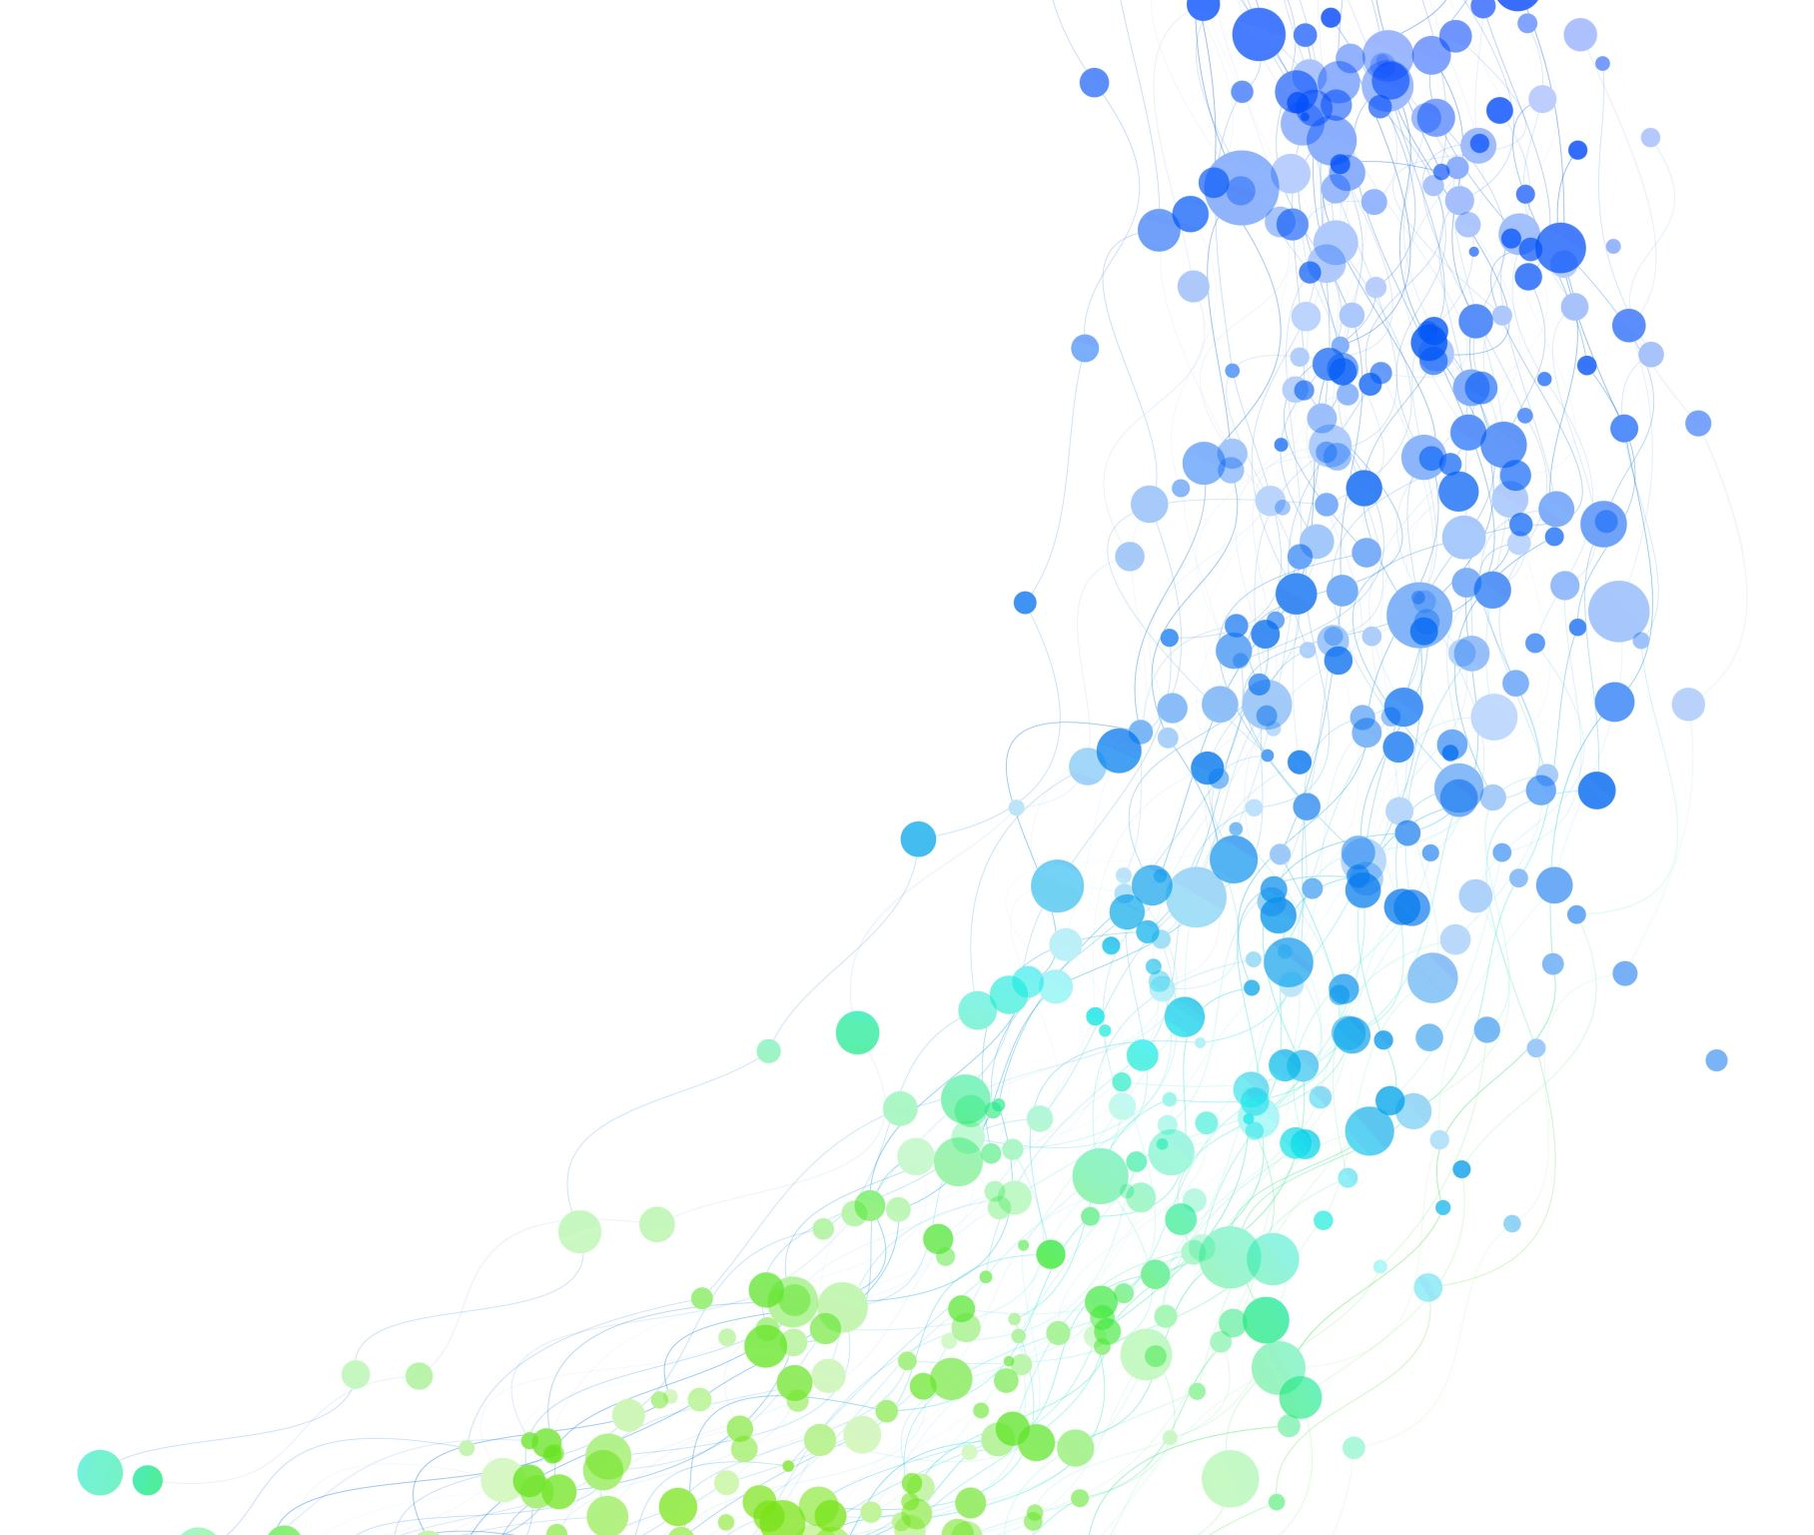
Final Project SCM 516
by Synergy Sparks
Akanksha Manohar
Meenakshi Rajeev Nair
Neha Tiwari
Niketha Venkatesh
Shriya Karthikeyan

Slide 2
Objective
To harness predictive modeling to extract meaningful insights from data using classification and regression algorithms.
Classification dataset: Naïve Bayes, Decision Tree, Random Forest, KNN, feature importance and conditional probability.
Regression dataset: linear and polynomial regression models to predict the values of a response (target) variable.
By the end, we aim to identify the most effective model and assess its generalization ability.
Notes:
The goal of this project is to harness predictive modeling to extract meaningful insights from data using classification algorithms. Machine learning classification is widely used across industries—from predicting disease outcomes in healthcare to fraud detection in finance. The ability to classify new observations accurately can drive impactful decision-making. In this study, we explored five major classification algorithms, tackling challenges such as imbalanced datasets and hyperparameter tuning. By the end, we aim to identify the most effective model and assess its generalization ability.

Slide 3
About Classification Dataset
Customer Churn Prediction Dataset:
Dataset Overview:
We will be predicting customer churn where definition of the target variable is:
Churn: 1 = Customer left,
0 = Customer stayed.
Key Features:
Demographics: Age of the customer.
Subscription Details: Subscription length, contract type (one-year, two-year, month-to-month).
Usage Behavior: Total data usage (GB), number of support calls.
Billing & Payment: Payment method, additional services subscribed.
Objective:
Use machine learning for binary classification to predict churn.
Help businesses identify at-risk customers and reduce churn.
Notes:
If you continuously find you have a high customer churn rate, you’ll quickly find that your business isn’t sustainable.
Getting new customers to sign up to your service is one thing, but it’s not enough to keep your business afloat for long.
To survive, your business needs loyal customers, and that means continuously looking at ways you can improve your service to keep your customers happy.
If you don’t, your business will become unviable.

Slide 4
Preprocessing steps:
﻿﻿Dataset Overview: Collected real-world data with multiple features for classification.
﻿﻿Handling Missing Data: Implemented imputation strategies to ensure data completeness.
Label Encoding: Converted categorical labels into numerical values.
Outlier Removal: Used boxplot analysis to detect and remove outliers.
SMOTE Analysis: Applied SMOTE to balance the dataset.
﻿﻿Data Normalization: Standardized feature values to enhance model efficiency.
﻿﻿Splitting Strategy: Divided data into training and testing sets for evaluation.
Notes:
Before applying machine learning models, it's crucial to preprocess data to ensure accuracy and reliability.
Our dataset consisted of multiple features requiring cleaning, transformation, and structuring for optimal classification.
Address missing values using imputation techniques and enhanced model performance through feature engineering.
Data normalization ensured that models like KNN, which are sensitive to scale, performed effectively.
Finally, we split our dataset into training and testing sets, ensuring a fair evaluation of our models.
Proper preprocessing lays the foundation for accurate and meaningful predictions.

Slide 5
Models
﻿Naïve Bayes
﻿Decision Trees
﻿Random Forest
KNN
Goodness of Models
﻿Confusion Matrix
﻿Accuracy
﻿Precision
Recall
F1 Score
ROC Curve
Notes:
Now that the data is pre-processed, let's move on to model training, where we apply different classification algorithms like ----------- to analyze and predict outcomes based on our customer churn dataset.
To evaluate the performance of each model, we will analyze their confusion matrices along with key metrics such as accuracy, precision, recall, and F1 score. Analyzing these metrics, we gain deeper insights into model reliability and effectiveness in real-world applications.
The confusion matrix provides a detailed breakdown of true positives, true negatives, false positives, and false negatives, helping us understand where the model makes correct predictions and where it misclassifies.
Accuracy measures overall correctness.
Precision indicates how many of the predicted positives are actually correct, making it important in scenarios where false positives need to be minimized (e.g., spam detection).
Recall measures how well the model identifies actual positives, which is crucial when missing positive cases is costly (e.g., disease detection).
F1 Score is a more holistic measure of performance, balances precision and recall.
By analyzing these metrics, we gain deeper insights into model reliability and effectiveness in real-world applications.

Slide 6
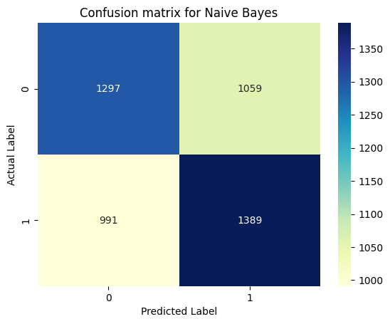
Confusion Matrix for Naïve Bayes
For Naïve Bayes:
  Accuracy: 63%
  Precision: 62%
  Recall: 68%
  F1 Score: 65%
Notes:
- Underfitting
-The performance is lower compared to others, indicating that while it catches a good number of positives (moderate recall),
- It also makes more errors in predicting negatives as positives (reflected in the precision and confusion matrix).

Slide 7
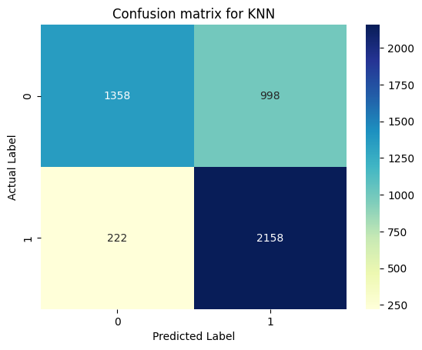
Confusion Matrix for KNN
For KNN:
  Accuracy: 68%
  Precision: 65%
  Recall: 78%
  F1 Score: 71%
Notes:
The KNN model has a good recall (78%), which means it captures most of the actual positives,
but the lower precision (65%) shows that it also has a higher rate of false positives compared to the Decision Tree or Random Forest.
Its overall performance is moderate.
KNN's performance is highly sensitive to the choice of K, making tuning essential.

Slide 8
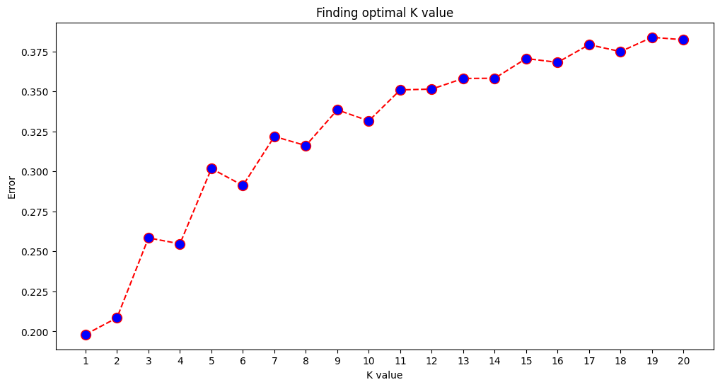
Finding the Optimal K:
Notes:
The graph shows the error rate for K values ranging from 1 to 20. Initially (at low K values), the error rate is low.
This is because with a small K, the model is very sensitive to noise and outliers in the data, leading to overfitting.
As K increases, the error rate generally increases.
This suggests that with larger K values, the model is becoming too generalized and might be underfitting the data.

Slide 9
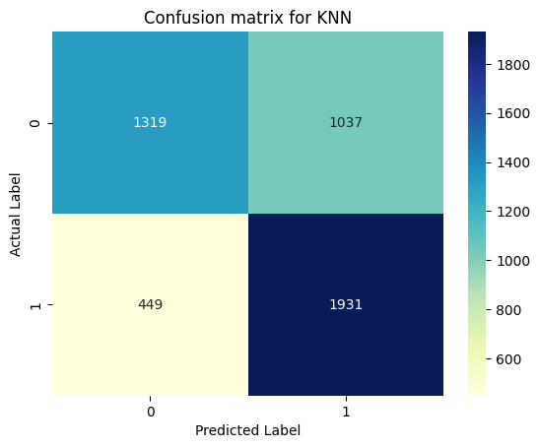
Confusion Matrix for KNN for optimal k=1
For KNN:
  Accuracy: 69%
  Precision: 65%
  Recall: 81%
  F1 Score: 72%
Notes:
The KNN model has a good recall (78%), which means it captures most of the actual positives,
but the lower precision (65%) shows that it also has a higher rate of false positives compared to the Decision Tree or Random Forest.
Its overall performance is moderate.
KNN's performance is highly sensitive to the choice of K, making tuning essential.

Slide 10
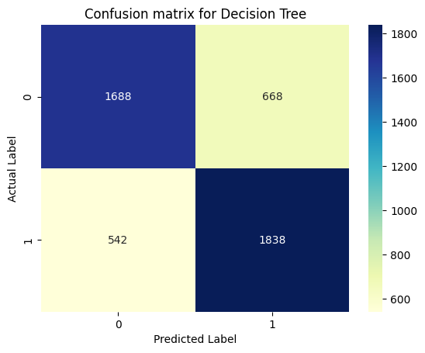
Confusion Matrix for Decision Tree
For Decision Tree:
  Accuracy: 76%
  Precision: 75%
  Recall: 77%
  F1 Score: 76%
Notes:
This model shows better performance overall than Naive Bayes with improved balance in all metrics, indicating it is better at distinguishing between classes.
Decision Trees, on the other hand, are interpretable but prone to overfitting, which means they may not generalize well to new data.

Slide 11
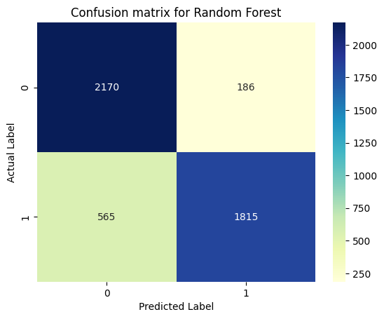
Confusion Matrix for Random Forest
For Random Forest:
  Accuracy: 85%
  Precision: 97%
  Recall: 72%
  F1 Score: 83%
Notes:
. This model has very high precision, meaning when it predicts a positive, it’s almost always correct.
However, its recall is slightly lower (72%), indicating it might be missing some actual positives.
Overall, it has the highest accuracy and F1 score, which suggests it's the best performer on this dataset, though it is slightly conservative in catching all positives.
- Random Forest emerges as a strong performer, mitigating overfitting by averaging multiple decision trees.

Slide 12
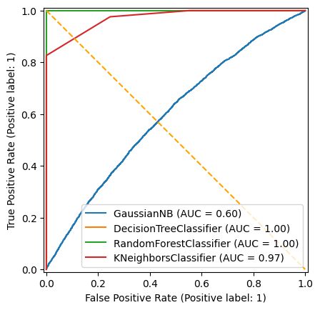
ROC Curve Analysis
(for training dataset):
On TRAINING Data-
Gaussian NB : Its curve is close to the diagonal line, indicating it's barely better than random guessing. The AUC is also relatively low.
K neighbors Classifier : This model performs very well, with its curve close to the top-left corner.
Decision Tree Classifier : This model has perfect performance. However, a perfect AUC often suggests potential overfitting.
Random Forest Classifier : Similar to the Decision Tree, the same caution about potential overfitting applies.
Notes:
The graph shows the ROC curves for four different classification models:
GaussianNB : This model has the worst performance. Its curve is close to the diagonal line, indicating it's barely better than random guessing. The AUC is also relatively low.
DecisionTreeClassifier : This model has perfect performance. However, a perfect AUC often suggests potential overfitting, meaning the model might be too tailored to the training data and may not generalize well to new data.
RandomForestClassifier : Similar to the Decision Tree, the same caution about potential overfitting applies.
KNeighborsClassifier : This model performs very well, with its curve close to the top-left corner. It achieves a high TPR with a low FPR. The AUC of 0.97 indicates strong discriminatory power.

Slide 13
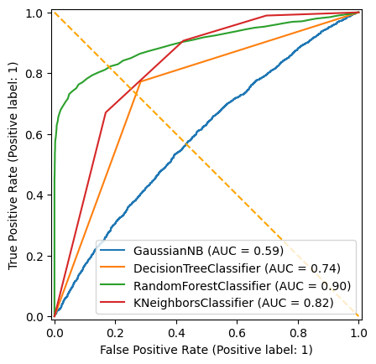
ROC Curve Analysis
(for testing dataset):
On TESTING DATA-
GaussianNB (AUC = 0.59): Very poor. The curve is close to the diagonal line.
Kneighbors Classifier (AUC = 0.82): Reasonably good performance. The curve is above the diagonal line. This model also performs well on the testing data, though not as strongly as Random Forest.
Decision Tree Classifier (AUC = 0.74): Moderate performance. The curve is above the diagonal line, but not significantly.
Random Forest Classifier (AUC = 0.90): Good performance. The curve is well above the diagonal line, indicating a strong ability to distinguish between classes. This model generalizes well to the testing data and is a good choice for this classification task.

Slide 14
Performance Comparison
Evaluating Model Effectiveness
﻿﻿Accuracy: Random Forest achieved the highest accuracy, outperforming other models.
﻿﻿Precision & Recall: Trade-off observed: Decision Trees had high precision but lower recall, while KNN struggled with both.
﻿﻿F1-Score: Random Forest maintained the best balance.
﻿﻿Class Imbalance: Some models were impacted by imbalanced data, affecting recall and precision.
Overall :
Random Forest demonstrated the best overall performance across all metrics.

Slide 15
Classification report of Random Forest
 | Precision | Recall | F1- score | support
Class 0 | 0.79 | 0.92 | 0.85 | 2356
Class 1 | 0.91 | 0.76 | 0.83 | 2380
Accuracy |  |  | 0.84 | 4736
Macro avg | 0.85 | 0.84 | 0.84 | 4736
Weighted avg | 0.85 | 0.84 | 0.84 | 4736
Conclusion: The model has an overall accuracy of 84% (0.84).
This means it correctly predicted the class labels for 84% of the samples in the test set.
Notes:
The Random Forest model shows good performance on this binary classification task, achieving an accuracy of 84% with a balanced F1-score for both classes.
The model is particularly strong in identifying class 0 instances (high recall) and in being correct when it predicts class 1 (high precision).

Slide 16

Let's see how well our model performs on unseen data?

Slide 17
New dataset:
 | Customer ID | Age | Subscription Length (months) | Monthly Bill ($) | Total Usage (GB) | Support Calls | Contract Type | Payment Method | Has Additional Services
1 | 10001 | 43.296 | 33.66 | 107.8 | 230.95 | 1 | Month-to-Month | Debit Card | 1
2 | 10002 | 55.704 | 48.45 | 144.6 | 398.05 | 9 | One Year | Credit Card | 1
3 | 10003 | 35.928 | 27.08 | 71.65 | 131.65 | 1 | Month-to-Month | PayPal | 0

Slide 18
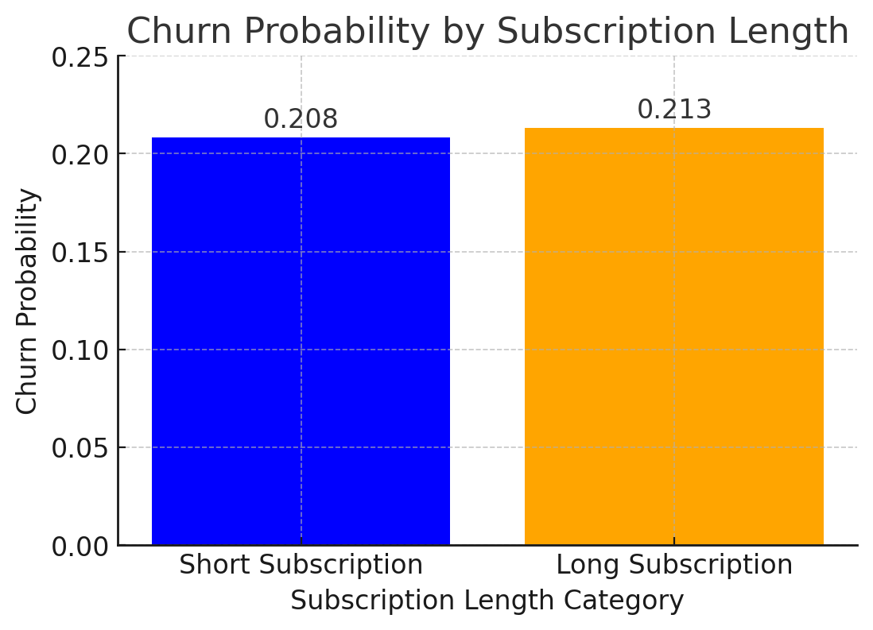
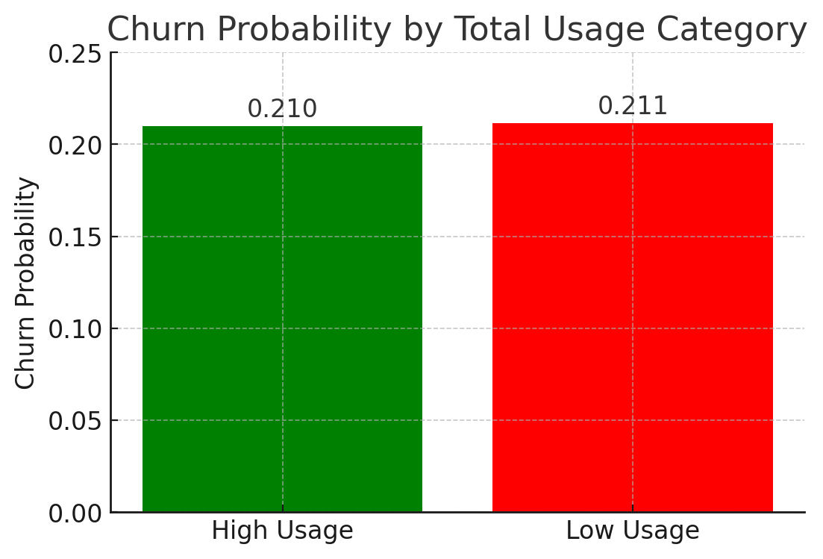
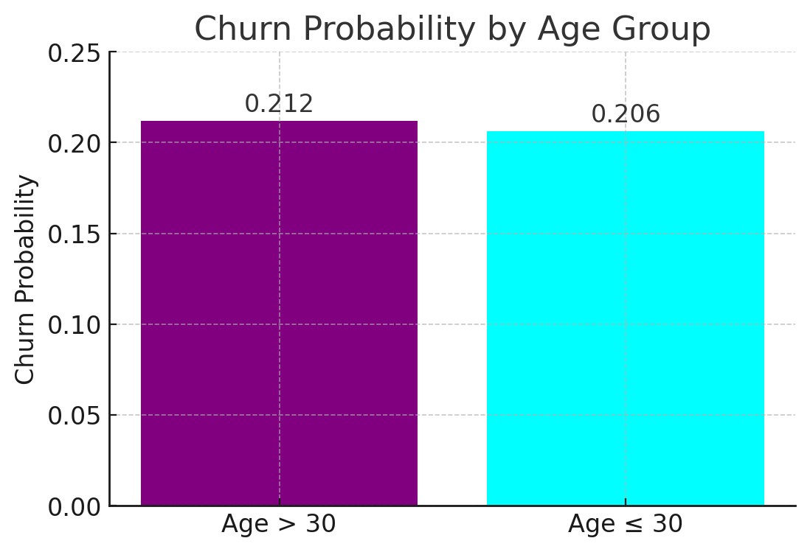
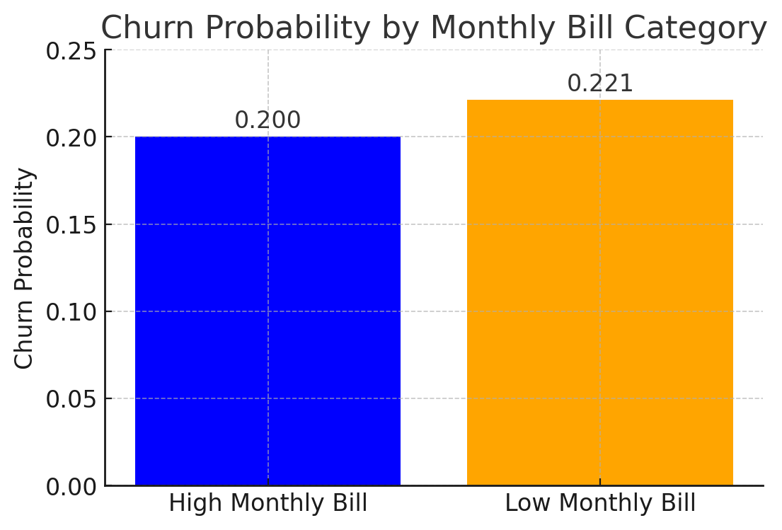
Feature Importance using Naïve Bayes
Notes:
Graph 1:
Customers with a lower monthly bill have a slightly higher churn probability (22.12%) compared to those with a higher monthly bill (20.02%).
Since the difference is small, Monthly Bill alone is likely not a strong predictor of churn.
Graph 2:
The difference is extremely small (21.00% vs. 21.14%), reinforcing that Total Usage is not a strong predictor of churn.
Graph 3:
A bar chart comparing churn probability for customers above and below 30 years old.
The difference is minimal (21.19% vs. 20.64%), suggesting that Age > 30 is not a significant predictor of churn on its own.

Slide 19
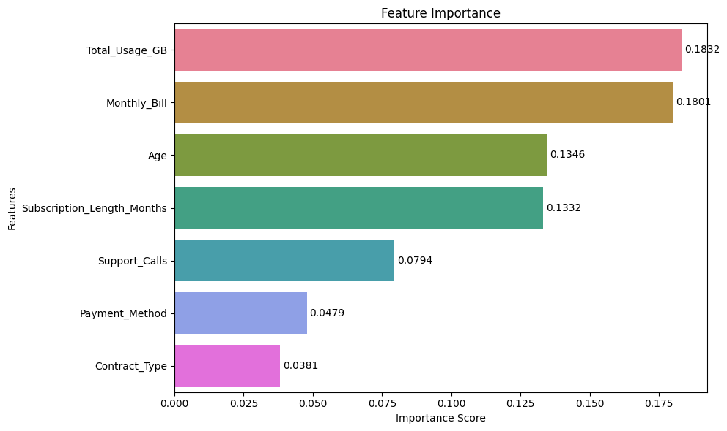
Importance of Feature
(determined using Random Forest):
Notes:
Importance Scores: The numbers at the end of each bar represent the importance scores.
These scores indicate how much each feature contributes to the model's predictions.
Higher scores mean greater importance.
Hence, we can conclude that the total amount of data used by a customer is the strongest predictor in the model.
Understanding feature importance helps in interpreting the model's behavior and understanding the underlying relationships in the data.

Slide 20
Which model performed best?
Random Forest emerged as the top-performing model due to its ensemble learning approach. Unlike a single decision tree, it aggregates predictions from multiple trees, significantly improving accuracy.
One of its key strengths is robustness—Random Forest is less sensitive to noisy data and missing values compared to other classifiers.
It also provides feature importance rankings, helping us understand which variables influence predictions the most.
Moreover, it strikes an excellent balance between bias and variance, avoiding overfitting while maintaining high predictive power.
Our results confirm that Random Forest consistently outperformed other models across all key performance metrics.
Notes:
Ensemble Learning: Combines multiple decision trees to improve accuracy and reduce overfitting.
﻿﻿Robust to Noise: Handles missing data and noisy features better than single-tree models.
﻿﻿Feature Importance: Effectively identifies key predictors, improving interpretability.
﻿﻿Balanced Bias-Variance: Avoids high variance of individual trees while maintaining predictive power.
﻿﻿Consistent Performance: Achieved highest accuracy, precision, recall, and F1-score in our tests.

Slide 21
New dataset with churn values:
 | Customer ID | Age | Subscription Length (months) | Monthly Bill ($) | Total Usage (GB) | Support Calls | Contract Type | Payment Method | Has Additional Services
1 | 10001 | 43.296 | 33.66 | 107.8 | 230.95 | 1 | Month-to-Month | Debit Card | 1
2 | 10002 | 55.704 | 48.45 | 144.6 | 398.05 | 9 | One Year | Credit Card | 1
3 | 10003 | 35.928 | 27.08 | 71.65 | 131.65 | 1 | Month-to-Month | PayPal | 0
No Churn | Churn = 1
62% | 38%
72% | 28%
61% | 39%

Slide 22
Are there any signs of overfitting?
While machine learning models offer powerful predictive capabilities, they come with challenges and limitations.
Data quality —no model can outperform the quality of its input data.
Overfitting – where a model performs exceptionally well on training data but struggles on new data.
Computational cost –models like Random Forest require significant processing power, making them less feasible for real-time applications.
Hyperparameter tuning – finding the right balance between bias and variance.
Interpretability – making it difficult to explain predictions, especially in fields requiring transparency, such as healthcare and finance.

Slide 23
Key Insights from Conditional Probability Analysis of Customer Churn:
Churn Risk Factors:
Customers with high monthly bills ($90+), heavy data usage (300GB+),
or multiple support calls (5+ calls) → (~20%)
Month-to-Month contract customers (especially heavy users) are at higher churn risk (33%)
Customers with long-term contracts (2+ years, 36+ months) have slightly lower churn (~21%)
Older customers (60+) with low usage (<100GB) have the lowest churn probability (~18%)

Slide 24

Regression Analysis:
Notes:
So, I will be taking it up from here about regression analysis. Today, I'll be discussing our analysis of a housing rent dataset using multiple linear and polynomial regression.

Slide 25
About Regression Dataset
House Rent Prediction Dataset:2
Dataset Overview:
Target variable is rent.
Key Features:
Includes numerical attributes like BHK, size, bathroom.
Objective:
Apply Multiple Linear and Polynomial Regression to predict rental prices based on relevant features.
Aims to predict rent prices based on other independent variables.
Analyze the impact of different property attributes on rent to improve decision-making for renters and property owners.
Includes categorical attributes like floor level, city, furnishing status and tenant preferences.
Notes:
- A quick overview – this dataset consists of rental listings from various cities, providing details like rent price, property size, number of bedrooms, and other relevant attributes.
- Key features include 12 columns and 4746 entries, with a mix of numerical and categorical data.
- Our target variable is rent, which we aim to predict using various property characteristics.
- Our main objective is to develop regression models that can estimate rental prices based on key factors like size, furnishing status, and location.
Through this, we hope to understand which features have the most significant impact on rent and improve decision-making for renters and property owners.
- With that, let’s dive into the dataset and explore the methodology!"

Slide 26
Preprocessing steps:
﻿﻿Dataset Overview: Real-world housing rental data with features like rent, size, location, and furnishing status.
﻿﻿Handling Missing Data: Used imputation techniques to ensure data completeness.﻿﻿
Categorical to Numerical Conversion: Transformed categorical features for model compatibility.
One-Hot Encoding: Applied one-hot Encoding to multi-category variables to retain information.
Boolean Conversion: Converted Boolean columns to integers (0/1).
﻿﻿Splitting Strategy: Split data into training and testing sets for evaluation.
Notes:
Before applying machine learning models, it's crucial to preprocess data to ensure accuracy and reliability.
Our dataset consisted of multiple features requiring cleaning, transformation, and structuring for optimal classification.
Address missing values using imputation techniques and enhanced model performance through feature engineering.
Data normalization ensured that models like KNN, which are sensitive to scale, performed effectively.
Finally, we split our dataset into training and testing sets, ensuring a fair evaluation of our models.
Proper preprocessing lays the foundation for accurate and meaningful predictions.

Slide 27
Independent variables (after preprocessing):
 | BHK | Size | Furnishing status | Bathroom | Floor number | Carpet Area | Super Area | Chennai | Delhi | Hyderabad | Kolkata | Mumbai
0 | 2 | 1100 | 0 | 2 | 0 | False | True | False | False | False | True | False
1 | 2 | 800 | 1 | 1 | 1 | False | True | False | False | False | True | False
2 | 2 | 1000 | 1 | 1 | 1 | False | True | False | False | False | True | False
3 | 2 | 800 | 0 | 1 | 1 | False | True | False | False | False | True | False
4 | 2 | 850 | 0 | 1 | 1 | True | False | False | False | False | True | False
Notes:
Here, as we can see this is the head of our dataframe which shows just the independent variables that help predict our target variable – rent. Here we have converted the categorical variables to numerical values.

Slide 28
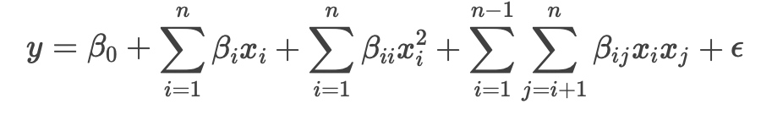
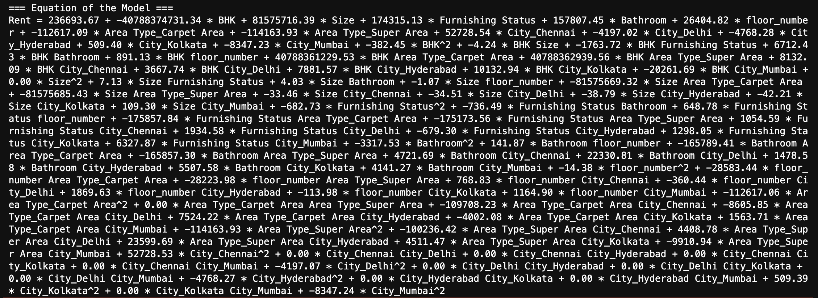
Equation of the Model:
Notes:
y is the dependent variable (the variable you are trying to predict).
β0​ is the intercept term.

Slide 29

Interpretation of the Regression Equation
Rent is influenced by multiple factors, including:
  Size: Larger properties generally have higher rents.
  BHK: Larger number of rooms tend to have a higher impact on rents.
  Furnishing Status: Furnished properties command higher rents.
  Bathrooms: More bathrooms increases the rent.
  Floor Number: Higher floors slightly increase rent.

Slide 30
Regression model methods:
Multiple Linear Regression
Polynomial Regression
Notes:
- To determine relationship between dependent and independent variables.

Slide 31

Interpretation of R2 and adjusted R2
(using Linear & Polynomial Regression):
For Polynomial Regression
(degree=2):
  R2: 0.8137733813128744
  Adjusted R2: 0.7942618613107308
For Multiple Linear Regression:
  R2: 0.5228843329265807
  Adjusted R2: 0.5167739935403682

Slide 32
Interpretation of R2 & R2 adjusted values:
Multiple Linear Regression:
  R2 = 0.52→ The model explains 52.29% of the variance in rent prices can be explained by the independent features.
  Adjusted R2 → After accounting for the number of predictors, the model still explains 51.7% of the variance, confirming that adding more features did not drastically improve the fit.
Polynomial Regression:
  R2 = 0.81 → The model explains 81.38% of the variance in rent prices can be explained bu the independent variable , which is significantly higher than the multiple linear regression model.
  Adjusted R² = 0.51 →After adjusting for additional predictors, the model still explains 79.4% of the variance.
  INTERPRETATION:
  Polynomial regression outperforms multiple linear regression in explaining the data, indicating that a nonlinear model is more suitable for our dataset.
Notes:
Polynomial reg with degree 2 provides the best fit model.

Slide 33
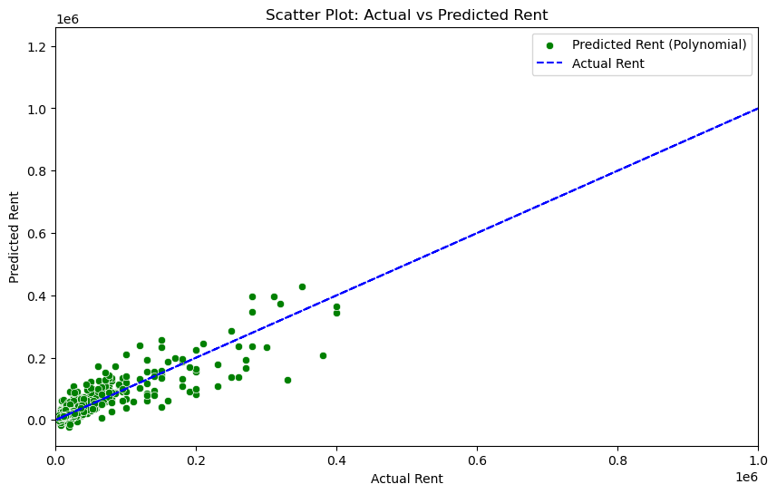
Actual vs Predicted Rent:
Notes:
A good model fit indicates that the model is
able to accurately capture the relationship
between the dependent and independent
variables.

Slide 34
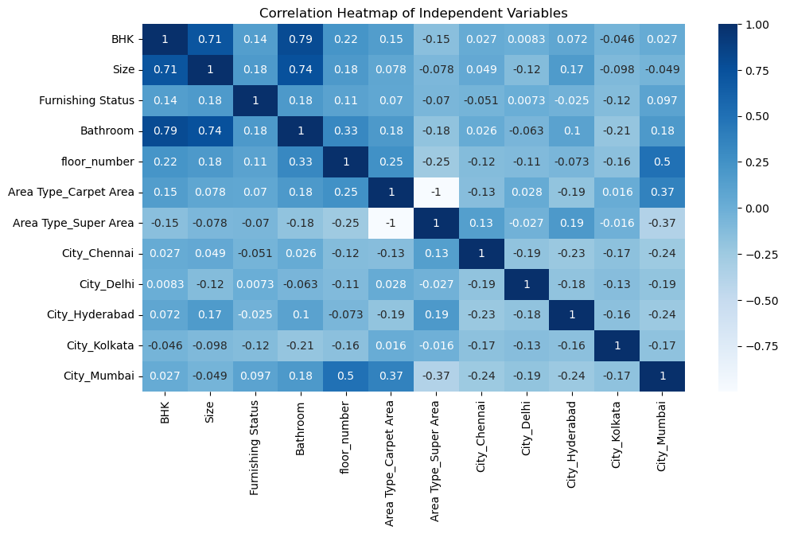
Correlation between Input variables:
Notes:
Strong positive correlation with Bathroom (0.79) and BHK.
Strong positive correlation with Size (0.74) and Bathroom.
Strong positive correlation with BHK (0.71) and Size.
The heatmap indicates that some variables are highly correlated with each other (e.g., BHK Size and Bathroom), which might indicate multicollinearity in a regression model. This could affect the performance and interpretability of the model, so it might be necessary to address these correlations, possibly by removing or combining some variables.

Slide 35
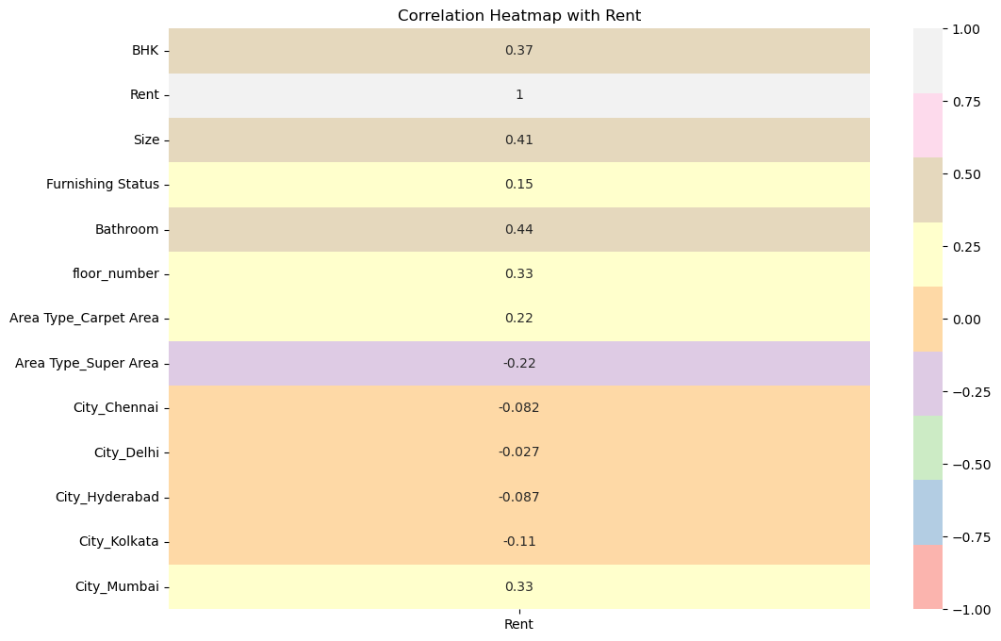
Correlation between Input & Output variable:

Slide 36
Visualization

Slide 37
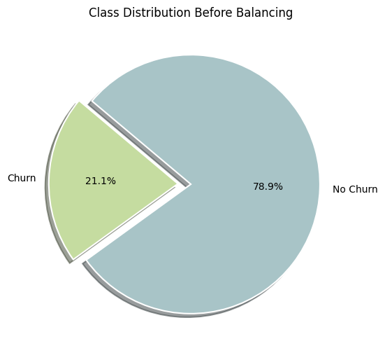
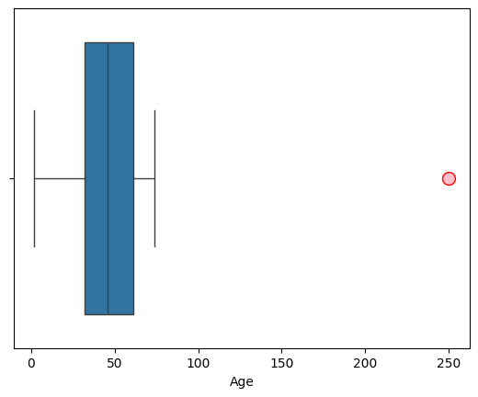
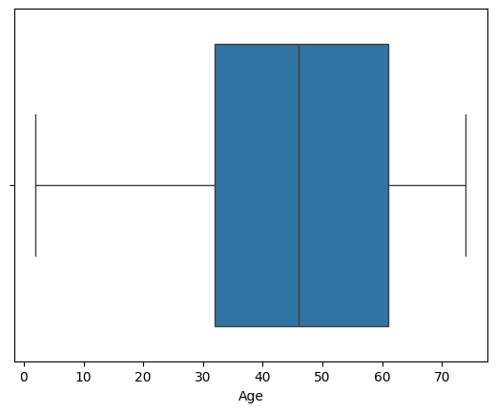
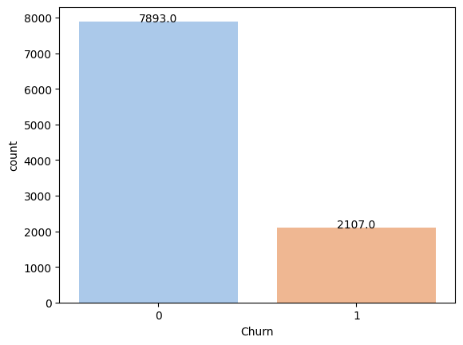
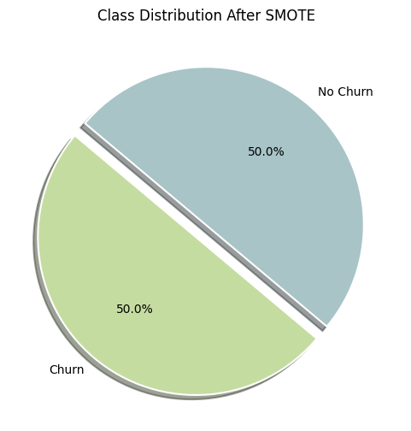
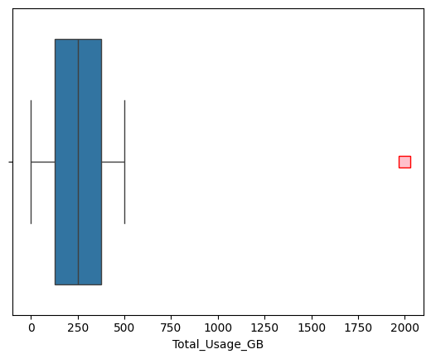
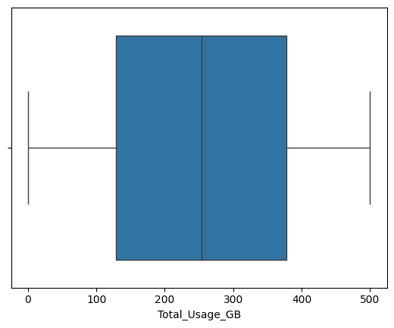
Visualizations for Binary Classification Analysis:
Class Distribution Before Balancing
Outliers detected and removed for “Age” column
Imbalanced data
Class Distribution After SMOTE
Outliers detected and removed for “Monthly Bill” column

Slide 38
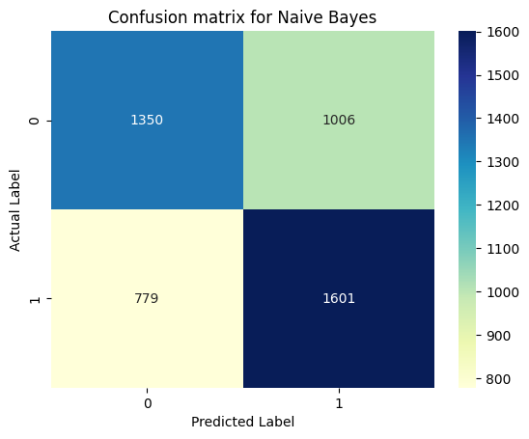
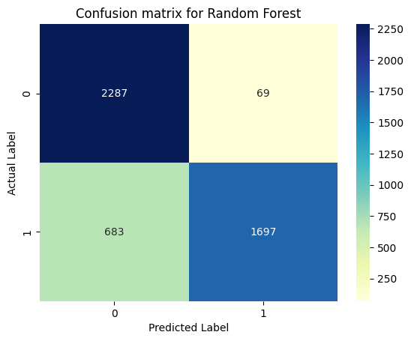
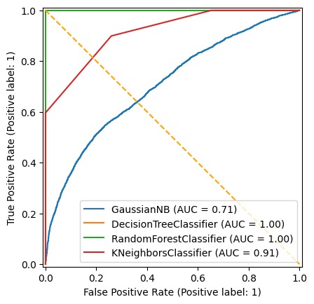
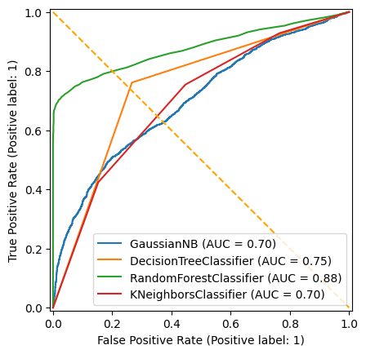

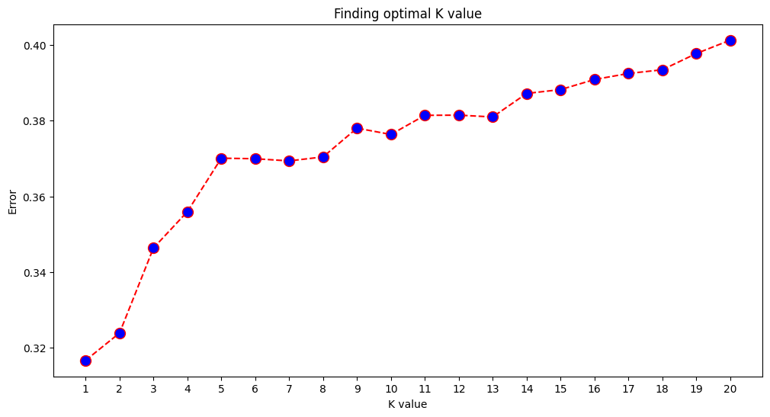
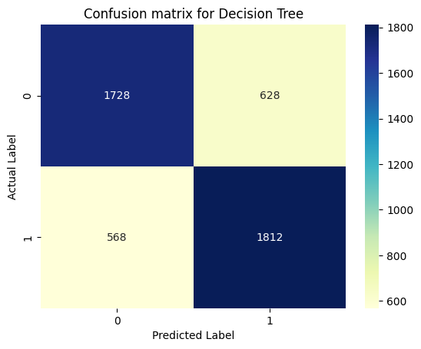
Visualizations for Binary Classification Analysis:
confusion matrix for Naive Bayes
confusion matrix for Random Forest
Features importance using Random Forest
ROC Curve for Training dataset
Finding best value of K in KNN
confusion matrix for Decision Tree
confusion matrix for KNN
ROC Curve for Testing dataset

Slide 39
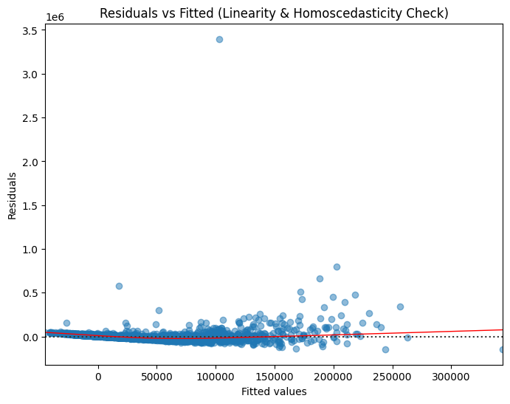
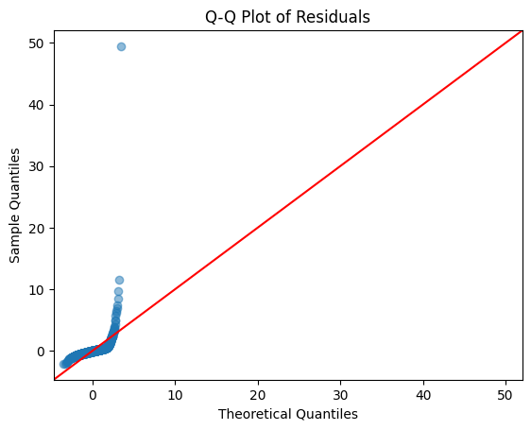
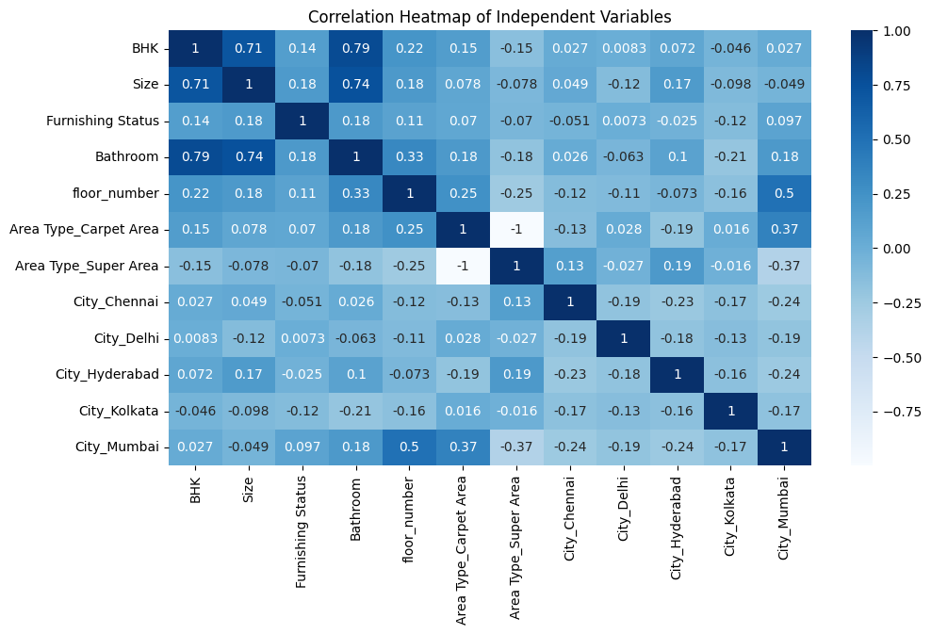
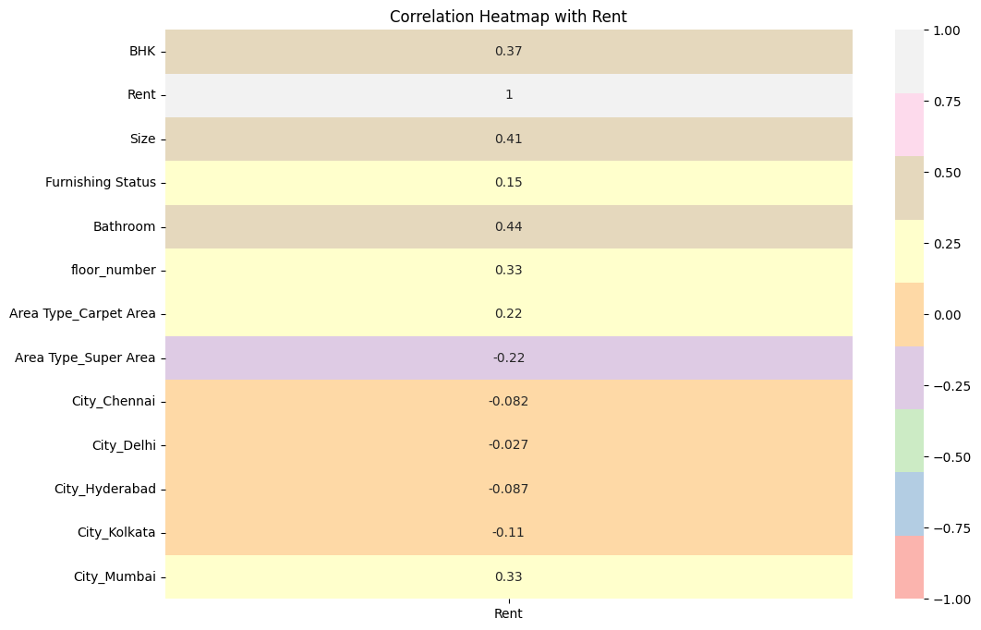
Visualizations for Regression Analysis:
Residuals vs Fitted (Homoscedasticity)
Q-Q Plot of Residuals
Correlation Heatmap of Independent Variables
Correlation Heatmap with Rent
Scatter Plot: Actual vs Predicted Rent

Slide 40
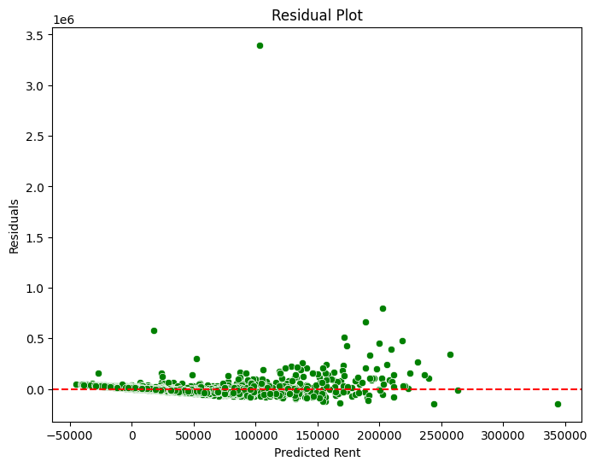
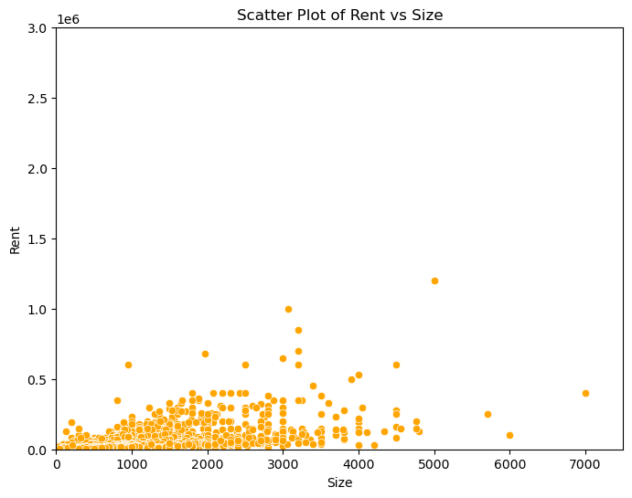
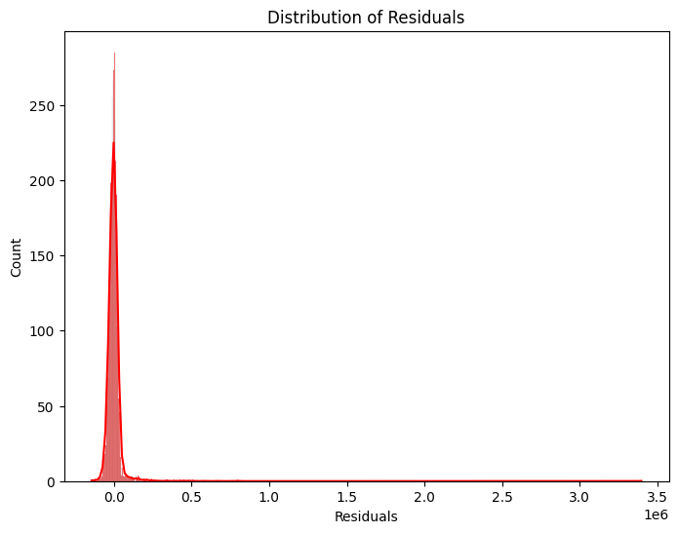
Visualizations for Regression Analysis:
Residual Plot
Scatter Plot of Rent vs Size
Distribution of Residuals

Slide 41

Thank you!

