Slide 1
Analyzing Happiness Factors of a Country
By : Meenakshi Shankara

Slide 2
Introduction
The Happiness of a country depends on various factors that cumulatively affect the happiness score.
The World Happiness 2017 was first released at the United Nations. The happiness indicators are factored in when making decisions. The Happiness scores are calculated based on the Economy, Health, Family, Freedom, Generosity, Trust on Government, Freedom of expression etc.
This project analyzes the Happiness dataset of 155 countries for the year 2017.

Slide 3
Attributes influencing happiness
Country-Country name
Happiness Rank - Classification of the country each year
Happiness Score
Economy – GDP per Capita score
Government Trust – general perception of trust in their governments
Generosity- perception of generosity experienced by the respondents
Family – influence of family on happiness
Freedom- general freedom of expression

Slide 4
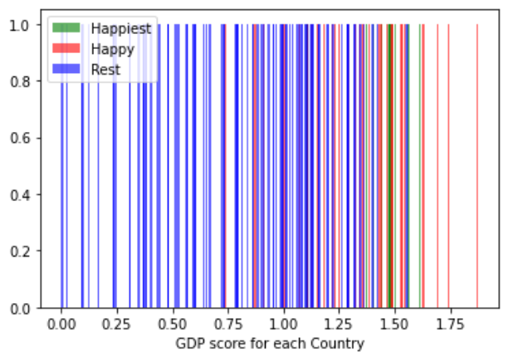
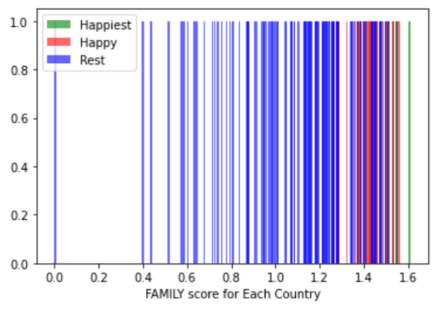
Histogram Plots for the variables

Slide 5
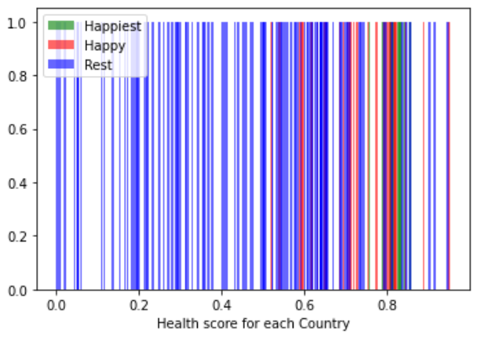
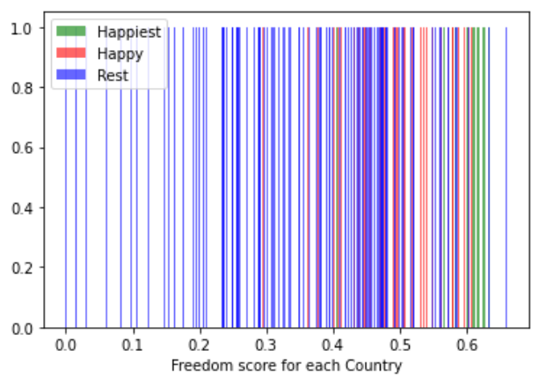
Histogram Plots for the variables

Slide 6
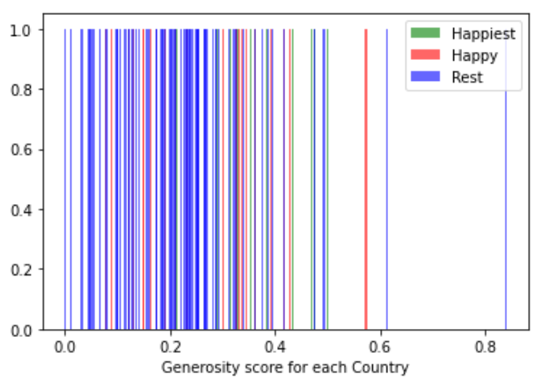
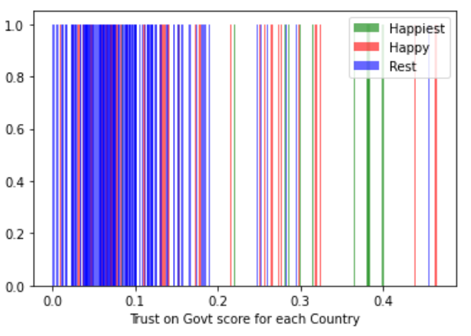
Histogram Plots for the variables

Slide 7
Summary & Analysis on Histograms
Each line in the histogram represents a country. Green lines represent the variable value for the countries with happiness scores >= 7, red lines for countries with happiness scores between 6 and 7, blue lines for countries with happiness scores less than 6.
We can clearly see that for most of the variables the values are higher for the happiest countries and are relatively lesser for less happy countries.
Of course, there are outliers for each variable. But for most part the variables positively affect the happiness score.

Slide 8
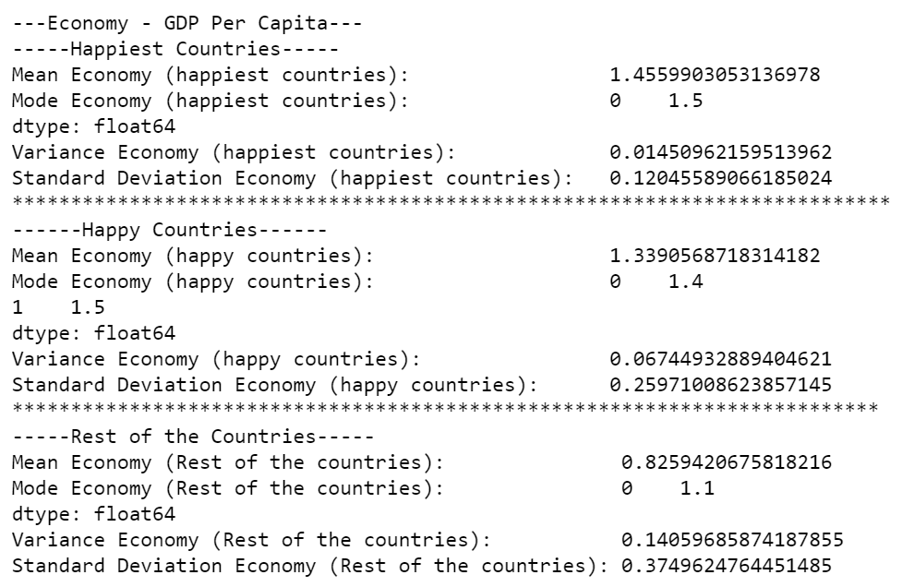
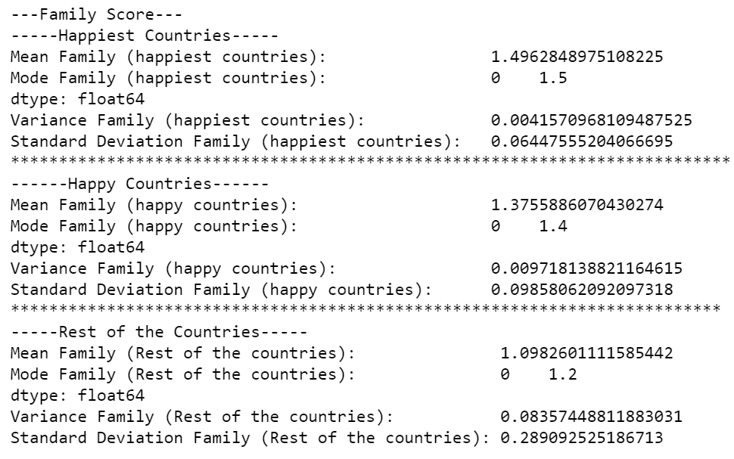
Mean, mode, variance, standard deviation
ECONOMY - GDP
family

Slide 9
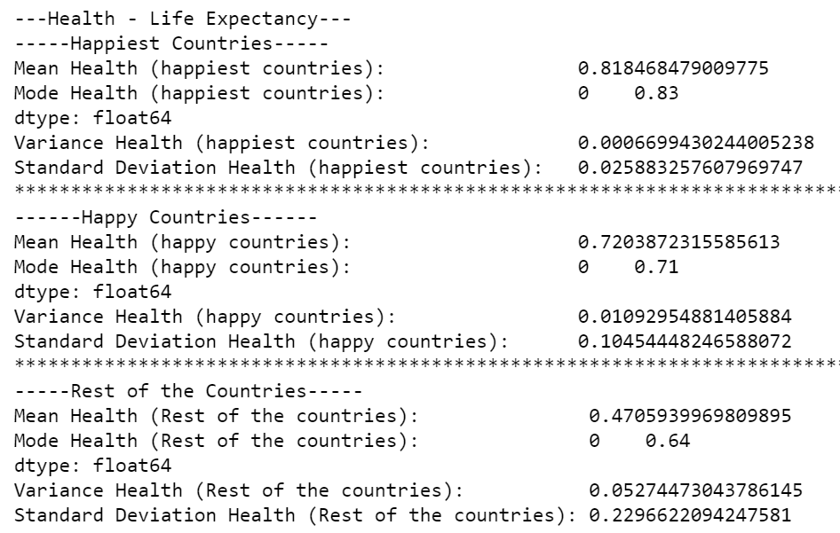
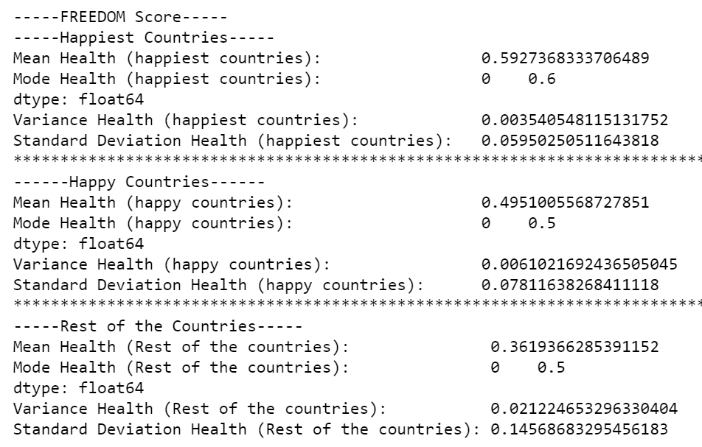
Mean, mode, variance, standard deviation
Health – life expectancy
freedom

Slide 10
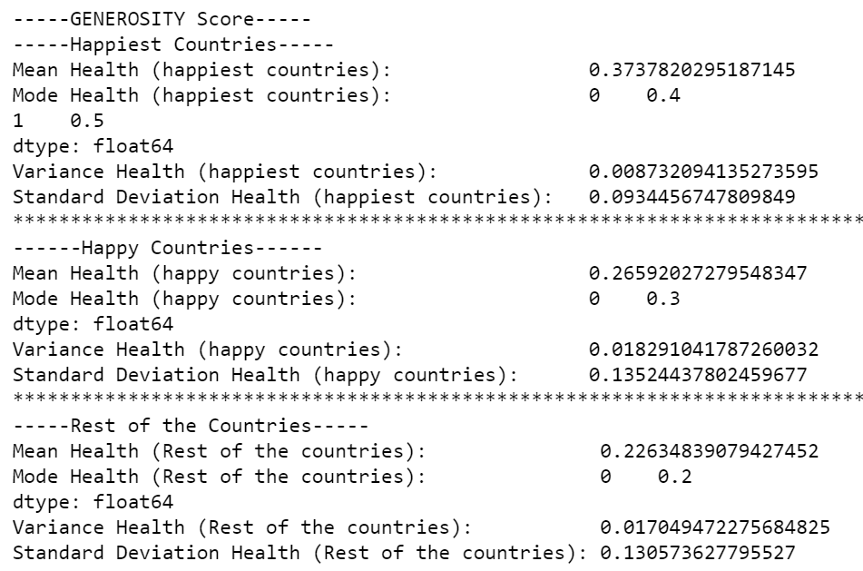
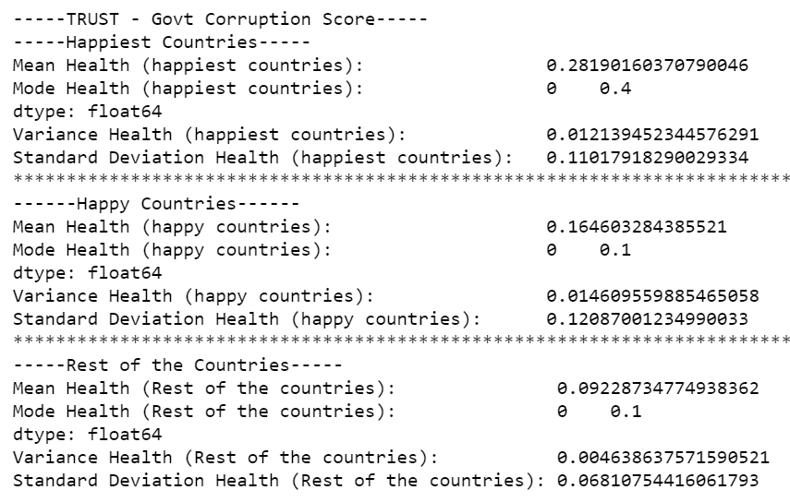
Mean, mode, variance, standard deviation
Generosity
Trust on government

Slide 11
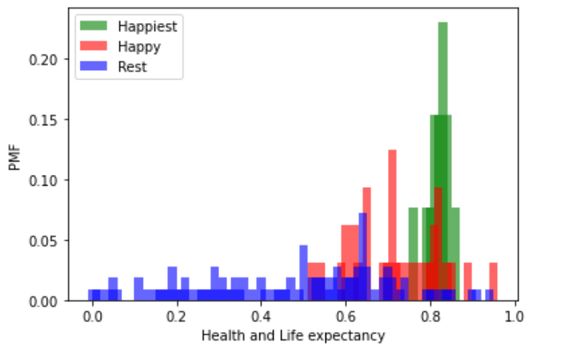
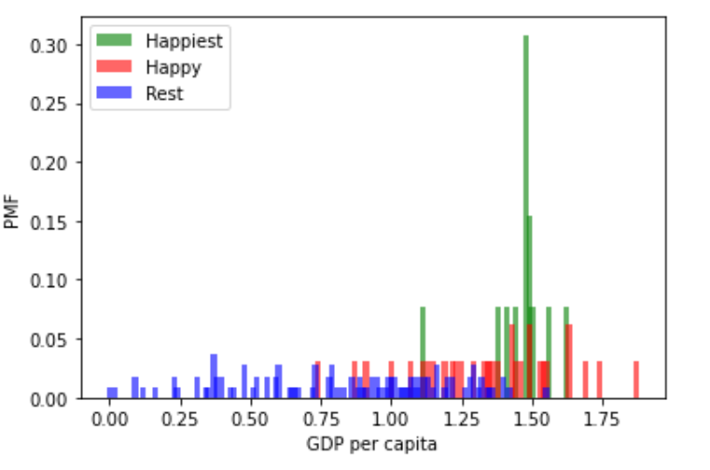
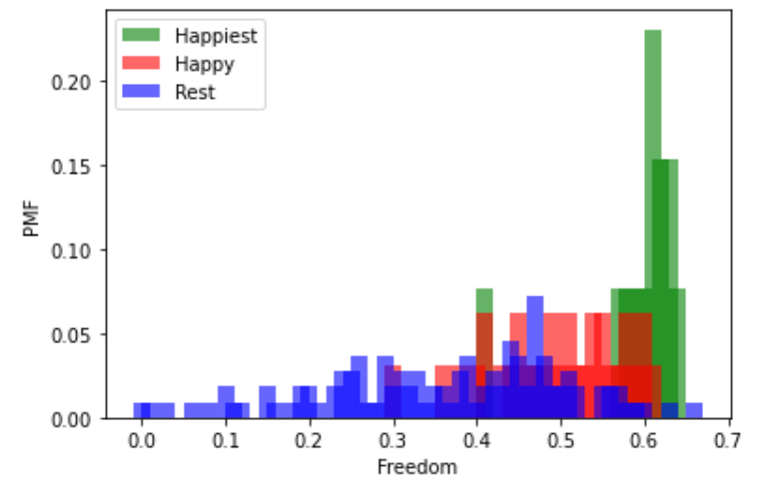
Probability mass functions

Slide 12
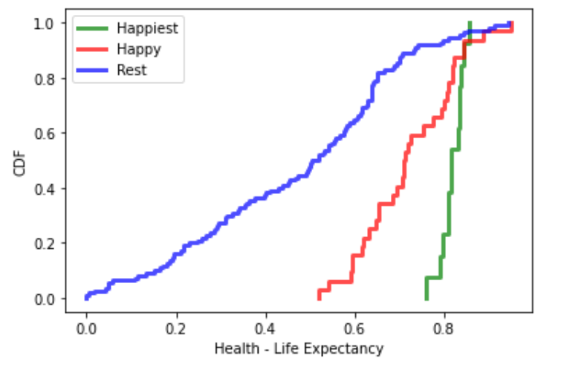
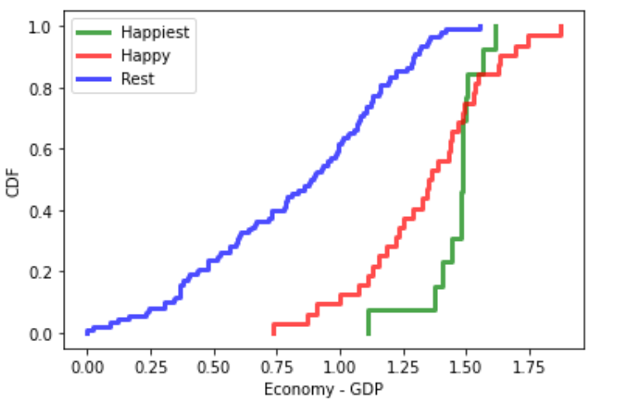
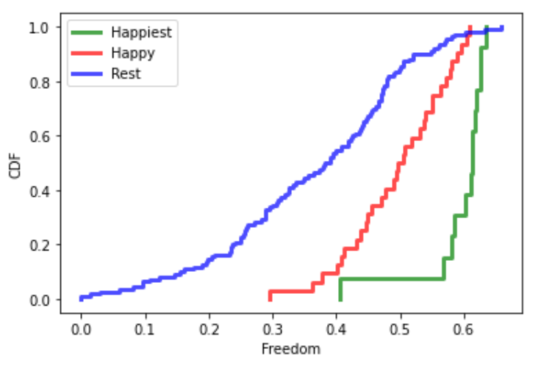
Cumulative distribution functions
The CDF for GDP, health, freedom all point to higher values for the happiest countries indicating that the variables positively affect the overall happiness score, i.e., higher the GDP, health score, freedom score, happier the country could be.

Slide 13
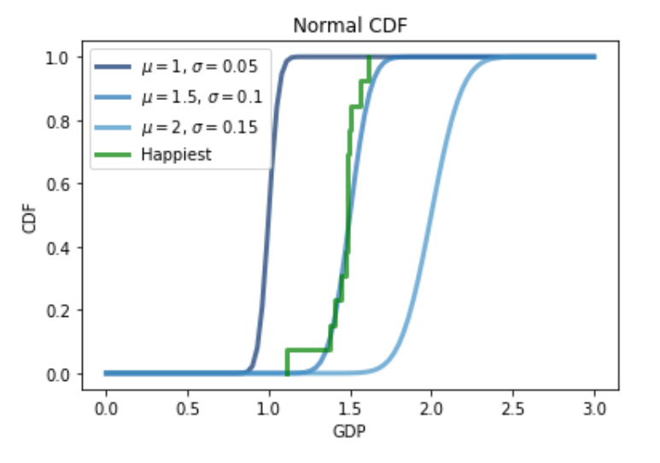
The GDP cdf for the happiest countries is moving along with the normal distribution.
Normal Cumulative distribution functions

Slide 14
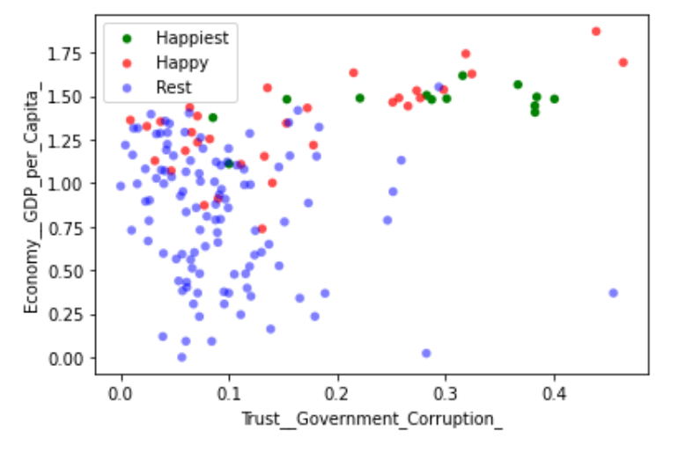
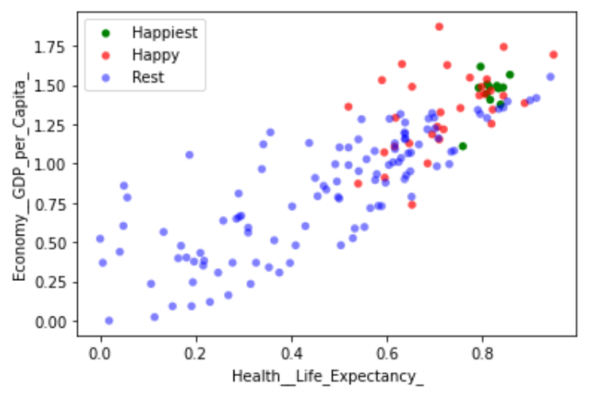
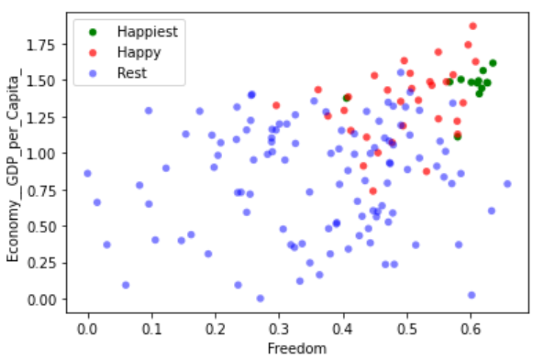
Scatter Plots
The scatter plots show that the relation between GDP and trust on govt or health or freedom is weak. For instance, we can see higher freedom score does not relate to high GDP.
But if the health, trust or freedom are high then the GDP could potentially be high as we see for the happiest countries.

Slide 15


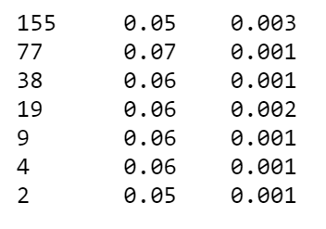
Hypothesis Test – Using Mean difference
The below hypothesis were tested -
1. GDP is higher for happiest countries than the happy and rest of the countries.
2. Health and life expectancy plays a critical role in the happiness score of a country
The hypothesis were tested using mean difference.
The tests for both the hypothesis returned positive results indicating positive effects of the variables on the happiness score of the country.
But the size of the data set should be noted as it is only 155 countries. The tests may return a different result if we divide each country into smaller regions and then assign scores for each variable.

Slide 16
References
Think Stats, Allen B Downey
Data set from -
https://www.kaggle.com/unsdsn/world-happiness
Referred below project on the data set by Leokobi -
https://www.kaggle.com/leonardokobiraki/world-happiness-report-analysis#World-Happiness-Report

