Slide 1
Label-Flip Poisoning Attack on Malware Detection

Slide 2
Title slide
Label‑Flip Poisoning Attack on ML‑based Malware Detectors
Your Name, Affiliation
Based on: Aryal et al., “Analysis of Label‑Flip Poisoning Attack on Machine Learning Based Malware Detector”
Paper: http://arxiv.org/pdf/2301.01044
Dataset: https://www.kaggle.com/competitions/malware-detection/data

Slide 3
Introduction
Why ML for malware detection:
  Scale: billions of samples → manual triage infeasible
  Generalization: beyond signatures and static rules
  Adaptivity: retrain as threats evolve
Feature sources:
  Static (PE headers, imports, byte/strings)
  Dynamic (behavior/API traces, network I/O)
  Hybrid/metadata (reputation, sandbox outcomes)
Models in practice/research:
  Linear/logistic, SVMs
  Trees/ensembles (Random Forest, boosting)
  k‑NN, MLPs, deeper architectures

Slide 4
Problem definition
Objective (paper): measure how training‑time label flips impact malware detector performance across model families
Threat model: flip y for a fraction of training samples (10–20%); clean test set
Why this paper:
  Realistic: weak/automated labeling pipelines introduce noise
  Comparative: 8 classic models → family‑specific brittleness
  Security: recall degradation = missed malware (critical risk)
Why evaluate across models:
  Linear boundaries shift under noise; trees often more resilient; MLPs mixed

Slide 5
Methodology (paper)
Dataset: VT/VirusShare‑style binary labels (paper’s corpus)
Models (8): SGD, RandomForest, LogisticRegression, KNN, LinearSVM, DecisionTree, Perceptron, MLP
Protocol:
  Stratified train/test; identical split for clean vs. poisoned
  Poisoning: random label flips at 10% and 20% of training labels
  Metrics: Accuracy, Precision, Recall; confusion analyses

Slide 6
Methodology (our implementation)
Data: ML-case-study/Kaggle-data.csv (label: legitimate)
Split: stratified 80/20, seed=42; sample ≈10k rows for runtime
Preprocessing: median impute; scaling for linear/NN/KNN; trees use imputation only
Models: same 8; unified pipelines
Command:
python ML-case-study/run_experiments.py \
--input-csv ML-case-study/Kaggle-data.csv \
--label-col legitimate \
--sample-size 10000 \
--test-size 0.2 \
--flip-fracs 0.0 0.1 0.2 0.3 0.4 \
--seed 42 \
--output-dir ML-case-study/outputs

Slide 7
Results and Discussion (paper findings)
Model | Acc Δ | Rec Δ | F1 Δ
SGD | −0.8% | −22.1% | −6.6%
Decision Tree | −13.0% | −26.5% | −19.8%
Random Forest | −4.2% | +11.3% | −0.4%
Logistic Regression | −9.8% | −14.6% | −13.4%
KNN | −11.1% | −15.7% | −14.7%
Linear SVM | −27.5% | −63.7% | −52.8%
Perceptron | −46.7% | −64.7% | (n/a)
MLP | +15.8% | −8.9% | +15.5%
10% flip — percent change vs. clean (paper):

Slide 8
Source: Aryal et al. — see paper for full figures

Slide 9
Results and Discussion (paper relevance)
Trends supported by paper visuals:
  Recall suffers most → more false negatives (missed malware)
  Linear/SVM degrade sharply; tree ensembles more resilient at low flip
  Patterns persist across settings/seeds
Insert paper screenshots (tables/plots) here if permitted
Reference: Aryal et al. PDF

Slide 10
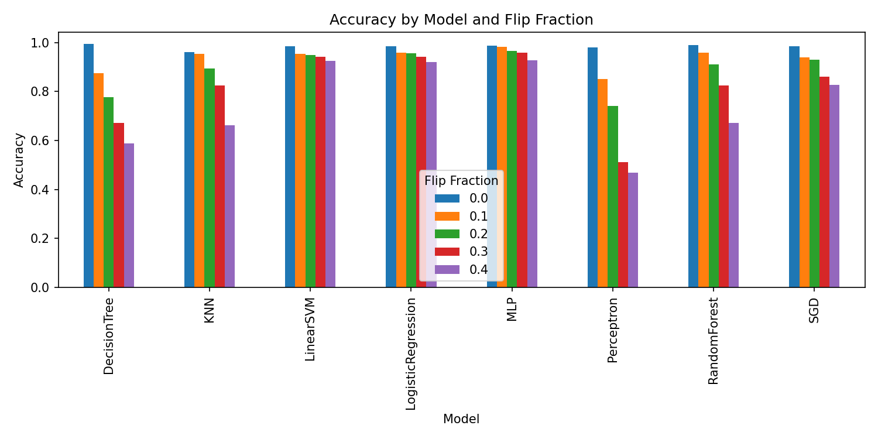
Results and Discussion (our local results)
Confusion matrices @ flip = 0.4:
Accuracy by model and flip fraction:
Barplot

Slide 11
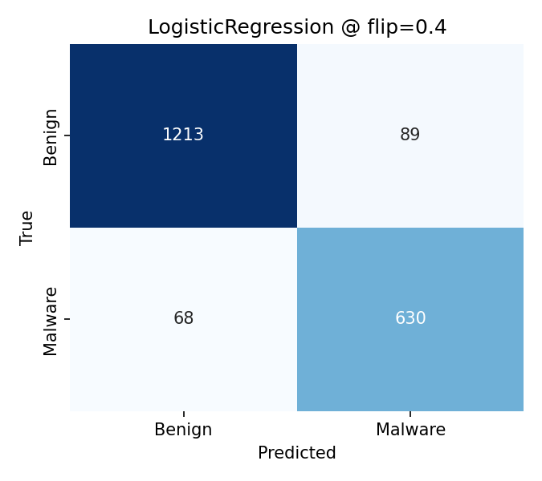
LR

Slide 12
RF MLP
Alignment: recall drops; linear models brittle; RF relatively robust
Differences vs paper: dataset/feature domain, sample size/runtime, preprocessing/regularization, single split/seed

Slide 13
Conclusion and future work (paper conclusion)
Label‑flip poisoning degrades malware detectors; impact varies by model family
Linear/SVM degrade most; tree ensembles relatively resilient at lower flip; MLP mixed
Takeaway: label integrity and data‑quality gates are essential in production pipelines

Slide 14
Conclusion and future work (defenses)
Data provenance & trusted labeling — Datasheets for Datasets (Gebru et al.)
Label sanitization / outlier detection — Confident Learning / Cleanlab (Northcutt et al.)
Influence‑based auditing — Influence Functions (Koh & Liang)
Robust learning objectives — Generalized Cross‑Entropy (Zhang & Sabuncu)
Adversarial / poison‑aware training — Certified Defenses for Data Poisoning (Steinhardt et al.)
Ensemble & cross‑validation across sources — Co‑Teaching (Han et al.)
Continuous monitoring & rollback — Hidden Technical Debt in ML (Sculley et al.)

