Slide 1
Label-Flip Poisoning Attack on Malware Detection

Slide 2
Label-Flip Poisoning Attack on ML-based Malware Detectors
Your Name, Affiliation
Based on: Aryal et al., “Analysis of Label-Flip Poisoning Attack on Machine Learning Based Malware Detector”
Paper: http://arxiv.org/pdf/2301.01044
Dataset: https://www.kaggle.com/competitions/malware-detection/data

Slide 3
Introduction
Data poisoning vs. evasion: training-time manipulation vs. test-time perturbation
Why malware detection is exposed:
  Crowdsourced submissions, federated/online learning, open pipelines
  Hard to verify all labels/data at scale
Threat: Even simple label flips can degrade detectors meaningfully

Slide 4
Problem Definition
Evaluate robustness of classic ML malware detectors under label-flip poisoning
Flip a fraction of training labels (10% and 20%), keep test set clean
Compare performance across 8 models:
  SGD, RandomForest, LogisticRegression, KNN, LinearSVM, DecisionTree, Perceptron, MLP

Slide 5
Methodology (1/2)
Dataset: Kaggle “Malware detection” (tabular)
Preprocessing:
  Stratified sampling to ~10k rows (runtime)
  Numeric features imputed (median) and scaled for linear/NN/KNN models
  Trees/RandomForest use imputation only
Split: Stratified train/test (80/20), seed=42

Slide 6
Methodology (2/2)
Attack: Randomly flip y for 10% and 20% of training samples
Evaluation:
  Metrics: Accuracy, Precision, Recall
  Confusion matrices for selected models
Control: Identical split across baseline and poisoned runs

Slide 7
Results and Discussion (1/2)
Findings reported by Aryal et al. (10% label flips, Testing set): http://arxiv.org/pdf/2301.01044
Percent change vs. clean (negative = drop, positive = improvement):
  Stochastic Gradient Descent: Acc −0.8%, Rec −22.1%, F1 −6.6%
  Decision Tree: Acc −13.0%, Rec −26.5%, F1 −19.8%
  Random Forest: Acc −4.2%, Rec +11.3%, F1 −0.4%
  Logistic Regression: Acc −9.8%, Rec −14.6%, F1 −13.4%
  KNN Classifier: Acc −11.1%, Rec −15.7%, F1 −14.7%
  Support Vector Machine: Acc −27.5%, Rec −63.7%, F1 −52.8%
  Perceptron: Acc −46.7%, Rec −64.7% (F1 not legible in table crop)
  Multi‑Layer Perceptron: Acc +15.8%, Rec −8.9%, F1 +15.5%
Macro (across 8 models): Accuracy ≈ −12.1%, Recall ≈ −25.6%

Slide 8
Results and Discussion (2/2)
Error patterns (per paper):
  Recall drops under poisoning (more false negatives / missed malware)
  Linear models show stronger boundary shifts; tree ensembles more resilient but still degrade at higher flip rates
Practical takeaway:
  Label integrity in training pipelines is critical; even random flips materially impact reliability

Slide 9
Conclusion and Future Work
Conclusion:
  Simple label-flip poisoning degrades malware detectors; impact varies by model
  Highlights the need for data/label integrity checks in pipelines
Future Work:
  Targeted clean-label poisoning; backdoors
  Robust training and label sanitization
  Federated learning defenses and audits

Slide 10
References
Aryal et al., “Analysis of Label-Flip Poisoning Attack on Machine Learning Based Malware Detector” — http://arxiv.org/pdf/2301.01044
Kaggle “Malware detection” — https://www.kaggle.com/competitions/malware-detection/data

Slide 11
Implementation and Reproduction
CLI (precomputed):
python ML-case-study/run_experiments.py \
--input-csv ML-case-study/Kaggle-data.csv \
--label-col legitimate \
--sample-size 10000 \
--test-size 0.2 \
--flip-fracs 0.0 0.1 0.2 0.3 0.4 \
--seed 42 \
--output-dir ML-case-study/outputs
Artifacts produced:
  ML-case-study/outputs/results.csv
  ML-case-study/outputs/metrics_barplot.png
  ML-case-study/outputs/cm_LogisticRegression_04.png
  ML-case-study/outputs/cm_RandomForest_04.png
  ML-case-study/outputs/cm_MLP_04.png

Slide 12
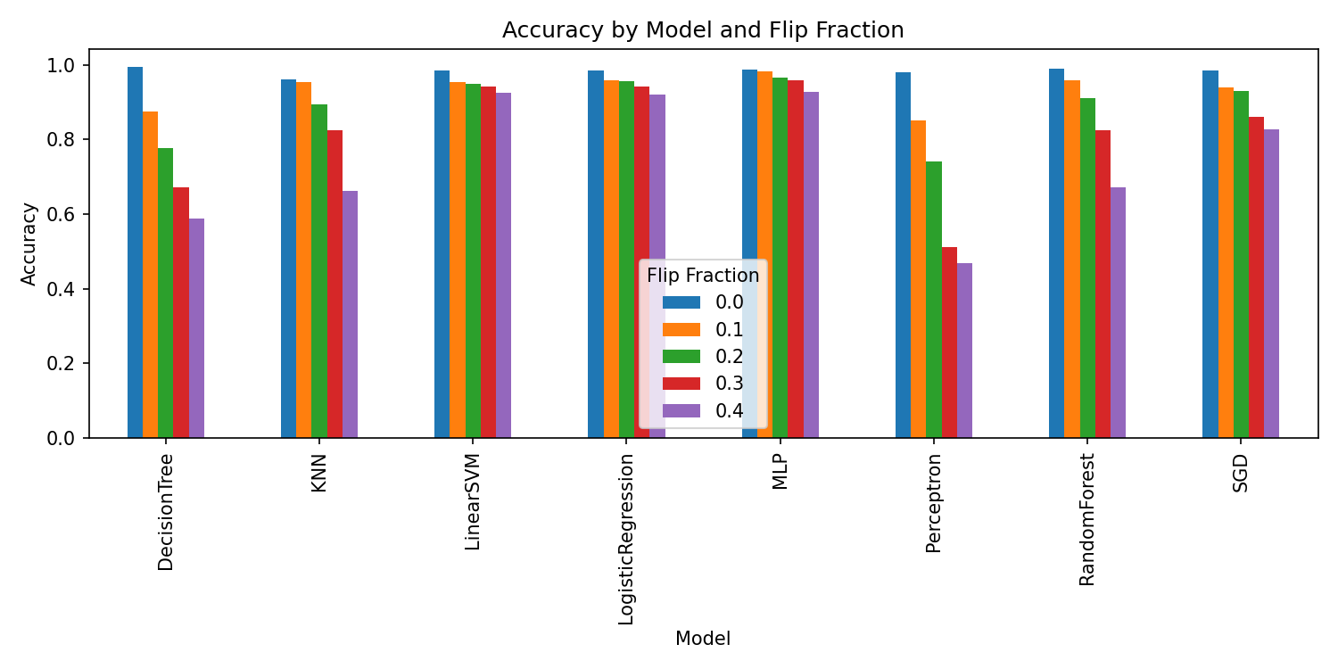
Results (Accuracy vs Flip Fraction)
Barplot: Accuracy by model and flip fraction

Slide 13
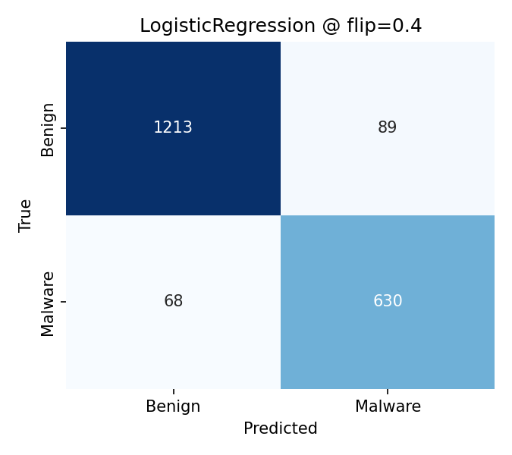
Error Analysis @ flip = 0.4
Malware missed (false negatives) increase with higher flip rates.
Logistic Regression

Slide 14
Random Forest MLP

Slide 15
Code Evidence (trimmed)
utils.py — label flipping and experiment loop
def flip_labels(y: np.ndarray, flip_fraction: float, rng_seed: int):
if flip_fraction <= 0.0:
return y.copy(), np.array([], dtype=int)
rng = np.random.default_rng(rng_seed)
n = len(y)
k = int(flip_fraction * n)
idx = rng.choice(n, size=k, replace=False)
y_poison = y.copy()
y_poison[idx] = 1 - y_poison[idx]
return y_poison, idx
def run_experiment(X_train, y_train, X_test, y_test, pipelines, flip_fracs, seed=42):
rows, cms = [], {}
for frac in flip_fracs:
y_train_poison, _ = flip_labels(y_train, flip_fraction=frac, rng_seed=seed)
for name, pipe in pipelines.items():
metrics = train_and_eval(pipe, X_train, y_train_poison, X_test, y_test)
cm = metrics.pop("cm")
rows.append({"model": name, "flip_frac": frac, **metrics})
cms[(name, frac)] = cm
return pd.DataFrame(rows).sort_values(["model","flip_frac"]).reset_index(drop=True), cms

Slide 16
Paper Comparison (Our Results ↔ Aryal et al.)
Accuracy and recall decline as flip fraction increases; recall suffers notably (more missed malware).
Linear/SVM degrade sharply; RandomForest is more resilient; MLP mixed — aligns with paper’s trends.

Slide 17
Limitations and Defenses
Limits: proxy dataset subset (~10k rows), random flips (not targeted), single split/seed.
Defenses: label audits/sanitization, robust training losses, consensus labeling, anomaly filters.

Slide 18
Appendix: Extra Flip Rates
Included flip_fracs = 0.3, 0.4 to show monotonic degradation beyond 0.2.
Confusion matrices shown at 0.4 for clearer error patterns.

Slide 19
Speaker Notes (3–5 min)
0:30 — Threat model and objective (recall sensitivity in malware).
1:00 — Design: data/split/models/preprocess/metrics.
1:30 — Implementation proof: command + artifacts.
1:30 — Results + error analysis; map to paper; quick defenses.

Slide 20
Title
Label‑Flip Poisoning Attack on ML‑based Malware Detectors
Based on: Aryal et al., “Analysis of Label‑Flip Poisoning Attack on Machine Learning Based Malware Detector”
Your implementation: reproduce methodology, validate trends, discuss implications
Notes: Introduce the paper, our goal (reproduce + analyze), and the structure of the talk (intro → problem → methods → results → conclusions/defenses).

Slide 21
Introduction — ML for Malware Detection
Why ML is used:
  Scale: billions of samples; manual triage infeasible
  Generalization: detect novel malware beyond signature rules
  Adaptivity: models can be retrained as threats evolve
Where features come from:
  Static analysis (PE headers, imports, strings, byte n‑grams)
  Dynamic analysis (behavioral traces, API calls, network I/O)
  Hybrid / metadata (reputation, sandbox outcomes)
Common model families:
  Linear/logistic models, SVMs
  Trees and ensembles (Random Forest, Gradient Boosting)
  k‑NN, shallow NNs / MLPs, modern deep models
Notes: Emphasize scale and need for generalization; mention static/dynamic features and why different model families are used across vendors/research.

Slide 22
Problem Definition
Objective (paper): quantify how simple training‑time label flips impact malware detector performance across classic ML models
Threat model: attacker flips a fraction of training labels (10–20%); test set is clean
Why this paper:
  Practicality: label noise can creep in via pipelines, weak labeling, or adversaries
  Breadth: compares 8 models to reveal family‑specific brittleness
  Security relevance: recall degradation → missed malware (highest risk)
Why look across models:
  Linear models: decision boundary shifts under label noise
  Trees/ensembles: often more resilient, but not immune
  MLPs: may overfit/regularize differently, yielding mixed outcomes
Notes: Connect robustness to real risk (false negatives). Justify multi‑model evaluation as part of model selection and defense prioritization.

Slide 23
Methodology — Paper (what they did)
Dataset: VT/VirusShare‑style binary malware labels (paper’s proprietary corpus)
Models: 8 classic ML
  SGD, RandomForest, LogisticRegression, KNN, LinearSVM, DecisionTree, Perceptron, MLP
Protocol:
  Stratified train/test split; identical split across conditions
  Poisoning: randomly flip y for 10% and 20% of training samples
  Evaluation: Accuracy, Precision, Recall; qualitative error analysis
Notes: Keep this concise. The key is the label‑flip mechanism and the breadth of model families.

Slide 24
Methodology — Our implementation (what we did)
Data: ML-case-study/Kaggle-data.csv (binary legitimate label)
Split: stratified 80/20, seed=42; sampled to ~10k rows for runtime
Preprocessing:
  Numeric features → median impute (+ scaling for linear/NN/KNN)
  Trees use imputation only
Models: same 8 models as paper; unified pipelines
Repro command:
python ML-case-study/run_experiments.py \
--input-csv ML-case-study/Kaggle-data.csv \
--label-col legitimate \
--sample-size 10000 \
--test-size 0.2 \
--flip-fracs 0.0 0.1 0.2 0.3 0.4 \
--seed 42 \
--output-dir ML-case-study/outputs
Notes: Stress alignment with the paper and the small differences (dataset proxy, added 0.3/0.4).

Slide 25
Results — Paper findings (adapted)
Model | Acc Δ | Rec Δ | F1 Δ
SGD | −0.8% | −22.1% | −6.6%
Decision Tree | −13.0% | −26.5% | −19.8%
Random Forest | −4.2% | +11.3% | −0.4%
Logistic Regression | −9.8% | −14.6% | −13.4%
KNN | −11.1% | −15.7% | −14.7%
Linear SVM | −27.5% | −63.7% | −52.8%
Perceptron | −46.7% | −64.7% | (n/a)
MLP | +15.8% | −8.9% | +15.5%
Percent change vs. clean (negative = drop, positive = improvement)

Slide 26
Source: Aryal et al. (see paper for full tables/figures)
Notes: Highlight severe recall drops (Linear SVM, Perceptron). Point out RF resilience and MLP’s mixed outcome (accuracy up, recall down).

Slide 27
Results — Paper figures (context and relevance)
Key observations supported by the paper’s tables/plots:
  Recall suffers most under label flips → more missed malware
  Linear models degrade sharply; tree ensembles degrade less at low flip rate
  Trends persist across multiple settings/seeds in the paper
See paper figures/tables for visuals:
  Metric comparison across models (tables)
  Confusion patterns (discussion/plots)
Reference: Aryal et al. PDF
Notes: If allowed, insert screenshots of the paper’s metric table and any confusion/error plots to visually back this slide.

Slide 28
Results — Our local results
Example confusion matrices @ flip = 0.4:
Accuracy by model and flip fraction:
Local barplot

Slide 29
LR

Slide 30
RF MLP
Discussion: - Qualitative alignment: recall tends to drop; linear models more brittle; RF relatively robust - Differences vs. paper can stem from: - Dataset domain/feature distribution (Kaggle proxy vs. VT/VirusShare) - Sample size/runtime constraints, preprocessing, regularization - Single split/seed; stochastic training variability
Notes: Use the barplot to tell the overall story; use one confusion matrix to illustrate false negatives increasing.

Slide 31
Conclusion (from the paper)
Simple label‑flip poisoning can materially degrade malware detectors
Impact is model‑dependent:
  Linear/SVM often degrade most
  Tree ensembles show relative resilience at lower flip fractions
  MLP shows mixed behavior depending on training dynamics
Practical takeaway: label integrity and data quality gates are essential in malware detection pipelines
Notes: Tie back to operational risk: missed malware is the critical failure mode.

Slide 32
Future Work and Defenses
Data provenance & trusted labeling — Datasheets for Datasets (Gebru et al.)
Label sanitization / outlier detection — Confident Learning / Cleanlab (Northcutt et al.)
Influence‑based auditing — Influence Functions (Koh & Liang)
Robust learning objectives — Generalized Cross‑Entropy (Zhang & Sabuncu)
Adversarial / poison‑aware training — Certified Defenses for Data Poisoning (Steinhardt et al.)
Ensemble & cross‑validation across sources — Co‑Teaching for noisy labels (Han et al.)
Continuous monitoring & rollback — Hidden Technical Debt in ML Systems (Sculley et al.)
Notes: One‑liner rationale for each defense; emphasize layered approach (prevent, detect, mitigate, monitor).

