Slide 1
Bias-Variance Trade-off
Characterization of the machine learning model’s error for given data
By
M. Meenakshi Sundaram, S. Ganesh

Slide 2
Bias How does the average ML model differ from the true value?
Inability of an ML model to capture the relationship between the features of the data and the predicted outcome owing to the assumptions made.
High Bias indicates unsuitable assumptions – ex: Take the red line in the plot shown, it fits a linear function with two parameters.
Low Bias indicates suitable assumptions – ex: Take the green line in the plot shown, it fits a quadratic function with three parameters.

Slide 3
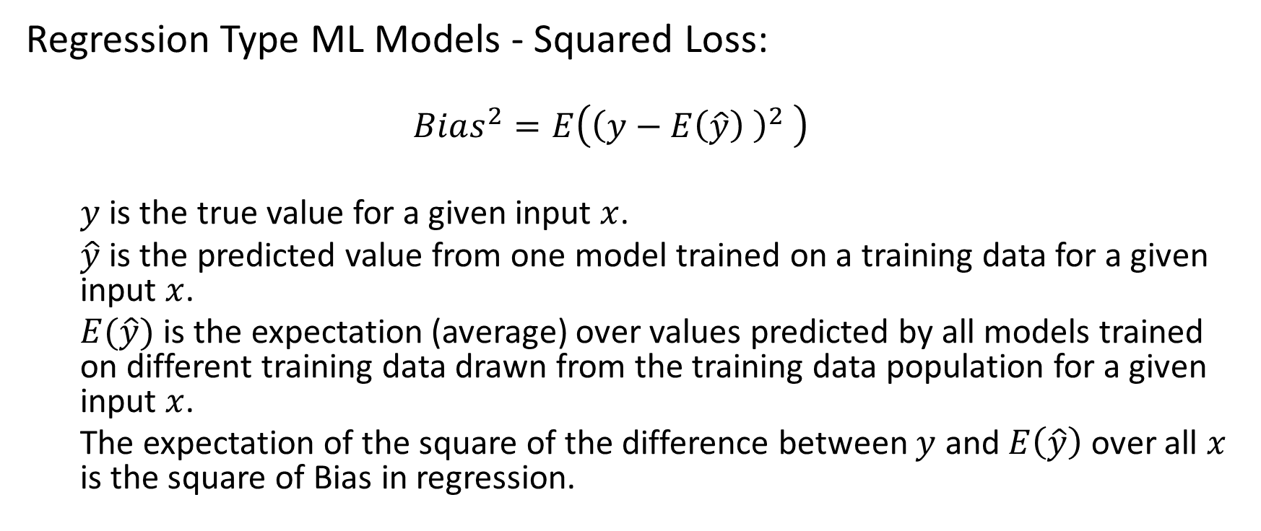
Bias – Regression Loss Metric
Regression Type ML Models - Squared Loss:
$$Bias^{2}=E\left({\left(y−E\left(\hat{y}\right) \right)}^{2} \right)$$
$y$ is the true value for a given input $x$.
$\hat{y}$ is the predicted value from one model trained on a training data for a given input $x$.
$E(\hat{y})$ is the expectation (average) over values predicted by all models trained on different training data drawn from the training data population for a given input $x$.
The expectation of the square of the difference between $y$ and $E\left(\hat{y}\right)$ over all $x$ is the square of Bias in regression.

Slide 4
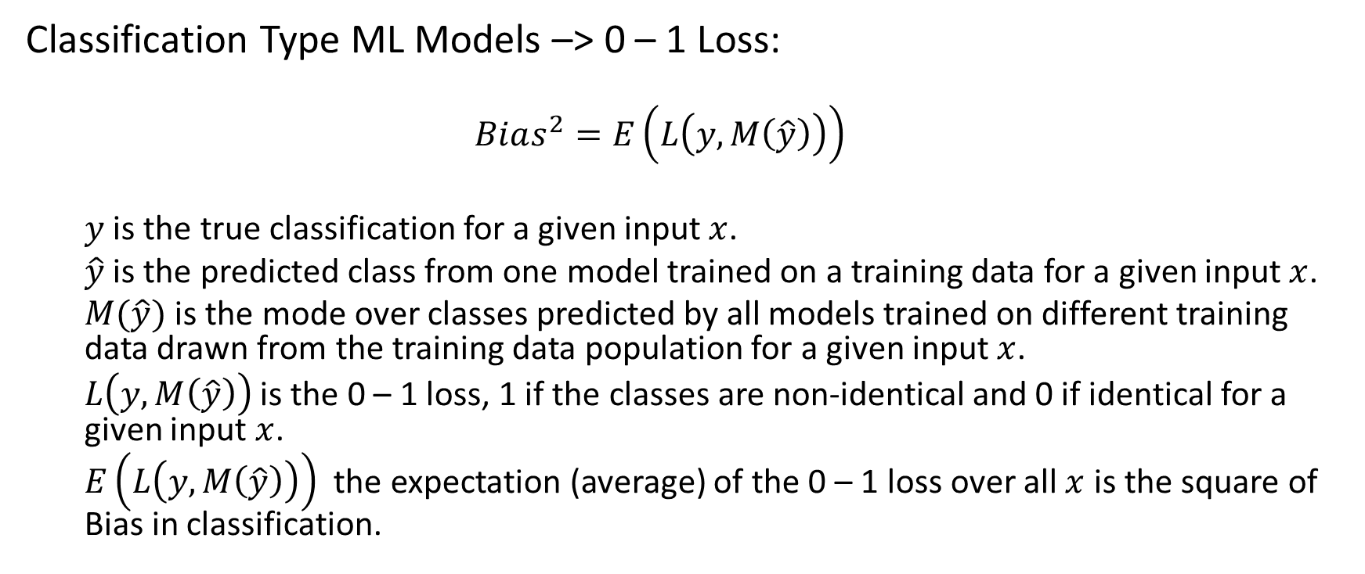
Bias – Classification Loss metric
Classification Type ML Models –> 0 – 1 Loss:
$$Bias^{2}=E\left(L\left(y,M\left(\hat{y}\right)\right)\right)$$
$y$ is the true classification for a given input $x$.
$\hat{y}$ is the predicted class from one model trained on a training data for a given input $x$.
$M(\hat{y})$ is the mode over classes predicted by all models trained on different training data drawn from the training data population for a given input $x$.
$L\left(y, M\left(\hat{y}\right)\right)$ is the 0 – 1 loss, 1 if the classes are non-identical and 0 if identical for a given input $x$.
$E\left(L\left(y,M\left(\hat{y}\right)\right)\right)$ the expectation (average) of the 0 – 1 loss over all $x$ is the square of Bias in classification.

Slide 5
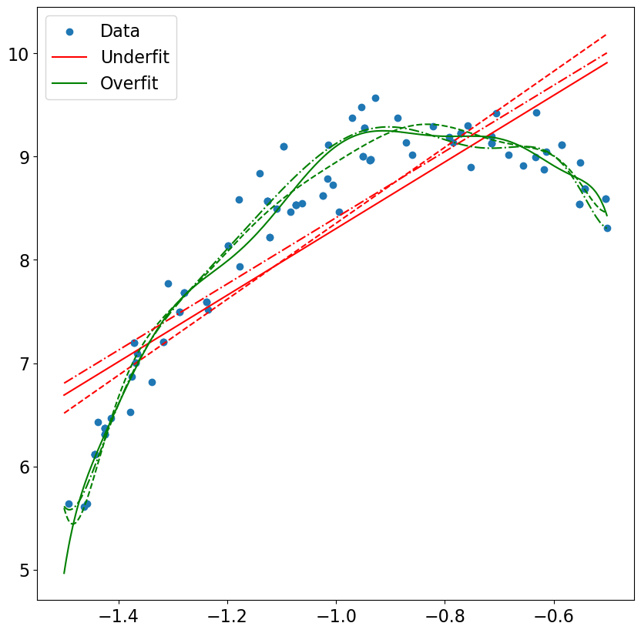
High Bias Vs Low Bias
Low Bias – Implies the model is likely to fit even the noise. It results in the overfit situation.
High Bias – Implies the model is unlikely to capture the real data’s nitty gritty.
Ex: In the figure the red linear models are unable to capture the curvature in the data while the green non-linear models capture the twists and turns of the data.
Low Bias
High Bias

Slide 6
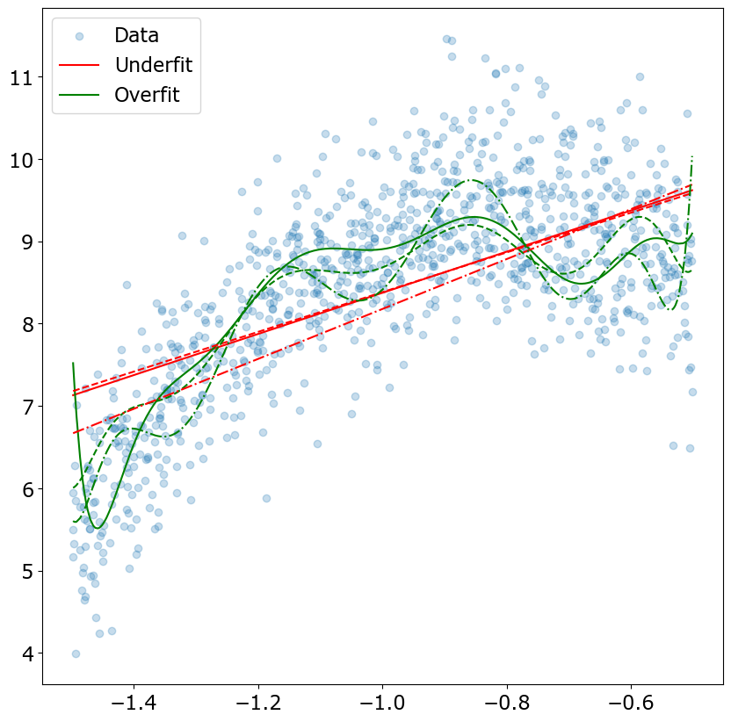
Variance How much do the predictions of the ML models trained on different subsets of the data differ from the each other?
High Variance indicates that the features in the dataset coupled with the ML model may not have a robust prediction capability
Ex: The dataset on the right has quite a bit of noise and the two types of ML models have different degrees of variability.
The green overfit models demonstrate high variance and have quite a bit of undulations with varying training data.
The red underfit model has lower undulations and lower variance in comparison to the green model.

Slide 7
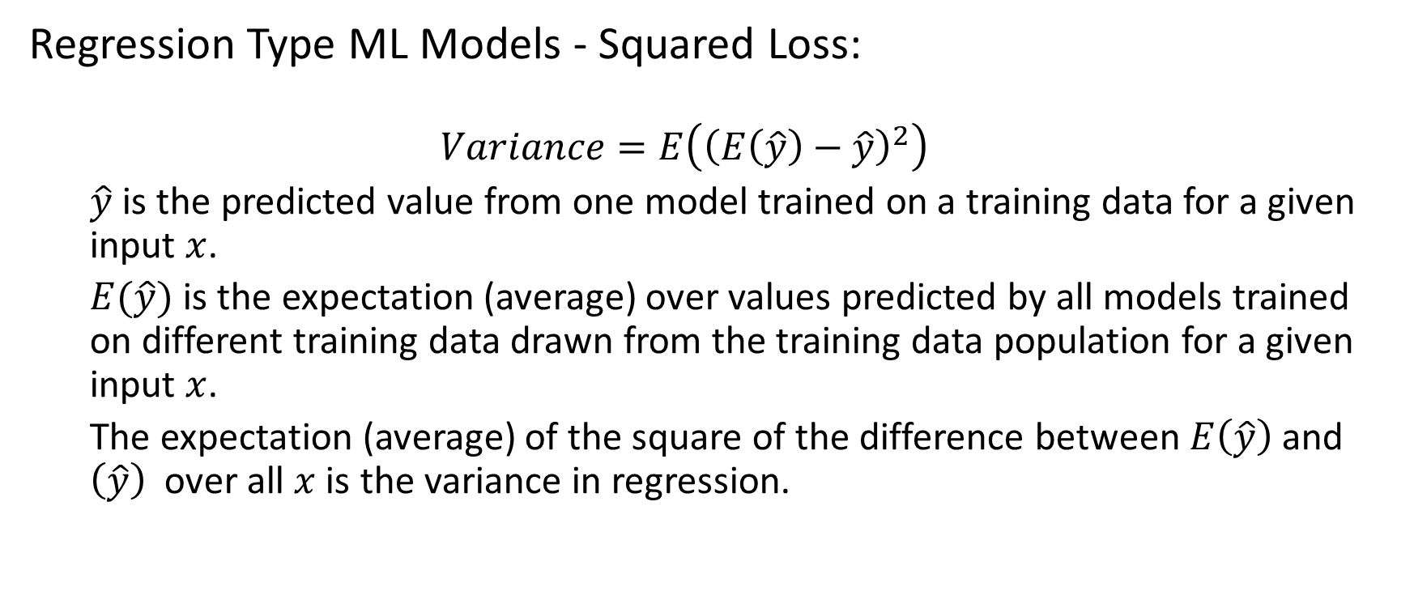
Variance – Regression Loss Metric
Regression Type ML Models - Squared Loss:
$$Variance=E\left({\left(E\left(\hat{y}\right)−\hat{y}\right)}^{2}\right)$$
$\hat{y}$ is the predicted value from one model trained on a training data for a given input $x$.
$E(\hat{y})$ is the expectation (average) over values predicted by all models trained on different training data drawn from the training data population for a given input $x$.
The expectation (average) of the square of the difference between $E\left(\hat{y}\right)$ and $\left(\hat{y}\right)$ over all $x$ is the variance in regression.

Slide 8
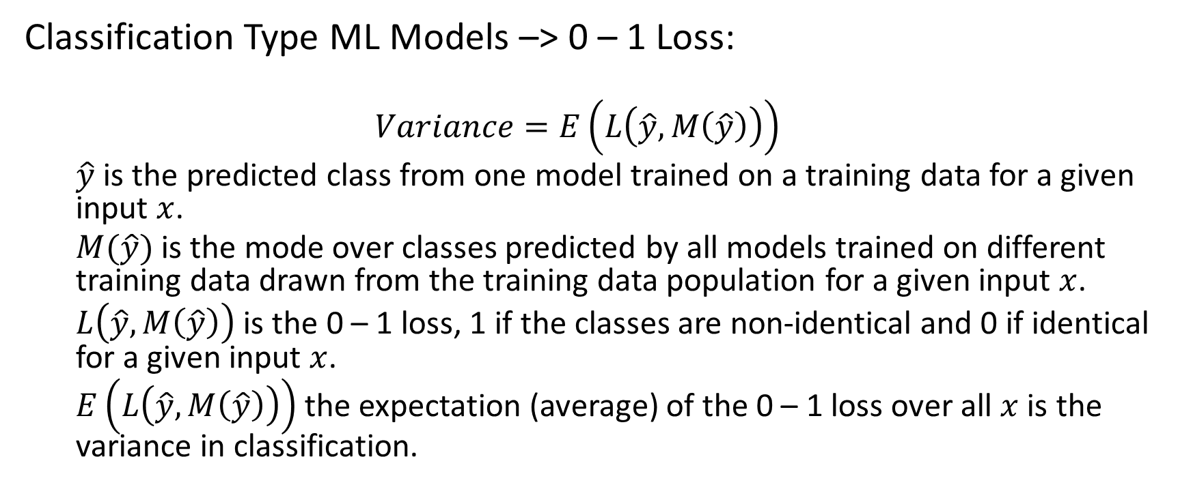
Variance – Classification Loss Metric
Classification Type ML Models –> 0 – 1 Loss:
$$Variance=E\left(L\left(\hat{y},M\left(\hat{y}\right)\right)\right)$$
$\hat{y}$ is the predicted class from one model trained on a training data for a given input $x$.
$M(\hat{y})$ is the mode over classes predicted by all models trained on different training data drawn from the training data population for a given input $x$.
$L\left(\hat{y}, M\left(\hat{y}\right)\right)$ is the 0 – 1 loss, 1 if the classes are non-identical and 0 if identical for a given input $x$.
$E\left(L\left(\hat{y},M\left(\hat{y}\right)\right)\right)$the expectation (average) of the 0 – 1 loss over all $x$ is the variance in classification.

Slide 9
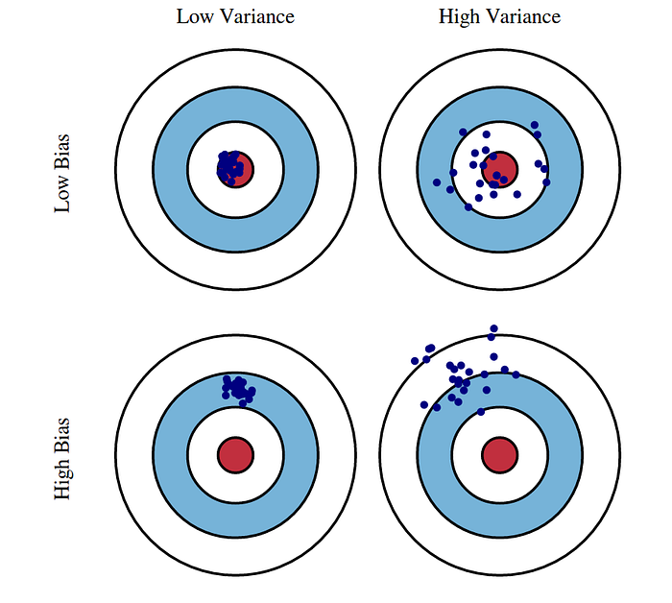
Bias Variance - Bull’s Eye

Slide 10
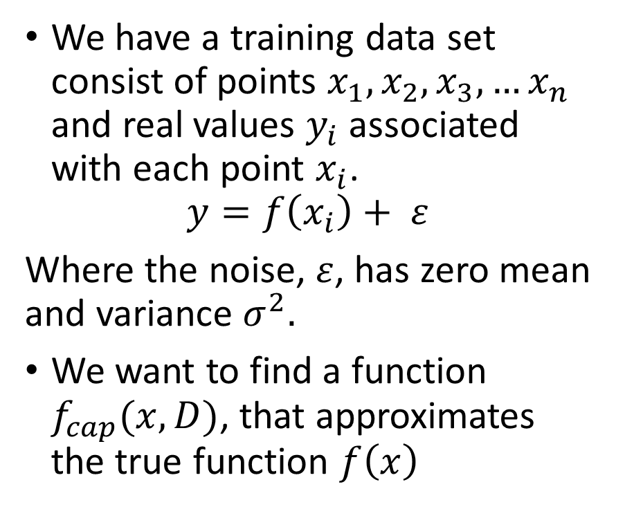
Bias
Bias error = 1 – Accuracy of a random forest
We have a training data set consist of points $x_{1},x_{2},x_{3},…x_{n}$ and real values $y_{i}$ associated with each point $x_{i}$.
$$y=f\left(x_{i}\right)+ ε$$
Where the noise, $ε$, has zero mean and variance $σ^{2}.$
We want to find a function $f_{cap}(x,D)$, that approximates the true function $f\left(x\right)$

Slide 11
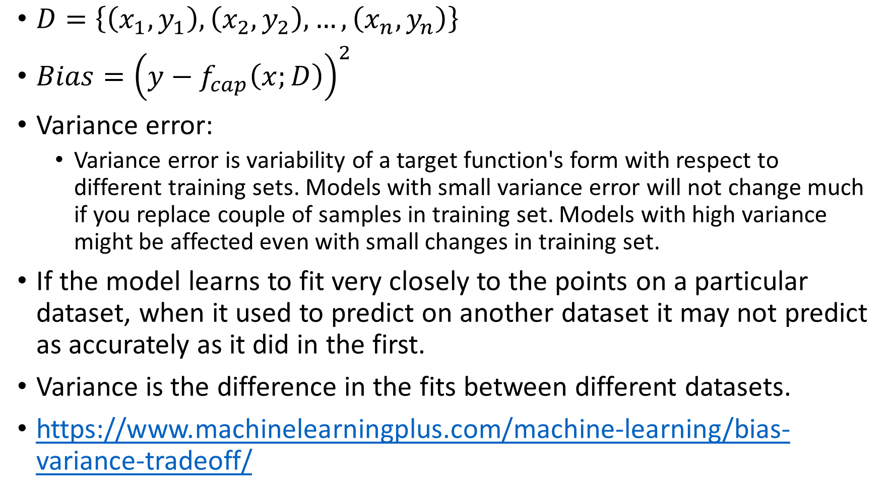
$D=\left\{\left(x_{1},y_{1}\right),\left(x_{2},y_{2}\right),…,\left(x_{n},y_{n}\right)\right\}$
$Bias={\left(y−f_{cap}\left(x;D\right)\right)}^{2}$
Variance error:
Variance error is variability of a target function's form with respect to different training sets. Models with small variance error will not change much if you replace couple of samples in training set. Models with high variance might be affected even with small changes in training set.
If the model learns to fit very closely to the points on a particular dataset, when it used to predict on another dataset it may not predict as accurately as it did in the first.
Variance is the difference in the fits between different datasets.
https://www.machinelearningplus.com/machine-learning/bias-variance-tradeoff/

Slide 12
If a model has high bias, then it implies that the model is too simple and does not capture the relationship between the variables. This is called the underfitting of data.

