Slide 1
Decision Trees

Slide 2
Machine Learning
It is a process by which machines automatically learn from experience or data to improve their performance on a specific task.

Slide 3
Types of Machine Learning
Machine Learning
Supervised Learning
Unsupervised Learning
Reinforcement Learning

Slide 4
Supervised Learning
The algorithm learns from a labeled dataset where the input data is paired with the corresponding output labels.
Supervised learning algorithms are trained using input-output pairs and learn to generalize from the provided examples.
Example:
Dataset: House prices
Features:
Size
Location
Number of bedrooms
Prediction: The price of a new house based on its features

Slide 5
Unsupervised Learning
Finding patterns, structures, and relationships in unlabeled data.
Unlike supervised learning, there are no predefined output labels or correct answers provided.
The algorithm learns to identify inherent patterns or groupings within the data.
Example:
Dataset: Customer purchase
Without prior knowledge of customer categories
Discover groups of similar purchasing patterns/segments

Slide 6
Reinforcement Learning
Training an agent to interact with an environment and learn from the consequences of its actions.
The agent receives feedback in the form of rewards or penalties based on its actions, allowing it to learn optimal strategies that maximize cumulative rewards over time.
Example:
Training an autonomous driving agent to learn how to navigate through traffic by receiving rewards for following traffic rules and penalties for collisions or traffic violations.

Slide 7
Classification
Identifying the qualitative nature of data

Slide 8





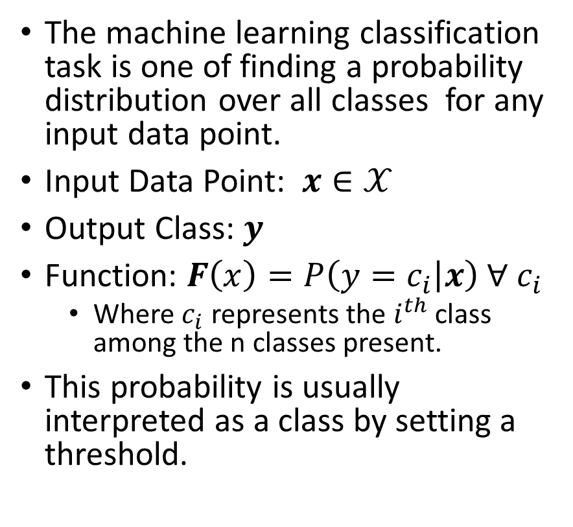
Classification
The machine learning classification task is one of finding a probability distribution over all classes for any input data point.
Input Data Point: $x∈𝒳$
Output Class: $y$
Function: $F\left(x\right)=P\left(y=c_{i} | x\right) ∀ c_{i}$
Where $c_{i}$ represents the $i^{th}$ class among the n classes present.
This probability is usually interpreted as a class by setting a threshold.
Spam
Email
Not Spam
Happy
Neutral
Tweet
Sad

Slide 9
Bias-Variance Trade-off

Slide 10
What does Success Look Like?
Effectiveness of a classification system is measured by using a supervised approach of testing the model with an unseen prelabeled dataset

Slide 11
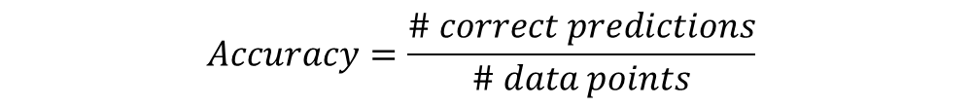
Accuracy
Accuracy measures the overall effectiveness of the classification model (classifier). It answers the question, “How many datapoints did the model classify correctly?”
$$Accuracy=\frac{\# correct predictions}{\# data points}$$
 | Model Cat | Model Dog | Model Bird
Data Cat | 76 | 10 | 12
Data Dog | 27 | 69 | 11
Data Bird | 6 | 3 | 81
$$Accuracy =\frac{76+69+81}{76+69+81+10+12+11+27+3+6}=76.66\%$$
Balanced Data: Nearly equal quantity of dogs, cats, and birds

Slide 12
Accuracy
Accuracy measures the overall effectiveness of the classification model (classifier). It answers the question, “How many datapoints did the model classify correctly?”
$$Accuracy=\frac{\# correct predictions}{\# data points}$$
 | Model Cat | Model Dog | Model Bird
Data Cat | 76 | 20 | 12
Data Dog | 27 | 180 | 11
Data Bird | 16 | 3 | 25
$$Accuracy =\frac{76+180+25}{76+180+25+20+12+11+27+3+16}=75.95\%$$
Even though the classification of “Birds” is poor, the accuracy is comparable to the previous scenario as the majority class is mostly captured by the model.
Unbalanced Data: More dogs in comparison to cats or birds

Slide 13
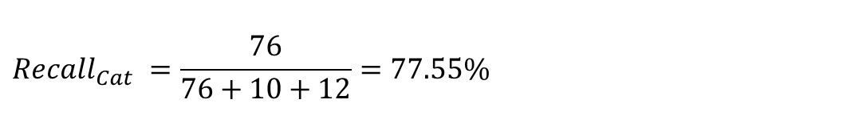
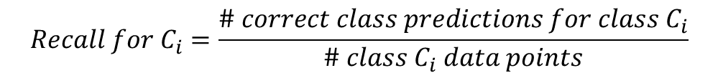
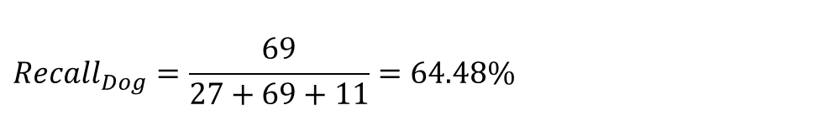
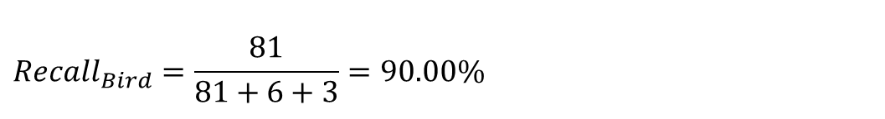
Recall
Recall measures the effectiveness of the classification model (classifier) on each class. It answers the question, “For the datapoints that belong to this class how many did the model classify correctly?” It is also called Sensitivity or True Positive Rate.
$$Recall for C_{i}=\frac{\# correct class predictions for class C_{i}}{\# class C_{i} data points}$$
 | Model Cat | Model Dog | Model Bird
Data Cat | 76 | 10 | 12
Data Dog | 27 | 69 | 11
Data Bird | 6 | 3 | 81
$$Recall_{Cat} =\frac{76}{76+10+12}=77.55\%$$
$$Recall_{Bird}=\frac{81}{81+6+3}=90.00\%$$
$$Recall_{Dog}=\frac{69}{27+69+11}=64.48\%$$
Balanced Data: Nearly equal quantity of dogs, cats, and birds

Slide 14
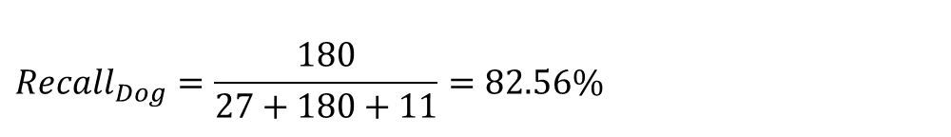
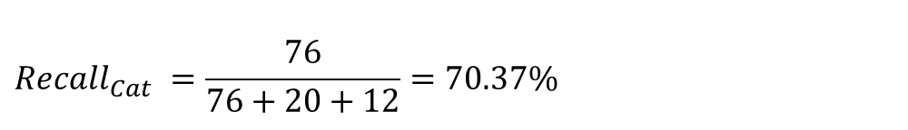
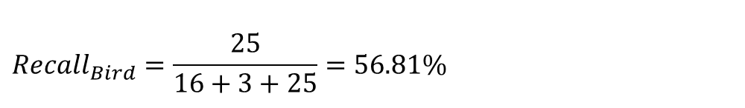
Recall
Recall measures the effectiveness of the classification model (classifier) on each class. It answers the question, “For the datapoints that belong to this class how many did the model classify correctly?” It is also called Sensitivity or True Positive Rate.
$$Recall for C_{i}=\frac{\# correct class predictions for class C_{i}}{\# class C_{i} data points}$$
 | Model Cat | Model Dog | Model Bird
Data Cat | 76 | 20 | 12
Data Dog | 27 | 180 | 11
Data Bird | 16 | 3 | 25
$$Recall_{Cat} =\frac{76}{76+20+12}=70.37\%$$
Clearly this model performs poorly on the identification of “Birds” relative to the previous scenario and the metric “Recall” captures this.
$$Recall_{Dog}=\frac{180}{27+180+11}=82.56\%$$
$$Recall_{Bird}=\frac{25}{16+3+25}=56.81\%$$
Unbalanced Data: More dogs in comparison to cats or birds

Slide 15
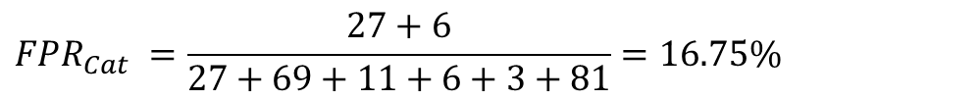
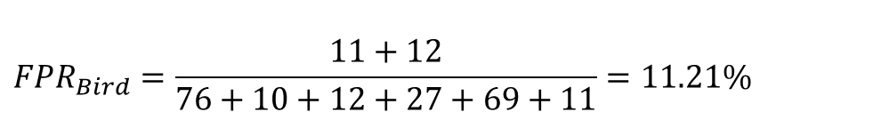
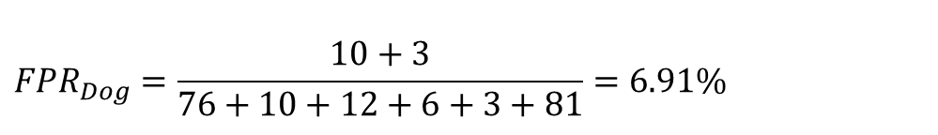
False Positive Rate (FPR)
FPR measures the impurity infiltration of the classification model (classifier) on each class. It answers the question, “For the datapoints that do not belong to this class how many did the model classify as belonging to this class?”
$$FPR_{C_{i}}=\frac{\# incorrect class predictions for class C_{i}}{\# non class C_{i} data points}$$
 | Model Cat | Model Dog | Model Bird
Data Cat | 76 | 10 | 12
Data Dog | 27 | 69 | 11
Data Bird | 6 | 3 | 81
$$FPR_{Cat} =\frac{27+6}{27+69+11+6+3+81}=16.75\%$$
$${FPR}_{Dog}=\frac{10+3}{76+10+12+6+3+81}=6.91\%$$
$$FPR_{Bird}=\frac{11+12}{76+10+12+27+69+11}=11.21\%$$
Balanced Data: Nearly equal quantity of dogs, cats, and birds

Slide 16
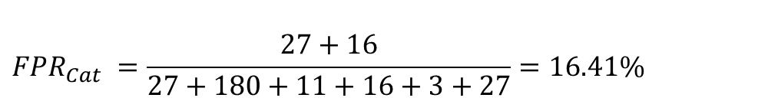
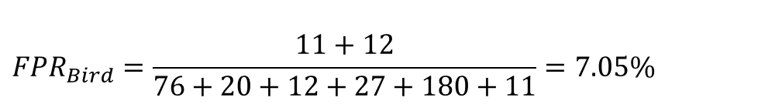
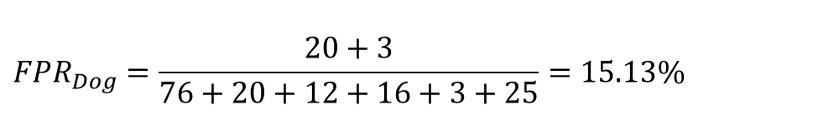
False Positive Rate (FPR)
FPR measures the impurity infiltration of the classification model (classifier) on each class. It answers the question, “For the datapoints that do not belong to this class how many did the model classify as belonging to this class?”
$$FPR_{C_{i}}=\frac{\# incorrect class predictions for class C_{i}}{\# non class C_{i} data points}$$
 | Model Cat | Model Dog | Model Bird
Data Cat | 76 | 20 | 12
Data Dog | 27 | 180 | 11
Data Bird | 16 | 3 | 25
$$FPR_{Cat} =\frac{27+16}{27+180+11+16+3+27}=16.41\%$$
$${FPR}_{Dog}=\frac{20+3}{76+20+12+16+3+25}=15.13\%$$
$$FPR_{Bird}=\frac{11+12}{76+20+12+27+180+11}=7.05\%$$
Unbalanced Data: More dogs in comparison to cats or birds

Slide 17
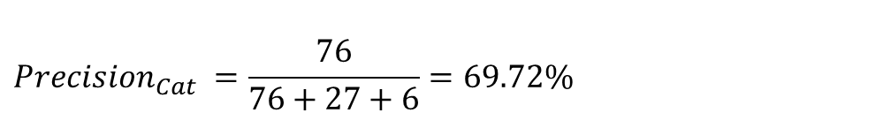
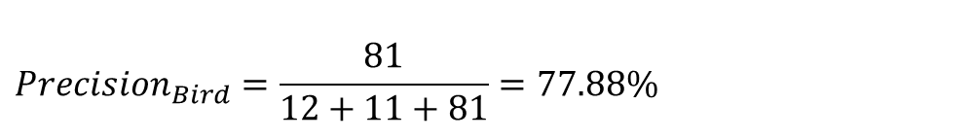
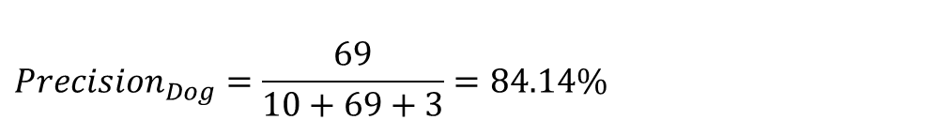
Precision
Precision measures the purity of the classification model (classifier) on each class. It answers the question, “For the datapoints that are classified by the model as belonging to this class how many did it capture correctly?”
$$Precision for C_{i}=\frac{\# Correct Class Predictions for Class C_{i}}{\# Class C_{i} Predictions}$$
 | Model Cat | Model Dog | Model Bird
Data Cat | 76 | 10 | 12
Data Dog | 27 | 69 | 11
Data Bird | 6 | 3 | 81
$$Precision_{Cat} =\frac{76}{76+27+6}=69.72\%$$
$${Precision}_{Dog}=\frac{69}{10+69+3}=84.14\%$$
$$Precision_{Bird}=\frac{81}{12+11+81}=77.88\%$$
Balanced Data: Nearly equal quantity of dogs, cats, and birds

Slide 18
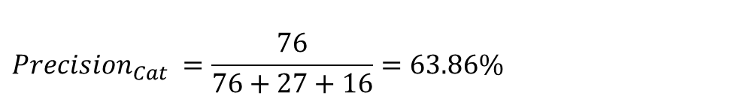
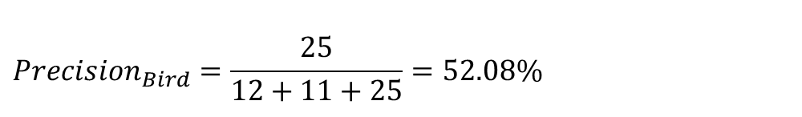
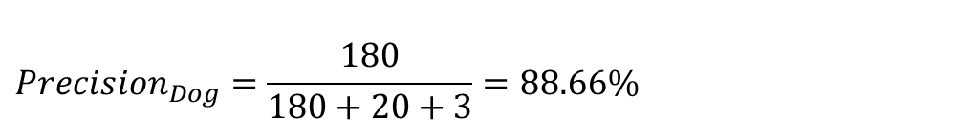
Precision
Precision measures the purity of the classification model (classifier) on each class. It answers the question, “For the datapoints that are classified by the model as belonging to this class how many did it capture correctly?”
$$Precision for C_{i}=\frac{\# Correct Class Predictions for Class C_{i}}{\# Class C_{i} Predictions}$$
 | Model Cat | Model Dog | Model Bird
Data Cat | 76 | 20 | 12
Data Dog | 27 | 180 | 11
Data Bird | 16 | 3 | 25
$$Precision_{Cat} =\frac{76}{76+27+16}=63.86\%$$
$${Precision}_{Dog}=\frac{180}{180+20+3}=88.66\%$$
$$Precision_{Bird}=\frac{25}{12+11+25}=52.08\%$$
Unbalanced Data: More dogs in comparison to cats or birds

Slide 19
Decision Trees
Identifying the rules for classification

Slide 20
Decision Tree
Root Node
Sunny?
A hierarchical binary tree model where every root and internal node represents a yes/no test based on an attribute of the data that leads us to a class label in the leaf node.
Construction algorithm:
Explicit evaluation of every training data point, for an attribute to find a threshold minimizing a metric of loss of class “purity”.
The attribute that provides the minimal loss is used for a given node.
Repeated recursively till satisfactory class “purity” is achieved.
Yes
No
Ice Cream
Rainy?
Leaf Node
Yes
No
Bajji
Tea
Leaf Node
Leaf Node

Slide 21
Loss Metrics

Slide 22
Misclassification Loss

Slide 23
Entropy Loss

Slide 24
Gini Loss

