Slide 1
Decision Trees

Slide 2
Classification
Identifying the qualitative nature of data

Slide 3





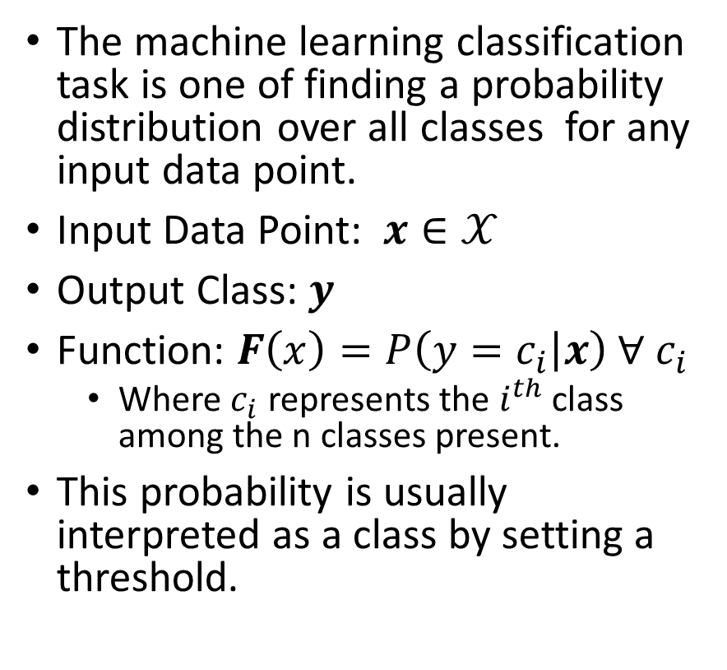
Classification
The machine learning classification task is one of finding a probability distribution over all classes for any input data point.
Input Data Point: $x∈𝒳$
Output Class: $y$
Function: $F\left(x\right)=P\left(y=c_{i} | x\right) ∀ c_{i}$
Where $c_{i}$ represents the $i^{th}$ class among the n classes present.
This probability is usually interpreted as a class by setting a threshold.
Spam
Email
Not Spam
Happy
Neutral
Tweet
Sad

Slide 4
Bias-Variance Trade-off

Slide 5
What does Success Look Like?
Effectiveness of a classification system is measured by using a supervised approach of testing the model with an unseen prelabeled dataset

Slide 6

Accuracy
Accuracy measures the overall effectiveness of the classification model (classifier). It answers the question, “How many datapoints did the model classify correctly?”
$$Accuracy=\frac{\# correct predictions}{\# data points}$$
 | Model Cat | Model Dog | Model Bird
Data Cat | 76 | 10 | 12
Data Dog | 27 | 69 | 11
Data Bird | 6 | 3 | 81
$$Accuracy =\frac{76+69+81}{76+69+81+10+12+11+27+3+6}=76.66\%$$
Balanced Data: Nearly equal quantity of dogs, cats, and birds

Slide 7
Accuracy
Accuracy measures the overall effectiveness of the classification model (classifier). It answers the question, “How many datapoints did the model classify correctly?”
$$Accuracy=\frac{\# correct predictions}{\# data points}$$
 | Model Cat | Model Dog | Model Bird
Data Cat | 76 | 20 | 12
Data Dog | 27 | 180 | 11
Data Bird | 16 | 3 | 25
$$Accuracy =\frac{76+180+25}{76+180+25+20+12+11+27+3+16}=75.95\%$$
Even though the classification of “Birds” is poor, the accuracy is comparable to the previous scenario as the majority class is mostly captured by the model.
Unbalanced Data: More dogs in comparison to cats or birds

Slide 8
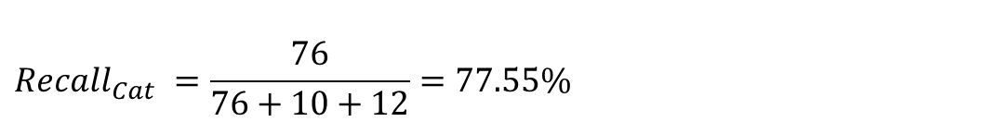
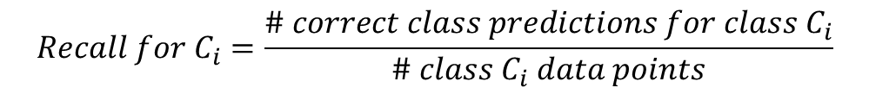
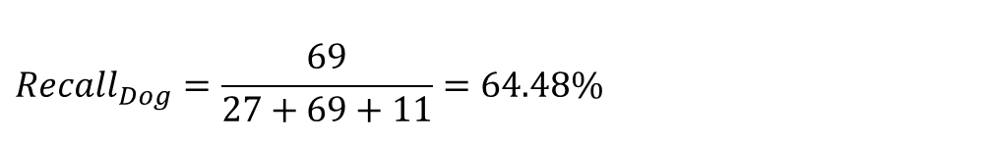
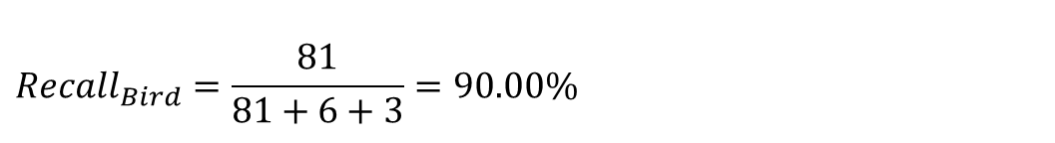
Recall
Recall measures the effectiveness of the classification model (classifier) on each class. It answers the question, “For the datapoints that belong to this class how many did the model classify correctly?” It is also called Sensitivity or True Positive Rate.
$$Recall for C_{i}=\frac{\# correct class predictions for class C_{i}}{\# class C_{i} data points}$$
 | Model Cat | Model Dog | Model Bird
Data Cat | 76 | 10 | 12
Data Dog | 27 | 69 | 11
Data Bird | 6 | 3 | 81
$$Recall_{Cat} =\frac{76}{76+10+12}=77.55\%$$
$$Recall_{Bird}=\frac{81}{81+6+3}=90.00\%$$
$$Recall_{Dog}=\frac{69}{27+69+11}=64.48\%$$
Balanced Data: Nearly equal quantity of dogs, cats, and birds

Slide 9
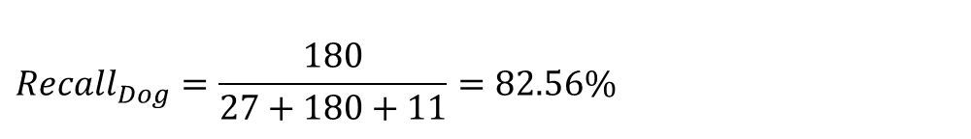
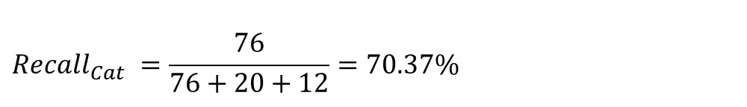
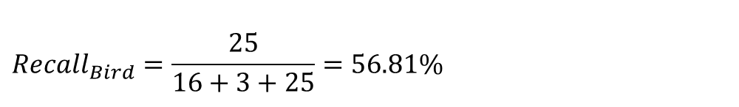
Recall
Recall measures the effectiveness of the classification model (classifier) on each class. It answers the question, “For the datapoints that belong to this class how many did the model classify correctly?” It is also called Sensitivity or True Positive Rate.
$$Recall for C_{i}=\frac{\# correct class predictions for class C_{i}}{\# class C_{i} data points}$$
 | Model Cat | Model Dog | Model Bird
Data Cat | 76 | 20 | 12
Data Dog | 27 | 180 | 11
Data Bird | 16 | 3 | 25
$$Recall_{Cat} =\frac{76}{76+20+12}=70.37\%$$
Clearly this model performs poorly on the identification of “Birds” relative to the previous scenario and the metric “Recall” captures this.
$$Recall_{Dog}=\frac{180}{27+180+11}=82.56\%$$
$$Recall_{Bird}=\frac{25}{16+3+25}=56.81\%$$
Unbalanced Data: More dogs in comparison to cats or birds

Slide 10
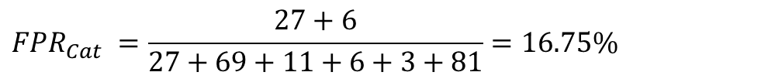
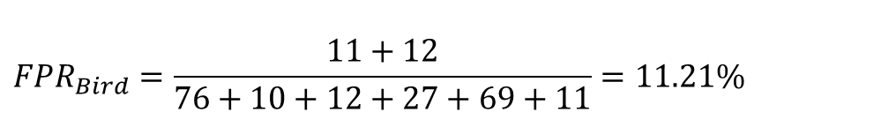
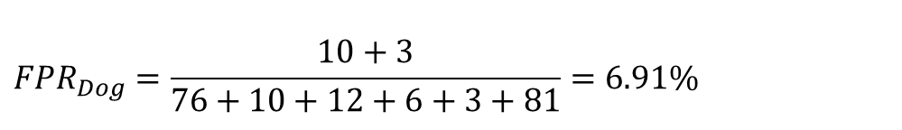
False Positive Rate (FPR)
FPR measures the impurity infiltration of the classification model (classifier) on each class. It answers the question, “For the datapoints that do not belong to this class how many did the model classify as belonging to this class?”
$$FPR_{C_{i}}=\frac{\# incorrect class predictions for class C_{i}}{\# non class C_{i} data points}$$
 | Model Cat | Model Dog | Model Bird
Data Cat | 76 | 10 | 12
Data Dog | 27 | 69 | 11
Data Bird | 6 | 3 | 81
$$FPR_{Cat} =\frac{27+6}{27+69+11+6+3+81}=16.75\%$$
$${FPR}_{Dog}=\frac{10+3}{76+10+12+6+3+81}=6.91\%$$
$$FPR_{Bird}=\frac{11+12}{76+10+12+27+69+11}=11.21\%$$
Balanced Data: Nearly equal quantity of dogs, cats, and birds

Slide 11
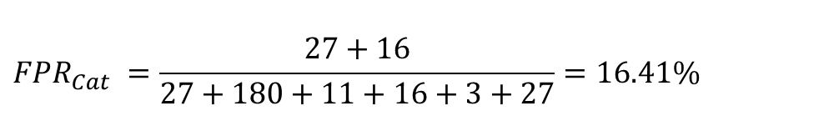
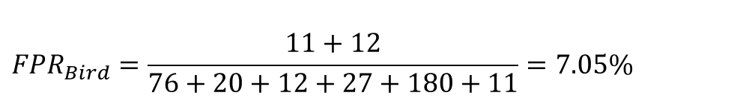
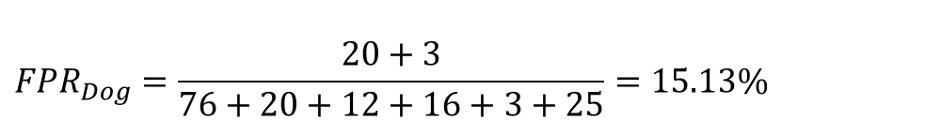
False Positive Rate (FPR)
FPR measures the impurity infiltration of the classification model (classifier) on each class. It answers the question, “For the datapoints that do not belong to this class how many did the model classify as belonging to this class?”
$$FPR_{C_{i}}=\frac{\# incorrect class predictions for class C_{i}}{\# non class C_{i} data points}$$
 | Model Cat | Model Dog | Model Bird
Data Cat | 76 | 20 | 12
Data Dog | 27 | 180 | 11
Data Bird | 16 | 3 | 25
$$FPR_{Cat} =\frac{27+16}{27+180+11+16+3+27}=16.41\%$$
$${FPR}_{Dog}=\frac{20+3}{76+20+12+16+3+25}=15.13\%$$
$$FPR_{Bird}=\frac{11+12}{76+20+12+27+180+11}=7.05\%$$
Unbalanced Data: More dogs in comparison to cats or birds

Slide 12
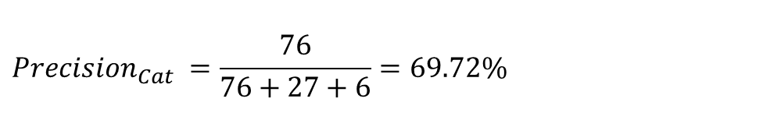
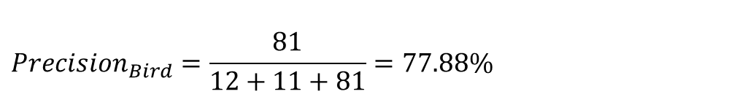
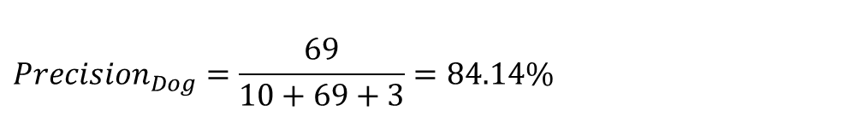
Precision
Precision measures the purity of the classification model (classifier) on each class. It answers the question, “For the datapoints that are classified by the model as belonging to this class how many did it capture correctly?”
$$Precision for C_{i}=\frac{\# Correct Class Predictions for Class C_{i}}{\# Class C_{i} Predictions}$$
 | Model Cat | Model Dog | Model Bird
Data Cat | 76 | 10 | 12
Data Dog | 27 | 69 | 11
Data Bird | 6 | 3 | 81
$$Precision_{Cat} =\frac{76}{76+27+6}=69.72\%$$
$${Precision}_{Dog}=\frac{69}{10+69+3}=84.14\%$$
$$Precision_{Bird}=\frac{81}{12+11+81}=77.88\%$$
Balanced Data: Nearly equal quantity of dogs, cats, and birds

Slide 13
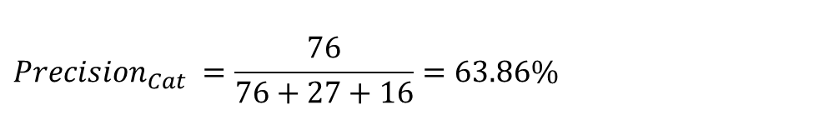
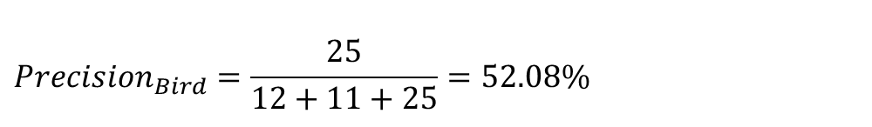
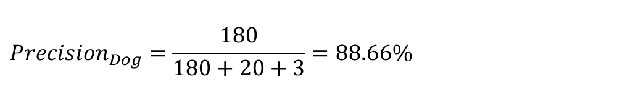
Precision
Precision measures the purity of the classification model (classifier) on each class. It answers the question, “For the datapoints that are classified by the model as belonging to this class how many did it capture correctly?”
$$Precision for C_{i}=\frac{\# Correct Class Predictions for Class C_{i}}{\# Class C_{i} Predictions}$$
 | Model Cat | Model Dog | Model Bird
Data Cat | 76 | 20 | 12
Data Dog | 27 | 180 | 11
Data Bird | 16 | 3 | 25
$$Precision_{Cat} =\frac{76}{76+27+16}=63.86\%$$
$${Precision}_{Dog}=\frac{180}{180+20+3}=88.66\%$$
$$Precision_{Bird}=\frac{25}{12+11+25}=52.08\%$$
Unbalanced Data: More dogs in comparison to cats or birds

Slide 14
Decision Trees
Identifying the rules for classification

Slide 15
Decision Tree
Root Node
Sunny?
What is Decision Tree:
Supervised ML algorithm
Tree structure
It have root, internal and terminal nodes
Construction:
Recursively splitting train data set into subsets
based on the values of the attributes until
a stopping criterion is met
Stopping criterion:
Maximum depth of the tree
Minimum number of samples required to split a node
Yes
No
Ice Cream
Rainy?
Leaf Node
Yes
No
Bajji
Tea
Leaf Node
Leaf Node

Slide 16
Misclassification Metric

Slide 17
Entropy Metric

Slide 18
Gini Metric

