Slide 1
Classification – The definition of Success
Effectiveness of a classification system is measured by using a supervised approach of validating the model with unseen prelabeled datasets.
The success metrics used to optimize/validate classification systems will be discussed in this section
By
M. Meenakshi Sundaram, S. Ganesh

Slide 2

Accuracy
Accuracy measures the overall effectiveness of the classification model (classifier). It answers the question, “How many datapoints did the model classify correctly?”
$$Accuracy=\frac{\# correct predictions}{\# data points}$$
 | Model Cat | Model Dog | Model Bird
Data Cat | 76 | 10 | 12
Data Dog | 27 | 69 | 11
Data Bird | 6 | 3 | 81
$$Accuracy =\frac{76+69+81}{76+69+81+10+12+11+27+3+6}=76.66\%$$
Balanced Data: Nearly equal quantity of dogs, cats, and birds

Slide 3
Accuracy
Accuracy measures the overall effectiveness of the classification model (classifier). It answers the question, “How many datapoints did the model classify correctly?”
$$Accuracy=\frac{\# correct predictions}{\# data points}$$
 | Model Cat | Model Dog | Model Bird
Data Cat | 76 | 20 | 12
Data Dog | 27 | 180 | 11
Data Bird | 16 | 3 | 25
$$Accuracy =\frac{76+180+25}{76+180+25+20+12+11+27+3+16}=75.95\%$$
Even though the classification of “Birds” is poor, the accuracy is comparable to the previous scenario as the majority class is mostly captured by the model.
Unbalanced Data: More dogs in comparison to cats or birds

Slide 4
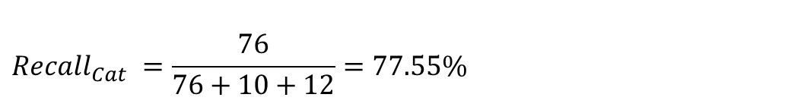
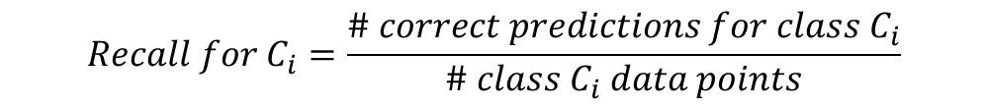
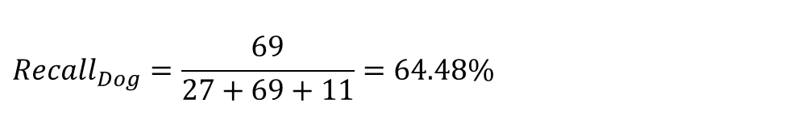
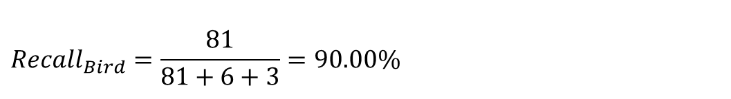
Recall
Recall measures the effectiveness of the classification model (classifier) on each class. It answers the question, “For the datapoints that belong to this class how many did the model classify correctly?” It is also called Sensitivity or True Positive Rate.
$$Recall for C_{i}=\frac{\# correct predictions for class C_{i}}{\# class C_{i} data points}$$
 | Model Cat | Model Dog | Model Bird
Data Cat | 76 | 10 | 12
Data Dog | 27 | 69 | 11
Data Bird | 6 | 3 | 81
$$Recall_{Cat} =\frac{76}{76+10+12}=77.55\%$$
$$Recall_{Bird}=\frac{81}{81+6+3}=90.00\%$$
$$Recall_{Dog}=\frac{69}{27+69+11}=64.48\%$$
Balanced Data: Nearly equal quantity of dogs, cats, and birds

Slide 5
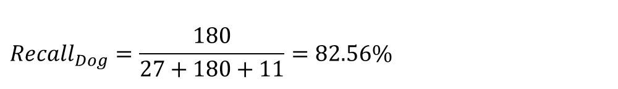
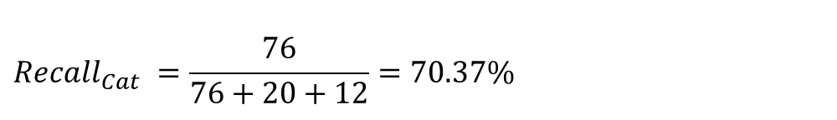
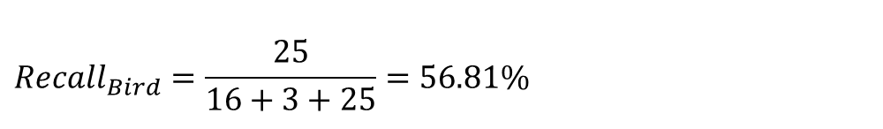
Recall
Recall measures the effectiveness of the classification model (classifier) on each class. It answers the question, “For the datapoints that belong to this class how many did the model classify correctly?” It is also called Sensitivity or True Positive Rate.
$$Recall for C_{i}=\frac{\# correct predictions for class C_{i}}{\# class C_{i} data points}$$
 | Model Cat | Model Dog | Model Bird
Data Cat | 76 | 20 | 12
Data Dog | 27 | 180 | 11
Data Bird | 16 | 3 | 25
$$Recall_{Cat} =\frac{76}{76+20+12}=70.37\%$$
Clearly this model performs poorly on the identification of “Birds” relative to the previous scenario and the metric “Recall” captures this.
$$Recall_{Dog}=\frac{180}{27+180+11}=82.56\%$$
$$Recall_{Bird}=\frac{25}{16+3+25}=56.81\%$$
Unbalanced Data: More dogs in comparison to cats or birds

Slide 6
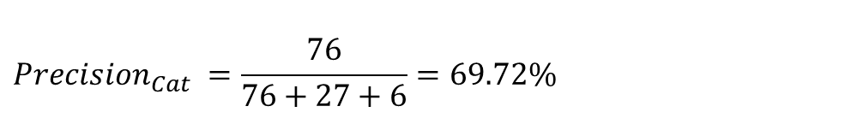


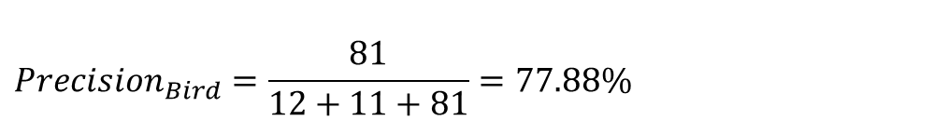
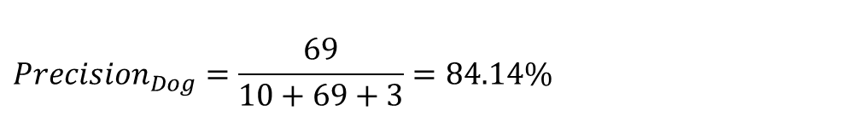
Precision
Precision measures the purity of the classification model (classifier) on each class. It answers the question, “For the datapoints that are classified by the model as belonging to this class how many did it capture correctly?”
$$Precision for C_{i}=\frac{\# correct predictions for class C_{i}}{\# class C_{i} predictions}$$
 | Model Cat | Model Dog | Model Bird
Data Cat | 76 | 10 | 12
Data Dog | 27 | 69 | 11
Data Bird | 6 | 3 | 81
$$Precision_{Cat} =\frac{76}{76+27+6}=69.72\%$$
When this model predicts “a cat” it is $≈$30% unlikely to be a cat.
$${Precision}_{Dog}=\frac{69}{10+69+3}=84.14\%$$
$$Precision_{Bird}=\frac{81}{12+11+81}=77.88\%$$
When this model predicts “a dog” it is $≈$84% likely to be a dog.
Balanced Data: Nearly equal quantity of dogs, cats, and birds

Slide 7
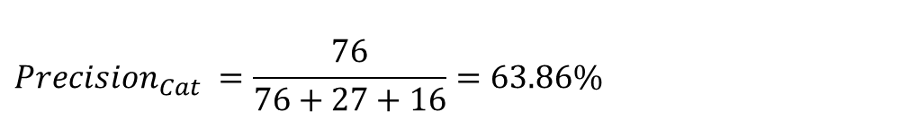


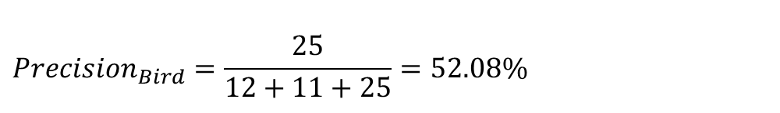
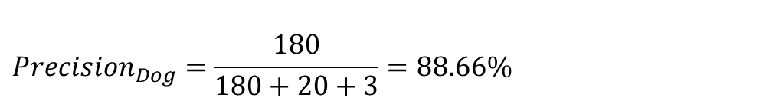
Precision
Precision measures the purity of the classification model (classifier) on each class. It answers the question, “For the datapoints that are classified by the model as belonging to this class how many did it capture correctly?”
$$Precision for C_{i}=\frac{\# correct predictions for class C_{i}}{\# class C_{i} predictions}$$
 | Model Cat | Model Dog | Model Bird
Data Cat | 76 | 20 | 12
Data Dog | 27 | 180 | 11
Data Bird | 16 | 3 | 25
$$Precision_{Cat} =\frac{76}{76+27+16}=63.86\%$$
When this model predicts “a dog” it is $≈$88% likely to be a dog.
$${Precision}_{Dog}=\frac{180}{180+20+3}=88.66\%$$
When this model predicts “a bird” it is $≈$48% unlikely to be a bird.
$$Precision_{Bird}=\frac{25}{12+11+25}=52.08\%$$
Unbalanced Data: More dogs in comparison to cats or birds

Slide 8
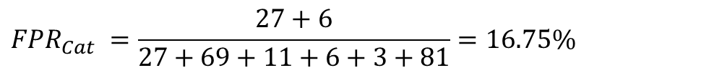
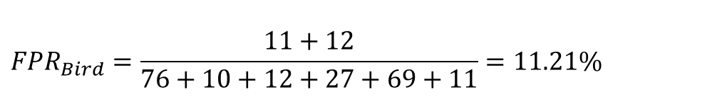
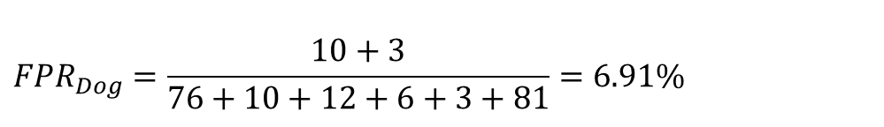
False Positive Rate (FPR)
FPR measures the impurity infiltration of the classification model (classifier) on each class. It answers the question, “For the datapoints that do not belong to this class how many did the model classify as belonging to this class?”
$$FPR_{C_{i}}=\frac{\# incorrect class predictions for class C_{i}}{\# non class C_{i} data points}$$
 | Model Cat | Model Dog | Model Bird
Data Cat | 76 | 10 | 12
Data Dog | 27 | 69 | 11
Data Bird | 6 | 3 | 81
$$FPR_{Cat} =\frac{27+6}{27+69+11+6+3+81}=16.75\%$$
$${FPR}_{Dog}=\frac{10+3}{76+10+12+6+3+81}=6.91\%$$
This model confuses “a cat for a dog” or “a bird for a dog” with the least probability.
$$FPR_{Bird}=\frac{11+12}{76+10+12+27+69+11}=11.21\%$$
Balanced Data: Nearly equal quantity of dogs, cats, and birds

Slide 9
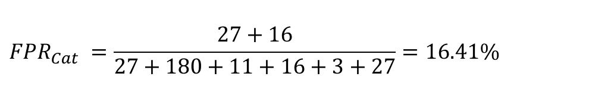
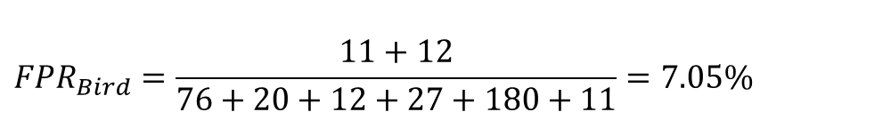
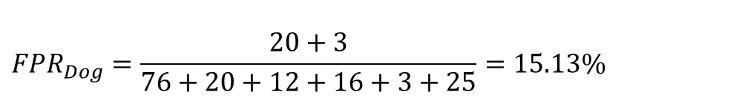
False Positive Rate (FPR)
FPR measures the impurity infiltration of the classification model (classifier) on each class. It answers the question, “For the datapoints that do not belong to this class how many did the model classify as belonging to this class?”
$$FPR_{C_{i}}=\frac{\# incorrect class predictions for class C_{i}}{\# non class C_{i} data points}$$
 | Model Cat | Model Dog | Model Bird
Data Cat | 76 | 20 | 12
Data Dog | 27 | 180 | 11
Data Bird | 16 | 3 | 25
$$FPR_{Cat} =\frac{27+16}{27+180+11+16+3+27}=16.41\%$$
$${FPR}_{Dog}=\frac{20+3}{76+20+12+16+3+25}=15.13\%$$
This model confuses “a cat for a bird” or “a dog for a bird” with the least probability.
$$FPR_{Bird}=\frac{11+12}{76+20+12+27+180+11}=7.05\%$$
Unbalanced Data: More dogs in comparison to cats or birds

Slide 10
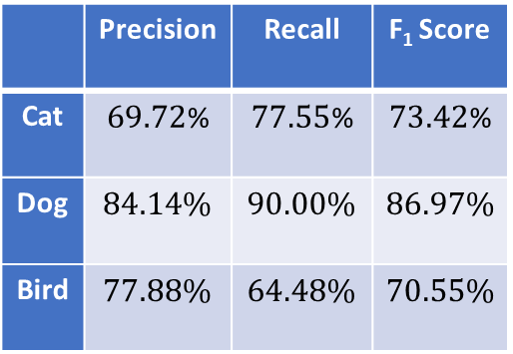
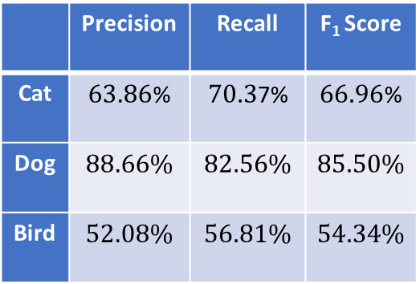
F₁ Score
The harmonic mean of precision and recall is F₁ Score. It offers a fine tradeoff between both the metrics.
$$F1 Score for C_{i}=2{\left(\frac{1}{Precision for C_{i}}+\frac{1}{Recall for C_{i}}\right)}^{−1}$$
 | Model Cat | Model Dog | Model Bird
Data Cat | 76 | 10 | 12
Data Dog | 27 | 69 | 11
Data Bird | 6 | 3 | 81
 | Precision | Recall | F₁ Score
Cat | $69.72$% | $77.55$% | $73.42$%
Dog | $$84.14\%$$ | $$90.00\%$$ | $$86.97\%$$
Bird | $$77.88\%$$ | $$64.48\%$$ | $$70.55\%$$
 | Model Cat | Model Dog | Model Bird
Data Cat | 76 | 20 | 12
Data Dog | 27 | 180 | 11
Data Bird | 16 | 3 | 25
 | Precision | Recall | F₁ Score
Cat | $63.86$% | $70.3$7% | $66.96$%
Dog | $$88.66\%$$ | $$82.56\%$$ | $$85.50\%$$
Bird | $$52.08\%$$ | $$56.81\%$$ | $$54.34\%$$
Balanced Data: Nearly equal quantity of dogs, cats, and birds
Unbalanced Data: More dogs in comparison to cats or birds

Slide 11
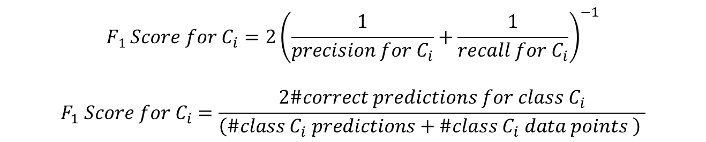
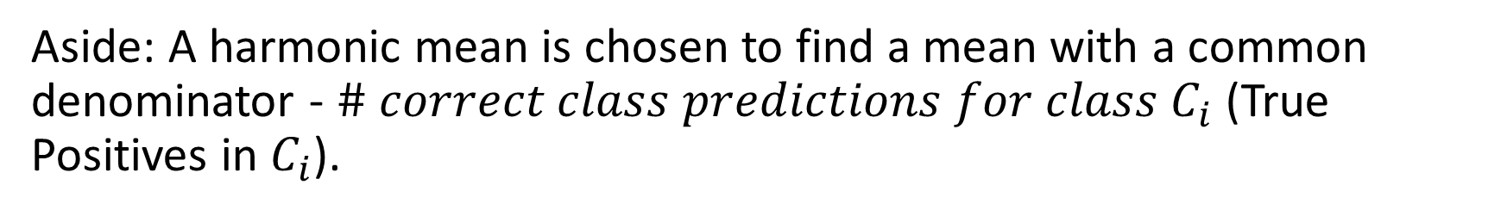
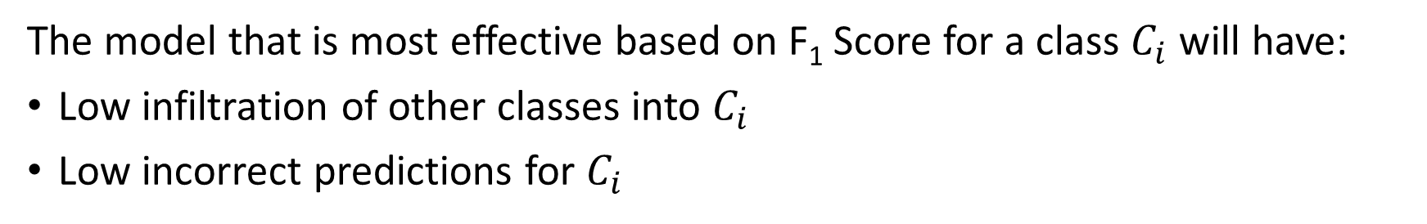
F₁ Score
Aside: A harmonic mean is chosen to find a mean with a common denominator - $\# correct class predictions for class C_{i}$ (True Positives in $C_{i}$).
$$F1 Score for C_{i}=2{\left(\frac{1}{precision for C_{i}}+\frac{1}{recall for C_{i}}\right)}^{−1}$$
$$F_{1} Score for C_{i}=\frac{2\#correct predictions for class C_{i}}{\left(\#class C_{i} predictions+\#class C_{i} data points \right) }$$
The model that is most effective based on F₁ Score for a class $C_{i}$ will have:
Low infiltration of other classes into $C_{i}$
Low incorrect predictions for $C_{i}$

Slide 12
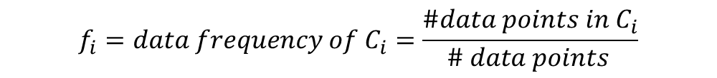
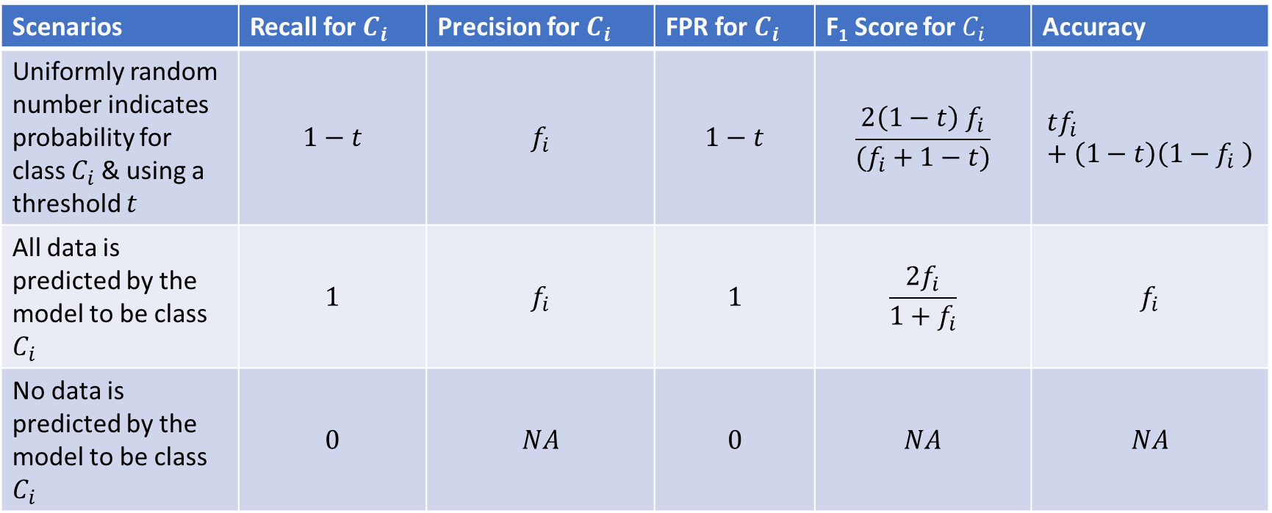
Some General & Corner Cases
Scenarios | Recall for $C_{i}$ | Precision for $C_{i}$ | FPR for $C_{i}$ | F₁ Score for $C_{i}$ | Accuracy
Uniformly random number indicates probability for class $C_{i}$ & using a threshold $t$ | $$1−t$$ | $$f_{i}$$ | $$1−t$$ | $$\frac{2\left(1−t\right) f_{i}}{(f_{i}+1−t)}$$ | $$tf_{i}+\left(1−t\right)\left(1−f_{i} \right)$$
All data is predicted by the model to be class $C_{i}$ | $$1$$ | $$f_{i}$$ | $$1$$ | $$\frac{2f_{i}}{1+f_{i}}$$ | $$f_{i}$$
No data is predicted by the model to be class $C_{i}$ | $$0$$ | $$NA$$ | $$0$$ | $$NA$$ | $$NA$$
$$f_{i}=data frequency of C_{i}=\frac{\#data points in C_{i}}{\# data points }$$

Slide 13
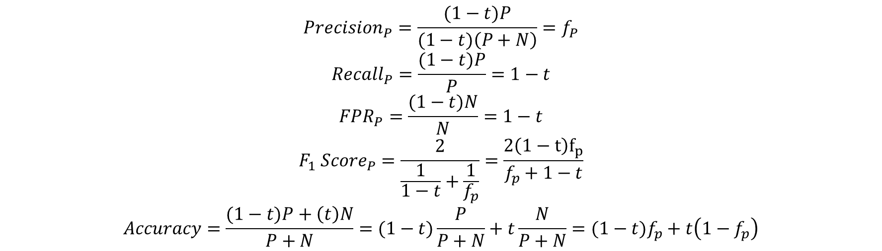
1
 | Model Positive | Model Negative
Positive = 100 | 100(1-t) | 100t
Negative = 200 | 200(1-t) | 200t
t
0
t
1
$$Precision_{P}=\frac{(1−t)P}{(1−t)\left(P+N\right)}=f_{P}$$
$$Recall_{P}=\frac{(1−t)P}{P}=1−t$$
$$FPR_{P}=\frac{(1−t)N}{N}=1−t$$
$$F_{1} Score_{P}=\frac{2}{\frac{1}{1−t}+\frac{1}{f_{p}}}=\frac{2\left(1−t\right)f_{p}}{f_{p}+1−t}$$
$$Accuracy=\frac{(1−t)P+\left(t\right)N}{P+N}=(1−t)\frac{P}{P+N}+t\frac{N}{P+N}=(1−t)f_{p}+t\left(1−f_{p}\right)$$

Slide 14

 | Model Cat | Model Dog | Model Bird
Data Cat 98 | 76 | 20 | 12
Data Dog 218 | 27 | 180 | 11
Data Bird 44 | 16 | 3 | 25
$$Precision_{C_{i}}=\frac{p_{C_{i}}{\#C}_{i}}{p_{C_{i}}\left(\sum_{j}{\#C_{j}}\right)}=f_{C_{i}}=p_{C_{i}}$$
$$Recall_{C_{i}}=\frac{p_{C_{i}}\#C_{i}}{\#C_{i}}=p_{C_{i}}$$
$$FPR_{C_{i}}=\frac{p_{C_{i}}\sum_{j≠i}{\#C_{j}}}{\sum_{j≠i}{\#C_{j}}}=p_{C_{i}}$$
$$F_{1} Score_{C_{i}}=p_{C_{i}}$$
$$Accuracy=\frac{\sum_{j}{p_{C_{j}}\#C_{j}}}{\sum_{j}{\#C_{j}}}=\sum_{j}{p_{C_{j}}f_{C_{j}}}=\sum_{j}{p_{C_{j}}^{2}}$$

Slide 15
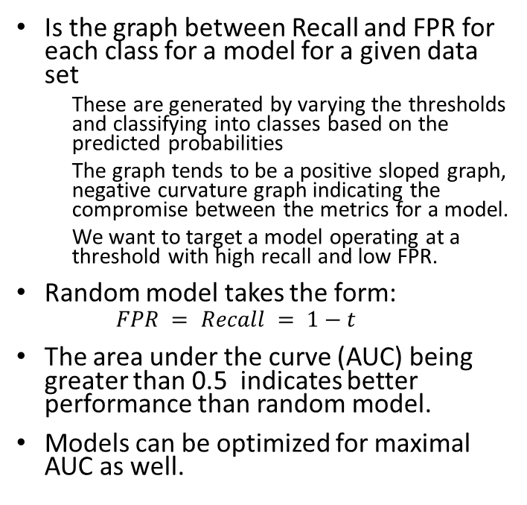
Receiver Operating Characteristic (ROC) Curve
All data is considered to be that class i.e., threshold = 0
Is the graph between Recall and FPR for each class for a model for a given data set
These are generated by varying the thresholds and classifying into classes based on the predicted probabilities
The graph tends to be a positive sloped graph, negative curvature graph indicating the compromise between the metrics for a model.
We want to target a model operating at a threshold with high recall and low FPR.
Random model takes the form:
$$FPR = Recall = 1−t$$
The area under the curve (AUC) being greater than 0.5 indicates better performance than random model.
Models can be optimized for maximal AUC as well.
Best Model
1
Model Operating Curve
Region where the model is useful
Operating threshold
Recall
Random model
No data belongs to that class i.e., threshold = 1
Region where the model is performing worse than a random model
0
FPR
1

Slide 16

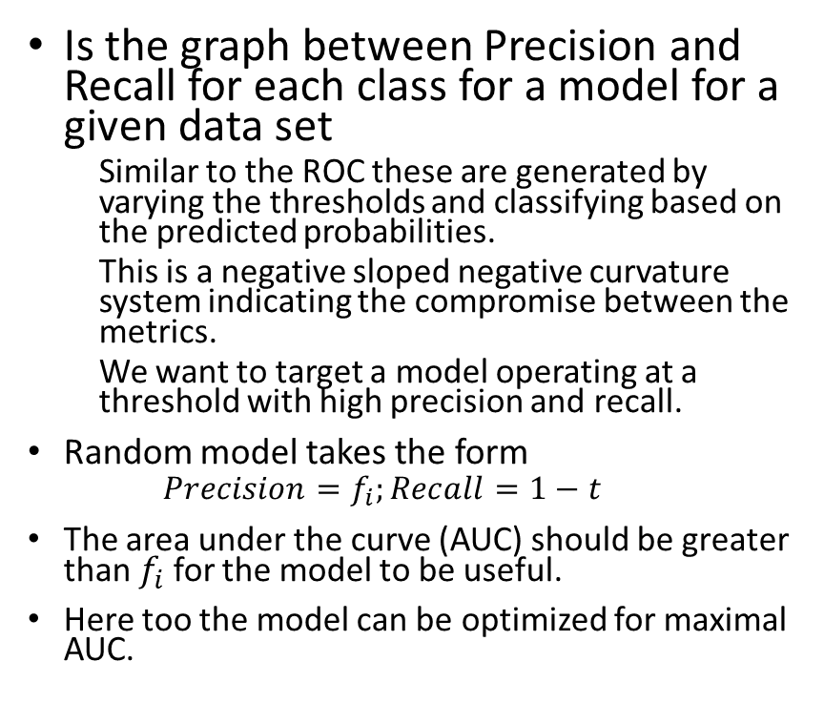

Precision Recall Curve
Threshold = 1
Precision Not Defined
Is the graph between Precision and Recall for each class for a model for a given data set
Similar to the ROC these are generated by varying the thresholds and classifying based on the predicted probabilities.
This is a negative sloped negative curvature system indicating the compromise between the metrics.
We want to target a model operating at a threshold with high precision and recall.
Random model takes the form
$$Precision=f_{i};Recall=1−t$$
The area under the curve (AUC) should be greater than $f_{i}$ for the model to be useful.
Here too the model can be optimized for maximal AUC.
Best Model
1
Operating threshold
Model Operating Curve
Threshold = 0
Precision
Region where the model is useful
$$f_{i}$$
Random model -> Precision = $f_{i}$
Region where the model is performing worse than a random model
0
Recall
1

