Slide 1
Introduction to Machine Learning
Process by which a computer automatically learns an algorithm for problem solving from data or experience.
Typically this involves the adjustment of parameters of a generic model
By
M. Meenakshi Sundaram, S. Ganesh

Slide 2
Types of Machine Learning
Machine Learning
Supervised Learning
Unsupervised Learning
Reinforcement Learning
Learning from a pre-labeled dataset to predict on unseen but similar data.
Ex: housing price prediction based on home features, location, school rating, age.
Identifying structure and patterns within an unlabeled dataset.
Ex: customer segmentation based on type and frequency of purchases made, demography.
Learning via interaction with an environment using a penalty-reward feedback.
Ex: learning to play a game of chess by playing against a human.

Slide 3
Types of Supervised Learning
Supervised Learning
Regression
Classification
To predict a quantitative value for a given data point.
Ex: Predicting the price of a house based on the features of the house and the market conditions.
To predict a qualitative characteristic/label for a given data point.
Ex: Detecting a human face from a photo.

Slide 4
Classification
Identifying the qualitative nature of data

Slide 5





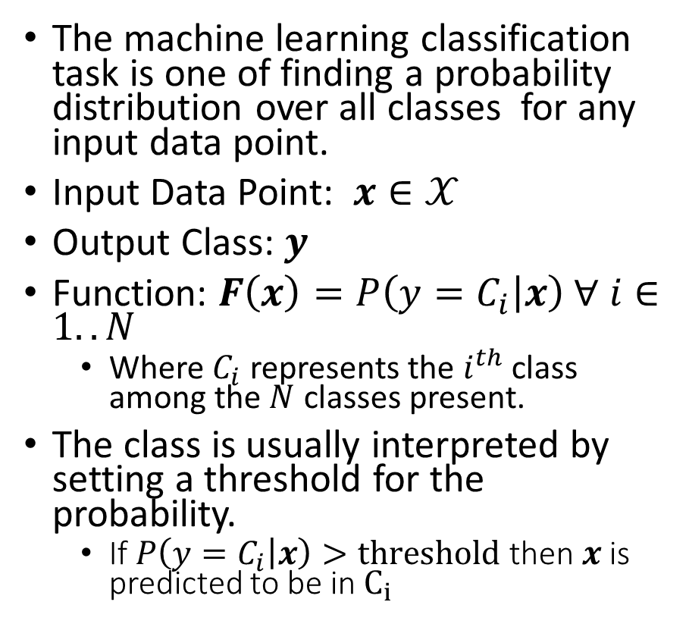
Classification
The machine learning classification task is one of finding a probability distribution over all classes for any input data point.
Input Data Point: $x∈𝒳$
Output Class: $y$
Function: $F\left(x\right)=P\left(y=C_{i} | x\right) ∀ i∈1..N$
Where $C_{i}$ represents the $i^{th}$ class among the $N$ classes present.
The class is usually interpreted by setting a threshold for the probability.
If$P\left(y=C_{i} | x\right)>threshold$ then $x$ is predicted to be in $C_{i}$
Spam
Email
Not Spam
Happy
Neutral
Tweet
Sad

