Slide 1
Decision Trees

Slide 2





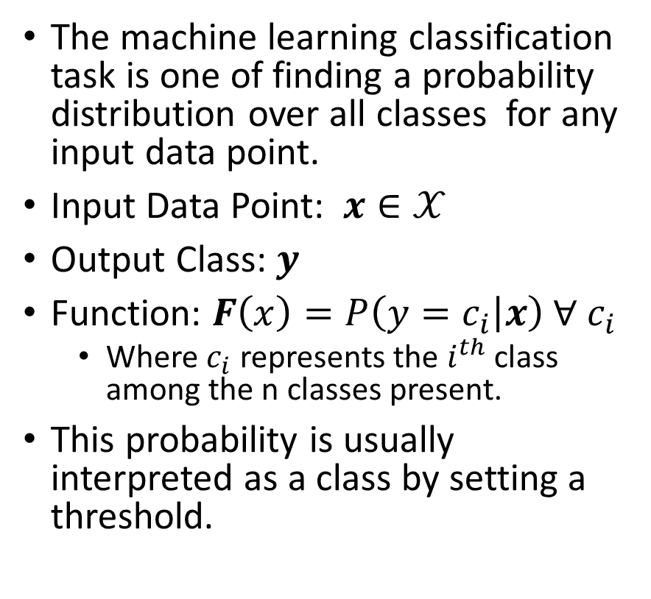
Classification
The machine learning classification task is one of finding a probability distribution over all classes for any input data point.
Input Data Point: $x∈𝒳$
Output Class: $y$
Function: $F\left(x\right)=P\left(y=c_{i} | x\right) ∀ c_{i}$
Where $c_{i}$ represents the $i^{th}$ class among the n classes present.
This probability is usually interpreted as a class by setting a threshold.
Spam
Email
Not Spam
Happy
Neutral
Tweet
Sad

Slide 3

Understanding Success
Effectiveness of a classification system is measured by using a supervised approach of having an unseen dataset that has existing class labels pass through the system.
$$Accuracy=\frac{\# correct predictions}{\# data points}$$
 | Model Cat | Model Dog | Model Bird
Data Cat | 76 | 10 | 12
Data Dog | 27 | 69 | 11
Data Bird | 6 | 3 | 81
$$Accuracy =\frac{76+69+81}{76+69+81+10+12+11+27+3+6}=76.66\%$$
Balanced Data: Equal quantity of dogs, cats, and birds

Slide 4

Understanding Success
Effectiveness of a classification system is measured by using a supervised approach of having an unseen dataset that has existing class labels pass through the system.
$$Accuracy=\frac{\# correct predictions}{\# data points}$$
 | Model Cat | Model Dog | Model Bird
Data Cat | 76 | 20 | 12
Data Dog | 27 | 180 | 11
Data Bird | 16 | 3 | 25
$$Accuracy =\frac{76+180+25}{76+180+25+20+12+11+27+3+16}=75.95\%$$
Even though the classification of “Birds” is poor, the accuracy is comparable to the previous scenario as the majority class is mostly captured by the model.
Unbalanced Data: more dogs in comparison to cats or birds

Slide 5
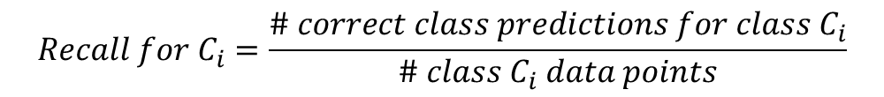
Understanding Success
$$Recall for C_{i}=\frac{\# correct class predictions for class C_{i}}{\# class C_{i} data points}$$
Other names: True Positive Rate, Sensitivity
Ex: Balanced Data
Ex: Imbalanced Data

Slide 6
Understanding Success
$$False Positive Ratefor C_{i}=\frac{\# incorrect class predictions for class C_{i}}{\# non class C_{i} data points}$$
Ex: Balanced Data
Ex: Imbalanced Data

Slide 7
Understanding Success
$$Precision for C_{i}=\frac{\# Correct Class Predictions for Class C_{i}}{\# Class C_{i} Predictions}$$
Ex: Balanced Data
Ex: Imbalanced Data

Slide 8
Decision Tree
Root Node
Sunny?
What is Decision Tree:
Supervised ML algorithm
Tree structure
It have root, internal and terminal nodes
Construction:
Recursively splitting train data set into subsets
based on the values of the attributes until
a stopping criterion is met
Stopping criterion:
Maximum depth of the tree
Minimum number of samples required to split a node
Yes
No
Ice Cream
Rainy?
Leaf Node
Yes
No
Bajji
Tea
Leaf Node
Leaf Node

Slide 9
Misclassification Metric

Slide 10
Entropy Metric

Slide 11
Gini Metric

