Slide 1
Decision Trees
Identifying the rules for classification
By
M. Meenakshi Sundaram, S. Ganesh

Slide 2
Decision Tree
Root Node
Sunny?
A hierarchical binary tree model where every root and internal node represents a yes/no test based on an attribute of the data that leads us to a class label in the leaf node.
ID3 construction algorithm:
Explicit evaluation of every training data point, for an attribute to find a threshold minimizing a “loss metric”.
The attribute that provides the “minimal loss” is used for a given node.
Repeated recursively till “satisfactory” class “purity” is achieved.
Yes
No
Ice Cream
Rainy?
Leaf Node
Yes
No
Bajji
Tea
Leaf Node
Leaf Node

Slide 3
Loss Metrics
Indicators of probability of miss-classification minimizing which helps us build tree classifiers.

Slide 4
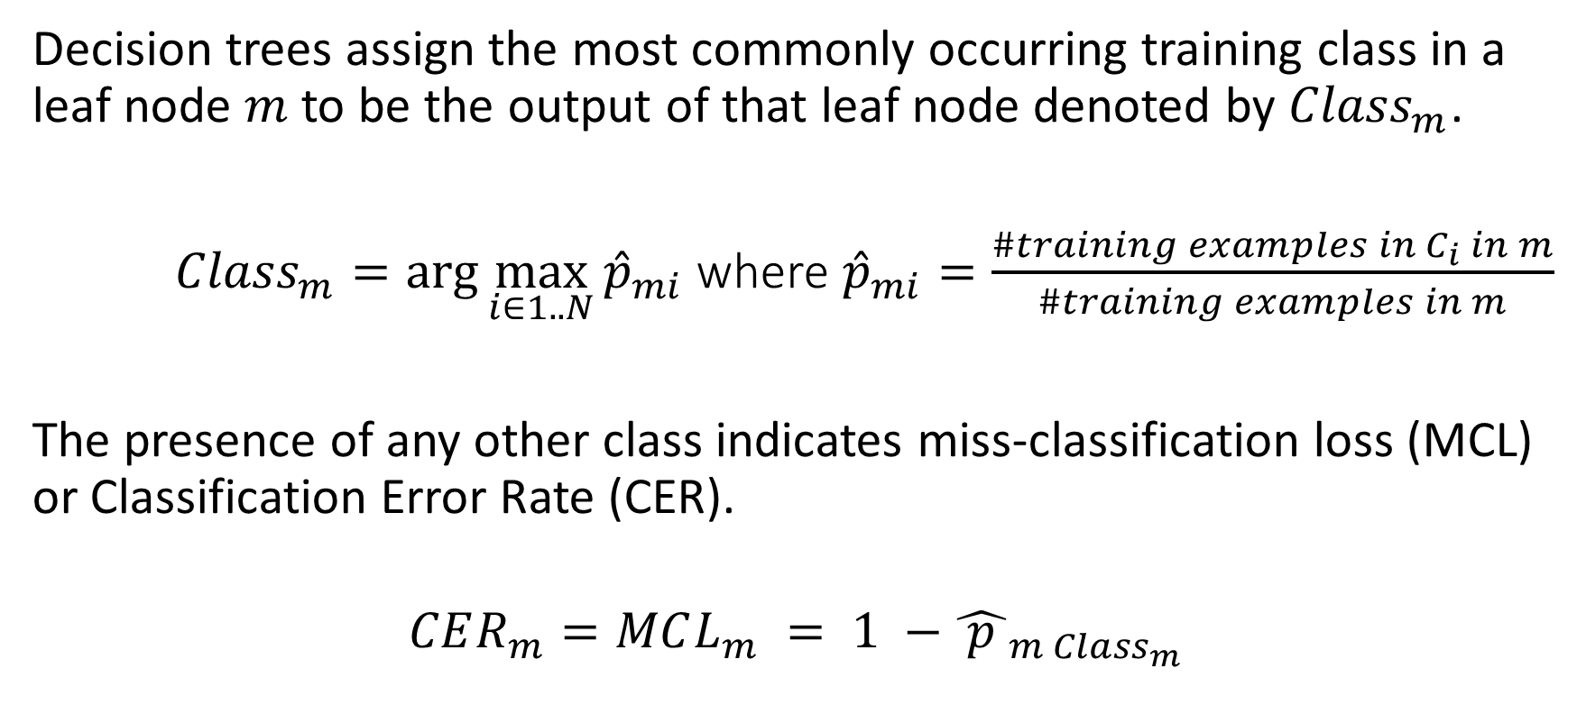
Miss-Classification Loss/Classification Error Rate - Definition

Slide 5
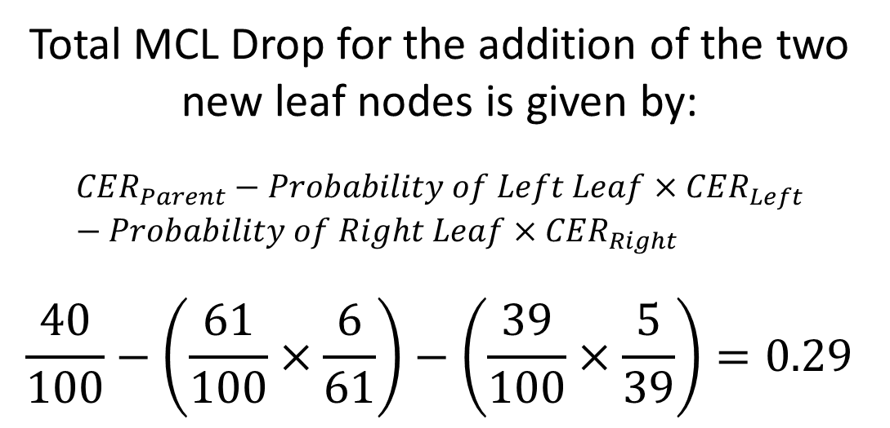



Miss-Classification Loss/Classification Error Rate - Example
Root Node
Sunny?
#Ice Cream 60
#Bajji 40
Yes
No
#Ice Cream 55
#Bajji 6
#Ice Cream 5
#Bajji 34
Ice Cream
Bajji
Leaf Node
Leaf Node

Slide 6
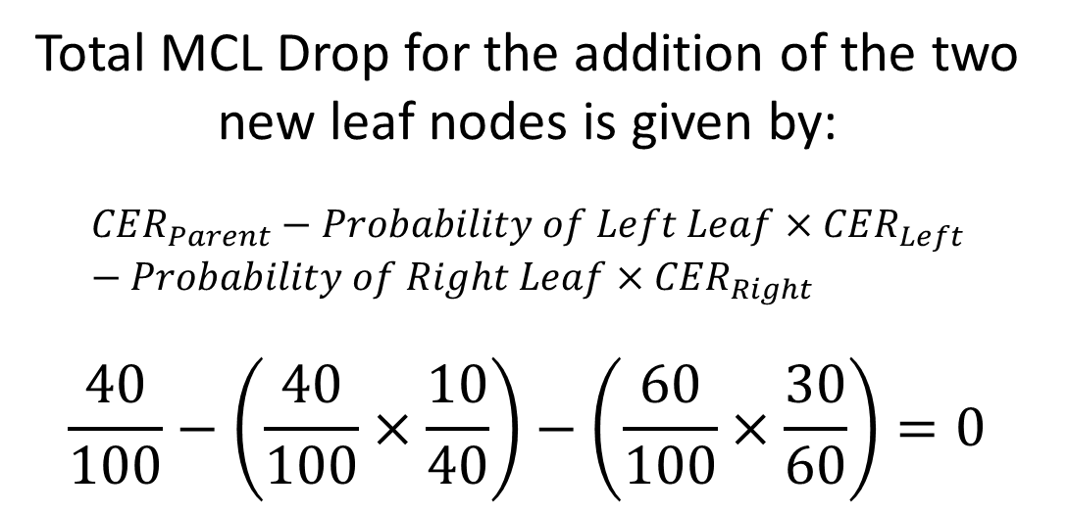


Miss-Classification Loss/Classification Error Rate – Insensitive Example
Root Node
Sunny?
#Ice Cream 60
#Bajji 40
Yes
No
#Ice Cream 30
#Bajji 10
#Ice Cream 30
#Bajji 30
Ice Cream
Bajji
Leaf Node
Leaf Node

Slide 7
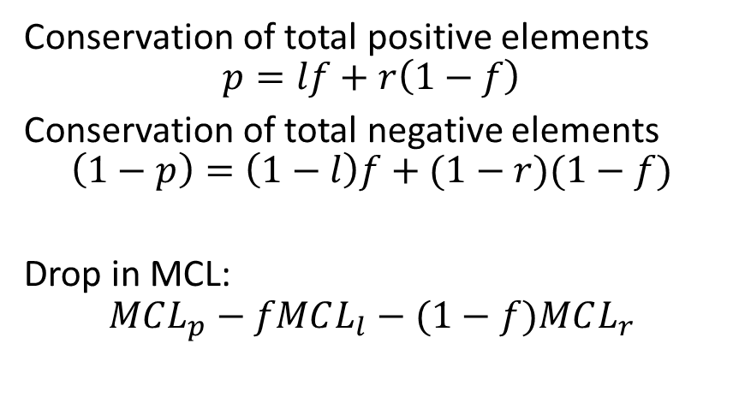
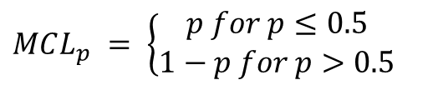
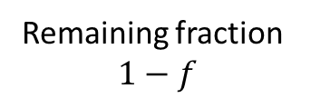

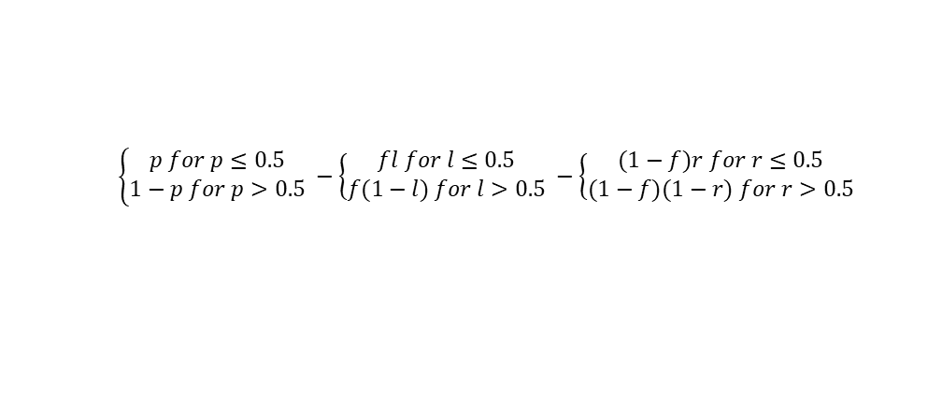
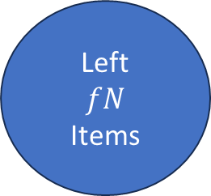
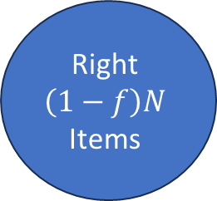
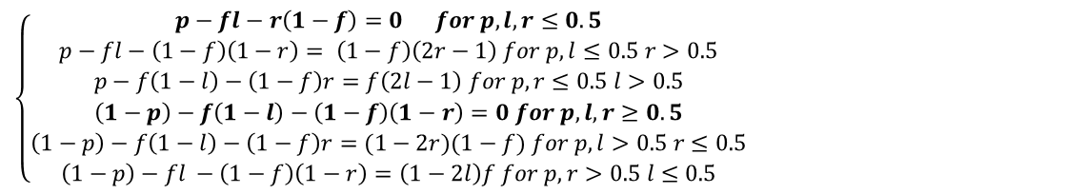
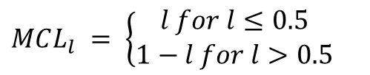
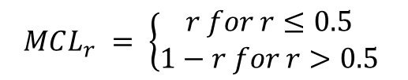
Miss-Classification Loss/Classification Error Rate – Insensitive Example
Root Node
Parent
N
Items

Slide 8



Miss-Classification Loss/Classification Error Rate – Reason for Insensitivity
Root Node
When the majority/minority class in parent node remains in majority/minority in both the leaf nodes, then the miss-classification loss reduction is 0.
The reason for this is the linearity of this metric.
Hence there is a need for a more sensitive metric to capture purity within such divisions.
Sunny?
#Ice Cream 60
#Bajji 40
Yes
No
#Ice Cream 30
#Bajji 10
#Ice Cream 30
#Bajji 30
Ice Cream
Bajji
Leaf Node
Leaf Node

Slide 9

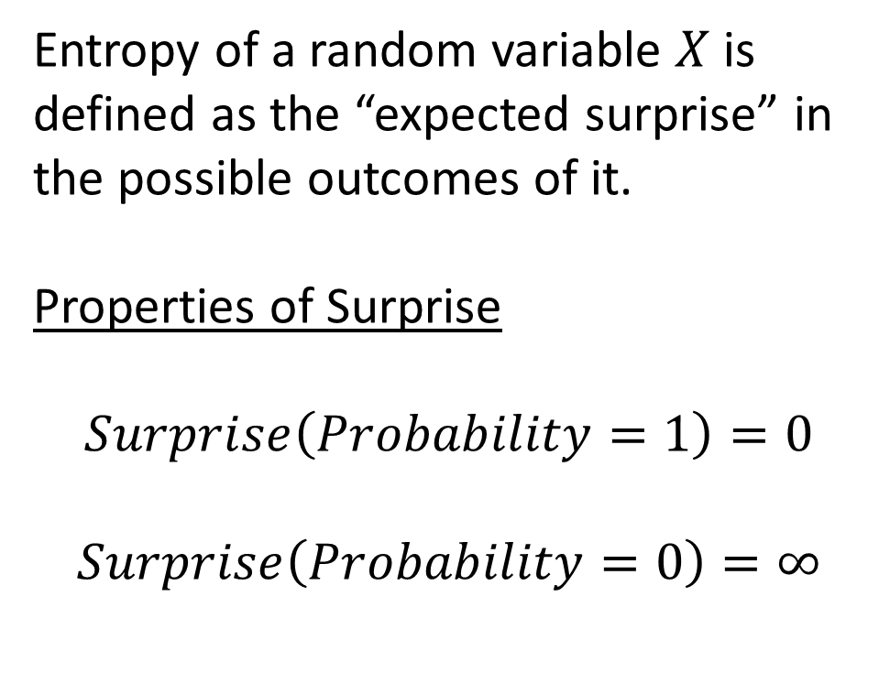



Entropy
Surprise
0
1
Probability
1
0
1

Slide 10
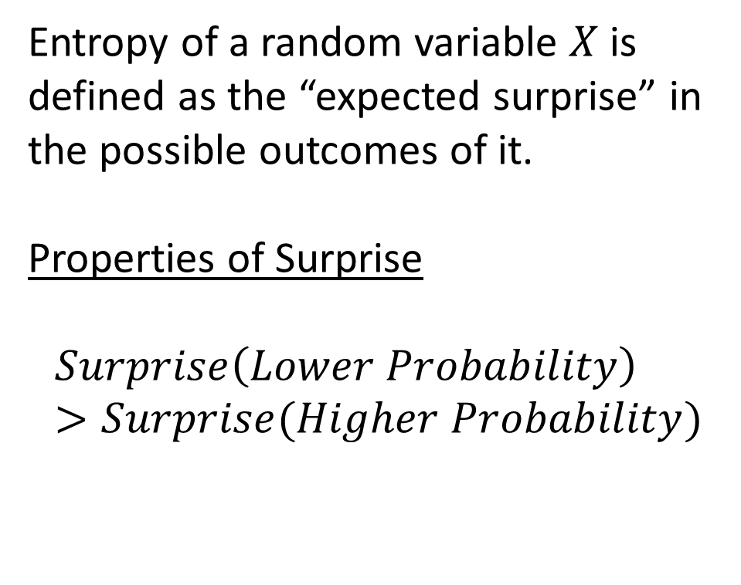




Entropy
Surprise
0
1
Probability
1
0
1

Slide 11
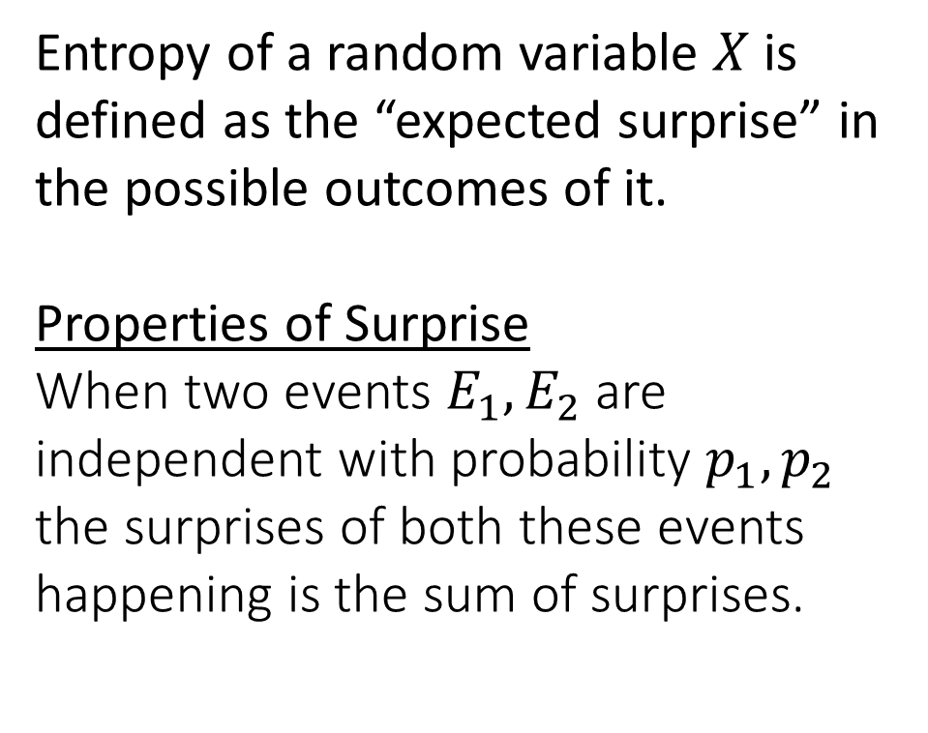
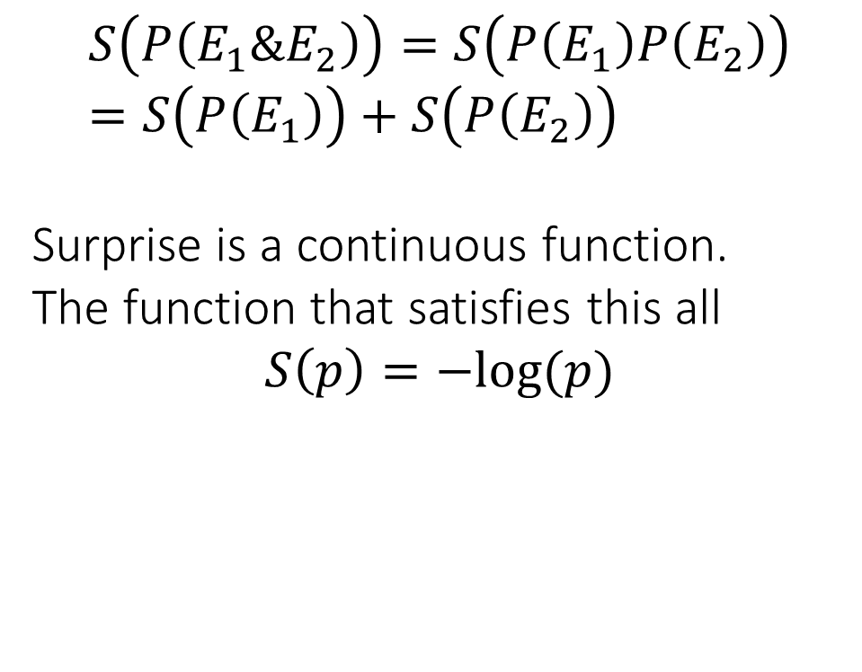
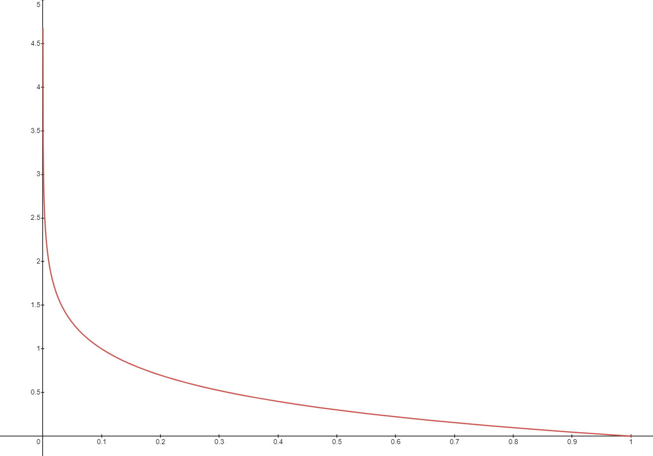
Entropy
0
1

Slide 12
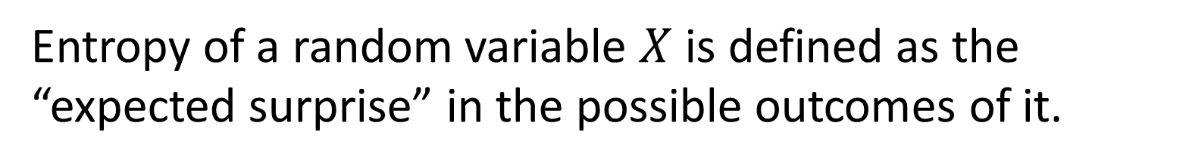
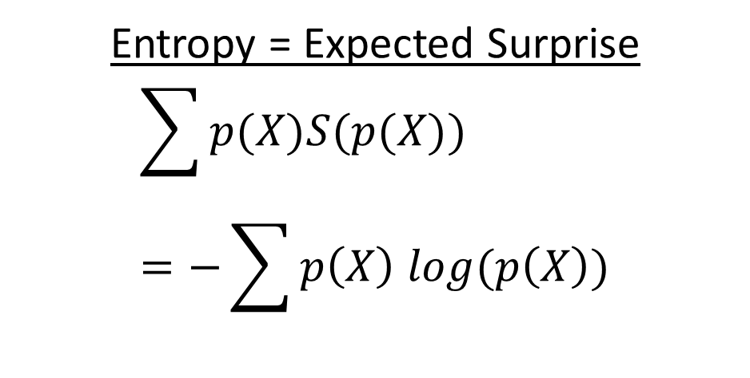
Entropy

Slide 13
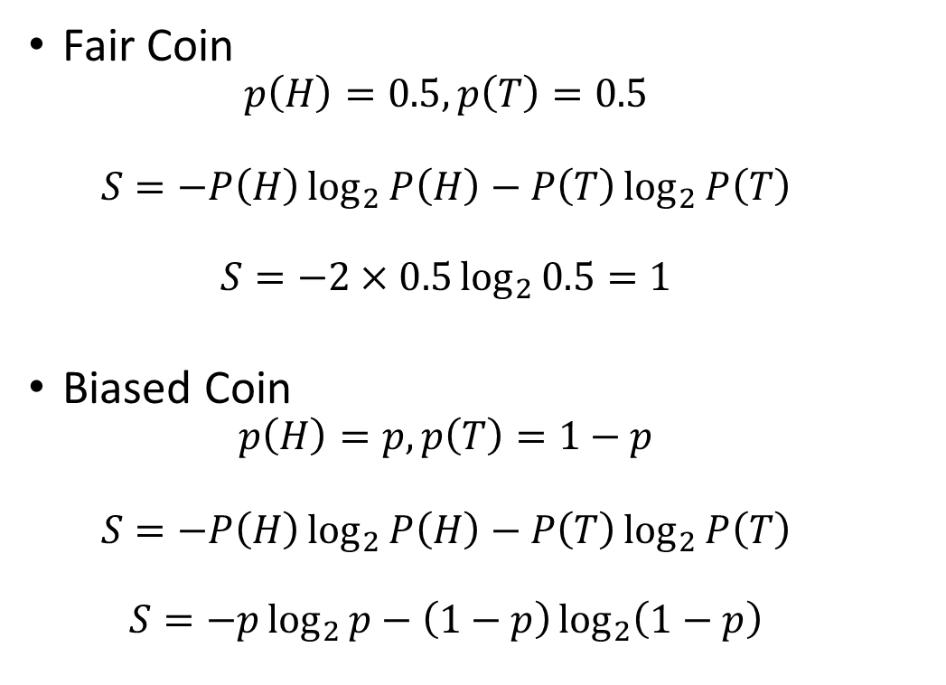
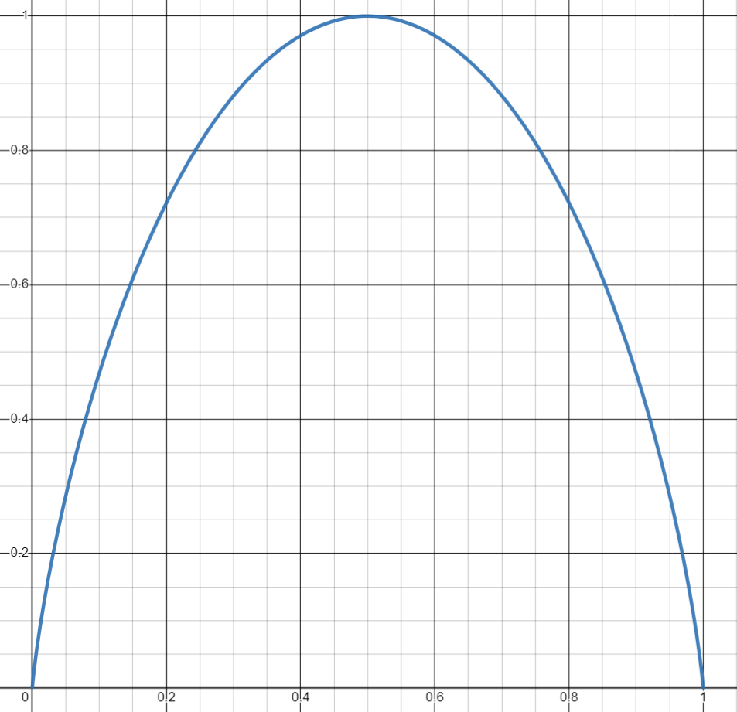
Entropy: Discrete
Entropy the expected surprise is high, i.e., when the “coin is fair”.
When the classifier is giving mixed signal.
Entropy is low when the expected surprise is low, i.e., when the “coin is unfair”.
When the classifier is giving a pure signal.
1
Entropy
0
0
1
Probability of Heads p

Slide 14
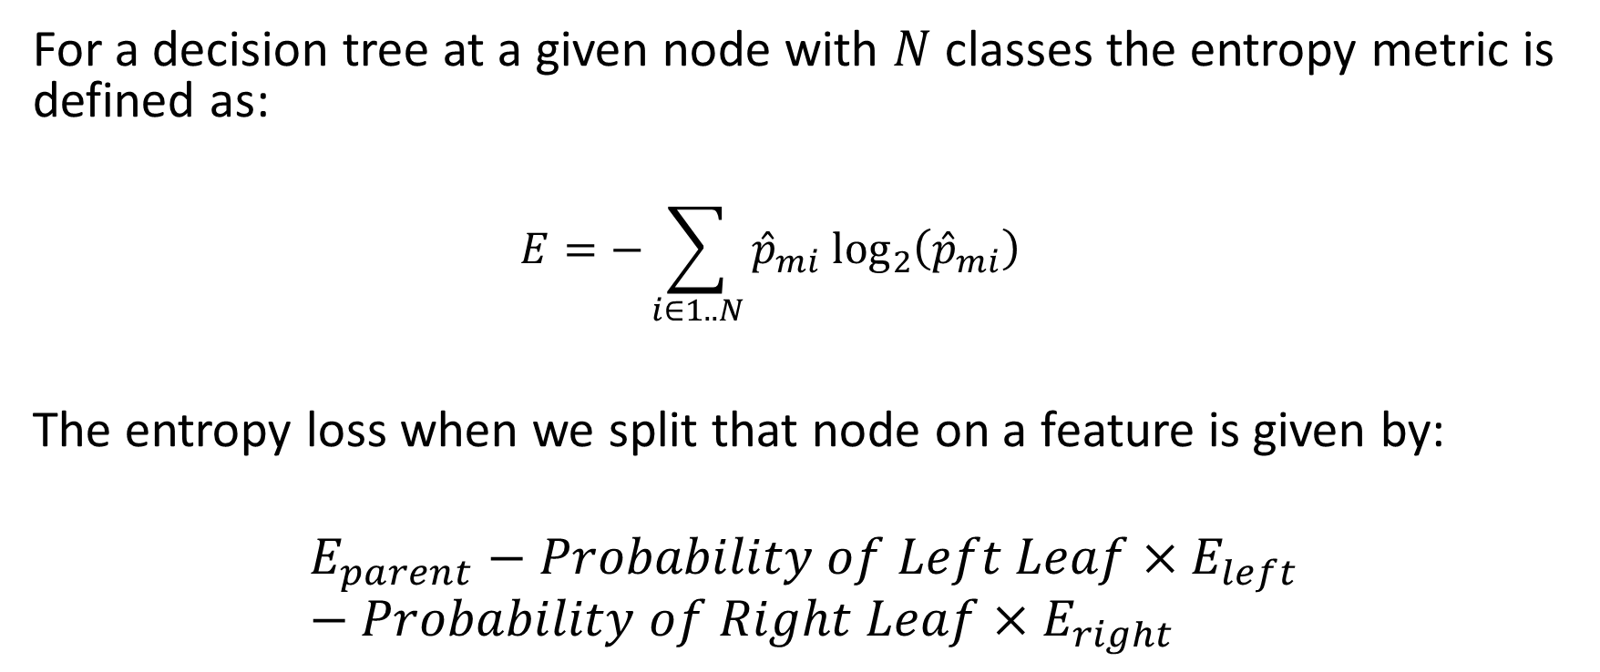
Entropy Loss/Log Loss

Slide 15

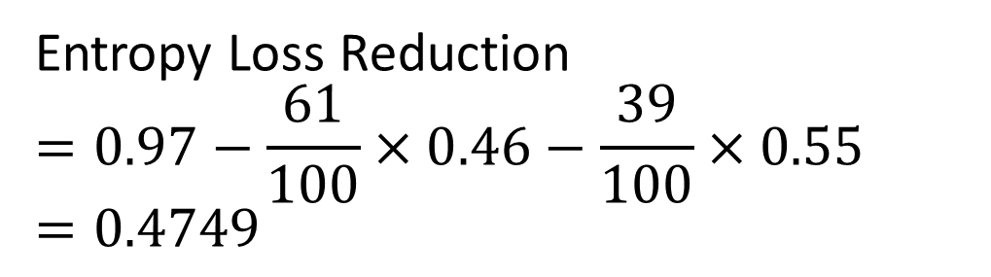


Entropy Loss/Log Loss - Example
Root Node
Sunny?
#Ice Cream 60
#Bajji 40
Yes
No
#Ice Cream 55
#Bajji 6
#Ice Cream 5
#Bajji 34
Ice Cream
Bajji
Leaf Node
Leaf Node

Slide 16
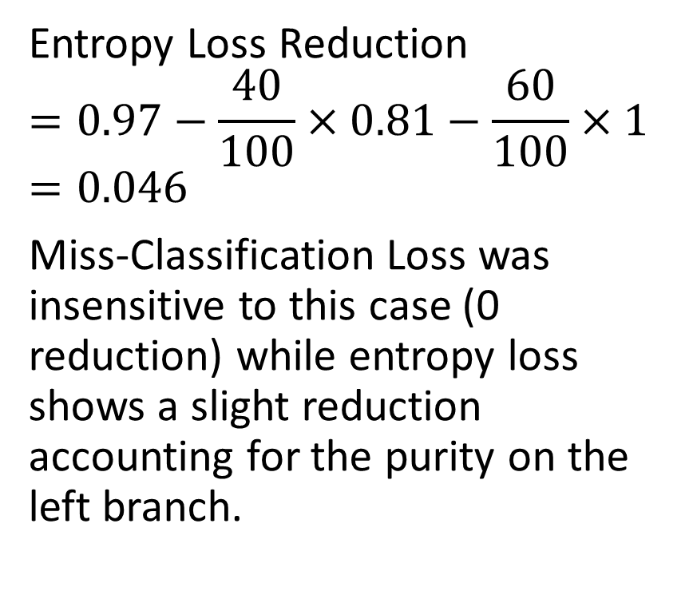


Entropy Loss/Log Loss – Another Example
Root Node
Sunny?
#Ice Cream 60
#Bajji 40
Yes
No
#Ice Cream 30
#Bajji 10
#Ice Cream 30
#Bajji 30
Ice Cream
Bajji
Leaf Node
Leaf Node

Slide 17
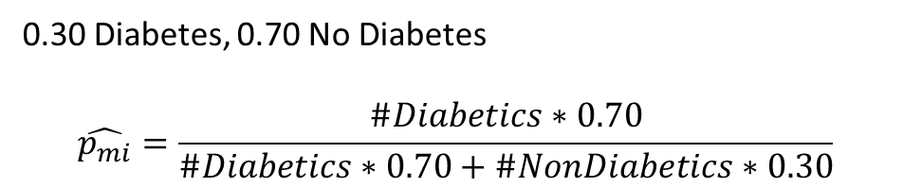
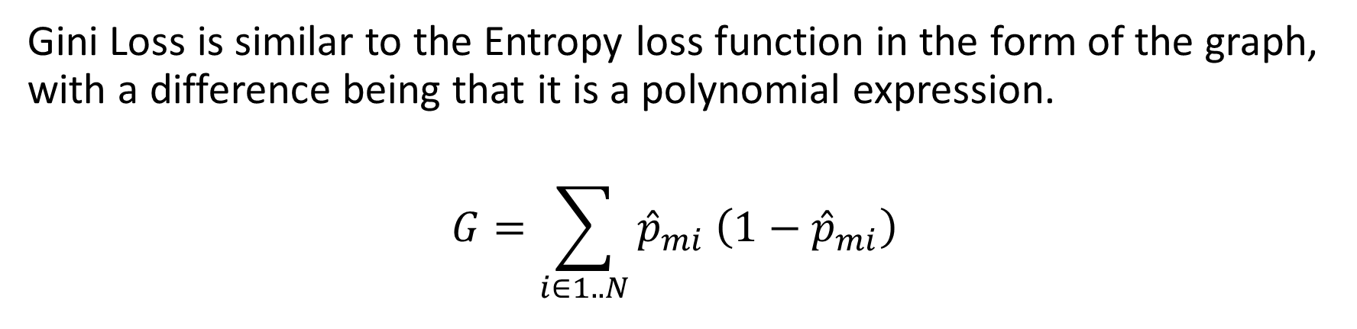
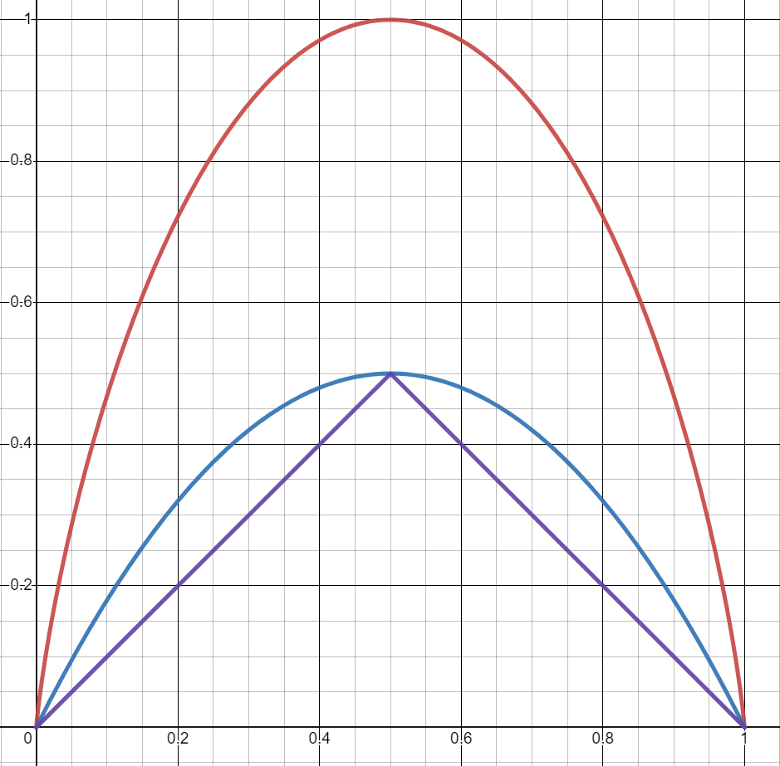
Gini Loss
Entropy
The graph for all metrics are compared for a binary classifier
Note: Reduction at a split is computed akin to entropy loss
Loss Metrics
Gini
Miss-Classification
Probability of binary classifier

Slide 18

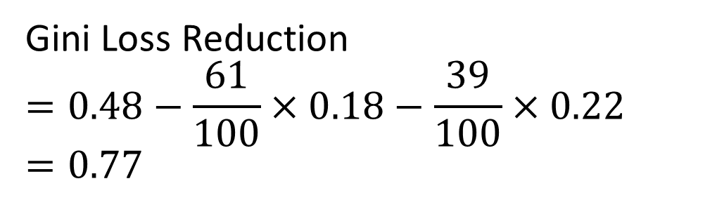


Gini Loss - Example
Root Node
Sunny?
#Ice Cream 60
#Bajji 40
Yes
No
#Ice Cream 55
#Bajji 6
#Ice Cream 5
#Bajji 34
Ice Cream
Bajji
Leaf Node
Leaf Node

Slide 19

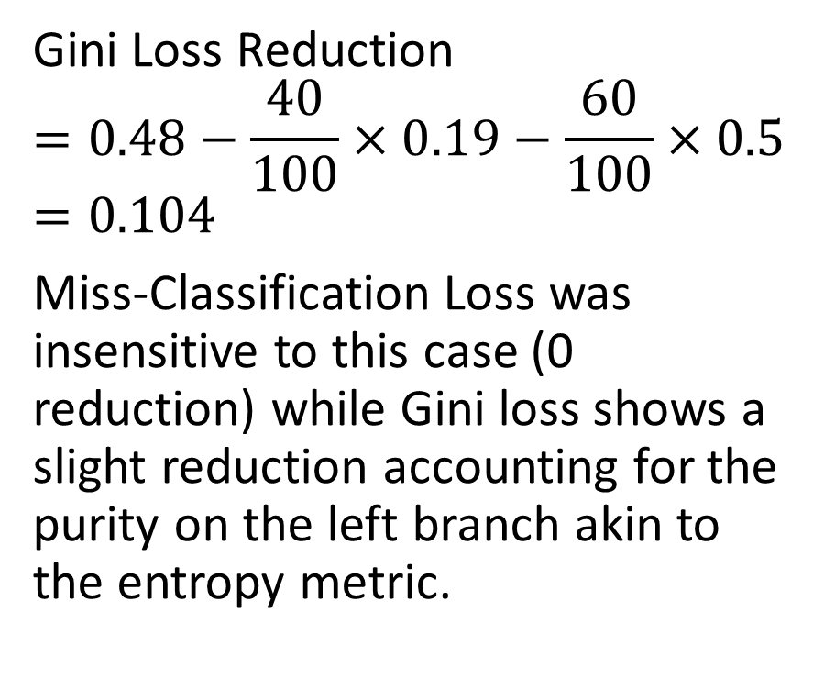


Gini Loss – Another Example
Root Node
Sunny?
#Ice Cream 60
#Bajji 40
Yes
No
#Ice Cream 30
#Bajji 10
#Ice Cream 30
#Bajji 30
Ice Cream
Bajji
Leaf Node
Leaf Node

Slide 20
Building a Decision Tree
Case Study

Slide 21
Example Data Source: Diabetes Data
https://www.kaggle.com/datasets/mathchi/diabetes-data-set
Accessed on:7/22/2023
Context
This dataset is originally from the National Institute of Diabetes and Digestive and Kidney Diseases. The objective is to predict based on diagnostic measurements whether a patient has diabetes.
Content
Several constraints were placed on the selection of these instances from a larger database. In particular, all patients here are females at least 21 years old of Pima Indian heritage.

Slide 22
Data Details & Prep
Clean dataset with no missing data.
One hot encoded categorical variables.
8 Features
Pregnancies,
Glucose,
Blood Pressure,
Skin Thickness,
Insulin,
BMI,
DiabetesPedigreeFunction,
Age
Data is randomly split into 70% training and 30% test
Training – 538
Diabetic – 202
Non-Diabetic – 336
Test – 230
Diabetic – 66
Non-Diabetic – 164

Slide 23
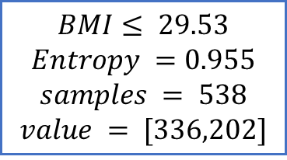
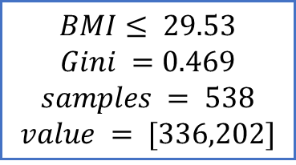
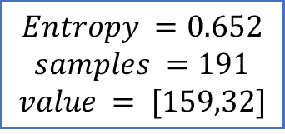
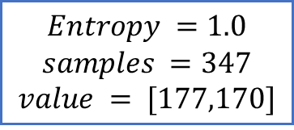
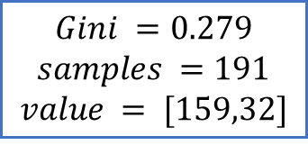
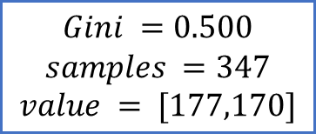
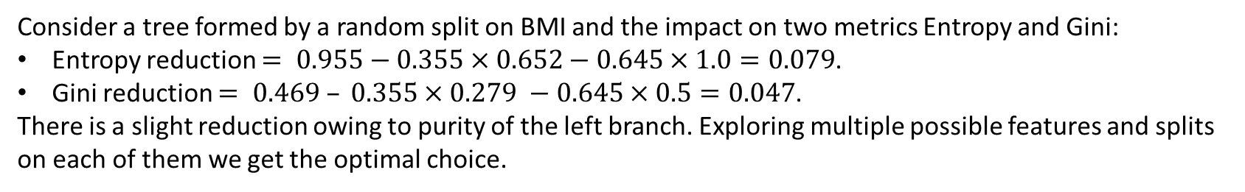
Approach: ID3 Optimizing the loss metric

Slide 24
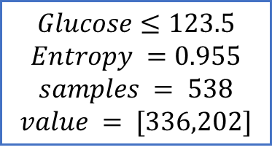
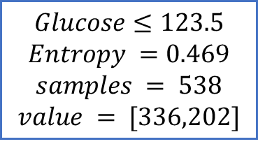
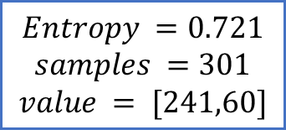
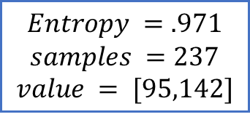
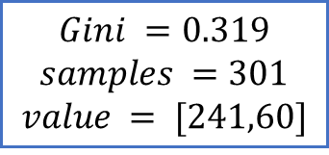
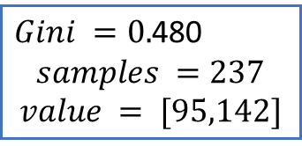
Approach: ID3 Optimizing the loss metric
Optimal Depth 1 Tree based on Entropy & Gini

Slide 25
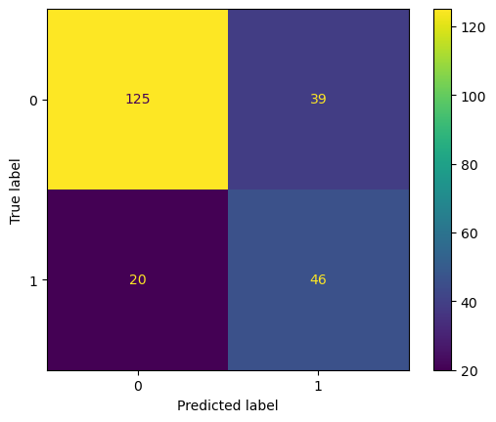
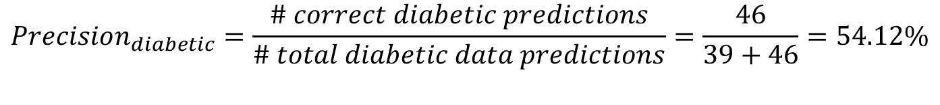
Depth 1 Tree Performance on test?

Slide 26
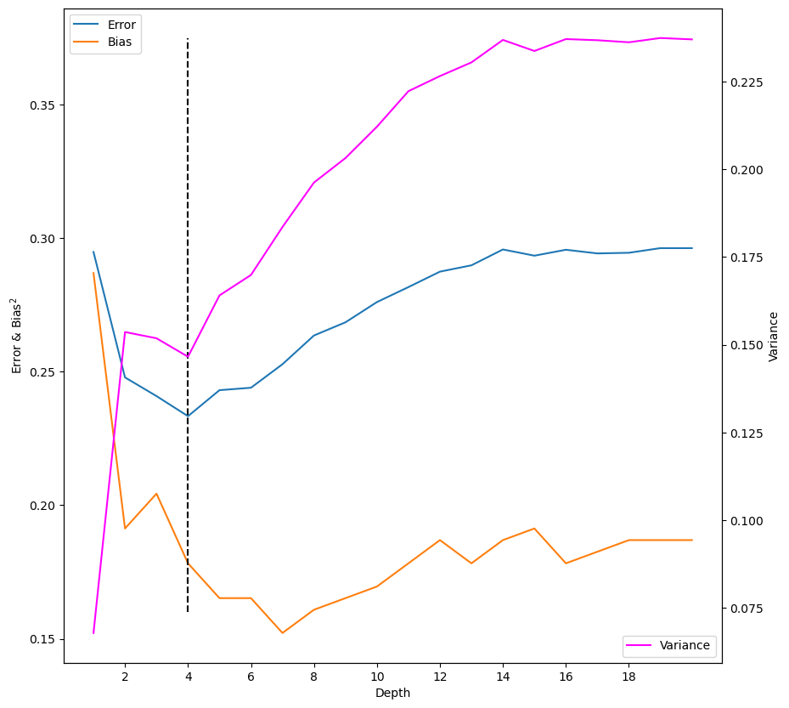
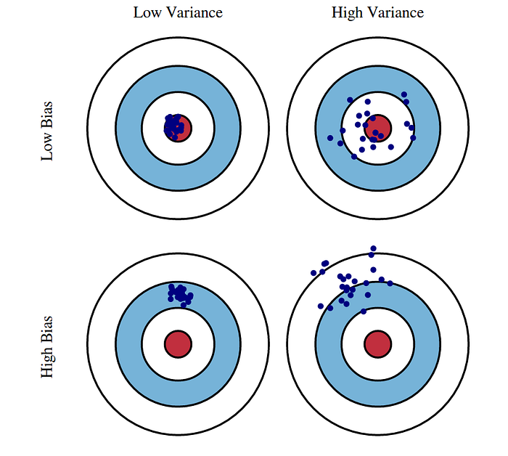
Bias & Variance: Can we do better if we grow the tree deeper?
We see that the low variance and low bias is between depth 2 - 7 with low prediction error.
While bias grows lower with increasing depth >7 we will be in higher variance territory and higher generalization error.
Low Bias
Low Variance
Low Bias
High Variance
High Bias
High Variance

Slide 27
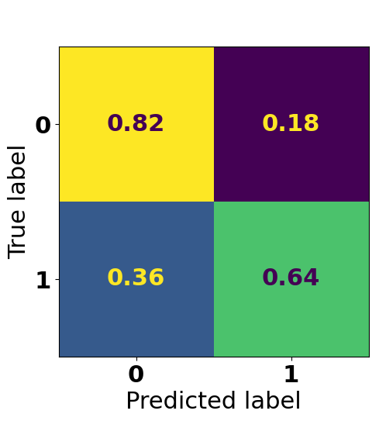
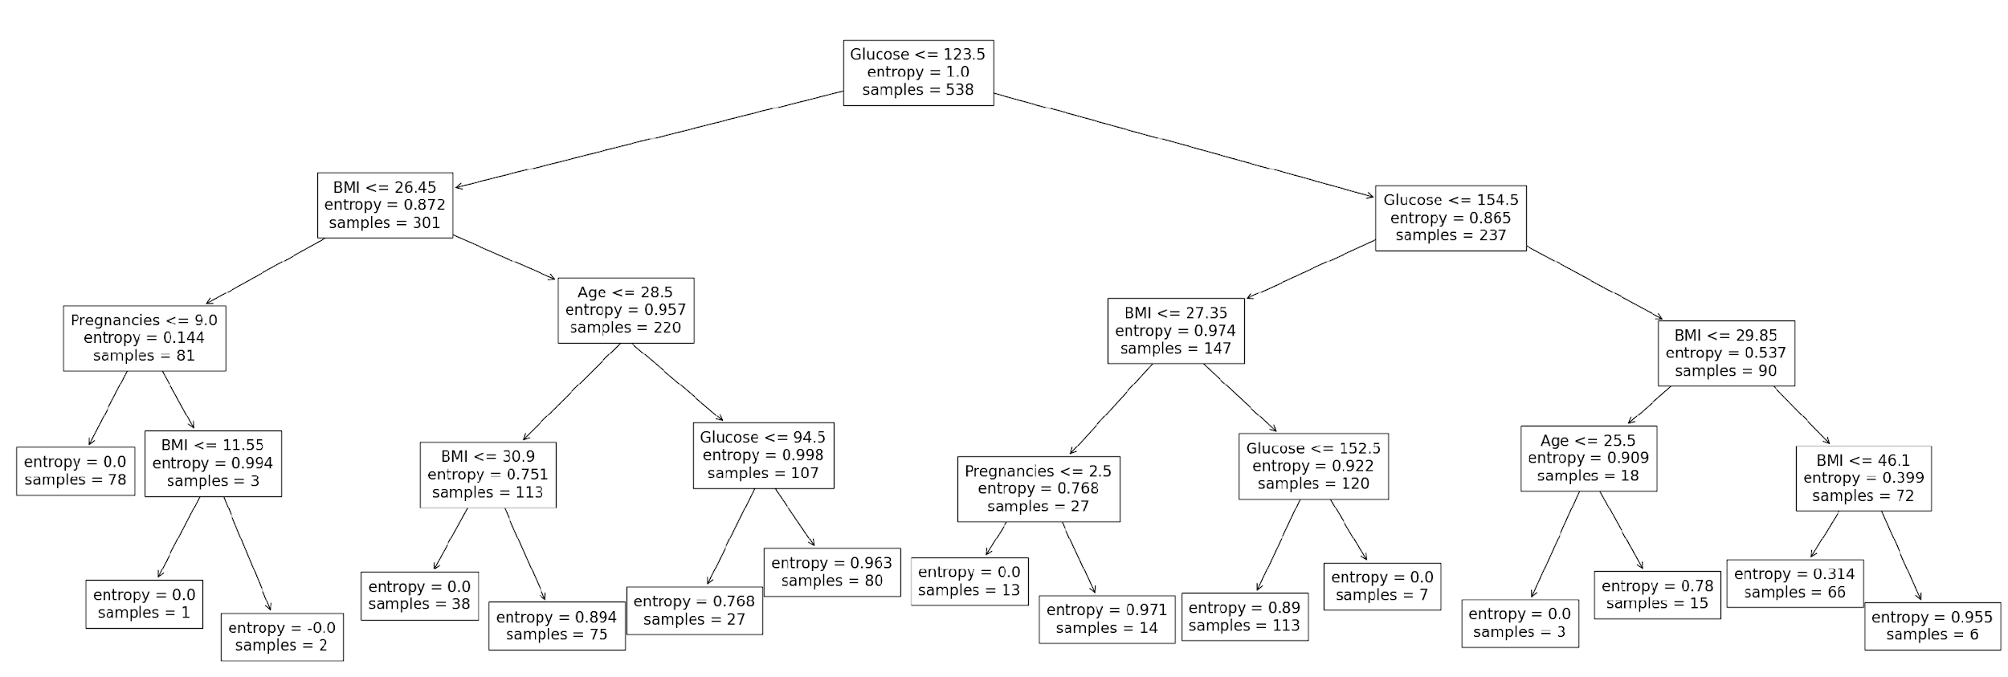
Entropy Loss Optimized Depth 4 Tree on a Training Data
Metrics | Value on Test
Accuracy | 76.52
Recall | 63.63
Precision | 58.33
FPR | 18.29
Test Confusion Matrix

Slide 29
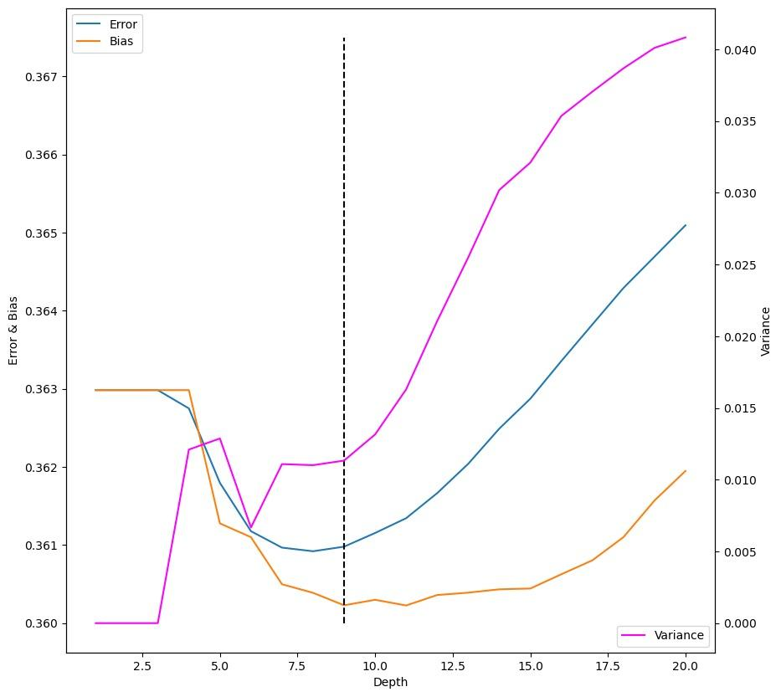
Generalization Error, Bias and Variance

Slide 30
Random Forest
Random Forest is to build multiple decision trees during the training phase and then combine their predictions to produce a more accurate and robust final prediction.
Random forest workflow:
Bootstrap sampling:
Random Forest starts by creating multiple bootstrap samples (random samples with replacement) from the original dataset. These samples are used to train individual decision trees.
Feature selection:
For each tree in the forest, a random subset of features (attributes) is selected. This helps introduce diversity among the trees and prevents overfitting. The number of features to consider at each split is a hyperparameter that can be tuned.
Tree construction:
For each bootstrap sample and using the selected subset of features, a decision tree is constructed. These trees can be either classification trees or regression trees, depending on the problem type.
Voting (Classification) or Average (Regression):
When making predictions, each tree in the forest produces a prediction. For classification problems, each tree's prediction is treated as a "vote," and the class with the most votes becomes the final prediction. For regression problems, each tree's prediction is averaged to obtain the final prediction.

Slide 31
Random Forest

