Slide 1
Decision Trees

Slide 2





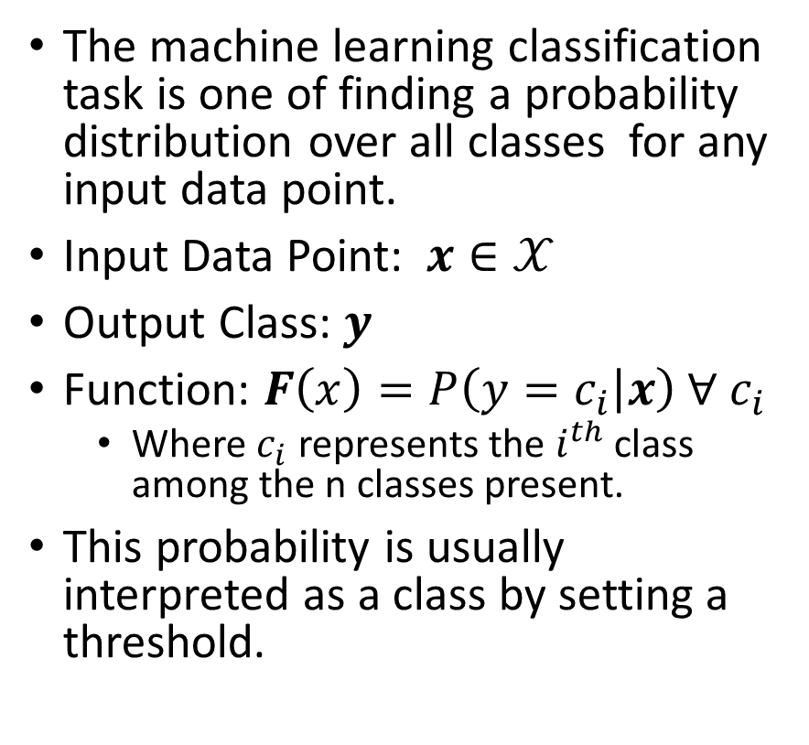
Classification
The machine learning classification task is one of finding a probability distribution over all classes for any input data point.
Input Data Point: $x∈𝒳$
Output Class: $y$
Function: $F\left(x\right)=P\left(y=c_{i} | x\right) ∀ c_{i}$
Where $c_{i}$ represents the $i^{th}$ class among the n classes present.
This probability is usually interpreted as a class by setting a threshold.
Spam
Email
Not Spam
Happy
Neutral
Tweet
Sad

Slide 3

Understanding Success
Effectiveness of a classification system is measured by using a supervised approach of having an unseen dataset that has existing class labels pass through the system.
$$Accuracy=\frac{\# correct predictions}{\# data points}$$
 | Model Cat | Model Dog | Model Bird
Data Cat | 76 | 10 | 12
Data Dog | 27 | 69 | 11
Data Bird | 6 | 3 | 81
$$Accuracy =\frac{76+69+81}{76+69+81+10+12+11+27+3+6}=76.66\%$$
Balanced Data: Nearly equal quantity of dogs, cats, and birds

Slide 4

Understanding Success
Effectiveness of a classification system is measured by using a supervised approach of having an unseen dataset that has existing class labels pass through the system.
$$Accuracy=\frac{\# correct predictions}{\# data points}$$
 | Model Cat | Model Dog | Model Bird
Data Cat | 76 | 20 | 12
Data Dog | 27 | 180 | 11
Data Bird | 16 | 3 | 25
$$Accuracy =\frac{76+180+25}{76+180+25+20+12+11+27+3+16}=75.95\%$$
Even though the classification of “Birds” is poor, the accuracy is comparable to the previous scenario as the majority class is mostly captured by the model.
Unbalanced Data: More dogs in comparison to cats or birds

Slide 5
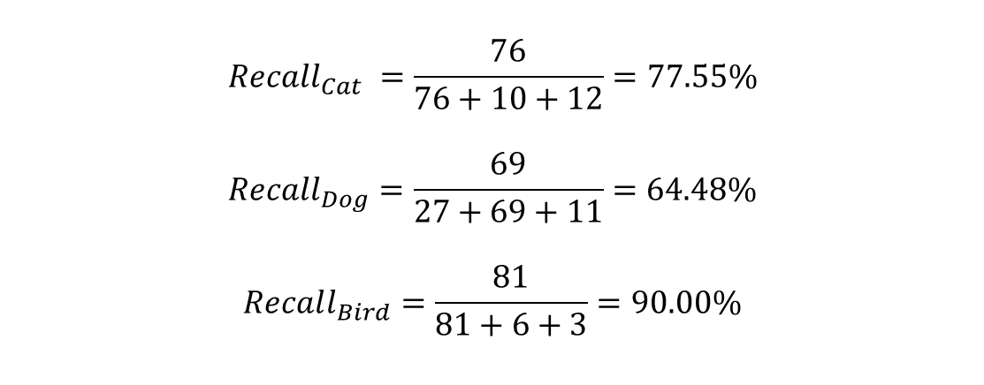
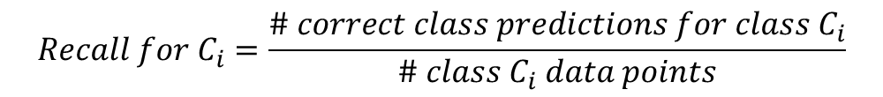
Understanding Success
$$Recall for C_{i}=\frac{\# correct class predictions for class C_{i}}{\# class C_{i} data points}$$
Other names: True Positive Rate, Sensitivity
$$Recall_{Cat} =\frac{76}{76+10+12}=77.55\%$$
$$Recall_{Dog}=\frac{69}{27+69+11}=64.48\%$$
$$Recall_{Bird}=\frac{81}{81+6+3}=90.00\%$$
 | Model Cat | Model Dog | Model Bird
Data Cat | 76 | 10 | 12
Data Dog | 27 | 69 | 11
Data Bird | 6 | 3 | 81
Balanced Data: Nearly equal quantity of dogs, cats, and birds

Slide 6
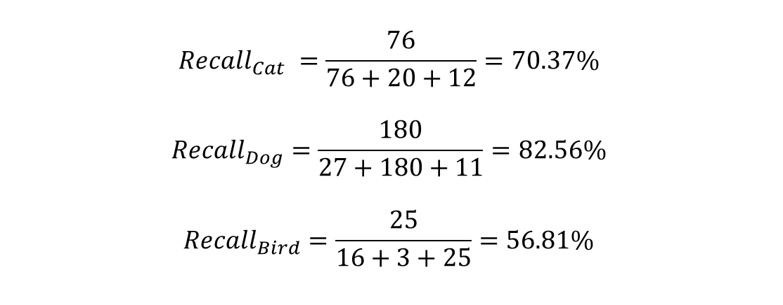
Understanding Success
$$Recall for C_{i}=\frac{\# correct class predictions for class C_{i}}{\# class C_{i} data points}$$
Other names: True Positive Rate (TPR), Sensitivity
$$Recall_{Cat} =\frac{76}{76+20+12}=70.37\%$$
$$Recall_{Dog}=\frac{180}{27+180+11}=82.56\%$$
$$Recall_{Bird}=\frac{25}{16+3+25}=56.81\%$$
 | Model Cat | Model Dog | Model Bird
Data Cat | 76 | 20 | 12
Data Dog | 27 | 180 | 11
Data Bird | 16 | 3 | 25
Clearly this model performs poorly on the identification of “Birds” relative to the previous scenario and the metric “Recall” captures this.
Unbalanced Data: More dogs in comparison to cats or birds

Slide 7
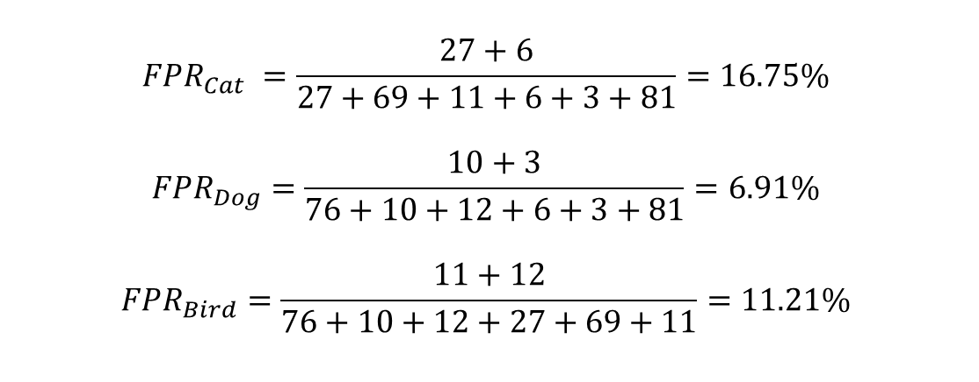
Understanding Success
$$False Positive Rate for C_{i}=\frac{\# incorrect class predictions for class C_{i}}{\# non class C_{i} data points}$$
Acronym: FPR
$$FPR_{Cat} =\frac{27+6}{27+69+11+6+3+81}=16.75\%$$
$${FPR}_{Dog}=\frac{10+3}{76+10+12+6+3+81}=6.91\%$$
$$FPR_{Bird}=\frac{11+12}{76+10+12+27+69+11}=11.21\%$$
 | Model Cat | Model Dog | Model Bird
Data Cat | 76 | 10 | 12
Data Dog | 27 | 69 | 11
Data Bird | 6 | 3 | 81
Balanced Data: Nearly equal quantity of dogs, cats, and birds

Slide 8
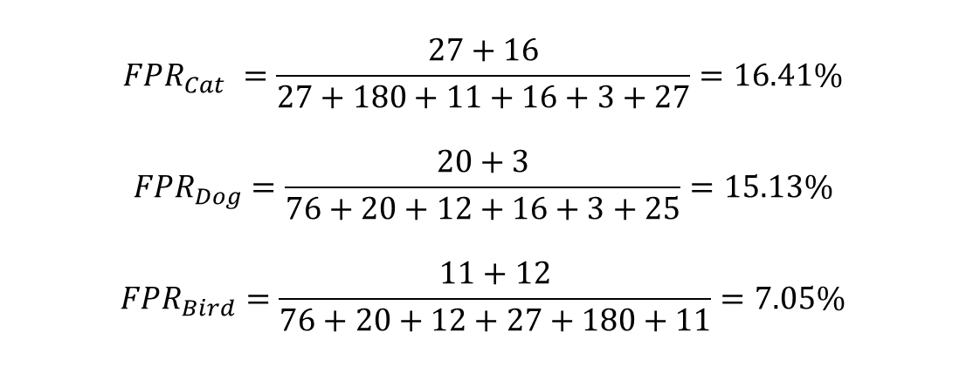
Understanding Success
$$False Positive Rate for C_{i}=\frac{\# incorrect class predictions for class C_{i}}{\# non class C_{i} data points}$$
Acronym: FPR
$$FPR_{Cat} =\frac{27+16}{27+180+11+16+3+27}=16.41\%$$
$${FPR}_{Dog}=\frac{20+3}{76+20+12+16+3+25}=15.13\%$$
$$FPR_{Bird}=\frac{11+12}{76+20+12+27+180+11}=7.05\%$$
 | Model Cat | Model Dog | Model Bird
Data Cat | 76 | 20 | 12
Data Dog | 27 | 180 | 11
Data Bird | 16 | 3 | 25
Unbalanced Data: More dogs in comparison to cats or birds

Slide 9
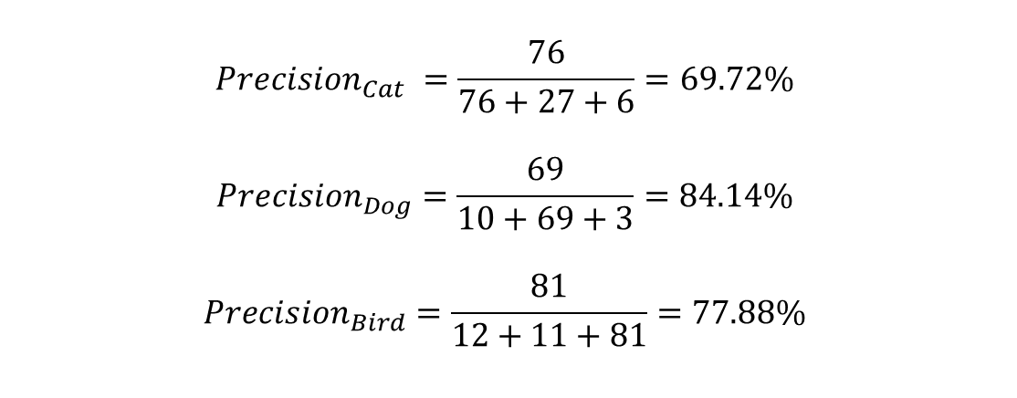
Understanding Success
$$Precision for C_{i}=\frac{\# Correct Class Predictions for Class C_{i}}{\# Class C_{i} Predictions}$$
$$Precision_{Cat} =\frac{76}{76+27+6}=69.72\%$$
$${Precision}_{Dog}=\frac{69}{10+69+3}=84.14\%$$
$$Precision_{Bird}=\frac{81}{12+11+81}=77.88\%$$
 | Model Cat | Model Dog | Model Bird
Data Cat | 76 | 10 | 12
Data Dog | 27 | 69 | 11
Data Bird | 6 | 3 | 81
Balanced Data: Nearly equal quantity of dogs, cats, and birds

Slide 10
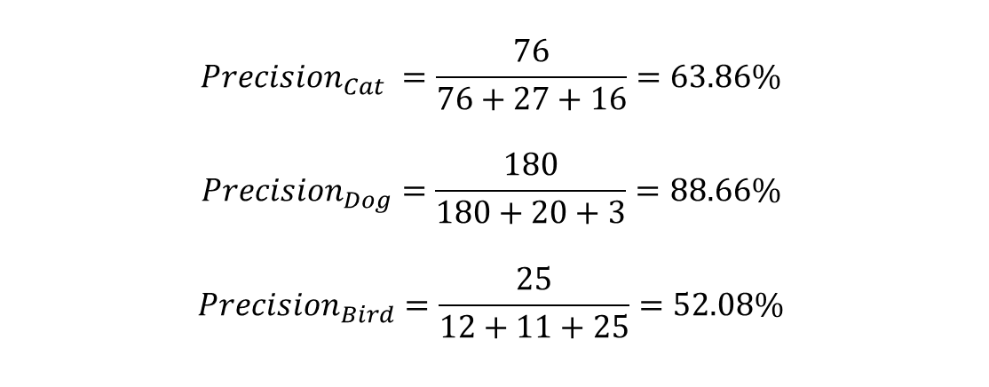
Understanding Success
$$Precision for C_{i}=\frac{\# Correct Class Predictions for Class C_{i}}{\# Class C_{i} Predictions}$$
$$Precision_{Cat} =\frac{76}{76+27+16}=63.86\%$$
$${Precision}_{Dog}=\frac{180}{180+20+3}=88.66\%$$
$$Precision_{Bird}=\frac{25}{12+11+25}=52.08\%$$
 | Model Cat | Model Dog | Model Bird
Data Cat | 76 | 20 | 12
Data Dog | 27 | 180 | 11
Data Bird | 16 | 3 | 25
Unbalanced Data: More dogs in comparison to cats or birds

Slide 11
Decision Tree
Root Node
Sunny?
What is Decision Tree:
Supervised ML algorithm
Tree structure
It have root, internal and terminal nodes
Construction:
Recursively splitting train data set into subsets
based on the values of the attributes until
a stopping criterion is met
Stopping criterion:
Maximum depth of the tree
Minimum number of samples required to split a node
Yes
No
Ice Cream
Rainy?
Leaf Node
Yes
No
Bajji
Tea
Leaf Node
Leaf Node

Slide 12
Misclassification Metric

Slide 13
Entropy Metric

Slide 14
Gini Metric

