Slide 1
Decision Trees
Identifying the rules for classification
By
M. Meenakshi Sundaram, S. Ganesh

Slide 2
Decision Tree
Root Node
Sunny?
A hierarchical binary tree model where every root and internal node represents a yes/no test based on an attribute of the data that leads us to a class label in the leaf node.
ID3 construction algorithm:
Explicit evaluation of every training data point, for an attribute to find a threshold minimizing a “loss metric”.
The attribute that provides the “minimal loss” is used for a given node.
Repeated recursively till:
“satisfactory” class “purity” is achieved.
“max depth criterion” is reached.
“min number of values in leaf node is achieved.
Yes
No
Ice Cream
Rainy?
Leaf Node
Yes
No
Bajji
Tea
Leaf Node
Leaf Node

Slide 3
Loss Metrics
Indicators of probability of miss-classification minimizing which helps us build tree classifiers.

Slide 4
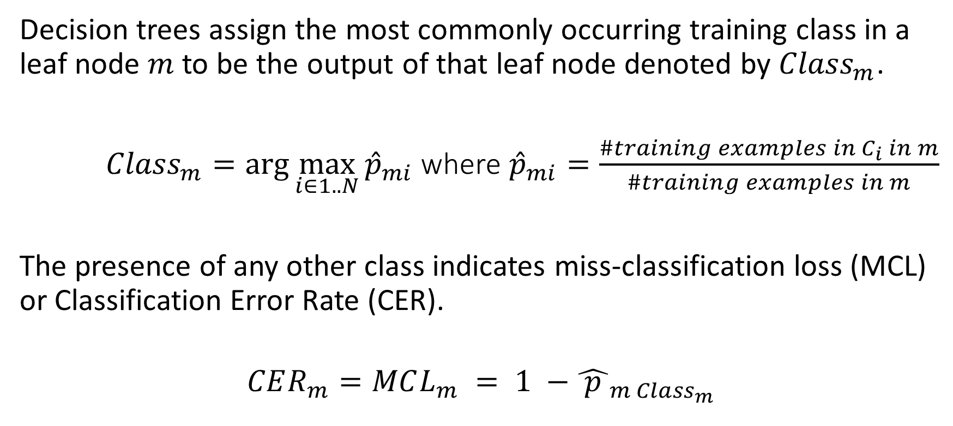
Miss-Classification Loss/Classification Error Rate - Definition
Decision trees assign the most commonly occurring training class in a leaf node $m$ to be the output of that leaf node denoted by ${Class}_{m}$.
${Class}_{m}=\arg{\max_{i∈1..N}{{\hat{p}}_{mi}}}$ where ${\hat{p}}_{mi}=\frac{\#training examples in C_{i} in m}{\#training examples in m}$
The presence of any other class indicates miss-classification loss (MCL) or Classification Error Rate (CER).
$$CER_{m}=MCL_{m} = 1 −{\hat{ p }}_{m {Class}_{m}}$$

Slide 5

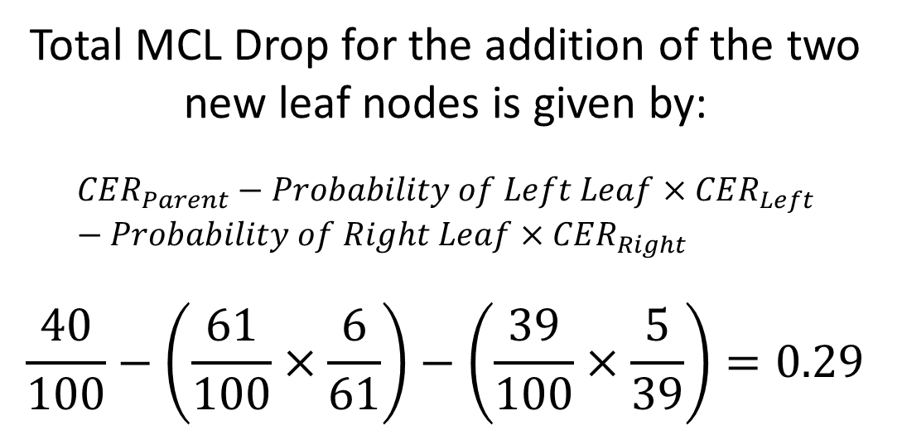


Miss-Classification Loss/Classification Error Rate - Example
$$CER_{m}=MCL_{m} = 1 −{\hat{ p }}_{m {Class}_{m}}$$
Root Node
Sunny?
#Ice Cream 60
#Bajji 40
Total MCL Drop for the addition of the two new leaf nodes is given by:
$$CER_{Parent}−Probability of Left Leaf×CER_{Left}−Probability of Right Leaf×CER_{Right}$$
$$\frac{40}{100}−\left(\frac{61}{100}×\frac{6}{61}\right)−\left(\frac{39}{100}×\frac{5}{39}\right)=0.29$$
MCL = $\frac{40}{100}$
Yes
No
#Ice Cream 55
#Bajji 6
#Ice Cream 5
#Bajji 34
Ice Cream
Bajji
Leaf Node
Leaf Node
MCL = $\frac{6}{61}$
MCL = $\frac{5}{39}$

Slide 6

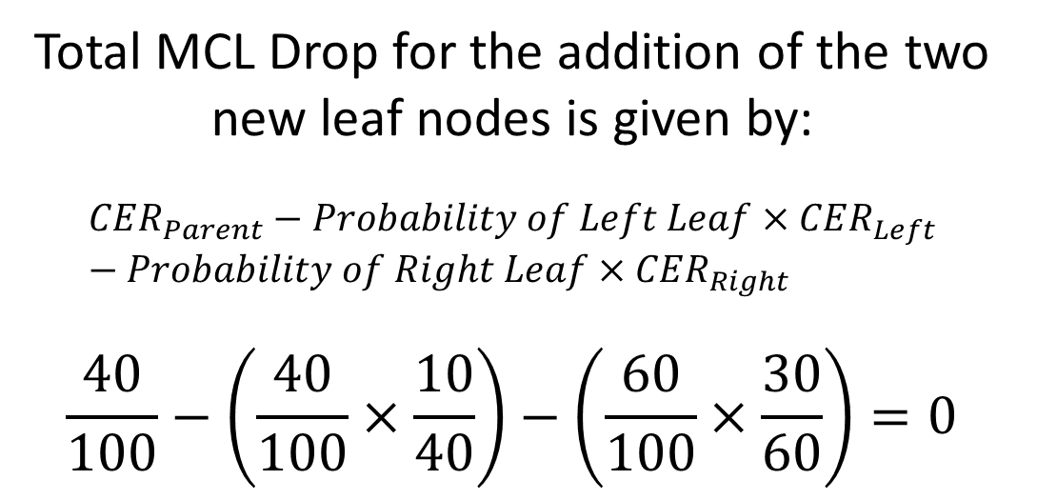

Miss-Classification Loss/Classification Error Rate – Insensitive Example
$$CER_{m}=MCL_{m} = 1 −{\hat{ p }}_{m {Class}_{m}}$$
Root Node
Sunny?
#Ice Cream 60
#Bajji 40
Total MCL Drop for the addition of the two new leaf nodes is given by:
$$CER_{Parent}−Probability of Left Leaf×CER_{Left}−Probability of Right Leaf×CER_{Right}$$
$$\frac{40}{100}−\left(\frac{40}{100}×\frac{10}{40}\right)−\left(\frac{60}{100}×\frac{30}{60}\right)=0$$
MCL = $\frac{40}{100}$
Yes
No
#Ice Cream 30
#Bajji 10
#Ice Cream 30
#Bajji 30
Ice Cream
Bajji
Leaf Node
Leaf Node
MCL = $\frac{15}{50}$
MCL = $\frac{25}{50}$

Slide 7
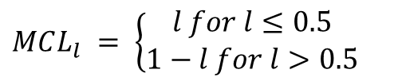
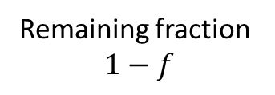
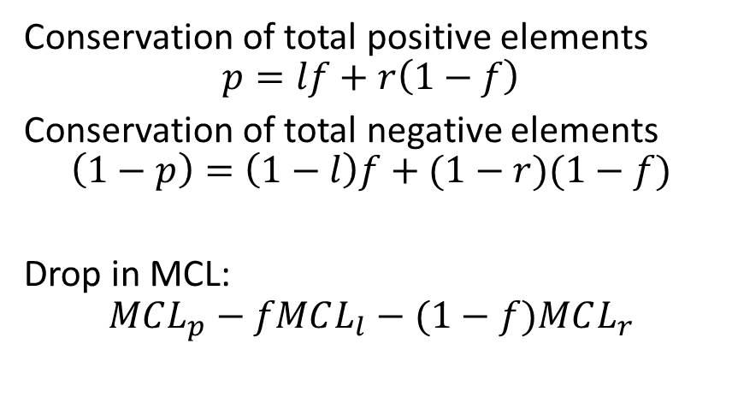

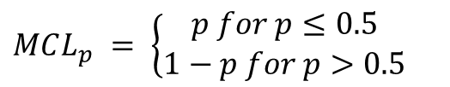
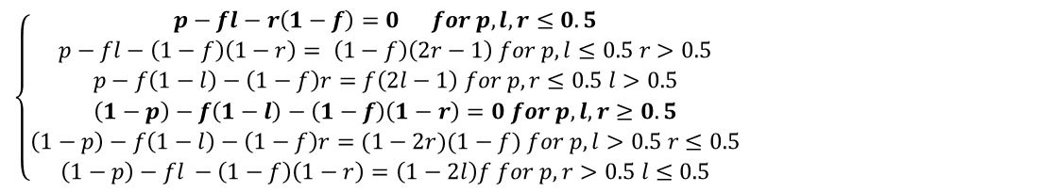
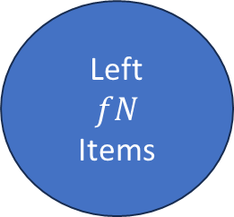
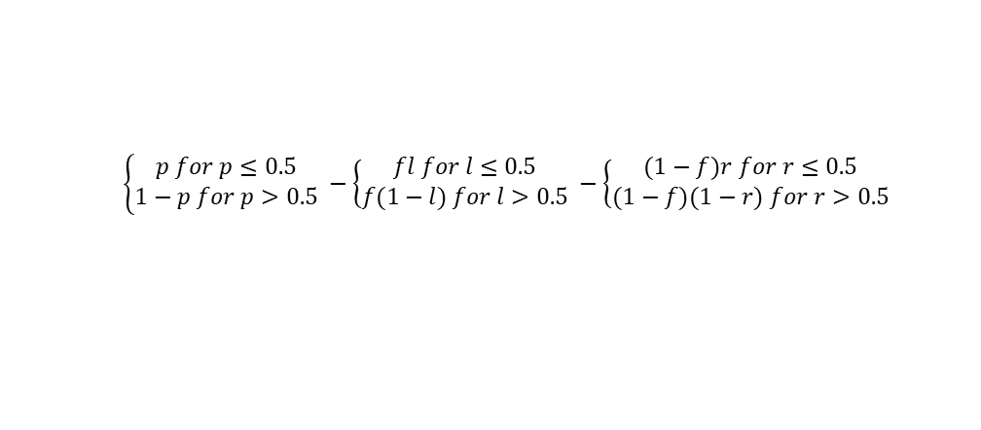
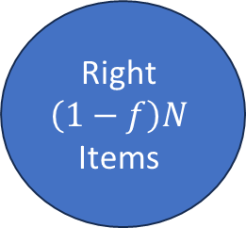
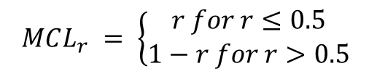
Miss-Classification Loss/Classification Error Rate – Insensitive Example
Root Node
Conservation of total positive elements
$$p=lf+r\left(1−f\right)$$
Conservation of total negative elements
$$\left(1−p\right)=\left(1−l\right)f+(1−r)(1−f)$$
Drop in MCL:
$$MCL_{p}−fMCL_{l}−(1−f)MCL_{r}$$
Parent
N
Items
$$MCL_{p} = \left\{\begin{aligned}p for p≤0.5 \\ 1−p for p>0.5\end{aligned} \right.$$
Remaining fraction
$$1−f$$
Fraction $f$
$$\left\{\begin{aligned}p for p≤0.5 \\ 1−p for p>0.5\end{aligned} −\left\{\begin{aligned}fl for l≤0.5 \\ f(1−l) for l>0.5\end{aligned} \right.\right.−\left\{\begin{aligned}(1−f)r for r≤0.5 \\ (1−f)(1−r) for r>0.5\end{aligned} \right.$$
Left
$$fN$$
Items
Right
$$\left(1−f\right)N$$
Items
$$\left\{\begin{aligned}p−fl−r\left(1−f\right)=0 for p,l,r≤0.5 \\ p−fl−\left(1−f\right)\left(1−r\right)= \left(1−f\right)\left(2r−1\right) for p,l≤0.5 r>0.5 \\ p−f\left(1−l\right)−\left(1−f\right)r=f\left(2l−1\right) for p,r≤0.5 l>0.5 \\ \left(1−p\right)−f\left(1−l\right)−\left(1−f\right)\left(1−r\right)=0 for p,l,r≥0.5 \\ \left(1−p\right)−f\left(1−l\right)−\left(1−f\right)r=(1−2r)(1−f) for p,l>0.5 r≤0.5 \\ \left(1−p\right)−fl −\left(1−f\right)\left(1−r\right)=\left(1−2l\right)f for p,r>0.5 l≤0.5\end{aligned} \right.$$
$$MCL_{l} = \left\{\begin{aligned}l for l≤0.5 \\ 1−l for l>0.5\end{aligned} \right.$$
$$MCL_{r} = \left\{\begin{aligned}r for r≤0.5 \\ 1−r for r>0.5\end{aligned} \right.$$

Slide 8



Miss-Classification Loss/Classification Error Rate – Reason for Insensitivity
Root Node
When the majority/minority class in parent node remains in majority/minority in both the leaf nodes, then the miss-classification loss reduction is 0.
The reason for this is the linearity of this metric.
Hence there is a need for a more sensitive metric to capture purity within such divisions.
Sunny?
#Ice Cream 60
#Bajji 40
MCL = $\frac{40}{100}$
Yes
No
#Ice Cream 30
#Bajji 10
#Ice Cream 30
#Bajji 30
Ice Cream
Bajji
Leaf Node
Leaf Node
MCL = $\frac{15}{50}$
MCL = $\frac{25}{50}$

Slide 9

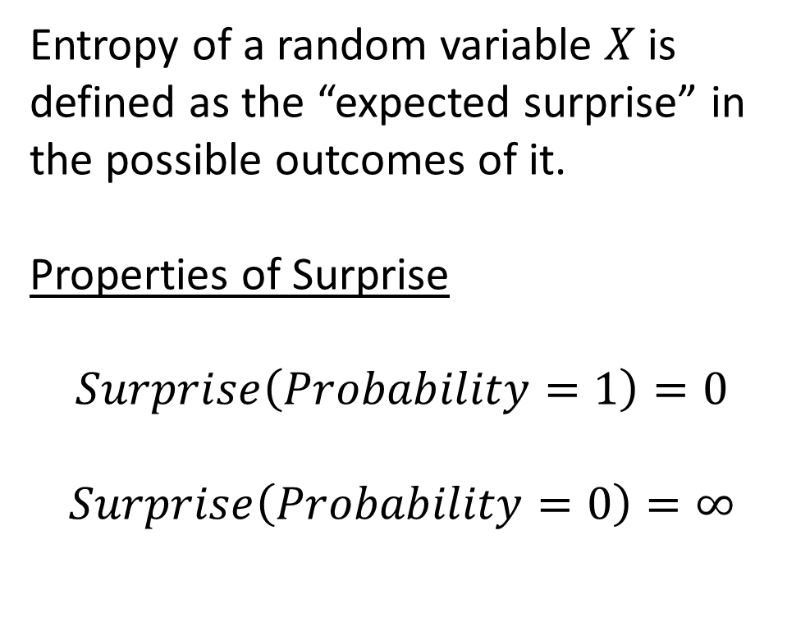



Entropy
Surprise
$$∞$$
Entropy of a random variable $X$ is defined as the “expected surprise” in the possible outcomes of it.
Properties of Surprise
$$Surprise\left(Probability=1\right)=0$$
$$Surprise\left(Probability=0\right)=∞$$
$$0$$
0
1
Probability
1
$$0$$
$$X$$
0
1

Slide 10



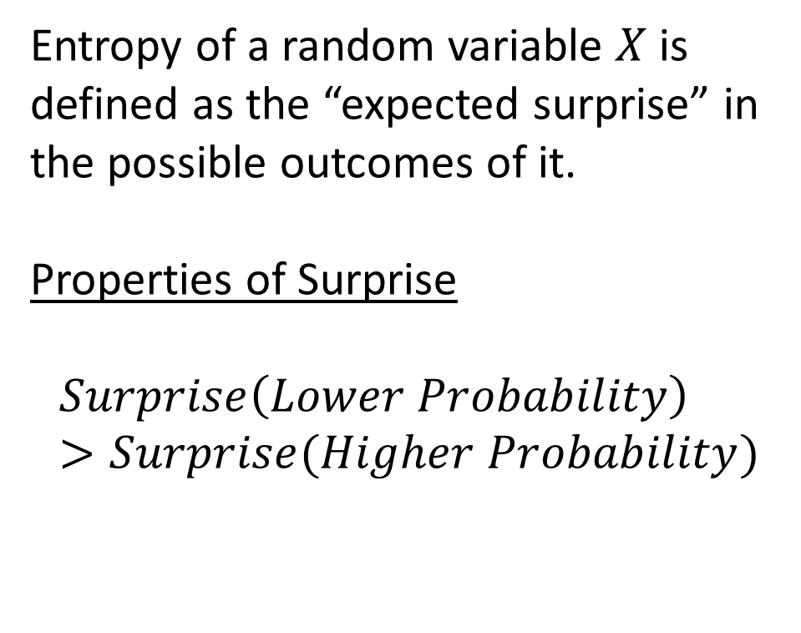

Entropy
Surprise
Entropy of a random variable $X$ is defined as the “expected surprise” in the possible outcomes of it.
Properties of Surprise
$$Surprise\left(Lower Probability\right)>Surprise(Higher Probability)$$
$$0$$
0
1
Probability
1
$$0. 75$$
$$0. 5$$
$$0.25$$
$$0$$
$$X$$
0
1

Slide 11
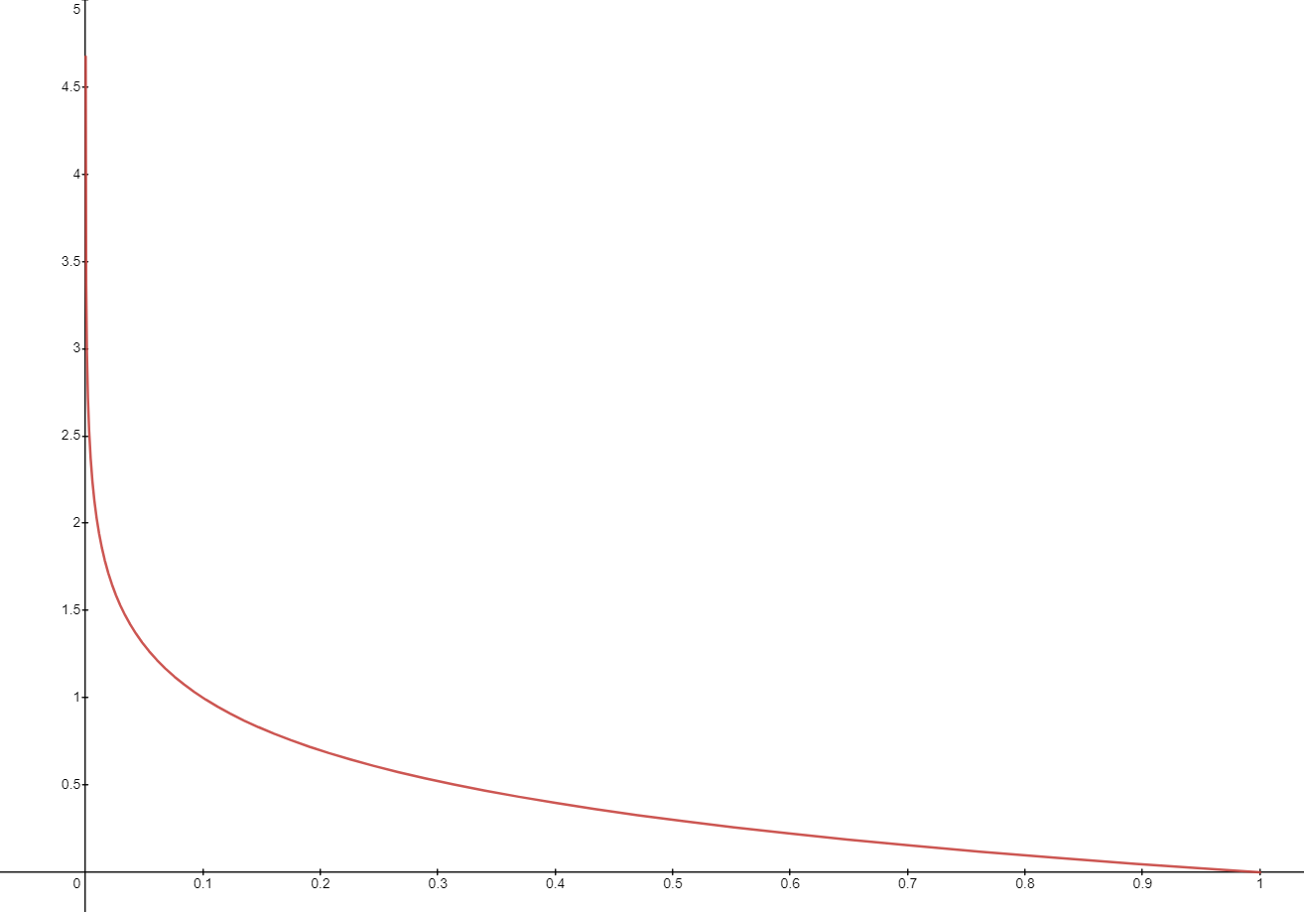
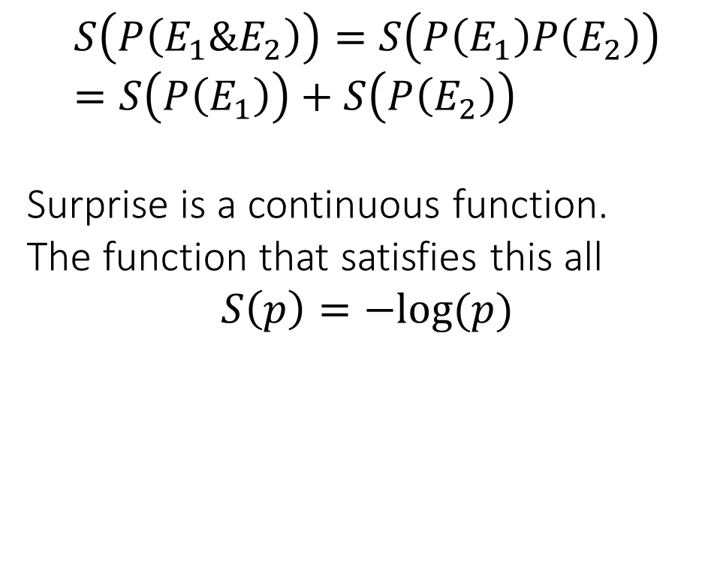
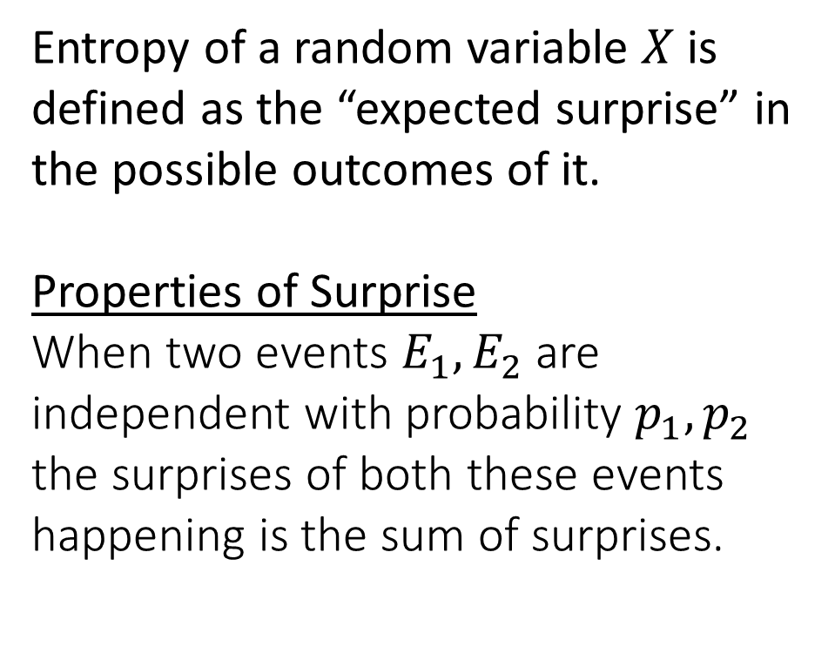
Entropy
Entropy of a random variable $X$ is defined as the “expected surprise” in the possible outcomes of it.
Properties of Surprise
When two events $E_{1},E_{2}$ are independent with probability $p_{1},p_{2}$ the surprises of both these events happening is the sum of surprises.
$$S\left(P\left(E_{1}\&E_{2}\right)\right)=S\left(P\left(E_{1}\right)P\left(E_{2}\right)\right)=S\left(P\left(E_{1}\right)\right)+S\left(P\left(E_{2}\right)\right)$$
Surprise is a continuous function.
The function that satisfies this all
$$S\left(p\right)=−log⁡(p)$$
0
1

Slide 12
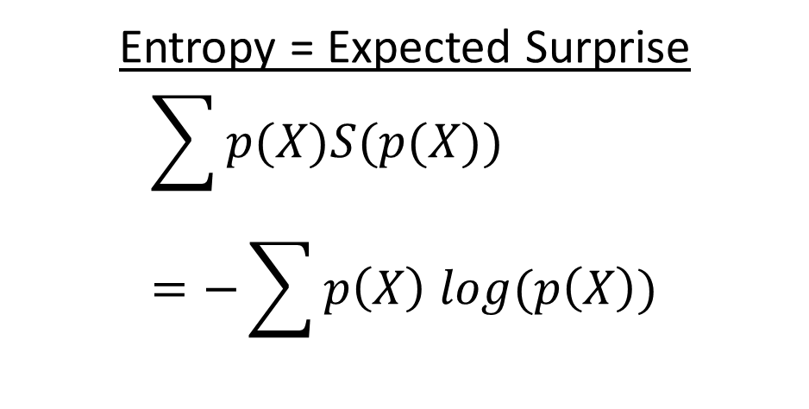
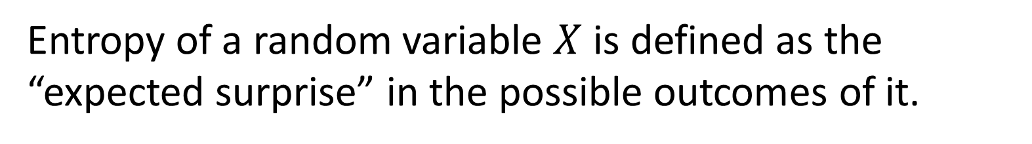
Entropy
Entropy of a random variable $X$ is defined as the “expected surprise” in the possible outcomes of it.
Entropy = Expected Surprise
$$\sum{p(X)S(p(X))}=−\sum{p\left(X\right) log(p\left(X\right))}$$

Slide 13
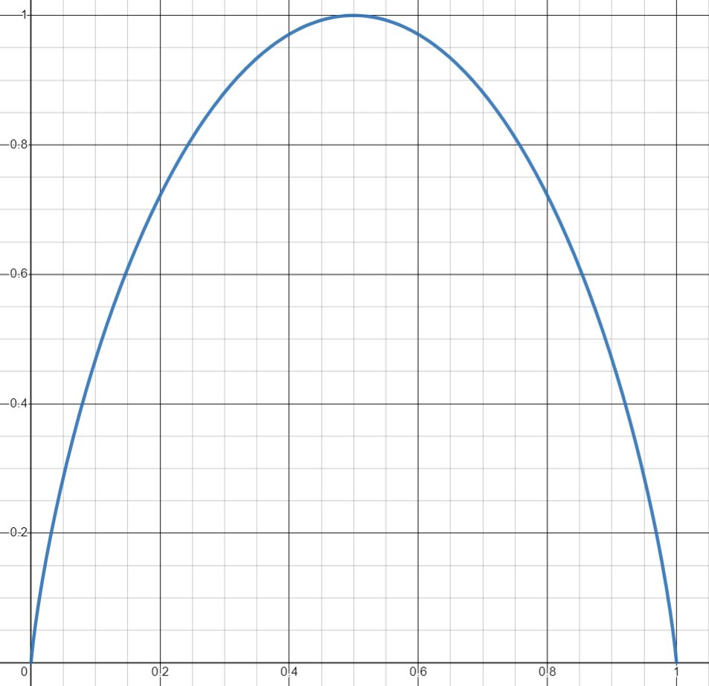
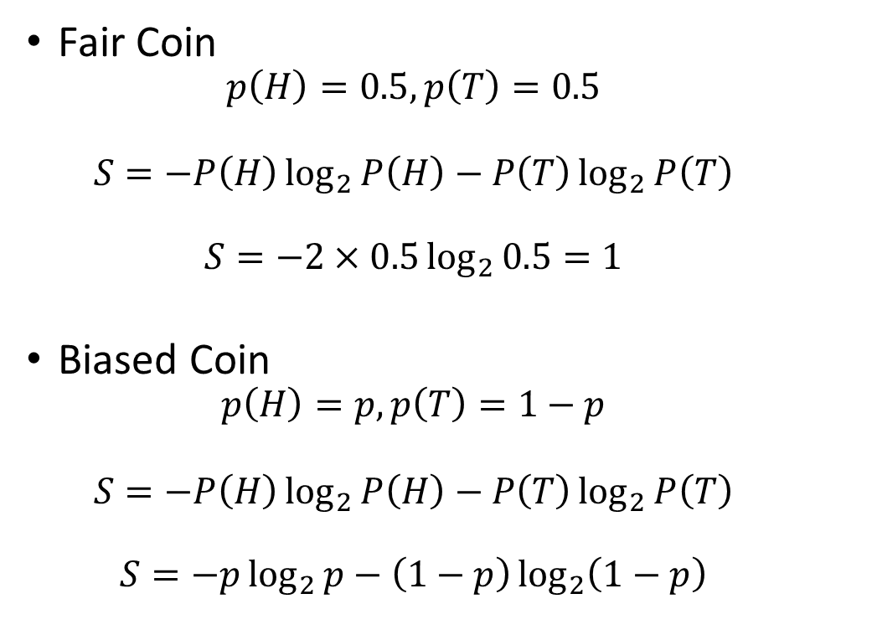
Entropy: Discrete
Entropy the expected surprise is high, i.e., when the “coin is fair”.
When the classifier is giving mixed signal.
Entropy is low when the expected surprise is low, i.e., when the “coin is unfair”.
When the classifier is giving a pure signal.
Fair Coin
$$p\left(H\right)=0.5, p\left(T\right)=0.5$$
$$S=−P\left(H\right)\log_{2}{P\left(H\right)}−P\left(T\right)\log_{2}{P\left(T\right)}$$
$$S=−2×0.5\log_{2}{0.5}=1$$
Biased Coin
$$p\left(H\right)=p, p\left(T\right)=1−p$$
$$S=−P\left(H\right)\log_{2}{P\left(H\right)}−P\left(T\right)\log_{2}{P\left(T\right)}$$
$$S=−p\log_{2}{p}−\left(1−p\right)\log_{2}\left(1−p\right)$$
1
Entropy
0
0
1
Probability of Heads p

Slide 14
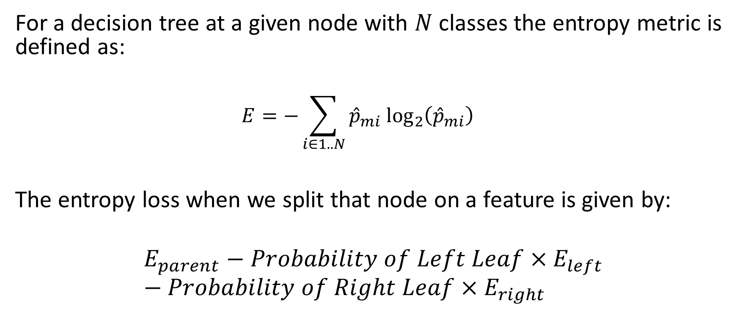
Entropy Loss/Log Loss
For a decision tree at a given node with $N$ classes the entropy metric is defined as:
$$E=−\sum_{i∈1..N}{{\hat{p}}_{mi} \log_{2}\left({\hat{p}}_{mi}\right)}$$
The entropy loss when we split that node on a feature is given by:
$$E_{parent}−Probability of Left Leaf×E_{left}−Probability of Right Leaf×E_{right}$$

Slide 15

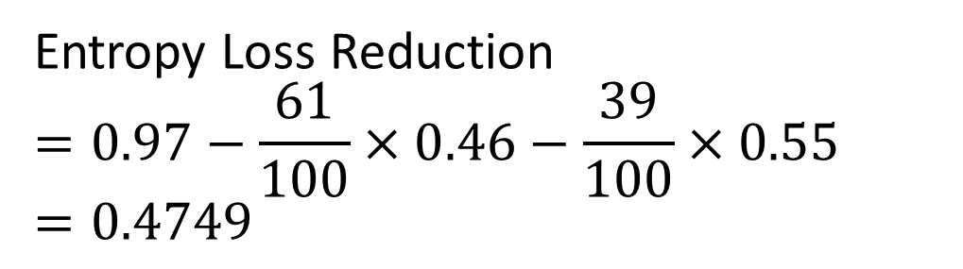


Entropy Loss/Log Loss - Example
E = $−\frac{40}{100}\log_{2}{\frac{40}{100}}−\frac{60}{100}\log_{2}{\frac{60}{100}}=0.97$
Root Node
Sunny?
#Ice Cream 60
#Bajji 40
Entropy Loss Reduction
$$=0.97−\frac{61}{100}×0.46−\frac{39}{100}×0.55 \\ =0.4749$$
Yes
No
#Ice Cream 55
#Bajji 6
#Ice Cream 5
#Bajji 34
Ice Cream
Bajji
Leaf Node
Leaf Node
E = $−\frac{6}{61}\log_{2}{\frac{6}{61}}−\frac{55}{61}\log_{2}{\frac{55}{61}}=0.46$
E =$−\frac{5}{39}\log_{2}{\frac{5}{39}}−\frac{34}{39}\log_{2}{\frac{34}{39}}=0.55$

Slide 16

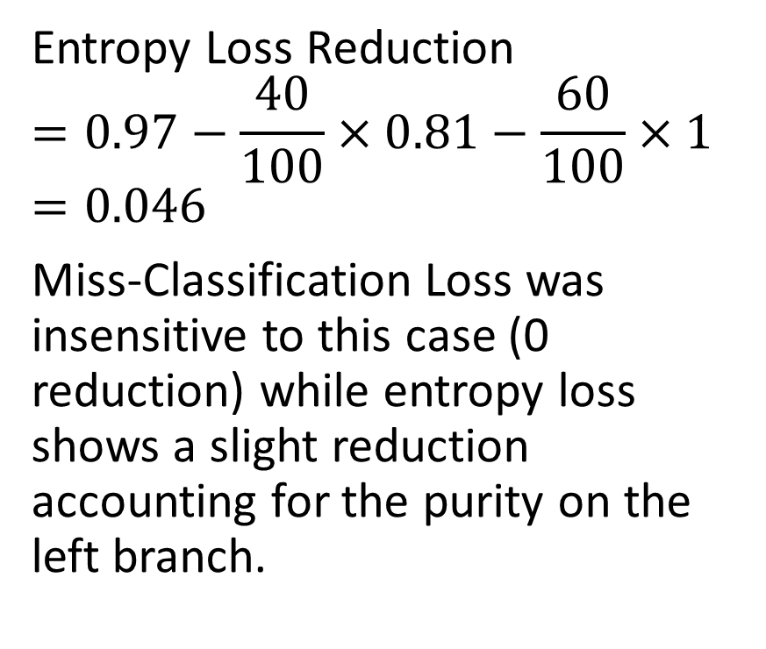

Entropy Loss/Log Loss – Another Example
E = $−\frac{40}{100}\log_{2}{\frac{40}{100}}−\frac{60}{100}\log_{2}{\frac{60}{100}}=0.97$
Entropy Loss Reduction
$$=0.97−\frac{40}{100}×0.81−\frac{60}{100}×1 \\ =0.046$$
Miss-Classification Loss was insensitive to this case (0 reduction) while entropy loss shows a slight reduction accounting for the purity on the left branch.
Root Node
Sunny?
#Ice Cream 60
#Bajji 40
Yes
No
#Ice Cream 30
#Bajji 10
#Ice Cream 30
#Bajji 30
Ice Cream
Bajji
Leaf Node
Leaf Node
E = $−\frac{10}{40}\log_{2}{\frac{10}{40}}−\frac{30}{40}\log_{2}{\frac{30}{40}}=0.81$
E =$−\frac{30}{60}\log_{2}{\frac{30}{60}}−\frac{30}{60}\log_{2}{\frac{30}{60}}=1$

Slide 17
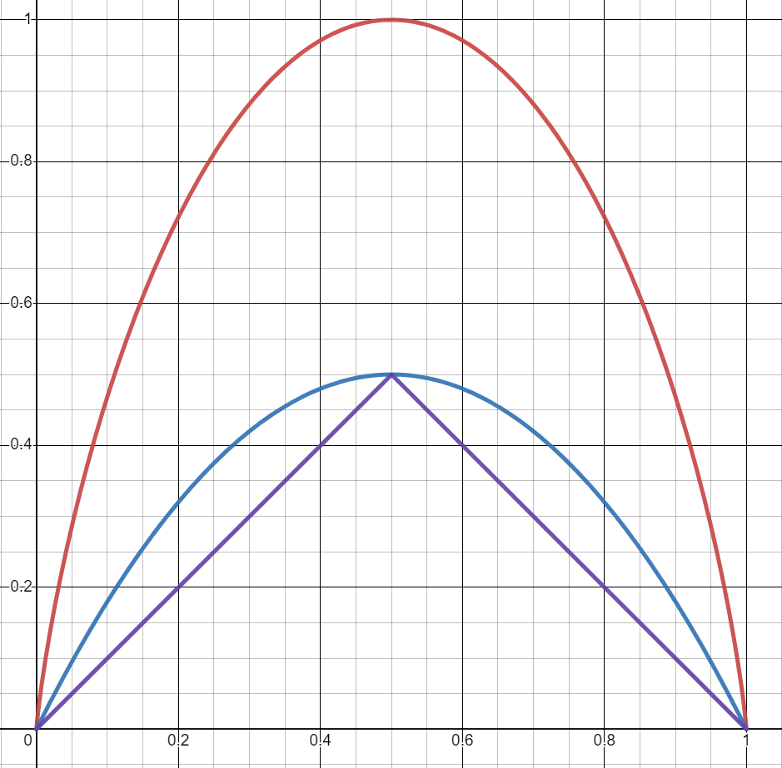
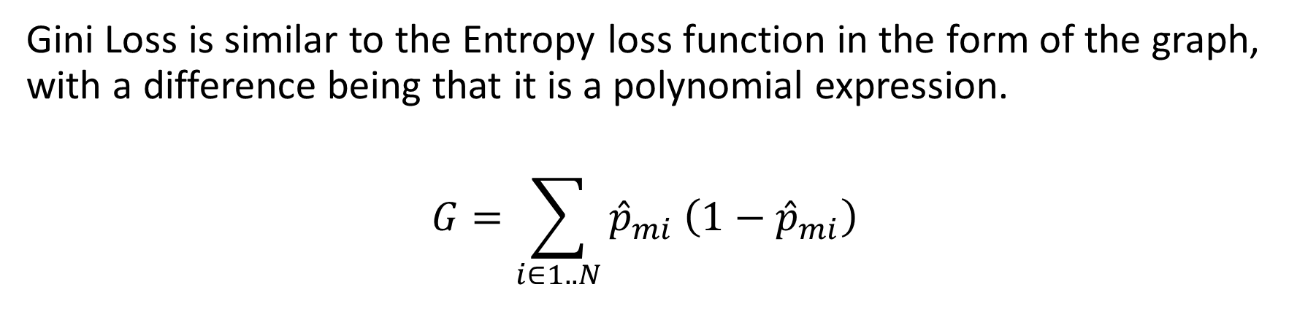
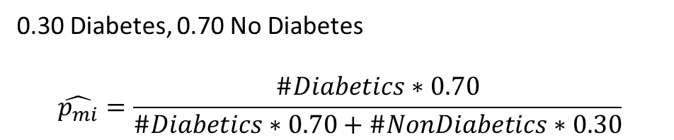
Gini Loss
0.30 Diabetes, 0.70 No Diabetes
$$\hat{p_{mi}}=\frac{\#Diabetics∗0.70}{\#Diabetics∗0.70+\#NonDiabetics∗0.30}$$
Gini Loss is similar to the Entropy loss function in the form of the graph, with a difference being that it is a polynomial expression.
$$G=\sum_{i∈1..N}{{\hat{p}}_{mi}\left(1−{\hat{p}}_{mi}\right)}$$
Entropy
The graph for all metrics are compared for a binary classifier
Note: Reduction at a split is computed akin to entropy loss
Loss Metrics
Gini
Miss-Classification
Probability of binary classifier

Slide 18

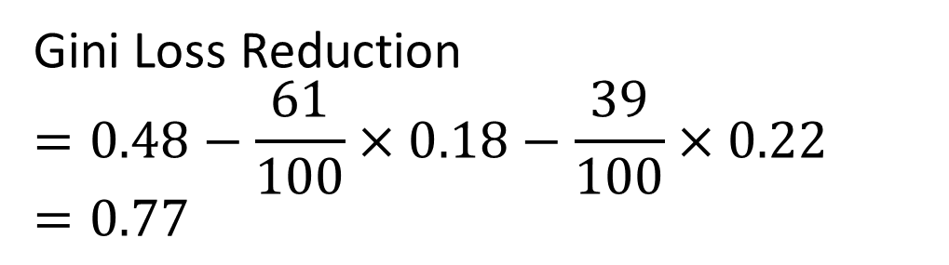


Gini Loss - Example
G = $\frac{40}{100}\left(1−\frac{40}{100}\right)+\frac{60}{100}\left(1−\frac{60}{100}\right)=0.48$
Root Node
Sunny?
#Ice Cream 60
#Bajji 40
Gini Loss Reduction
$$=0.48−\frac{61}{100}×0.18−\frac{39}{100}×0.22 \\ =0.77$$
Yes
No
#Ice Cream 55
#Bajji 6
#Ice Cream 5
#Bajji 34
Ice Cream
Bajji
Leaf Node
Leaf Node
G = $\frac{6}{61}\left(1−\frac{6}{61}\right)+\frac{55}{61}\left(1−\frac{55}{61}\right)=0.18$
G =$\frac{5}{39}\left(1−\frac{5}{39}\right)+\frac{34}{39}\left(1−\frac{34}{39}\right)=0.22$

Slide 19

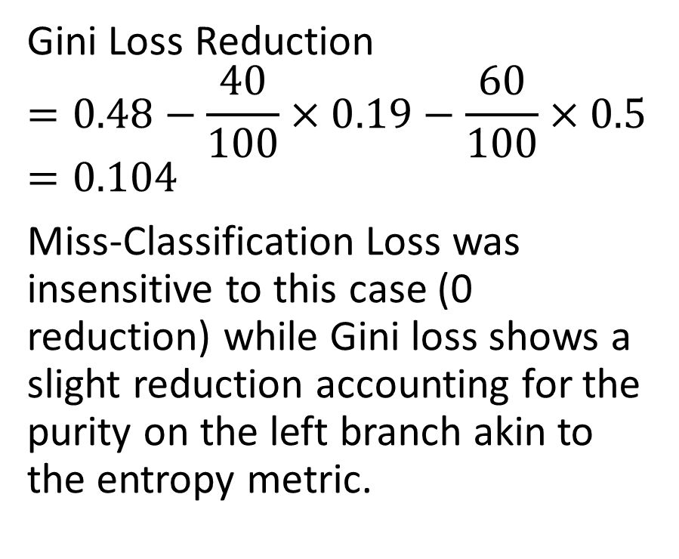


Gini Loss – Another Example
G = $\frac{40}{100}\left(1−\frac{40}{100}\right)+\frac{60}{100}\left(1−\frac{60}{100}\right)=0.48$
Gini Loss Reduction
$$=0.48−\frac{40}{100}×0.19−\frac{60}{100}×0.5 \\ =0.104$$
Miss-Classification Loss was insensitive to this case (0 reduction) while Gini loss shows a slight reduction accounting for the purity on the left branch akin to the entropy metric.
Root Node
Sunny?
#Ice Cream 60
#Bajji 40
Yes
No
#Ice Cream 30
#Bajji 10
#Ice Cream 30
#Bajji 30
Ice Cream
Bajji
Leaf Node
Leaf Node
E = $\frac{10}{40}\left(1−\frac{10}{40}\right)+\frac{30}{40}\left(1−\frac{30}{40}\right)=0.19$
E =$\frac{30}{60}\left(1−\frac{30}{60}\right)+\frac{30}{60}\left(1−\frac{30}{60}\right)=0.5$

Slide 20
Building a Decision Tree
Case Study

Slide 21
Example Data Source: Diabetes Data
https://www.kaggle.com/datasets/mathchi/diabetes-data-set
Accessed on:7/22/2023
Context
This dataset is originally from the National Institute of Diabetes and Digestive and Kidney Diseases. The objective is to predict based on diagnostic measurements whether a patient has diabetes.
Content
Several constraints were placed on the selection of these instances from a larger database. In particular, all patients here are females at least 21 years old of Pima Indian heritage.

Slide 22
Data Details & Prep
Clean dataset with no missing data.
One hot encoded categorical variables.
8 Features
Pregnancies,
Glucose,
Blood Pressure,
Skin Thickness,
Insulin,
BMI,
DiabetesPedigreeFunction,
Age
Data is randomly split into 70% training and 30% test
Training – 538
Diabetic – 202
Non-Diabetic – 336
Test – 230
Diabetic – 66
Non-Diabetic – 164

Slide 23
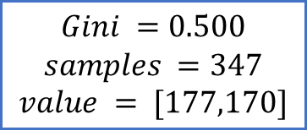
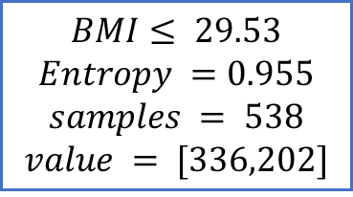
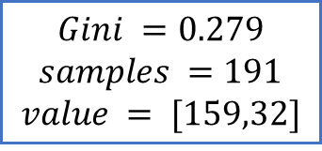
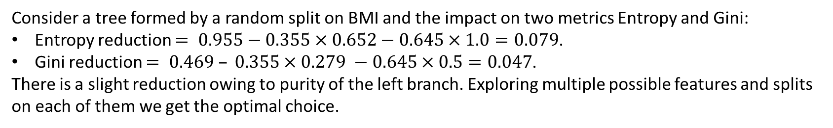
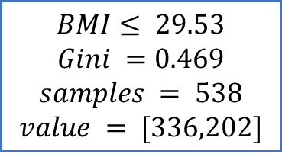
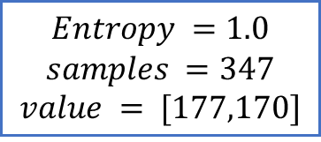
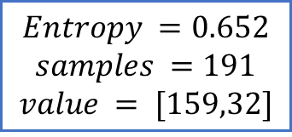
Approach: ID3 Optimizing the loss metric
$$BMI≤ 29.53$$
$$Entropy =0.955$$
$$samples = 538$$
$$value = [336,202]$$
$$BMI≤ 29.53$$
$$Gini =0.469$$
$$samples = 538$$
$$value = [336,202]$$
$$Entropy =0.652$$
$$samples =191$$
$$value = [159,32]$$
$$Entropy =1.0$$
$$samples =347$$
$$value = [177,170]$$
$$Gini =0.279$$
$$samples =191$$
$$value = [159,32]$$
$$Gini =0.500$$
$$samples =347$$
$$value = [177,170]$$
Consider a tree formed by a random split on BMI and the impact on two metrics Entropy and Gini:
Entropy reduction $= 0.955−0.355×0.652−0.645×1.0=0.079$.
Gini reduction $= 0.469 – 0.355×0.279 −0.645×0.5=0.047$.
There is a slight reduction owing to purity of the left branch. Exploring multiple possible features and splits on each of them we get the optimal choice.

Slide 24
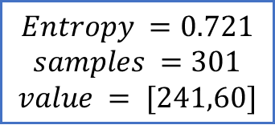
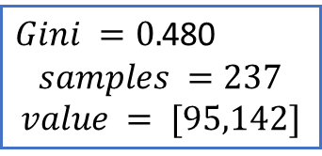
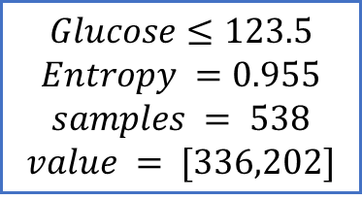
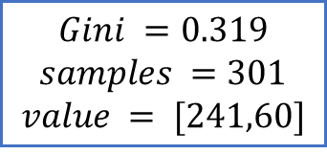
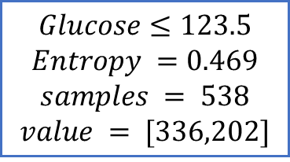
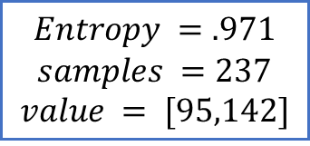
Approach: ID3 Optimizing the loss metric
$$Glucose≤123.5$$
$$Entropy =0.955$$
$$samples = 538$$
$$value = [336,202]$$
$$Glucose≤123.5$$
$$Entropy =0.469$$
$$samples = 538$$
$$value = [336,202]$$
$$Entropy =0.721$$
$$samples =301$$
$$value = [241,60]$$
$$Entropy =.971$$
$$samples =237$$
$$value = [95,142]$$
$$Gini =0.319$$
$$samples =301$$
$$value = [241,60]$$
$Gini =0.$480
$$samples =237$$
$$value = [95,142]$$
Optimal Depth 1 Tree based on Entropy & Gini

Slide 25
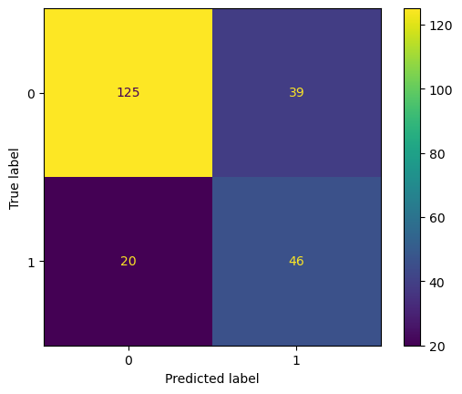
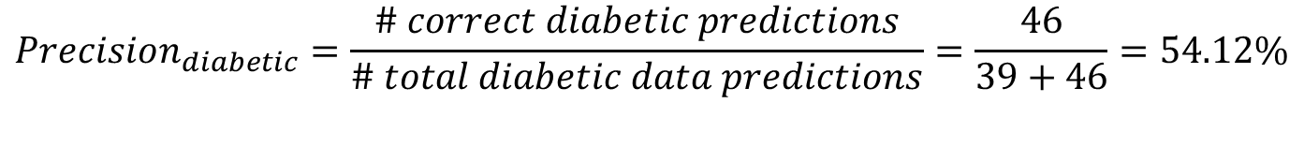
Depth 1 Tree Performance on test
$Accuracy=\frac{\# correct predictions}{\# data points}=\frac{46+125}{(46+125+39+20)}=74.35\%$
$Recall_{diabetic}=\frac{\# correct diabetic predictions}{\# diabetic data points}=\frac{46}{(46+20)}=69.70\%$
$$FPR_{diabetic}=\frac{\# incorrect diabetic predictions}{\# non diabetic data points}=\frac{39}{39+125}=23.78\%$$
$$Precision_{diabetic}=\frac{\# correct diabetic predictions}{\# total diabetic data predictions}=\frac{46}{39+46}=54.12\%$$

Slide 26
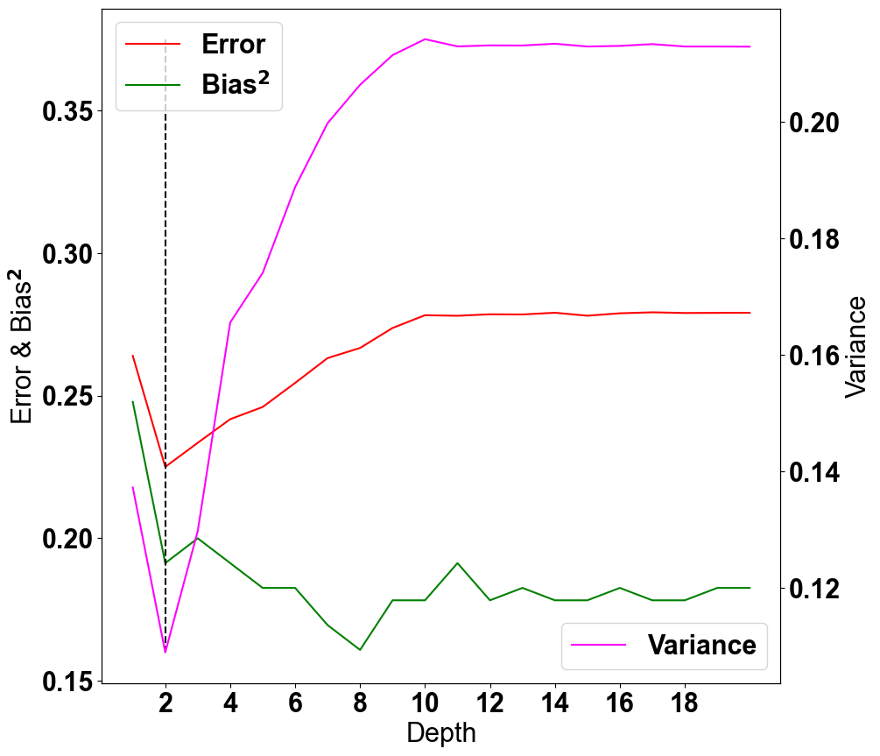
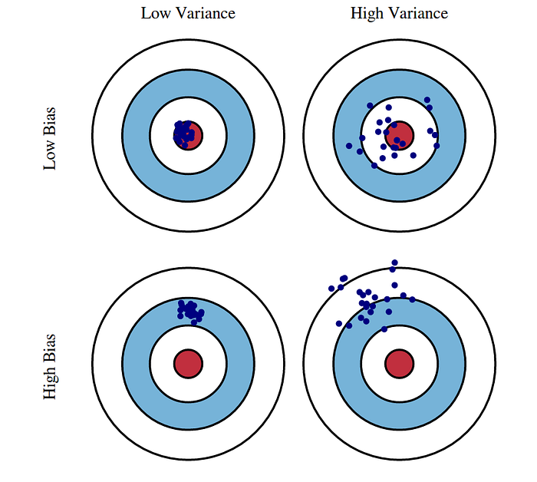
Bias & Variance Can we do better if we grow the tree deeper?
We see that the low variance and low bias is at depth 2 - 7 with low prediction error.
While bias grows lower with increasing depth >7 we will be in higher variance territory and higher generalization error.
High Bias
High Variance
Low Bias
Low Variance
Low Bias
High Variance
Note: This graph is from the perspective of the “0-1 loss” i.e., accuracy.

Slide 27
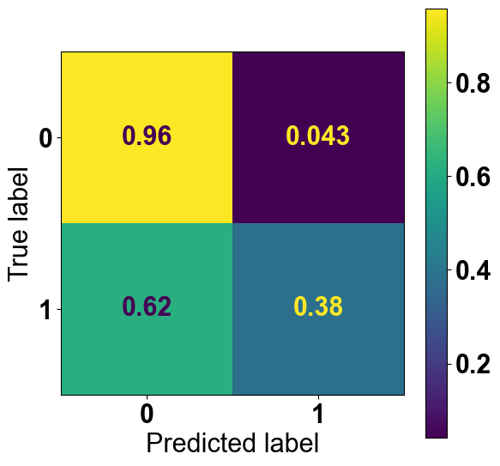
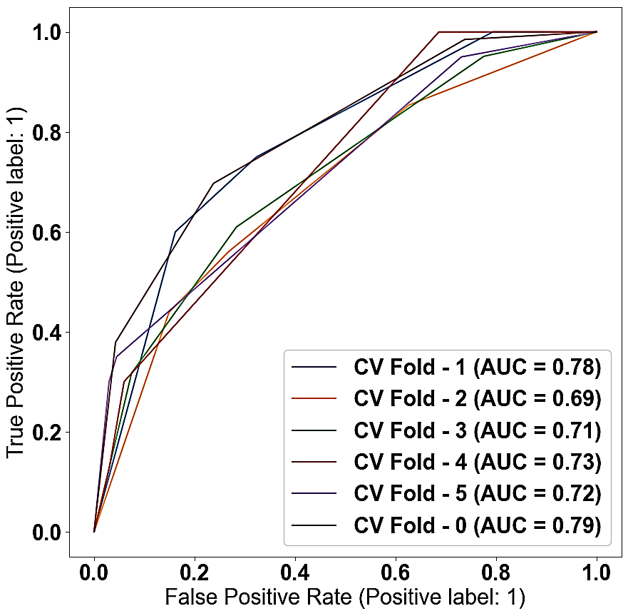
Depth 2 Tree Optimized Results
Metrics | Value on Test
Accuracy | 79.13
Recall | 37.88
Precision | 78.13
FPR | 4.27
ROC- AUC | 0.79
Test Confusion Matrix
ROC
Average AUC 0.74
Fold 0
Train using all folds and predict for test data
Note: The values shown at every tree node is the behavior on training data

Slide 28
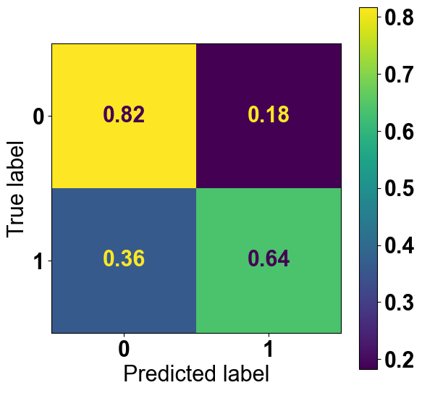
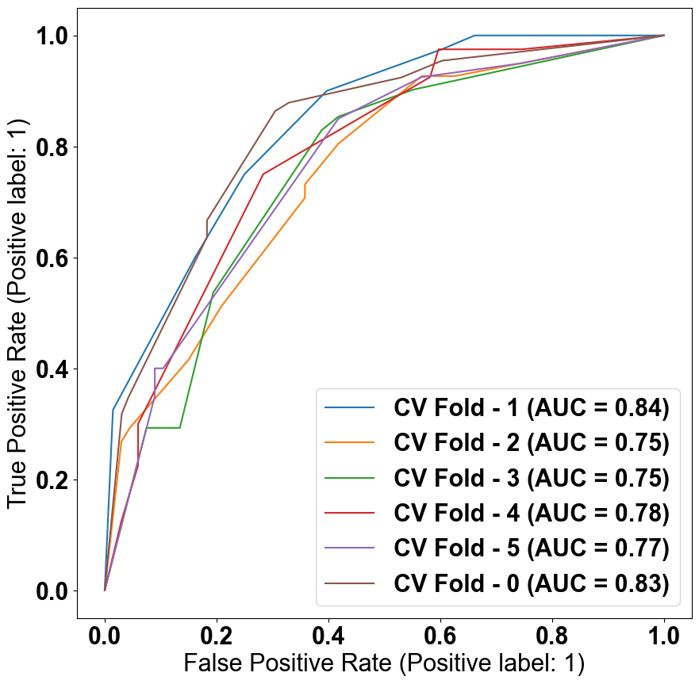
Depth 4 Tree Optimized Results
Metrics | Value on Test
Accuracy | 76.52
Recall | 63.64
Precision | 58.33
FPR | 18.29
ROC- AUC | 0.83
Test Confusion Matrix
ROC
Fold 0
Train using all folds and predict for test data
Average AUC 0.79
Note: The values shown at every tree node is the behavior on training data

Slide 29
Depth 2 vs 4 Tree Optimized Results
Notes:
Operating threshold is the probability above which we consider the data to indicate diabetes. Operating threshold varies metrics like recall, precision, FPR. This does not vary the ROC curve or its AUC.
The dataset used for testing/training varies ROC-AUC, and in turn all metrics.
Overall model performance is indicated by: ROC curve, the ROC-AUC and the cross validation average, standard deviation of all metrics.
Conclusion:
Depth 2 model has lower recall variance and recall percentage relative to Depth 4 model. Depth 4 model has lower precision percentage relative to Depth 2 model.
These point to the fact that Depth 4 model is able to identify data indicative of diabetes better than Depth 2 model but it also generates more false positives. If this is reasonable for the business needs then we can go with Depth 4 model.
Also, the ROC-AUC is higher for Depth 4 relative to Depth 2 indicating that Depth 4 model has better recall rate for the same FPR. So expected Depth 4 model performance is better with increased variability relative to Depth 2 model.
Depth 2
Metrics | Value on Test | Average (5 Fold CV + Test) | STD (5 Fold CV + Test)
Accuracy | 79.13 | 72.67 | 3.53
Recall | 37.88 | 39.75 | 10.11
Precision | 78.13 | 73.43 | 5.96
FPR | 4.27 | 8.88 | 4.85
ROC- AUC | 0.79 | 0.74 | 0.04
ROC
Average AUC 0.74
Depth 4
Metrics | Value on Test | Average (5 Fold CV + Test) | STD (5 Fold CV + Test)
Accuracy | 76.52 | 71.62 | 2.94
Recall | 63.64 | 65.50 | 15.87
Precision | 58.33 | 61.17 | 5.81
FPR | 18.29 | 25.09 | 10.63
ROC- AUC | 0.83 | 0.79 | 0.04
ROC
Average AUC 0.79

Slide 30


Instead of Depth – Min Samples In Leaf
Let say we have n samples in a dataset. I construct a decision tree, when I have $k$ minimum samples then I will split a node. Variating the min sample leaves causes different nodes.
In decision tree making we can pass a parameter min sample leaf to control this. This can be fraction too. In the case of fraction it’s consider round of the value of $n∗\left(fraction\right).$
In the diagram variating the min sample leaves we noticed the Bias variance and error.
From the analysis 0.0010 – 0.0535 we have a low bias and high variance.
0.0535 – 0.1586 we have Lows Bias and Low variance.
0.3424 – 0.3949 we have high bias and high variance.
Low Bias
Low Variance
High Bias
High Variance
Low Bias
High Variance
Fraction of number of values in root node

Slide 31


Min Sample Leaf 0.1061 Tree Optimized Results
Metrics | Value on Test
Accuracy | 78.70
Recall | 60.61
Precision | 63.49
FPR | 14.02
ROC- AUC | 0.83
Test Confusion Matrix
ROC
Average AUC 0.798
Fold 0
Train using all folds and predict for test data
Note: The values shown at every tree node is the behavior on training data
M. Meenakshi Sundaram, S. Ganesh

Slide 32


Min Sample Leaf 0.0892 Tree Optimized Results
Metrics | Value on Test
Accuracy | 78.26
Recall | 77.27
Precision | 59.03
FPR | 21.34
ROC- AUC | 0.85
Test Confusion Matrix
ROC
Average AUC 0.798
Fold 0
Train using all folds and predict for test data
Note: The values shown at every tree node is the behavior on training data

Slide 33
Min sample leaf 0.1232 vs 0.1061 Tree Optimized Results
Notes:
Operating threshold is the probability above which we consider the data to indicate diabetes. Operating threshold varies metrics like recall, precision, FPR. This does not vary the ROC curve or its AUC.
The dataset used for testing/training varies ROC-AUC, and in turn all metrics.
Overall model performance is indicated by: ROC curve, the ROC-AUC and the cross validation average, standard deviation of all metrics.
Conclusion:
Msl 0.1061 accuracy, precision is higher percentage than Msl 0.0892 on both test and CV validation.
Msl 0.0892 recall is better than Msl 0.1061 recall on both test and CV validation.
Msl 0.1061 FPR is better than Msl 0.0892. Even on test data Msl 0.0892’s AUC is higher than Msl 0.1061’s AUC, but Msl 0.0892 wrong predictions also high.
In this two things we can’t say this is better model, it’s depends on our business need. If we need more recall rate then we chosen Msl 0.0892. If we need more precision we chosen Msl 0.1061.
Msl 00892’s variability is higher than Msl 0.1061.
Min sample leaf 0.1061
Metrics | Value on Test | Average (5 Fold CV + Test) | STD (5 Fold CV + Test)
Accuracy | 78.70 | 75.38 | 4.17
Recall | 60.61 | 59.18 | 11.27
Precision | 63.49 | 67.76 | 3.80
FPR | 14.02 | 15.48 | 0.91
ROC- AUC | 0.83 | 0.798 | 0.03
ROC
Average AUC 0.798
Min sample leaf 0.0892
Metrics | Value on Test | Average (5 Fold CV + Test) | STD (5 Fold CV + Test)
Accuracy | 78.26 | 75 | 4.52
Recall | 77.27 | 62.40 | 13.41
Precision | 59.03 | 67.06 | 7.18
FPR | 21.34 | 17.42 | 5.83
ROC- AUC | 0.85 | 0.798 | 0.004
ROC
Average AUC 0.798
M. Meenakshi Sundaram, S. Ganesh

Slide 34
${Class}_{m}=\arg{\max_{i∈1..N}{{\hat{p}}_{mi}}}$ where ${\hat{p}}_{mi}=\frac{\#training examples in m C_{i}×W_{C_{i}}}{\sum_{k}{\#training examples in m in C_{k}×W_{C_{k}}}}$

Slide 35

Generalization Error, Bias and Variance

Slide 36
Random Forest
It is an ensemble learning method that combines the predictions of multiple decision trees to improve the accuracy and robustness of the model.
For classification tasks, Random Forest combines the predictions of individual trees through majority voting.
For regression tasks, it takes the average of the predictions from all the trees.
Two level of randomness:
Bootstrapping (Random Sampling):
When building each decision tree in the forest, Random Forest randomly selects a subset of the training data with replacement.
Feature Randomness:
Instead of considering all features for splitting at each node, it randomly selects a subset of features. This helps in reducing the correlation between individual trees.
Advantages:
Compare to single decision tree, it has high accuracy and low variance.

