Slide 1
Decision Trees

Slide 2
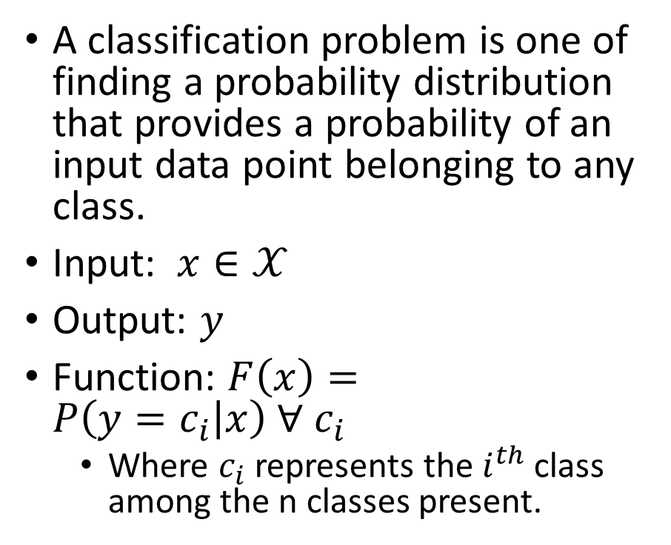
Classification
A classification problem is one of finding a probability distribution that provides a probability of an input data point belonging to any class.
Input: $x∈𝒳$
Output: $y$
Function: $F\left(x\right)=P\left(y=c_{i} | x\right) ∀ c_{i}$
Where $c_{i}$ represents the $i^{th}$ class among the n classes present.

