Slide 1
Decision Trees

Slide 2
Machine Learning
Process by which a computer automatically learns an algorithm for problem solving from data or experience. Typically this involves the adjustment of parameters of a generic model

Slide 3
Types of Machine Learning
Machine Learning
Supervised Learning
Unsupervised Learning
Reinforcement Learning
Learning from a pre-labeled dataset to predict on unseen but similar data.
Ex: housing price prediction based on home features, location, school rating, age.
Identifying structure and patterns within an unlabeled dataset.
Ex: customer segmentation based on type and frequency of purchases made, demography.
Learning via interaction with an environment using a penalty-reward feedback.
Ex: learning to play a game of chess by playing against a human.

Slide 4
Types of Supervised Learning
Supervised Learning
Regression
Classification
To predict a quantitative value for a given data point.
Ex: Predicting the price of a house based on the features of the house and the market conditions.
To predict a qualitative characteristic/label for a given data point.
Ex: Detecting a human face from a photo.

Slide 5
Bias-Variance Trade-off
Characterization of the machine learning model’s error for a given data

Slide 6
Bias How does the average ML model differ from the true value?
Inability of an ML model to capture the relationship between the features of the data and the predicted outcome owing to the assumptions made.
High Bias indicates unsuitable assumptions – ex: Take the red line in the plot shown, it fits a linear function with two parameters.
Low Bias indicates suitable assumptions – ex: Take the green line in the plot shown, it fits a quadratic function with three parameters.

Slide 7
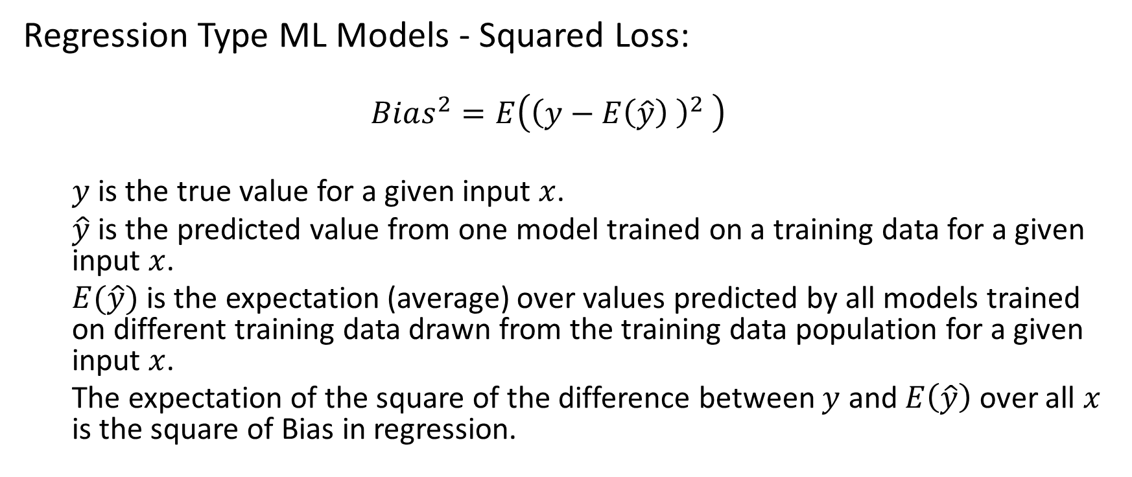
Bias – Regression Loss Metric
Regression Type ML Models - Squared Loss:
$$Bias^{2}=E\left({\left(y−E\left(\hat{y}\right) \right)}^{2} \right)$$
$y$ is the true value for a given input $x$.
$\hat{y}$ is the predicted value from one model trained on a training data for a given input $x$.
$E(\hat{y})$ is the expectation (average) over values predicted by all models trained on different training data drawn from the training data population for a given input $x$.
The expectation of the square of the difference between $y$ and $E\left(\hat{y}\right)$ over all $x$ is the square of Bias in regression.

Slide 8
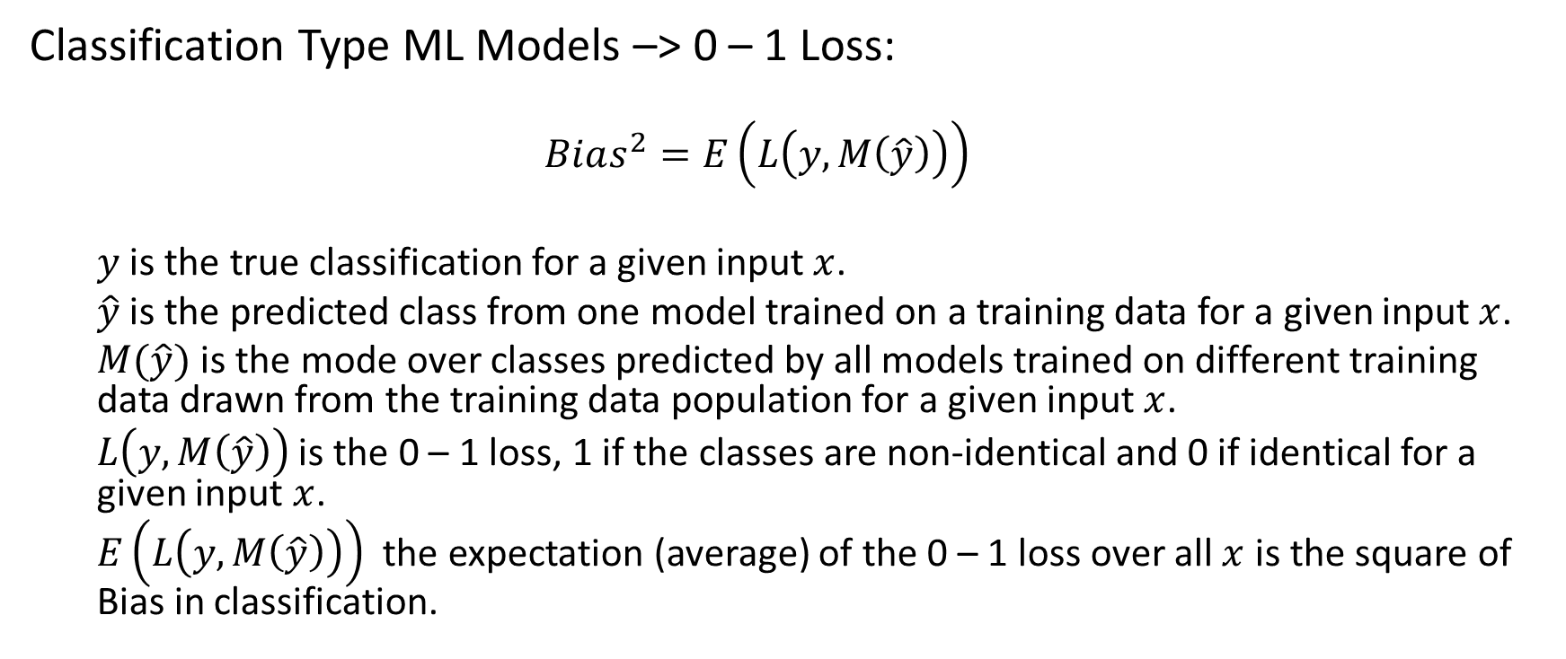
Bias – Classification Loss metric
Classification Type ML Models –> 0 – 1 Loss:
$$Bias^{2}=E\left(L\left(y,M\left(\hat{y}\right)\right)\right)$$
$y$ is the true classification for a given input $x$.
$\hat{y}$ is the predicted class from one model trained on a training data for a given input $x$.
$M(\hat{y})$ is the mode over classes predicted by all models trained on different training data drawn from the training data population for a given input $x$.
$L\left(y, M\left(\hat{y}\right)\right)$ is the 0 – 1 loss, 1 if the classes are non-identical and 0 if identical for a given input $x$.
$E\left(L\left(y,M\left(\hat{y}\right)\right)\right)$ the expectation (average) of the 0 – 1 loss over all $x$ is the square of Bias in classification.

Slide 9
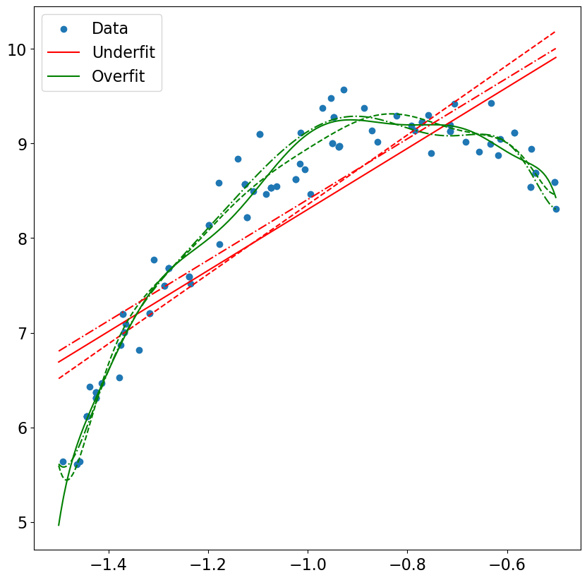
High Bias Vs Low Bias
Low Bias – Implies the model is likely to fit even the noise. It results in the overfit situation.
High Bias – Implies the model is unlikely to capture the real data’s nitty gritty.
Ex: In the figure the red linear models are unable to capture the curvature in the data while the green non-linear models capture the twists and turns of the data.
Low Bias
High Bias

Slide 10
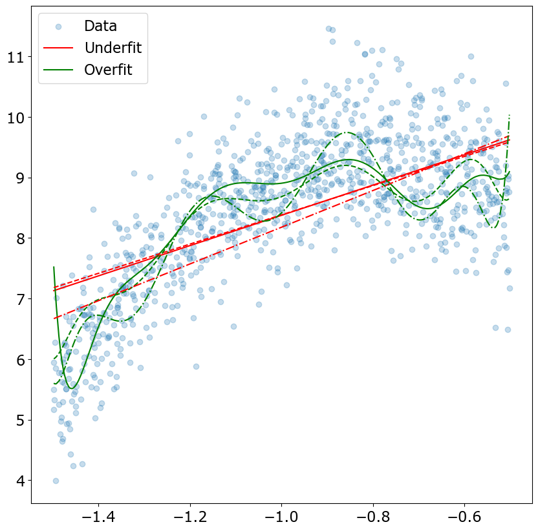
Variance How much do the predictions of the ML models trained on different subsets of the data differ from the each other?
High Variance indicates that the features in the dataset coupled with the ML model may not have a robust prediction capability
Ex: The dataset on the right has quite a bit of noise and the two types of ML models have different degrees of variability.
The green overfit models demonstrate high variance and have quite a bit of undulations with varying training data.
The red underfit model has lower undulations and lower variance in comparison to the green model.

Slide 11
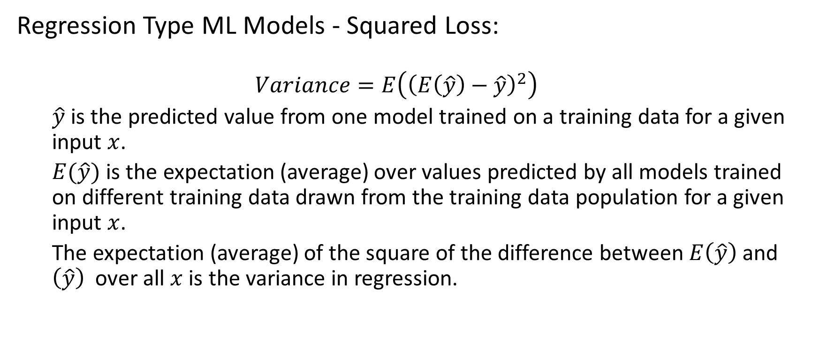
Variance – Regression Loss Metric
Regression Type ML Models - Squared Loss:
$$Variance=E\left({\left(E\left(\hat{y}\right)−\hat{y}\right)}^{2}\right)$$
$\hat{y}$ is the predicted value from one model trained on a training data for a given input $x$.
$E(\hat{y})$ is the expectation (average) over values predicted by all models trained on different training data drawn from the training data population for a given input $x$.
The expectation (average) of the square of the difference between $E\left(\hat{y}\right)$ and $\left(\hat{y}\right)$ over all $x$ is the variance in regression.

Slide 12
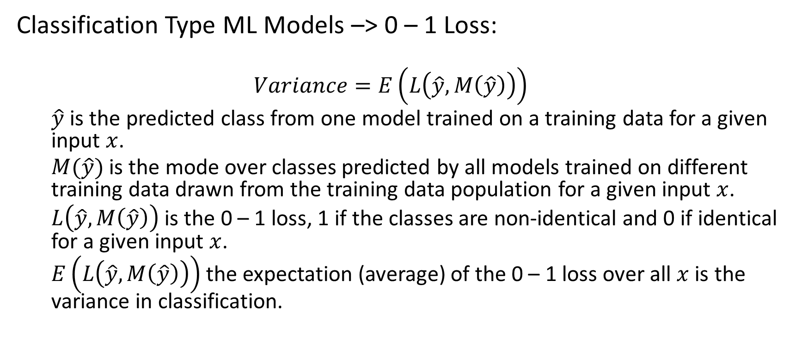
Variance – Classification Loss Metric
Classification Type ML Models –> 0 – 1 Loss:
$$Variance=E\left(L\left(\hat{y},M\left(\hat{y}\right)\right)\right)$$
$\hat{y}$ is the predicted class from one model trained on a training data for a given input $x$.
$M(\hat{y})$ is the mode over classes predicted by all models trained on different training data drawn from the training data population for a given input $x$.
$L\left(\hat{y}, M\left(\hat{y}\right)\right)$ is the 0 – 1 loss, 1 if the classes are non-identical and 0 if identical for a given input $x$.
$E\left(L\left(\hat{y},M\left(\hat{y}\right)\right)\right)$the expectation (average) of the 0 – 1 loss over all $x$ is the variance in classification.

Slide 13
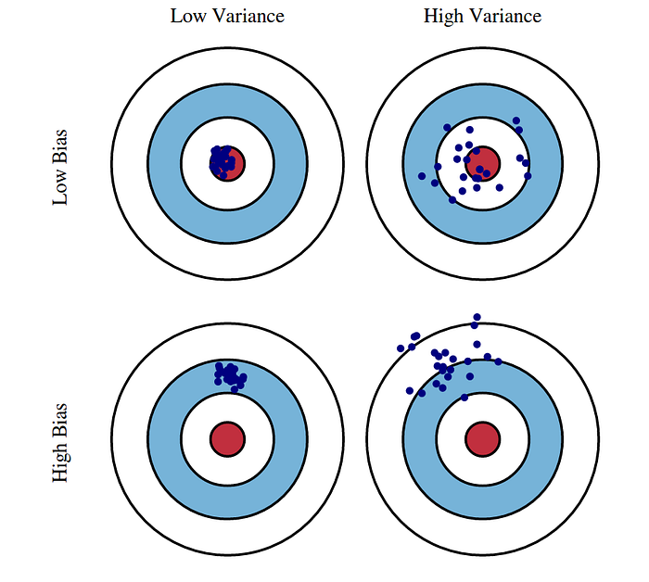
Bias Variance - Bull’s Eye

Slide 14
Classification
Identifying the qualitative nature of data

Slide 15





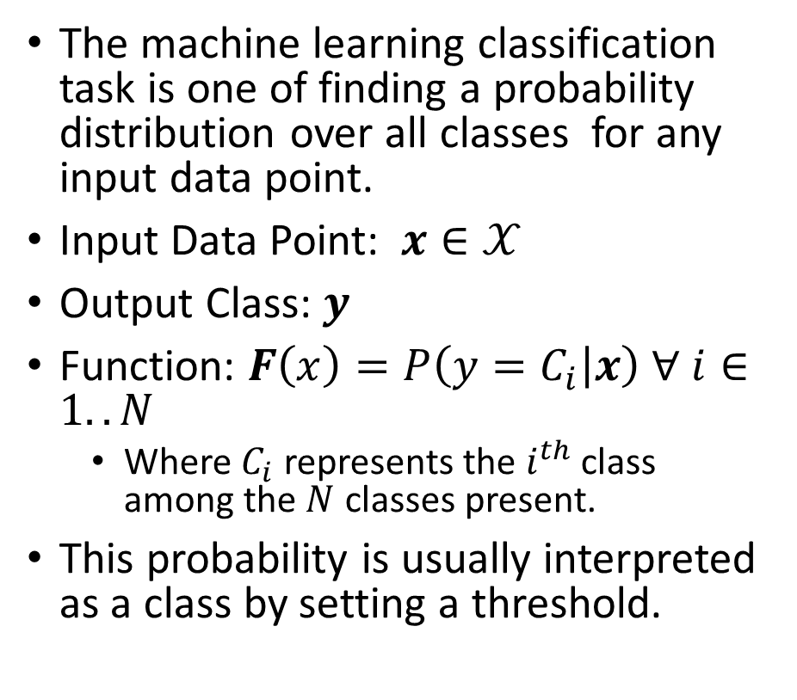
Classification
The machine learning classification task is one of finding a probability distribution over all classes for any input data point.
Input Data Point: $x∈𝒳$
Output Class: $y$
Function: $F\left(x\right)=P\left(y=C_{i} | x\right) ∀ i∈1..N$
Where $C_{i}$ represents the $i^{th}$ class among the $N$ classes present.
This probability is usually interpreted as a class by setting a threshold.
Spam
Email
Not Spam
Happy
Neutral
Tweet
Sad

Slide 16
What does Success Look Like?
Effectiveness of a classification system is measured by using a supervised approach of testing the model with an unseen prelabeled dataset

Slide 17
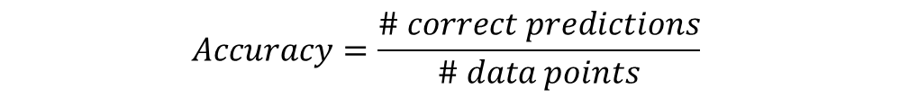
Accuracy
Accuracy measures the overall effectiveness of the classification model (classifier). It answers the question, “How many datapoints did the model classify correctly?”
$$Accuracy=\frac{\# correct predictions}{\# data points}$$
 | Model Cat | Model Dog | Model Bird
Data Cat | 76 | 10 | 12
Data Dog | 27 | 69 | 11
Data Bird | 6 | 3 | 81
$$Accuracy =\frac{76+69+81}{76+69+81+10+12+11+27+3+6}=76.66\%$$
Balanced Data: Nearly equal quantity of dogs, cats, and birds

Slide 18
Accuracy
Accuracy measures the overall effectiveness of the classification model (classifier). It answers the question, “How many datapoints did the model classify correctly?”
$$Accuracy=\frac{\# correct predictions}{\# data points}$$
 | Model Cat | Model Dog | Model Bird
Data Cat | 76 | 20 | 12
Data Dog | 27 | 180 | 11
Data Bird | 16 | 3 | 25
$$Accuracy =\frac{76+180+25}{76+180+25+20+12+11+27+3+16}=75.95\%$$
Even though the classification of “Birds” is poor, the accuracy is comparable to the previous scenario as the majority class is mostly captured by the model.
Unbalanced Data: More dogs in comparison to cats or birds

Slide 19
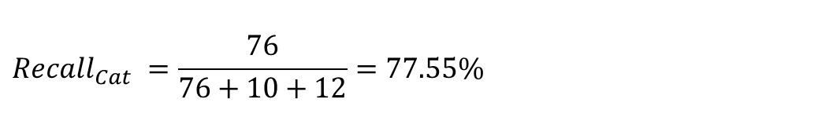
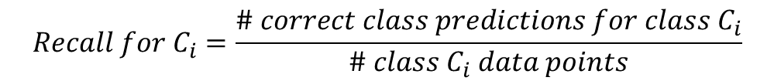
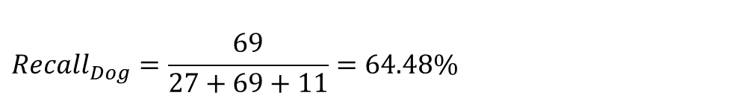
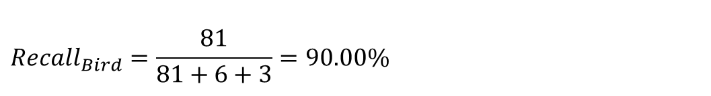
Recall
Recall measures the effectiveness of the classification model (classifier) on each class. It answers the question, “For the datapoints that belong to this class how many did the model classify correctly?” It is also called Sensitivity or True Positive Rate.
$$Recall for C_{i}=\frac{\# correct class predictions for class C_{i}}{\# class C_{i} data points}$$
 | Model Cat | Model Dog | Model Bird
Data Cat | 76 | 10 | 12
Data Dog | 27 | 69 | 11
Data Bird | 6 | 3 | 81
$$Recall_{Cat} =\frac{76}{76+10+12}=77.55\%$$
$$Recall_{Bird}=\frac{81}{81+6+3}=90.00\%$$
$$Recall_{Dog}=\frac{69}{27+69+11}=64.48\%$$
Balanced Data: Nearly equal quantity of dogs, cats, and birds

Slide 20
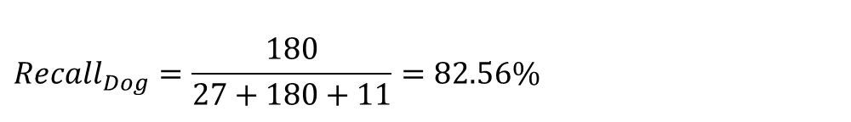
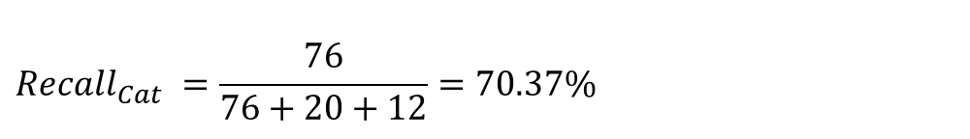
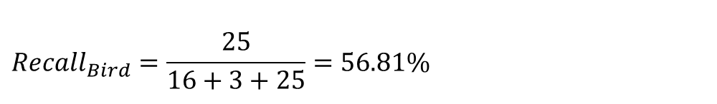
Recall
Recall measures the effectiveness of the classification model (classifier) on each class. It answers the question, “For the datapoints that belong to this class how many did the model classify correctly?” It is also called Sensitivity or True Positive Rate.
$$Recall for C_{i}=\frac{\# correct class predictions for class C_{i}}{\# class C_{i} data points}$$
 | Model Cat | Model Dog | Model Bird
Data Cat | 76 | 20 | 12
Data Dog | 27 | 180 | 11
Data Bird | 16 | 3 | 25
$$Recall_{Cat} =\frac{76}{76+20+12}=70.37\%$$
Clearly this model performs poorly on the identification of “Birds” relative to the previous scenario and the metric “Recall” captures this.
$$Recall_{Dog}=\frac{180}{27+180+11}=82.56\%$$
$$Recall_{Bird}=\frac{25}{16+3+25}=56.81\%$$
Unbalanced Data: More dogs in comparison to cats or birds

Slide 21
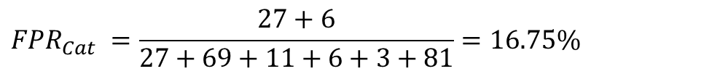
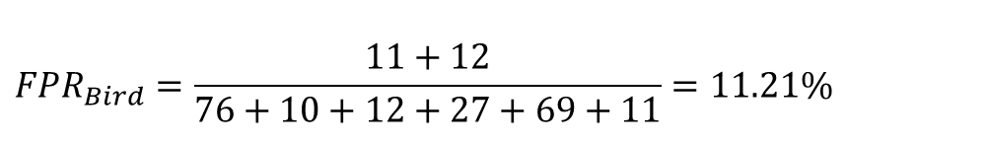
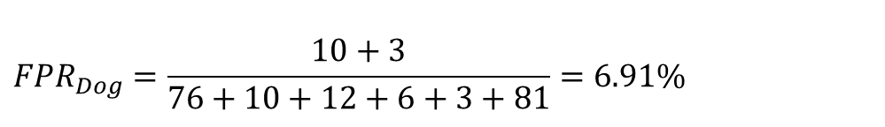
False Positive Rate (FPR)
FPR measures the impurity infiltration of the classification model (classifier) on each class. It answers the question, “For the datapoints that do not belong to this class how many did the model classify as belonging to this class?”
$$FPR_{C_{i}}=\frac{\# incorrect class predictions for class C_{i}}{\# non class C_{i} data points}$$
 | Model Cat | Model Dog | Model Bird
Data Cat | 76 | 10 | 12
Data Dog | 27 | 69 | 11
Data Bird | 6 | 3 | 81
$$FPR_{Cat} =\frac{27+6}{27+69+11+6+3+81}=16.75\%$$
$${FPR}_{Dog}=\frac{10+3}{76+10+12+6+3+81}=6.91\%$$
$$FPR_{Bird}=\frac{11+12}{76+10+12+27+69+11}=11.21\%$$
Balanced Data: Nearly equal quantity of dogs, cats, and birds

Slide 22
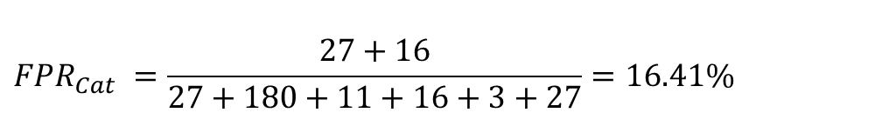
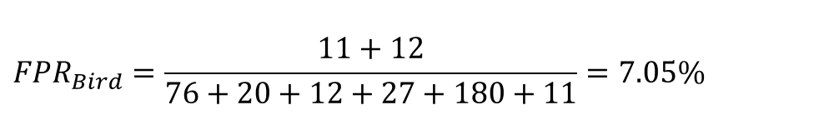
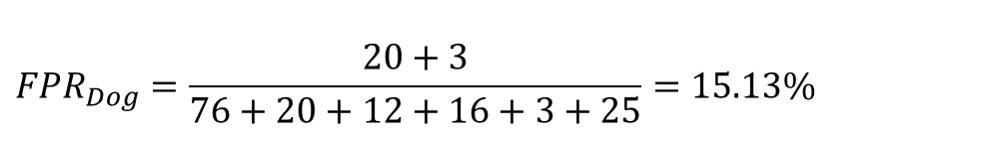
False Positive Rate (FPR)
FPR measures the impurity infiltration of the classification model (classifier) on each class. It answers the question, “For the datapoints that do not belong to this class how many did the model classify as belonging to this class?”
$$FPR_{C_{i}}=\frac{\# incorrect class predictions for class C_{i}}{\# non class C_{i} data points}$$
 | Model Cat | Model Dog | Model Bird
Data Cat | 76 | 20 | 12
Data Dog | 27 | 180 | 11
Data Bird | 16 | 3 | 25
$$FPR_{Cat} =\frac{27+16}{27+180+11+16+3+27}=16.41\%$$
$${FPR}_{Dog}=\frac{20+3}{76+20+12+16+3+25}=15.13\%$$
$$FPR_{Bird}=\frac{11+12}{76+20+12+27+180+11}=7.05\%$$
Unbalanced Data: More dogs in comparison to cats or birds

Slide 23
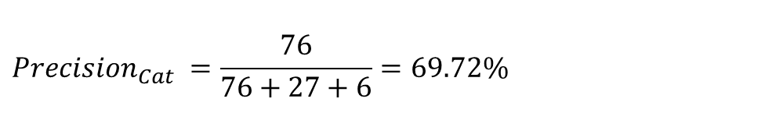
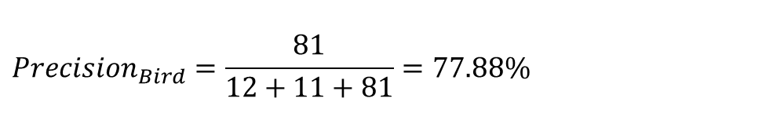
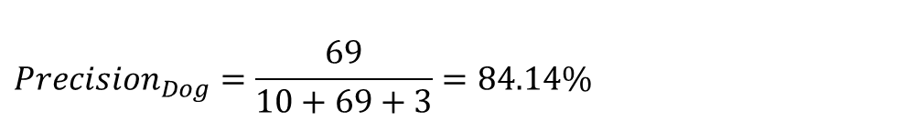
Precision
Precision measures the purity of the classification model (classifier) on each class. It answers the question, “For the datapoints that are classified by the model as belonging to this class how many did it capture correctly?”
$$Precision for C_{i}=\frac{\# Correct Class Predictions for Class C_{i}}{\# Class C_{i} Predictions}$$
 | Model Cat | Model Dog | Model Bird
Data Cat | 76 | 10 | 12
Data Dog | 27 | 69 | 11
Data Bird | 6 | 3 | 81
$$Precision_{Cat} =\frac{76}{76+27+6}=69.72\%$$
$${Precision}_{Dog}=\frac{69}{10+69+3}=84.14\%$$
$$Precision_{Bird}=\frac{81}{12+11+81}=77.88\%$$
Balanced Data: Nearly equal quantity of dogs, cats, and birds

Slide 24
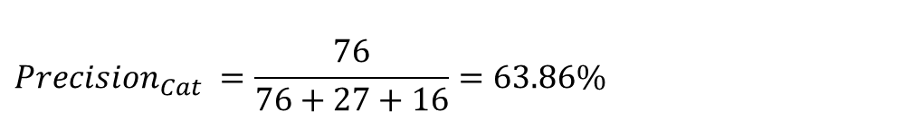
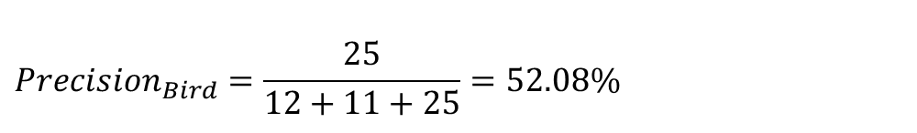
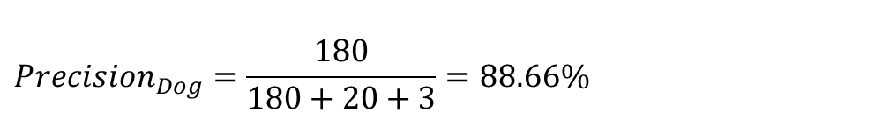
Precision
Precision measures the purity of the classification model (classifier) on each class. It answers the question, “For the datapoints that are classified by the model as belonging to this class how many did it capture correctly?”
$$Precision for C_{i}=\frac{\# Correct Class Predictions for Class C_{i}}{\# Class C_{i} Predictions}$$
 | Model Cat | Model Dog | Model Bird
Data Cat | 76 | 20 | 12
Data Dog | 27 | 180 | 11
Data Bird | 16 | 3 | 25
$$Precision_{Cat} =\frac{76}{76+27+16}=63.86\%$$
$${Precision}_{Dog}=\frac{180}{180+20+3}=88.66\%$$
$$Precision_{Bird}=\frac{25}{12+11+25}=52.08\%$$
Unbalanced Data: More dogs in comparison to cats or birds

Slide 25
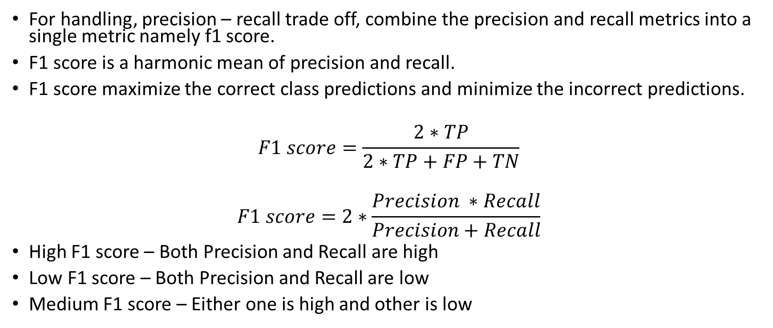
F1-Score
For handling, precision – recall trade off, combine the precision and recall metrics into a single metric namely f1 score.
F1 score is a harmonic mean of precision and recall.
F1 score maximize the correct class predictions and minimize the incorrect predictions.
$$F1 score=\frac{2∗TP}{2∗TP+FP+TN}$$
$$F1 score=2∗\frac{Precision ∗Recall}{Precision+Recall}$$
High F1 score – Both Precision and Recall are high
Low F1 score – Both Precision and Recall are low
Medium F1 score – Either one is high and other is low

Slide 26
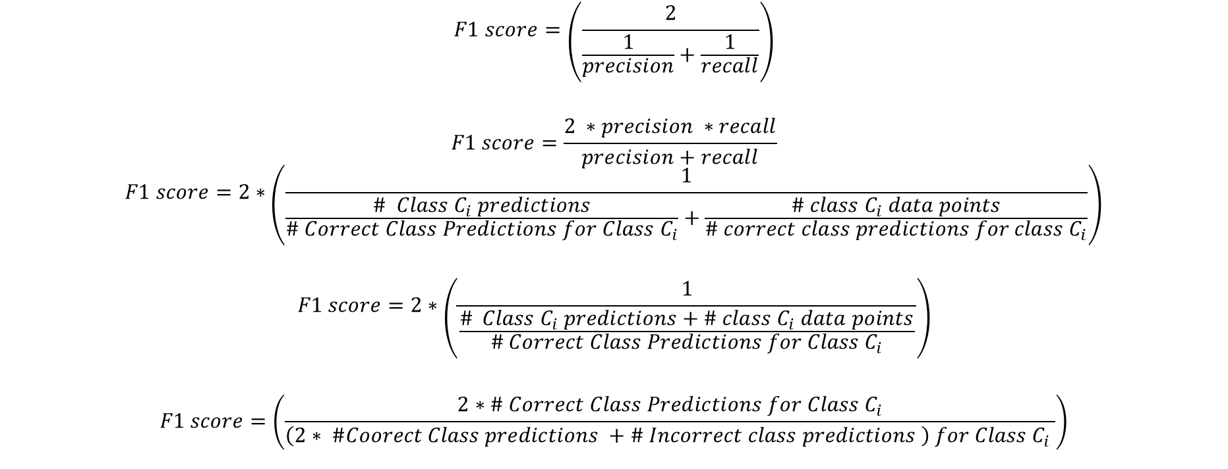
$$F1 score=\left(\frac{2}{\frac{1}{precision}+\frac{1}{recall}}\right)$$
$$F1 score=\frac{2 ∗precision ∗recall}{precision+recall}$$
$$F1 score=2∗\left(\frac{1}{\frac{\# Class C_{i} predictions}{\# Correct Class Predictions for Class C_{i}}+\frac{\# class C_{i} data points}{\# correct class predictions for class C_{i}}}\right)$$
$$F1 score=2∗\left(\frac{1}{\frac{\# Class C_{i} predictions+\# class C_{i} data points}{\# Correct Class Predictions for Class C_{i}}}\right)$$
$$F1 score=\left(\frac{2∗\# Correct Class Predictions for Class C_{i}}{\left(2∗ \#Coorect Class predictions +\# Incorrect class predictions \right) for Class C_{i} }\right)$$

Slide 27
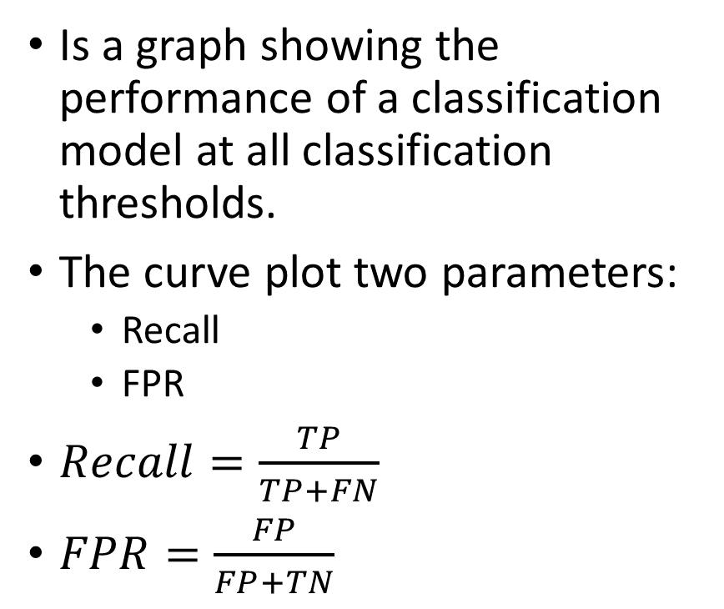
Receiver Operating Characteristic Curve
1
Is a graph showing the performance of a classification model at all classification thresholds.
The curve plot two parameters:
Recall
FPR
$Recall=\frac{TP}{TP+FN}$
$FPR=\frac{FP}{FP+TN}$
Recall
0
FPR
1
0

Slide 28
AUC – Area Under Curve (ROC)
1
Recall
FPR
1
0

Slide 29
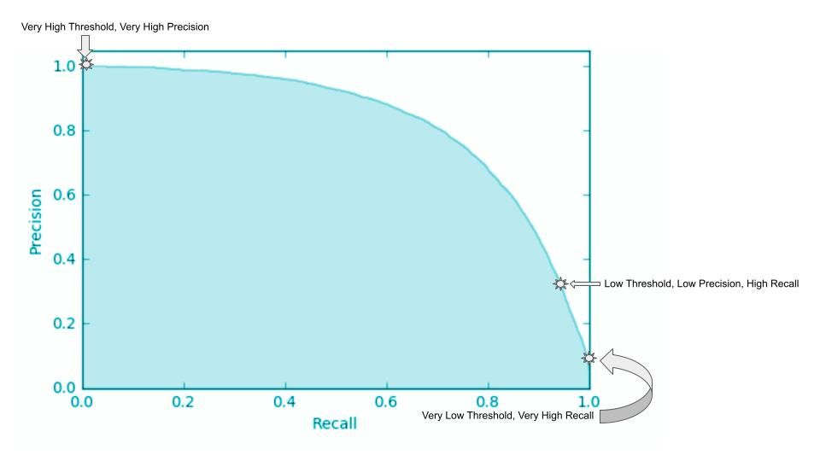
Precision Recall Curve
Illustrates a negative slope function. It represents the trade-off between precision and recall for a given model. Considering the inverse relationship between precision and recall, the curve is generally non-linear, implying that increasing one metric decreases the other, but the decrease might not be proportional.

Slide 30
Decision Trees
Identifying the rules for classification

Slide 31
Decision Tree
Root Node
Sunny?
A hierarchical binary tree model where every root and internal node represents a yes/no test based on an attribute of the data that leads us to a class label in the leaf node.
ID3 construction algorithm:
Explicit evaluation of every training data point, for an attribute to find a threshold minimizing a “loss metric”.
The attribute that provides the “minimal loss” is used for a given node.
Repeated recursively till “satisfactory” class “purity” is achieved.
Yes
No
Ice Cream
Rainy?
Leaf Node
Yes
No
Bajji
Tea
Leaf Node
Leaf Node

Slide 32
Loss Metrics
Indicators of probability of miss-classification minimizing which helps us build tree classifiers.

Slide 33
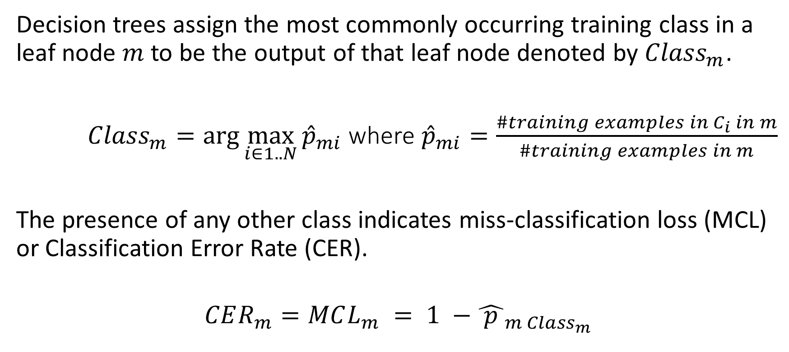
Miss-Classification Loss/Classification Error Rate - Definition
Decision trees assign the most commonly occurring training class in a leaf node $m$ to be the output of that leaf node denoted by ${Class}_{m}$.
${Class}_{m}=\arg{\max_{i∈1..N}{{\hat{p}}_{mi}}}$ where ${\hat{p}}_{mi}=\frac{\#training examples in C_{i} in m}{\#training examples in m}$
The presence of any other class indicates miss-classification loss (MCL) or Classification Error Rate (CER).
$$CER_{m}=MCL_{m} = 1 −{\hat{ p }}_{m {Class}_{m}}$$

Slide 34

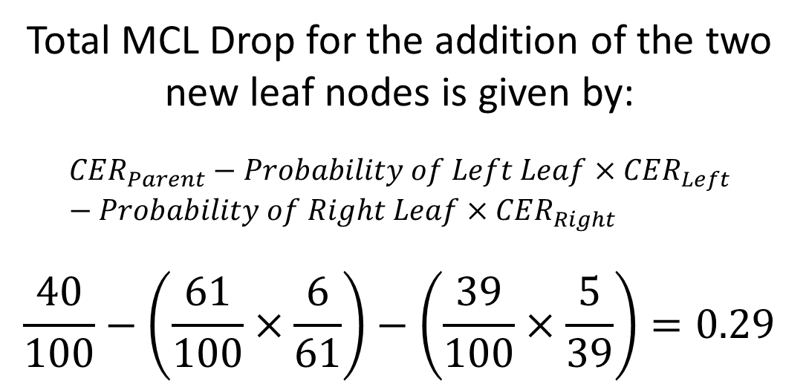


Miss-Classification Loss/Classification Error Rate - Example
$$CER_{m}=MCL_{m} = 1 −{\hat{ p }}_{m {Class}_{m}}$$
Root Node
Sunny?
#Ice Cream 60
#Bajji 40
Total MCL Drop for the addition of the two new leaf nodes is given by:
$$CER_{Parent}−Probability of Left Leaf×CER_{Left}−Probability of Right Leaf×CER_{Right}$$
$$\frac{40}{100}−\left(\frac{61}{100}×\frac{6}{61}\right)−\left(\frac{39}{100}×\frac{5}{39}\right)=0.29$$
MCL = $\frac{40}{100}$
Yes
No
#Ice Cream 55
#Bajji 6
#Ice Cream 5
#Bajji 34
Ice Cream
Bajji
Leaf Node
Leaf Node
MCL = $\frac{6}{61}$
MCL = $\frac{5}{39}$

Slide 35

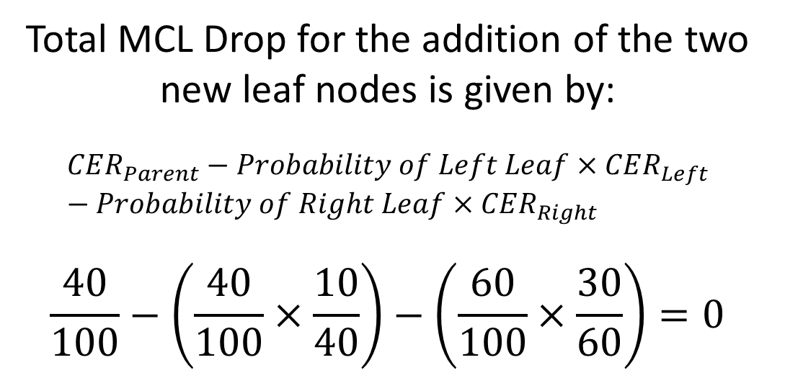

Miss-Classification Loss/Classification Error Rate – Insensitive Example
$$CER_{m}=MCL_{m} = 1 −{\hat{ p }}_{m {Class}_{m}}$$
Root Node
Sunny?
#Ice Cream 60
#Bajji 40
Total MCL Drop for the addition of the two new leaf nodes is given by:
$$CER_{Parent}−Probability of Left Leaf×CER_{Left}−Probability of Right Leaf×CER_{Right}$$
$$\frac{40}{100}−\left(\frac{40}{100}×\frac{10}{40}\right)−\left(\frac{60}{100}×\frac{30}{60}\right)=0$$
MCL = $\frac{40}{100}$
Yes
No
#Ice Cream 30
#Bajji 10
#Ice Cream 30
#Bajji 30
Ice Cream
Bajji
Leaf Node
Leaf Node
MCL = $\frac{15}{50}$
MCL = $\frac{25}{50}$

Slide 36
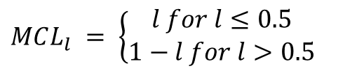
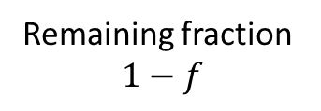
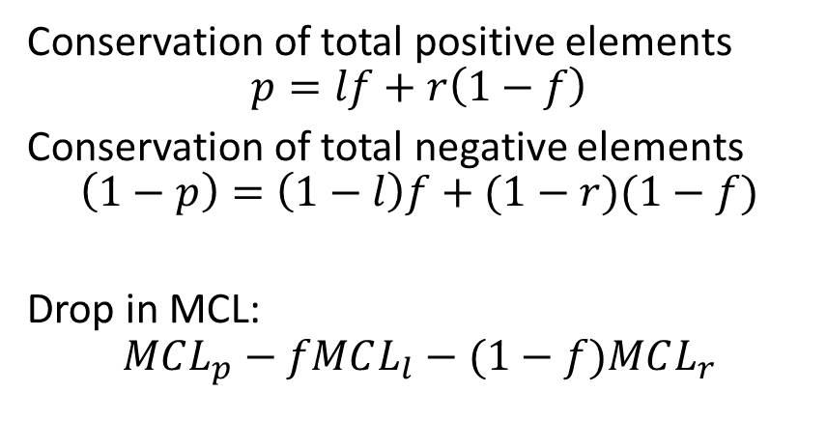

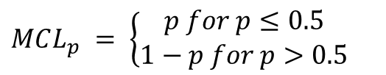
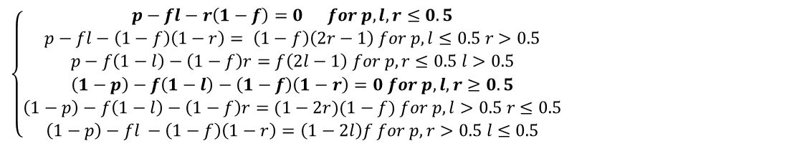
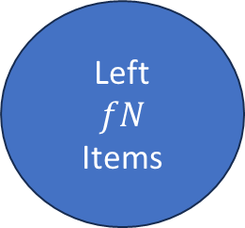
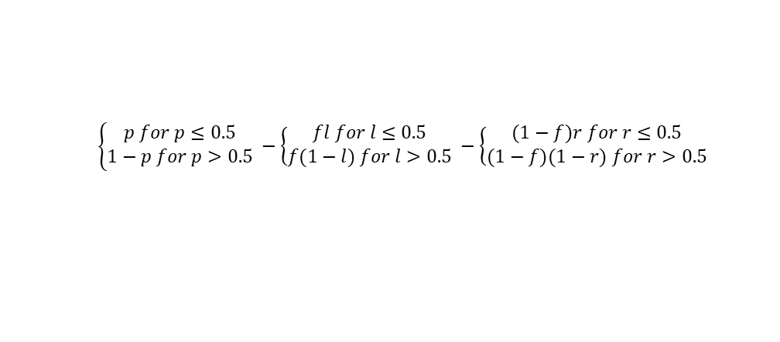
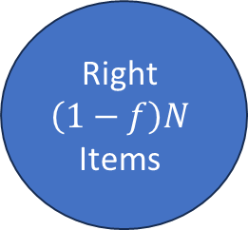
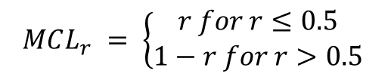
Miss-Classification Loss/Classification Error Rate – Insensitive Example
Root Node
Conservation of total positive elements
$$p=lf+r\left(1−f\right)$$
Conservation of total negative elements
$$\left(1−p\right)=\left(1−l\right)f+(1−r)(1−f)$$
Drop in MCL:
$$MCL_{p}−fMCL_{l}−(1−f)MCL_{r}$$
Parent
N
Items
$$MCL_{p} = \left\{\begin{aligned}p for p≤0.5 \\ 1−p for p>0.5\end{aligned} \right.$$
Remaining fraction
$$1−f$$
Fraction $f$
$$\left\{\begin{aligned}p for p≤0.5 \\ 1−p for p>0.5\end{aligned} −\left\{\begin{aligned}fl for l≤0.5 \\ f(1−l) for l>0.5\end{aligned} \right.\right.−\left\{\begin{aligned}(1−f)r for r≤0.5 \\ (1−f)(1−r) for r>0.5\end{aligned} \right.$$
Left
$$fN$$
Items
Right
$$\left(1−f\right)N$$
Items
$$\left\{\begin{aligned}p−fl−r\left(1−f\right)=0 for p,l,r≤0.5 \\ p−fl−\left(1−f\right)\left(1−r\right)= \left(1−f\right)\left(2r−1\right) for p,l≤0.5 r>0.5 \\ p−f\left(1−l\right)−\left(1−f\right)r=f\left(2l−1\right) for p,r≤0.5 l>0.5 \\ \left(1−p\right)−f\left(1−l\right)−\left(1−f\right)\left(1−r\right)=0 for p,l,r≥0.5 \\ \left(1−p\right)−f\left(1−l\right)−\left(1−f\right)r=(1−2r)(1−f) for p,l>0.5 r≤0.5 \\ \left(1−p\right)−fl −\left(1−f\right)\left(1−r\right)=\left(1−2l\right)f for p,r>0.5 l≤0.5\end{aligned} \right.$$
$$MCL_{l} = \left\{\begin{aligned}l for l≤0.5 \\ 1−l for l>0.5\end{aligned} \right.$$
$$MCL_{r} = \left\{\begin{aligned}r for r≤0.5 \\ 1−r for r>0.5\end{aligned} \right.$$

Slide 37



Miss-Classification Loss/Classification Error Rate – Reason for Insensitivity
Root Node
When the majority/minority class in parent node remains in majority/minority in both the leaf nodes, then the miss-classification loss reduction is 0.
The reason for this is the linearity of this metric.
Hence there is a need for a more sensitive metric to capture purity within such divisions.
Sunny?
#Ice Cream 60
#Bajji 40
MCL = $\frac{40}{100}$
Yes
No
#Ice Cream 30
#Bajji 10
#Ice Cream 30
#Bajji 30
Ice Cream
Bajji
Leaf Node
Leaf Node
MCL = $\frac{15}{50}$
MCL = $\frac{25}{50}$

Slide 38

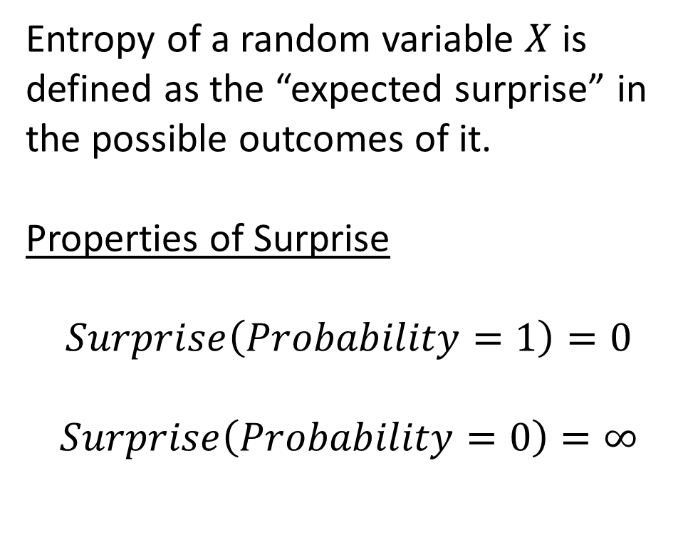



Entropy
Surprise
$$∞$$
Entropy of a random variable $X$ is defined as the “expected surprise” in the possible outcomes of it.
Properties of Surprise
$$Surprise\left(Probability=1\right)=0$$
$$Surprise\left(Probability=0\right)=∞$$
$$0$$
0
1
Probability
1
$$0$$
$$X$$
0
1

Slide 39



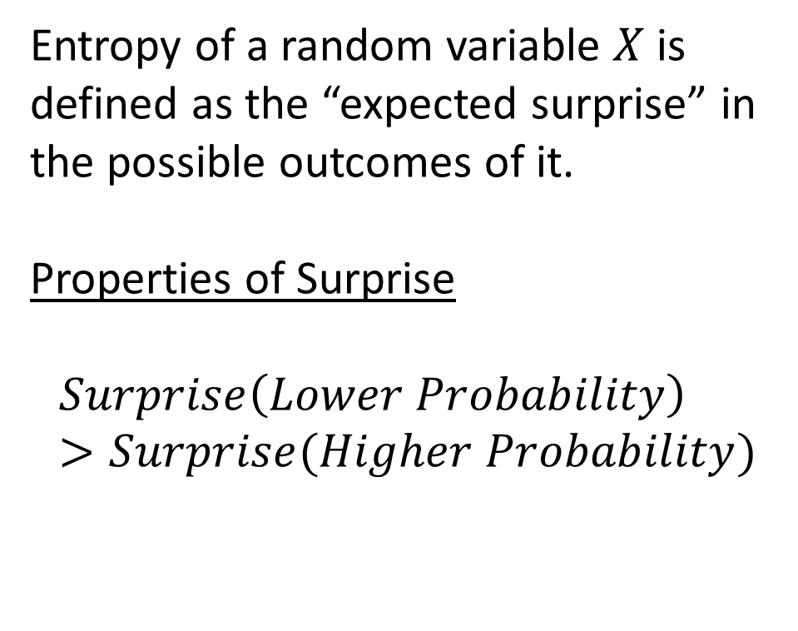

Entropy
Surprise
Entropy of a random variable $X$ is defined as the “expected surprise” in the possible outcomes of it.
Properties of Surprise
$$Surprise\left(Lower Probability\right)>Surprise(Higher Probability)$$
$$0$$
0
1
Probability
1
$$0. 75$$
$$0. 5$$
$$0.25$$
$$0$$
$$X$$
0
1

Slide 40
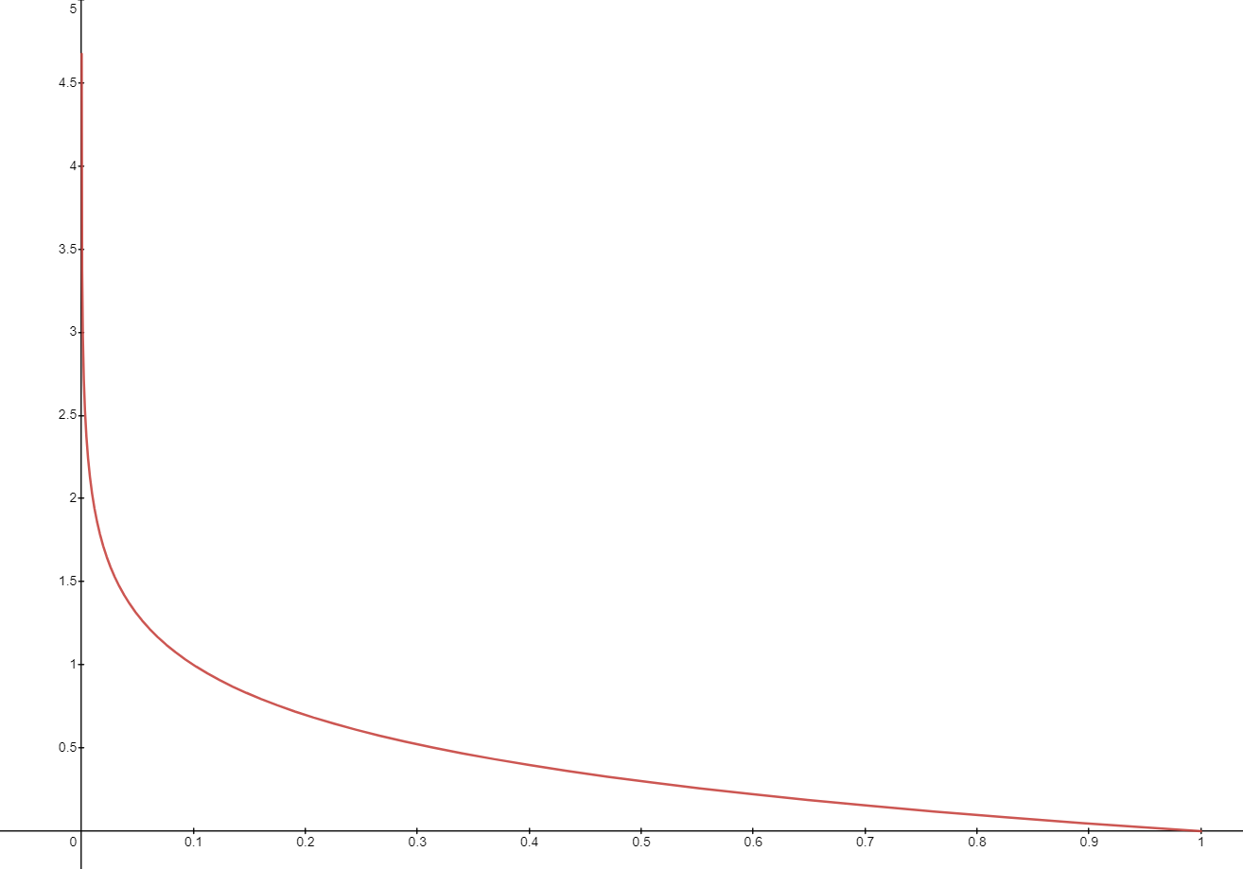
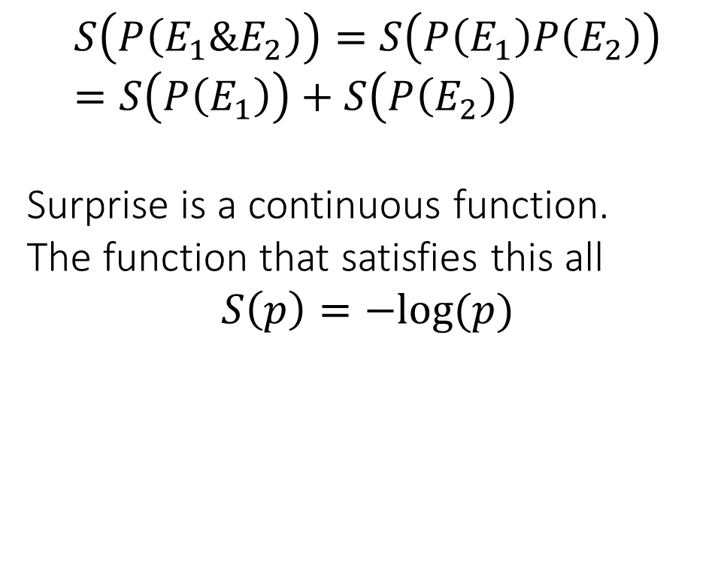
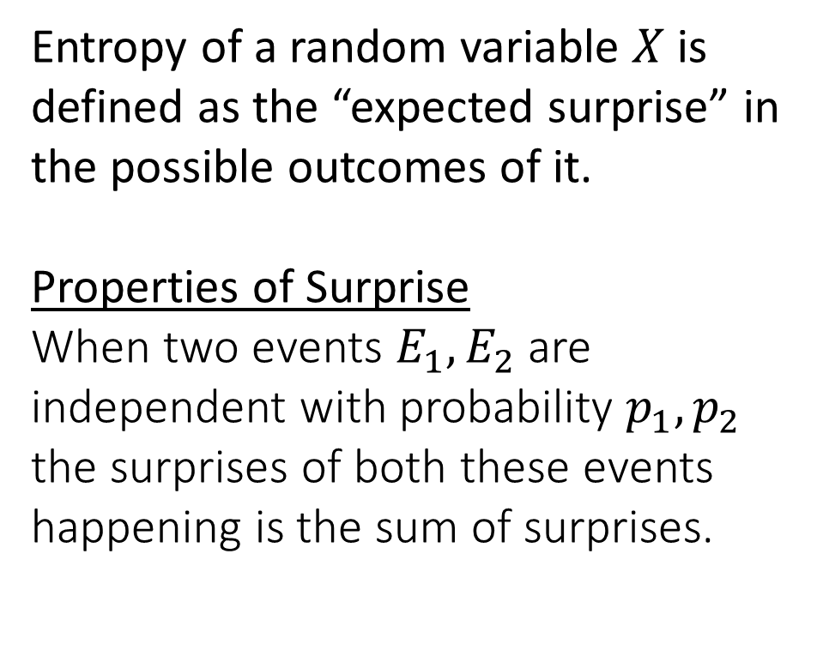
Entropy
Entropy of a random variable $X$ is defined as the “expected surprise” in the possible outcomes of it.
Properties of Surprise
When two events $E_{1},E_{2}$ are independent with probability $p_{1},p_{2}$ the surprises of both these events happening is the sum of surprises.
$$S\left(P\left(E_{1}\&E_{2}\right)\right)=S\left(P\left(E_{1}\right)P\left(E_{2}\right)\right)=S\left(P\left(E_{1}\right)\right)+S\left(P\left(E_{2}\right)\right)$$
Surprise is a continuous function.
The function that satisfies this all
$$S\left(p\right)=−log⁡(p)$$
0
1

Slide 41
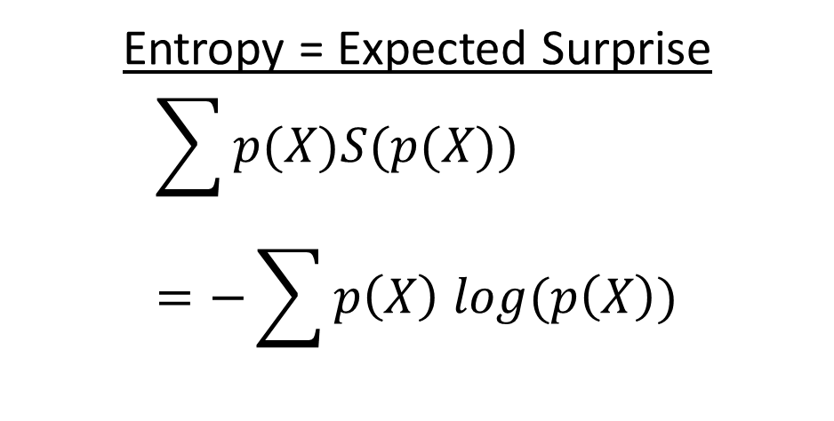

Entropy
Entropy of a random variable $X$ is defined as the “expected surprise” in the possible outcomes of it.
Entropy = Expected Surprise
$$\sum{p(X)S(p(X))}=−\sum{p\left(X\right) log(p\left(X\right))}$$

Slide 42


Entropy: Discrete
Entropy the expected surprise is high, i.e., when the “coin is fair”.
When the classifier is giving mixed signal.
Entropy is low when the expected surprise is low, i.e., when the “coin is unfair”.
When the classifier is giving a pure signal.
Fair Coin
$$p\left(H\right)=0.5, p\left(T\right)=0.5$$
$$S=−P\left(H\right)\log_{2}{P\left(H\right)}−P\left(T\right)\log_{2}{P\left(T\right)}$$
$$S=−2×0.5\log_{2}{0.5}=1$$
Biased Coin
$$p\left(H\right)=p, p\left(T\right)=1−p$$
$$S=−P\left(H\right)\log_{2}{P\left(H\right)}−P\left(T\right)\log_{2}{P\left(T\right)}$$
$$S=−p\log_{2}{p}−\left(1−p\right)\log_{2}\left(1−p\right)$$
1
Entropy
0
0
1
Probability of Heads p

Slide 43

Entropy Loss/Log Loss
For a decision tree at a given node with $N$ classes the entropy metric is defined as:
$$E=−\sum_{i∈1..N}{{\hat{p}}_{mi} \log_{2}\left({\hat{p}}_{mi}\right)}$$
The entropy loss when we split that node on a feature is given by:
$$E_{parent}−Probability of Left Leaf×E_{left}−Probability of Right Leaf×E_{right}$$

Slide 44




Entropy Loss/Log Loss - Example
E = $−\frac{40}{100}\log_{2}{\frac{40}{100}}−\frac{60}{100}\log_{2}{\frac{60}{100}}=0.97$
Root Node
Sunny?
#Ice Cream 60
#Bajji 40
Entropy Loss Reduction
$$=0.97−\frac{61}{100}×0.46−\frac{39}{100}×0.55 \\ =0.4749$$
Yes
No
#Ice Cream 55
#Bajji 6
#Ice Cream 5
#Bajji 34
Ice Cream
Bajji
Leaf Node
Leaf Node
E = $−\frac{6}{61}\log_{2}{\frac{6}{61}}−\frac{55}{61}\log_{2}{\frac{55}{61}}=0.46$
E =$−\frac{5}{39}\log_{2}{\frac{5}{39}}−\frac{34}{39}\log_{2}{\frac{34}{39}}=0.55$

Slide 45



Entropy Loss/Log Loss – Another Example
E = $−\frac{40}{100}\log_{2}{\frac{40}{100}}−\frac{60}{100}\log_{2}{\frac{60}{100}}=0.97$
Entropy Loss Reduction
$$=0.97−\frac{40}{100}×0.81−\frac{60}{100}×1 \\ =0.046$$
Miss-Classification Loss was insensitive to this case (0 reduction) while entropy loss shows a slight reduction accounting for the purity on the left branch.
Root Node
Sunny?
#Ice Cream 60
#Bajji 40
Yes
No
#Ice Cream 30
#Bajji 10
#Ice Cream 30
#Bajji 30
Ice Cream
Bajji
Leaf Node
Leaf Node
E = $−\frac{10}{40}\log_{2}{\frac{10}{40}}−\frac{30}{40}\log_{2}{\frac{30}{40}}=0.81$
E =$−\frac{30}{60}\log_{2}{\frac{30}{60}}−\frac{30}{60}\log_{2}{\frac{30}{60}}=1$

Slide 46



Gini Loss
0.30 Diabetes, 0.70 No Diabetes
$$\hat{p_{mi}}=\frac{\#Diabetics∗0.70}{\#Diabetics∗0.70+\#NonDiabetics∗0.30}$$
Gini Loss is similar to the Entropy loss function in the form of the graph, with a difference being that it is a polynomial expression.
$$G=\sum_{i∈1..N}{{\hat{p}}_{mi}\left(1−{\hat{p}}_{mi}\right)}$$
Entropy
The graph for all metrics are compared for a binary classifier
Note: Reduction at a split is computed akin to entropy loss
Loss Metrics
Gini
Miss-Classification
Probability of binary classifier

Slide 47




Gini Loss - Example
G = $\frac{40}{100}\left(1−\frac{40}{100}\right)+\frac{60}{100}\left(1−\frac{60}{100}\right)=0.48$
Root Node
Sunny?
#Ice Cream 60
#Bajji 40
Gini Loss Reduction
$$=0.48−\frac{61}{100}×0.18−\frac{39}{100}×0.22 \\ =0.77$$
Yes
No
#Ice Cream 55
#Bajji 6
#Ice Cream 5
#Bajji 34
Ice Cream
Bajji
Leaf Node
Leaf Node
G = $\frac{6}{61}\left(1−\frac{6}{61}\right)+\frac{55}{61}\left(1−\frac{55}{61}\right)=0.18$
G =$\frac{5}{39}\left(1−\frac{5}{39}\right)+\frac{34}{39}\left(1−\frac{34}{39}\right)=0.22$

Slide 48




Gini Loss – Another Example
G = $\frac{40}{100}\left(1−\frac{40}{100}\right)+\frac{60}{100}\left(1−\frac{60}{100}\right)=0.48$
Gini Loss Reduction
$$=0.48−\frac{40}{100}×0.19−\frac{60}{100}×0.5 \\ =0.104$$
Miss-Classification Loss was insensitive to this case (0 reduction) while Gini loss shows a slight reduction accounting for the purity on the left branch akin to the entropy metric.
Root Node
Sunny?
#Ice Cream 60
#Bajji 40
Yes
No
#Ice Cream 30
#Bajji 10
#Ice Cream 30
#Bajji 30
Ice Cream
Bajji
Leaf Node
Leaf Node
E = $\frac{10}{40}\left(1−\frac{10}{40}\right)+\frac{30}{40}\left(1−\frac{30}{40}\right)=0.19$
E =$\frac{30}{60}\left(1−\frac{30}{60}\right)+\frac{30}{60}\left(1−\frac{30}{60}\right)=0.5$

Slide 49
Building a Decision Tree
Case Study

Slide 50
Example Data Source: Diabetes Data
https://www.kaggle.com/datasets/mathchi/diabetes-data-set
Accessed on:7/22/2023
Context
This dataset is originally from the National Institute of Diabetes and Digestive and Kidney Diseases. The objective is to predict based on diagnostic measurements whether a patient has diabetes.
Content
Several constraints were placed on the selection of these instances from a larger database. In particular, all patients here are females at least 21 years old of Pima Indian heritage.

Slide 51
Data Details & Prep
Clean dataset with no missing data.
One hot encoded categorical variables.
8 Features
Pregnancies,
Glucose,
Blood Pressure,
Skin Thickness,
Insulin,
BMI,
DiabetesPedigreeFunction,
Age
Data is randomly split into 70% training and 30% test
Training – 538
Diabetic – 202
Non-Diabetic – 336
Test – 230
Diabetic – 66
Non-Diabetic – 164

Slide 52







Approach: ID3 Optimizing the loss metric
$$BMI≤ 29.53$$
$$Entropy =0.955$$
$$samples = 538$$
$$value = [336,202]$$
$$BMI≤ 29.53$$
$$Gini =0.469$$
$$samples = 538$$
$$value = [336,202]$$
$$Entropy =0.652$$
$$samples =191$$
$$value = [159,32]$$
$$Entropy =1.0$$
$$samples =347$$
$$value = [177,170]$$
$$Gini =0.279$$
$$samples =191$$
$$value = [159,32]$$
$$Gini =0.500$$
$$samples =347$$
$$value = [177,170]$$
Consider a tree formed by a random split on BMI and the impact on two metrics Entropy and Gini:
Entropy reduction $= 0.955−0.355×0.652−0.645×1.0=0.079$.
Gini reduction $= 0.469 – 0.355×0.279 −0.645×0.5=0.047$.
There is a slight reduction owing to purity of the left branch. Exploring multiple possible features and splits on each of them we get the optimal choice.

Slide 53






Approach: ID3 Optimizing the loss metric
$$Glucose≤123.5$$
$$Entropy =0.955$$
$$samples = 538$$
$$value = [336,202]$$
$$Glucose≤123.5$$
$$Entropy =0.469$$
$$samples = 538$$
$$value = [336,202]$$
$$Entropy =0.721$$
$$samples =301$$
$$value = [241,60]$$
$$Entropy =.971$$
$$samples =237$$
$$value = [95,142]$$
$$Gini =0.319$$
$$samples =301$$
$$value = [241,60]$$
$Gini =0.$480
$$samples =237$$
$$value = [95,142]$$
Optimal Depth 1 Tree based on Entropy & Gini

Slide 54


Depth 1 Tree Performance on test?
$Accuracy=\frac{\# correct predictions}{\# data points}=\frac{46+125}{(46+125+39+20)}=74.35\%$
$Recall_{diabetic}=\frac{\# correct diabetic predictions}{\# diabetic data points}=\frac{46}{(46+20)}=69.70\%$
$$FPR_{diabetic}=\frac{\# incorrect diabetic predictions}{\# non diabetic data points}=\frac{39}{39+125}=23.78\%$$
$$Precision_{diabetic}=\frac{\# correct diabetic predictions}{\# total diabetic data predictions}=\frac{46}{39+46}=54.12\%$$

Slide 55

Bias & Variance: Can we do better if we grow the tree deeper?
We see that the lowest variance is at depth 2 with low prediction error.
While bias grows lower with increasing depth we will be in higher variance territory.
Low Bias
Low Variance
Low Bias
High Variance
High Bias
High Variance

Slide 56

Low Bias Low Variance Tree
Accuracy - 74.35
Recall - 69.70
Precision - 54.12
FPR - 23.78

Slide 57
${Class}_{m}=\arg{\max_{i∈1..N}{{\hat{p}}_{mi}}}$ where ${\hat{p}}_{mi}=\frac{\#training examples in m C_{i}×W_{C_{i}}}{\sum_{k}{\#training examples in m in C_{k}×W_{C_{k}}}}$

Slide 58

Generalization Error, Bias and Variance

Slide 59

Bias
Bias error = 1 – Accuracy of a random forest
We have a training data set consist of points $x_{1},x_{2},x_{3},…x_{n}$ and real values $y_{i}$ associated with each point $x_{i}$.
$$y=f\left(x_{i}\right)+ ε$$
Where the noise, $ε$, has zero mean and variance $σ^{2}.$
We want to find a function $f_{cap}(x,D)$, that approximates the true function $f\left(x\right)$

Slide 60

$D=\left\{\left(x_{1},y_{1}\right),\left(x_{2},y_{2}\right),…,\left(x_{n},y_{n}\right)\right\}$
$Bias={\left(y−f_{cap}\left(x;D\right)\right)}^{2}$
Variance error:
Variance error is variability of a target function's form with respect to different training sets. Models with small variance error will not change much if you replace couple of samples in training set. Models with high variance might be affected even with small changes in training set.
If the model learns to fit very closely to the points on a particular dataset, when it used to predict on another dataset it may not predict as accurately as it did in the first.
Variance is the difference in the fits between different datasets.
https://www.machinelearningplus.com/machine-learning/bias-variance-tradeoff/

Slide 61
If a model has high bias, then it implies that the model is too simple and does not capture the relationship between the variables. This is called the underfitting of data.

