Slide 1
Decision Trees

Slide 2





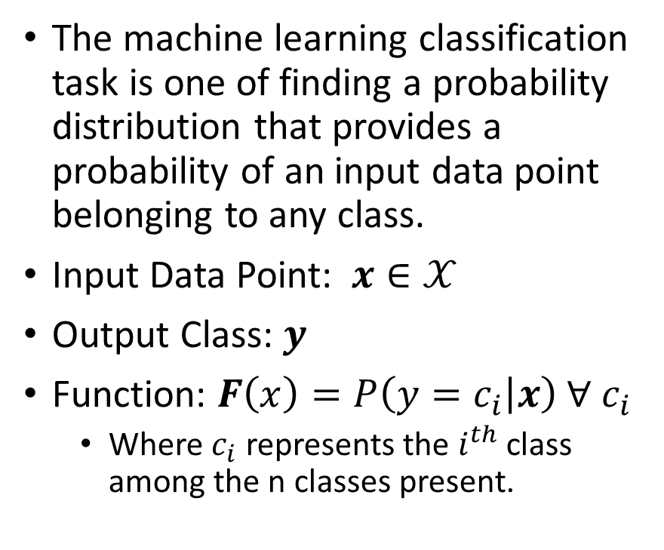
Classification
The machine learning classification task is one of finding a probability distribution that provides a probability of an input data point belonging to any class.
Input Data Point: $x∈𝒳$
Output Class: $y$
Function: $F\left(x\right)=P\left(y=c_{i} | x\right) ∀ c_{i}$
Where $c_{i}$ represents the $i^{th}$ class among the n classes present.
Spam
Email
Not Spam
Happy
Neutral
Tweet
Sad

Slide 3
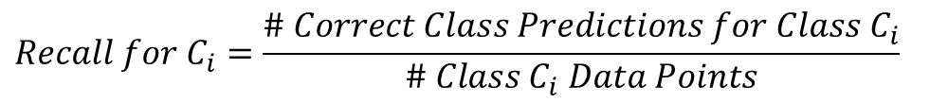
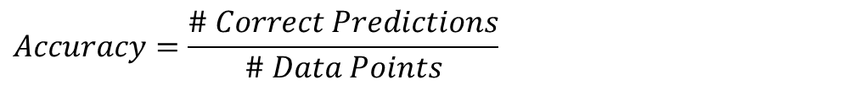
Understanding Success
Effectiveness of a classification system is measured by using a dataset that has existing class labels.
Indicators:
$$Accuracy=\frac{\# Correct Predictions}{\# Data Points}$$
$$Recall for C_{i}=\frac{\# Correct Class Predictions for Class C_{i}}{\# Class C_{i} Data Points}$$
$$Precision for C_{i}=\frac{\# Correct Class Predictions for Class C_{i}}{\# Class C_{i} Predictions}$$

Slide 4
Decision Tree
Root Node
Sunny?
What is Decision Tree:
Supervised ML algorithm
Tree structure
It have root, internal and terminal nodes
Construction:
Recursively splitting train data set into subsets
based on the values of the attributes until
a stopping criterion is met
Stopping criterion:
Maximum depth of the tree
Minimum number of samples required to split a node
Yes
No
Ice Cream
Rainy?
Leaf Node
Yes
No
Bajji
Tea
Leaf Node
Leaf Node

Slide 5
Misclassification Metric

Slide 6
Entropy Metric

Slide 7
Gini Metric

